Slide 1
ST: Graph and Social Network Analysis
CS 43118 & CS 53118
Fall 2020

Slide 2
Syllabus
3. Types of Networks and its Applications
Road Networks
Biological Networks
Social Networks
Bibliography Networks
Geo-social Networks
4. Introduction to Social Network Analysis
5. Application of Social Network Analysis
6. Properties of Social Networks
7. Algorithms in Social Networks
Community Detection
Community Search
Influence Maximization
8. Data mining in Social Networks
Graph Clustering
Graph Pattern Matching
Introduction to Graphs and Networks
Graph Terminologies
Graph Models
Graph Representation
Graph Properties
Graph Visualization
Graph Problems
Graph matching
Graph isomorphism
Graph Algorithms
Single source shortest path query
All-pair shortest path queries

Slide 3
CS 43118 & CS 53118
ST: Graph and Social Network Analysis
Chapter 1: Introduction to Graph and Network
Niranjan Rai
Department of Computer Science
Kent State University

Slide 4
Objectives
In this chapter, you will get familiar with the introduction of graph:
Definition and example
Graph theory
Application of graphs
Algorithms in graphs

Slide 5
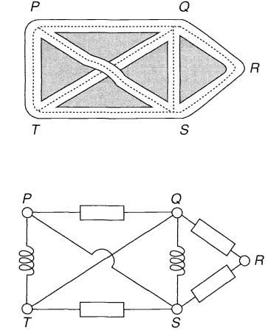
Graph
Definition: A simple graph G consists of non-empty finite set V(G) of elements called vertices (or nodes), and a finite set E(G) of distinct unordered pairs of distinct elements of V(G) called egdes^{[1]}
In simple terms, it is a pair of sets. G = (V, E).
V(G) is the set of vertices
E(G) is the set of edges
E is made up of pairs of elements from V
Fig: 1.1
Fig: 1.2

Slide 6
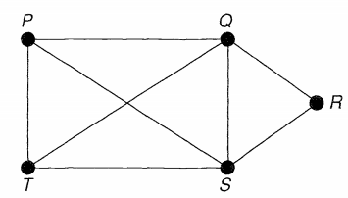
Graph (cont’d)
For example : V = {P, Q, R, S, T} and E = {PQ, QR, PT, TS, PS, SR, SQ, TQ}
Graph theory is the study of graphs, which are mathematical structures used to model pairwise relations between objects
e₁
e₅
e₈
e₂
e₃
e₇
e₆
e₄

Slide 7
Graph Types
Graph can be divided into different types based on the properties of graph
For example: simple graph vs. multigraph, directed graph vs. undirected graph, regular graph vs. loop graph, etc.
Fig 1.4: Complete graph
Fig 1.5: Directed multi graph
Fig 1.6: Simple directed graph

Slide 8
Graph Applications
Widely used to study and model various applications, in different areas such as:
In computer science, graphs are used to represent the flow of computation
Google maps uses graphs for calculating the shortest path between two vertices/locations
In Facebook, Facebooks friend suggestion algorithm uses graph theory
In World Wide Web, Google Page Ranking Algorithm uses the webpages as vertices and link from page u to page v as edge.
In Chemistry, graph is used to study of molecules, construction of bonds, and study of atoms, etc.

Slide 9
Graph Networks
Network: a graph in which nodes and/or edges have attributes
Example:
Social Network
Biological Network
Gene Regulatory Network
Road Network etc.

Slide 10
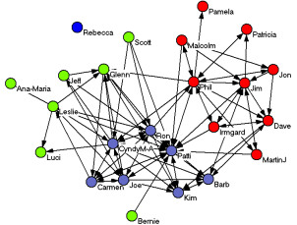
Graph Networks
Social Network
Network of social actors
Vertices = Individuals , Edges = friendships/ connection / followers
Example: Facebook, Twitter, Instagram, etc.
Fig : Example of social network

Slide 11
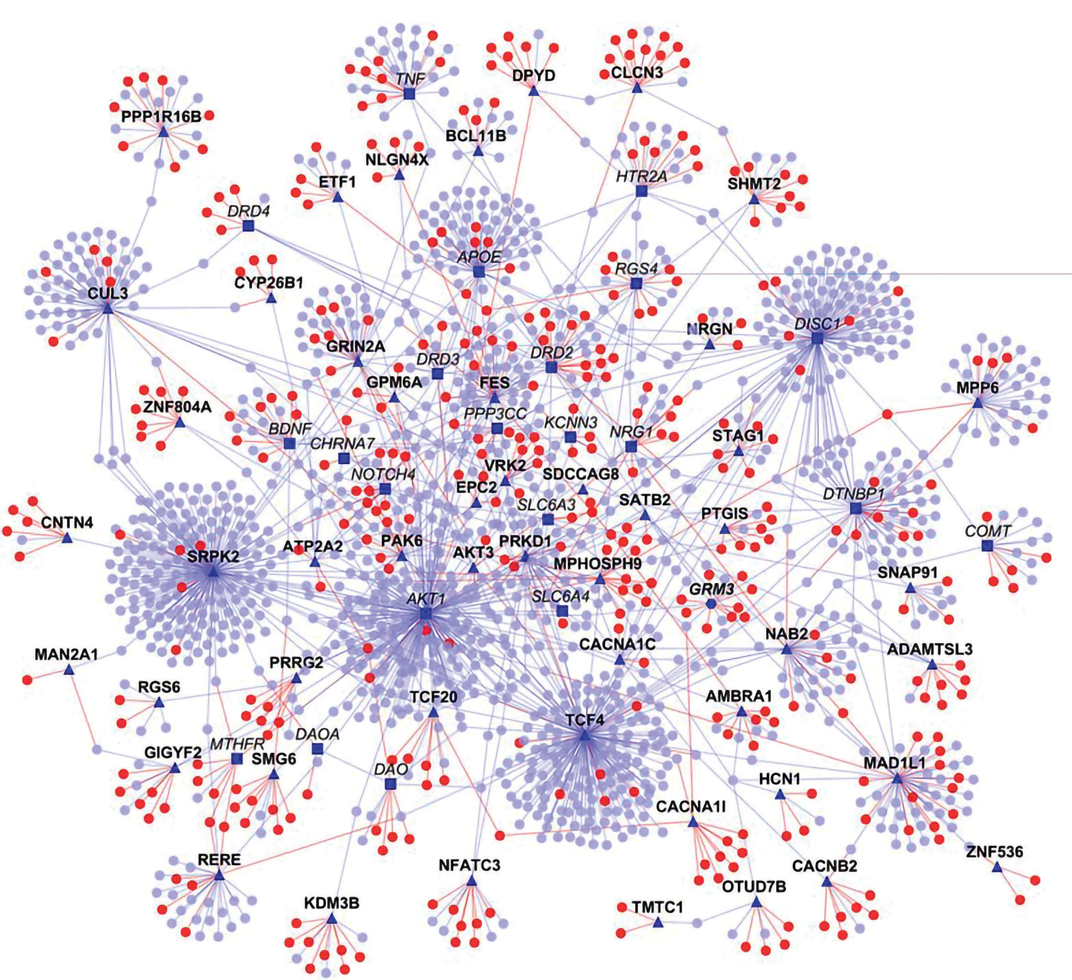
Graph Networks
Biological Network
Network of social actors
Vertices = Units (e.g. proteins) , Edges = interaction between units
Example: Protein-Protein Interaction (PPI) Network, DNA-Protein Interaction network, Neuronal Network, etc.
Fig : Example of biological network

Slide 12
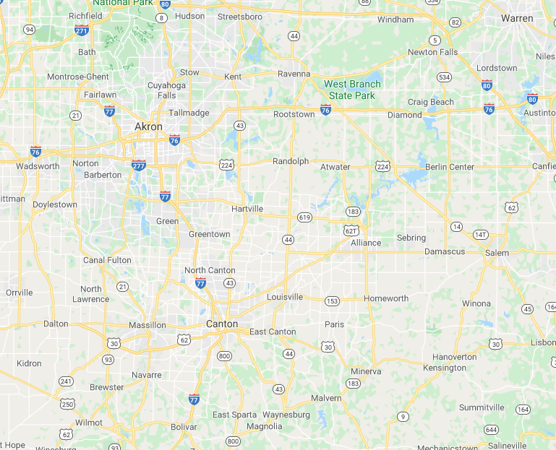
Graph Networks
Road Network
Network of roads / streets / highways
Vertices = Intersection / POI , Edges = road
Applications: Google Maps, GPS, Community Search, etc.
Fig : Example of road network

Slide 13
Graph Queries / Algorithms
Single Source shortest path query
Finds the shortest path from a source vertex to all other vertices in the graph
All-pair shortest path query
Finds the shortest path from each vertex in the graph to all other vertices in the graph
Graph Coloring Algorithm
Color each vertex with minimum no. of colors such that no two adjacent vertex has same color
Used in map coloring of countries, scheduling problems (class, sports match, etc.)
Community Search / Detection Algorithm
Given a community property (e.g. k-core, k-clique), detect all the communities of find a particular community in the graph

Slide 14
Graph Queries / Algorithms
P
Q
5
2
3
1
S
2
4
8
Single Source shortest path query
For example, Source = P in the given Figure
Min(P, R) = 2, min(P, T) = 2, and so on
T
1
R
P
Q
5
2
3
1
S
2
4
8
T
1
R
P
Q
P
Q
P
Q
5
5
5
2
3
1
S
2
3
1
S
3
1
S
2
2
4
2
4
2
4
8
8
8
T
1
R
T
1
R
T
1
R
Fig : Example of Single source shortest path solution using Dijkstra’s algorithm

Slide 15
References
Introduction to Graph Theory – Robin J. Wilson. Fourth Edition.

