Slide 1
CS 43118 & CS 53118
ST: Graph and Social Network Analysis
Chapter 2: Graph Terminologies
Niranjan Rai
Department of Computer Science
Kent State University

Slide 2
Chapter 2: Terminologies
Graph Models
Graph Representation
Graph Properties
Graph Visualization
Graph Problems
Graph matching
Graph isomorphism
Graph Algorithms
Single source shortest path query
All-pair shortest path queries

Slide 3
Graph Models / Types
Directed / Digraph
Undirected / non-digraphs
Simple Graph
Multigraph
Complete Graph
Loop Graph
Regular Graph
Null Graph
Hypergraph
Bipartite Graph

Slide 4
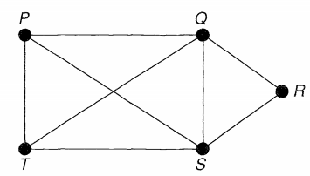
Undirected graph / Non-digraph
Edges are not directed
If two vertices are connected by an edge both direction are accessible
Each vertex has a degree
Degree: number of edges connected to a vertex
(a)
(b)
Fig 2.1: Undirected graphs

Slide 5
Directed graphs / Digraphs
Graph where edges are directed
Edge maps onto ordered pair of vertices (V_{i}, V_{j})
In Fig 2.2 (b), edge (Q, S) is available but not edge (S, Q)
Each vertex has “indegree” and “outdegree”.
Indegree : incoming edges
Outdegree : outgoing edges
Example: In Fig 2.2 (b): S_in = 2, R_out = 4
(a)
P
Q
S
T
R
(b)
Fig 2.2: Directed graph

Slide 6
Simple Graph
An undirected graph that has only one edge between two vertices
Example: Two atom in a chemical compound can be only connected by a single bond
(a)
(b)
(c)
Fig 2.3: Simple graph
Notes:
What are other different types of graphs? H.W.

Slide 7
Multi Graph
May have more than one edge (multiple path) between two vertices
Example: Road Networks
P
Q
S
(a)
T
(b)
R
Fig 2.4: Multi graph
Notes:
What are other different types of graphs? H.W.

Slide 8
Complete / Full Graph
A simple graph with each vertex connected to all other vertices
(a)
(b)
(c)
Fig 2.5: Complete Graph

Slide 9
Loop Graph
Edge connects the same vertex
Contains a loop
(a)
(b)
(c)
Fig 2.6: Loop Graph

Slide 10
Regular Graph
A simple graph with all vertices having same degree
In Fig 2.7, all vertices in (a) has degree 1, (b) has degree 2, and (c) has degree 3
(a)
(b)
(c)
Fig 2.7: Regular Graph

Slide 11
Null Graphs
Has no edges
P
Q
S
T
R
Fig 2.8: Null Graph

Slide 12
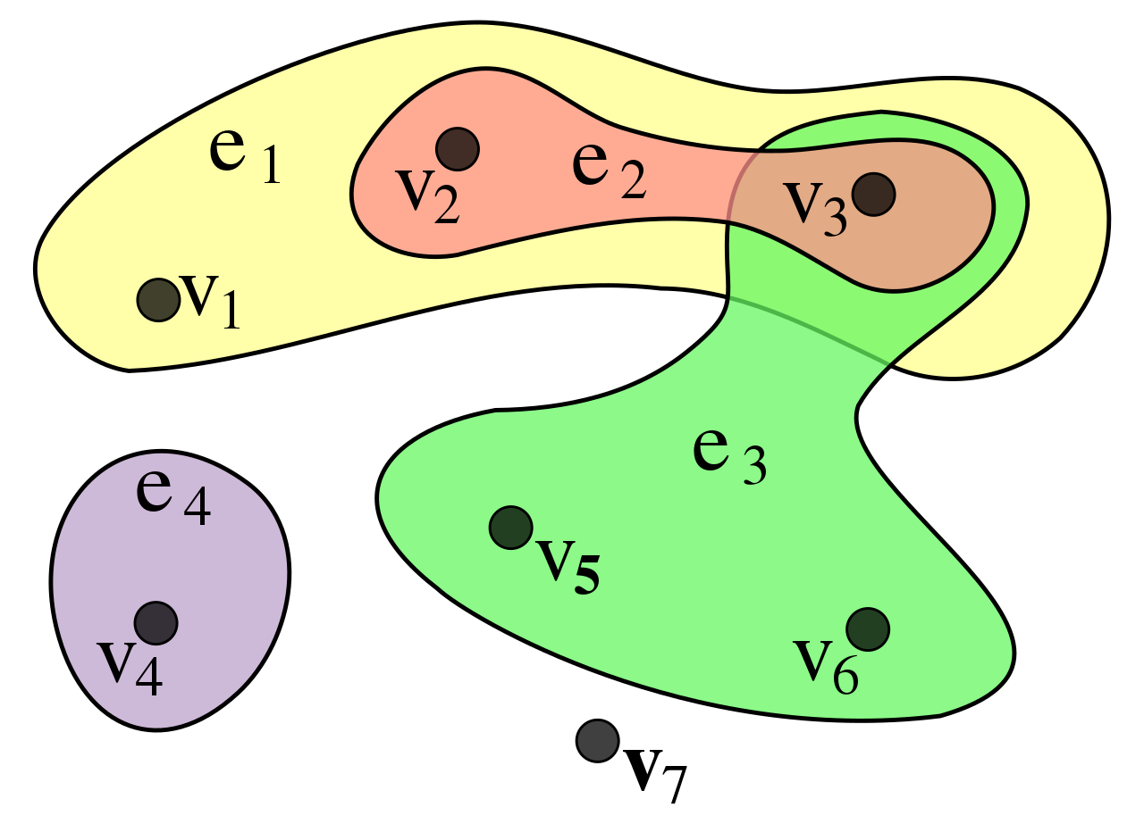
Hyper graph
Graph where edge can connect multiple vertices
Usually, one edge connects two vertices, but in hyper graph an edge can join any number of vertices
e₁ = {v₁,v₂, v₃}, e₂ = {v₂, v₃}, e₃ = {v₃, v₅, v₆}, e₄ = {v₄}
Fig 2.9: Hyper Graph

Slide 13
Bipartite graph
Can be divided into two sets U and V such that every edge connects a vertex in U to one in V
U
V
U
V
(a) Bipartite graph
(b) Complete bipartite graph
Fig 2.10: Example of Bipartite graphs

Slide 14
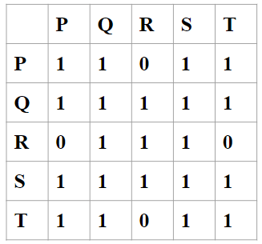
Graph Representation
Adjacency Matrix
Matrix representation of a graph
Square matrix
Fig 2.11: Adjacency matrix representaion of graph

Slide 15
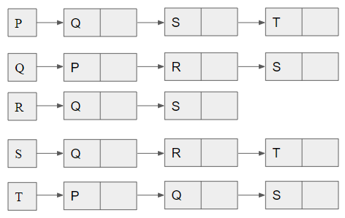
Graph Representation
Adjacency List
an adjacency list is a collection of unordered lists used to represent a finite graph
Each list describes the set of neighbors of a vertex in the graph
Fig 2.11: Adjacency list representaion of graph

Slide 16
Graph Properties
Some of the graph properties are:
Connectedness
Bipartite
Planarity
Eccentricity
Radius
Diameter

Slide 17
Graph Properties (cont’d)
Graph Planarity:
Can be embedded in a plane
Can be drawn with no edges crossing each other
P
Q
P
Q
S
S
T
R
T
R
(a) Non-planar graph
(b) Planar Graph
Fig 2.12: Examples of planar and non-planar graphs

Slide 18
Graph Properties (cont’d)
P
Q
Graph Connectedness / Connected Graph:
Can get from every vertex to all other vertices through a series of edges
There exists a path to all the vertices
Connectivity is the measure of minimum number of edges/nodes that need to be removed to make the graph disconnected
T
R
Q
P
S
T
R
Fig: 2.13: Example of a connected graph

Slide 19
Graph Properties (cont’d)
Eccentricity:
Maximum distance (hops) between a vertex to all other vertices
Here, eccentricity of P, e(P) = 2 and e(R) = 1
P
Q
S
T
R
Fig: 2.14: Graph Eccentricity

Slide 20
Graph Properties
Radius:
Minimum eccentricity from all the vertices
The minimum among all the maximum distances between a vertex to all other vertices
Radius of graph G, r(G) = 1
Fig: 2.15: Graph Radius

Slide 21
Graph Properties
Diameter
Maximum eccentricity from all the vertices
Diameter of graph G, d(G) = 2
P
Q
S
T
R
Fig: 2.16: Graph Diameter

Slide 22
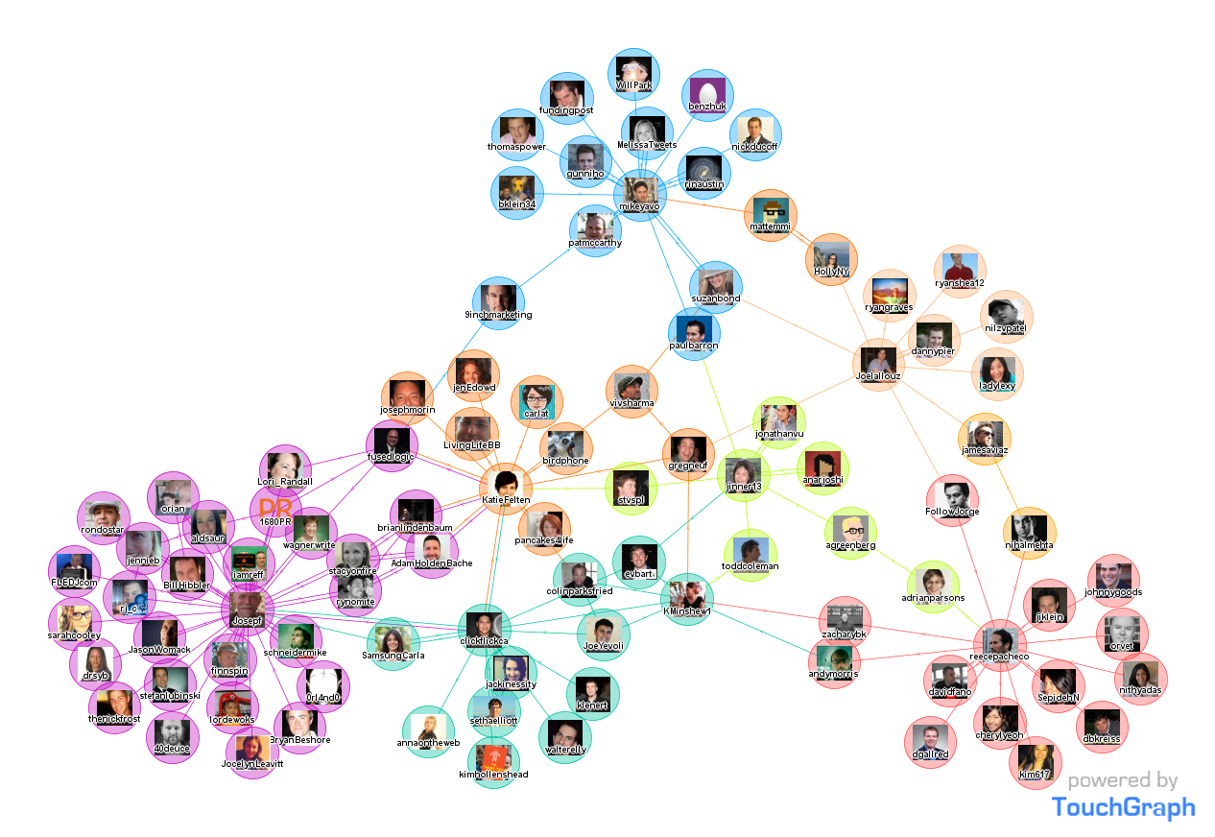
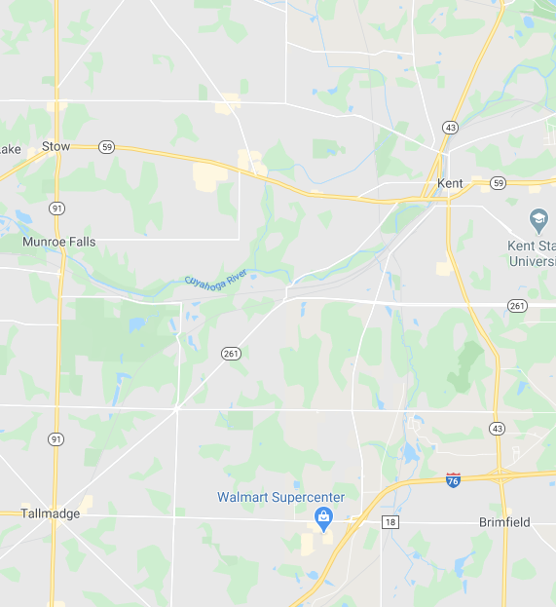
Graph Visualization
Intersection of geometric graph theory and information visualization
Visual representation of graphs
Helps reveal structures and anomalies that may be present in the data
Helps understand and analyze the underlying data
Graph Visualization Tools: GraphViz, Neo4j, D3.js etc.

Slide 23
Graph Problems
Graph Matching
Graph Isomorphism
Notes:
[1] . http://www.sc.ehu.es/acwbecae/ikerkuntza/these/Ch2.pdf
[2]. https://en.wikipedia.org/wiki/Graph_isomorphism

Slide 24
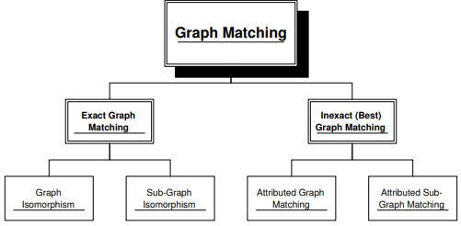
Graph Matching
Graph Matching is the problem of finding similar graphs
Important tool in computer vision, pattern recognition, etc.
The case of exact graph matching is known as graph isomorphism problem
Fig 2.17: Graph Matching Tree ^{[1]}

Slide 25
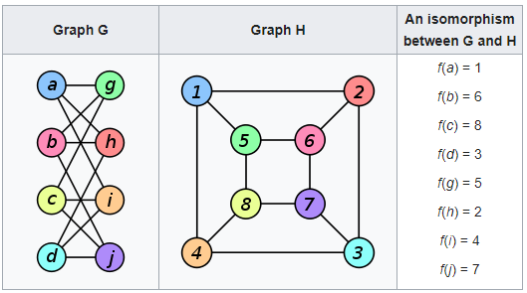
Graph Isomorphism
The case of exact graph matching is known as graph isomorphism problem
Two graphs with the same number of graph vertices connecting in the same way are isomorphic
Fig 2.18: Graph Isomorphism ^{[2]}
Notes:
[1] . http://www.sc.ehu.es/acwbecae/ikerkuntza/these/Ch2.pdf
[2]. https://en.wikipedia.org/wiki/Graph_isomorphism

Slide 26
Graph Algorithms
Single source shortest path query
All-pair shortest path query
Notes:
[3]. http://chbrown.github.io/kdd-2013-usb/kdd/p998.pdf
[4]. https://jeffe.cs.illinois.edu/teaching/algorithms/book/09-apsp.pdf

Slide 27
Single source shortest path query
P
Q
5
S
2
3
1
2
4
8
T
1
R
Problem: given source = P, find shortest path to all other vertices
Solutions: Dijkstra’s algorithm, Bellman-Ford algorithm, Floyd-Warshall algorithms, etc.
P
Q
5
2
3
1
S
2
4
8
T
1
R
P
Q
P
Q
P
Q
5
5
5
2
3
1
S
2
3
1
S
3
1
S
2
2
4
2
4
2
4
8
8
8
T
1
R
T
1
R
T
1
R
Fig : Example of single source shortest paths solution using dijkstra’s algorithm

Slide 28
All-pair shortest path query
Problem: finding the shortest (weighted) path between all pairs of vertices / nodes
Solutions: Dijkstra’s algorithm, Floyd-Warshall algorithm

Slide 29
References
[1] . http://www.sc.ehu.es/acwbecae/ikerkuntza/these/Ch2.pdf
[2]. https://en.wikipedia.org/wiki/Graph_isomorphism
[3]. http://chbrown.github.io/kdd-2013-usb/kdd/p998.pdf
[4]. https://jeffe.cs.illinois.edu/teaching/algorithms/book/09-apsp.pdf

