Slide 1
CS 43118 & CS 53118
ST: Graph and Social Network Analysis
Chapter 5: Application of Social Network Analysis
Niranjan Rai
Department of Computer Science
Kent State University

Slide 2
In this chapter, we will
Learn about where we can apply Social Network Analysis (SNA)
How different real world organizations / entities use social network analysis
How social network analysis helps us understand different features / trends of social networks

Slide 3
Where can we use Social Network Analysis?
Businesses / Marketing / Advertising
Recommendation and Ecommerce systems
Behavioral Information Security Research
Air Force
Textual Analysis
Community Welfare and Public Health
Covert Networks
Collaboration and Co-citation Networks
Web Applications Network and Organizational Issues

Slide 4

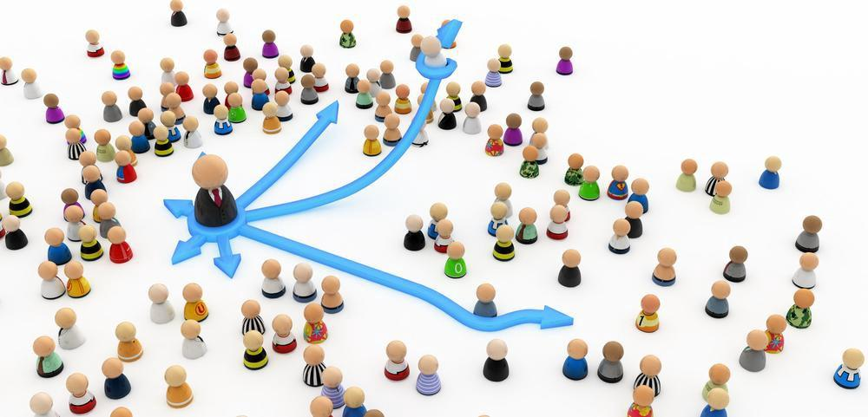
Businesses / Marketing / Advertising
Social networks has influencers / celebrities followed by millions of people
Who are the influencers?

Slide 5
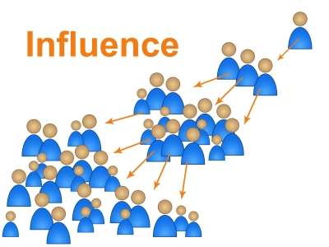
Businesses / Marketing / Advertising
How to maximize influence?
Who to give free products to so that we create a network effect?

Slide 6



Recommendation and E-commerce Systems
What kind of movies / products to recommend based on the social network?
Who is s/he connected to? and what do they like?
Example: Netflix, Amazon, EBay, etc.
+

Slide 7
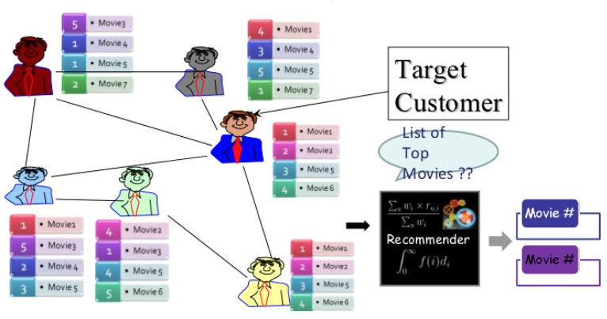
Recommendation and E-commerce Systems
If A, B, C are friends, if A and B likes Movie1, recommend Movie1 to C
A
B
C
Notes:
Figure source: https://www.slideshare.net/xiwangyang/on-topk-recommendation-using-social-networks

Slide 8
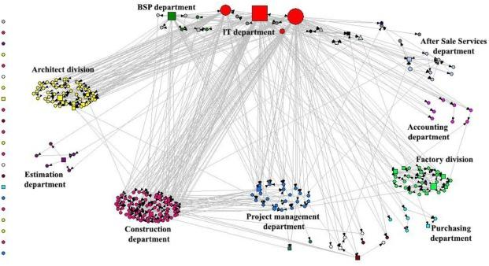
Behavioral Information Security Research^{[1]}
Management of information security
Vulnerable to cyber-attacks due to the stress at workplace^{[2]}
Feasible to find security champions rather than making training video and booklets^{[1]}
Fig: Influence security network ^{[2]}
Notes:
https://reader.elsevier.com/reader/sd/pii/S0167404817300639?token=C44B7684935F1E4817FE7CE6ADE15FDE25F1C19AFD5C43E55BEF87F86B1E7C74401C692C4E39CF97946CA9242134785D

Slide 9
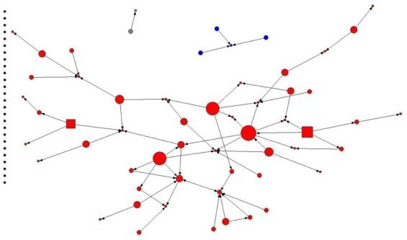
SNA in Behavioral Information Security Research^{[1]}
Examine and evaluate the social environment in a workplace such as connectedness, reciprocity, transitivity, or hierarchy, etc.
SNA methods are suitable for designing change programs and interventions for organizational development purposes^{[2]}
Fig: “Influence security network” of Construction department
Notes:
https://implementationscience.biomedcentral.com/articles/10.1186/1748-5908-8-116

Slide 10
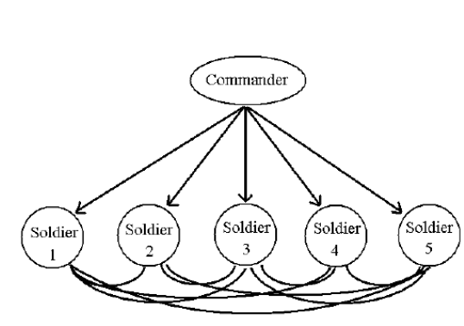
Air Force ^{[4]}
In Air Force, there are network among soldiers and commanders
A robustly networked force improves information sharing
Notes:
https://www.researchgate.net/publication/258716463_Why_Social_Network_Analysis_is_Important_to_Air_Force_Applications

Slide 11
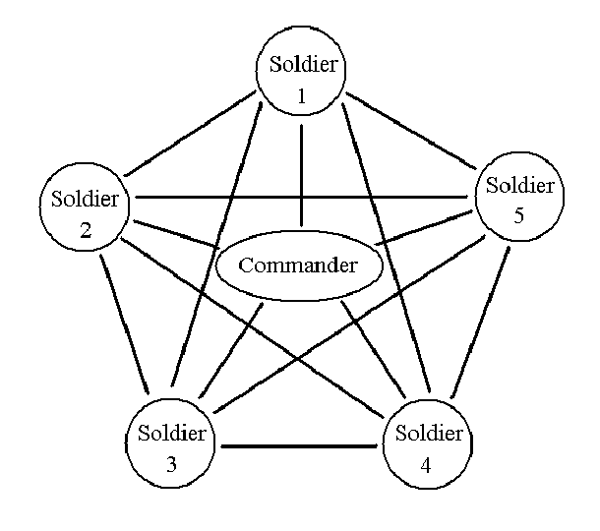
SNA in Air Force ^{[4]}
Information sharing and collaboration enhance the quality of information and shared situation awareness
Shared situation awareness enables self-synchronization
These, in turn, dramatically increase mission effectiveness
Fig: Information flow in an air force network
Notes:
https://www.researchgate.net/publication/258716463_Why_Social_Network_Analysis_is_Important_to_Air_Force_Applications

Slide 12
Textual Analysis
Large text data can be turned into network and then analyzed with the help of social network analysis
For example: Automated analysis of US presidential elections using Big Data and Network analysis ^{[5]}
Notes:
Automated analysis of US presidential elections using Big Data and Network analysis
https://journals.sagepub.com/doi/10.1177/2053951715572916

Slide 13
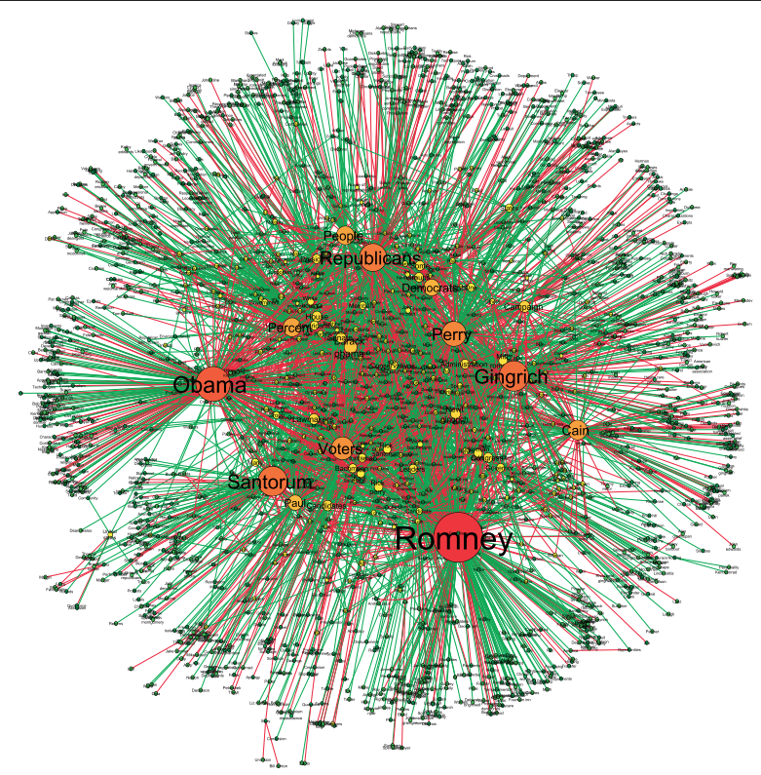

Automated Analysis of US Elections^{[5]}
The study is based on the automated analysis of 130,213 news articles related to the US presidential elections
Notes:
Automated analysis of US presidential elections using Big Data and Network analysis
https://journals.sagepub.com/doi/10.1177/2053951715572916

Slide 14
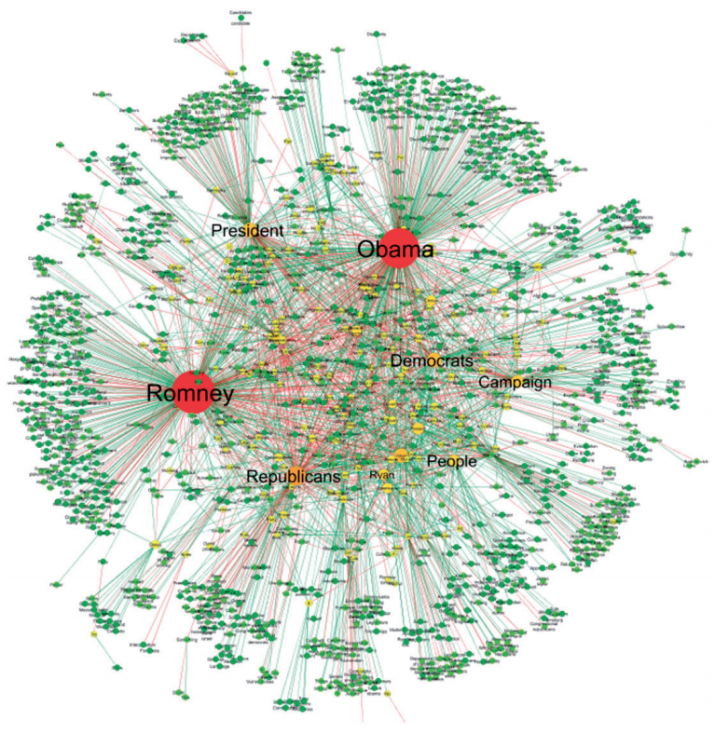
Automated Analysis of US Elections^{[5]}
Applied different insights and techniques, including: graph partitioning, centrality, assortativity, hierarchy and structural balance
Helped observe fundamental split between the Republican and Democrat camps
Helped identify the most central nodes of the political camps
Notes:
Automated analysis of US presidential elections using Big Data and Network analysis
https://journals.sagepub.com/doi/10.1177/2053951715572916

Slide 15
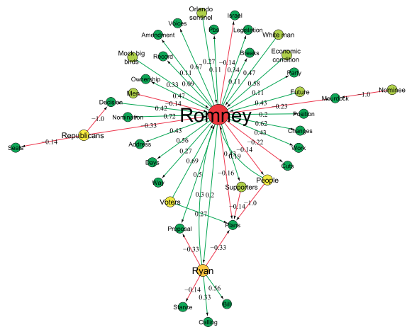
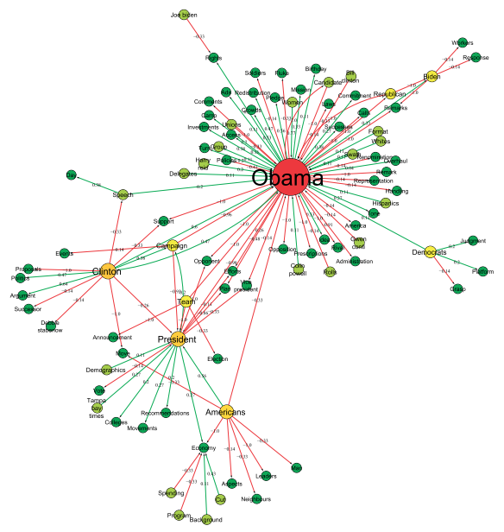
Automated Analysis of US Elections^{[5]}
Detecting the central actors in the semantic graphs
Notes:
Automated analysis of US presidential elections using Big Data and Network analysis
https://journals.sagepub.com/doi/10.1177/2053951715572916

Slide 16
SNA for Community Welfare
Analyze different types of relations such as communication patterns, physical contacts, sexual relationship etc.
Social networks which are made for strengthening community resilience against disasters (natural or human-made) can reveal vulnerabilities within a network
Reveal the patterns of human contact which may lead to spread of disease such as HIV in population
Help identify diffusion of epidemics and other diseases in society

Slide 17
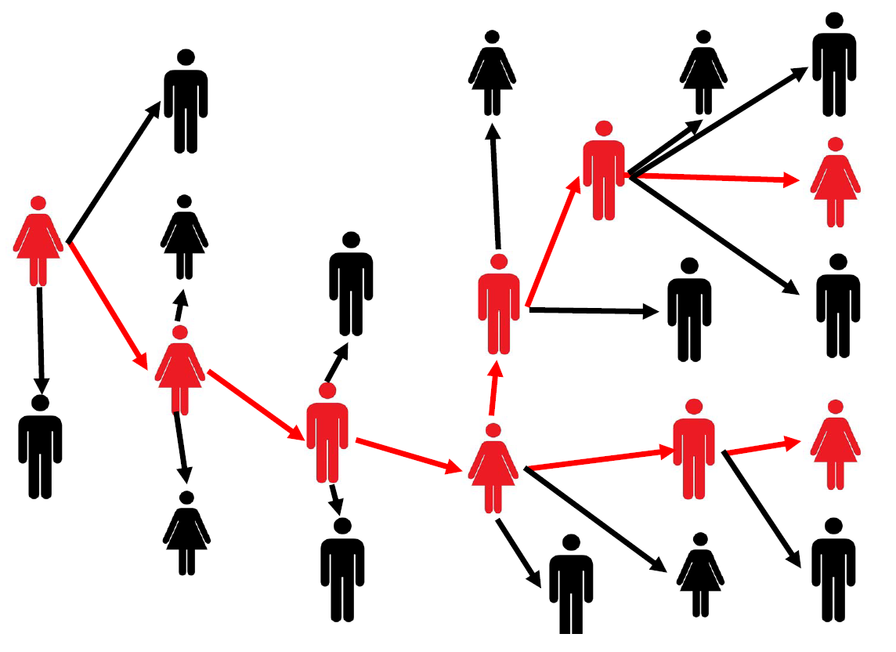
Diffusion of Epidemics / Contact Tracing
How to trace information as it spreads?
How to efficiently detect epidemics and information outbreaks?
Notes:
Social Network Analysis in Epidemiology: Current Trends and Perspectives
https://ieeexplore.ieee.org/stamp/stamp.jsp?tp=&arnumber=6006866

Slide 18

Covert Networks
Hidden networks
Actors do not disclose information to external world
Example: terrorist and criminal networks

Slide 19
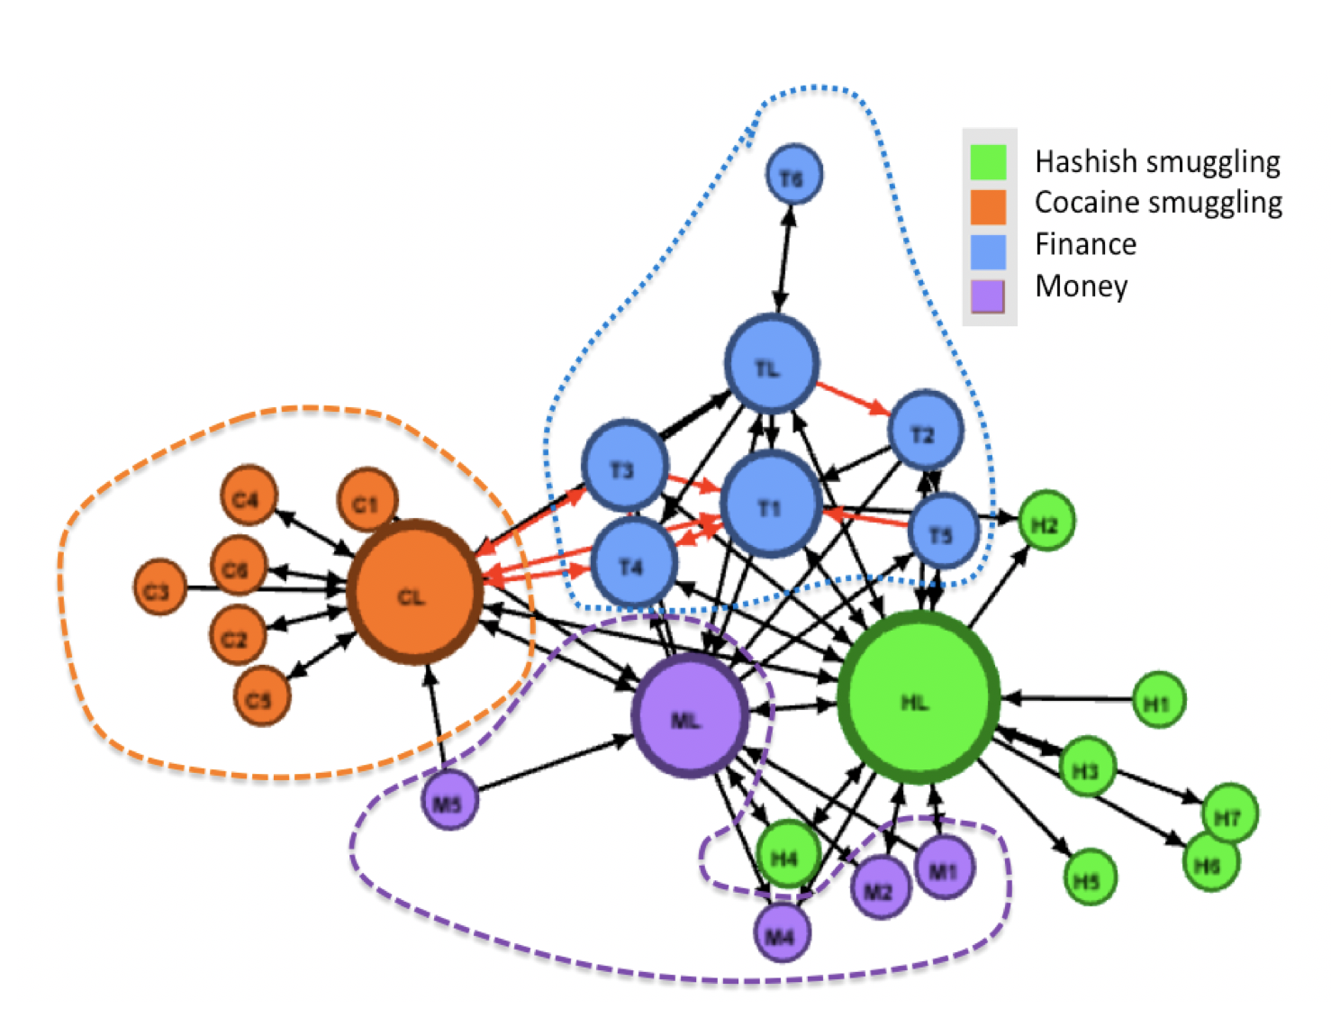

SNA in Covert Networks
Help understand covert cell operations and their organization
Discover interesting patterns and actors involved in an event
Predict terrorism activities
Notes:
Detecting criminal organizations in mobile phone networks
http://www.emilio.ferrara.name/2014/04/14/detecting-criminal-organizations-in-mobile-phone-networks/

Slide 20
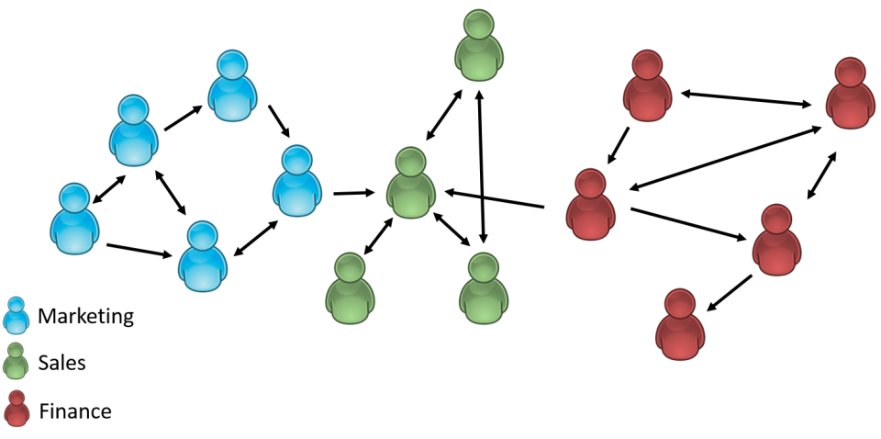
Collaboration Networks
Collaboration network consists of groups of persons working together to perform particular activity
Studying human collaboration is an important topic in sociology
Co-authorship collaboration network and movie actor collaboration networks are widely studied
Notes:
http://www.informationr.net/ir/22-2/paper758.html

Slide 21

SNA in Collaboration Networks
To study dynamics in patterns of interactions between educational entities or communities
To study and understand the interdisciplinary research which is key factor for innovation
To distribute the information about open-source software amongst community or users in knowledge collaboration network
Notes:
http://www.informationr.net/ir/22-2/paper758.html

Slide 22
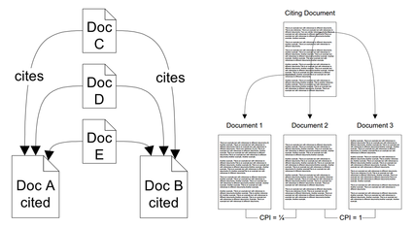
Co-citation Networks
Co-citation is used as a measure of similarity between two objects
Basic two approaches of co-citation are
  Author co-citation and
  Document co-citation

Slide 23
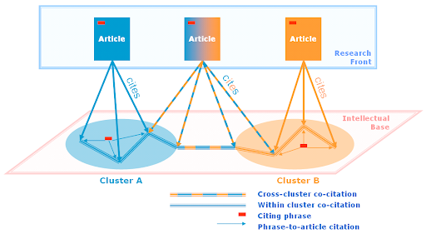
SNA in Co-citation Networks
Help to understand the status and structure of scientific research
Help reveal the research network consisting of different institutions linked to each other informally by having documents/papers with similar ongoing research

Slide 24

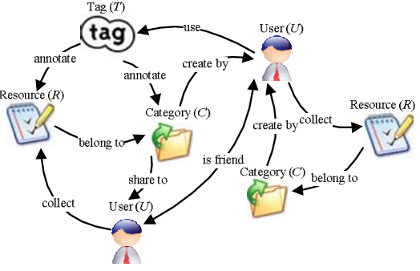

Web Applications Network
Web pages = nodes and hyperlinks = edges
Heterogeneous Web social network
  Nodes = webpages or actors
  Edges = hyperlink or action
Notes:
Recommendation over a Heterogeneous Social Network
https://ieeexplore.ieee.org/stamp/stamp.jsp?tp=&arnumber=4597029

Slide 25


SNA in Web Applications
Understand online behavior by individuals, organizations, and between websites
Analyze the connections between web pages to examine how information flows as individuals navigate the web
Hyperlink analysis to examine organizations within an issue community (e.g. LGBTQ community ^{[7]})
Notes:
Pink Links: Visualizing the Global LGBTQ Network
https://www.researchgate.net/publication/323756718_Pink_Links_Visualizing_the_Global_LGBTQ_Network

Slide 26
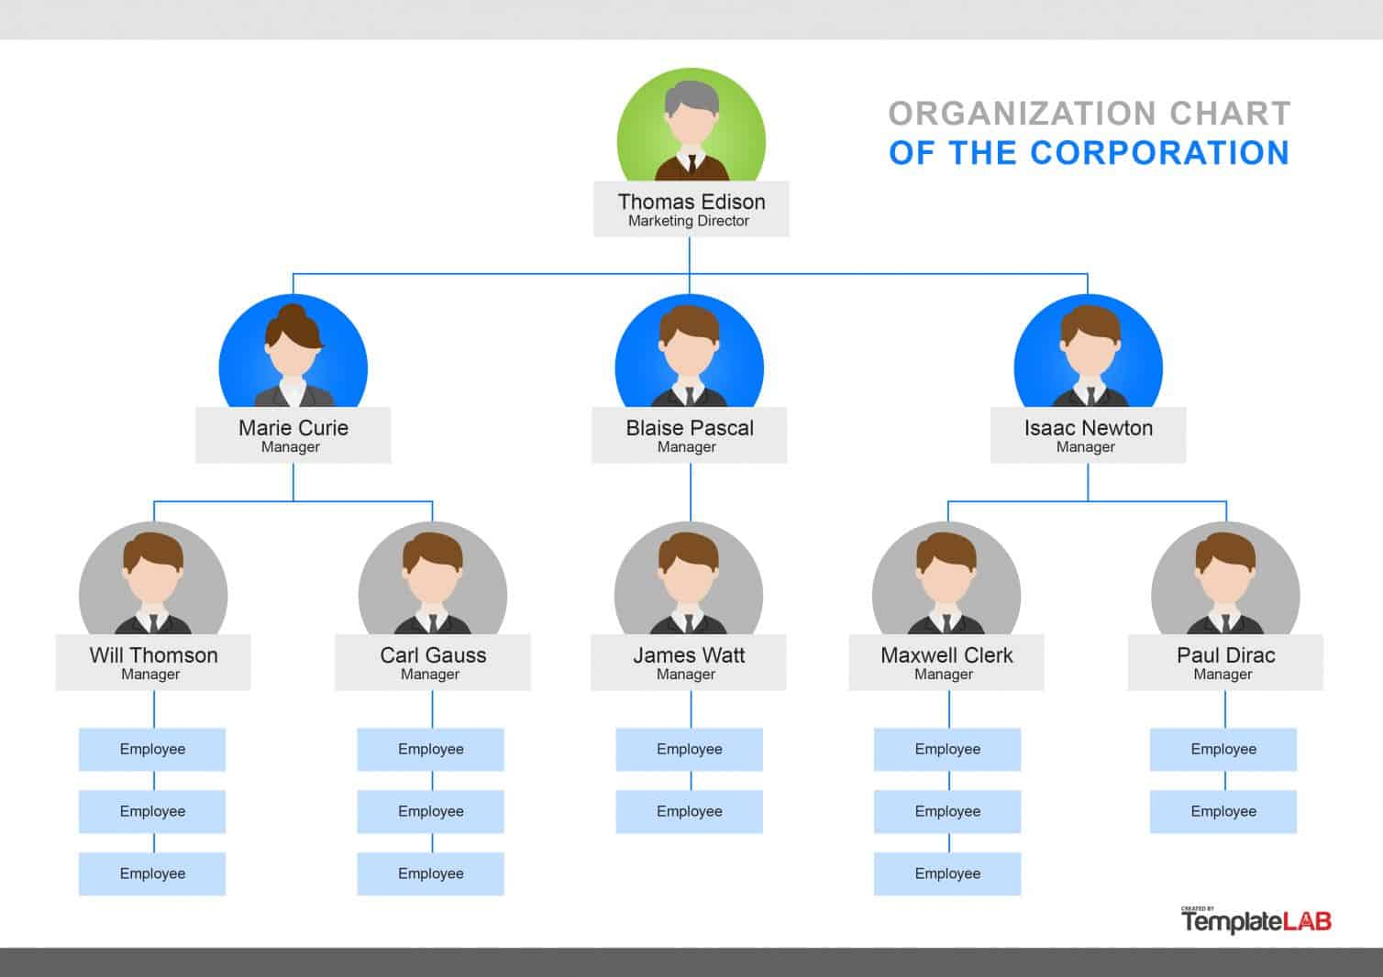
Organizational Issues
How people, individuals, and groups act within an organization?
Identify the key or central persons of an organization
Understand important to go people in an organization for:
  Team Formation
  Improved Information sharing
  Identifying bottlenecks
  Hidden barriers
Image Source: http://mgmtzone101.blogspot.com/2014/01/difference-between-organization.html
Notes:
In any organization, cooperation and information sharing among the workers is very important for the success of an organization
http://mgmtzone101.blogspot.com/2014/01/difference-between-organization.html

Slide 27
References
Applications of social network analysis in behavioral information security research: Concepts and empirical analysis – Duy Dang-Pham, Siddhi Pittayachawan, Vince Bruno.
Dang-Pham D, Pittayachawan S, Bruno V. 2014. Towards a complete understanding of information security misbehaviors: a proposal for future research with social network approach. In 25th Australasian Conference on Information Systems (ACIS). Auckland, New Zealand.
Social network diagnostics: a tool for monitoring group interventions – S.B. Gesell, S. L. Barkin, T.W. Valente.
Why Social Network Analysis is Important to Air Force Applications – Paul et. al.
Automated analysis of the US presidential elections using Big Data and network analysis – S. Sudhahar et. al.
Social Network Analysis in Epidemiology: Current Trends and Perspectives https://ieeexplore.ieee.org/stamp/stamp.jsp?tp=&arnumber=6006866
Pink Links: Visualizing the Global LGBTQ Network https://www.researchgate.net/publication/323756718_Pink_Links_Visualizing_the_Global_LGBTQ_Network

