Slide 1
Method of providing Secure Network Channel among Secure OSs
Jae-Deok Lim*, Joon-Suk Yu*, Jeong-Nyeo Kim*
*Electronics and Telecommunications Research Institute(ETRI) , KOREA

Slide 2
Method of providing Secure Network Channel among Secure OSs
Prepared By:
Ibrahim Aljubayri

Slide 3
What is the paper about ?
This paper propose a secure operating system trusted channel, SOSTC, as a prototype of a simple secure network protocol that can protect network traffic among secure operating systems and can transfer security information of the subject. It is significant that SOSTC can be used to extend a security range of secure operating system to the network environment.

Slide 4
Introduction
Many security systems are under development for protecting data and systems from intruders, such as IDS(Intrusion Detection System) and Firewall. But they are exposed to the limitation that the IDS does not protect from new attack methods, and the firewall is defenseless if the intruder is already in the system. And system security patches and version upgrades were being applied but they are also exposed to some limitations.

Slide 5
Introduction …
But, even if secure OS is running under various access control policies, network traffic among these secure OSs can be captured and exposed easily by network monitoring tools like packet sniffer if there is no protection policy for network traffic among secure OSs. For this reason, protection for data within network traffic is as important as protection for data within
local system.

Slide 6
What are Packet Sniffers
Host A
Host B
Router A
Router B
A packet sniffer is a software application that uses a network adapter card in promiscuous mode to capture all network packets. The following are the packet sniffer features:
Packet sniffers exploit information passed in clear text. Protocols that pass information in the clear include the following:
Telnet
FTP
SNMP
POP

Slide 7
Design and Implementation SOSTC
SOSTC was implemented to provide a part of the items recommended in CC (Common Criteria) within the FreeBSD secure OS. The items provided in SOSTC are some functions of ‘Class FTP: Trusted path/channels. Because SOSTC conducts encryption and authentication of packets within the kernel level, it guarantees confidentiality and integrity of network packets and provides transparency to users. The architecture of SOSTC is shown in Fig. 1. (Next slide) SOSTC is working within the IP protocol stack.

Slide 8
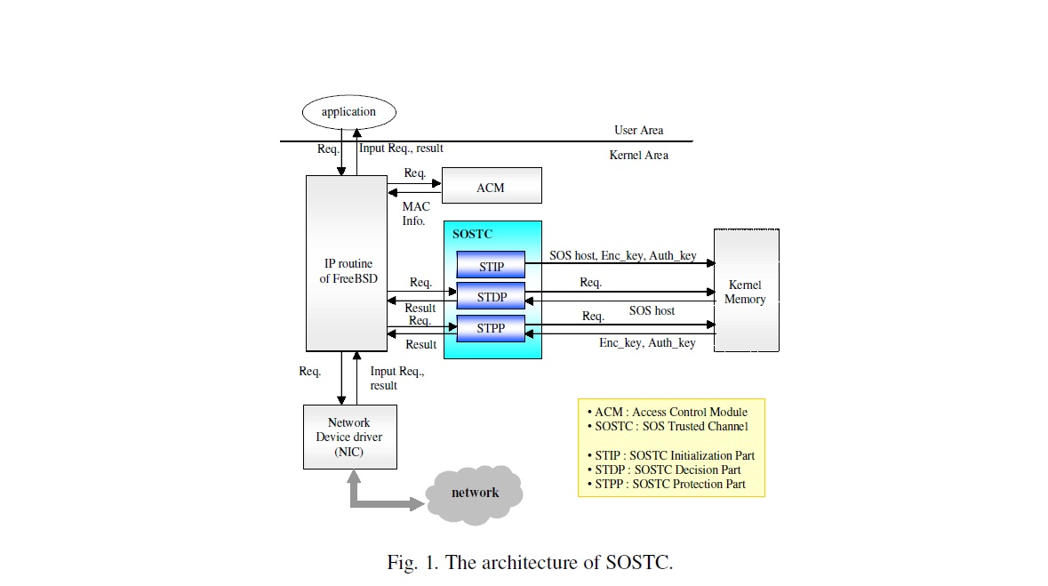

Slide 9
SOSTC consists of three parts

Slide 10
1 )
STIP(SOSTC Initialization Part) loads the initial data needed for SOSTC into kernel memory at the system boot-time. The initial data are an encryption key for packet encryption, an authentication key for packet authentication and IP addresses of secure OS to be applied to SOSTC. An encryption key and an authentication key are self-encoded within kernel for increasing security before being loaded into kernel memory. The initial data are stored in their own file and these files can be protected with RBAC policy of secure OS. We assume that all the secure OSs which will deploy SOSTC have shared the IP addresses of secure OS, the algorithm and key for encryption and authentication in advance.

Slide 11
2)
STDP(SOSTC Decision Part) determines whether SOSTC is applied to packets. It is different that the procedures of STDP in input and output processing of packets respectively.
In the output processing, if the destination address of a sending packet is one of the addresses of host loaded into kernel memory for applying SOSTC, that is, the destination of packet is secure OS, the packet is passed to STPP for SOSTC output processing.
In the input processing, if the ‘next_protocol’ field of IP header of a received packet is the value defined as SOSTC, the packet is passed to STPP for SOSTC input processing

Slide 12
3)
STPP executes a SOSTC processing essentially. In the output processing, STPP makes a SOSTC packet with SOSTC header, executes an encryption of packet for confidentiality and computes an authentication data of packet for integrity.
In the input processing, STPP checks the authentication data of packet for integrity and executes a decryption of packet and restores SOSTC packet to common IP packet by removing SOSTC header.

Slide 13
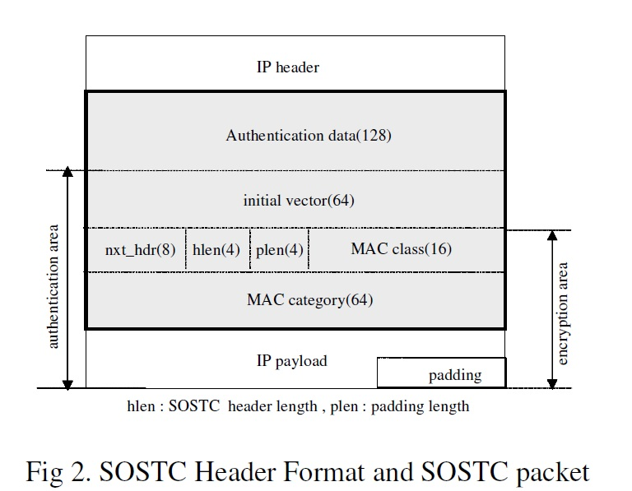

Slide 14
Fig. 2 shows the SOSTC header format for SOSTC communication and SOSTC packet. The shaded area indicates SOSTC header.
SOSTC header consists of authentication data field for packet integrity, initial vector and padding length field for packet encryption, next protocol field for proper packet processing in the upper protocol level, and so on. Especially, it has MAC information filed to deliver MAC class and category of process(user) who tries to send a packet. This can maintain the consistency of security information in a network environment consisted of secure OSs.

Slide 15
How Is Packet Processing done ?
The processing of SOSTC packet is done as follows in the input and output routine of IP layer respectively

Slide 16
How Packet Processing done ?
In the output processing, when the request of data sending from user process is issued, the relevant packet is passed to the IP output routine after processing in an upper protocol output routine, e.g. TCP output routine.
After packet processing except fragmentation is done in IP output routine, this packet is determined in STDP whether SOSTC is applied to it or not by comparing its destination IP address with secure OS IP address loaded into kernel memory at the boot-time.

Slide 17
How Packet Processing done ?
If SOSTC is needed, the packet is passed to STPP and then SOSTC packet is created with SOSTC header. After this, SOSTC packet is configured completely by encrypting an encryption area and computing an authentication data with authentication area shown Fig. 2. After completing to configure a SOSTC packet, the remaining process of IP layer, namely fragmentation, is executed if needed. And then the packet is passed to the lower protocol output routine to be sent. If SOSTC is not applied, the packet to be sent is a common IP packet.

Slide 18
How Packet Processing done ?
In STPP, the blowfish encryption algorithm is used with CBC(Cipher Block Chaining) mode for confidentiality of packet and HMAC-MD5 authentication algorithm for integrity of packet.

Slide 19
Performance
We can expect easily that the performance of network with SOSTC is not as good as that of network without SOSTC, because when SOSTC is applied, additional processes related to encryption and authentication for packets are required essentially and these works may consume many computing resources.

Slide 20
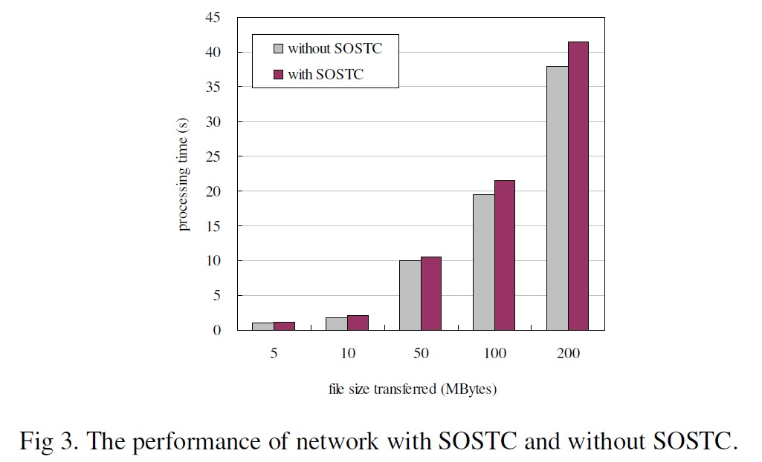

Slide 21
Conclusion
In conclusion, the paper proposed a secure operating system trusted channel, SOSTC, that can provide secure communication to secure OSs. SOSTC can provide network traffic among secure OSs with integrity and confidentiality and can maintain consistency of security information by transferring security information of the subject

Slide 22
References
[1] J. G. Ko, J. N. Kim, & K. I. Jeong, “Access Control for Secure FreeBSD Operating
System,” Proc. of WISA2001, The Second International Workshop on Information Security
Applications, 2001.
[2] Bell, David Elliott, & Leonard J. La Padula, “Secure computer system: Unified exposition
and multics interpretation,” MITRE Technical Report 2997, MITRE Corp, Bedford, MA,
1975.
[3] David F. Ferraiolo, Ravi Sandu, & Serban Gavrila, “A Proposed Standard for Role-Based
Access Control,” ACM transaction on Information and System Security, VOL.4, NO.3,
pp.224-274, Aug. 2001.
[4] “Class FTP: Trusted path/channels,” Common Criteria for Information Technology
Security Evaluation, Part 2: Security functional requirements, Version 2.1, 1999.
[5] S. Kent, R. Atkinson, “Security Architecture for the Internet Protocol,” RFC 2401, Nov.
1998.
[6] C. Kaufman, et al., “Code-preserving simplifications and improvements to IKE,” draftkaufman-
ipsec-improveike-00.txt, 2001.
[7] FreeBSD 4.3-RELEASE Source Code
[8] Behrouz A. Forouzan, Sophia Chung Fegan, TCP/IP Protocol Suite, Boston : McGraw-
Hill, 2000.
[9] B. Schineier, Applied Cryptography, John Wiley & Sons, 1996, pp. 336-339.

Slide 23
Thank you for your attention
If you have any question email me @
y1yy2@hotmail.com
Ibrahim

