Slide 1
CLOUD COMPUTING SECURITY
Shilpashree Srinivasamurthy
David Q. Liu
Presented by,
Jithu Jose

Slide 2
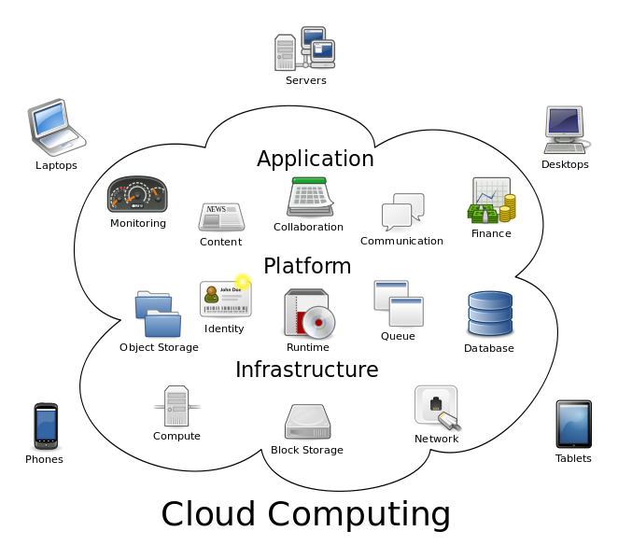
What is Cloud Computing
Large numbers of computers are connected through a communication network.
Cloud computing is a collection of virtualized and scalable resources which are capable of providing required resources to users on-demand.

Slide 3
Essential Characteristics
On-Demand self-service
Broad network access
Resource pooling
Rapid elasticity
Measured service

Slide 4
Deployment Type:
Types of Cloud
  SaaS(Software as a Service)
  PaaS(Platform as a Service)
  IaaS(Infrastructure as a Service)
Private Cloud
Public Cloud
Community Cloud
Hybrid Cloud

Slide 5
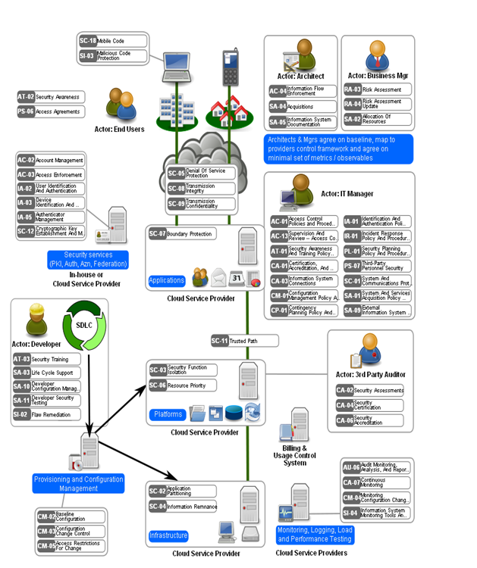
Open Security Architecture of Cloud Computing
Several key controls are to be taken before moving a computing operation into clouds: Contractual agreements, Certification and third-party audits, Compliance requirements, Availability, reliability, and resilience, Backup and recovery, Service levels and performance,
Decommissioning.

Slide 6
Advantages of Cloud Computing
  Virtualization
  Feasibility to choose vendor
  Elasticity
  Cost reduction
  Scalability and Speed

Slide 7
Security Threats & reccomendations
Abuse and Nefarious Use of Cloud Computing
    Remedies:
-Initial registration and validation process must be done in a proper way.
-Monitoring public blacklist for one’s own network blocks.
Insecure application programming interfaces
    Remedies:
      -Proper analysis of security model of the cloud provider interfaces must be done.
      -Strong authentication and access control should be ensured.
Malicious insiders
    Remedies:
    -Transparency into overall information security and management practices.
    -Strict supply chain management must be enforced.

Slide 8
Security Threats & reccomendations (Cont’d)
  Shared technology vulnerabilities
        Remedies:
        -Installation/Configuration must be implemented with best security practices.
        -Unauthorized changes/activities must be monitored.
        -Vulnerability scanning and configuration audits must be conducted.
  Data loss/leakage
      Remedies:
        -Strong API access control must be implemented.
        -Encrypt and protect integrity of data in transit.
        -Providers must wipe persistent media before it is released into the pool.
        -Specify provider backup and retention strategies

Slide 9
Security Threats & recommendations (Cont’d)
  Account ,Service & Traffic hijacking
      Remedies:
      -Sharing of account credentials between users and services must be prohibited.
      -Strong two-factor authentication techniques must be implemented wherever possible.
      -Proactive monitoring must be done to detect unauthorized activity
Unknown risk profile
    Remedies
    -Applicable logs and data must be disclosed.
    -Infrastructure details like patch levels, firewalls, etc. must be disclosed.
    -Monitoring and alerting on necessary information.

Slide 10
OTHER SECURITY THREATS
Failures in Provider security
Attacks by other costumers
Legal and regulatory issues
Perimeter security model broken
Integrating provider and Customer security systems

Slide 11
SECURITY IN CLOUD COMPUTING
Infrastructure Security: This can be addresses by understanding which party provides which part of security.
Data Security and Storage: Data protection methods must be viewed with great concern. Homomorphic encryption can be used for data security encryption.
Identity and access: By using “Identity as a Service ” providers may be a useful tool for outsourcing identity management capabilities which one of the key factor.
Security management: As the flexibility increase, the control over the services also increases. In an virtualized environment ,the data gets commingled and hence we need to understand the location of the services, service-level latencies and storage access latency.

Slide 12
SECURITY IN CLOUD COMPUTING (CONT’D)
Privacy: This is an important issue in cloud computing. It can be achieved by minimize personal information sent to and stored in the cloud, maximizing user control, specify and limit the purpose of usage.
Audit and Compliance: Cloud Service Providers must have strong internal monitoring coupled with external audit process.
Security-as-a Service: Two proactive controls: identity management and key management. Two reactive controls: scalable and effective SIEM, and data leakage prevention (DLP).

Slide 13
EXISTING SOLUTIONS FOR SECURITY THREATS
MIRAGE IMAGE MANAGEMENT SYSTEM:
This system addresses the issues related to secure management of the virtual-machine images that encapsulate each application of the cloud.
It has 4 components:
-Access Control
-Image Transformation by running filters
-Provenance Tracking
-Image maintenance
Limitations: Huge performance overheads, both in space
and time.

Slide 14
EXISTING SOLUTIONS FOR SECURITY THREATS(Cont’d)
CLIENT BASED PRIVACY MANAGER
This helps to reduce the risk of data leakage and loss of privacy of the sensitive data processed in the cloud, and provides additional privacy related benefits.
Main features of privacy manager are:
-Obfuscation
-Preference Setting
-Data Access
-Feedback
-Personae
Limitation: If the service provider does not provide
full cooperation the features of the Privacy Manager other
than obfuscation will not be effective.

Slide 15
EXISTING SOLUTIONS FOR SECURITY THREATS(Cont’d)
TRANSPARENT CLOUD PROTECTION SYSTEM:
This is intended to protect the integrity of guest Virtual Machines (VM) and of the distributed computing middleware by allowing the host to monitor guest VMs and infrastructure components.
SECURE AND EFFICIENT ACCESS TO OUTSOURCED DATA:
This forms a foundation for information management and other operations. Right keys should be provided to the end users to control
their access.
Limitation: This approach is applicable only for owner-write-users-read applications and hence not generic.

Slide 16
CONCLUSION
Though cloud computing has many advantages, there are several threats and issues to be considered.
Each algorithm proposed to overcome has its own pros and cons.
Its security deficiencies and benefits needs to be weighed before making an decision.

Slide 17
REFERENCES
Shilpashree Srinivasamurthy, David Q. Liu. Survey on Cloud Computing Security. A survey paper. DOI=http://salsahpc.indiana.edu/CloudCom2012/Poster/cloudcom2010_submission_67.pdf
http://en.wikipedia.org/wiki/Cloud_computing
https://www.dialogic.com/~/media/products/docs/whitepapers/12023-cloud-computing-wp.pdf

Slide 18


