Slide 1

Ensuring Operating System Kernel Integrity with OSck
Kent State University
College of Arts and Sciences
Department of Computer Science
By
Owen S. Hofmann Alan M. Dunn Sangman Kim
Indrajit Roy Emmett Witchel
Presented by:
Khulud Alsultan
7/18/2013

Slide 2
Outlines
Introduction
Detecting Kernel Rootkits
Design
Implementation
Rootkits
Evaluation
Conclusion

Slide 3
Introduction
Rootkits: software packages left on an exploited system to facilitate further malicious access.
- It is difficult for modern tools to detect.
Kernel Rootkits: use access to kernel memory to subvert the integrity of kernel code or data structures, giving control of critical resources to a malicious entity .
Why dangerous to system security: modify OS state to avoid detection →gain unauthorized access to computer resources and to prevent detection.

Slide 4
Introduction
Why are kernel rootkits difficult to detect ?
OS have Complicated data structure with no explicit integrity constraints →providing a large and growing attack surface to rootkit authors.
User- or kernel-level security tools should not trust a compromised OS kernel to correctly execute security checks.

Slide 5
Solution:OSck
Osck: a system that discovers kernel rootkits by detecting malicious modifications to OS data.
Integrates and extends existing techniques for detecting rootkits.
Verifies safety properties for large portions of the kernel heap with minimal overhead.
Detects when the state of kernel data structures violates the integrity properties specified to the hypervisor.

Slide 6
Solution: OSck
High-performance integrity checks that execute concurrently with a running OS create data races
Demonstrate a solution for ensuring kernel memory is in a consistent state.
Introduce two new classes of kernel rootkits that are undetectable by current systems.

Slide 7
Detecting Kernel Rootkits
Kernel rootkits obscure signs of their presence
Three techniques to hide the presence of rootkits:
1- Diverting control to code that hides presence of the rootkit.
2- Executing code or storing data outside of a traditional process or file context.
3- Modifying OS data structures to conceal the presence of the rootkit.

Slide 8
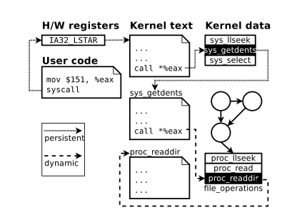
Detecting Kernel Rootkits
1- Protecting control flow:
Rootkit may modify control flow to run its code in a context undetectable by users.
Rootkit may modify OS control flow to hide resources visible to user level monitoring tools
- Control transfers categories:
*Static and persistent control transfers:
OSck force transfers to remain immutable.
*Dynamic control transfers:
OSck checks certain type-safety
Properties of the kernel heap.

Slide 9
Detecting Kernel Rootkits
2- Protecting non-control data:
Rootkit may conceal system resources from the user by modifying non-control data in the kernel heap.
OSck focuses on exporting a convenient interface for writing integrity checks.
OSck extracts data structure definitions from kernel source
generates an API for writing integrity checks as if they are code that would execute
within a kernel thread, handling translation of kernel addresses

Slide 10
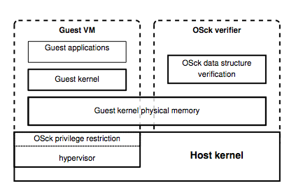
Design
OSck architecture:
Most of OSck’s verification runs in a thread at the same privilege level as the guest OS, isolated by process and VM boundaries.

Slide 11
Design
1- Determining which code to trust:
→ OSck must manage the regions of memory that are considered to be valid kernel code.
Modules dynamically loaded into the kernel must also become a part of the memory regions that OSck considers to be valid code.
Currently, OSck relies on a whitelist and cryptographic hash of trusted modules.

Slide 12
Design
2- Verifying heap safety:
OSck verifies the entire heap in a linear scan of kernel memory:
Several advantages:
1- A linear scan is efficient: in the common case, checking pointer targets is a read-only operation
2- Facilitates incremental verification.

Slide 13
Design
2- Verifying heap safety:
Type information from an untrusted kernel
Two mapping of kernel address to data types:
1- The effective mapping: is the mapping implicitly created by the actions of kernel code
2- The bound mapping: is the map that OSck creates

Slide 14
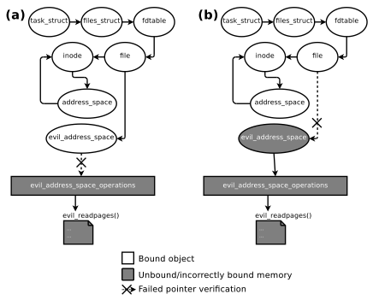
Design
2- Verifying heap safety:
Type-safety example:

Slide 15
Design
3- Handling concurrency:
Goal of Osck: minimize the performance impact of monitoring kernel state .
Assumptions that allow OSck to verify the state of the kernel with no synchronization in the common case:
1- assume that false negatives due to unsynchronized accesses are transient and rare.
Two steps that OSck performs in the event of an integrity violation:
1- Immediately re-verify the state of the kernel.
2- Enforce quiescence.

Slide 16
Implementation
- Implement OSck as part of the KVM hypervisor. KVM virtualizes a guest kernel within a host Linux kernel.
- A user-level launcher binary allocates a region of memory to serve as the guest’s physical memory, loads the guest kernel, and then calls into the host kernel to run the virtualized guest.
- The majority of kernel data structures are addressed in a large portion of the virtual address space that linearly maps physical memory.

Slide 17
Implementation
1- Restricting guest privilege:
OSck protects the static and persistent control transfers on system call entry
2- Slabs for efficient safety:
data structures in the Linux kernel are allocated via slab allocation, which provides caches, or specialized per-type allocators.
Kernel caches allocate memory from groups of pages called slabs containing a single type of object

Slide 18
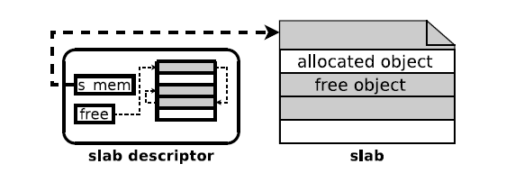
Implementation
2- slabs for efficient safety
The slab descriptor specifies the cache that contains the given slab
alignment information for objects within the slab,
and a list of free objects.

Slide 19
Implementation
3- Automatic type-safety checks:
For each data type, OSck generates a C function that takes a pointer to kernel memory as input.
For each pointer within the data type, OSck outputs a call to our pointer-based type safety verifier.
For each nested data type, OSck outputs a call to the function responsible for verifying that data type.

Slide 20
Implementation
4- Manual integrity checks:
OSck exports an interface for writing verification code that is convenient for those who understand kernel internals best: kernel developers.

Slide 21
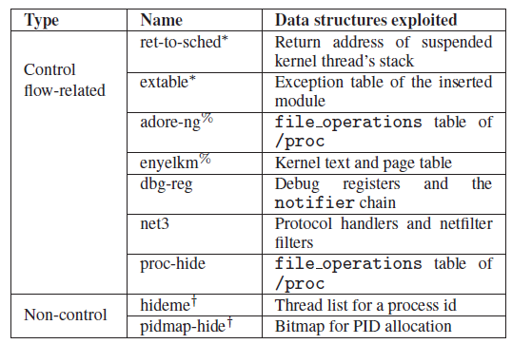
Evaluation
-Measure the performance and detection capability of OSck
Rootkits that used in evaluation:

Slide 22
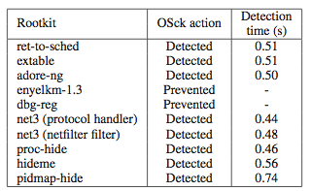
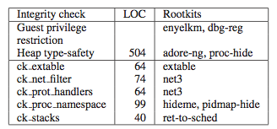
Evaluation
1- Rootkit detection
Rootkits detected by OSck
Kernel integrity checks implemented by OSck

Slide 23
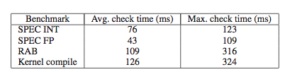
Evaluation
2- performance of OSck integrity checks
Execution times for a single iterations of OSck’s complete integrity checks for each single core benchmark.

Slide 24
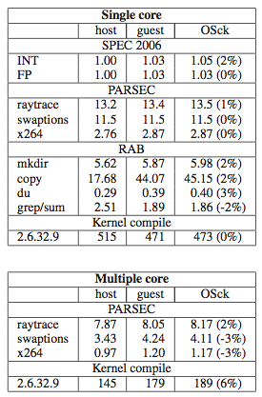
Evaluation
3-Benchmarks
Benchmark execution time (slowdown of OSck checks over guest execution in parentheses).

Slide 25

Evaluation
4- OSck and concurrency
Percent of OSck’s runqueue integrity checks that fail for different numbers of user processes that do nothing but yield the processor.

Slide 26
Conclusion
OSck is a virtual machine based system that detects rootkits by determining violations to OS invariants.
OSck introduces new mechanisms for bulk verification of types, and consistent data structure views to provide practical and efficient detection.
OSck can efficiently detect many kinds of rootkits including two new classes that cannot be handled by any previous rootkit detection system.

Slide 27
References
Hofmann, Owen S., et al. "Ensuring operating system kernel integrity with OSck." ACM SIGPLAN Notices. Vol. 46. No. 3. ACM, 2011.

Slide 28


Slide 29


