Slide 1
AI for DB (AI4DB)
Course Syllabus
Instructor: Xiang Lian
Email: xxl1584@case.edu
Homepage: http://www.cs.kent.edu/~xlian/
Notes:
The slides of this AI4DB course used some public slides/materials on the Web for teaching purposes only. I would like to acknowledge these resources, and please let me know if I failed to cite them or you want to remove them from my slides.

Slide 2
In-Class Questions
Have you taken any course(s) related to relational databases (or Database Management Systems)?
Have you taken any courses related to NoSQL databases?
Have you taken any AI courses?
Have you written any AI code or implemented any AI-related project?
Have you tried ChatGPT? ☺

Slide 3
Welcome to AI4DB Class!
Instructor: Xiang Lian
  Homepage: http://www.cs.kent.edu/~xlian/
  Office: Olin 706
Email: xxl1584@case.edu
  Office Hours: 9am-10am, 11:15am-12:30pm, Tuesday and Thursday; or any other convenient time for both you and the instructor by email appointment (xxl1584@case.edu)

Slide 4
AI for DB (AI4DB)
Course website: http://www.cs.kent.edu/~xlian/2025Fall_CSDS600_AI4DB.html
Prerequisite: None
Location: Glennan 400
Time: 10am-11:15am, Tuesday and Thursday

Slide 5
Knowledge You Will Learn or Practice in This Course
AI techniques (e.g., deep neural networks)
Database techniques (e.g., indexing, queries)
Algorithms & data structures
Hands-on experience on any of the programming languages below
  Python
  Java
  C/C++/C#
  ...

Slide 6
Skills Required
This course is like a seminar course
  Ability to read books, surveys, and research papers
  Ability to identify problems
  Ability to solve problems
  Ability to use programming language and write programs to do projects
  Ability to communicate and collaborate with other team members

Slide 7
Textbook
No textbook!!
Online Resources
  AI/DB conferences/journals
    SIGMOD, PVLDB, ICDE, TODS, VLDBJ, TKDE, …
    NeurIPS, ICML, AAAI, CVPR, IJCAI, …
  Surveys
    ACM Computing Surveys: https://dl.acm.org/journal/csur
  Tutorials
    LinkedIn Learning: https://www.linkedin.com/learning/

Slide 8
Digital Library
ACM digital library
  http://dl.acm.org/
IEEE Xplore Digital Library
  http://ieeexplore.ieee.org/Xplore/home.jsp
DBLP
  http://dblp.uni-trier.de/

Slide 9
DB/AI Conferences/Journals
Database Journals
  ACM Transactions on Database Systems (TODS): http://dblp.uni-trier.de/db/journals/tods/index.html
  The International Journal on Very Large Data Bases (VLDBJ): http://dblp.uni-trier.de/db/journals/vldb/
  IEEE Transactions on Knowledge and Data Engineering (TKDE): http://dblp.uni-trier.de/db/journals/tkde/index.html

Slide 10
DB/AI Conferences/Journals (cont'd)
Database Conferences
  The ACM Special Interest Group on Management of Data (SIGMOD): http://dblp.uni-trier.de/db/conf/sigmod/
  Proceedings of the VLDB Endowment (PVLDB): http://www.vldb.org/pvldb/ or http://dblp.uni-trier.de/db/journals/pvldb/index.html
  IEEE International Conference on Data Engineering (ICDE): http://ieeexplore.ieee.org/xpl/conhome.jsp?punumber=1000178 or http://dblp.uni-trier.de/db/conf/icde/

Slide 11
DB/AI Conferences/Journals (cont'd)
AI Conferences
  International Conference on Learning Representations (ICLR): https://dblp.org/db/conf/iclr/index.html
  Neural Information Processing Systems (NeurIPS): https://dblp.org/db/conf/nips/index.html
  IEEE/CVF Conference on Computer Vision and Pattern Recognition (CVPR): https://dblp.org/db/conf/cvpr/index.html
  International Conference on Machine Learning (ICML): https://dblp.org/db/conf/icml/index.html
  The Association for the Advancement of Artificial Intelligence (AAAI): https://aaai.org/ or https://dblp.org/db/conf/aaai/index.html
  International Joint Conference on Artificial Intelligence (IJCAI): https://dblp.org/db/conf/ijcai/index.html

Slide 12
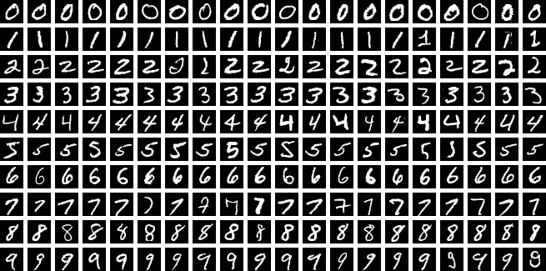
AI Benchmark Data Sets
ImageNet (2009)
  https://www.image-net.org/
MNIST
  https://www.kaggle.com/datasets/hojjatk/mnist-dataset
  https://en.wikipedia.org/wiki/MNIST_database
…
Notes:
https://en.wikipedia.org/wiki/MNIST_database#/media/File:MNIST_dataset_example.png

Slide 13
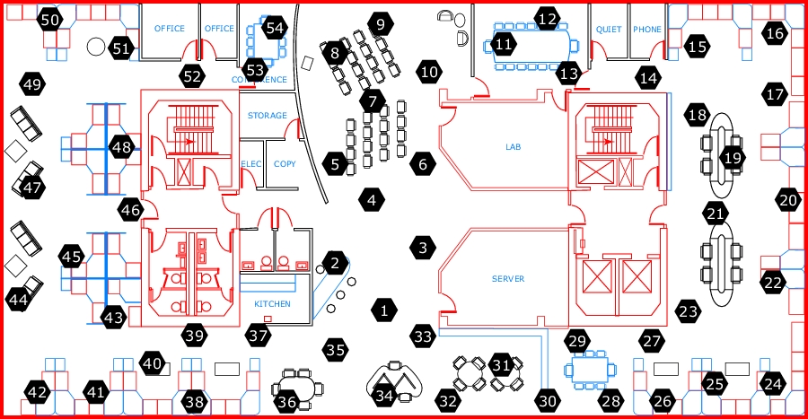





DB Benchmark Data Sets
Intel Lab Data
  https://db.csail.mit.edu/labdata/labdata.html
U.S. Government’s Open Data
  https://www.data.gov/
Stanford Large Network Dataset Collection
  https://snap.stanford.edu/data/
DBpedia RDF Data
  http://www.dbpedia.org
Freebase RDF Data
  https://developers.google.com/freebase/
YAGO1, YAGO2s, YAGO3 RDF Data
  https://www.mpi-inf.mpg.de/departments/databases-and-information-systems/research/yago-naga/yago/archive/
Notes:
https://en.wikipedia.org/wiki/MNIST_database#/media/File:MNIST_dataset_example.png
https://commons.wikimedia.org/wiki/File:Freebase_Logo_optimised.svg

Slide 14
Scoring and Grading
40% - 4 Homeworks (10 points each)
15% - Survey
  A survey on papers for the selected research topics in recent database/AI conferences/journals
10% - Paper Presentation [10-15 min]
  Presentation of 1 AI and 1 DB terms/problems/approaches (2%)
  Presentation of an AI4DB research paper (8%)
30% - Project Presentation, Demonstration, and Project Report
  Presentation and demonstration (10%) [15-20 min]
  Research project report (e.g., introduction, related works, problem definition, solutions, experiments, and conclusions) (20%)
5% - Rating by other team members
5% - Bonus presentation of any AI4DB paper [10-15 min]

Slide 15
Scoring and Grading (cont'd)
A = 90 or higher
B = 80 - 89
C = 70 - 79
D = 60 - 69
F = <60
The maximum score you can get is: 105!

Slide 16
Study Group
Please form a team with 2-4 team members
  The workload (e.g., on AI, DB, and AI4DB topics) should be distributed evenly to each team member
Group Assignments
  1 Paper Presentation
  1 Project + 1 Project Presentation
Individual Assignments
  4 homework
  Bonus presentation of one AI4DB paper (optional)

Slide 17
Academic Dishonesty Policy
Warning: Do not copy from any sources
  Any form of academic dishonesty will be strictly forbidden and will be punished to the maximum extent
  Allowing another student to copy one's work will be treated as an act of academic dishonesty, leading to the same penalty as copying

Slide 18
The Schedule for the Class
I expect to give lectures and introduce the concepts and techniques of AI/DB/AI4DB problems for the first 3 months; each team also give a presentation of 1AI term, 1 DB term and an AI4DB paper (August & September & October)
Then, each team will submit a survey on related works in the literature (October)
Finally, each team will start to identify research problems and find solutions. You need to write a project report in the paper format, do experiments (comparing with the existing approaches), and present/demonstrate your paper in class (November & December)

Slide 19
Advices & Suggestions
Editor Tools:
  Latex vs. MS Word
  Latex: https://www.overleaf.com/
Survey
  Check "Related Work" sections in most recent papers, and you can obtain more related papers
  Read abstract/introductions of papers, and classify papers into different categories (this will help you later to identify problems that have not been solved before)
Project Report
  Even if you are not familiar with some topics, try to read as many related works as possible to understand the general problems and solutions in these topics (you can skip some part, if it is too hard to understand)
  Stick to the problem you want to solve, and use any resource you can find to solve the problem (note: DO NOT simply apply previous techniques to your problem, since it is not counted as your contributions!!)

Slide 20
Advices & Suggestions (cont'd)
Project Report
  Introduction
  Related works
  Problem definition
  Solutions
  Experiments
  Conclusions
In the project, it is recommended to add a module to visualize your experimental results

Slide 21
AI4DB Topics
Learning-based Cardinality/Value Estimation
Learned Index
Learning-based Data Quality Improvement
Learning-based Privacy Preserving
AI for DB Systems
AI for DB Configuration
AI for DB Optimization
AI for DB Design
AI for DB Queries
AI for Data Mining
Learning-based Data (Graph) Generation
Explainable AI for DB
Learning-based Anomaly Detection
AI for DB Applications
Machine Unlearning for DB

Slide 22
AI for DB (AI4DB)
Chapter 1: Introduction
Instructor: Xiang Lian
Email: xlian@kent.edu
Homepage: http://www.cs.kent.edu/~xlian/
Notes:
The slides of this AI4DB course used some public slides/materials on the Web. I would like to acknowledge these resources, and please let me know if I failed to cite them.

Slide 23



Objectives
AI
In this chapter, we will introduce :
  DB/AI definitions, data models, algorithms, and/or applications
  AI4DB classification
  AI4DB challenges
  Recent AI4DB problems and techniques
  Pros and cons of AI4DB techniques
DB

Slide 24
Database Definition
Database (DB, from Wikipedia)
  In computing, a database is an organized collection of data or a type of data store based on the use of a database management system (DBMS), the software that interacts with end users, applications, and the database itself to capture and analyze the data
DB
https://en.wikipedia.org/wiki/Database

Slide 25

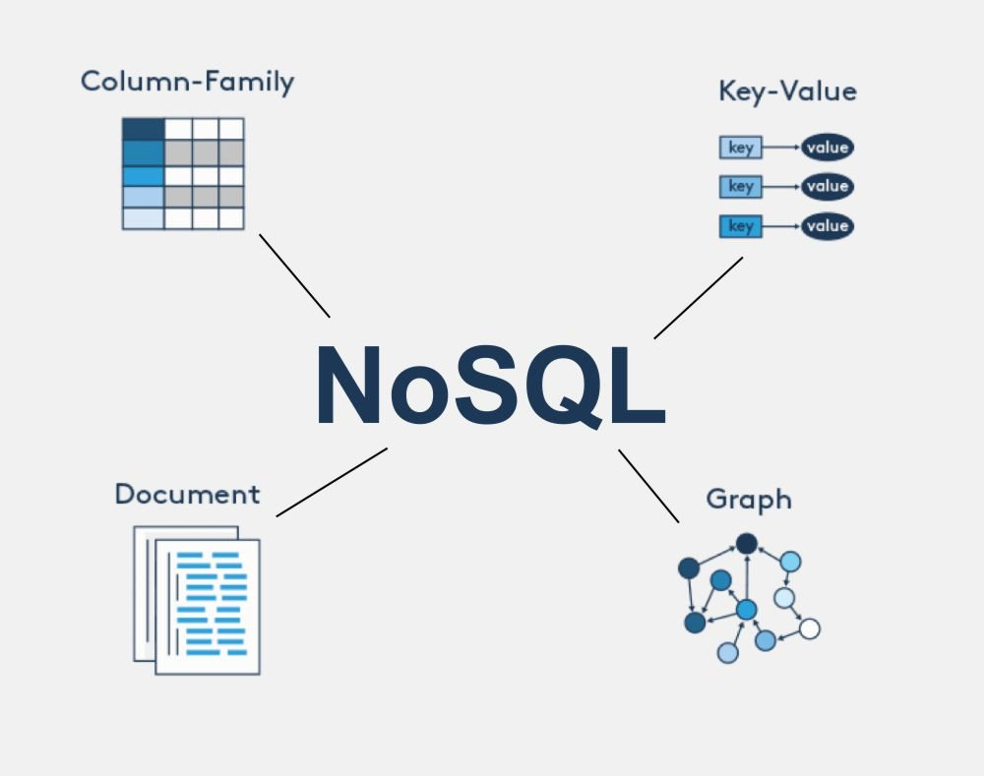
Databases
Relational Databases
  Relational tables
NonSQL Databases
  Spatio-temporal databases
  Multimedia databases
  Time-series databases
  Graph databases
  …

Slide 26
Data Models
Structured data
  Relational tables
Semi-structured data
  XML document
  RDF graph
Unstructured data
  Text data

Slide 27
Database Applications
SQL query answering over relational tables
Time series analysis
  Sensory, stock, and trajectory data analysis/prediction
Image/audio/video retrieval
Queries over spatio-temporal databases
Supply chain management over road networks
Knowledge graph discovery in Semantic Web
Social network analysis
Anomaly detection over graphs
…

Slide 28



Artificial Intelligence Definition
Artificial Intelligence (AI, from Wikipedia)
  Artificial intelligence (AI) is the capability of computational systems to perform tasks typically associated with human intelligence, such as learning, reasoning, problem-solving, perception, and decision-making
AI
https://en.wikipedia.org/wiki/Artificial_intelligence
Notes:
http://en.wikipedia.org/wiki/Artificial_intelligence
https://freesvg.org/balanced-scale

Slide 29
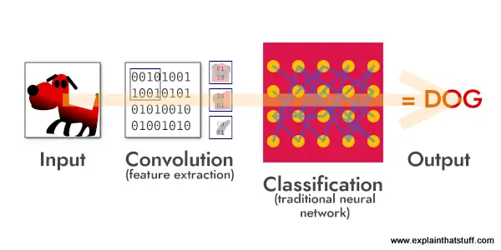

AI-based Decision Making
Image Recognition
Notes:
https://rightwave.com/rwi/the-future-is-now-how-agentic-ai-is-shaping-the-next-wave-of-marketing-operations
https://biginnovates.com/the-power-of-neural-networks/

Slide 30
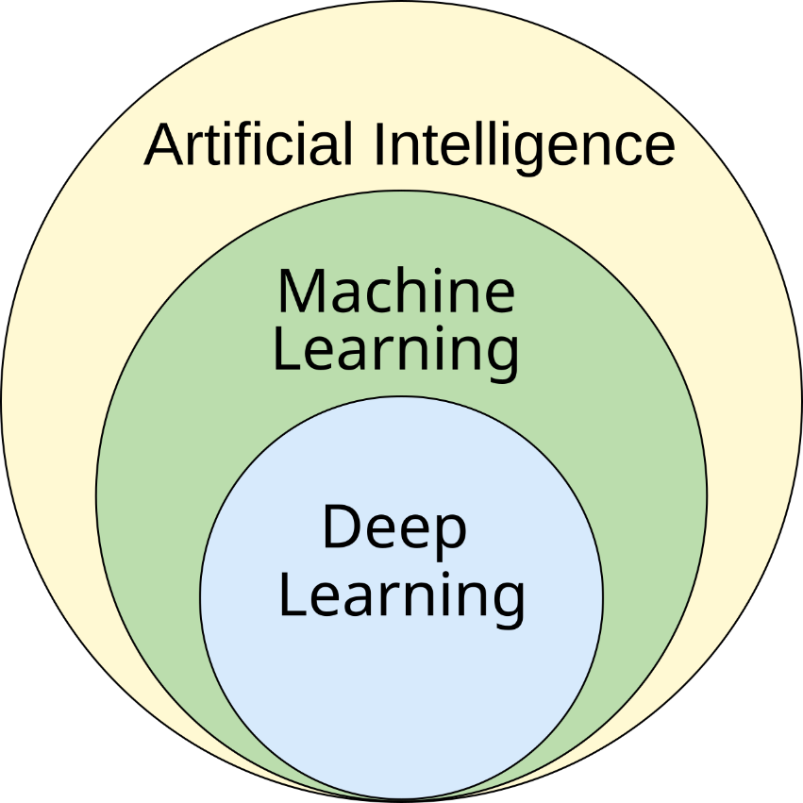
Types of Machine Learning (ML) Algorithms
Supervised Learning
  Training with labeled data
  Regression vs. classification
Unsupervised Learning
  Training with unlabeled data
  Clustering / association rule learning
Reinforcement Learning
  No training data
Notes:
https://upload.wikimedia.org/wikipedia/commons/1/1b/AI_hierarchy.svg

Slide 31
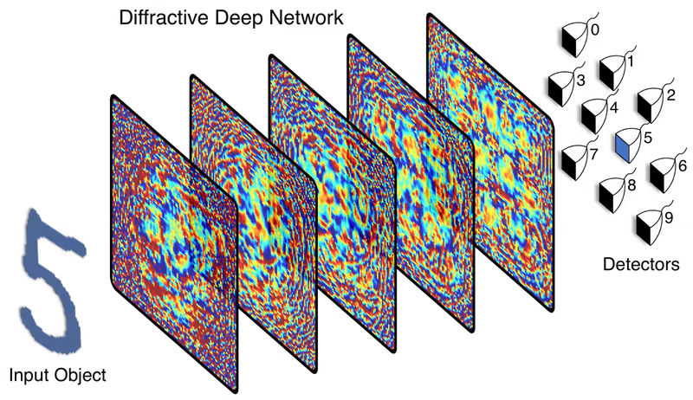

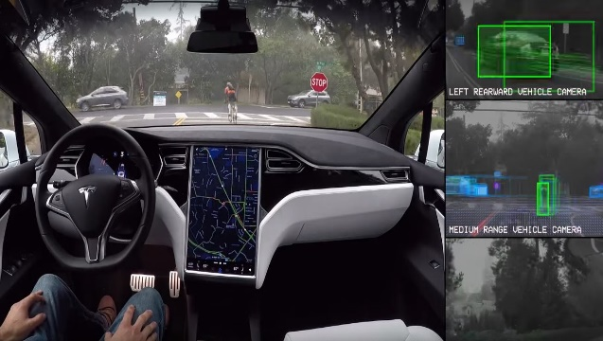


AI Applications
Artificial Intelligence (AI) has recently been widely used in real-life applications
  Computer vision
  Natural language processing
  Robotics
  Healthcare
  Autonomous driving
  Financial services
  Cybersecurity
  Personalized recommendations

Slide 32

DB vs. AI Techniques
You will never know the effectiveness/accuracy before you test new AI techniques!
AI Techniques
DB Techniques
Pros (Goals)
  Fast decision making
  High accuracy for unseen testing data
Cons
  Not very scalable to large data size
  No accuracy guarantee
Pros (Goals)
  Efficiency
  Scalability
  Accuracy (usually 100%)
Cons
  Not adaptable to unseen data
  Not efficient enough!!
AI
DB

Slide 33
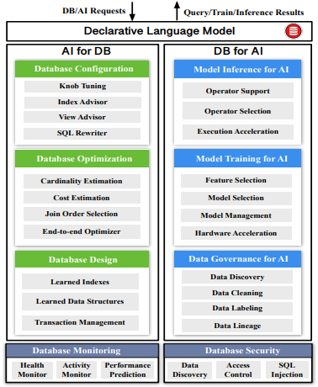
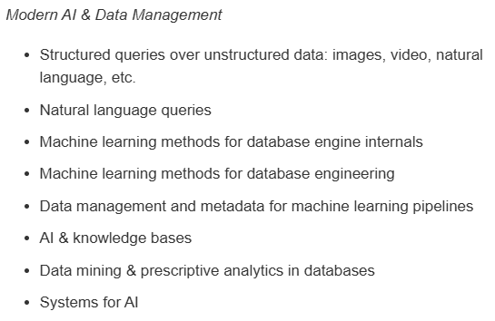

Artificial Intelligence (AI) & Database (DB)
AI for DB (AI4DB)
DB for AI (DB4AI)
SIGMOD 2025
PVLDB 2025
ICDE 2025
Source: Database Meets Artificial Intelligence: A Survey
Notes:
Xuanhe Zhou, Chengliang Chai, Guoliang Li, Ji Sun:
Database Meets Artificial Intelligence: A Survey. IEEE Trans. Knowl. Data Eng. 34(3): 1096-1116 (2022)

Slide 34
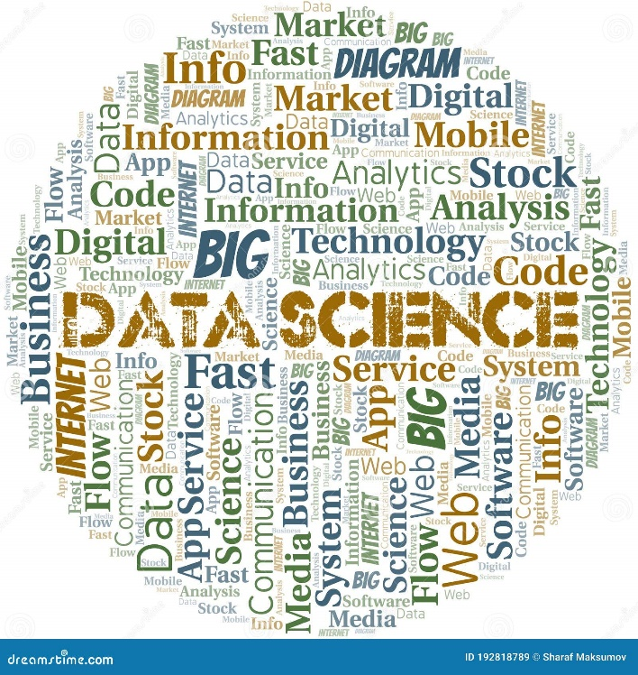
AI for Data Science (AI4DB)
AI
DB
Notes:
https://www.dreamstime.com/data-science-vector-word-cloud-made-text-image192818789

Slide 35
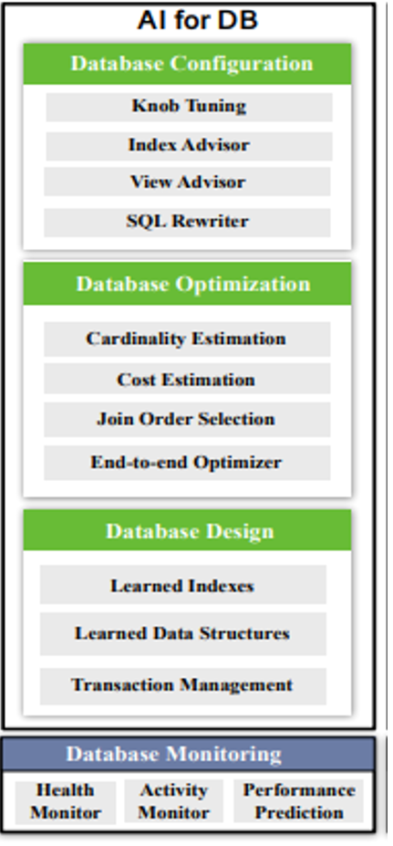
AI4DB Classification
AI for Database Configuration
  Tuning parameters, selecting indexes/views, rewriting SQL, etc.
AI for Database Optimization
  Optimizing database operators
AI for Database Design
  Participating in the index design, scheduling, etc.
Notes:
Xuanhe Zhou, Chengliang Chai, Guoliang Li, Ji Sun:
Database Meets Artificial Intelligence: A Survey. IEEE Trans. Knowl. Data Eng. 34(3): 1096-1116 (2022)

Slide 36
AI4DB Challenges (1)
Data for AI techniques
  Lacking of the training data set
  Low-quality training data set
    Missing attributes
    Noisy data
    Abnormal/erroneous data
It is challenging to apply AI techniques to DB problems with no/low-quality training data

Slide 37
AI4DB Challenges (2)
Accuracy
  AI techniques cannot guarantee 100% accuracy on test data (even if it is 100% accurate for training data)
It is challenging to use AI techniques for solving database problems with the guaranteed accuracy
  100% accuracy, or
  Error-bounded accuracy

Slide 38
AI4DB Challenges (3)
Efficiency / scalability
  AI techniques usually take numerous parameters (e.g., weight/bias parameters for neural networks)
  In neural networks, any layer's inputs are waiting for the outputs of previous layer(s)
  Computation/space costs of AI techniques may be higher than DB techniques, especially for large-scale data
It is challenging to plug in AI techniques into DB problems with lower time/space costs

Slide 39
AI4DB Challenges (4)
Adaptivity of AI techniques to DB problems
  Each DB problem has its own characteristics
It is challenging to design AI techniques specific for each DB problem
  AI cannot do everything!!
  Not all DB problems are suitable for AI optimizations!!

Slide 40
AI4DB Problems
Use AI techniques as tools to solve the database problems, such that:
  The database performance is better
    The time cost is lower
    The space cost is lower
    The communication cost is lower
    The throughput is higher
  The database's scalability is better
    Still efficient to handle large-scale data
Notes:
Xuanhe Zhou, Chengliang Chai, Guoliang Li, Ji Sun:
Database Meets Artificial Intelligence: A Survey. IEEE Trans. Knowl. Data Eng. 34(3): 1096-1116 (2022)

Slide 41
Potential AI4DB Problems
Learning-based Cardinality/Value Estimation
Learned Index
Learning-based Data Quality Improvement
Learning-based Privacy Preserving
AI for DB Systems
AI for DB Configuration
AI for DB Optimization
AI for DB Design
AI for DB Queries
AI for Data Mining
Learning-based Data (Graph) Generation
Explainable AI for DB
Learning-based Anomaly Detection
AI for DB Applications
Machine Unlearning for DB

Slide 42
AI4DB Techniques
Replacing some DB component with AI module
  E.g., the cost estimation for the selection of the join order
Adapting existing AI techniques, or designing new AI techniques for DB problems
  Choose appropriate AI approaches based on the data type and DB problem
Notes:
Xuanhe Zhou, Chengliang Chai, Guoliang Li, Ji Sun:
Database Meets Artificial Intelligence: A Survey. IEEE Trans. Knowl. Data Eng. 34(3): 1096-1116 (2022)

Slide 43
Pros and Cons of AI4DB Techniques
Pros
  Fast decision making
  High accuracy, even for unseen test data
Cons
  Requiring a lot of data with the groundtruth for offline training
  High accuracy is not always theoretically guaranteed
  Very costly for online re-training over dynamically changing data

Slide 44
In-Class Exercises
Are the following problems [DB] or [AI] problems?
  Retrieve k images from the image repository that are the most similar to a given query image
  Judge whether or not an image contains a cat
  Produce a new image based on the descriptions from users
  Find a record from a table that contains a keyword
  Compute the shortest path distance between two nodes in a graph
Can we use AI4DB techniques to DB problems above?

Slide 45
Summary
Course syllabus
DB/AI definitions, data models, algorithms, and/or applications
AI4DB classification
AI4DB challenges
AI4DB problems and techniques
Pros and cons of AI4DB techniques

