Slide 1
AI for DB (AI4DB)
Chapter 2-1: Database Background
Instructor: Xiang Lian
Email: xxl1584@case.edu
Homepage: http://www.cs.kent.edu/~xlian/
Notes:
The slides of this AI4DB course used some public slides/materials on the Web for teaching purposes only. I would like to acknowledge these resources, and please let me know if I failed to cite them or you want to remove them from my slides.

Slide 2

Objectives
DB
In this chapter, we will introduce :
  Database history/applications/systems
  Recent database problems and techniques
  Pros and cons of database techniques

Slide 3
DB
Database: History, Applications, and Techniques

Slide 4
Introduction
Database (from Wikipedia)
  In computing, a database is an organized collection of data or a type of data store based on the use of a database management system (DBMS), the software that interacts with end users, applications, and the database itself to capture and analyze the data
DB
https://en.wikipedia.org/wiki/Database

Slide 5
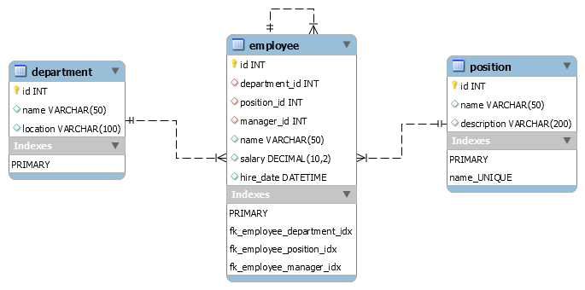

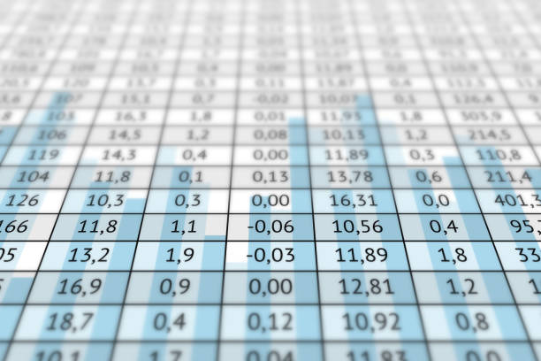




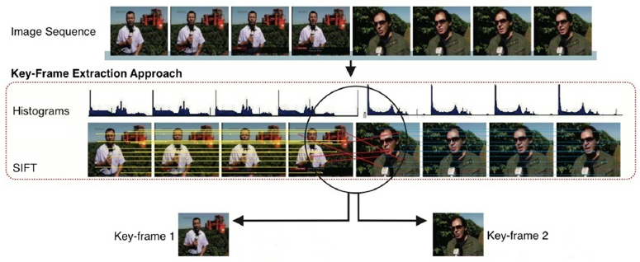
Types of Data
Relational Tables
  Binary data
  Numerical data
  Text data
  Images
  Audio
  Videos
This Photo by Unknown Author is licensed under CC BY-SA

Slide 6
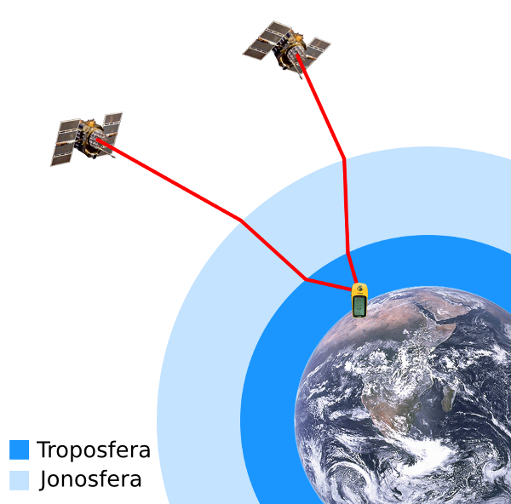
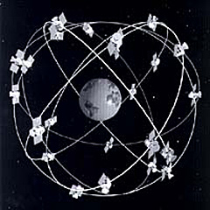
Types of Data (cont'd)
Spatial Databases
  GPS data
(latitude, longitude, elevation)
Notes:
References
NOAA. The Orbiting Constellation of GPS Satellites. [object HTMLTableCellElement]. http://www.oceanservice.noaa.gov/topics/navops/positioning/welcome.html, Wikimedia Commons, https://commons.wikimedia.org/wiki/File:GPS_satellite_constellation.jpg. Changes were not made.
Javiersanp, Gps-atmospheric-efects png: *The Earth seen from Apollo 17 jpg: NASANavstar-2. jpg: NASAGPS tracking satellites jpg: Vaughan Weatherderivative work: Español: Efecto de La Atmósfera En La Propagación de La Señal GPS. English: Effect of the Atmosphere in the GPS Signal Propagation. 18 Apr. 2011. Gps-atmospheric-efects.png, Wikimedia Commons, https://commons.wikimedia.org/wiki/File:Sygnal_GPS-opoznienie_atmosferyczne.png. Changes were not made.
In spatial databases, we may encounter GPS data with attributes such as latitude, longitude, and elevation.

Slide 7
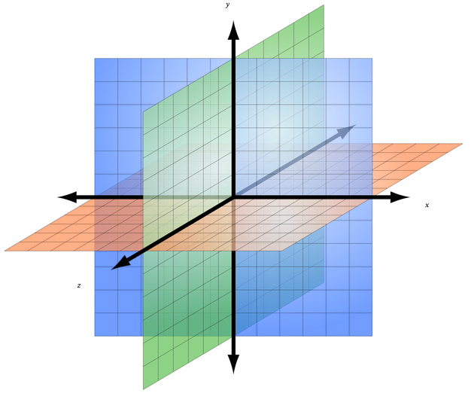
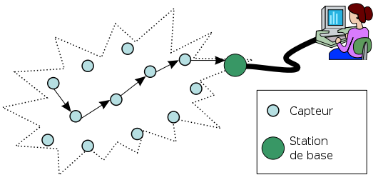
Types of Data (cont'd)
Spatial Databases
  Sensory data
(temperature, humidity, density of oxygen, …)
density of oxygen
temperature
humidity
Notes:
References
V, WSN svg: Original by Adi Mallikarjuna Reddy. Wireless Sensor Network - French Version. 13 Jan. 2010. WSN.svg, Wikimedia Commons, https://commons.wikimedia.org/wiki/File:WSN-french.svg. Changes were not made.
assumed, No machine-readable author provided Sakurambo~commonswiki. A Right-Handed Three-Dimensional Cartesian Coordinate System with the +z Axis Pointing towards the Viewer. Own Work, Produced as a Replacement for Image:3D Cartesian Coordinates.PNG. 26 July 2007. No machine-readable source provided. Own work assumed (based on copyright claims)., Wikimedia Commons, https://commons.wikimedia.org/wiki/File:3D_coordinate_system.svg. Changes were made.
In sensor networks, we may deploy sensors to different sites (such as forests), and collect sensory data such as temperature, humidity, density of oxygen, and so on.

Slide 8
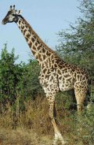
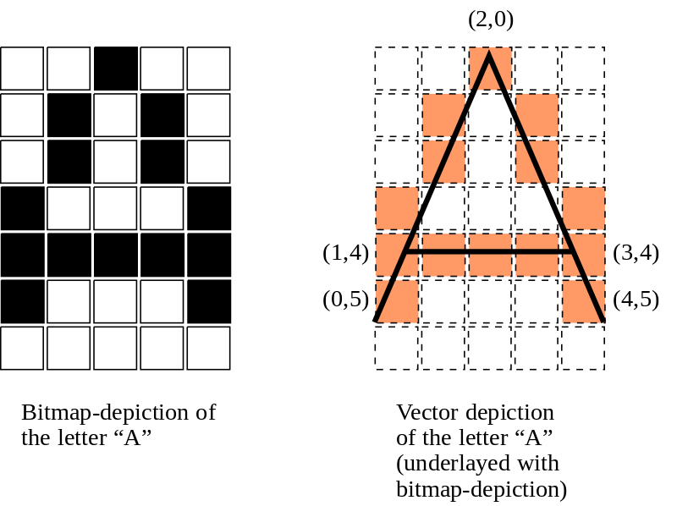
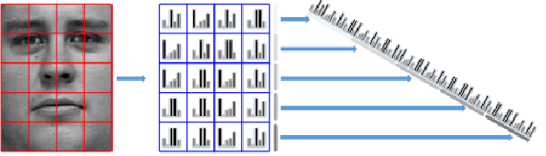
Types of Data (cont'd)
Image database
  Feature vectors
    Color histogram
    Texture
    Interest points
Height is my feature!
giraffe
Feature vector:
[0, 0, 1, 0, 0, 0, 1, 0, 1, 0,
0, 1, 0, 1, 0, 1, 0, 0, 0, 1,
1, 1, 1, 1, 1, 1, 0, 0, 0, 1,
0, 0, 0, 0, 0]
Notes:
References
File:Giraffe.Jpg - Wikimedia Commons. https://commons.wikimedia.org/wiki/File:Giraffe.jpg. Accessed 26 Feb. 2019. Changes were not made.
Wgabrie, Bitmap vs vector png: Fbjderivative work: Deutsch: Vergleichende Darstellung Des Buchstaben „A“ Als Bitmap-Darstellung Und Als Vektor-Darstellung (Bitmap-Font vs. Vektorfont). 19 Feb. 2010. Bitmap vs vector.png, Wikimedia Commons, https://commons.wikimedia.org/wiki/File:Bitmap_vs_vector.svg. Changes were not made.
Karolina Nurzynska, Bogdan Smolka: Facial Displays Description Schemas for Smiling vs. Neutral Emotion Recognition. ICAISC (1) 2015: 594-605
In image databases, we may extract feature vectors from images, for example, color histogram, texture, interest points, and so on. For example, in an image with black-and-white pixels, it can be transformed to a sequence of 0’s and 1’s, which can be considered as one feature vector. Similarly, we can also extract colors from pixels of images, and obtain color feature vector. Or we can divide an image into multiple partitions, and concatenate color histograms of all partitions as one feature vector.

Slide 9

Types of Data (cont'd)
Temporal Databases
  Moving object database
    Mobile computing
Notes:
References
Clipart - User 1. https://openclipart.org/detail/171432/user-1. Accessed 26 Feb. 2019. Changes were not made.
For mobile computing, mobile users periodically send their GPS locations to central servers, which form a temporal moving object database.

Slide 10
Types of Data (cont'd)
Temporal Databases
  Bank account over time
account
balance
deposit $100
withdraw $50
$150
$100
$50
Jan.
Feb.
Mar.
time
Notes:
For the bank account balance over time, we can also store the balance data of each account as a temporal object, and form a temporal database. As shown in the figure, initially the account balance is $50. Then, in January, the account owner deposited $100, so that the curve jumps to $150 in total. Next, in February, the account owner withdrew $50, so that the curve goes down to $100 balance. The temporal database records the changes of such an account balance over time.

Slide 11
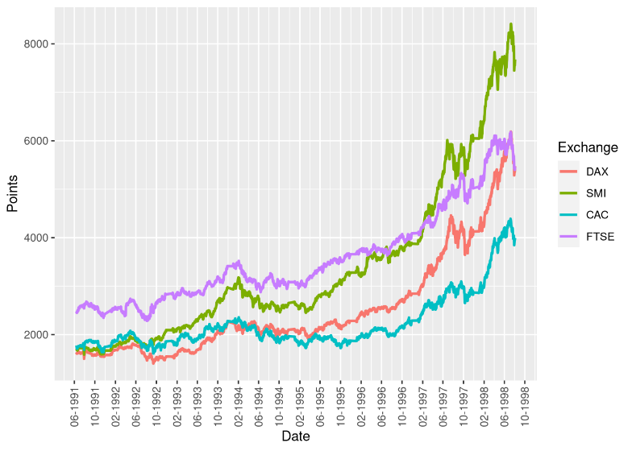
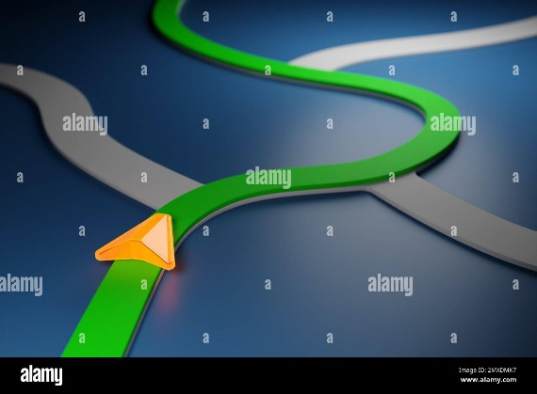

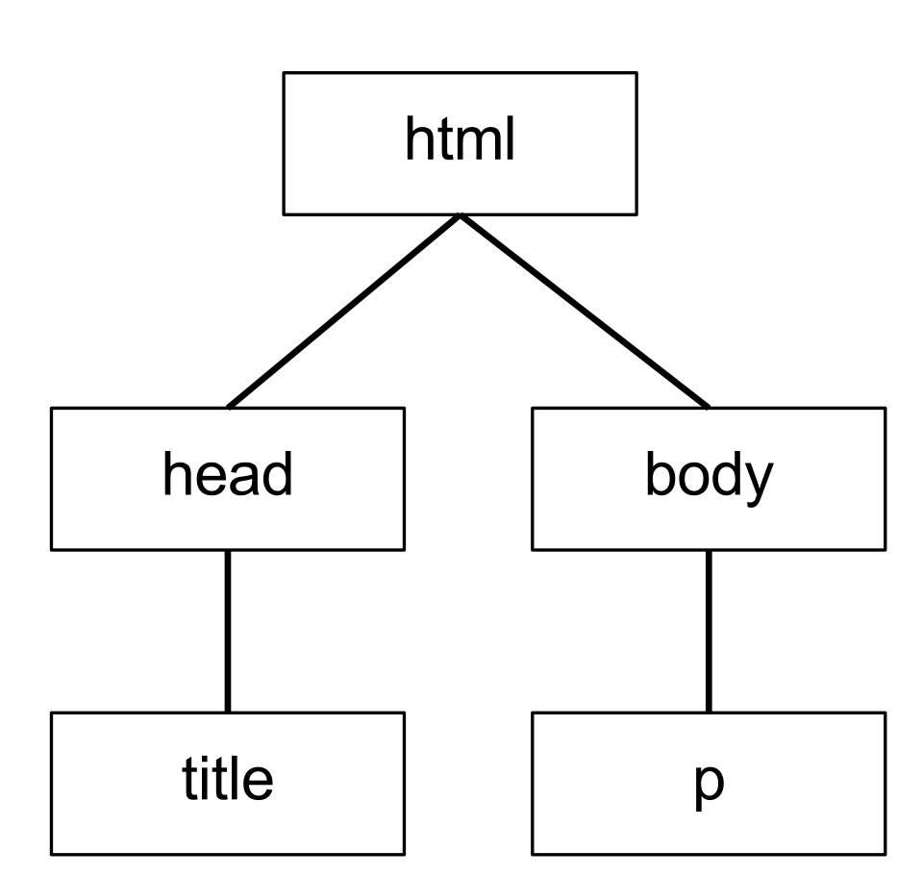

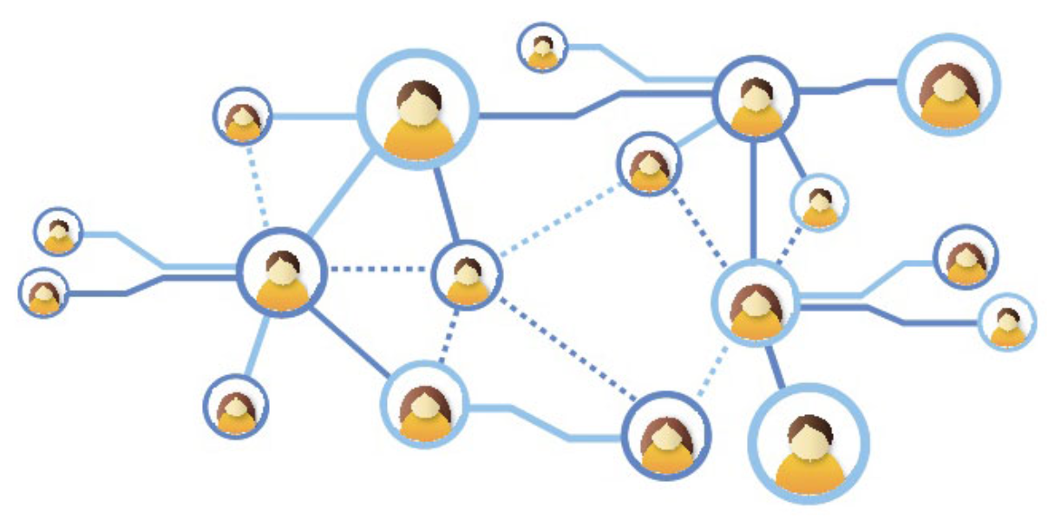

Types of Data (cont'd)
Time series data
  Stock data
  Trajectories
  Sensory data
Tree
  XML documents
Graphs
  Social network
  Knowledge graph
Stream data
Notes:
https://medium.com/@renatondomingues/lets-talk-about-time-series-part-i-22a516d1817f
https://freesvg.org/1541611306
https://commons.wikimedia.org/wiki/File:DOM_tree.svg
https://vectorportal.com/vector/social-network-free-graphic.ai/2477
https://www.picpedia.org/highway-signs/s/social-network.html

Slide 12


Time-Series Databases
Stock data: {(x₁, t₁); (x₂, t₂); …}
Notes:
References
Free Image on Pixabay - Stock, Trading, Monitor, Business. https://pixabay.com/photos/stock-trading-monitor-business-1863880/. Accessed 26 Feb. 2019. Changes were not made.
Free Image on Pixabay - Stock Exchange, Bull, Bear. https://pixabay.com/illustrations/stock-exchange-bull-bear-securities-642896/. Accessed 26 Feb. 2019. Changes were not made.
Another important database is the time-series database in real applications such as stock market analysis, sensor networks, and trajectory data analysis, where each time series is an ordered sequence of values. The figure shows the time series of stock prices over time.

Slide 13
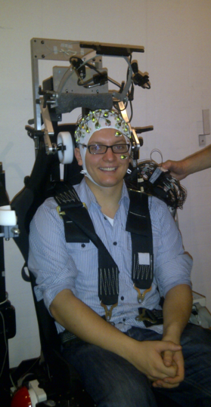
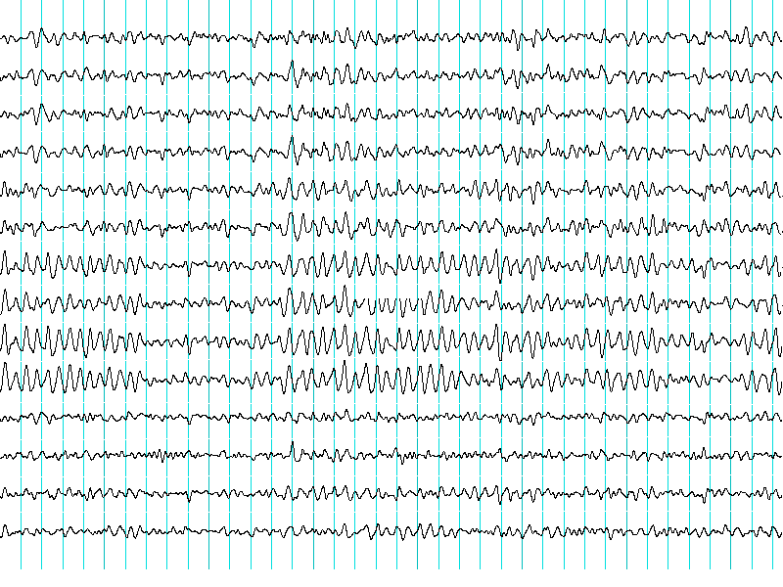
Time-Series Databases (cont'd)
EEG: {(x₁, t₁); (x₂, t₂); …}
Notes:
References
Alexhvl15. English: An Experimental Subject Is Partaking in an EEG Experiment. 3 Dec. 2012. Own work, Wikimedia Commons, https://commons.wikimedia.org/wiki/File:EEG.png. Changes were not made.
File:ElectroEncephalogram.Png - Wikimedia Commons. https://commons.wikimedia.org/wiki/File:ElectroEncephalogram.png. Accessed 26 Feb. 2019. Changes were not made.
Electroencephalogram (EEG) data are also in the form of time series, which collects sequences of signals from sensors.

Slide 14
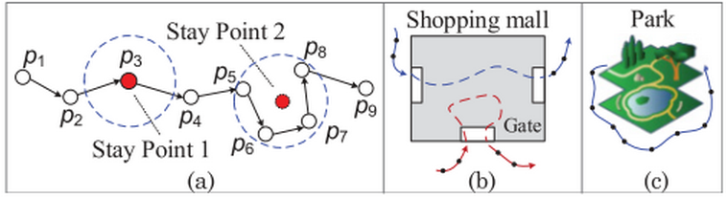
Time-Series Databases (cont'd)
Trajectory data: {(x₁, y₁, t₁); (x₂, y₂, t₂); …}
Notes:
References
Yu Zheng: Trajectory Data Mining: An Overview. ACM TIST 6(3): 29:1-29:41 (2015)
The trajectory data is also an ordered sequence of locations, which can be considered as time series. The analysis of trajectories is important for location-based services, study of customer behaviors in the shopping malls or parks, and detection of abnormal behaviors for the transportation system.

Slide 15
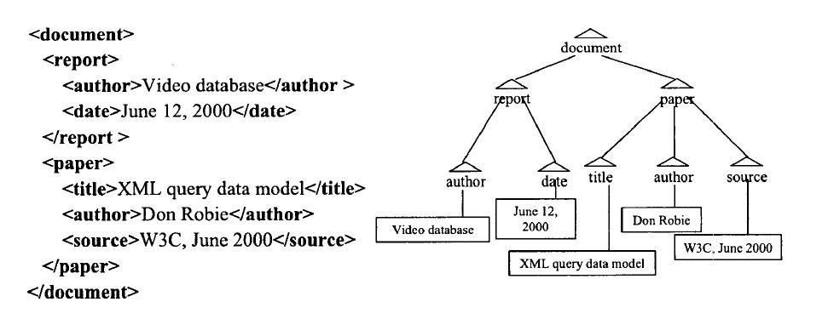
Tree Data
XML documents
  Semi-structured data
Notes:
XML document is semi-structured data, represented by a tree structure, which can be used for the data exchange among programs. As shown in the figure, the “document” tag is a root, under which there are two tags “report” and “paper”. The “report” tag contains “author” and “date” tags, which are two children under “report” in the XML tree.

Slide 16
Graph Databases
Many application data can be represented by graphs
  Chemical database
  Biological database
  Computer networks
  Sensor networks
  Social networks
  Workflow database
  RDF graph database
Notes:
There are also many applications that deal with graph databases such as chemical database, biological database, computer networks, sensor networks, social media, workflow database, RDF graph database, and so on.

Slide 17
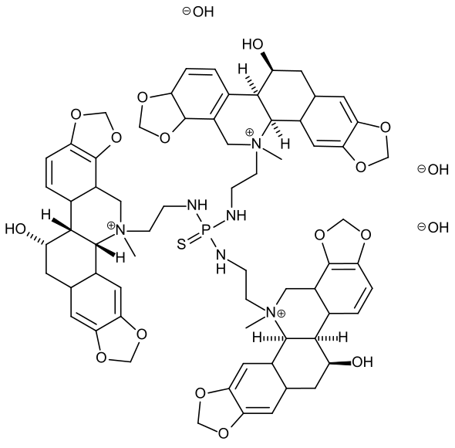
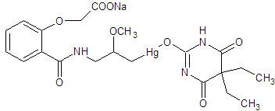
Chemical Compounds
Notes:
References
Zhilin, Denis. English: Ctructural Formula of Mersalin (Allyrgal, Diluvit, Dimed, Diuregan, Diurette, Diursal, Fernmersyl, Gortulina, Hg-Phyllin, Hydrargan, Irgrosin, Mercuprocyl, Mercurgan, Mercurosalyl, Mercusalum, Mercuzal, Merphyllin, Mersaline, Mersalpin, Mersalyn, Merthipyl, Neomersyl, Neptal, Salirgan, Salurin, Salyrgan, Sibilen, Syralgan, Thesalyl, Theurin, Uragan, Uragon). 3 July 2012. Own work, Wikimedia Commons, https://commons.wikimedia.org/wiki/File:Merkusal.png. Changes were not made.
Hennersdorf, Felix. English: Chemical Structure of Ukrain. 19 Feb. 2008. Own work, Wikimedia Commons, https://commons.wikimedia.org/wiki/File:Alleged_molecular_structure_of_ukrain.svg. Changes were not made.
For example, chemical compounds can be represented by graph structures, where nodes are atoms and edges are relationships between two atoms.

Slide 18
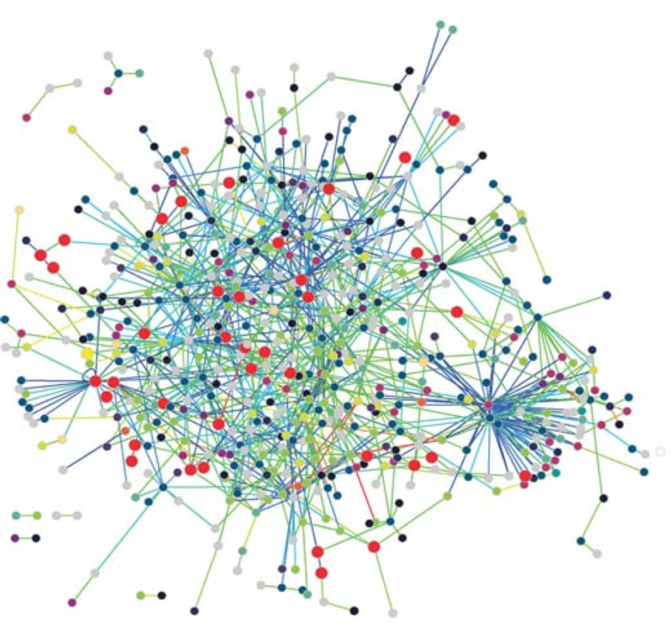
Biological Databases – Protein-to-Protein Interaction Networks
Notes:
References
al, Häuser et. English: The Protein Interaction Network of T. Pallidum Including 576 Proteins and 991 Interactions. Nodes Are Color-Coded According to TIGR Main Roles. Proteins Involved in DNA Metabolism Are Shown as Enlarged Red Circles.[object HTMLTableCellElement]. Titz B, Rajagopala SV, Goll J, Ha ̈user R, McKevitt MT, et al. (2008) The Binary Protein Interactome of Treponema pallidum – The Syphilis Spirochete. PLoS ONE 3(5): e2292. doi:10.1371/journal.pone.0002292, Wikimedia Commons, https://commons.wikimedia.org/wiki/File:The_protein_interaction_network_of_Treponema_pallidum.png. Changes were not made.
In biological databases, protein-to-protein interaction networks (PPI) can be represented by a graph, where each vertex is a protein, and each edge represents the interaction relationship between two proteins.

Slide 19
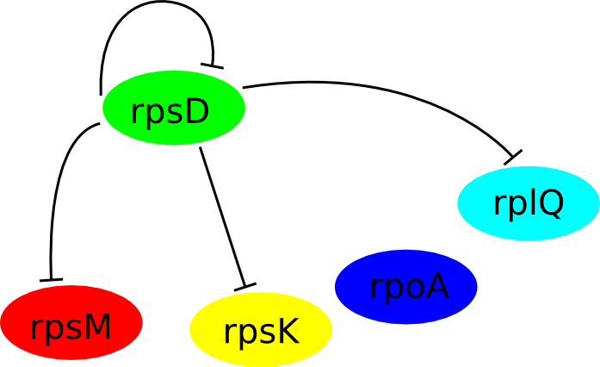
Biological Databases – Gene Regulatory Networks (GRNs)
Notes:
References
Aravindabharathi. Alpha Operon Gene Regulatory Network Diagram. 27 Sept. 2013. Own work, Wikimedia Commons, https://commons.wikimedia.org/wiki/File:Alpha_operon_gene_regulatory_network.png. Changes were not made.
Similarly, gene regulatory network (GRN) is also a graph with genes as vertices and regulatory relationships between any two genes as edges.

Slide 20
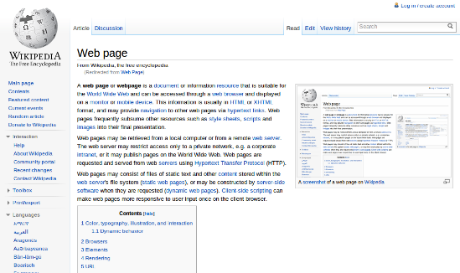
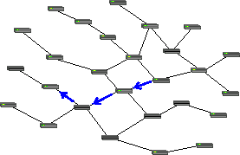
Computer Networks
Internet
Web Pages
Notes:
References
assumed, No machine-readable author provided Baccala@freesoft org~commonswiki. A Unicast Forwarding Pattern in a Computer Network. 27 Sept. 2005. No machine-readable source provided. Own work assumed (based on copyright claims)., Wikimedia Commons, https://commons.wikimedia.org/wiki/File:Unicast_forwarding.png. Changes were not made.
en.wikipedia, Lulzmango at. English: A Screenshot of a Web Page. Русский: Скриншот Веб-Страницы. 21 Sept. 2010. en:Web_page, Wikimedia Commons, https://commons.wikimedia.org/wiki/File:Web_Page.png. Changes were not made.
We also encounter other graphs such as computer networks that connects multiple servers/routers, and Web pages with hyperlinks linking to one another.

Slide 21
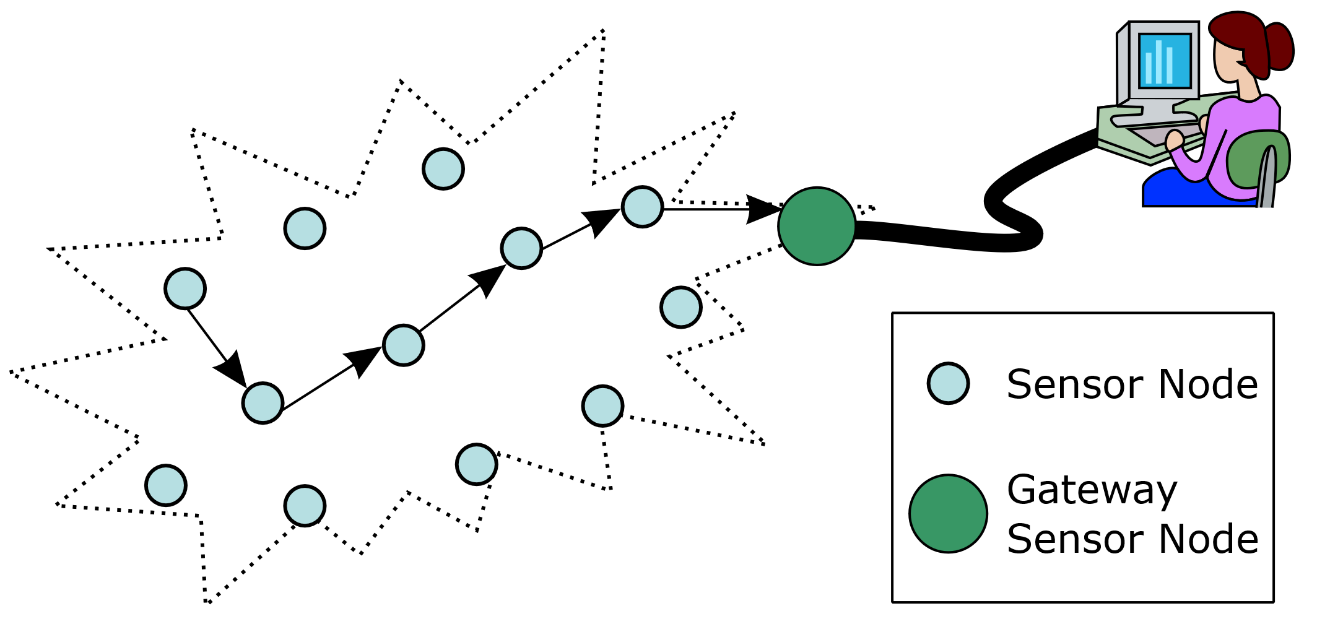
Sensor Networks
sink
sensors
Notes:
References
V, Original by Adi Mallikarjuna Reddy. Wireless Sensor Network. 11 June 2007. Own work, Wikimedia Commons, https://commons.wikimedia.org/wiki/File:WSN.svg. Changes were not made.
Sensor networks is also in the form of graphs, where sensors can be considered as nodes, and the communication between any two sensors can be considered as an edge.

Slide 22
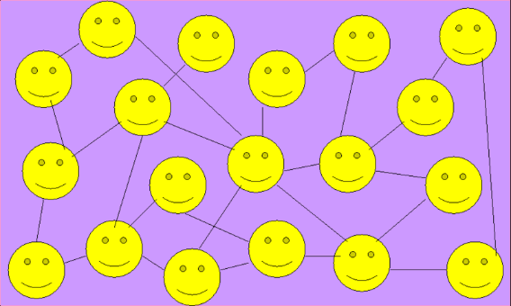
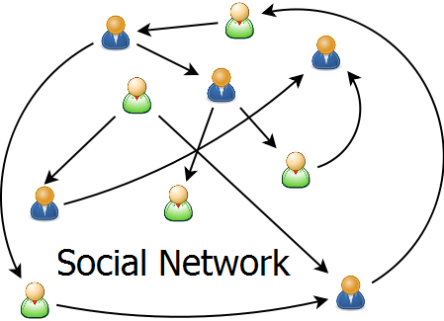
Social Networks
Twitter
Facebook
Google+
Instagram
…
Notes:
References
Thor4bp, Zigomitros Athanasios-. English: Social Network. 27 Feb. 2012. Own work, Wikimedia Commons, https://commons.wikimedia.org/wiki/File:Social_Network.png. Changes were not made.
Wikibooks, Koreshky at English. English: Description: Social Networking Source: Own Work Author: Koreshky Date: 12/10/2007. 11 Dec. 2007. Transferred from en.wikibooks to Commons by Adrignola using CommonsHelper., Wikimedia Commons, https://commons.wikimedia.org/wiki/File:Social_Networking.png. Changes were not made.
In social networks such as Twitter, Facebook, Google+, and Instagram, users have their own profiles and follow or be followed by their friends. In this case, social networks are also graphs with users as vertices and friendships as edges.

Slide 23
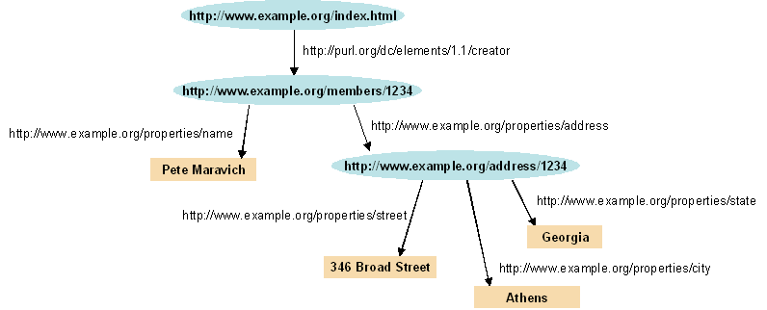
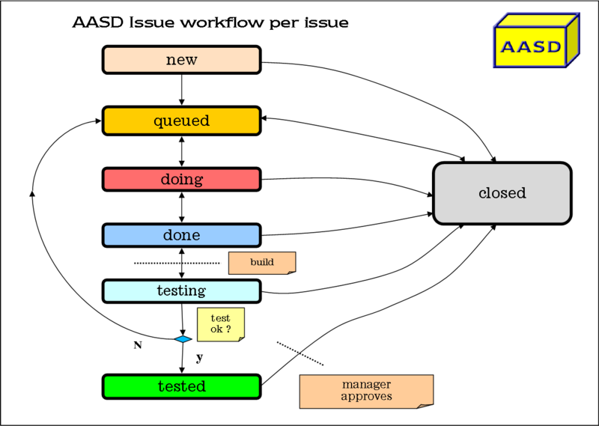
Semantic Web and Workflows
Semi-structured data
RDF Graph
Workflow
Notes:
References
File:Rdf-Graph2.Png - Wikimedia Commons. https://commons.wikimedia.org/wiki/File:Rdf-graph2.png. Accessed 26 Feb. 2019. Changes were not made.
en.wikipedia, Sbvb at. English: Version 2 of Aasd Workflow. 7 Sept. 2010. Transferred from SreeBot to Commons by SreeBot., Wikimedia Commons, https://commons.wikimedia.org/wiki/File:Aasd_workflow_v2.png. Changes were not made.
There are other examples of graphs such as workflow data and RDF graphs in the Semantic Web.

Slide 24
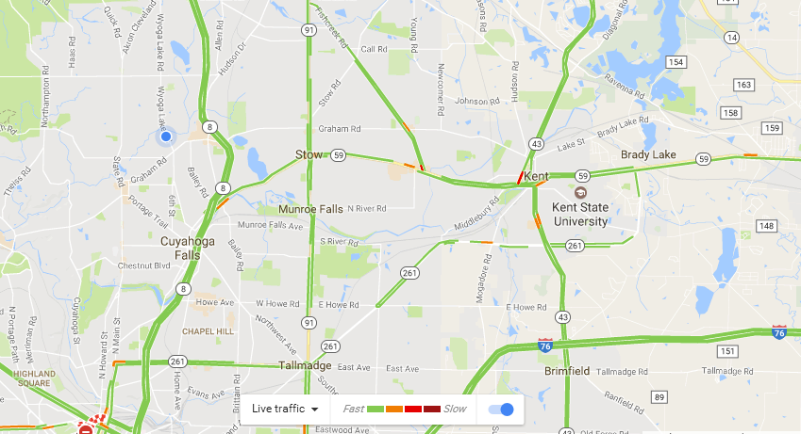
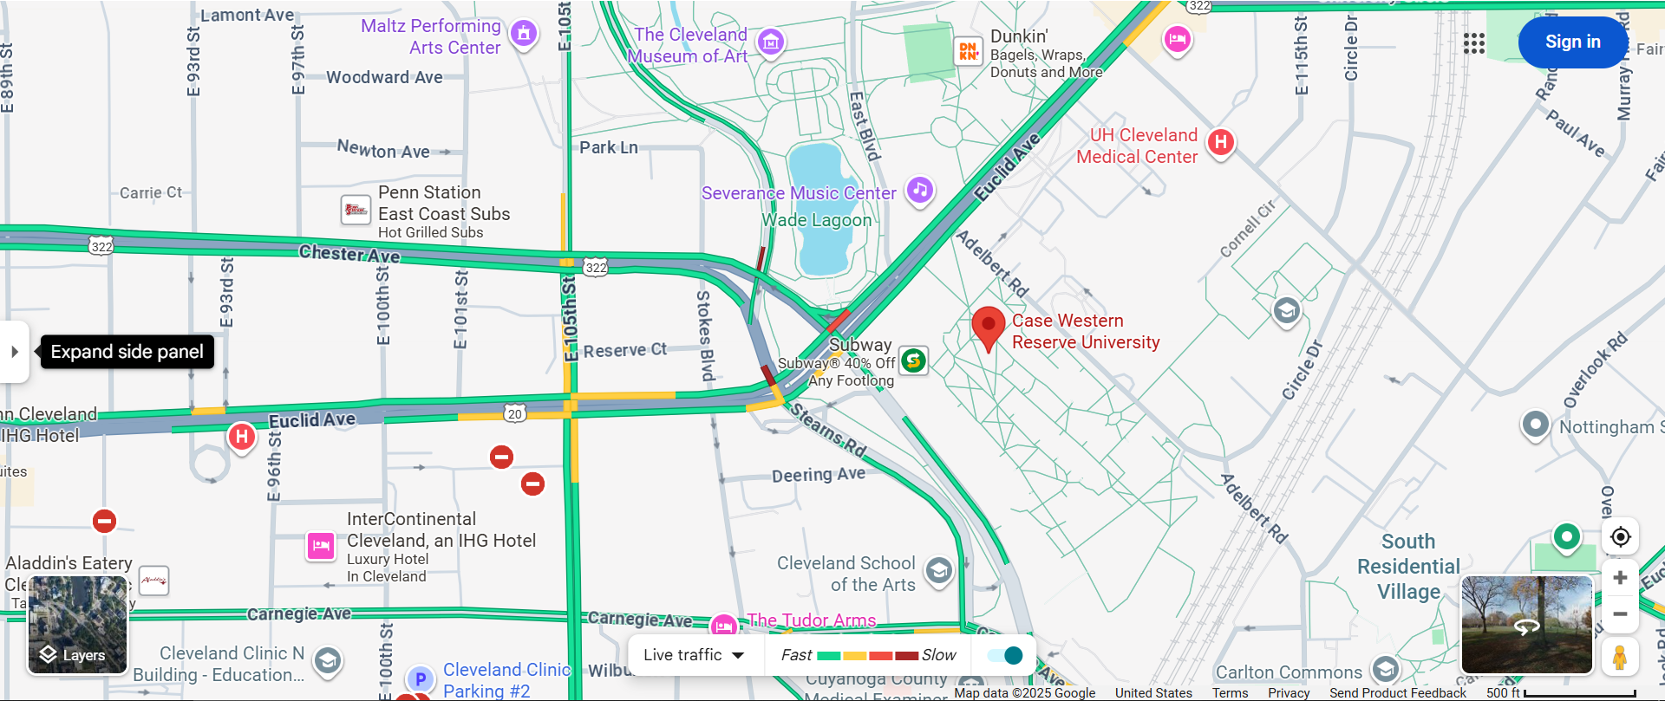
Road Networks
Road Networks (from Google Map)
Notes:
Moreover, spatial road networks can be also modeled by a graph, where edges are road segments and vertices are intersection points of roads.

Slide 25


DataBase Management System (DBMS)
Database Management System (DBMS) for Relational Databases (from Wikipedia)
  A software system that enables users to define, create, maintain, and control access to the database
Notes:
https://en.wikipedia.org/wiki/Database#Database_management_system
https://www.needpix.com/photo/973239/database-blue-sql-server-storage-network-data-information-cloud

Slide 26
Relational Tables
Set of rows, or tuples (no duplicates)
Each row describes a different entity
Each column states a particular fact about each entity
  Each column has an associated domain
    Domain of Status = {fresh, soph, junior, senior}
ID Name Address Status
1111 John 123 Main fresh
2222 Mary 321 Oak soph
1234 Bob 444 Pine soph
9999 Joan 777 Grand senior
Student Table

Slide 27
ER Model
Entity-Relationship (ER) Model
  Entity
    Student, Course
  Relationship
    enroll
ID Name Address Status
1111 John 123 Main fresh
2222 Mary 321 Oak soph
1234 Bob 444 Pine soph
9999 Joan 777 Grand senior
Student Table
Student
enroll
Course

Slide 28




Commercial Relational Database Systems
Microsoft SQL Server
IBM DB2
Oracle Database
MySQL (open-source relational DBMS)
…

Slide 29
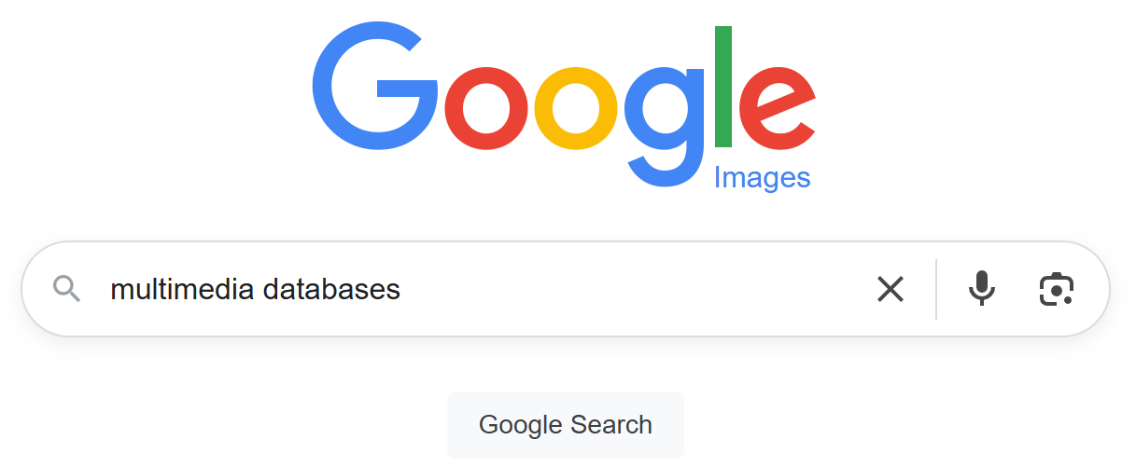
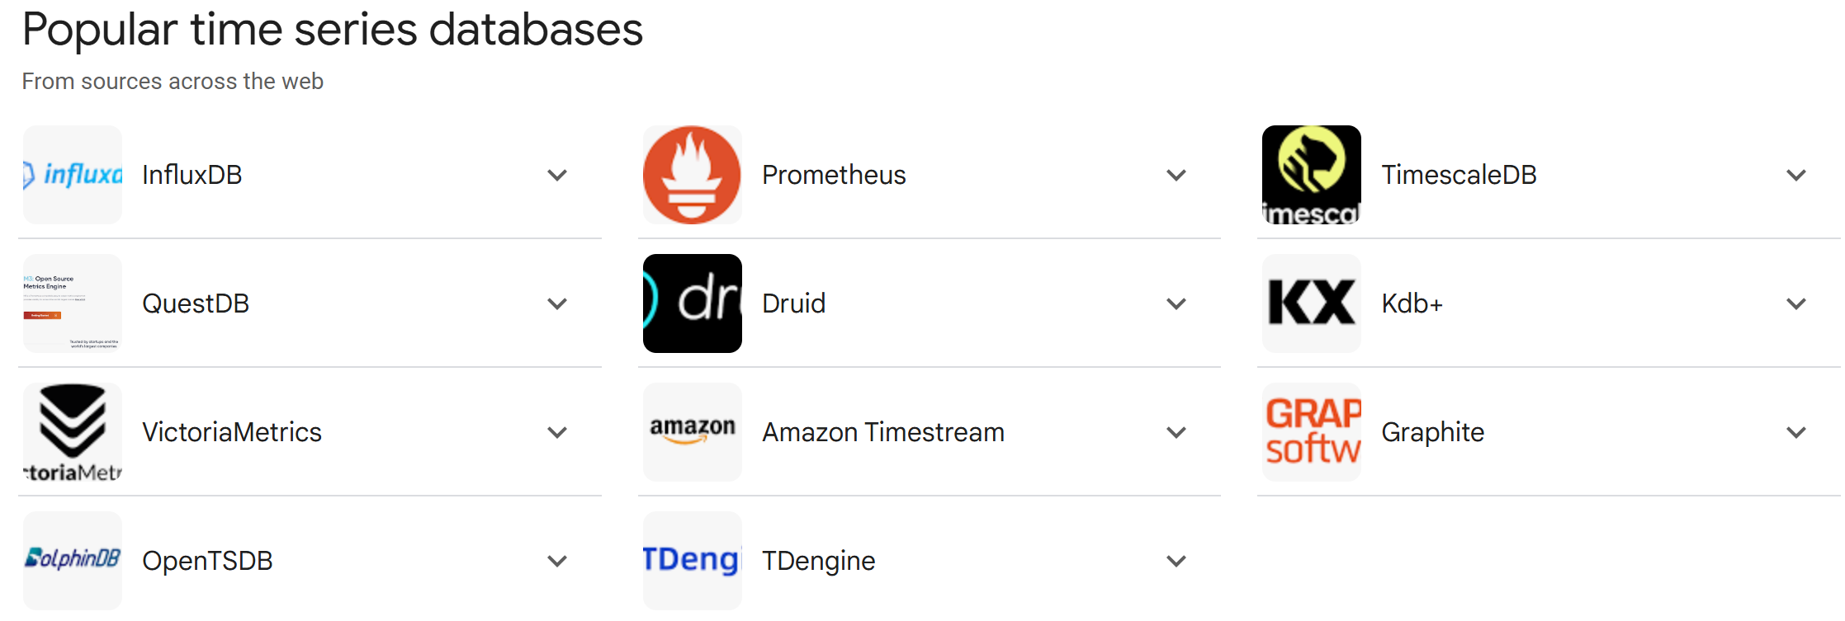


Systems for Other Data Types
Multimedia databases
Time-series databases
Graph databases
…
Notes:
https://www.google.com/search?q=time-series+databases+commercial&sca_esv=6a8bc30cf81663d6&rlz=1C1GCEA_enUS1170US1170&sxsrf=AE3TifOvgAbmVk1XqMDoqte7ZZxeVCHCIw%3A1752119950381&ei=jjpvaIKCF_SrptQPr6XGgAo&ved=0ahUKEwiCgfy5s7GOAxX0lYkEHa-SEaAQ4dUDCBE&uact=5&oq=time-series+databases+commercial&gs_lp=Egxnd3Mtd2l6LXNlcnAiIHRpbWUtc2VyaWVzIGRhdGFiYXNlcyBjb21tZXJjaWFsMggQABiABBiiBDIIEAAYgAQYogQyBRAAGO8FSIYgUOwJWOkdcAN4AZABAJgBzwGgAegNqgEGMS4xMS4xuAEDyAEA-AEBmAINoAK-CsICChAAGLADGNYEGEfCAgoQABgHGAgYChgewgIIEAAYBxgIGB7CAggQABgIGA0YHsICChAAGAgYChgNGB6YAwCIBgGQBgiSBwU0LjguMaAH1zGyBwUxLjguMbgHqgrCBwgwLjEuMTEuMcgHQA&sclient=gws-wiz-serp
https://www.publicdomainpictures.net/en/view-image.php?image=260867&picture=social-media-twitter-google-plus
https://commons.wikimedia.org/wiki/File:Social_media_collection_2020s.png
https://ourcodeworld.com/articles/read/1034/using-the-nosql-database-example

Slide 30
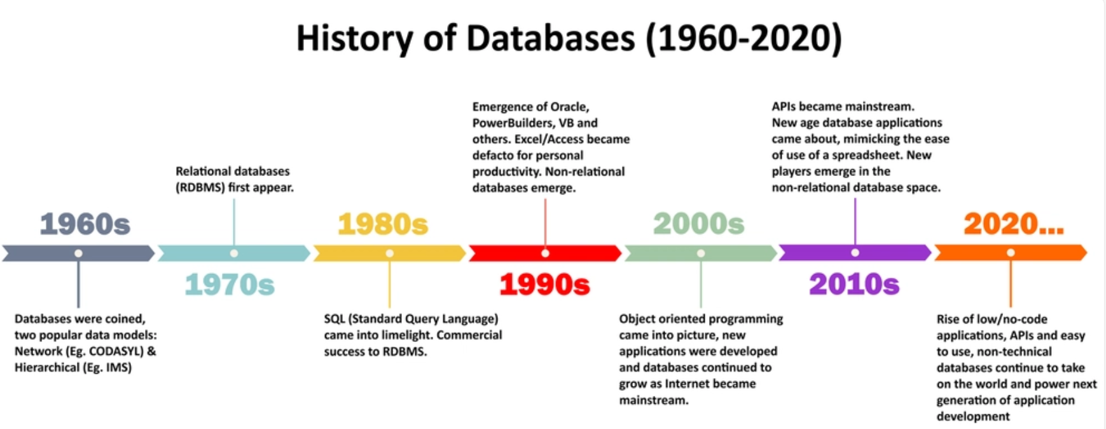
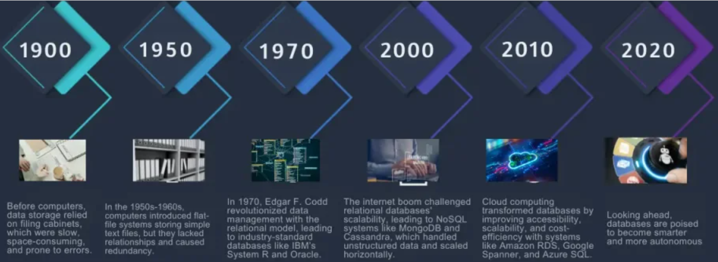
History of Databases
Notes:
https://dev.to/susheelthapa/history-of-database-28nd
https://nam-it.com/evolution-of-databases/

Slide 31
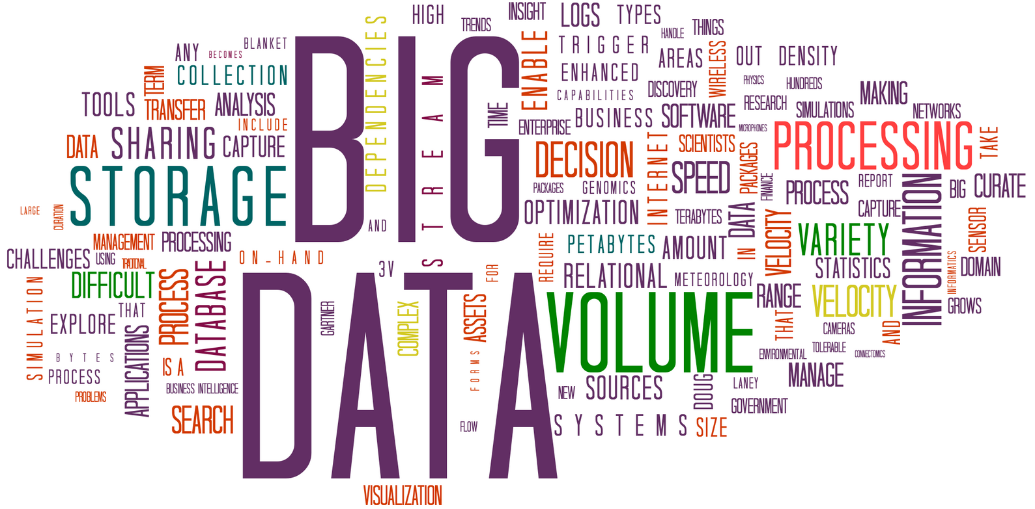
Recent Hot Topics of Databases
Big Data (from Wikipedia)
  "Big data is a term for data sets that are so large or complex that traditional data processing applications are inadequate to deal with them. Challenges include analysis, capture, data curation, search, sharing, storage, transfer, visualization, querying, updating and information privacy"
Gartner (2011)
  Big data is a popular term used to acknowledge the exponential growth, availability and use of information in the data-rich landscape of tomorrow
Notes:
https://en.wikipedia.org/wiki/Big_data

Slide 32
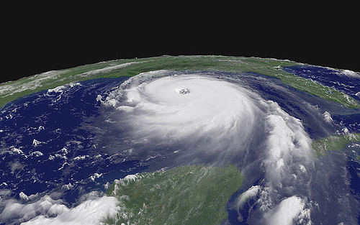
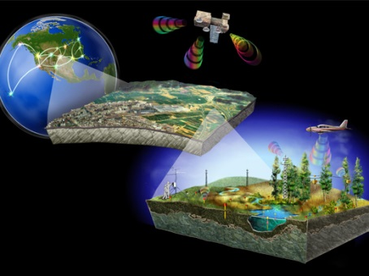
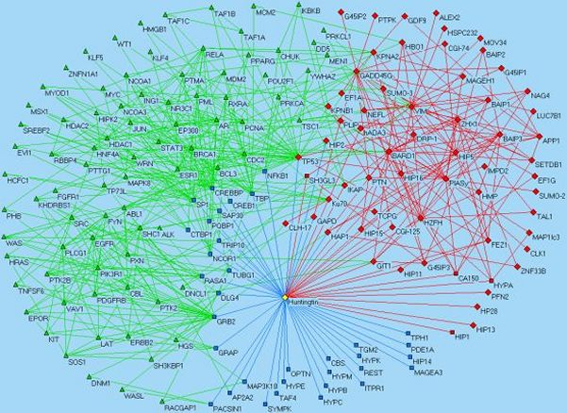

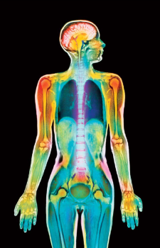
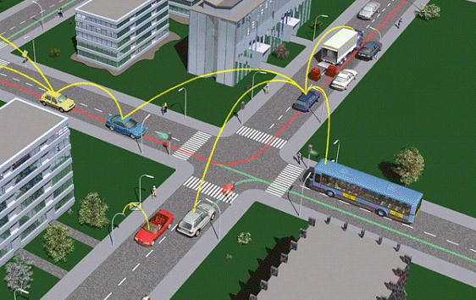
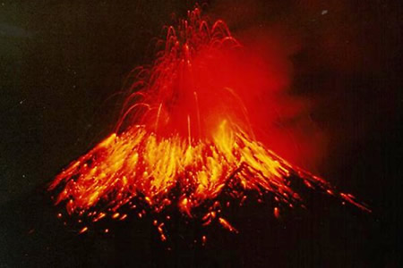
Applications of Big Data
Hurricane moving path predication
Protein-to-protein interaction networks
Satellite imagery, mobile station, distributed sensor networks, geographical plotting
Web data
Digital health care
Intelligent transportation
32
Volcano monitoring
Notes:
Big data have many real-life applications such as sensor networks, scientific databases, smart city, smart healthcare, Semantic Web, and so on.
https://commons.wikimedia.org/wiki/File:BigData_2267x1146_white.png

Slide 33
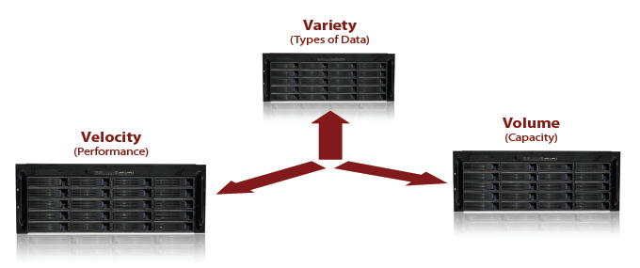
Characteristics of Big Data
Big data
Notes:
Gartner thinks the essential features of Big data can be summarized in 3V features.
Variety: the ability to handle heterogeneous data source, representation and quality.
Volume: the ability to scale out the storage
Velocity: the ability to capture and analyze data with performance guarantees

Slide 34
Characteristics of Big Data (cont'd)
Variety: ability to handle heterogeneous data source, representation and quality
Velocity: the ability to capture and analyze data with performance guarantees
Volume: the ability to scale out the storage as long as there is a data allocation require
Other features (from Wiki and P. Valduriez):
  Variability: Inconsistency of the data set can hamper processes to handle and manage it
  Veracity: The quality of captured data can vary greatly, affecting accurate analysis
  Validity: Is the data correct and accurate?
  Volatility: How long do you need to store the data?
https://en.wikipedia.org/wiki/Big_data
Patrick Valduriez, Indexing and Processing Big Data, slides
Notes:
There are many other Vs, for example, variability, veracity, validity, and volatility. For the variability, there may be inconsistencies contained in the data set which can affect how we handle and manage the data. For the veracity, the quality of captured data can vary greatly, affecting accurate analysis. For the validity, the data may or may not be correct and accurate. For the volatility, the data may have their lifetimes, and you may not need some data long time ago (e.g., ten years ago). Therefore, some data may be expired and can be updated by removing them.

Slide 35
Variety
Hurricane moving path predication
Protein-to-protein interaction networks
Satellite imagery, mobile station, distributed sensor networks, geographical plotting …
Web data
Digital health care
Intelligent transportation
Volcano monitoring
Notes:
Let us briefly talk about each of the 3V features. For the variety, in real-world applications such as satellite images, sensor networks, biological database, Web data analysis, scientific databases, smart city/transportation systems, or smart healthcare, many real-world data are involved of different data types. For example, data can be of numeric values, text data, graphs, images, audio, videos, and so on.

Slide 36
Variety
Hurricane moving path predication
Protein-to-protein interaction networks
Heterogeneous
Data
Satellite imagery, mobile station, distributed sensor networks, geographical plotting …
Web data
Digital health care
Intelligent transportation
Volcano monitoring
Notes:
These data are quite heterogeneous.

Slide 37
Variety
Hurricane moving path predication
Protein-to-protein interaction networks
Heterogeneous
Data
Satellite imagery, mobile station, distributed sensor networks, geographical plotting …
Web data
Digital health care
Heterogeneous Data of Various Formats and Data Qualities!!
Intelligent transportation
Volcano monitoring
Notes:
What is more, these data may contain noises and come from different data sources of various data qualities. Therefore, in practice, we need to handle heterogeneous big data of different data formats and different data qualities, which requires different data models/techniques and is rather challenging.

Slide 38
Variety (cont'd)
Many types of big data
  Key-value pairs
  Relational tables
    Numeric data, text data
  Arrays
  Documents
    Unstructured text data (Web)
    Semi-structured data (XML, RDF triples, etc.)
  Graphs
    Social networks, Semantic Web (RDF graphs), road networks, …
  Data streams
    Sensor data, RFID data, network data, trajectory data, etc.
  Time series data
    Stock exchange data, video/audio data, trajectory, EEG data, etc.
  Multimedia data
    Audio, video, image, etc.
Patrick Valduriez, Indexing and Processing Big Data, slides
Notes:
For types of big data, they can be key-value pairs which are used for distributed computing. They can be classical relational tables in relational databases (containing numeric, text or complex data attributes). We also have array data in biological databases, textual documents (containing unstructured, semi-structured XML or RDF data)), graphs in social networks, Semantic Web, or road networks, and data streams for sensor, RFID, Internet networks, trajectories, and so on. We may also encounter time series data (i.e., ordered data sequences over time), including stock exchange data, video/audio data, trajectory, EEG data (signal data collected from the scalp), and so on.

Slide 39
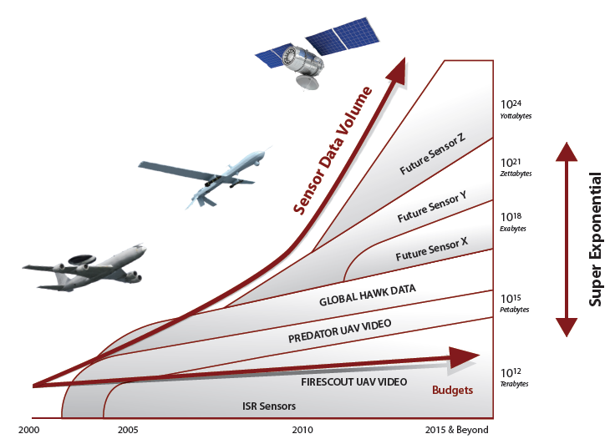

Volume
Super exponential growth in data volume
Copyright belongs to “Data Analysis Challenges”, JSR-08-142, Dec
Notes:
For the volume feature, the collected big data are now increasing dramatically over time. In the figure, the sensory data are collected with more and more sensors, and the volume of the sensory data increases exponentially over years.

Slide 40
Volume
Super exponential growth in data volume
Copyright belongs to “Data Analysis Challenges”, JSR-08-142, Dec
Large-Scale Data to Collect, Store, Organize, and Manipulate!
Notes:
With such large-scale data, it is very challenging to collect, store, organize and manipulate these data.

Slide 41


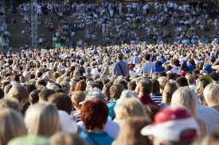

Volume (cont'd)
Old days: Only a few companies are generating data, all others are consuming data
Nowadays: All of us are generating data, and all of us are consuming data
Notes:
In the old days, we do not have many data. So as long as we have the data for analysis, people can do better than others. However, nowadays, we have too many data, sometimes overwhelmed by the data. Everyone is generating data. For example, on social networks, users (maybe you) often post messages, images, or videos, generating data with smartphones. Therefore, now we have too many data to process and analyze.

Slide 42
Volume (cont'd)
Data volume is increasing exponentially
1.8 zetabytes (10²¹ bytes, or 1,024 exabytes)
  An estimation for the data stored by human kind in 2011
40 zetabytes in 2020
But
  Less than 1% of big data is analyzed
  Less than 20% of big data is protected
Source: Digital Universe study of International Data Corporation (IDC), December, 2012
Patrick Valduriez, Indexing and Processing Big Data, slides
Notes:
In 2011, there are about 1.8 zetabytes for data stored by human kind. It is expected that 40 zetabytes will be produced in 2020. It is not trivial how to efficiently process them.
It is reported that only less than 1% of big data is analyzed, and others are just left/stored without any analysis. Moreover, less than 20% of big data is protected, and the remaining ones are under the risks of releasing people’s privacy. Therefore, recently, the security and privacy preserving are vey hot for big data. This is however out of the scope of this course, and will not be covered by this course.

Slide 43





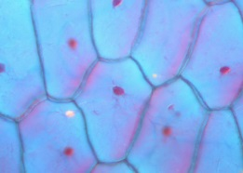

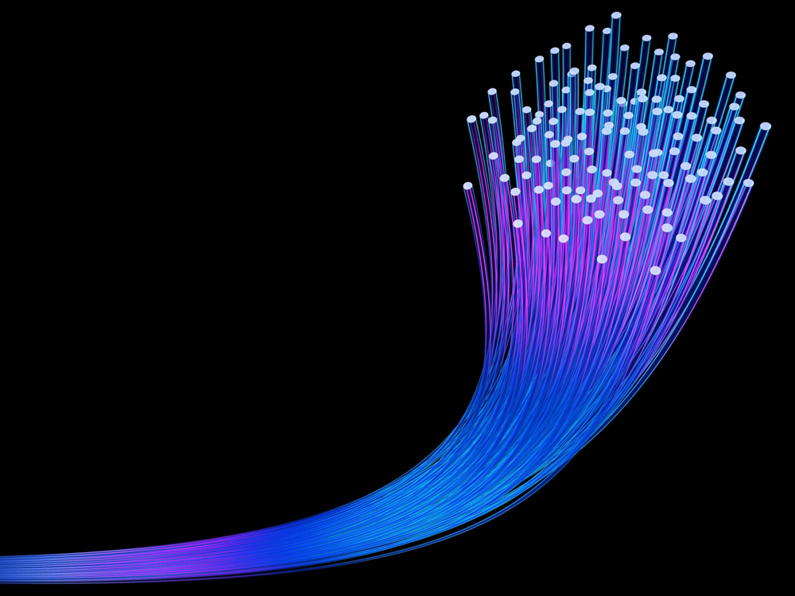
Velocity
Fast Data Retrieval, Analysis, and Mining
Notes:
For the velocity, since we have large-scale data and some data are arriving or generated very fast in real applications, it is also challenging to fast analyze these data, retrieve useful information from these data, and even mine some new knowledge from the data.

Slide 44
Velocity
Fast Data Retrieval, Analysis, and Mining
Efficient and Quality-Aware Query Processing Over Big Data!
Notes:
Therefore, we also need to design efficient and quality-aware approaches to process queries on such big data with small response time and low resource consumptions (such as the memory consumption).

Slide 45
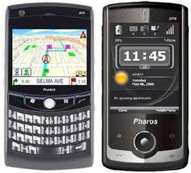
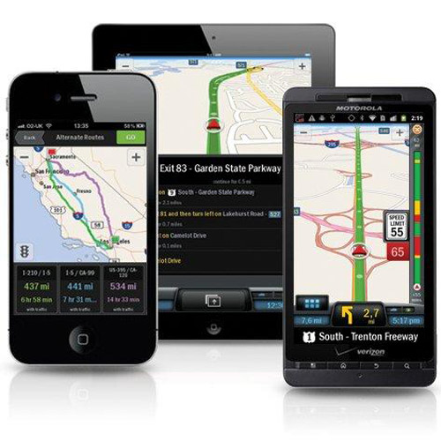

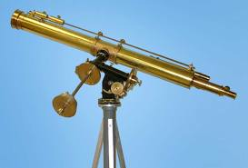






Real-Time/Fast Data
Mobile devices
(tracking all objects all the time)
Scientific instruments
(collecting all sorts of data)
Social media and networks
(all of us are generating data)
Sensor technology and networks
(measuring all kinds of data)
The progress and innovation are no longer hindered by the ability to collect data
But, by the ability to manage, analyze, summarize, visualize, and discover knowledge from the collected data in a timely manner and in a scalable fashion
Notes:
Nowadays, we have many real-time and fast arriving data such as social media data, scientific data, mobile data, and sensory data. The progress and innovations are no longer hindered by the ability to collect data, but by the ability to manipulate large-scale data in a timely manner and in a scalable fashion.

Slide 46



How to Tackle Challenges of Big Data?
Heterogeneity
Data Modeling with Quality Guarantees
Storage and Indexing
Efficient and Quality-Aware Query Answering
Big Data
Large Scale
Efficiency
Notes:
In order to tackle the challenges of big data, for 3V features, we will design different techniques. For example, for variety, we will model heterogeneous big data with quality guarantees. For volume, we will design effective storage and indexing mechanisms to deal with large-scale data, such as cloud-based storage. For velocity, we will develop effective and efficient query processing algorithms that consider data/query qualities.

Slide 47





Indexing Mechanism in Databases
B⁺-tree, extensible hashing, bitmap
Grid file
Z-order, Hilbert curve
Bitmap index
Quadtree
k-d tree
R-tree, R⁺-tree, R*-tree
SS-tree, SR-tree
X-tree
M-tree
Embedding-based index
Inverted index
Local sensitive hashing
B⁺-tree
hashing file
R*-tree
M-tree
Notes:
https://commons.wikimedia.org/wiki/File:Bplustree.png
https://commons.wikimedia.org/wiki/File:Extendible_hashing_6.svg
https://commons.wikimedia.org/wiki/File:R-tree_built_with_Guttman%27s_linear_split.png
https://commons.wikimedia.org/wiki/File:RTree-Visualization-3D.svg
https://commons.wikimedia.org/wiki/File:M-tree_built_with_MMRad_split.png

Slide 48
Queries in Relational Databases
Relational Databases
  Data Definition Language (DDL)
  Data Manipulation Language (DML)
  Data Control Language (DCL)
Structured Query Language (SQL)
  Selection
  Projection
  Group By
  Having
  Join
  …
Notes:
https://commons.wikimedia.org/wiki/File:Sql_data_base_with_logo.svg
https://www.w3schools.com/sql/sql_where.asp

Slide 49


Relational Database Queries
Structured Query Language (SQL) in relational databases
  SELECT column1, column2, ...
  FROM table_name
  WHERE condition;

Slide 50

Queries in NoSQL Databases (a.k.a. Non-Relational Databases)
Spatio-temporal databases
  Range Query
  Nearest Neighbor (NN) Query
  k-Nearest Neighbor (kNN) Query
  Group Nearest Neighbor (GNN) Query
  Reverse Nearest Neighbor (RNN) Query
  Top-k Query
  Skyline Query
  Top-k Dominating Query
  Reverse Skyline Query
  Inverse Ranking Query
  Aggregate Queries
Notes:
https://commons.wikimedia.org/wiki/File:Advantages_of_NoSQL.png

Slide 51


Queries in NoSQL Databases (cont'd)
Graph databases
  Shortest path search
  Keyword search
  k-Nearest neighbor search
  Subgraph matching
  Subgraph similarity search
  Community search/detection
  …
This Photo by Unknown Author is licensed under CC BY-SA
Notes:
https://www.flickr.com/photos/marc_smith/6798665887

Slide 52

Ultimate Goals of the Database Research
Data Quality
  Data cleaning
Efficiency
  Main DB focus
Scalability
  Large-scale data
Accuracy
  Usually database queries require 100% accuracy or be error-bounded
DB
Query Engine
users

Slide 53
Query Processing in NoSQL Databases

Slide 54
Types of Queries
Range Query
Nearest Neighbor (NN) Query
k-Nearest Neighbor (kNN) Query
Group Nearest Neighbor (GNN) Query
Reverse Nearest Neighbor (RNN) Query
Top-k Query
Skyline Query
Top-k Dominating Query
Reverse Skyline Query
Inverse Ranking Query
Range Aggregate Queries
Keyword Search Query
Graph Queries
Notes:
Here is a short list of spatial queries over data. There are many other queries and their variants which are not covered in the slides.

Slide 55
The Efficiency of Query Processing
When the NoSQL database is of large scale
  It is not efficient to scan the entire database for each query
  It is not efficient to enumerate all possible (sometimes exponential number of) candidate query answers and check query predicates

Slide 56
A General Framework for Query Processing
Maintain a multidimensional index structure over uncertain database // indexing phase
For each query
  Apply the pruning methods during the index traversal // pruning phase
  Refine candidates and return the answer set
  // refinement phase

Slide 57
Range Queries
One of the most widely used spatial queries
  A range query retrieves all objects o_{i} falling into the query range Q
q
a query range Q₁
a query range Q₂
data objects o_{i}
Notes:
We will start from the classic range query, which retrieves all objects falling into a given query range Q. The shape of the query range can be hyperrectangle or hypersphere. The range query is very useful in applications like location-based services, map services, and so on. For example, the range query can be used to find all restaurants within a city region, or all hotels within 15 miles away from your current location (query point q).

Slide 58
A Straightforward Method
For each object o
  Check if o is in the query range Q
Disadvantages
  Not efficient for large-scale spatial data sets
Notes:
The straightforward method is to sequentially scan the entire database, and check if each object is inside the query range Q. This is however not efficient, especially for databases of large scale.

Slide 59
Multidimensional Index: R*-Tree
Minimum Bounding Rectangle (MBR)
  Use a smallest rectangle (or hyperrectangle in the multidimensional space) to bound objects/nodes
X₂
x_{2max}
MBR
(x_{1min}, x_{1max}; x_{2min}, x_{2max})
x_{2min}
X₁
x_{1min}
x_{1max}
Notes:
Recall that we talked about the R-tree index over spatial objects, which can use MBRs to summarize a number of spatial objects.

Slide 60


Multidimensional Index: R*-Tree (cont'd)
R-tree is a height-balanced multi-way external memory tree over n multidimensional data objects (height: log_{F}(n))
  Non-leaf node (or intermediate node): contains a number of entries (MBRs) that minimally bound their child nodes, as well as pointers pointing to child nodes
  Leaf node: contains spatial objects
node fanout: F ∈ [m, M],
where m ≤ M/2
Notes:
To answer the range query, instead of checking objects one by one, we can check whether MBRs are intersecting with the query range, with the help of the R-tree.
By using the concept of the MBR, we can save the computation cost for checking a group of objects in an MBR (if this MBR does not intersect with the query range at all).

Slide 61
Pruning Heuristics
Pruning Strategy with the index (e.g., R-tree family)
  Basic idea if the query range Q is not intersection with an MBR E, then all objects in E can be safely pruned
q
a query range Q₁
a query range Q₂
an MBR node E in an R-tree
Notes:
To enable efficient range query processing, our goal is to derive some pruning conditions w.r.t. MBRs for the range query. If an MBR node in the R-tree can be safely pruned, then we do not have to access all objects inside this MBR node, which can save a lot of computation cost.
For example, the blue rectangle is an MBR node E in an R-tree. If this node E is completely outside the query range, then we can see that none of objects under node E can be the query answer. We thus can safely prune the node E without accessing its underlying objects.

Slide 62
Pruning Heuristics (cont'd)
Pruning conditions
q
a query range Q₁
a query range Q₂
an MBR node E in an R-tree
Notes:
Therefore, for range query Q_1, we only need to decide if two rectangles are intersecting or not. For range query Q_2, we only need to decide whether or not the rectangle E is outside the query circle.

Slide 63
Pruning Heuristics (cont'd)
Pruning condition for circular query range Q₂
  if mindist(q, E) > r, then all objects in E can be safely pruned
mindist (q, E)
radius r
q
a query range Q₂
an MBR node E in a R-tree
Notes:
For the range query Q_2 with circular query range, we need to compute the minimum distance, mindist(q, E), from query point q to node E. If this mindist() has distance larger than radius r, then MBR node E must be outside the query range, and can be safely pruned.

Slide 64
Range Query Processing
Traverse the R-tree index, I, starting from the root
If we encounter a leaf node E
  For each object o in E, check if o is in the query range Q
  If yes, add o to an answer set S_{cand}
If we encounter a non-leaf node E
  For each entry E_{i}, check if E_{i} is intersecting with Q
  If yes, continue to check E_{i}'s children
Notes:
After discussing the pruning heuristics, we present how to process range queries via R-tree index. Specifically, we traverse the R-tree index starting from the root. If we encounter a leaf node, we then add objects in the leaf node that fall into the query range Q to the answer set S_{cand}. When we encounter a non-leaf node E, we will find those entries E_i under E that are intersecting with Q, and continue to check these child entries.

Slide 65
Range Query Processing Algorithm
Queue H=empty;
Insert root(index I) into H;
while (H is not empty){
Pop out a node E from H;
If (E is a leaf node){
for each object o in E
if o is in Q
add o to candidate set S_{cand}
}
else // non-leaf nodes{
for each entry, E_{i}, in E
if E_{i} intersects with Q
insert E_{i} into H;
}
}
Notes:
This is the pseudo code of range query processing over the R-tree index. We use a queue H to facilitate the traversal of the R-tree, which contains MBR nodes that intersect with the query range Q.

Slide 66
Nearest Neighbor (NN) Query
Given a query point q and a spatial database D, a nearest neighbor (NN) query retrieves an object o_{i} in D that is the closed to q
  For other objects o', dist(q, o_{i}) ≤ dist(q, o')
q
data objects o_{i}
Notes:
Assume that you want to go to a restaurant that is closest to your current location, and have your dinner there. In this case, you need to issue a nearest neighbor (or NN) query over all restaurants in the city, and find the closest one to your current location (which is a query point).
Formally, given a query point q, and a spatial database containing data objects o_i, a nearest neighbor query retrieves an object o_i that is the closest to query point q.
We can definitely enumerate all objects in the database, compute their distances to q, and obtain the one with the smallest distance. However, this is not efficient for large-scale database.

Slide 67
NN Pruning Heuristics
Basic idea
  Given a object candidate o, an MBR node E, and a query point q
    If dist(q, o) ≤ mindist(q, E), then all objects in E can be safely pruned
MBR E
o
dist(q, o)
mindist(q, E)
q
Notes:
Therefore, we need to design some pruning heuristics to quickly filter out false alarms of query answers and reduce the problem search space. Our basic idea is also to utilize MBRs in the R-tree index to fast eliminate a group of objects in each MBR (without even checking them).
In particular, assume that we have encountered an object o. If we find that the minimum distance from query point q to MBR E is greater than or equal to the distance from q to object o, then any object inside MBR E can never become the nearest neighbor of q (due to the existence of object o). In this case, MBR node E can be safely pruned.

Slide 68
NN Pruning Heuristics (cont'd)
Two MBR nodes E₁ and E₂?
  If maxdist(q, E₁) ≤ mindist(q, E₂), then all objects in node E₂ can be safely pruned
MBR E₂
MBR E₁
maxdist(q, E₁)
mindist(q, E₂)
q
Notes:
Previously, we say that we have encountered an object o, which is used for pruning the MBR. However, during the index traversal, what if we are still traversing the nodes of the R-tree and have not accessed the objects. Can we still prune MBR nodes? The answer is yes.
As shown in the figure, we have two MBR nodes E_1 and E_2. Assume that we have encountered MBR E_1. In this case, we can still use MBR E_1 to prune E_2, if the maximum distance from q to E_1 is smaller than or equal to the minimum distance from q to E_2. In other words, we can draw a circle centered at q with radius maxdist(q, E_1). If MBR E_2 is completely outside the circle, then we can safely prune MBR node E_2. Intuitively, the distance from q to any object in E_2 is always greater than or equal to that from q to that in E_1, so objects in E_2 can never be NN answers. We thus can safely prune MBR node E_2.

Slide 69
NN Pruning Heuristics (cont'd)
Can we prune more objects?
  If minmaxdist(q, E₁) ≤ mindist(q, E₂), then all objects in node E₂ can be safely pruned
MBR E₃
MBR E₂
MBR E₁
maxdist(q, E₁)
minmaxdist(q, E₁)
mindist(q, E₂)
q
Notes:
One more question, can we achieve even higher pruning power? The answer is yes.
According to the definition of MBR, MBR is the minimum bounding rectangle of all objects inside MBR. Therefore, for each edge of the MBR, there must exist at least one object on the boundary. Instead of using maximum distance from q to E_1, we now can use the minmaxdist(q, E_1), which is the smallest maximum distance from q to each edge/boundary of MBR E_1. We can see that, the minmaxdist() is much smaller than maxdist(). Similarly, we can draw a circle centered at query point q, and with radius minmaxdist(q, E_1). In this case, we can obtain a smaller circle (compared with the one with maxdist()), which will lead to higher pruning power. As shown in the figure, MBR E_3 cannot be pruned by using maxdist(), but can be pruned by minmaxdist().

Slide 70
Best-First Algorithm
best_dist_so_far = +∞; S_{cand}=Φ;
Initialize a minimum heap H = Φ;
Insert <root(I), mindist(q, root(I))> into heap H
while (H is not empty){
(E, d_{min}) = pop-out (H)
if (d_{min}> best_dist_so_far), then terminate;
if E is a leaf node
for each object o in E
compute dist(q, o)
if (dist(q, o) < best_dist_so_far)
S_{cand} = {o}; best_dist_so_far = dist(q, o);
else // non-leaf node
for each entry E_{i} in E
compute mindist(q, E_{i})
if (mindist(q, E_{i}) < best_dist_so_far) // pruning
insert (E_{i}, mindist(q, E_{i})) into heap H
update best_dist_so_far with minmaxdist(q, E_{i})
}
Notes:
Here is the pseudo code of the best-first algorithm. It is a more efficient algorithm than the DF traversal algorithm.

Slide 71
Reverse Nearest Neighbor Query (RNN)
Rescue tasks in oceans
  In the case of emergency, a ship will ask its nearest ship for help
  A rescue ship needs to monitor those ships that have itself as their nearest neighbors
  In other words, the rescue ship needs to obtain its reverse nearest neighbors (RNNs)
Notes:
We first introduce the motivation example of the reverse nearest neighbor (RNN) query. In the application of rescue tasks in oceans, if a ship is in danger, it tends to ask for help from its nearest ship. Therefore, a rescue ship needs to keep track of those ships that have itself as their nearest neighbors.
As shown in the figure, q is a rescue ship, and the nearest neighbor of Ship #2 is exactly the rescue ship q. We say that, Ship #2 is the reverse nearest neighbor (or RNN) of q.

Slide 72
Other Applications
Mixed-Reality Games
Notes:
Similarly, in the mixed-reality games, each player tends to shoot one’s nearest player. Therefore, if I am a query player q, I need to know who tend to shoot me, in other words, who have me as their nearest neighbors. Or I would like to find out my reverse nearest neighbor (RNN) of my current location q.

Slide 73
RNN Problem Definition
Reverse Nearest Neighbor Query (RNN)
  Given a database D and a query object q, a RNN query retrieves those data objects o ∈ D that have q as their nearest neighbors
o₅
q
o₄
o₁
o₂
o₃
F. Korn and S. Muthukrishnan. Influence Sets Based on Reverse Nearest Neighbor Queries. In SIGMOD, 2000.
Notes:
Formally, an RNN query retrieves those objects from the database such that they have a given query point q as their nearest neighbors.
As shown in the example, query point q is the nearest neighbor (NN) of object o_1, thus, o_1 is the reverse nearest neighbor (RNN) of q.
Note that, NN of q and RNN of q are two different sets. As shown in the example, object o_1 is the RNN of q, whereas object o_2 is the NN of q.

Slide 74
TPL Pruning Idea
TPL Approach
q
RNN candidate
o₅
o₄
o₁
o₂
o₃
pruning region
Y. Tao, D. Papadias, and X. Lian. Reverse kNN Search in Arbitrary Dimensionality. In VLDB, 2004.
74
Notes:
Another RNN approach, called TPL, designs a pruning region for filtering out false alarms of RNN candidates. We illustrate the basic idea of TPL using the example in the figure. Given an RNN candidate o_1 and a query point q, we can draw a perpendicular bisector between o_1 and q, which divides the data space into two halfplanes. Then, the halfplane containing the RNN candidate o_1 can be defined as the pruning region.
It can be proved that any object, for example, o_2, inside the pruning region can never be RNN and can be safely pruned. The reason is that the distance from o_2 to RNN candidate o_1 is guaranteed to be smaller than that from o_2 to q. Then, q cannot be the nearest neighbor of o_2, due to the existence of o_1, and in turn o_2 inside the pruning region cannot be the reverse nearest neighbor of q.

Slide 75
TPL Pruning Idea (cont'd)
TPL Approach [VLDB'04]
RNN candidate
q
RNN candidate
o₅
o₄
o₁
o₂
MBR E
o₃
pruning region
75
Notes:
In practice, we have more than one candidate (e.g., candidates o_1 and o_5), and can define multiple pruning regions. This way, we can prune all objects or MBRs E inside any of the pruning regions.

Slide 76


Pruning with MBRs
q
q
Notes:
If an MBR is partially inside the pruning region, TPL approach will only consider the residual MBR (as shown in the shaded region of the figure), that is, only access those children of the node intersecting with the residual MBR.

Slide 77


Example of TPL Query Processing
q
Notes:
The TPL approach uses the R*-tree to index data objects in the spatial database, and traverse the index in a best-first manner to retrieve the RNN candidates by applying the pruning methods.
In particular, the RNN processing procedure is as follows. We maintain a minimum heap to traverse the R*-tree index, which stores nodes that may contain RNN answers. Each time we pop out a node with the smallest mindist() to query point q. Intuitively, those nodes close to query point may have higher pruning power to prune other objects/nodes.
Initially, we visit the root of the R*-tree, and add entries N_10, N_11, and N_12 to the heap. Then, node N_10 is first popped out from the heap, and its children N_1, N_2, and N_3 are entered into the heap. Next, node N_3 is popped out, and its child objects p_1 and p_3 are accessed. In this case, p_1 is a candidate, and the pruning region between p_1 and q can rule out p_3, which is moved to a refinement set.
For the next iteration, we pop out N_5, and obtain objects p_2 and p_6. While p_6 can be pruned by p_1 and moved to refinement set S_rfn, object p_2 cannot be pruned and is added to the candidate set S_cand. Next, N_2 can be pruned by the pruning region of p_1, and moved to the refinement set S_rfn. Then, N_1 is accessed, p_7 is pruned, and p_5 is added to the candidate set S_cand. Finally, node N_12 can be pruned by candidate p_2, and heap becomes empty.
As a result, objects p_1, p_2, and p_5 are RNN candidates, and we refine them by calculating their actual nearest neighbors for objects/nodes in the refinement set.

Slide 78

TPL Query Processing Algorithm
Maintain a minimum heap H to traverse the index
Notes:
Here is the pseudo code of the TPL query processing algorithm. If you are interested in this algorithm, please check the detailed descriptions in the TPL paper.

Slide 79
Top-k Queries – Motivation
Many real-world applications are interested in top-k results
  Multimedia search by contents
  Middleware
  Search engines (e.g., Google, Bing, etc.)
  Data mining
Requirements
  Multi-criteria ranking
  Aggregates from external sources
  Ranking joined streams
Notes:
Let us first give the motivation for top-k queries, which rank and return k objects with the highest ranks. There are many real-world applications for top-k queries, such as multimedia search by contents, middleware, search engines, and data mining. In these applications, we usually need to rank objects with multiple criteria. Sometimes the ranking score needs the aggregates from external sources. Moreover, for some applications, we need to perform the ranking from multiple infinite streams.

Slide 80

Example: Ranking in Multimedia Retrieval
Color Histogram
Edge Histogram
Texture
Video
Database
Query
top-k most similar images/frames
Notes:
References
Benjamint444. White-Browed Scrubwren (Sericornis Frontalis, Cat.)English: A White-Browed Scrubwren Female (Sericornis Frontalis) Vocalising, Taken in South-Eastern Australia. 1 Oct. 2007. Own work, Wikimedia Commons, https://commons.wikimedia.org/wiki/File:Scrub_wren_female_Vocalising444.jpg. Changes were not made.
Examples of the top-k query include ranking in multimedia retrieval. From video database, we may want to retrieve k most similar frames to a given query image (or frame). Here, the similarity between two frames can be defined by a similarity function that involves color histogram, edge histogram, texture, and so on.

Slide 81

Top-k Queries
Given a spatial database D, a ranking function (or preference function) f(o), and an integer parameter k, a top-k query retrieves k objects, o, from the database D such that they have the highest ranking score f(o) among all objects in D
Notes:
Formally, given a spatial database, a ranking function f(), and a parameter k, a top-k query returns k objects from the database, with the highest ranking scores f(o).

Slide 82
Ranking Functions
Various ranking functions
  f(o) = o.x + o.y
  f(o) = w₁ ⋅ o.x + w₂ ⋅ o.y
  …
Notes:
In practice, the user can specify different ranking functions such as the sum of attributes, weighted sum, and so on.

Slide 83
Pruning with MBRs?
Obtain lower/upper bounds of ranking scores
  k = 2
E
f(E_{top-right})
f(E_{bottom-left})
Notes:
So far we have talked about two pre-computation techniques to obtain top-k answers. For online top-k query processing without offline pre-computations, we can also use the R-tree index to facilitate the query processing. For example, on the MBR node level, we can obtain the lower and upper bounds of scores for all objects in an MBR E. As shown in the figure, for preference function f() and MBR E, the score lower bound of MBR E is achieved at the bottom-left corner of the MBR E, whereas the score upper bound is achieved at the top-right corner. This way, we can obtain lower and upper bounds for all MBRs.
In the example of the figure, MBR E contains more than 2 (=k) objects, and its score lower bound is larger than the upper bound of all other MBRs. In this case, MBR node E contains top-k candidates, and we can safely prune other MBRs (since they cannot contain objects with high scores).

Slide 84
Pruning Conditions for Top-k Queries
Given k candidate objects
  Let threshold T be the k-th largest lower bound of ranking scores for all k candidates
  If an MBR E has the score upper bound, UB_f(E), smaller than or equal to T, then all objects in E can be safely pruned
E
T
UB_f(E)
Notes:
Similarly, if we have obtained k candidate objects, we can set a threshold T as the k-th largest lower bound of ranking scores. For any MBR E, if it has a score upper bound UB_f(E) smaller than or equal to T, then this MBR node E can be safely pruned. This is because, all objects in E must have scores lower than at least k candidates.

Slide 85


Skyline
Skyline operator
Skyline of Hotels
Skyline of Manhattan
S. Börzsönyi, D. Kossmann, and K. Stocker. The Skyline Operator. In ICDE, 2001.
Notes:
The first skyline paper was proposed in ICDE 2001. The right figure shows the skyline of Manhattan, and the skylines over objects in a 2D space are shown in the left figure.
The classic motivation example of the skyline query is the selection of hotels. Each hotel has two attributes, its price and distance to the beach. Intuitively, we want to select a hotel with low price and short distance to the beach. However, in practice, some hotel close to the beach might have higher price, and some hotel with low price has long distance to the beach. Usually there is a trade-off between these two factors/attributes. Therefore, the skyline query is going to return a number of hotels, such that there are no other hotels better than these returned hotels, in terms of both price and distance.

Slide 86
Dominance
Object o dominates object p, iff
  o[i] ≤ p[i], for all dimension i
  o[j] < p[j], for at least one dimension j
distance to beach
p"
p
dominating
region of o
p'
o
O
price
hotels
Notes:
Formally, we first define the dominance relationship between two objects. In a multidimensional space, we say that object o dominates object p, if and only if two conditions hold: (1) for all dimensions, the attributes of object o are smaller than or equal to that of object p; and (2) for at least one dimension, object o has the attribute strictly smaller than that of object p.
As shown in the figure, the shaded region is called the dominating region of hotel o. Any points inside the dominating region are dominated by hotel o (since they have both price and distance to beach worse than hotel o). In the example, we can see that, hotel o is dominating hotels p, p’, and p”.

Slide 87
Skyline Query
Given a spatial database D, a skyline query retrieves those objects in D that are not dominated by other objects
distance to beach
o₆
skyline objects
o₃
o₇
o₅
o₄
o₁
o₂
o₈
O
price
Notes:
For the skyline query, given a spatial database D, we want to retrieve those objects from database D such that they are not dominated by other objects. In the example of the figure, o_3, o_1, and o_2 are skyline points, since they are not dominated by other objects. For other objects, for example object o_6, which is dominated by object o_3, and thus it cannot be the skyline answer.

Slide 88
A Naïve Way to Compute Skylines
For each object p
  If p is not dominated by all other points in D, then p is a skyline point
Time complexity: O(|D|²)
Notes:
To answer the skyline query, one naïve way is to consider each object p, and compare the dominance relationship with all other objects in the database. If p cannot be dominated by all other objects, then p is a skyline point. This naïve method incurs quadratic cost with respect to the size of the database, which is not very efficient.

Slide 89


Branch and Bound Skyline (BBS)
BBS uses R-tree to retrieve the skyline objects
D. Papadias, Y. Tao, G. Fu, and B. Seeger. An Optimal and Progressive Algorithm for Skyline Queries. In SIGMOD, 2003.
Notes:
Another index-based skyline approach is the branch and bound skyline (or BBS), which uses R-tree to facilitate the skyline query processing.

Slide 90

BBS Algorithm
y
e
o
e
O
x
BBS is proved to be I/O optimal!
D. Papadias, Y. Tao, G. Fu, and B. Seeger. An Optimal and Progressive Algorithm for Skyline Queries. In SIGMOD, 2003.
Notes:
Here is the pseudo code of the BBS algorithm. We start from the root of the R-tree and initially insert entries of the root into heap. Each time we pop out an entry from the heap. Here, the order to access node entries in the heap is in ascending order of mindist() from origin to the node MBR. If the entry e is dominated by some point in a skyline candidate set S, then we can safely discard this entry e (as no points under e can be skylines). Otherwise, we need to access children of this entry e.
If entry e is a non-leaf or leaf node, then we check if any of its children is dominated by some point in S. If the answer is yes, then we can prune that child entry; otherwise we insert it into the heap for further checking.
If entry e is a data point, then we simply add it to candidate set S (as it has not been dominated by other objects seen so far).
The BBS algorithm is proved to be I/O optimal, in the sense that those MBR nodes that do not contain skylines will not be accessed.

Slide 91
Top-k Queries
monotonic preference function
f(o) = o.height + o.weight
For newborn babies, large values of weight and height would indicate their good health
Given a monotonic preference function f(.) that outputs the score of a baby, we can rank babies sorted on scores
In literature, the problem of retrieving k babies with the highest scores is called top-k query
Notes:
Let me first give an example of top-k query.
Assume that we have a number of newborn babies. Each baby has his/her own height and weight, which is represented by a point in this data space.
Normally, if a baby has large values of weight and height, then it indicates a good health of this baby. The top-k problem would specify a preference function, for example, to compute the summation of weight and height. Then, each baby has a score based on this preference function. In our example, baby a has the largest score, baby b has the second largest score, and so on. The top-k problem is to retrieve k babies who have the highest scores, that is, k healthiest babies.

Slide 92
Inverse Ranking Queries [Li, 2007]
monotonic preference function
f(o) = o.height + o.weight
For a newborn baby, we may be interested in his/her health compared with other babies, for example, in terms of height and weight
Given a query baby q and a preference function f(.), an inverse ranking problem is to obtain the rank of baby q among other babies, in order to infer q's health
query baby q
C. Li. Enabling data retrieval: by ranking and beyond. In Ph.D. Dissertation, University of Illinois at Urbana-Champaign, 2007.
Notes:
In contrast, for the inverse ranking query, instead of finding babies with the highest scores in the existing database, we are given a query baby q, and we want to determine the health level of this query baby compared with other babies. In other words, we want to obtain the rank of this query baby in this database. In this example, we can see that the rank of this query baby is 3.

Slide 93
Inverse Ranking Queries (cont'd)
monotonic preference function
f(o) = o.credit + o.salary
Credit Card Application
  The information of customers includes the credit history and salary
  To determine the credit line of a new customer among his/her peers
query customer q
Notes:
The inverse ranking query has many other applications, for example, in the credit card application. Each customer has his/her own information including the credit history and salary. Similarly, assume that we have a preference function which sums up credit and salary of each customer.
Now given a new customer q, the credit card company may want to determine the credit line of this customer by comparing his/her score with those of other customers. In this case, we can use the inverse ranking query to obtain the rank of this new customer q among all other customers.

Slide 94
Problem Definition of Inverse Ranking Query
Inverse Ranking Queries
  A spatial database, D
  A query object, q
  A monotonic preference function, f(·)
  An inverse ranking query computes the rank of the given query object q in the database D
Notes:
Here is the formal definition of the inverse ranking query. Given a spatial database D, a query object q, and a preference function f(), an inverse ranking query computes the rank of the query object q in the database D.
Definitely it is not efficient to compute the scores for all objects in the database, sort them according to scores, and obtain the rank of the query object q.

Slide 95
Reducing the Search Space
Classify MBRs/objects into 3 categories
  R⁺ – a set of MBRs/objects o with scores f(o) definitely larger than f(q)
  R₀ – a set of MBRs/objects o that might have scores f(o) equal to f(q)
  R⁻ – a set of MBRs/objects o with scores f(o) definitely smaller than f(q)
R⁺
R₀
query point q
R⁻
Notes:
To efficiently tackle this problem, we can use a variant of the R-tree index, aR-tree, to facilitate the query processing. In particular, in order to compute the rank of the query object q, we can classify MBRs or objects in the data space into 3 categories (or subsets), R+, R_0, and R-. For R+, scores of MBRs/objects are definitely larger than that of query object q. For R-, scores of MBRs/objects are definitely smaller than that of q. Moreover, MBRs/objects in R_0 may have scores smaller or greater than that of q.
By such a classification, our inverse ranking query only needs to check objects in sets R+ and R_0, and see how many objects have scores exactly greater than that of q.

Slide 96

Aggregate R-Tree
I. Lazaridis and S. Mehrotra. Progressive Approximate Aggregate Queries with a Multi-Resolution Tree Structure. In SIGMOD, 2001.
Notes:
For the exact solution, we can traverse the aR-tree to obtain aggregate answers. Recall that we talked about the aR-tree index, in which each intermediate node stores some aggregate information (e.g., COUNT, SUM, etc.).
For range COUNT query, we can start from the root of the aR-tree, and visit those nodes whose MBRs intersect with the query range. If we encounter an MBR node completely inside the query range, then we can directly use its associated COUNT value, without accessing its underlying objects; if we encounter an MBR node partially intersecting with the query range, then we need to further check its children; if an MBR node does not intersect with the query range, then we can simply ignore this node. After the index traversal, we can obtain the exact number of objects inside the query range.

Slide 97
Pruning Idea
R⁺
Indexing
  Aggregate R-tree (aR-tree)
  Aggregate: COUNT
While traversing aR-tree
  Obtain the size, |R⁺|, of set R⁺
  Retrieve all the MBRs /objects in the set R₀
R₀
query point q
R⁻
Notes:
We use aR-tree index which stores the COUNT aggregate information in MBR nodes. During the index traversal, we only need to obtain the size of subset R+, without the need to access the detailed objects under the MBR nodes. Moreover, for subset R_0, we need to traverse to the leaf node level, and count objects with higher scores than f(q). This way, we can efficiently retrieve the answers to the inverse ranking query.

Slide 98
Range Aggregate Queries
A database D contains data objects o, each associated with an attribute o.A
Range aggregate queries
  Given a database D and a query range Q, find the aggregate, f(D, Q), of all objects o ∈ D inside Q
  Aggregate function
    COUNT
    SUM
    MIN/MAX
    AVG
    Medium
    Quantile
Notes:
There are many aggregate query types, such as COUNT, SUM, MIN/MAX, AVG, medium, and quantile.

Slide 99
Examples of Aggregate Queries
Range COUNT query
query range
Notes:
As an example, for range COUNT query, given a query range, we want to retrieve the number of objects falling into this range.

Slide 100
Keyword Search Query
Given a set of query keywords, find relevant documents or other data (e.g., relational tables, graphs, etc.) that contain these query keywords
Advantages of the keyword search query
  Ease to use: only need to specify a few query keywords
  No need to know the detailed schema of the data
    Good for non-experts without any domain knowledge
Notes:
The keyword search query is to return a number of relevant documents and their relationships, such that these documents contain a given set of query keywords. The keyword search is easy to use, that is, users only need specify a few query keywords and the results will be returned. Moreover, those users who are not experts about the underlying data schema can still use the keyword search query. He/she does not need to have the domain knowledge about the structure or meanings of the data.
This type of the query is very similar to a search engine such as Google. But different from the search engine that returns separate URLs/documents, the keyword search query will return a few documents that are highly correlated.

Slide 101
Example of Keyword Search in Graphs
Query keywords: {John, Mary}
Find the relationship between John and Mary
topics
Keyword Search
Query Keywords: John, Mary
papers
authors
John Smith
Mary Green
A. Hulgeri and C. Nakhe. Keyword Searching and Browsing in Databases using BANKS. In ICDE, 2002.
H. He, H. Wang, J. Yang, and P. S. Yu. BLINKS: ranked keyword searches on graphs. In SIGMOD, 2007.

Slide 102
Graph Queries
The Shortest Path Search Queries
The Subgraph Matching Queries
The Subgraph Similarity Search Queries
The Community Search Queries

Slide 103

The Shortest Path Search Queries
The Shortest Path Search Query
  Return a path with the minimal traveling time or distance
source
destination
Source: https://memgraph.github.io/networkx-guide/algorithms/shortest-path/
Notes:
https://memgraph.github.io/networkx-guide/algorithms/shortest-path/
Dijkstra’s algorithm,

Slide 104



The Subgraph Matching Queries
The Subgraph Matching Query
  Subgraph isomorphism
subgraph matching
subgraph $g$
collaboration networks G
target team q

Slide 105
The Subgraph Similarity Search Queries
The Subgraph Similarity Search Query
  Retrieves all subgraphs from a data graph that are similar to a given query graph
    Graph edit distance (GED)
    Other ranking scores …
G₁
Q
Arijit Khan, Yinghui Wu, Xifeng Yan. Emerging Graph Queries in Linked Data. In ICDE, 2012.
G₂

Slide 106
The Community Search Queries
Given a data graph G, a query vertex q, and community parameters, find all subgraphs (communities), g, satisfying:
  q ∈ V(g)
  Subgraph g satisfies the community predicates
Popular community predicates
  k-core
  k-truss
  (k, d)-truss

Slide 107

k-Core Community Search
Vertex degree ≥ k in the community
Notes:
https://www.baeldung.com/cs/graph-k-core

Slide 108
Pros of Database Techniques
Efficiency
Scalability
Accuracy
  Usually requires 100% accuracy
  Or error-bounded

Slide 109
Cons of Database Techniques
Not adaptable to unseen data
Not efficient enough!!

Slide 110
Summary
Data types in databases
Database history/applications/systems
Recent database problems and techniques
  Relational databases vs. NoSQL databases
  Ultimate goals of the database research
  Indexing mechanisms
  Query types
Pros and cons of database techniques

