Slide 1
AI for DB (AI4DB)
Chapter 3: AI4DB Problems, Techniques, and Challenges
Instructor: Xiang Lian
Email: xxl1584@case.edu
Homepage: http://www.cs.kent.edu/~xlian/
Notes:
The slides of this AI4DB course used some public slides/materials on the Web for teaching purposes only. I would like to acknowledge these resources, and please let me know if I failed to cite them or you want to remove them from my slides.

Slide 2



Objectives
AI
In this chapter, we will introduce :
  Pros and cons of AI and DB techniques
  AI4DB challenges
  Potential AI4DB problems
  AI4DB techniques
DB

Slide 3
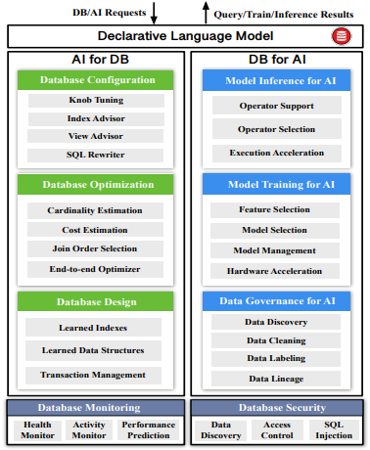

AI4DB and DB4AI
AI
DB
DB
AI
Source: Database Meets Artificial Intelligence: A Survey

Slide 4
DB vs. AI Techniques
AI Techniques
DB Techniques
Pros (Goals)
  Fast decision making
  High accuracy for unseen testing data
Cons
  Not very scalable to large data size
  No accuracy guarantee
Pros (Goals)
  Efficiency
  Scalability
  Accuracy (usually 100%)
Cons
  Not adaptable to unseen data
  Not efficient enough!!

Slide 5
Pros and Cons of AI4DB Techniques
Pros
  [AI] Fast estimation or decision making
  [AI] High accuracy, even for unseen data
  [DB] Time / space efficiency & scalability
Cons
  [AI] Requiring a lot of data with the groundtruth for offline training
  [AI] High accuracy is not always theoretically guaranteed
  [AI] Very costly for online re-training over dynamically changing data
  [AI + DB] Not adaptable to unseen data distributions

Slide 6
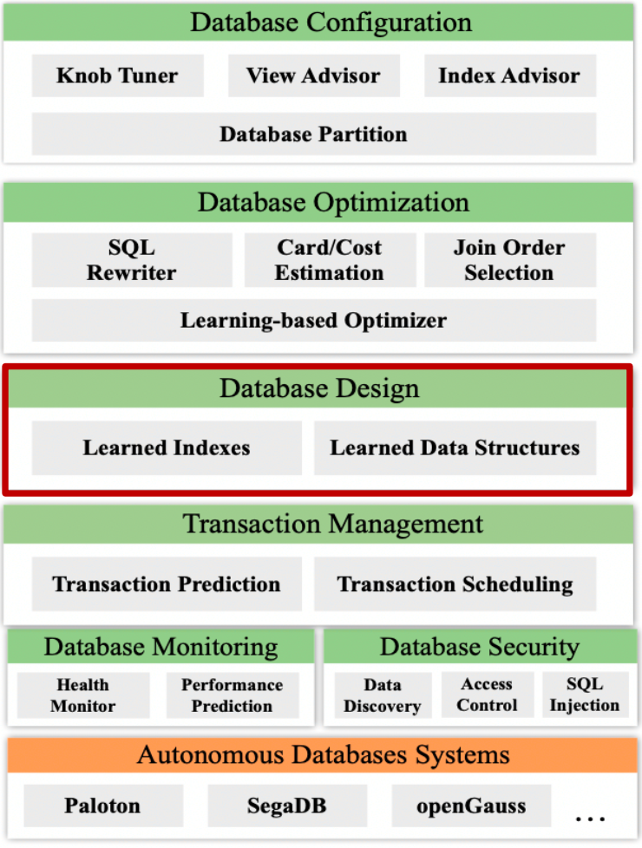
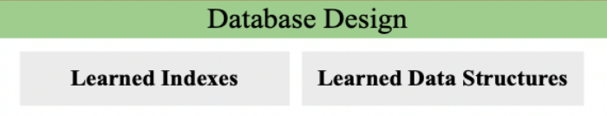
AI4DB Problems, Techniques, and Challenges
Guoliang Li, Xuanhe Zhou, Lei Cao: AI Meets Database: AI4DB and DB4AI. SIGMOD Conference 2021: 2859-2866
Xuanhe Zhou, Chengliang Chai, Guoliang Li, Ji Sun: Database Meets Artificial Intelligence: A Survey. IEEE Trans. Knowl. Data Eng. 34(3): 1096-1116 (2022)
Notes:
Guoliang Li, Xuanhe Zhou, Lei Cao:
AI Meets Database: AI4DB and DB4AI. SIGMOD Conference 2021: 2859-2866
Xuanhe Zhou, Chengliang Chai, Guoliang Li, Ji Sun: Database Meets Artificial Intelligence: A Survey. IEEE Trans. Knowl. Data Eng. 34(3): 1096-1116 (2022)

Slide 7



Motivation
Traditional database techniques have challenges:
  Various real-world applications
  Large-scale data
  Diversified workloads
It is challenging for traditional databases or humans (e.g., DBAs) to efficiently manage/query large-scale, dynamically changing data in various domains
Notes:
Guoliang Li, Xuanhe Zhou, Lei Cao:
AI Meets Database: AI4DB and DB4AI. SIGMOD Conference 2021: 2859-2866

Slide 8

Driving Factors for the Success of AI Techniques (1)
The availability of the training data
  More and more training data sets have been collected and labeled
  E.g., Sensors, mobile devices, crowdsourcing

Slide 9
Sources of Training Data
Sensors
  Temperature, humidity, density of oxygen, …
Mobile devices
  GPS trajectory data
  Images
  Audio
  Videos
Social networks
  Data sharing / composing

Slide 10


Sources of Training Data (cont'd)
Another data source – crowdsourcing
  Task Requesters post questions, called Human Intelligent Tasks (HITs)
  Human Workers answer questions (e.g., tag images) and obtain incentives (e.g., credits or cash)
Commercial crowdsourcing platform
  Amazon Mechanical Turk (AMT)
  https://www.mturk.com/

Slide 11
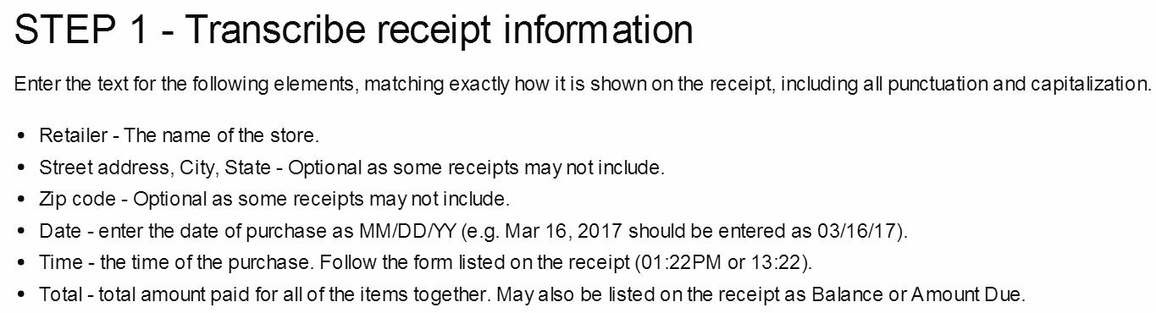
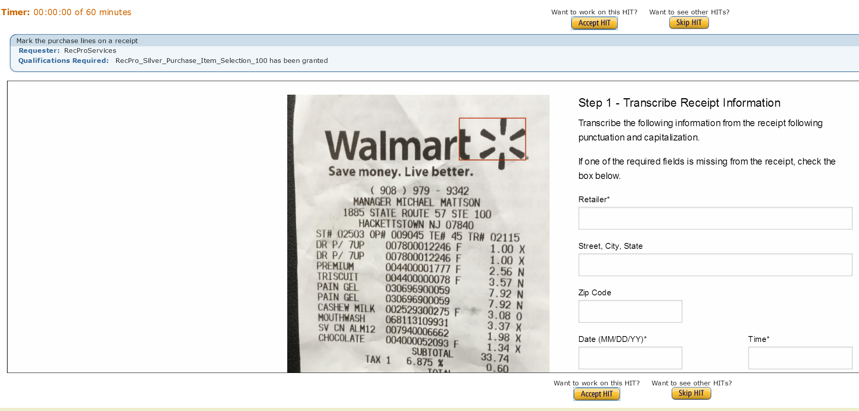
Examples of HITs (1)
Mark the purchase lines on a receipt

Slide 12
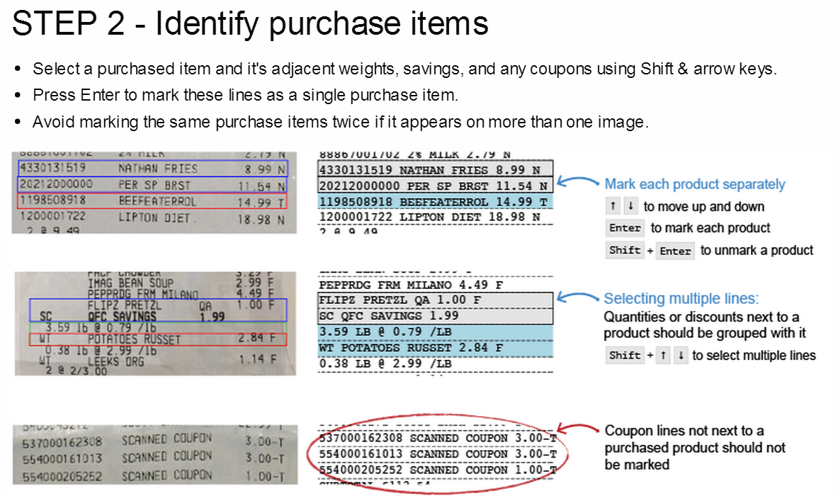
Examples of HITs (1) (cont'd)
Mark the purchase lines on a receipt

Slide 13


Examples of HITs (2)
Compare if two images contain the same person
  Computer algorithms are not able to accomplish this task accurately

Slide 14

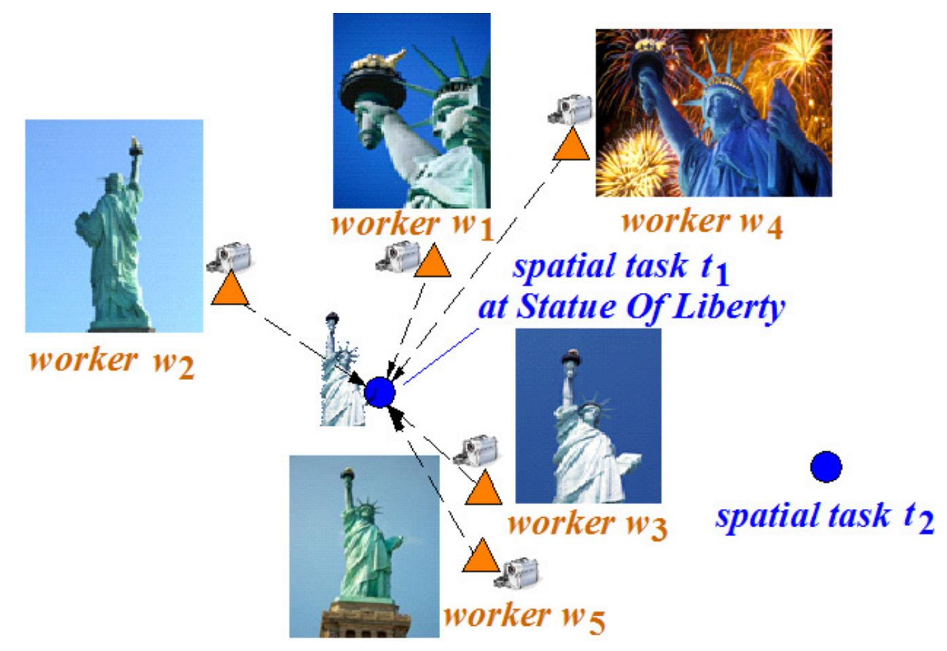
Spatial Crowdsourcing
Do tasks at spatial locations
  Waze
  Gigwalk
  TaskRabbit
  gMission
  …
(Picture provided by Hien To)
Notes:
Waze: https://www.waze.com/
Gigwalk: https://play.google.com/store/apps/details?id=com.gigwalk&hl=en
TaskRabbit: https://www.taskrabbit.com/
gMission: http://www.gmissionhkust.com
…

Slide 15
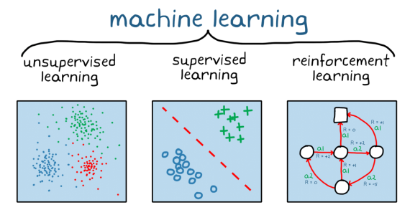
Driving Factors for the Success of AI Techniques (2)
AI Algorithms
  Deep learning

Slide 16
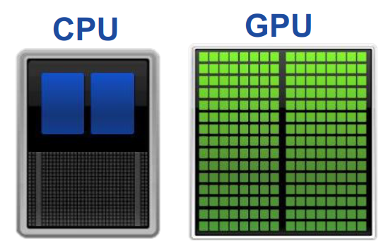

Driving Factors for the Success of AI Techniques (3)
Advances of new hardware
  Central Processing Unit (CPU)
  Graphical Processing Unit (GPU)
  Optical chips, or photonic integrated circuits (PICs)
  …

Slide 17
AI4DB Problems and Techniques
Notes:
Guoliang Li, Xuanhe Zhou, Lei Cao:
AI Meets Database: AI4DB and DB4AI. SIGMOD Conference 2021: 2859-2866
Xuanhe Zhou, Chengliang Chai, Guoliang Li, Ji Sun: Database Meets Artificial Intelligence: A Survey. IEEE Trans. Knowl. Data Eng. 34(3): 1096-1116 (2022)

Slide 18
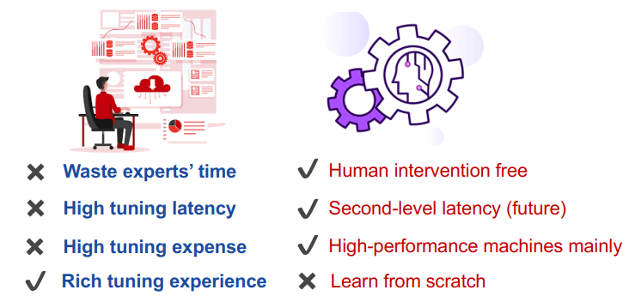
AI4DB Problems and Techniques (1)
Learned Database Configuration
  Automate database configurations
    E.g., DRL for knob tuning, binary classifier for index selection
Notes:
Guoliang Li, Xuanhe Zhou, Lei Cao:
AI Meets Database: AI4DB and DB4AI. SIGMOD Conference 2021: 2859-2866

Slide 19
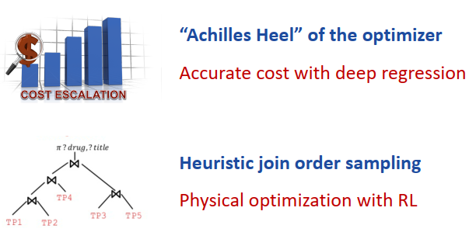
AI4DB Problems and Techniques (2)
Learned Query Optimization
  Utilize machine learning to address the hard optimization problems
    E.g., cardinality estimation, join order selection
Notes:
Guoliang Li, Xuanhe Zhou, Lei Cao:
AI Meets Database: AI4DB and DB4AI. SIGMOD Conference 2021: 2859-2866

Slide 20
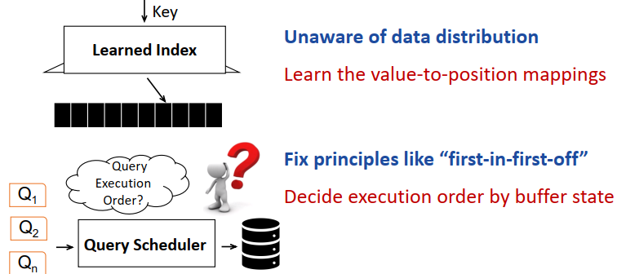
AI4DB Problems and Techniques (3)
Learned Database Design
  Utilize machine learning to design database modules
    E.g., indexes, KV storage, transaction management
Notes:
Guoliang Li, Xuanhe Zhou, Lei Cao:
AI Meets Database: AI4DB and DB4AI. SIGMOD Conference 2021: 2859-2866

Slide 21



AI4DB in Existing Database Systems
Oracle
  Automate some routine tasks
  Knob tuning, security, backups
openGauss
  Integrate AI in the whole lifecycle
  Database tuning, optimization, diagnosis
OtterTune
  Provide automatic tuning service
Notes:
Guoliang Li, Xuanhe Zhou, Lei Cao:
AI Meets Database: AI4DB and DB4AI. SIGMOD Conference 2021: 2859-2866

Slide 22

AI4DB Problems
Database Configuration
  Knob Tuner
  View Advisor
  Index Advisor
  Database Partition
Notes:
Guoliang Li, Xuanhe Zhou, Lei Cao:
AI Meets Database: AI4DB and DB4AI. SIGMOD Conference 2021: 2859-2866
Xuanhe Zhou, Chengliang Chai, Guoliang Li, Ji Sun: Database Meets Artificial Intelligence: A Survey. IEEE Trans. Knowl. Data Eng. 34(3): 1096-1116 (2022)

Slide 23
Learned Database Configuration – Knob Tuner
Automatic Knob Tuning
  The number of database knobs is huge and the relationships between knobs are complex
  Tunable knobs control nearly all aspects of database runtime operations
  DBA is usually good at a particular database and takes relatively long time
J. Lu, Y. Chen, H. Herodotou, and S. Babu. Speedup your analytics: Automatic parameter tuning for databases and big data systems. PVLDB, 12(12):1970–1973, 2019.
Notes:
Rule-based Approach
Cost Modeling Approach
Simulation-based Approach
Experiment-driven Approach
Machine Learning Approach
Adaptive Approach
1. Rule-based approaches assist users with tuning system parameters based on the experience of human experts, online tutorials, or tuning instructions. They usually require no models and are suitable for quickly bootstrapping the system.
2. Cost modeling approaches build efficient performance prediction models by using statistical cost functions via a deep understanding of system internals. No or few experimental logs are required to establish the model.
3. Simulation-based approaches build performance prediction models based on modular or complete system simulation, enabling users to simulate an execution under different parameter settings or cluster resources.
4. Experiment-driven approaches execute an application, i.e., an experiment, repeatedly with different parameter settings, guided by a search algorithm and the feedback provided by actual runs.
5. Machine learning approaches establish performance prediction models by employing machine learning methods. They typically consider the complex system as a whole and assume no knowledge of system internals.
6. Adaptive approaches tune configuration parameters adaptively while an application is running, meaning that they can adjust the parameter settings as the environment changes. They enable tuning of ad-hoc applications.

Slide 24
Existing Works on Automatic Parameter Tuning
Rule-based Approach
Cost Modeling Approach
Simulation-based Approach
Experiment-Driven Approach
Machine Learning Approach
Adaptive Approach
J. Lu, Y. Chen, H. Herodotou, and S. Babu. Speedup your analytics: Automatic parameter tuning for databases and big data systems. PVLDB, 12(12):1970–1973, 2019.
Notes:
1. Rule-based approaches assist users with tuning system parameters based on the experience of human experts, online tutorials, or tuning instructions. They usually require no models and are suitable for quickly bootstrapping the system.
2. Cost modeling approaches build efficient performance prediction models by using statistical cost functions via a deep understanding of system internals. No or few experimental logs are required to establish the model.
3. Simulation-based approaches build performance prediction models based on modular or complete system simulation, enabling users to simulate an execution under different parameter settings or cluster resources.
4. Experiment-driven approaches execute an application, i.e., an experiment, repeatedly with different parameter settings, guided by a search algorithm and the feedback provided by actual runs.
5. Machine learning approaches establish performance prediction models by employing machine learning methods. They typically consider the complex system as a whole and assume no knowledge of system internals.
6. Adaptive approaches tune configuration parameters adaptively while an application is running, meaning that they can adjust the parameter settings as the environment changes. They enable tuning of ad-hoc applications.

Slide 25
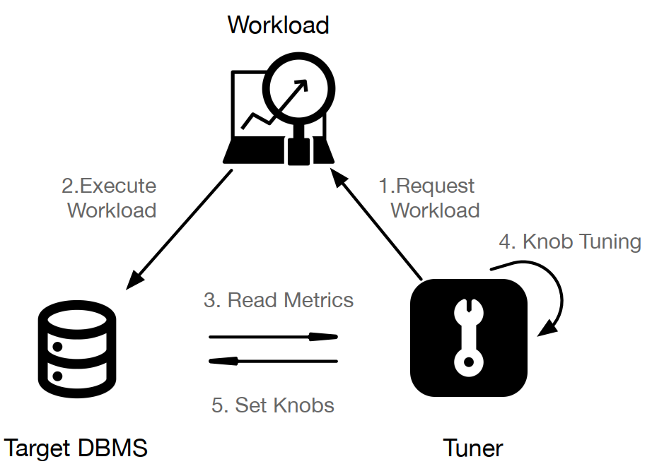
Workflow of Knob Tuning

Slide 26
Challenges of Database Knob Tuning
Tune hundreds of system knobs
  Correlated knobs
  Continuous knob values
  Different semantics
    Memory allocation, I/O control, logging
    E.g., Work_Mem, Max_Connections, Active_Statements
Improve the performance with history data
  Traditional methods cannot learn from previous knowledge
Generalize to different workloads
  Fine granularity tuning
  Unseen workloads?
Notes:
Guoliang Li, Xuanhe Zhou, Lei Cao:
AI Meets Database: AI4DB and DB4AI. SIGMOD Conference 2021: 2859-2866

Slide 27
Classification of Database Knob Tuning
Search-based tuning
Traditional ML-based tuning
Reinforcement learning based tuning
Deep learning based tuning
Notes:
Guoliang Li, Xuanhe Zhou, Lei Cao:
AI Meets Database: AI4DB and DB4AI. SIGMOD Conference 2021: 2859-2866
Xuanhe Zhou, Chengliang Chai, Guoliang Li, Ji Sun: Database Meets Artificial Intelligence: A Survey. IEEE Trans. Knowl. Data Eng. 34(3): 1096-1116 (2022)

Slide 28
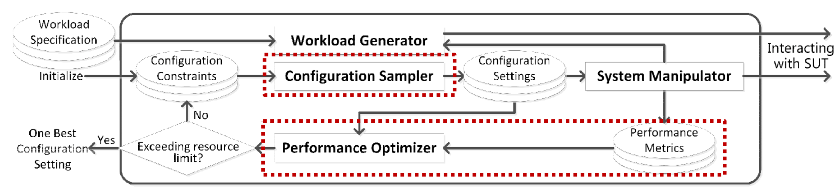
Search-based Tuning
Iteratively select local-optimal knobs with sampling & searching methods
  Sample Phase: Divide the knob space into subspaces and replace each subspace with a sampled knob setting
  Search Phase: Select the best sampled knob setting and build search space around the best setting
Y. Zhu, J. Liu, M. Guo, Y. Bao, W. Ma, Z. Liu, K. Song, and Y. Yang. Bestconfig: Tapping the performance potential of systems via automatic configuration tuning. CoRR, abs/1710.03439, 2017.
Notes:
Y. Zhu, J. Liu, M. Guo, Y. Bao, W. Ma, Z. Liu, K. Song, and Y. Yang. Bestconfig: Tapping the performance potential of systems via automatic configuration tuning. CoRR, abs/1710.03439, 2017.

Slide 29
Limitations of Search-based Tuning
It is heuristic and the knob space is too large to find optimal settings within limited time
It takes relatively long time to find high-quality settings by searching through the knob space
Notes:
Y. Zhu, J. Liu, M. Guo, Y. Bao, W. Ma, Z. Liu, K. Song, and Y. Yang. Bestconfig: Tapping the performance potential of systems via automatic configuration tuning. CoRR, abs/1710.03439, 2017.

Slide 30
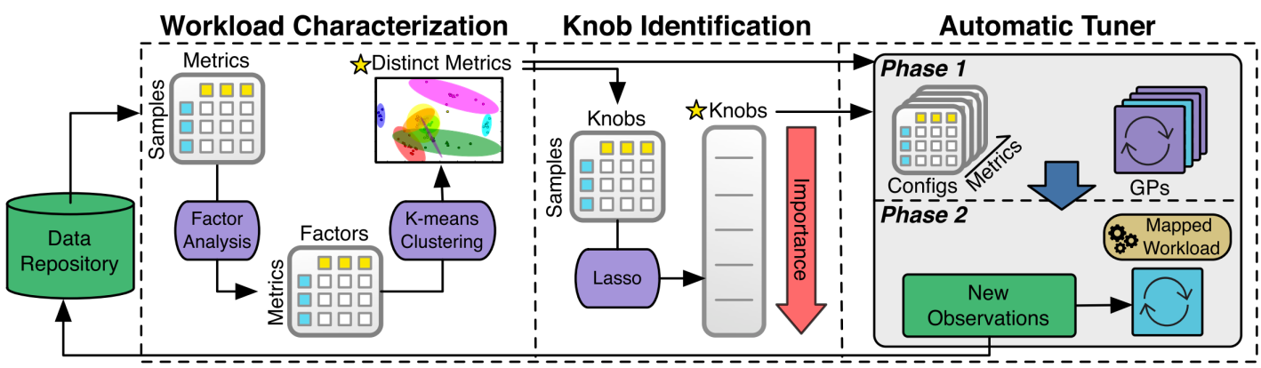
Traditional ML-based Tuning
Automatically tune knobs with numerous training data
  Characterize workload with system metrics
  Filter impactful metrics (Factor Analysis, Clustering) and knobs (Lasso)
  Tune knob settings with Gaussian Process Regression
Dana Van Aken, Andrew Pavlo, et al. Automatic Database Management System Tuning Through Large-scale Machine Learning. In SIGMOD, 2017.
Notes:
Gaussian Process Regression Gaussian Process Regression (GPR) is a non-parametric, kernel-based probabilistic model that provides predictions and uncertainty quantification for regression tasks
Lasso Lasso (Least Absolute Shrinkage and Selection Operator) regression is a penalized regression method that performs both feature selection and coefficient shrinkage, reducing the number of variables in a model by setting some of their coefficients to exactly zero.

Slide 31
Limitations of Traditional ML-based Tuning
It is based on a pipeline architecture where the optimal solution obtained in the current stage may not be global optimum
It requires a large number of high-quality prepared training samples, which is generally hard to obtain

Slide 32
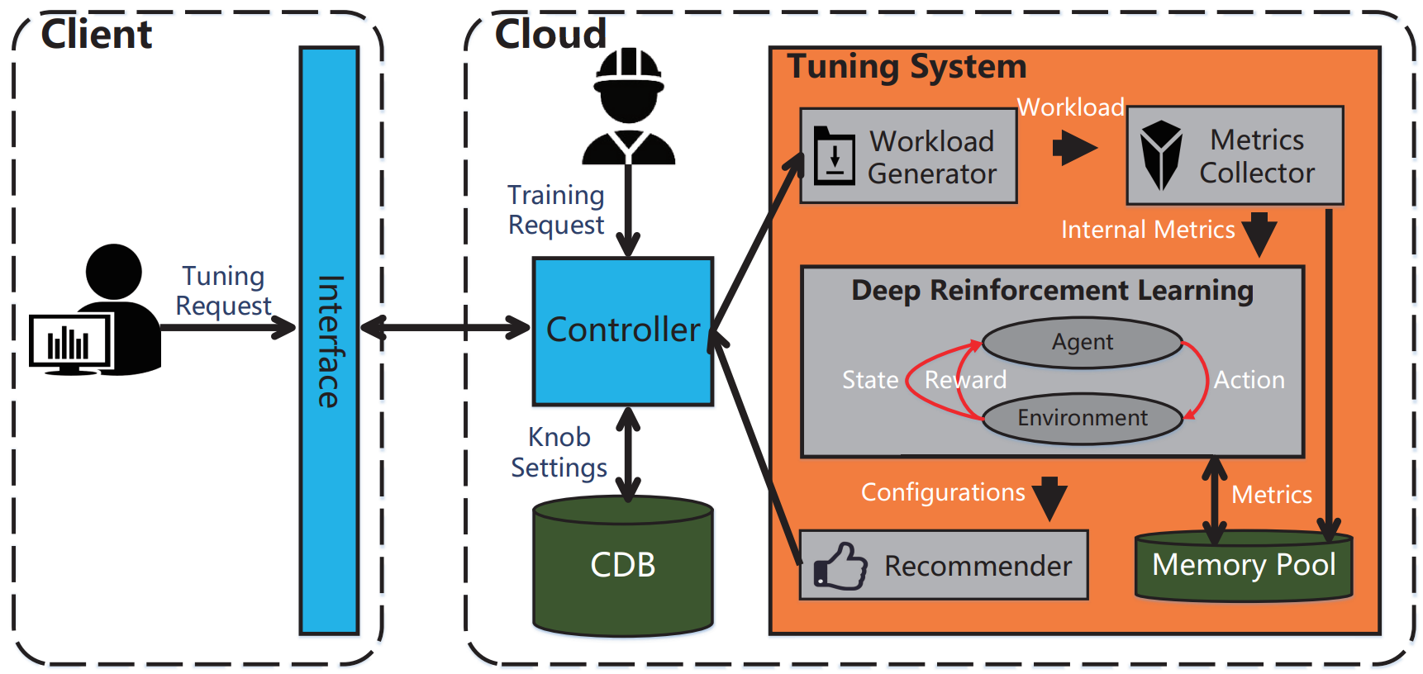
Reinforcement Learning based Tuning
Traditional ML requires numerous training data, and filters out potentially vital knobs
RL-based Tuning System Architecture
Ji Zhang, Yu Liu, Ke Zhou, Guoliang Li et al. An End-to-End Automatic Cloud Database Tuning System Using Deep Reinforcement Learning. SIGMOD 2019.
Notes:
Ji Zhang, Yu Liu, Ke Zhou, Guoliang Li et al. An End-to-End Automatic Cloud Database Tuning System Using Deep Reinforcement Learning. SIGMOD 2019.

Slide 33
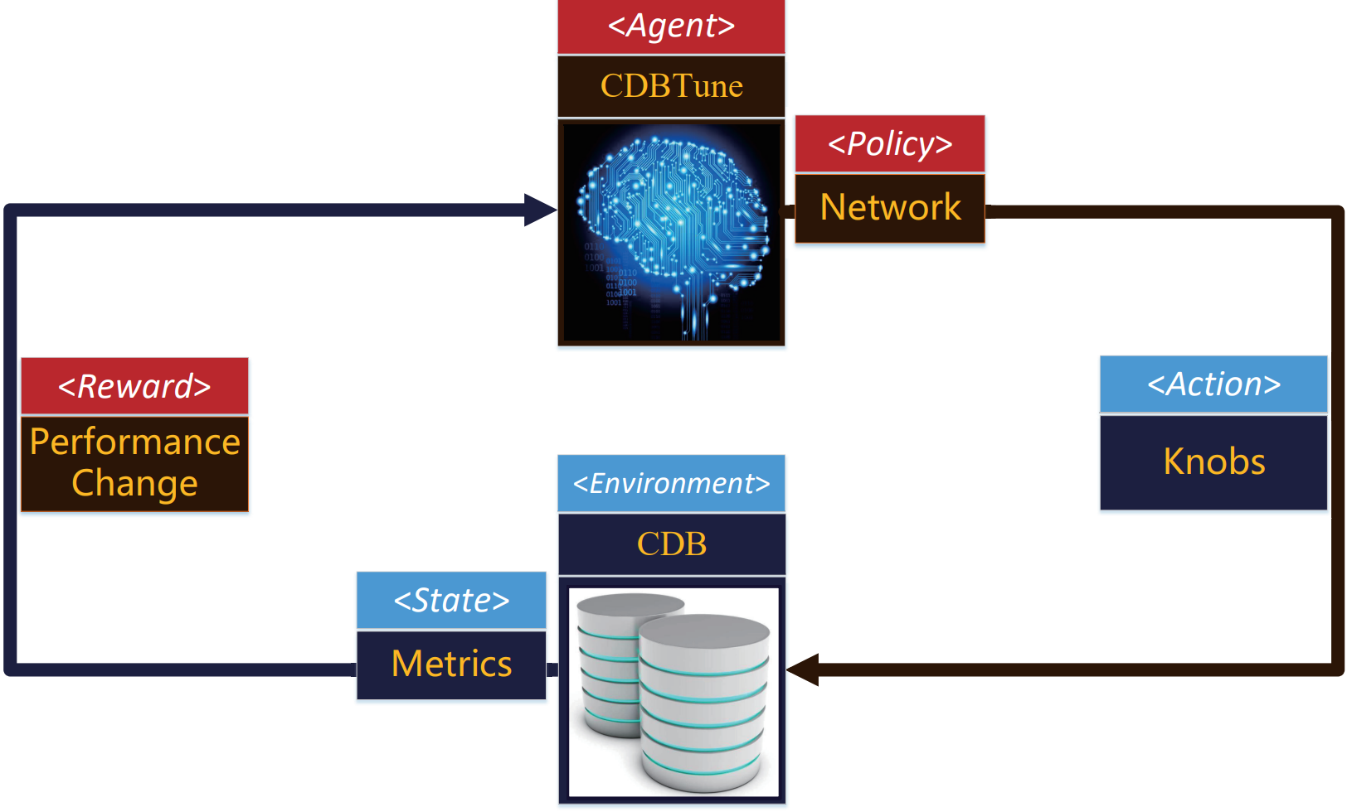
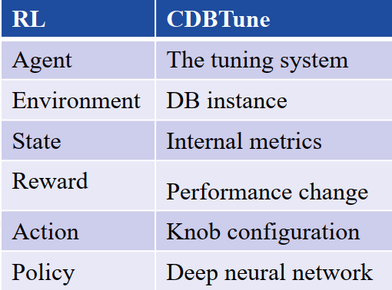
Reinforcement Learning based Tuning
Reinforcement Learning (RL) based Tuning Framework
  Learn with limited samples
Similar to Try-and-Error Method by DBAs
Notes:
Ji Zhang, Yu Liu, Ke Zhou, Guoliang Li et al. An End-to-End Automatic Cloud Database Tuning System Using Deep Reinforcement Learning. SIGMOD 2019.

Slide 34


RL Approaches Used for Knob Tuning
Value-based approaches
  Q-Learning model
    Q-table
  Deep Q-Network (DQN) model
    Replacing the Q-table with a neural network
Policy-based approaches
  Deep Deterministic Policy Gradient (DDPG)
Notes:
Ji Zhang, Yu Liu, Ke Zhou, Guoliang Li et al. An End-to-End Automatic Cloud Database Tuning System Using Deep Reinforcement Learning. SIGMOD 2019.

Slide 35
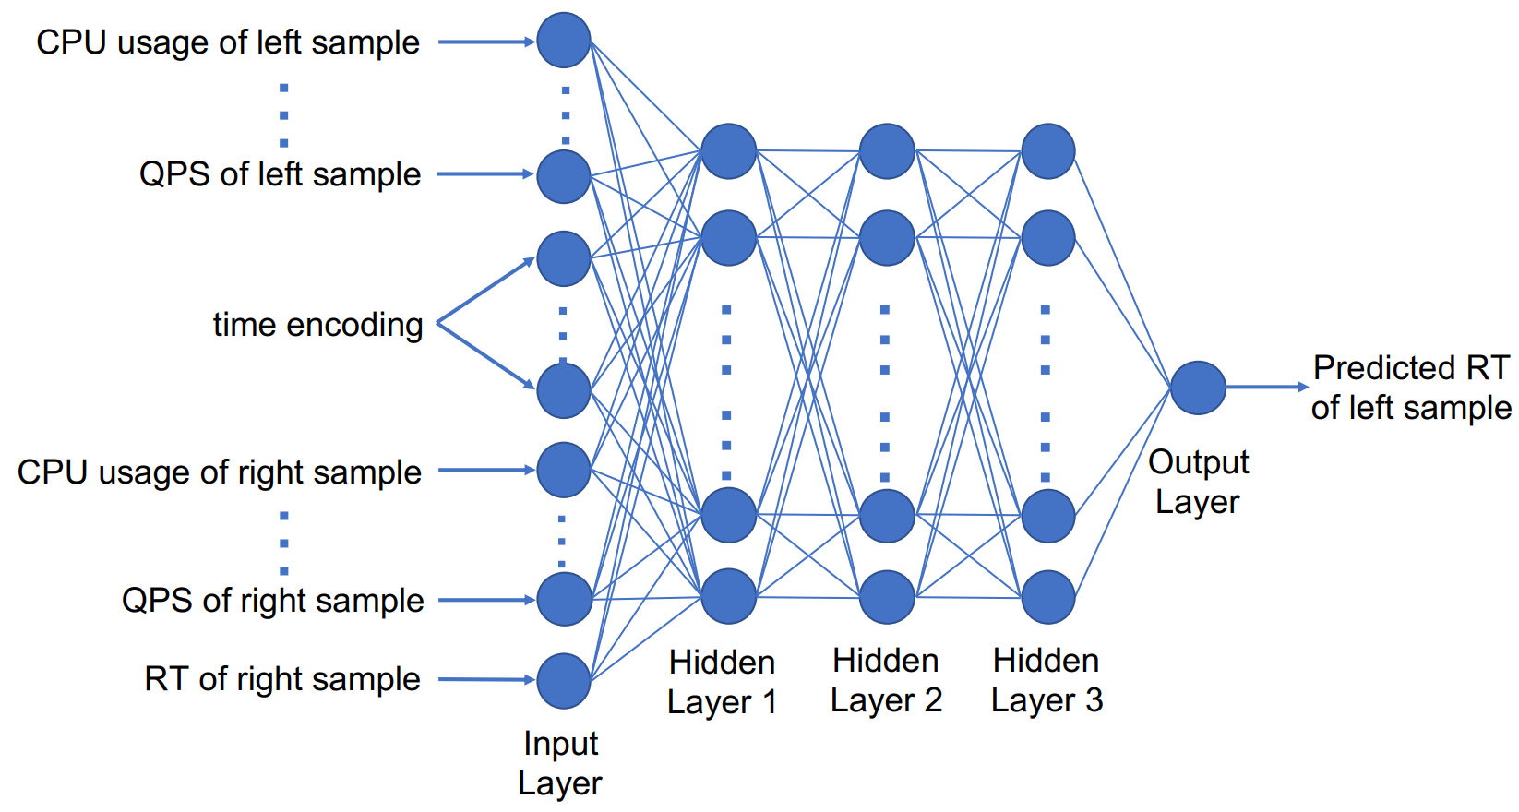
Deep Learning Based Tuning
DL for tuning buffer pool size
  Pairwise deep neural network predicts the response time (RT) change for different buffer sizes
J. Tan, T. Zhang, F. Li, et al. iBTune: Individualized Buffer Tuning for Large-Scale Cloud Databases. VLDB 2019.
Notes:
J. Tan, T. Zhang, F. Li, et al. iBTune: Individualized Buffer Tuning for Large-Scale Cloud Databases. VLDB 2019.

Slide 36
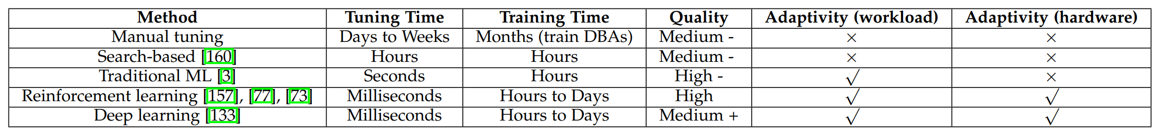
The Performance of Database Knob Tuning Methods
Summary
Guoliang Li, Xuanhe Zhou, Lei Cao: AI Meets Database: AI4DB and DB4AI. SIGMOD Conference 2021: 2859-2866
Xuanhe Zhou, Chengliang Chai, Guoliang Li, Ji Sun: Database Meets Artificial Intelligence: A Survey. IEEE Trans. Knowl. Data Eng. 34(3): 1096-1116 (2022)

Slide 37
Take-Aways of Knob Tuning
Learning based methods can find better knobs than search based methods with the increase of knobs
Learning based methods take long training time, e.g., hours to days, from scratch. However, it only takes minutes to tune the database after well trained.
Learning based methods may recommend bad settings when migrated to a new workload
Simple regression methods can quickly converge if selecting a small number of knobs
It is vital to combine the understanding of the underlying database and its applications (empirical knowledge)
Open problems:
  Predict workload execution performance for knob tuning
  One tuning model fits all the databases
  More explainable tuning mode
Notes:
Guoliang Li, Xuanhe Zhou, Lei Cao: AI Meets Database: AI4DB and DB4AI. SIGMOD Conference 2021: 2859-2866
Xuanhe Zhou, Chengliang Chai, Guoliang Li, Ji Sun: Database Meets Artificial Intelligence: A Survey. IEEE Trans. Knowl. Data Eng. 34(3): 1096-1116 (2022)

Slide 38
AI4DB Problems
Database Configuration
  Knob Tuner
  View Advisor
  Index Advisor
  Database Partition
Notes:
Guoliang Li, Xuanhe Zhou, Lei Cao:
AI Meets Database: AI4DB and DB4AI. SIGMOD Conference 2021: 2859-2866
Xuanhe Zhou, Chengliang Chai, Guoliang Li, Ji Sun: Database Meets Artificial Intelligence: A Survey. IEEE Trans. Knowl. Data Eng. 34(3): 1096-1116 (2022)

Slide 39
Learned Database Configuration – View Advisor
Materialized Views (MVs) can optimize queries
  Multiple queries may share common subqueries
  MVs offline materialize results of common subqueries
MVs trade the space for efficiency
  Materialize hot data within the space limit
However, the number of MVs can be exponential!
  It is important to select the best MVs with good utility and under the space constraint
  AI-based view advisor

Slide 40
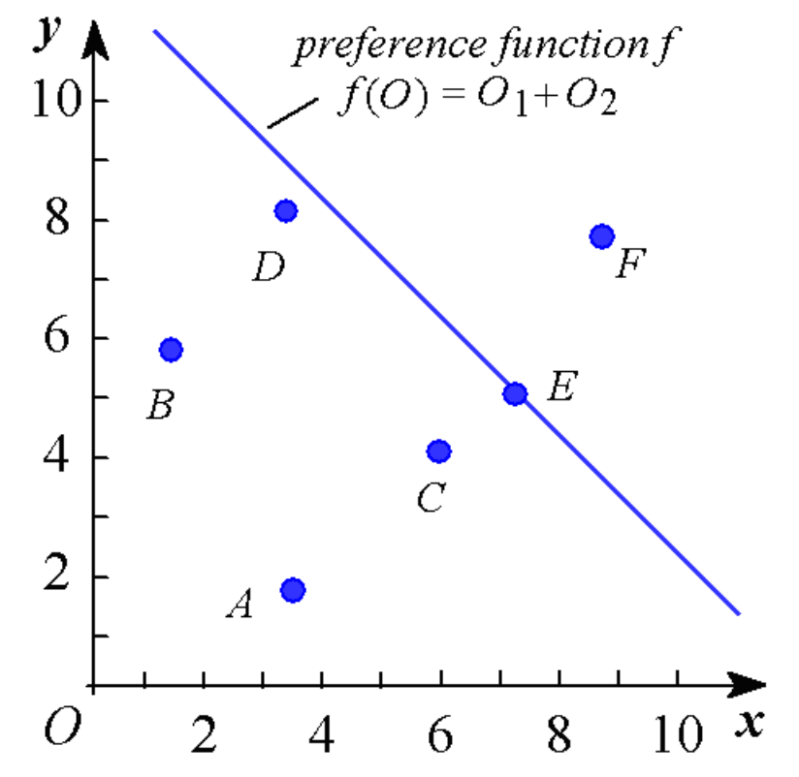
Example: Materialized View for Top-k Queries
Given a spatial database D, a ranking function (or preference function) f(o), and an integer parameter k, a top-k query retrieves k objects, o, from the database D such that they have the highest ranking score f(o) among all objects in D
Notes:
Formally, given a spatial database, a ranking function f(), and a parameter k, a top-k query returns k objects from the database, with the highest ranking scores f(o).

Slide 41
PREFER: A View-Based Approach
Pre-define some preference functions f_{v}(.)
Create a materialized view of objects in non-descending order w.r.t. each preference function f_{v}(.)
Given a query ranking function f(.)
  We select one of the pre-computed views, with respect to a preference function f_{v}(·) that is the most similar to f(·)
  Sequentially scan only a portion of this materialized view (w.r.t. f_{v}(·)), stopping at the watermark point
V. Hristidis, N. Koudas, and Y. Papakonstantinou. PREFER: A system for the efficient execution of multi-parametric ranked queries. In SIGMOD, 2001.
Notes:
PREFER is a view-based method, which predefines some preference (or ranking) functions, and creates a materialized view of sorted objects for each preference function.
For any query ranking function, we can first find one pre-defined preference function that is most similar to the query preference function, and then use its corresponding materialized view of sorted objects to find top-k answers. Intuitively, if a pre-defined preference function is very similar to the query preference function, then we only need to access a very small portion of the materialized view, based on the pre-defined preference function.

Slide 42
Example of PREFER
f(o)
f₁(o)
f₂(o)
V. Hristidis, N. Koudas, and Y. Papakonstantinou. PREFER: A system for the efficient execution of multi-parametric ranked queries. In SIGMOD, 2001.
Notes:
As an example in the figure, PREFER offline pre-computes the ranking of objects with respect to two preference functions, f_1() and f_2(). Then, for any given online query preference function f(), we first find one pre-computed ranking function that is the most similar to function f(). In this example, f_1() is more similar to f(). Next, we will access the offline sorted objects in descending order of f_1(), and obtain top-k objects o with the highest score f(o).

Slide 43
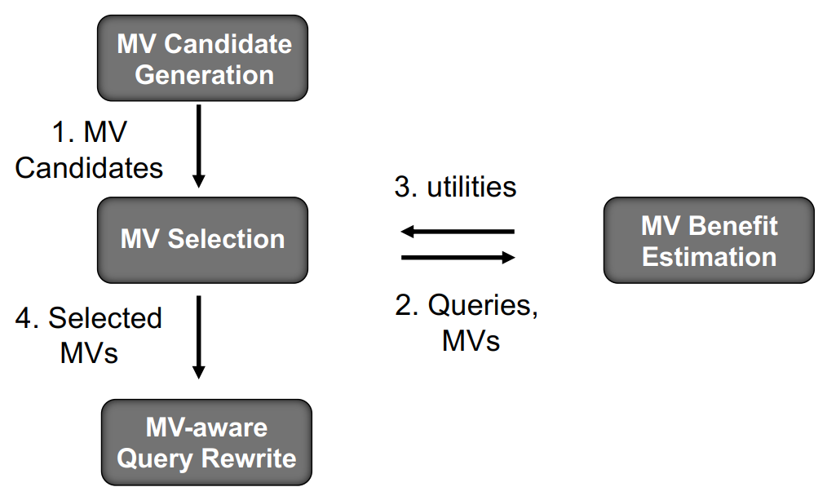
The Workflow of View Advisor
Given a set of queries, generate a collection of high quality views to optimize the future queries → NP-hard

Slide 44
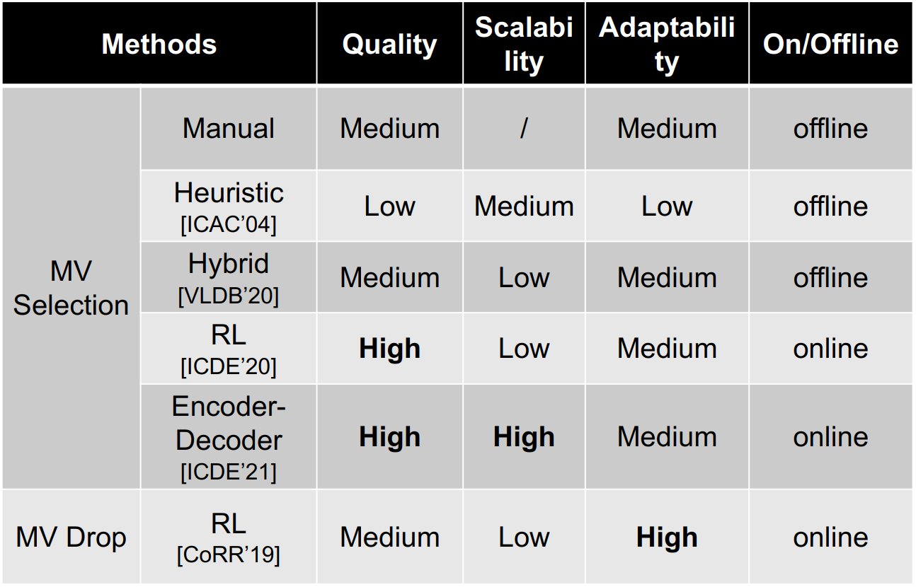
Classification of MV Advisors

Slide 45
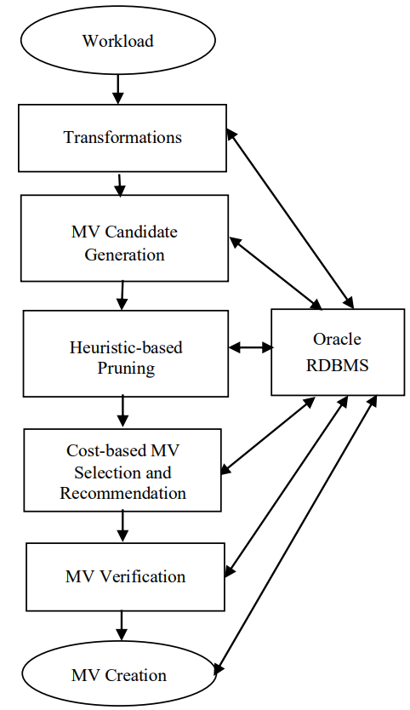
Hybrid MV Selection
Greedily select MVs and predict trends with ML
  ① Generate candidate MVs that balance between conflict queries
  ② Enumerate queries, MVs, and estimate the queries costs with/without the created MVs
  ③ Verify the performance of selected MVs
MV Refresh (Auto-MV Maintenance): Predict MV usage with a neural network
Ahmed, R., Bello, R., Witkowski, A. Kumar. Automated generation of materialized views in Oracle. VLDB 2020.

Slide 46
Reinforcement Learning for View Advisor
Use RL to select and maintain MVs for relational database
  Extract subqueries from the workload
    Consider nonequivalent subplans starting with aggregate / join / project
  Recommend MVs with RL
    Apply Q-learning to select MVs with maximum utility
    Use a Wide-Deep model to predict the utility
  Train the RL models offline
    Utility Model – Features: query plan, view plan, related tables; Label: utility
    Selection Model – Features: query, view; Label: cost of the rewritten query
H. Yuan, G. Li, L. Feng, and et al. Automatic view generation with deep learning and reinforcement learning. In ICDE, 2020.

Slide 47
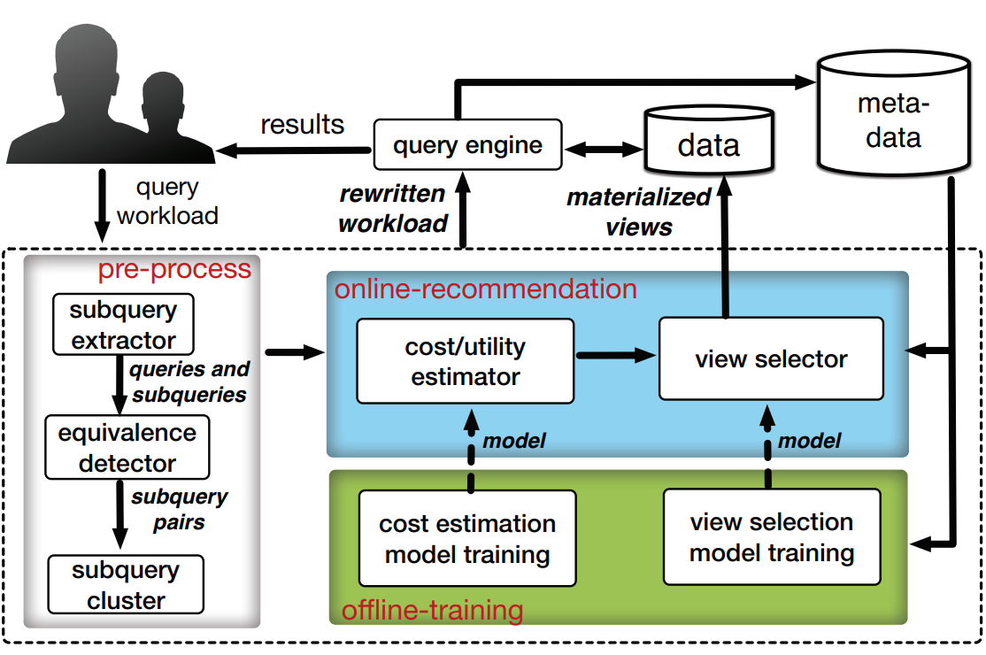
Reinforcement Learning for View Advisor (cont'd)
H. Yuan, G. Li, L. Feng, and et al. Automatic view generation with deep learning and reinforcement learning. In ICDE, 2020.

Slide 48
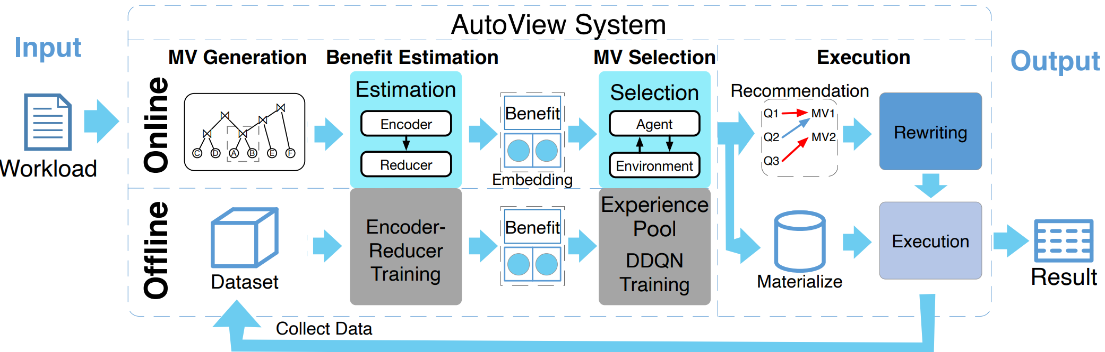
Encoder-Decoder for View Advisor
To support dynamic workloads with variable state length
Y. Han, G. Li, H. Yuan, and J. Sun. An autonomous materialized view management system with deep reinforcement learning. In ICDE, 2021.

Slide 49
Take-Aways of View Advisor
Learned MV utility estimation is more accurate than traditional empirical methods
Learned MV utility estimation is also accurate for multiple MV optimization
Learned MV selection is more robust than heuristics
Learned MV selection works well in online service, but takes much time for model training (cold start)
Query encoding model needs to be trained periodically for data update
Open problems
  MV benefit prediction for future workload
  Cost of MV initialization and future updates
  Support MV updates/drops
  …
Notes:
Guoliang Li, Xuanhe Zhou, Lei Cao: AI Meets Database: AI4DB and DB4AI. SIGMOD Conference 2021: 2859-2866
Xuanhe Zhou, Chengliang Chai, Guoliang Li, Ji Sun: Database Meets Artificial Intelligence: A Survey. IEEE Trans. Knowl. Data Eng. 34(3): 1096-1116 (2022)

Slide 50
AI4DB Problems
Database Configuration
  Knob Tuner
  View Advisor
  Index Advisor
  Database Partition
Notes:
Guoliang Li, Xuanhe Zhou, Lei Cao:
AI Meets Database: AI4DB and DB4AI. SIGMOD Conference 2021: 2859-2866
Xuanhe Zhou, Chengliang Chai, Guoliang Li, Ji Sun: Database Meets Artificial Intelligence: A Survey. IEEE Trans. Knowl. Data Eng. 34(3): 1096-1116 (2022)

Slide 51
Learned Database Configuration – Index Advisor
Indexes are essential for efficient execution
Select from numerous indexable columns
  Columns have different access frequencies, data distribution
Redundant indexes may cause negative effects
  Extra space cost for redundant indexes
  Increase maintenance costs for update/delete operations
Notes:
Guoliang Li, Xuanhe Zhou, Lei Cao:
AI Meets Database: AI4DB and DB4AI. SIGMOD Conference 2021: 2859-2866
Xuanhe Zhou, Chengliang Chai, Guoliang Li, Ji Sun: Database Meets Artificial Intelligence: A Survey. IEEE Trans. Knowl. Data Eng. 34(3): 1096-1116 (2022)

Slide 52
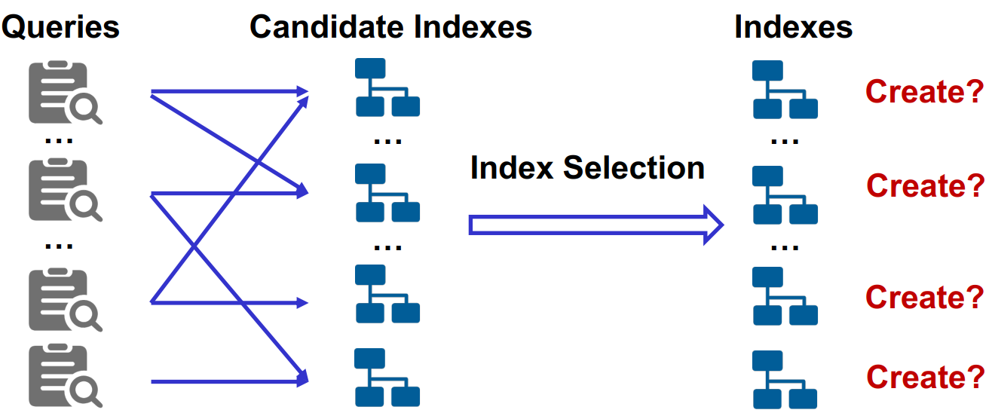
Learned Database Configuration – Index Advisor (cont'd)
Given a workload and constraints (e.g., disk limit), find an index set, such that the performance is optimal with the constraint
Guoliang Li, Xuanhe Zhou, Lei Cao. Machine Learning for Databases (Tutorial). In VLDB, 2021.
Notes:
Guoliang Li, Xuanhe Zhou, Lei Cao. Machine Learning for Databases (Tutorial). In VLDB, 2021.

Slide 53
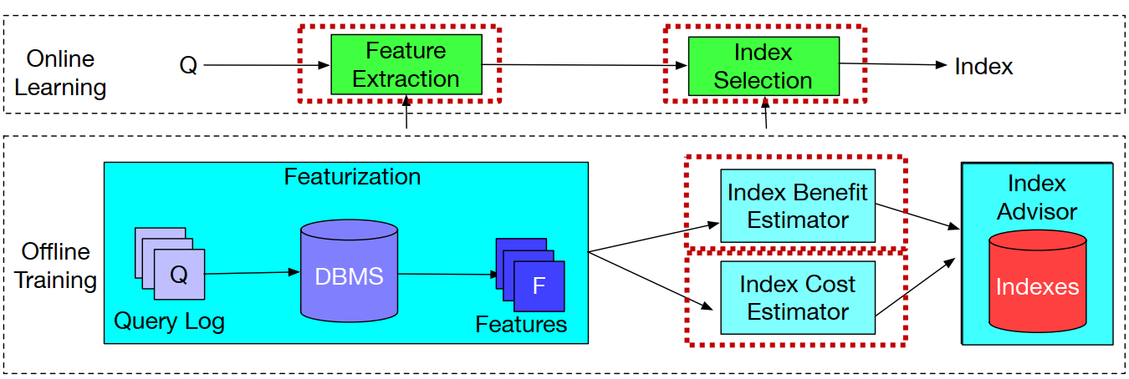
Workflow of the Index Advisor
Given a set of queries, generate a collection of indexes to optimize the queries → NP-hard

Slide 54
Challenges of the Index Advisor
The index benefit is hard to evaluate
  Multiple evaluation metrics (e.g., index benefit, space cost)
  Cost estimation by the optimizer is inaccurate
Interactions between existing indexes
  Multiple column access, data refresh
The set of possible index combinations is huge
  Increase with the number of indexable attributes
  Increase with the number of columns per index

Slide 55
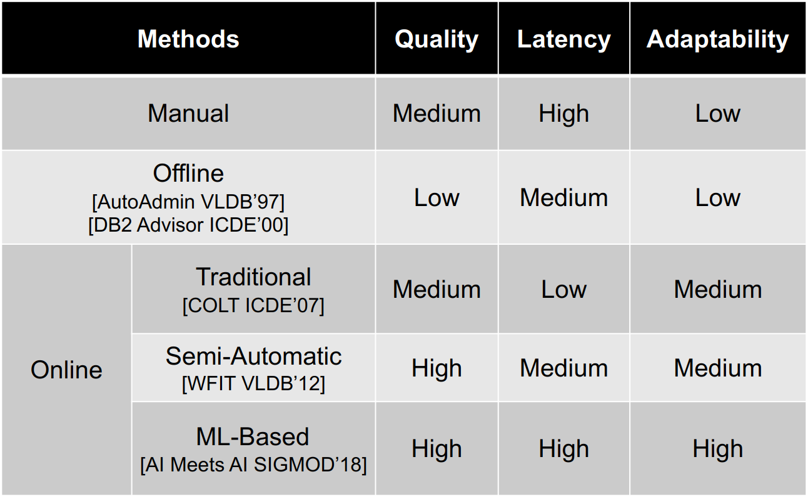
Classification of Index Advisors

Slide 56
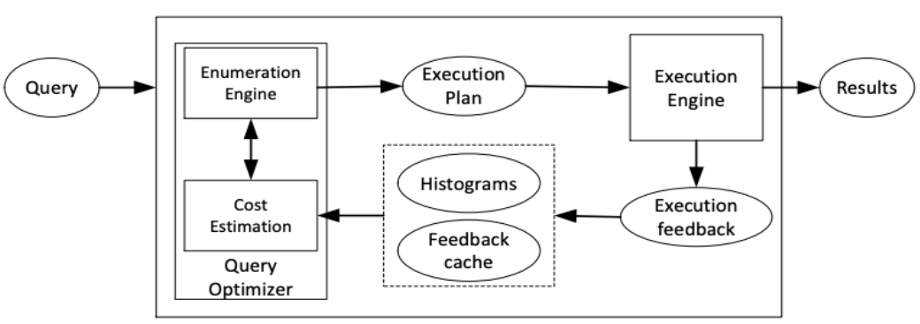
Offline Index Advisor (AutoAdmin)
Select index scheme for each query and extend to queries in the workload
  For each query, extract indexable columns
  Enumerate column combinations with highest benefit (an index scheme)
  For the workload, rank top-k schemes, and greedily add indexes until arriving limited disk space
S. Chaudhuri and V. R. Narasayya. An efficient cost-driven index selection tool for microsoft SQL server. In VLDB 1997.

Slide 57
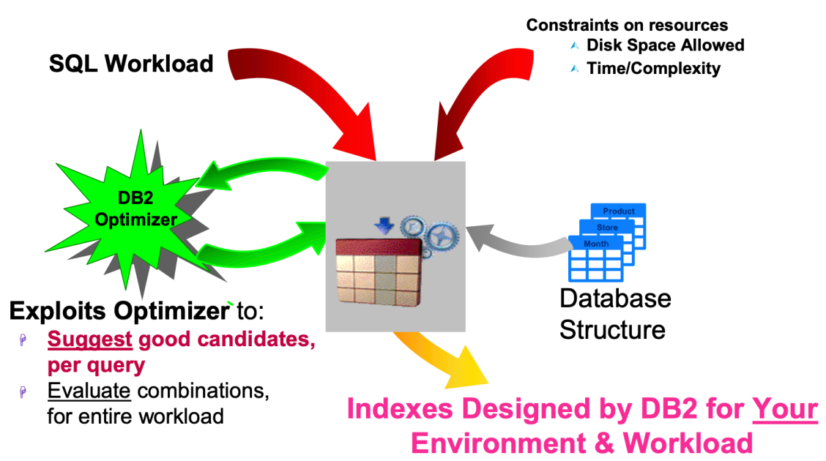
Offline Index Advisor (Dynamic Programming)
Model the index selection as a knapsack problem
  Candidate index scheme as item
  Index size as item weight
  Benefit of the item as value
Use DP to select the highest-benefit indexes
NP-complete
G. Valentin, M. Zuliani, D. C. Zilio, G. M. Lohman, and A. Skelley. DB2 advisor: An optimizer smart enough to recommend its own indexes. In ICDE 2000.
Notes:
https://en.wikipedia.org/wiki/Knapsack_problem
The knapsack problem is the following problem in combinatorial optimization:
Given a set of items, each with a weight and a value, determine which items to include in the collection so that the total weight is less than or equal to a given limit and the total value is as large as possible.

Slide 58
Online Index Advisor (what-if index)
Divide a workload into epochs of queries
Profile candidate indexes for each new query
  Index Benefit: average latency reduction for the queries within the same epoch (time-series)
  Estimate the index benefit through a what-if call
  Update the index set and statistics
Create indexes with highest index benefit at the end of each epoch
K. Schnaitter, S. Abiteboul, T. Milo and N. Polyzotis. On-Line Index Selection for Shifting Workloads. In ICDE 2007.

Slide 59
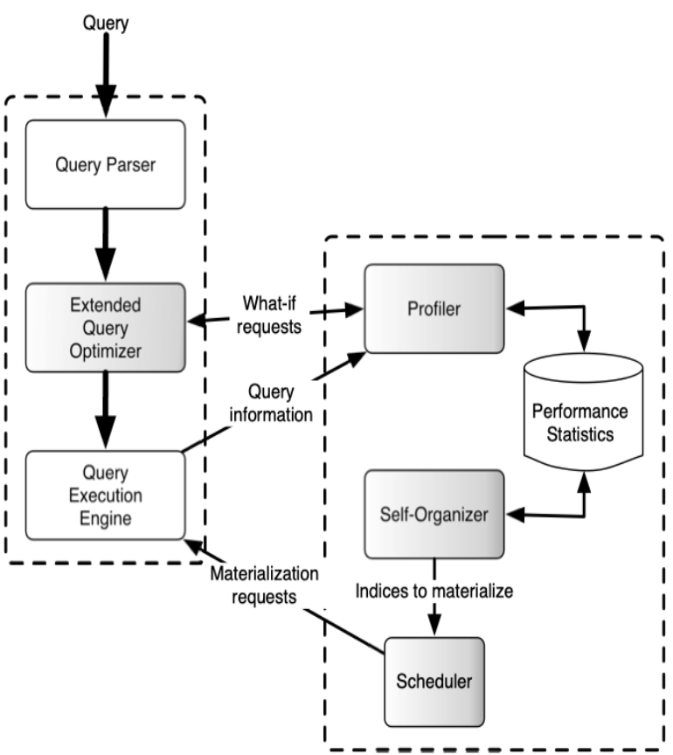
Online Index Advisor (what-if index) (cont'd)
K. Schnaitter, S. Abiteboul, T. Milo and N. Polyzotis. On-Line Index Selection for Shifting Workloads. In ICDE 2007.

Slide 60
Online Index Advisor (Semi-Automated)
Enumerate candidate indexes under the supervision of DBAs
  Candidate Generation
    Generate and partition indexes relevant to the workload
  Human Feedback
    DBA submits positive / negative votes for the selected index
  Candidate Update
    Eliminate unnecessary indexes from the schemes
K. Schnaitter and N. Polyzotis. Semi-automatic index tuning: Keeping dbas in the loop.
PVLDB, 5(5):478–489, 2012.

Slide 61
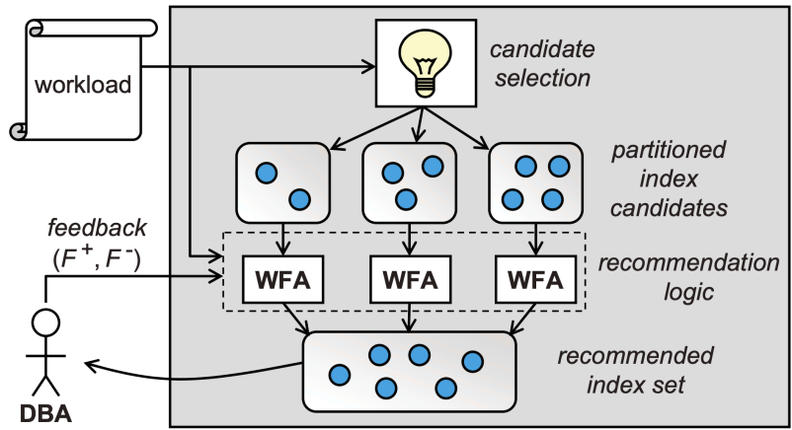
Online Index Advisor (Semi-Automated) (cont'd)
K. Schnaitter and N. Polyzotis. Semi-automatic index tuning: Keeping dbas in the loop.
PVLDB, 5(5):478–489, 2012.

Slide 62
Online Index Advisor (Deep Regression)
It is critical to compare execution costs of plans and decide index benefits
  Training Data: Workloads and execution feedback from customers
  Evaluation Model: Predict the index performance
  Use the evaluation model to create indexes with performance gains
Use a classification task in ML to compare two plans!
Bailu Ding, Sudipto Das, et al. AI meets ai: leveraging query executions to improve index recommendations. In SIGMOD, 2019.

Slide 63
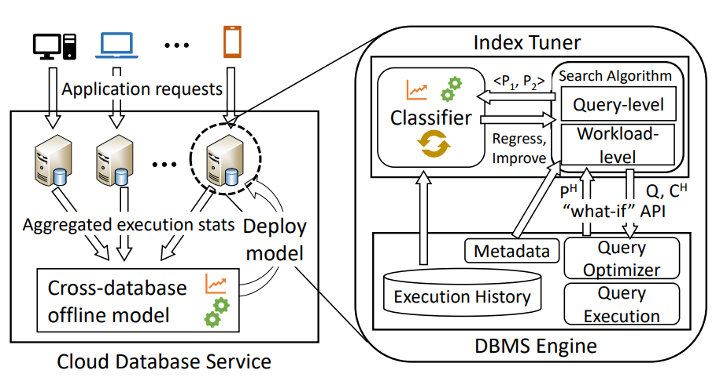
Online Index Advisor (Deep Regression) (cont'd)
Bailu Ding, Sudipto Das, et al. AI meets ai: leveraging query executions to improve index recommendations. In SIGMOD, 2019.

Slide 64
Take-Aways of Index Advisor
Learned methods mainly outperform traditional methods in index benefit estimation
Search based index selection efficiently works in query level, but ignores effects in workload level
Traditional index selection cannot adaptively balance between index benefit and maintain/storage cost
No promising learned index selection model
Open problems
  Online advisor
    Online learning/selection/update
  Index update
  Adaptability
    Other DBs

Slide 65
AI4DB Problems
Database Configuration
  Knob Tuner
  View Advisor
  Index Advisor
  Database Partition
Notes:
Guoliang Li, Xuanhe Zhou, Lei Cao:
AI Meets Database: AI4DB and DB4AI. SIGMOD Conference 2021: 2859-2866
Xuanhe Zhou, Chengliang Chai, Guoliang Li, Ji Sun: Database Meets Artificial Intelligence: A Survey. IEEE Trans. Knowl. Data Eng. 34(3): 1096-1116 (2022)

Slide 66
Learned Database Configuration – Database Partitioning
A vital component in distributed database
  Place partitions on different nodes to speedup queries
  Trade-off between data balance & access frequency
Database partitioning problem is NP-hard
  Combinatorial problem: 61 tpch columns, 145 query relations, 2.3 x 10¹⁸ candidate combinations
Existing partitioning functions is non-ideal
  Hash/Round Robin access multiple nodes for small transactions
  Range partition requires careful manual design

Slide 67
Challenges of Database Partitioning
Numerous candidate partitions to choose from
  Column combinations for relational database
The partitioning performance is hard to estimate
  Balance between data & workload distributions
  Actual partitioning is costly
Partitioning functions suit different scenarios
  Hash partitioning balances the data distribution, but only enhance single-point queries, not range queries

Slide 68
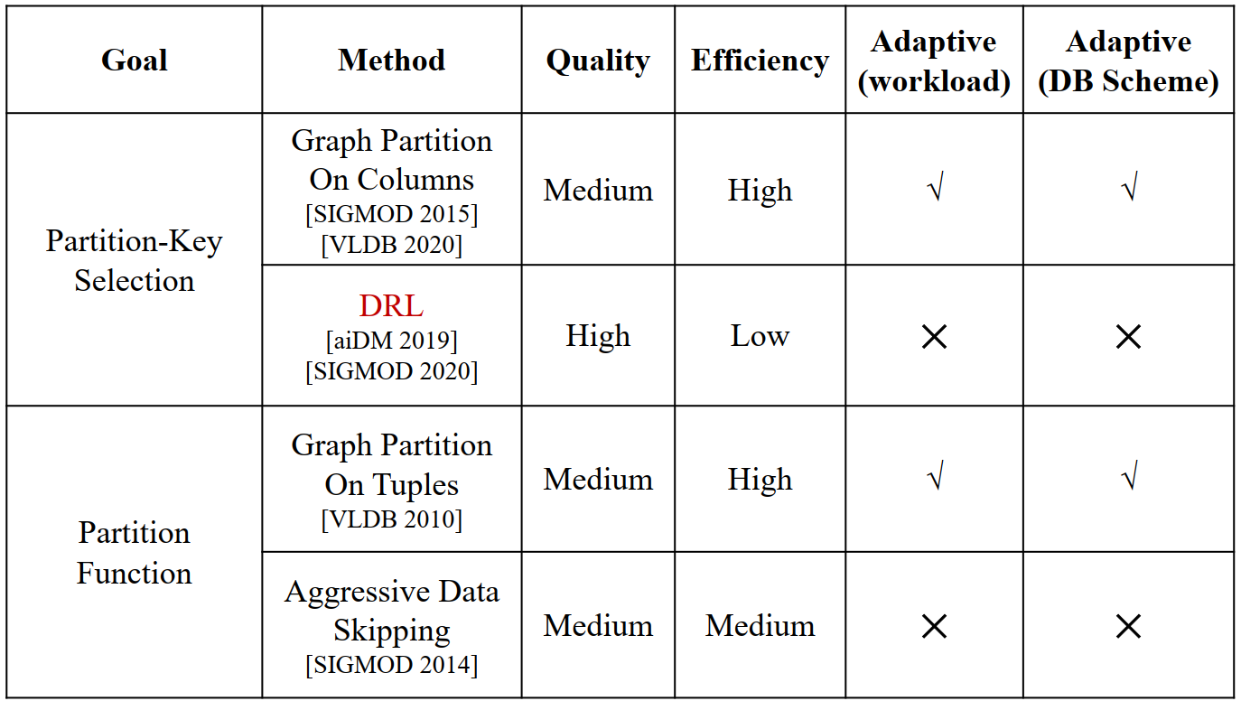
Classification of Database Partitioning

Slide 69
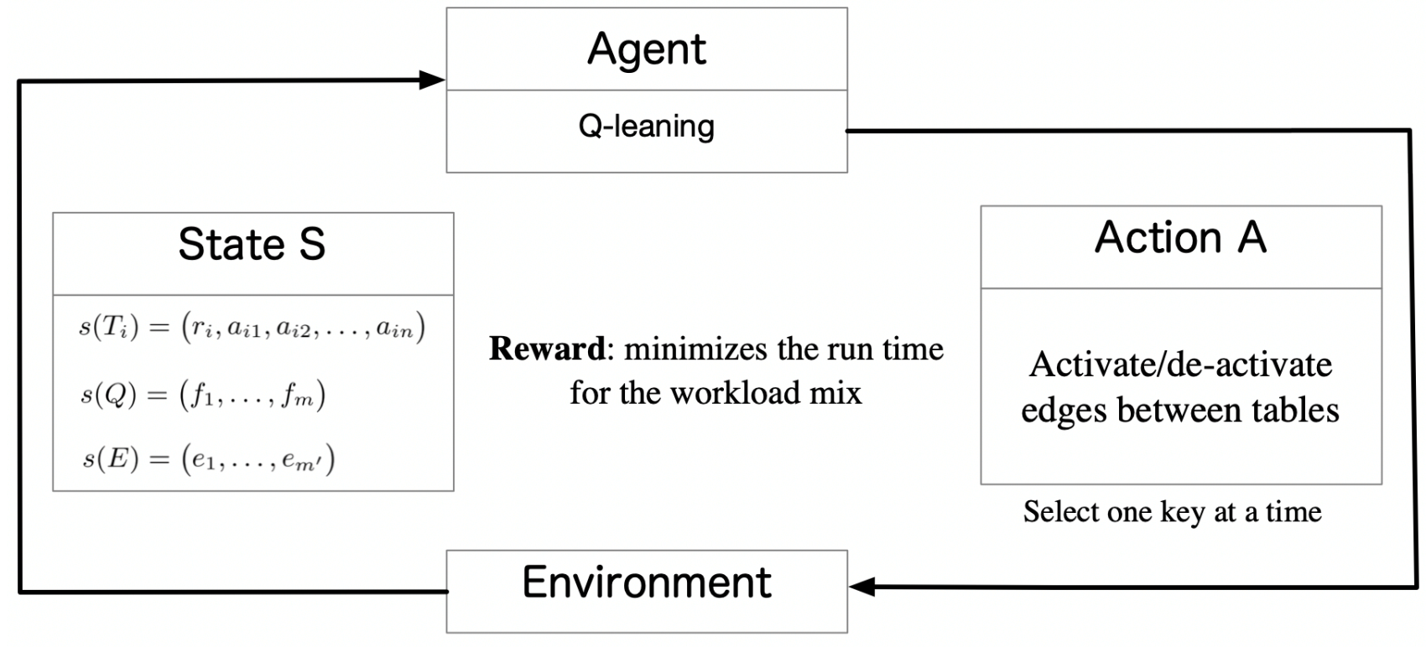
Partition-Key Selection (DRL)
Use DRL to select partition keys or replication tables
  State: [tables, query frequencies, foreign keys]
  Scenario Changes: A cluster of models for different workloads
Benjamin Hilprecht, Carsten Binnig, Uwe Röhm. Towards learning a partitioning advisor with deep reinforcement learning. SIGMOD 2019.

Slide 70
Take-Aways of Database Partitioning
Learned key-selection method outperforms heuristic partitioning
Learned key-selection method has much higher partitioning latency for model training
Tuple-level partition function outperforms traditional functions
Tuple-level partition function may not work for some scenarios
Open Problems
  Adaptive partitioning for relational databases
  Partitioning performance prediction
  Improve partitioning availability with replicates

Slide 71
AI4DB Problems
Database Optimization
  SQL Rewriter
  Cardinality/Cost Estimation
  Join Order Selection
  Learning-based Optimization
Notes:
Guoliang Li, Xuanhe Zhou, Lei Cao:
AI Meets Database: AI4DB and DB4AI. SIGMOD Conference 2021: 2859-2866
Xuanhe Zhou, Chengliang Chai, Guoliang Li, Ji Sun: Database Meets Artificial Intelligence: A Survey. IEEE Trans. Knowl. Data Eng. 34(3): 1096-1116 (2022)

Slide 72
SQL Rewriter
SQL rewriter transforms SQL queries to an equivalent form with the best execution efficiency
  E.g., pushing down the filters, transforming nested queries to join queries
Learned SQL rewriter can help with:
  Rule selection (given a set of rewriting rules)
    A reinforcement model makes the rewrite decision based on the estimated execution cost (by agent)
  Rule generation (for new scenarios)
    An LSTM model learns the correlations between queries, compilers, hardware features, and the corresponding rules
Notes:
Xuanhe Zhou, Chengliang Chai, Guoliang Li, Ji Sun: Database Meets Artificial Intelligence: A Survey. IEEE Trans. Knowl. Data Eng. 34(3): 1096-1116 (2022)

Slide 73
AI4DB Problems
Database Optimization
  SQL Rewriter
  Cardinality/Cost Estimation
  Join Order Selection
  Learning-based Optimization
Notes:
Guoliang Li, Xuanhe Zhou, Lei Cao:
AI Meets Database: AI4DB and DB4AI. SIGMOD Conference 2021: 2859-2866
Xuanhe Zhou, Chengliang Chai, Guoliang Li, Ji Sun: Database Meets Artificial Intelligence: A Survey. IEEE Trans. Knowl. Data Eng. 34(3): 1096-1116 (2022)

Slide 74
Cardinality Estimation Problem
Consider a table T with d numerical attributes A₁, A₂, …, and A_{d}
A conjunctive query q is in the form of:
  (lb₁ ≤ A₁ ≤ ub₁) ∧ . . . ∧ (lb_{d} ≤ A_{d} ≤ ub_{d})
Estimate the selectivity est(q) close to the actual selectivity act(q)
A₂
# of tuples inside the query range q
ub₂
lb₂
O
lb₁
ub₁
A₁

Slide 75
Cardinality/Cost Estimation Methods
Traditional methods for cardinality estimation
  Sampling (on base tables or joins)
    The estimation over one or multiple columns
    Not suitable for sparse/complex queries due to 0-tuple problem (small sample size has bad accuracy)
  Kernel-based Methods (Gaussian Model on Samples)
    The estimation over one or multiple columns
  Histogram (on single column or multiple columns)
Viktor Leis, Andrey Gubichev, Atanas Mirchev, Peter Boncz, Alfons Kemper, and Thomas Neumann. How good are query optimizers, really? In VLDB, 2015.

Slide 76
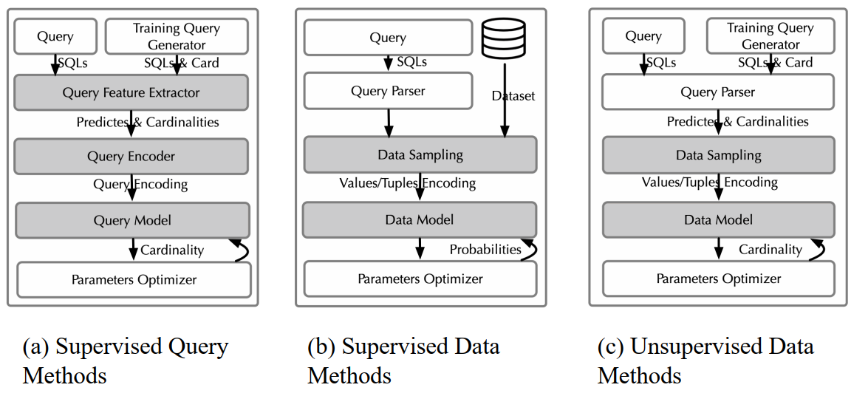
Workflow of Learning-Based Cardinality Estimation

Slide 77
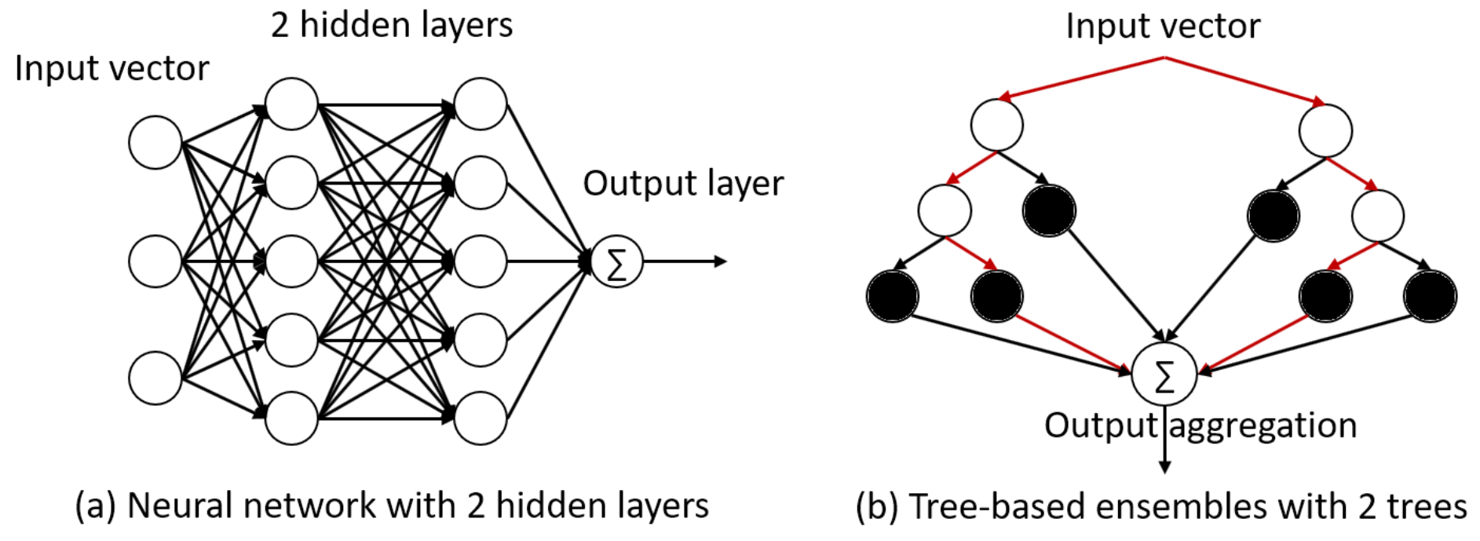
Supervised Query Model (Tree-based Assembling)
A regression model M
  Input: 2d range feature vector (lb₁, ub₁, …, lb_{d}, ub_{d}) given by query range q
  Output: the cardinality inside q
A. Dutt, C. Wang, A. Nazi, S. Kandula, V. R. Narasayya, and S. Chaudhuri. Selectivity estimation for range predicates using lightweight models. PVLDB, 12(9):1044–1057, 2019.

Slide 78
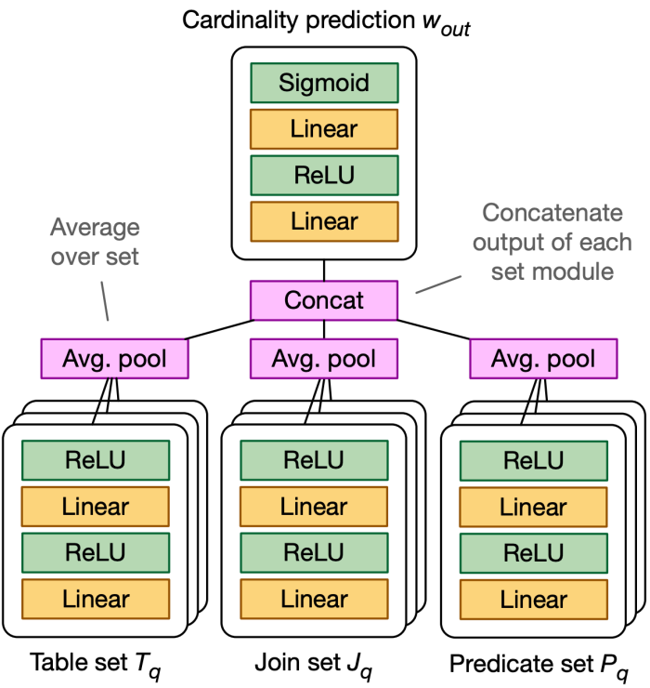
Supervised Query Model (Deep Learning)
Multi-set Convolutional Neural Network
  Linear Models for different part of SQL (table, joins, predicates)
  Pooling varying-sized representations (avg pooling)
  Concatenate different parts
A. Kipf, T. Kipf, B. Radke, V. Leis, P. A. Boncz, and A. Kemper. Learned cardinalities: Estimating correlated joins with deep learning. In CIDR, 2019.

Slide 79
Supervised Data Model (Feedback-KDE)
Construct a kernel-density estimation (KDE) based selectivity estimator for a given table
  Collect representative queries for a robust optimization
  Sample rows from the table and initialize the bandwidth (distance from the true distribution) of KDE
  Pick optimal bandwidth H* via stochastic gradient descent (subtract gradient ∇_{H}𝐿 of the error function for each query)
M. Heimel, M. Kiefer, and V. Markl. Self-tuning, GPU-accelerated kernel density models for multidimensional selectivity estimation. SIGMOD, 2015.

Slide 80
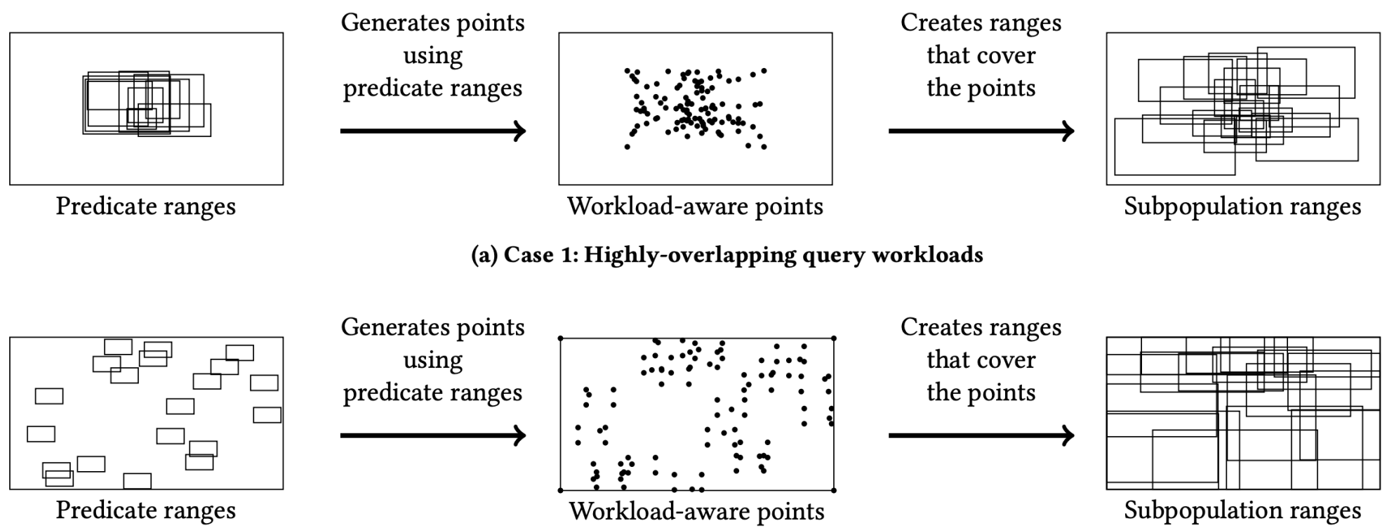
Supervised Data Model (Mixture Model)
Range Queries
  Sample points within historical queries
  Generate subgroups for each point
  Learn the weights of all the Uniformity Mixture Models
Yongjoo Park, Shucheng Zhong, and Barzan Mozafari. Quicksel: Quick selectivity learning with mixture models. SIGMOD 2020.

Slide 81
Unsupervised Data Model (Sum-Product Network)
Support join queries without executing queries
  Split data table into multiple segments and columns in each segment are near independent
  SPN: Sum for different filters and Product for different joins
  RSPN is for AVG aggregation, NULL values support, non-key attributes modeling and updatability
Benjamin Hilprecht, Andreas Schmidt, Moritz Kulessa, Alejandro Molina, Kristian Kersting, and Carsten Binnig. DeepDB: Learn from Data, not from Queries! PVLDB 13, 13(7): 992-1005, 2020

Slide 82
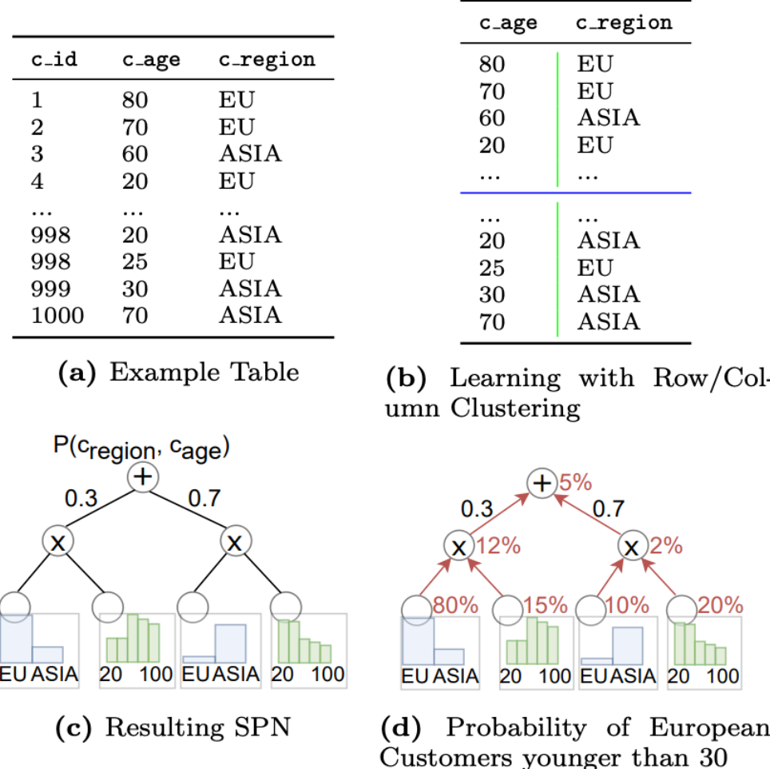
Example of Sum-Product Network

Slide 83
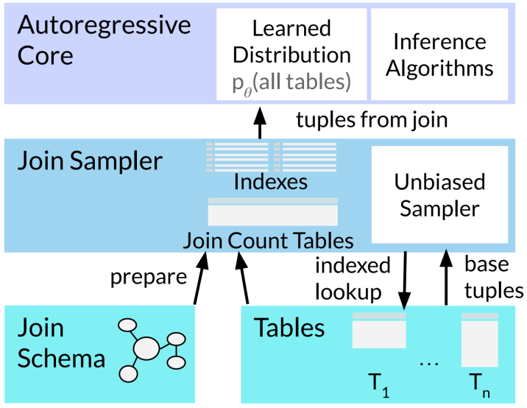
Unsupervised Data Model (AutoRegressive)
Learn a single autoregressive model for all the tables (joined)
Join Sampler provides correct training data (sampled tuples from join) by using unbiased join counts
Down sampling some tuples when estimating query with only a subset of tables according to the fanout scaling
Join Queries

Slide 84
Take-Aways of Learning-based Cardinality Estimation
Data Models are more effective for single tables
Query Models are more effective for multiple tables
Query Models are more efficient than Data Models
Data Models are more robust than Query Models
Training queries are vital to Query Models
Samples are crucial to Data Models
Estimators based on neural network are more accurate than statistic-based estimators
Statistic-based query model is the most efficient

Slide 85
AI4DB Problems
Database Optimization
  SQL Rewriter
  Cardinality/Cost Estimation
  Join Order Selection
  Learning-based Optimization
Notes:
Guoliang Li, Xuanhe Zhou, Lei Cao:
AI Meets Database: AI4DB and DB4AI. SIGMOD Conference 2021: 2859-2866
Xuanhe Zhou, Chengliang Chai, Guoliang Li, Ji Sun: Database Meets Artificial Intelligence: A Survey. IEEE Trans. Knowl. Data Eng. 34(3): 1096-1116 (2022)

Slide 86
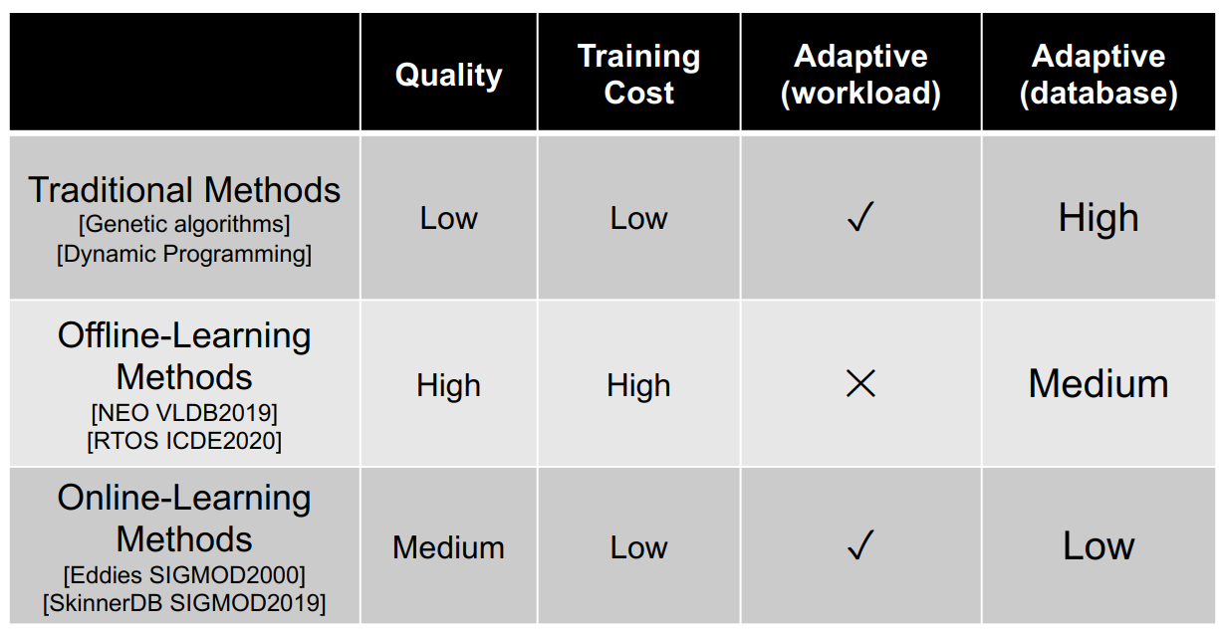
Classification of Join Order Selection

Slide 87
Join Order Selection
Given a SQL query, select the “cheapest” join ordering (according to the cost model)
  Offline Learning Methods
    Use existing workload to train a learned optimizer, which predicts the plan for future queries
  Online Learning Methods
    The query plan can change during the execution
    The query can switch to another better plan
    Learn when the database executes the query

Slide 88
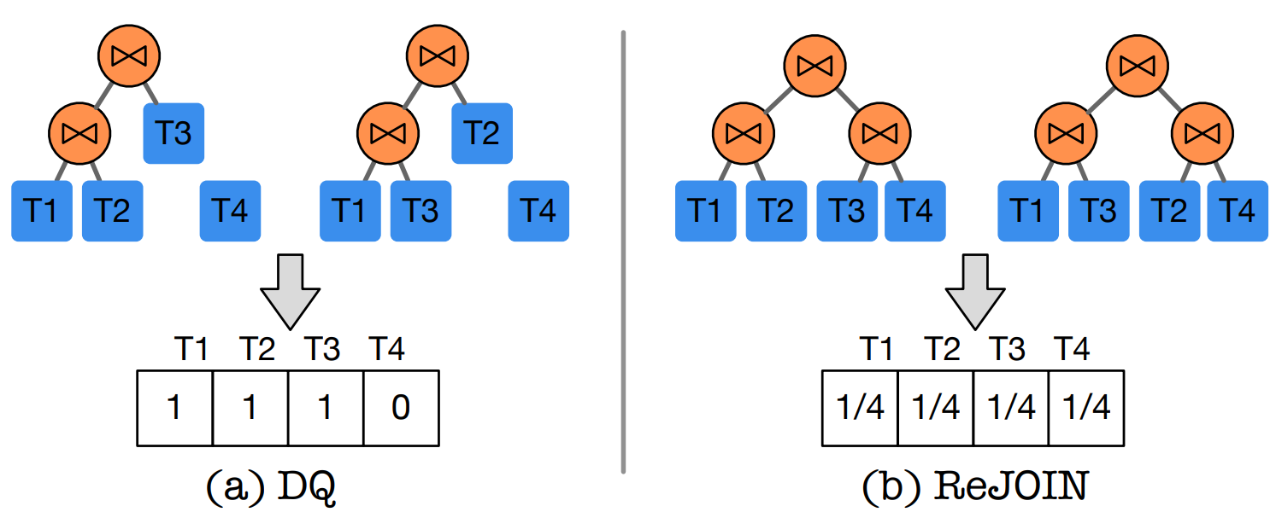
Offline Learning Methods – DQ, ReJOIN
Encode the join trees with feature vectors
existence of the table in the join tree
feature: (1/2)^{depth}=1/4
depth of the table in the join tree = 2
Marcus R, Papaemmanouil O. Deep reinforcement learning for join order enumeration
Krishnan S, Yang Z, Goldberg K, et al. Learning to optimize join queries with deep reinforcement learning
Notes:
X. Yu, G. Li, and C.C. et al. Reinforcement learning with Tree-LSTM for join order selection. In ICDE, 2020.
Marcus R, Papaemmanouil O. Deep reinforcement learning for join order enumeration
Krishnan S, Yang Z, Goldberg K, et al. Learning to optimize join queries with deep reinforcement learning

Slide 89
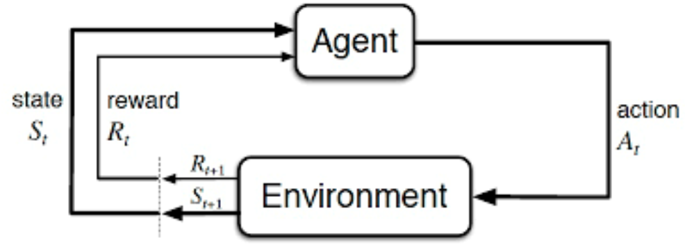
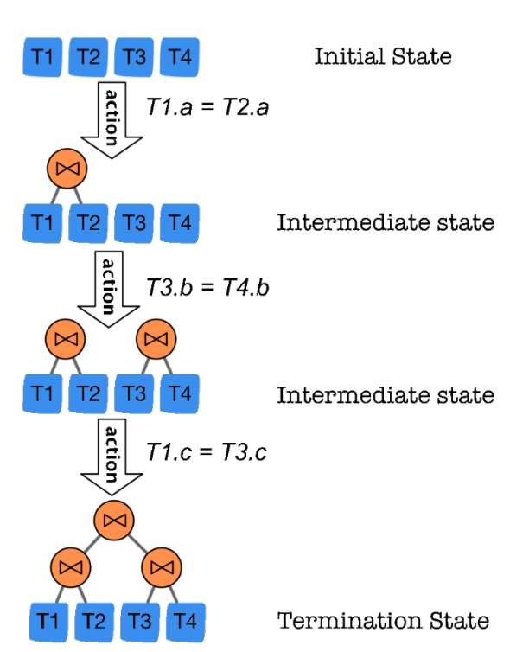
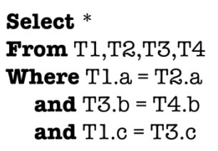
Offline Learning Methods – DQ, ReJOIN (cont'd)
RL
  Agent: optimizer
  Action: join
  Environment: Cost model, database
  Reward: Cost, latency
  State: join order
Marcus R, Papaemmanouil O. Deep reinforcement learning for join order enumeration
Krishnan S, Yang Z, Goldberg K, et al. Learning to optimize join queries with deep reinforcement learning
Notes:
Marcus R, Papaemmanouil O. Deep reinforcement learning for join order enumeration
Krishnan S, Yang Z, Goldberg K, et al. Learning to optimize join queries with deep reinforcement learning

Slide 90
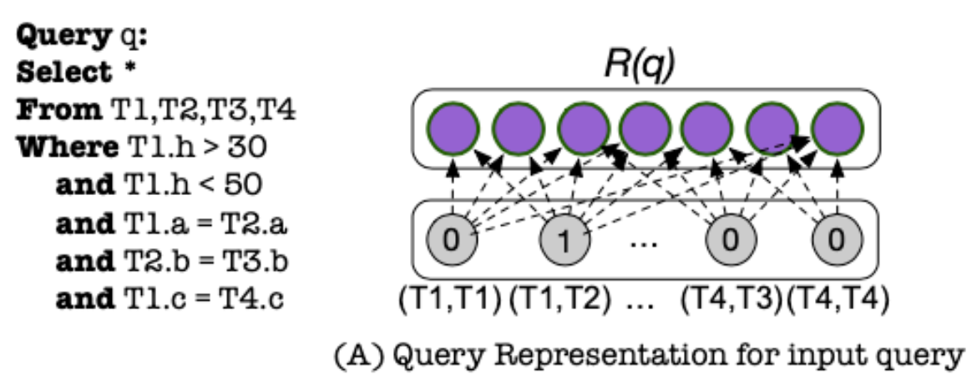
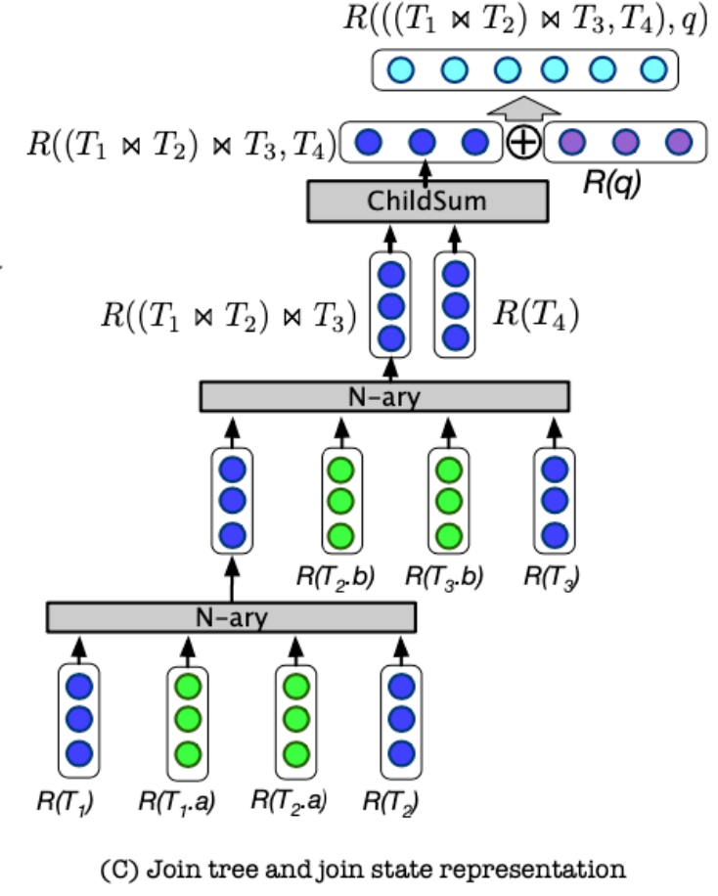
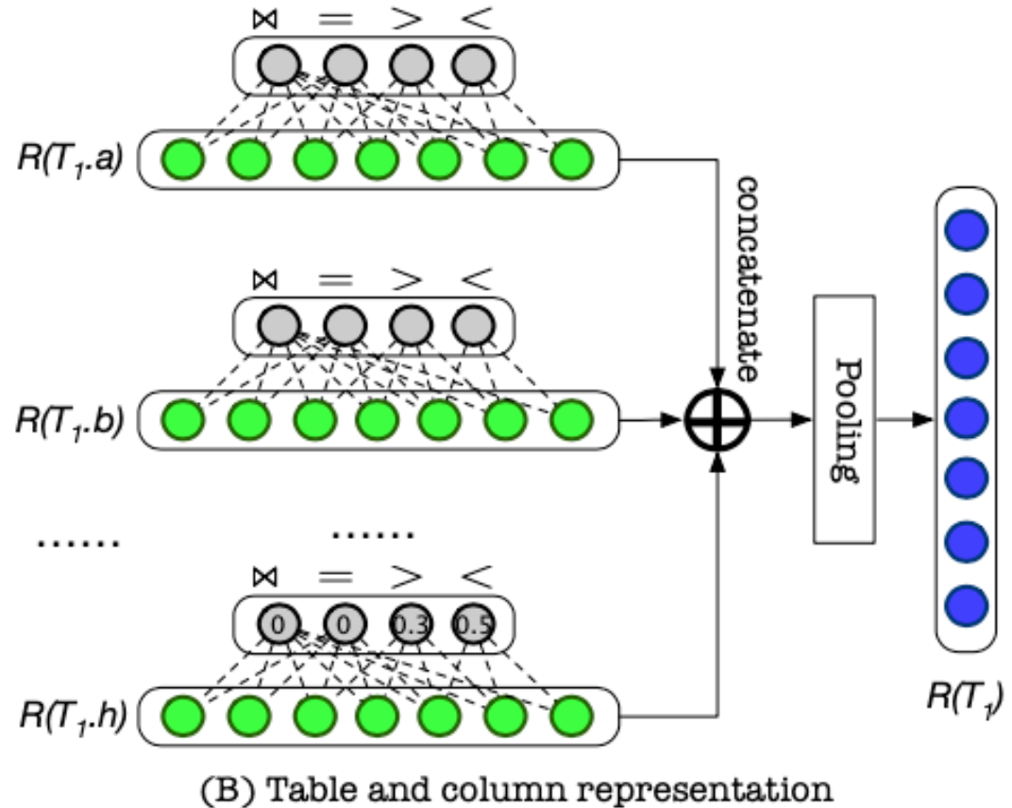
Offline Learning Methods–RTOS
Deep reinforcement learning (DRL) with tree-structured LSTM (Tree-LSTM) for the join order selection
  Encode the operator relations and metadata of a query
  Embed the query features with Tree-LSTM and decide join orders with reinforcement learning
tree as the input
X. Yu, G. Li, and C.C. et al. Reinforcement learning with Tree-LSTM for join order selection. In ICDE, 2020.
Notes:
X. Yu, G. Li, and C.C. et al. Reinforcement learning with Tree-LSTM for join order selection. In ICDE, 2020.

Slide 91

Offline Learning Methods–RTOS (cont'd)
X. Yu, G. Li, and C.C. et al. Reinforcement learning with Tree-LSTM for join order selection. In ICDE, 2020.

Slide 92

Online Learning Methods – Eddies
Adaptive query processing mechanism
  It combines the execution and optimization of a query
  It inputs the data and route the data (from R, S, T) to the best operator (join order) each time
Ron Avnur and Joseph M. Hellerstein. Eddies: Continuously Adaptive Query Processing. SIGMOD, 2000.

Slide 93

Online Learning Methods–SkinnerDB
Do not require pre-training
Learn during the runtime
  Divide the query execution into many time slices
  Different join orders (except for Cartesian product) on data batches are tried in different time slices with timeouts
Trummer, et al Skinnerdb: Regret-bounded query evaluation via reinforcement learning. In SIGMOD 2019, pages 1153–1170, 2019.

Slide 94
Take-Aways of Join Order Selection
Learning based algorithm usually gives the plan with low time complexity, especially for large queries
Offline learning methods use the sampled workload to pretrained the model. It will give good plans for the incoming queries
A new database (even a big update to original database) will lead to model retraining
Online-learning methods does not need previous workload and can give good plans. But it needs the customized engine and is hard to be applied in existing databases
Open Problems
  Raise the generalization performance of offline learning methods for unseen queries
  Ensure the plan given by learned model is robust (explicable)
  Speed up the model training time, e.g., transferring previous knowledge
  Make the model aware of the data update

Slide 95
AI4DB Problems
Database Design
  Learned Indexes
  Learned Data Structures
Notes:
Guoliang Li, Xuanhe Zhou, Lei Cao:
AI Meets Database: AI4DB and DB4AI. SIGMOD Conference 2021: 2859-2866
Xuanhe Zhou, Chengliang Chai, Guoliang Li, Ji Sun: Database Meets Artificial Intelligence: A Survey. IEEE Trans. Knowl. Data Eng. 34(3): 1096-1116 (2022)

Slide 96
Motivation of the Learned Index
Indexes are essential for database system
  Indexes can speed up the query processing
  Indexes can handle large-scale data
Limitations of traditional indexes
  Unaware of data features
  Trade-off between space and access efficiency
Advantages of learned indexes
  Space efficient
  Highly parallel, adaptive to modern hardware like GPU and TPU

Slide 97


Basic Idea of Learned Index
Replace the B⁺-tree index with a neural network (NN) model
  Model the cumulative distribution function (CDF) of the data, Key, to predict the location, pos, as:
𝒑os = 𝑭(𝑲𝒆𝒚) ∗ 𝑵
Learned Index
B+-Tree
Tim Kraska, Alex Beutel, Ed H. Chi, Jeffrey Dean, Neoklis Polyzotis. The Case for Learned Index Structures. SIGMOD Conference, 2018.

Slide 98
Challenges of Learned Index
Multi-Dimensional Indexes
  Correlated datasets
  Skewed workloads
Updatable Indexes
  Inserts, deletes, updates will modify data distribution, which require learned index models support dynamic data modifications

Slide 99

Classification of Learned Indexes

Slide 100
Take-Aways of Learned Index
Learned index uses machine learning technology, which provides probability of combining new hardware with database system in future
The performance in industrial level data scale still needs to be studied, especially in updatable and multi-dimensional situations
Open problems
  Distributed System: Concurrency Control algorithms for the learned index
  Data scale and stability: Make the learned index applicable to industrial database systems

Slide 101
AI4DB Problems
Transaction Management
  Transaction Prediction
  Transaction Scheduling
Notes:
Guoliang Li, Xuanhe Zhou, Lei Cao:
AI Meets Database: AI4DB and DB4AI. SIGMOD Conference 2021: 2859-2866
Xuanhe Zhou, Chengliang Chai, Guoliang Li, Ji Sun: Database Meets Artificial Intelligence: A Survey. IEEE Trans. Knowl. Data Eng. 34(3): 1096-1116 (2022)

Slide 102
Motivation of Learned Transaction Scheduling
Effective scheduling can improve the performance
  Minimize conflicts between transactions
Concurrency control is challenging
  # of CPU cores increases
Transaction Management Tasks
  Transaction Prediction
  Transaction Scheduling

Slide 103

Learned Transaction Prediction
Predict the future trend of different workloads
  Pre-Processor identifies query templates and the arrival-rate from the workload
  Clusterer combines templates with similar arrival rate patterns
  Forecaster utilizes ML models to predict arrival rate in each cluster
Lin Ma, Dana Van Aken, and et al. Query-based Workload Forecasting for Self-Driving Database Systems. In SIGMOD, 2018.
Notes:
Lin Ma, Dana Van Aken, and et al. Query-based Workload Forecasting for Self-Driving Database Systems. In SIGMOD, 2018.

Slide 104

Learned Transaction Scheduling
ML balances between Concurrency and Conflict Rates
  Database collects requested data blocks
  Record the blocks cached in the Buffer Pool and the buffer hits of each query
  Schedule queries to optimize global performance with RL
Chi Zhang, Ryan Marcus, and et al. Buffer Pool Aware Query Scheduling via Deep Reinforcement Learning. In VLDB, 2020.
Notes:
Chi Zhang, Ryan Marcus, and et al. Buffer Pool Aware Query Scheduling via Deep Reinforcement Learning. In VLDB, 2020.

Slide 105
AI4DB Problems
Database Monitoring
Database Security
Notes:
Guoliang Li, Xuanhe Zhou, Lei Cao:
AI Meets Database: AI4DB and DB4AI. SIGMOD Conference 2021: 2859-2866
Xuanhe Zhou, Chengliang Chai, Guoliang Li, Ji Sun: Database Meets Artificial Intelligence: A Survey. IEEE Trans. Knowl. Data Eng. 34(3): 1096-1116 (2022)

Slide 106
Learned Database Monitoring
Database collects metrics → ML models analyze/predict anomaly (health/activity/workload)
Performance prediction of single queries
  R. Marcus and O. Papaemmanouil. Plan-structured deep neural network models for query performance prediction. Proc. VLDB Endow., 2019.
Performance prediction of concurrent queries
  X. Zhou, J. Sun, G. Li, et al. Query Performance Prediction for Concurrent Queries using Graph Embedding. VLDB, 2020.
System diagnosis for OLTP or OLAP
  D. Yoon, N. Niu, B. Mozafari. DBSherlock- A Performance Diagnostic Tool for Transactional Databases. SIGMOD, 2016.
  M. Ma, Z. Yin, and S. Z. et al. Diagnosing root causes of intermittent slow queries in cloud databases. PVLDB, 2020.
  P. Kalmegh, S. Babu, S. Roy. iQCAR: inter-Query Contention Analyzer for Data Analytics Frameworks. SIGMOD, 2019.
  N. Borisov, S. Uttamchandani, R. Routray, A. Singh. Why Did My Query Slow Down? CIDR, 2009.

Slide 107
AI4DB Problems
Database Monitoring
Database Security
Notes:
Guoliang Li, Xuanhe Zhou, Lei Cao:
AI Meets Database: AI4DB and DB4AI. SIGMOD Conference 2021: 2859-2866
Xuanhe Zhou, Chengliang Chai, Guoliang Li, Ji Sun: Database Meets Artificial Intelligence: A Survey. IEEE Trans. Knowl. Data Eng. 34(3): 1096-1116 (2022)

Slide 108
Learned Database Security
Sensitivity Data Discovery
  Traditional methods use user-defined rules
  Learned Model: Learn the real access frequency of data records
Access Control
  Traditional methods are based on static rules
  Learned Model: Customize policies to regulate data requests based on the actions and data
SQL Injection
  Traditional methods take long time in scanning
  Learned Model: Classifier for SQL Injection Detection; Fuzzy network to detect attack patterns

Slide 109
Summary
Pros and cons of AI and DB techniques
AI4DB challenges
Potential AI4DB problems
  Learned database configuration
  Learned database optimization
  Learned database design
  Learned transaction management
  Learned database monitoring
  Learned database security
  …
AI4DB techniques
  Next chapters

