Slide 1
AI for DB (AI4DB)
Chapter 4: Learned Index
Instructor: Xiang Lian
Email: xxl1584@case.edu
Homepage: http://www.cs.kent.edu/~xlian/
Notes:
The slides of this AI4DB course used some public slides/materials on the Web for teaching purposes only. I would like to acknowledge these resources, and please let me know if I failed to cite them or you want to remove them from my slides.

Slide 2
Objectives
In this chapter, we will:
  Understand the motivation, structure, and usage of the B⁺-tree index and bloom filters (BF)
  Learn the details of the learned index
  Know variants of the learned indexes
    1D and multidimensional learned indexes
    Learned bloom filter for static or stream data
  Pros and cons of the learned index

Slide 3
Outline
Introduction to the B⁺-Tree Index
Range Index – Learned Index to Replace B⁺-Tree
Point Index – Learned Hash-Map
Existence Index – Learned Bloom Filter
Variants of Learned Indexes

Slide 4
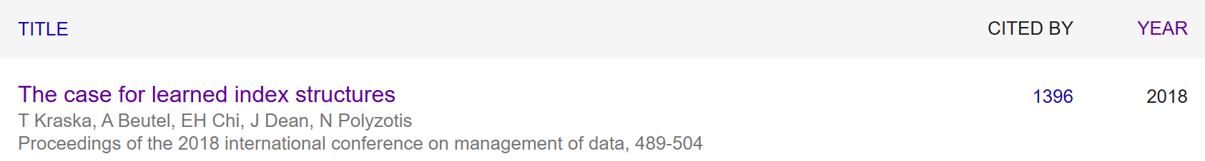
Learned Indexes [2018]
From Google Scholar, 8/7/2025

Slide 5
Introduction
For a large-scale database
  Sequential scan is not efficient!!
Indexes are often designed for fast accesses to data locations in the database
  B⁺-tree (1D Range Index)
  Hash file (1D Point Index)
  Bloom filter (Existence Index)
  R*-tree (Multidimensional Index)
  …

Slide 6
The Reason for Indexes
Consider a relational table with two attributes, PID (person ID) and Age
Find those people with age between 20 and 30
  Two records: {(PID: 1, Age: 25), (PID: 2, Age: 31)}
  How about 10 records?
  100 records?
  1,000 records?
  1,000,000 records?
The search efficiency is not scalable for large data sets!

Slide 7
The Reason for Indexes (cont'd)
Consider a relational table with two attributes, PID (person ID) and Age
Find those people with age between 20 and 30
  1,000,000 records?
Usually, the size of the answer set is much smaller than the total data size (e.g., 1,000,000)!
Index is often used to reduce the search space, that is, access only a small number of records (<<1,000,000) before we obtain answers

Slide 8
Example: Enroll Table
ID CrsCode Semester GPA
666666 MGT123 F1994 4.0
123456 CS305 S1996 4.0 page 0
987654 CS305 F1995 2.0
717171 CS315 S1997 4.0
666666 EE101 S1998 3.0 page 1
765432 MAT123 S1996 2.0
515151 EE101 F1995 3.0
234567 CS305 S1999 4.0
page 2
878787 MGT123 S1996 3.0
Heap File
(random order)

Slide 9
Example: Enroll Table (cont'd)
ID CrsCode Semester GPA
111111 MGT123 F1994 4.0
111111 CS305 S1996 4.0 page 0
123456 CS305 F1995 2.0
123456 CS315 S1997 4.0
123456 EE101 S1998 3.0 page 1
232323 MAT123 S1996 2.0
234567 EE101 F1995 3.0
234567 CS305 S1999 4.0
page 2
313131 MGT123 S1996 3.0
Sorted File
(sorted order)

Slide 10
Indexing for Relational Tables
In relational databases, we can build indexes over one or multiple attributes in relational tables
S
search key
value
Location Mechanism
Location mechanism
facilitates finding
index entry for S
S
index entries
Once index entry is found, the row can be directly accessed
S, …….

Slide 11
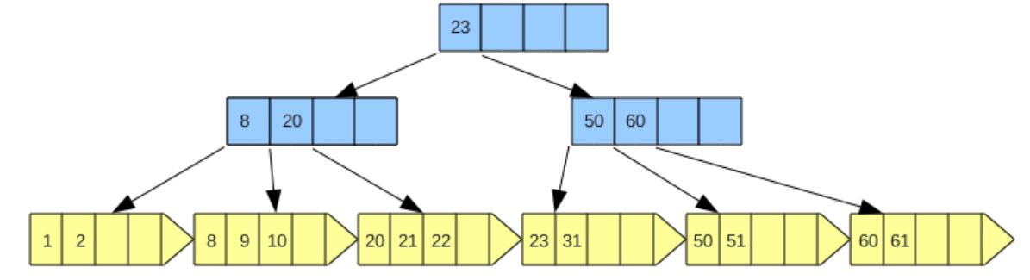
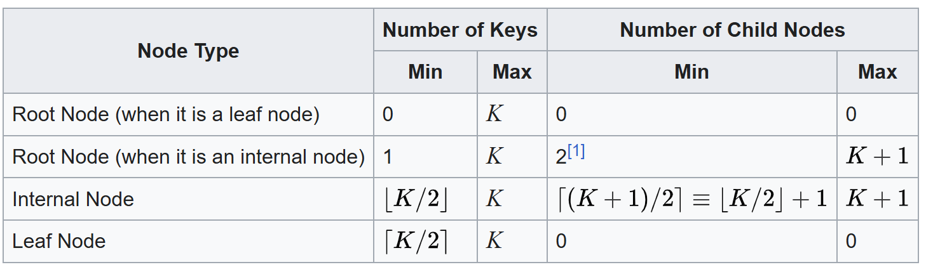
Range Index – B⁺-Tree
A B⁺-tree is an m-ary tree
  A B⁺-tree consists of a root, internal nodes, and leaf nodes
  Each internal node contains (m-1) keys and m pointers pointing to the children
https://en.wikipedia.org/wiki/B%2B_tree
Notes:
https://commons.wikimedia.org/wiki/File:B%2B-tree-remove-30.png

Slide 12
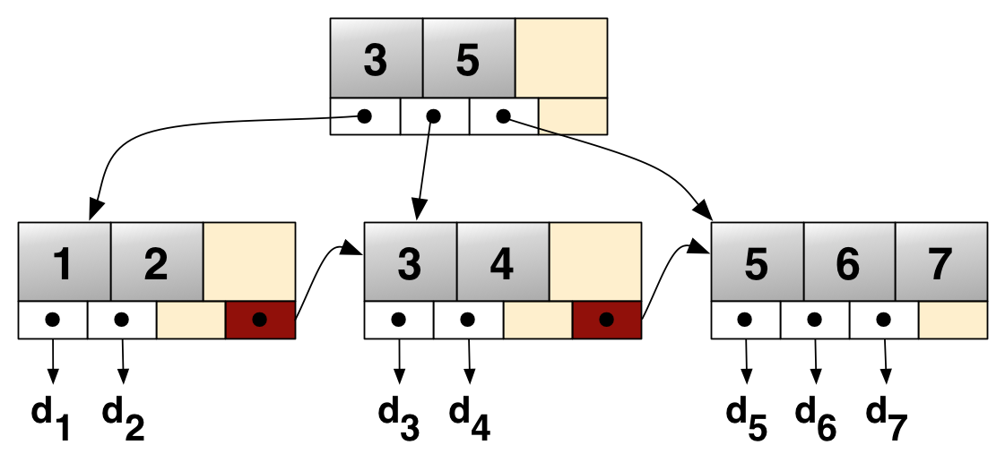
Example: B⁺-Tree
https://en.wikipedia.org/wiki/B%2B_tree

Slide 13
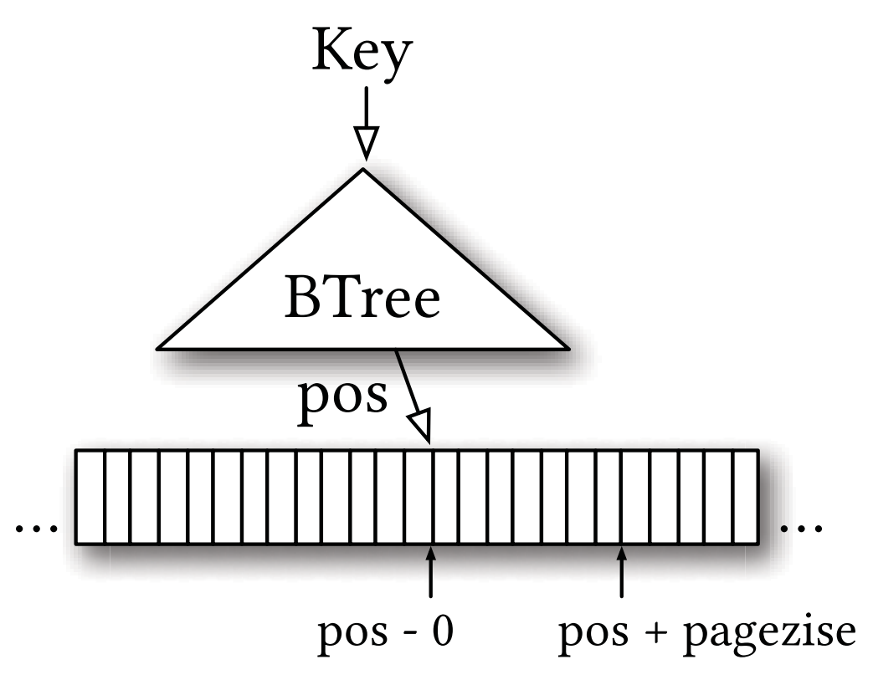
Learned Index for B⁺-Tree
Essentially, B⁺-tree "predicts" the location of a key within a key-sorted set
O(log N)
Tim Kraska, Alex Beutel, Ed H. Chi, Jeffrey Dean, Neoklis Polyzotis. The Case for Learned Index Structures. SIGMOD Conference, 2018.
Notes:
Tim Kraska, Alex Beutel, Ed H. Chi, Jeffrey Dean, Neoklis Polyzotis. The Case for Learned Index Structures. SIGMOD Conference, 2018.

Slide 14
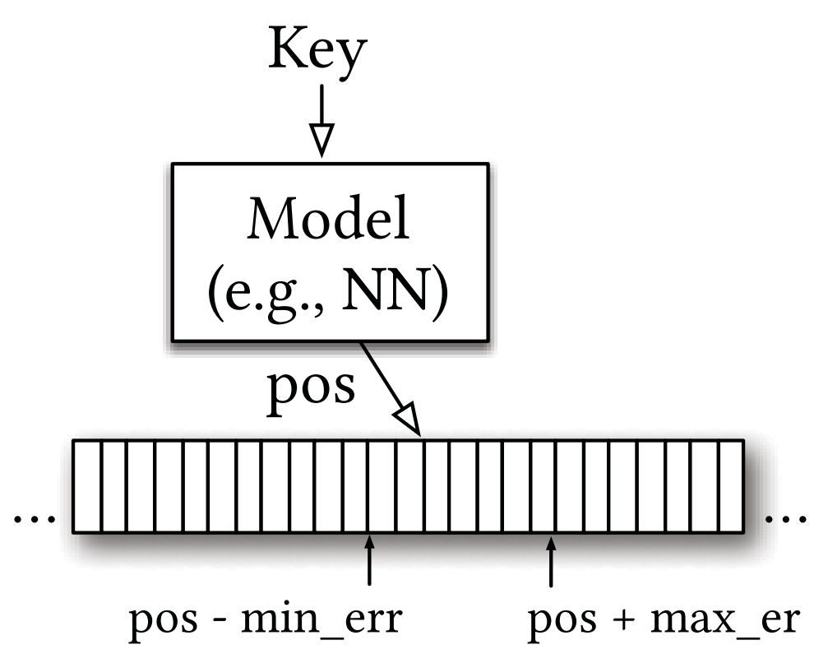
Learned Index for B⁺-Tree (cont'd)
Learned index: replacing the B⁺-tree index with a neural network (NN) model
  Learn a mapping from a look-up key to a position
constant cost O(1)
Tim Kraska, Alex Beutel, Ed H. Chi, Jeffrey Dean, Neoklis Polyzotis. The Case for Learned Index Structures. SIGMOD Conference, 2018.

Slide 15
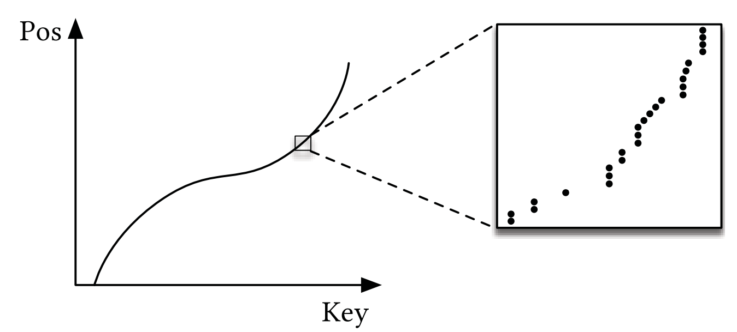
Cumulative Distribution Function (CDF) Model
(Key, Pos)-Mapping
  Pos = f (Key) * N, where f (Key) = Pr{X ≤ Key}, and N is the database size
Tim Kraska, Alex Beutel, Ed H. Chi, Jeffrey Dean, Neoklis Polyzotis. The Case for Learned Index Structures. SIGMOD Conference, 2018.

Slide 16
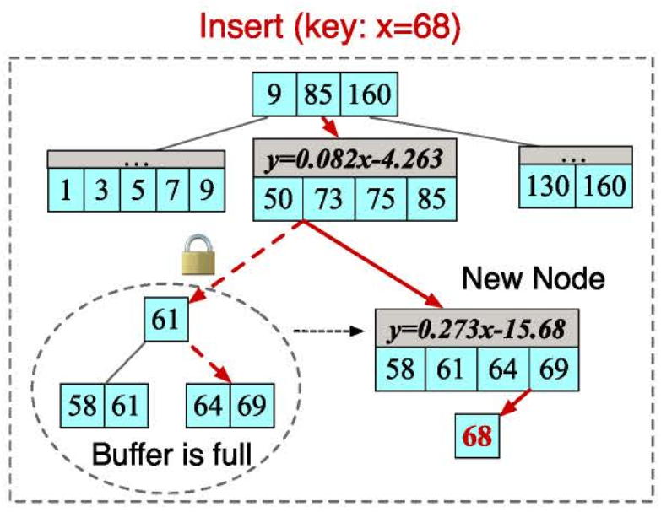
Insertion Design of the Learned Index
Given an insert pair (Key, Pos), the learned index first finds the position, Pos, of Key, and then inserts the pair into the corresponding leaf node
When the node is full, …
  Delta-buffer insert
    Index-Level (e.g., DPGM)
    Node-Level (e.g., XIndex, SIndex)
    Pair-Level (e.g., FINEdex)
  In-place insert
    Reserve gaps for each node
FINEdex
[FINEdex] P. Li, Y. Hua, J. Jia, and P. Zuo. FINEdex: A Fine-grained Learned Index Scheme for Scalable and Concurrent Memory Systems. In VLDB, volume 15, pages 321–334, 2021.
Notes:
Zhaoyan Sun, Xuanhe Zhou, and Guoliang Li. Learned Index: A Comprehensive Experimental Evaluation, PVLDB, 2023. URL: https://www.vldb.org/pvldb/vol16/p1992-li.pdf
[FINEdex] P. Li, Y. Hua, J. Jia, and P. Zuo. FINEdex: A Fine-grained Learned Index Scheme for
Scalable and Concurrent Memory Systems. In VLDB, volume 15, pages 321–334, 2021.

Slide 17
Delta-Buffer Insertion Strategies
Index-Level Methods (e.g., DPGM)
  Shares one buffer for all the insert operations
Node-Level Methods (e.g., XIndex, SIndex)
  Maintains a delta buffer for each leaf node to cache the inserted pairs
Pair-Level Methods (e.g., FINEdex)
  Uses finer-grained delta buffers, and allocates a buffer for each key in the leaf node
[DPGM] P. Ferragina and G. Vinciguerra. The PGM-index: A fully-dynamic compressed learned index with provable worst-case bounds. In VLDB, volume 13, pages 1162–1175, 2020.
[XIndex] C. Tang, Y. Wang, Z. Dong, G. Hu, Z. Wang, M. Wang, and H. Chen. Xindex: A scalable learned index for multicore data storage. In PPoPP, pages 308–320, 2020
[SIndex] Y. Wang, C. Tang, Z. Wang, and H. Chen. SIndex: A scalable learned index for string keys. In APSys 2020, pages 17–24, 2020.
[FINEdex] P. Li, Y. Hua, J. Jia, and P. Zuo. FINEdex: A Fine-grained Learned Index Scheme for Scalable and Concurrent Memory Systems. In VLDB, volume 15, pages 321–334, 2021.
Notes:
[DPGM] P. Ferragina and G. Vinciguerra. The PGM-index: A fully-dynamic compressed learned index with provable worst-case bounds. In VLDB, volume 13, pages 1162–1175, 2020.
[XIndex] C. Tang, Y. Wang, Z. Dong, G. Hu, Z. Wang, M. Wang, and H. Chen. Xindex: A scalable learned index for multicore data storage. In PPoPP, pages 308–320, 2020
[SIndex] Y. Wang, C. Tang, Z. Wang, and H. Chen. SIndex: A scalable learned index for string keys. In APSys 2020, pages 17–24, 2020.
[FINEdex] P. Li, Y. Hua, J. Jia, and P. Zuo. FINEdex: A Fine-grained Learned Index Scheme for Scalable and Concurrent Memory Systems. In VLDB, volume 15, pages 321–334, 2021.

Slide 18
In-Place Insertion Strategies
For each insertion, if there is a gap in the target position, insert the pair directly
Otherwise, …
  [ALEX] shifts the pairs between the target position and the closest gap to make space for the new pair (the insert cost is high)
  [LIPP] creates a new node with both the inserted pair and the existing pair in the target position, and replaces the target position with a pointer to the new node
[ALEX] J. Ding, U. F. Minhas, J. Yu, C. Wang, J. Do, Y. Li, H. Zhang, B. Chandramouli, J. Gehrke, D. Kossmann, D. Lomet, and T. Kraska. ALEX: An Updatable Adaptive Learned Index. In SIGMOD, pages 969–984, 2020.
[LIPP] J. Wu, Y. Zhang, S. Chen, J. Wang, Y. Chen, and C. Xing. Updatable learned index with precise positions. In VLDB, volume 14, page 1276, 2021.
Notes:
[ALEX] J. Ding, U. F. Minhas, J. Yu, C. Wang, J. Do, Y. Li, H. Zhang, B. Chandramouli, J. Gehrke, D. Kossmann, D. Lomet, and T. Kraska. ALEX: An Updatable Adaptive Learned Index. In SIGMOD, pages 969–984, 2020.
[LIPP] J. Wu, Y. Zhang, S. Chen, J. Wang, Y. Chen, and C. Xing. Updatable learned index with precise positions. In VLDB, volume 14, page 1276, 2021.

Slide 19
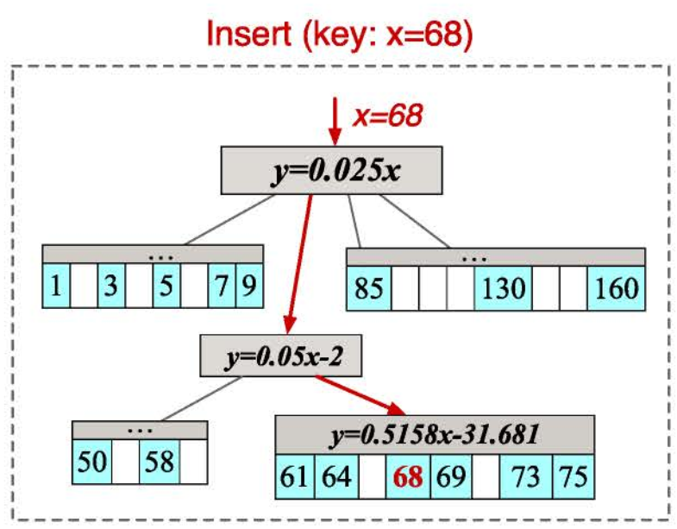
Examples of Insertion Handling
FINEdex
(Delta-Buffer Insert, Pair-Level)
ALEX
(In-Place Insert)
Zhaoyan Sun, Xuanhe Zhou, and Guoliang Li. Learned Index: A Comprehensive Experimental Evaluation, PVLDB, 2023. URL: https://www.vldb.org/pvldb/vol16/p1992-li.pdf
Notes:
Zhaoyan Sun, Xuanhe Zhou, and Guoliang Li. Learned Index: A Comprehensive Experimental Evaluation, PVLDB, 2023. URL: https://www.vldb.org/pvldb/vol16/p1992-li.pdf

Slide 20
Structural Changes/Modifications (Homework)
What triggers the structural modifications of the learned index? Please provide at least 2 causes
  Read the following reference and find out the answer
Zhaoyan Sun, Xuanhe Zhou, and Guoliang Li. Learned Index: A Comprehensive Experimental Evaluation, PVLDB, 2023. URL: https://www.vldb.org/pvldb/vol16/p1992-li.pdf

Slide 21
Other Issues of Learned Indexes
Deletion Design
Concurrency Design
  Lock the affected objects of the learned index when updating the index
Bulk Loading Design
  Processing a batch of key-position pairs
  Top-down vs. bottom-up bulk loading
  …
Notes:
Zhaoyan Sun, Xuanhe Zhou, and Guoliang Li. Learned Index: A Comprehensive Experimental Evaluation, PVLDB, 2023. URL: https://www.vldb.org/pvldb/vol16/p1992-li.pdf

Slide 22
Two-Step Position Search
Given the sorted key-position pairs (D[pos], pos) in database D and a query key Key
  Range Prediction: If the predicted key D[pos] > Key, the search range is D[0 : pos] (or D[pos-min_err : pos]); otherwise, the search range is D[pos+1 : N] (or D[pos : pos+max_err])
  Search within the Range:
    Linear Search (small error)
    Binary Search (large error)
The Learned B⁺-Tree also Supports Range Queries and Duplicated Keys
Notes:
Zhaoyan Sun, Xuanhe Zhou, and Guoliang Li. Learned Index: A Comprehensive Experimental Evaluation, PVLDB, 2023. URL: https://www.vldb.org/pvldb/vol16/p1992-li.pdf

Slide 23
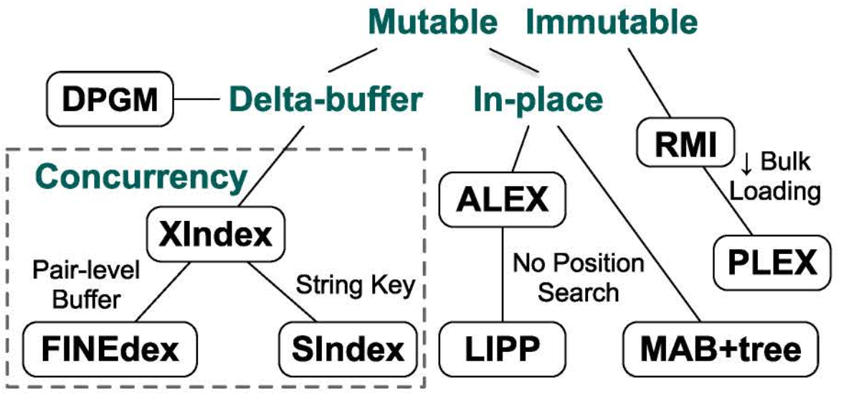
A Lineage of Learned Indexes
Notes:
Zhaoyan Sun, Xuanhe Zhou, and Guoliang Li. Learned Index: A Comprehensive Experimental Evaluation, PVLDB, 2023. URL: https://www.vldb.org/pvldb/vol16/p1992-li.pdf
[MAB+tree] A. H. 0001 and T. Heinis. MADEX: Learning-augmented Algorithmic Index Structures. In B. He, B. Reinwald, and Y. Wu, editors, AIDB@VLDB 2020, 2020.
[RMI] Tim Kraska, Alex Beutel, Ed H. Chi, Jeffrey Dean, Neoklis Polyzotis. The Case for Learned Index Structures. SIGMOD Conference, 2018. URL: https://dl.acm.org/doi/10.1145/3183713.3196909
[PLEX] M. Stoian, A. Kipf, R. Marcus, and T. Kraska. Towards Practical Learned Indexing. In AIDB@VLDB 2021, 2021.
DPGM-index – Dynamic Piecewise Geometric Model index

Slide 24
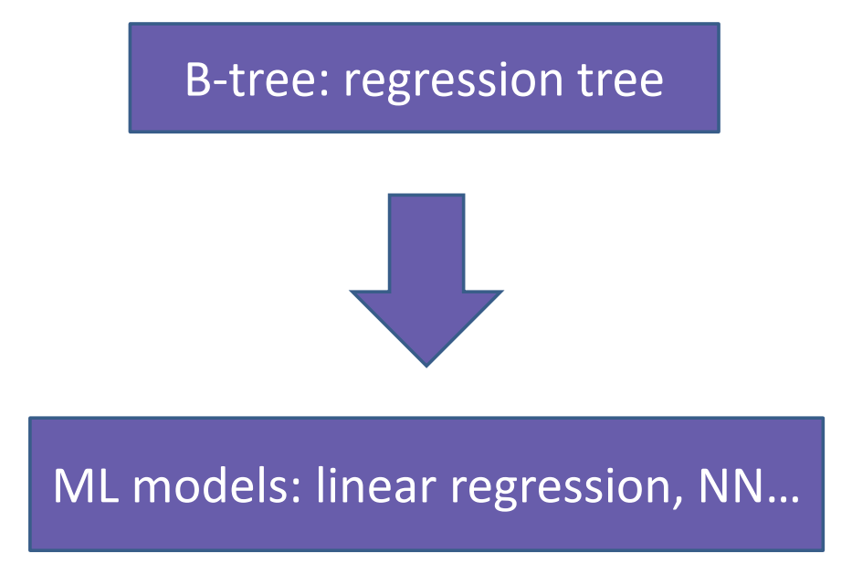
Basic Idea of Learned Index to Replace B⁺-Tree
⁺
Notes:
https://huangliu0909.github.io/2020/09/11/Reading_ppt_Learned_Index/

Slide 25
Advantages of Learned Indexes
Smaller index
  Less main-memory storage
Faster lookup
  E.g., Linear function
More parallelism
  Use multiplications instead of if-statement
Notes:
https://huangliu0909.github.io/2020/09/11/Reading_ppt_Learned_Index/

Slide 26
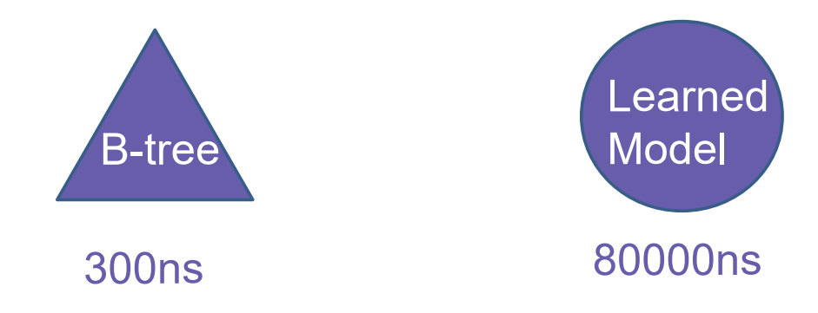
A First Naive Learned Index
Tensorflow
200M web-server log records
Input features: timestamps (keys)
Labels: positions in sorted array
2 fully-connected layers, 32 neurons/layer, ReLU activation functions
Learn a big model
<<
~30ns ?
Notes:
https://huangliu0909.github.io/2020/09/11/Reading_ppt_Learned_Index/

Slide 27
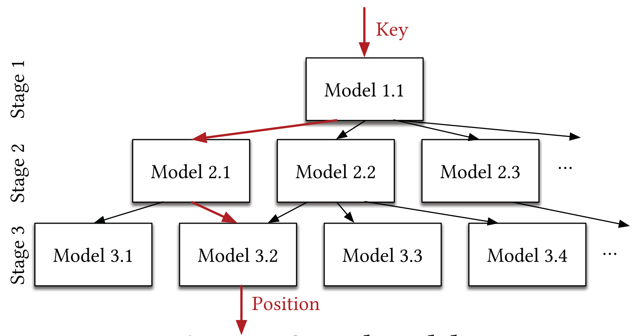
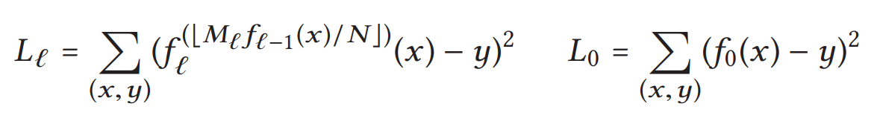
Recursive-Model Indexes (RMI)
Recursive regression model
Loss function:
Notes:
https://huangliu0909.github.io/2020/09/11/Reading_ppt_Learned_Index/
[RMI] Tim Kraska, Alex Beutel, Ed H. Chi, Jeffrey Dean, Neoklis Polyzotis. The Case for Learned Index Structures. SIGMOD Conference, 2018.

Slide 28
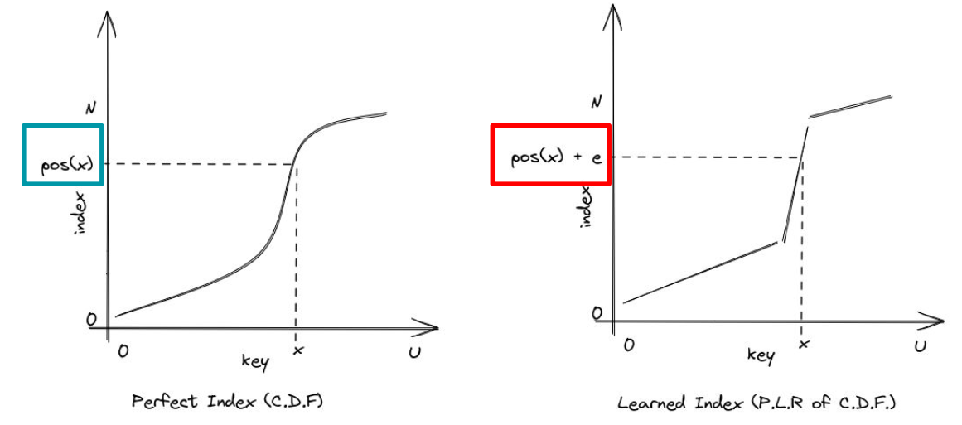
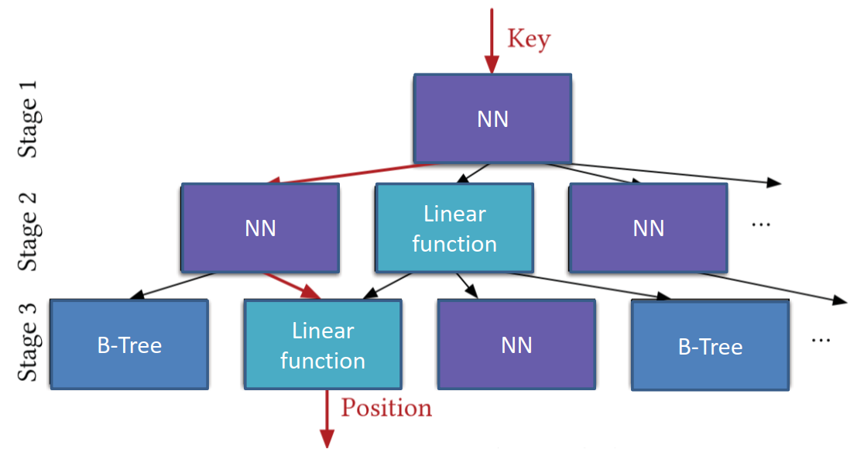
Hybrid Indexes
Simple ReLU neural net (with 0 ~ 2 hidden layers)
Linear regression model
B⁺-tree
Notes:
https://huangliu0909.github.io/2020/09/11/Reading_ppt_Learned_Index/

Slide 29
Data Fitting Models
Linear Model
  Linear interpolation model [MAB+-tree]
  Linear regression model
Non-Linear Model
  Polynomial fitting model
  Neural network model
Hybrid Model
  XIndex: two layers, RMI+piecewise linear models
  …
Zhaoyan Sun, Xuanhe Zhou, and Guoliang Li. Learned Index: A Comprehensive Experimental Evaluation, PVLDB, 2023.
Non-linear models often achieve higher prediction accuracy than linear models, but take more training/prediction overhead
Notes:
Zhaoyan Sun, Xuanhe Zhou, and Guoliang Li. Learned Index: A Comprehensive Experimental Evaluation, PVLDB, 2023. URL: https://www.vldb.org/pvldb/vol16/p1992-li.pdf
LIPP [49] extends the linear function as 𝐹 (𝑥) = 𝑘 · 𝐺 (𝑥) + 𝑏, where 𝑘 is the slope, 𝑏 is the intercept and 𝐺 (𝑥) is any monotonically increasing function that helps to learn more complex key-to-position mappings.
[49] J. Wu, Y. Zhang, S. Chen, J. Wang, Y. Chen, and C. Xing. Updatable learned index with precise positions. In VLDB, volume 14, page 1276, 2021
XIndex [43] adopts a two-layer hierarchical structure, where the first-layer uses an RMI model (as the first layer contains many pairs) and the second-layer nodes use piecewise linear models
[43] C. Tang, Y. Wang, Z. Dong, G. Hu, Z. Wang, M. Wang, and H. Chen. Xindex: A
scalable learned index for multicore data storage. In PPoPP, pages 308–320, 2020.
[MAB+tree] A. H. 0001 and T. Heinis. MADEX: Learning-augmented Algorithmic Index Structures. In B. He, B. Reinwald, and Y. Wu, editors, AIDB@VLDB 2020, 2020.

Slide 30
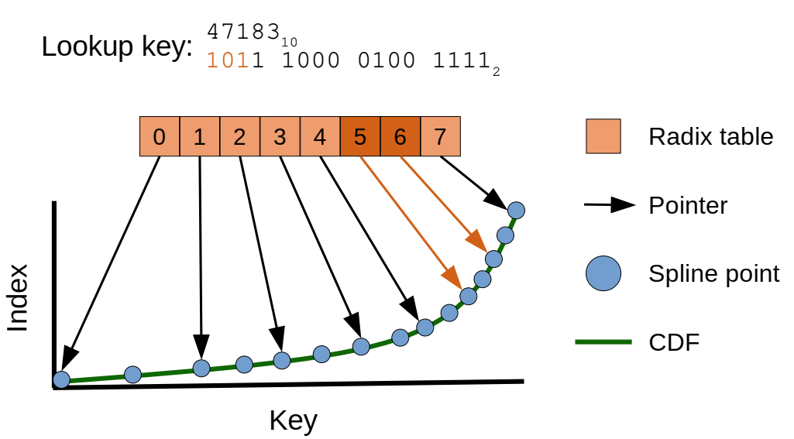
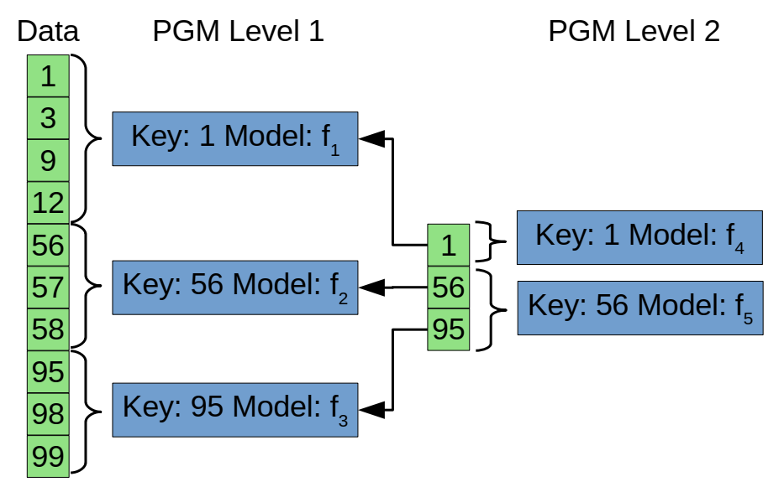
Other Models
Radix Spline (RS) Index
  A radix table
  A set of spline points
Piecewise Geometric Model (PGM) Index
  Multi-level structure
  Error-bounded piecewise linear regression
Notes:
[RS] A. Kipf, R. Marcus, A. van Renen, M. Stoian, A. Kemper, T. Kraska, and T. Neumann. RadixSpline: A single-pass learned index. In Proceedings of the Third International Workshop on Exploiting Artificial Intelligence Techniques for Data Management, aiDM @ SIGMOD ’20, pages 1–5, Portland, Oregon, June 2020.
[PGM] P. Ferragina and G. Vinciguerra. The PGM-index: A fully-dynamic compressed learned index with provable worst-case bounds. Proceedings of the VLDB Endowment, 13(8):1162–1175, Apr. 2020.

Slide 31
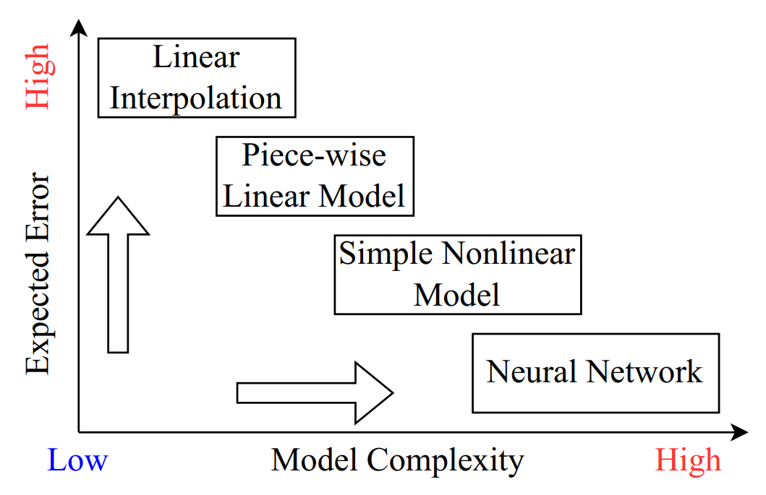
Characteristics of Different Model Choices
Notes:
How good are multi-dimensional learned indexes? An experimental survey
Qiyu Liu, Maocheng Li, Yuxiang Zeng, Yanyan Shen, Lei Chen
The VLDB Journal, 34(2), 2025
URL: https://arxiv.org/abs/2405.05536

Slide 32
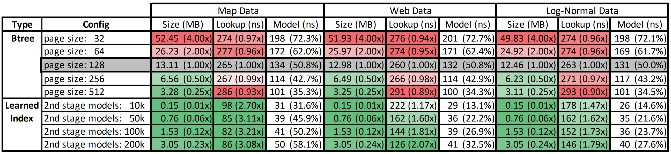
Experimental Results
Learned Index
  2-stage RMI, NN with 0~2 hidden layers and layer width 4-32
Learned Index vs. B⁺-Tree

Slide 33
Some Findings About the Learned Indexes (1)
Some learned indexes can outperform traditional indexes for simple data distributions and read-heavy scenarios
Existing learned indexes have no advantages for complicated data distributions and write-heavy workloads
Zhaoyan Sun, Xuanhe Zhou, and Guoliang Li. Learned Index: A Comprehensive Experimental Evaluation, PVLDB, 2023. URL: https://www.vldb.org/pvldb/vol16/p1992-li.pdf
Notes:
Zhaoyan Sun, Xuanhe Zhou, and Guoliang Li. Learned Index: A Comprehensive Experimental Evaluation, PVLDB, 2023. URL: https://www.vldb.org/pvldb/vol16/p1992-li.pdf

Slide 34
Some Findings About the Learned Indexes (2)
Learned indexes have no significant advantage against traditional indexes for range queries
Learned indexes have no advantage on string keys
Learned indexes have no advantage on bulk loading
Zhaoyan Sun, Xuanhe Zhou, and Guoliang Li. Learned Index: A Comprehensive Experimental Evaluation, PVLDB, 2023. URL: https://www.vldb.org/pvldb/vol16/p1992-li.pdf
Notes:
Zhaoyan Sun, Xuanhe Zhou, and Guoliang Li. Learned Index: A Comprehensive Experimental Evaluation, PVLDB, 2023. URL: https://www.vldb.org/pvldb/vol16/p1992-li.pdf

Slide 35
Some Findings About the Learned Indexes (3)
Non-linear models often achieve higher prediction accuracy than linear models, but take more training/prediction overhead
Some learned indexes (e.g. XIndex and FINEdex) gain both large index size and high insert/lookup latency
Zhaoyan Sun, Xuanhe Zhou, and Guoliang Li. Learned Index: A Comprehensive Experimental Evaluation, PVLDB, 2023. URL: https://www.vldb.org/pvldb/vol16/p1992-li.pdf
Notes:
Zhaoyan Sun, Xuanhe Zhou, and Guoliang Li. Learned Index: A Comprehensive Experimental Evaluation, PVLDB, 2023. URL: https://www.vldb.org/pvldb/vol16/p1992-li.pdf

Slide 36
Some Findings About the Learned Indexes (4)
Learned indexes cannot outperform traditional indexes for concurrent lookups/writes
Learned indexes and traditional indexes achieve similar concurrency performance for range queries
Zhaoyan Sun, Xuanhe Zhou, and Guoliang Li. Learned Index: A Comprehensive Experimental Evaluation, PVLDB, 2023. URL: https://www.vldb.org/pvldb/vol16/p1992-li.pdf
Notes:
Zhaoyan Sun, Xuanhe Zhou, and Guoliang Li. Learned Index: A Comprehensive Experimental Evaluation, PVLDB, 2023. URL: https://www.vldb.org/pvldb/vol16/p1992-li.pdf

Slide 37
Outline
Introduction to the B⁺-Tree Index
Range Index – Learned Index to Replace B⁺-Tree
Point Index – Learned Hash-Map
Existence Index – Learned Bloom Filter
Variants of Learned Indexes

Slide 38
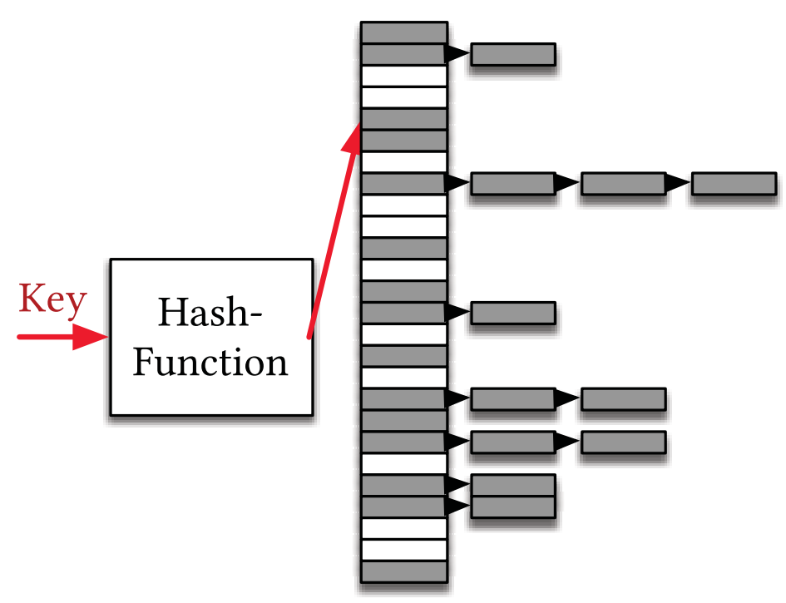
Point Index – Hash-Maps
Hash-maps are for point look-up
  Use a hash-function to deterministically map keys to positions inside an array
Tim Kraska, Alex Beutel, Ed H. Chi, Jeffrey Dean, Neoklis Polyzotis. The Case for Learned Index Structures. SIGMOD Conference, 2018.
Notes:
Tim Kraska, Alex Beutel, Ed H. Chi, Jeffrey Dean, Neoklis Polyzotis. The Case for Learned Index Structures. SIGMOD Conference, 2018. URL: https://dl.acm.org/doi/10.1145/3183713.3196909

Slide 39
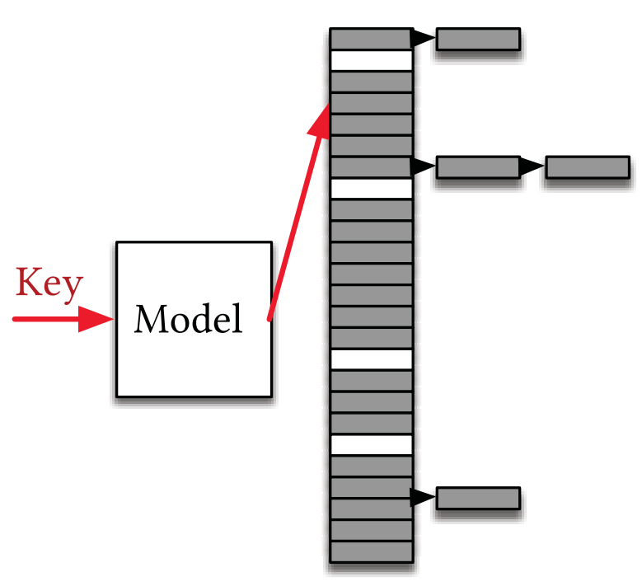
Learned Hash-Map
h(Key) = f (Key)∗M
  M is the size of hash-map
  f is the learning model (recursive model architecture)
Notes:
Tim Kraska, Alex Beutel, Ed H. Chi, Jeffrey Dean, Neoklis Polyzotis. The Case for Learned Index Structures. SIGMOD Conference, 2018. URL: https://dl.acm.org/doi/10.1145/3183713.3196909

Slide 40
Outline
Introduction to the B⁺-Tree Index
Range Index – Learned Index to Replace B⁺-Tree
Point Index – Learned Hash-Map
Existence Index – Learned Bloom Filter
Variants of Learned Indexes

Slide 41

Existence Index – Bloom Filter
Given a Key, return whether or not Key exists in the database
  A bloom filter (BF) is a space-efficient probabilistic data structure (i.e., bit vector) for checking the item existence
Real applications
  Google Chrome has a database of malicious URLs, but it takes a long time to query
  Keyword search in relational databases/knowledge graphs
  Google BigTable uses Bloom filters to reduce disk lookups
  Internet routers often use Bloom filters to track blocked IP addresses
Notes:
https://courses.cs.washington.edu/courses/cse312/21au/files/slides/lec10.pdf

Slide 42
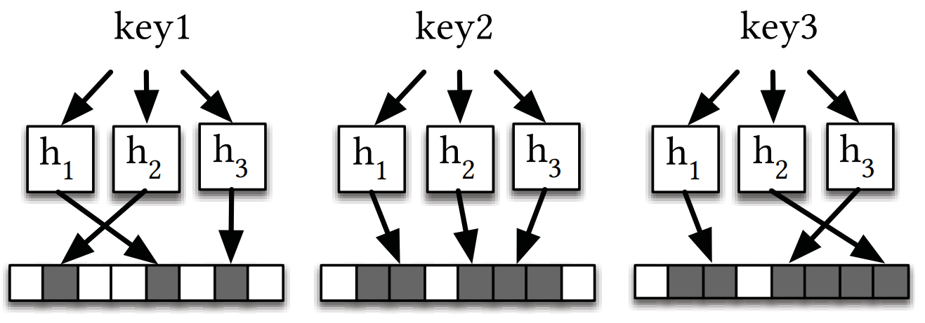
Bloom Filter Insertions
Insertion of key₁, key₂, …, and key_{N} into the bloom filter
Hashing functions, h₁, h₂, …, and h_{m}
Bloom Filter Insertions

Slide 43
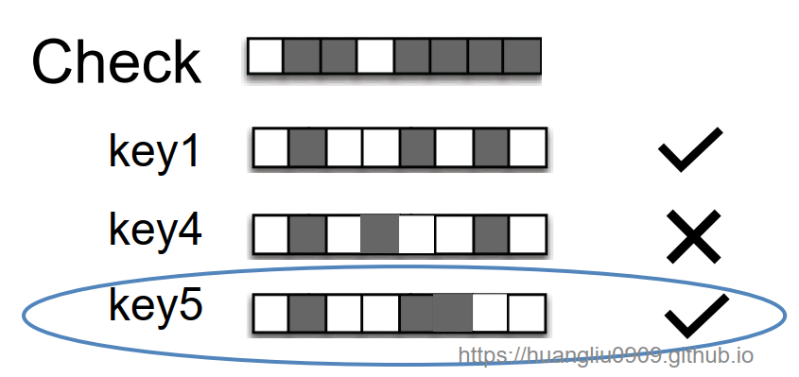


The Usage of the Bloom Filter
No false negatives!
However, false positives may exist!
{key1, key2, key3}
Bloom Filter:
false positive
Notes:
https://huangliu0909.github.io/2020/09/11/Reading_ppt_Learned_Index/

Slide 44
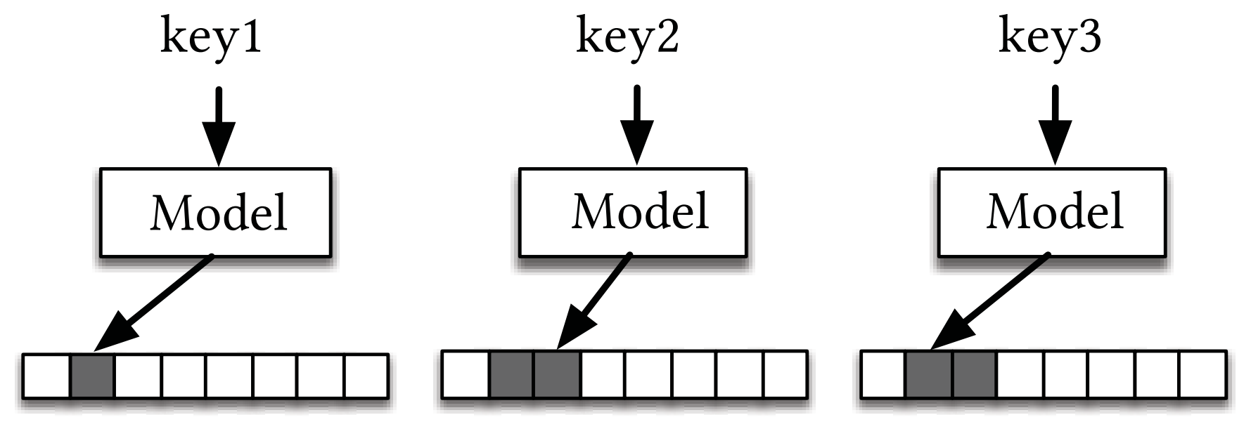
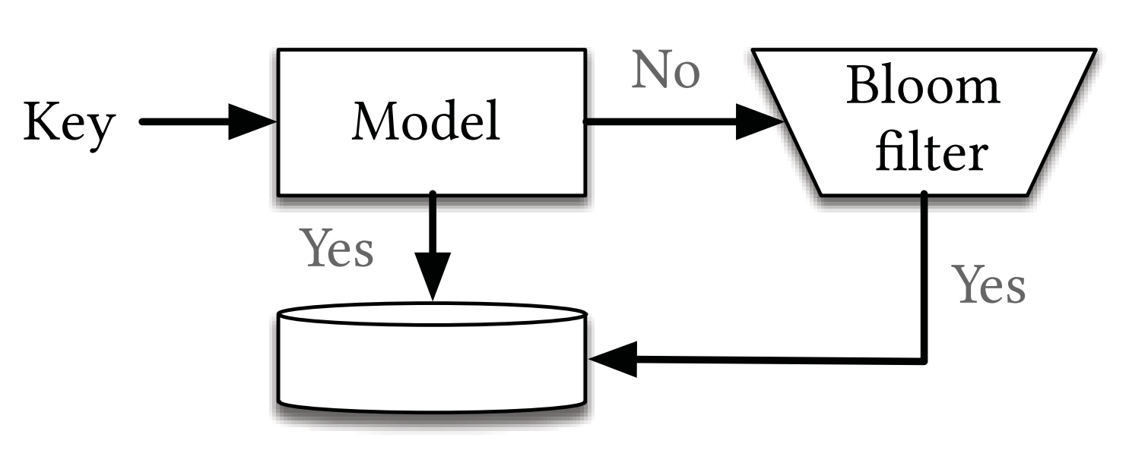
Learned Bloom Filters
Insertions
Existence Checking (Classification)
Notes:
Tim Kraska, Alex Beutel, Ed H. Chi, Jeffrey Dean, Neoklis Polyzotis. The Case for Learned Index Structures. SIGMOD Conference, 2018. URL: https://dl.acm.org/doi/10.1145/3183713.3196909

Slide 45
Learned Bloom Filters (cont'd)
Recurrent Neural Network (RNN) or Convolutional Neural Network (CNN) + Overflow Bloom Filter (BF)
  Map most keys to higher range of bit positions and non-keys to the lower range
  Activation function: Sigmoid
  Minimize the log loss:
Overflow BF
(f (x) ≥ τ)
false positives may exist
No false negatives!

Slide 46
Optimization Question (Homework)
How to set threshold τ in the learned bloom filter?
  Goal: to minimize the false positive rate (FPR), p*
(f (x) ≥ τ)
Tim Kraska, Alex Beutel, Ed H. Chi, Jeffrey Dean, Neoklis Polyzotis. The Case for Learned Index Structures. SIGMOD Conference, 2018.

Slide 47
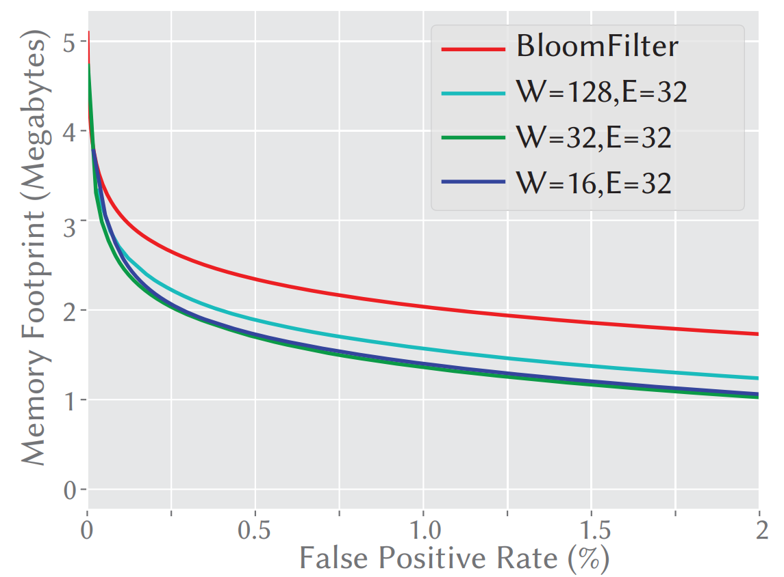
Experimental Results on Memory Consumption
W is the RNN width and E is the embedding size for each character

Slide 48
Outline
Introduction to the B⁺-Tree Index
Range Index – Learned Index to Replace B⁺-Tree
Point Index – Learned Hash-Map
Existence Index – Learned Bloom Filter
Variants of Learned Indexes

Slide 49
Variant Classifications of Learned Indexes
Immutable vs. mutable learned indexes
  Over static or dynamic data
1D vs. multidimensional (→high dimensional) learned indexes
  Over 1-dimensional or multi-dimensional data
Learned indexes over static vs. stream data
…

Slide 50
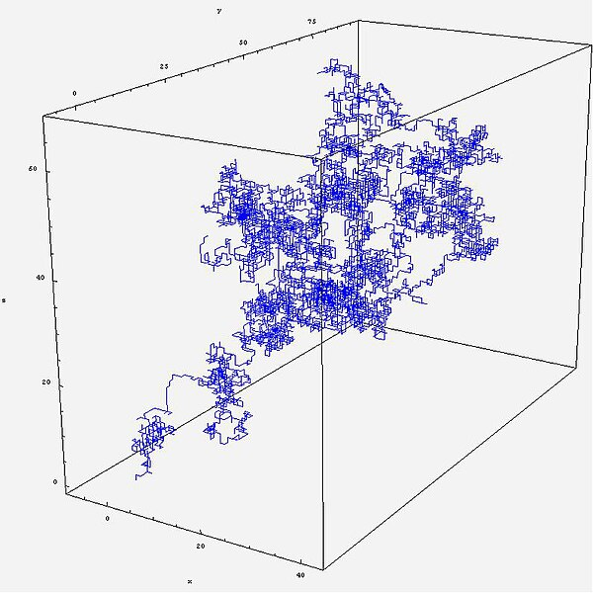
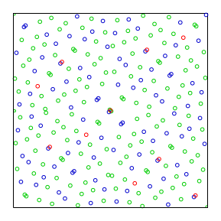

Multidimensional Learned Indexes
Multidimensional (spatial) data
1-dimensional data
2D data
3D data
d-dimensional data
(vector)
(28*28)-dimensional data
(MNIST)
Notes:
https://commons.wikimedia.org/wiki/File:Sobol_sequence_2D.svg
https://commons.wikimedia.org/wiki/File:Marche_aleatoire_3d_bis.JPG
https://www.kaggle.com/datasets/hojjatk/mnist-dataset

Slide 51

Multidimensional Learned Indexes (cont'd)
In multidimensional space, it is not obvious to have a total sort order of multidimensional data
1-dimensional data
d-dimensional data

Slide 52
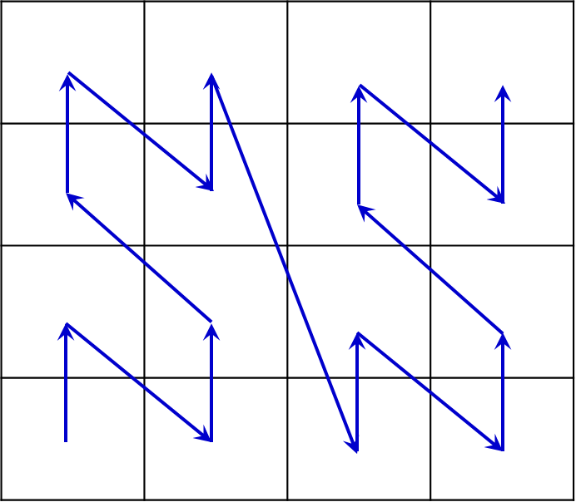
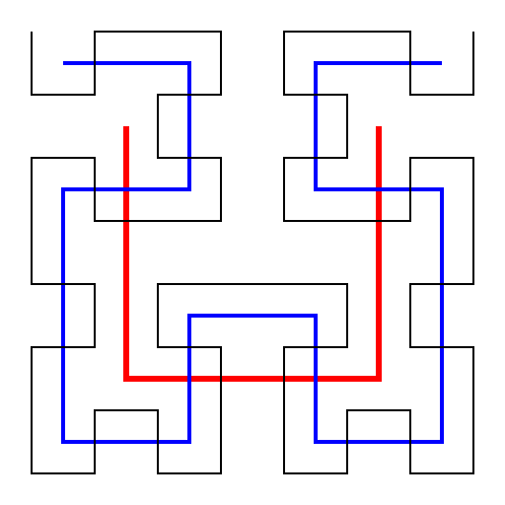
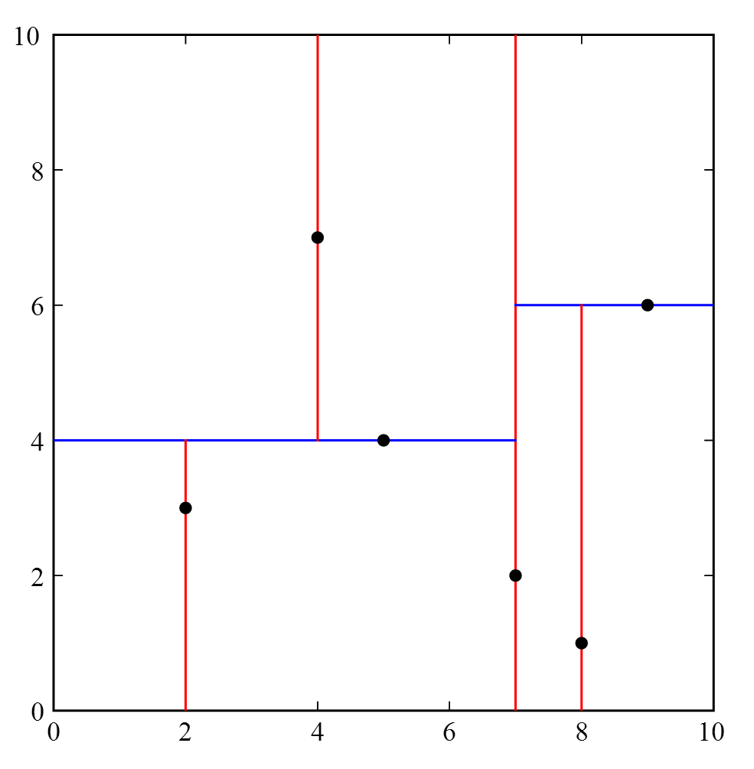
Data Layouts for Multidimensional Learned Indexes
Data Layouts
  Order-based Layout
    Organize multidimensional data points in a pre-defined sorting order
  Partition-based Layout
    Divide the data space into partitions recursively, based on the data distributions [data-based partitioning]
  Grid-based Layout
    Partition the data space into grid cells (usually of equal size) [space partitioning]
Notes:
How good are multi-dimensional learned indexes? An experimental survey
Qiyu Liu, Maocheng Li, Yuxiang Zeng, Yanyan Shen, Lei Chen
The VLDB Journal, 34(2), 2025
URL: https://arxiv.org/abs/2405.05536
H. V. Jagadish: Linear Clustering of Objects with Multiple Atributes. ACM SIGMOD Conference 1990: 332-342
https://en.wikipedia.org/wiki/Hilbert_curve
https://en.wikipedia.org/wiki/K-d_tree
Rigaux, P., Scholl, M., and Voisard, A. 2002. Spatial Databases - with application to GIS. Morgan Kaufmann, San Francisco, 410pp.

Slide 53
Categories of Multidimensional Learned Indexes
Projection-based Indexes
Augmentation-based Indexes
Grid-based Indexes
Notes:
How good are multi-dimensional learned indexes? An experimental survey
Qiyu Liu, Maocheng Li, Yuxiang Zeng, Yanyan Shen, Lei Chen
The VLDB Journal, 34(2), 2025
URL: https://arxiv.org/abs/2405.05536

Slide 54
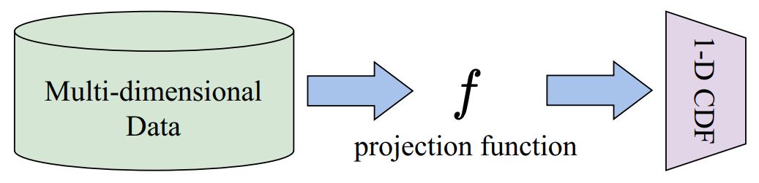
Projection-Based Learned Indexes
Project d-dimensional data points into 1D values
  E.g., Z-order, Hilbert curves, etc.
Use 1D learned index over 1D projected values
  E.g., RMI, PGM, etc.
Index Examples: SageDB, LISA, ZM-Index, ML-Index, etc.
Notes:
How good are multi-dimensional learned indexes? An experimental survey
Qiyu Liu, Maocheng Li, Yuxiang Zeng, Yanyan Shen, Lei Chen
The VLDB Journal, 34(2), 2025
URL: https://arxiv.org/abs/2405.05536

Slide 55
Projection-Based Learned Indexes – ZM-Index
Z-order curve is used as the projection function
Z-order
[ZM-Index] Wang, H., Fu, X., Xu, J., Lu, H.: Learned index for spatial queries. In: MDM, pp. 569–574. IEEE, 2019.
Notes:
[ZM-Index] Wang, H., Fu, X., Xu, J., Lu, H.: Learned index for spatial queries. In: MDM, pp. 569–574. IEEE, 2019.
P. Rigaux, M. Scholl, and A. Voisard. Spatial Databases - with application to GIS. Morgan Kaufmann, San Francisco, 2002.

Slide 56
Z-Ordering
Any object in the cell/pixel has an encoding:
01 10
11
10
01
00
00
01
10
11

Slide 57
Bit-Shuffling
Any object in the cell/pixel has an encoding:
01 10
11
x y
01 10
10
z = (0 1 1 0)₂ = 6
01
00
00
01
10
11
Notes:
http://www.cs.cmu.edu/~christos/courses/721.S03/LECTURES-PDF/0230-z-ordering.PDF

Slide 58
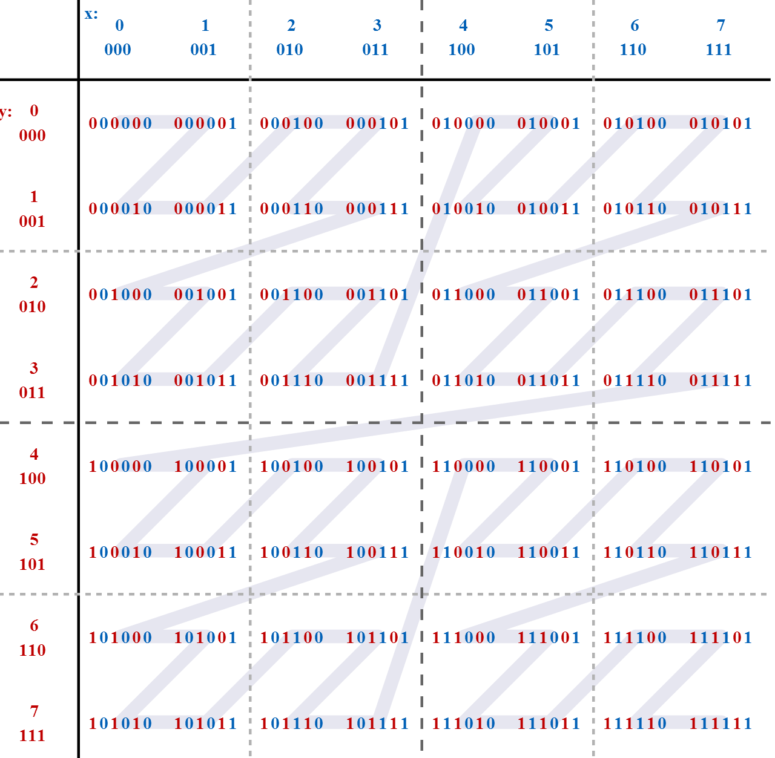
Bit-Shuffling (cont'd)
Interleaving the binary coordinate values yields binary z-values
Notes:
https://en.wikipedia.org/wiki/Z-order_curve#/media/File:Z-curve.svg

Slide 59
Hilbert Curve
Hilbert Curve
  Objects that are close in 1D space are also close in 2D space
  We want objects that are close in 2D space to be close in 1D space
Z-order has some "jumps", whereas Hilbert curve does not
Z-order
Hilbert curve

Slide 60
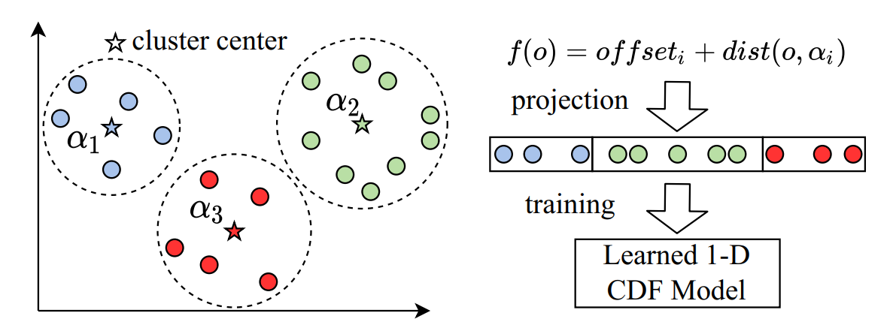
Projection-Based Learned Indexes – ML-Index
Similar to the idea of iDistance (a dimensionality reduction method)
k-means cluster centers are used as reference points
Notes:
[ML-Index] Davitkova, A., Milchevski, E., Michel, S.: The ML-index: A multidimensional, learned index for point, range, and nearest-neighbor queries. In: EDBT, pp. 407–410. OpenProceedings.org, 2020.

Slide 61
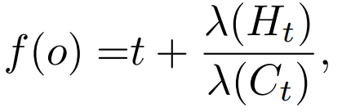
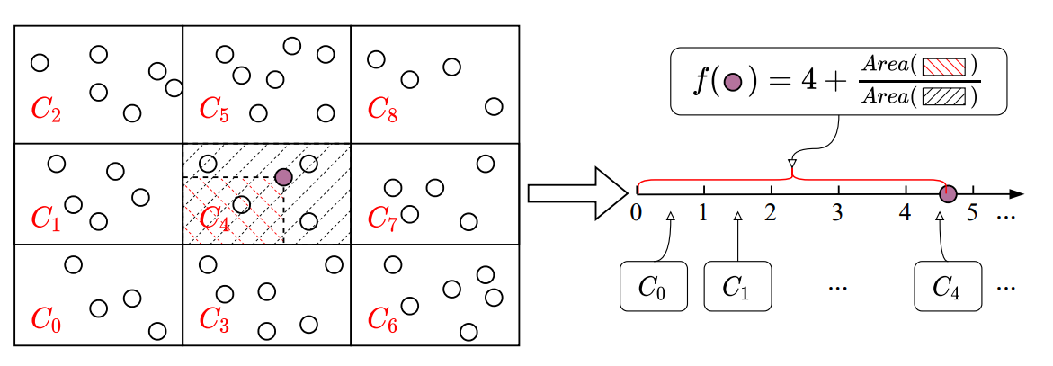
Projection-Based Learned Indexes – LISA
d-dimensional data points are partitioned into T₁ × T₂ × … × T_{d} equal-depth grid cells
Each cell, C_{t}, is associated with a unique ID t
For any object o falling into C_{t} , the projection function f(o) is given by:
Notes:
[LISA] Li, P., Lu, H., Zheng, Q., Yang, L., Pan, G.: LISA: A learned index structure for spatial data. In: SIGMOD Conference, pp. 2119–2133. ACM, 2020.

Slide 62
Categories of Multidimensional Learned Indexes
Projection-based Indexes
Augmentation-based Indexes
Grid-based Indexes
Notes:
How good are multi-dimensional learned indexes? An experimental survey
Qiyu Liu, Maocheng Li, Yuxiang Zeng, Yanyan Shen, Lei Chen
The VLDB Journal, 34(2), 2025
URL: https://arxiv.org/abs/2405.05536

Slide 63
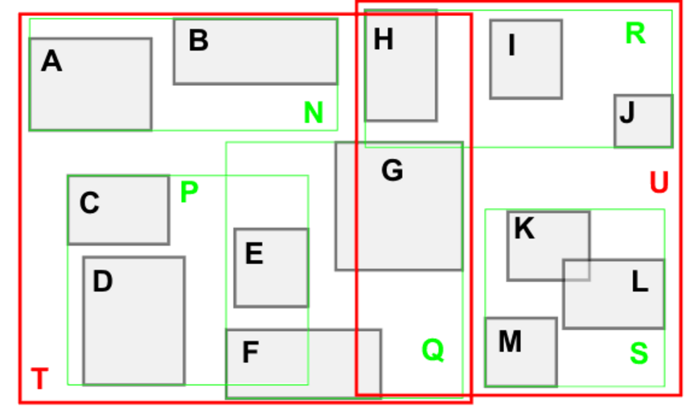
Augmentation-Based Learned Indexes
Extend traditional multidimensional index structures that are based on recursive space partitioning
  E.g., R-tree, kd-tree, etc.
Plug learned models into traditional indexes
Augment the ordinary node search with model-based search
Index Examples: IF-Index, RSMI, etc.
Notes:
http://cglab.ca/~cdillaba/comp5409_project/R_Trees.html
https://en.wikipedia.org/wiki/K-d_tree
How good are multi-dimensional learned indexes? An experimental survey
Qiyu Liu, Maocheng Li, Yuxiang Zeng, Yanyan Shen, Lei Chen
The VLDB Journal, 34(2), 2025
URL: https://arxiv.org/abs/2405.05536

Slide 64
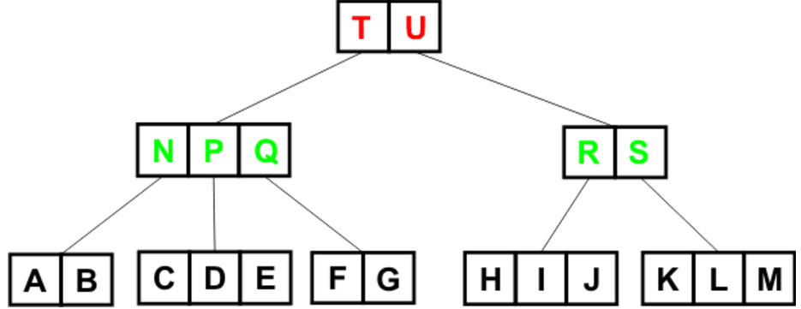
Augmentation-Based Learned Indexes – IF-Index
Augmented R-tree with learned models
A. Guttman. R-trees: a dynamic index structure for spatial searching. In SIGMOD, 1984.
Notes:
[IF-Index] Hadian, A., Kumar, A., Heinis, T.: Hands-off model integration in spatial index structures. In: AIDB@VLDB, 2020.
A. Guttman. R-trees: a dynamic index structure for spatial searching. In SIGMOD, 1984.
http://cglab.ca/~cdillaba/comp5409_project/R_Trees.html

Slide 65
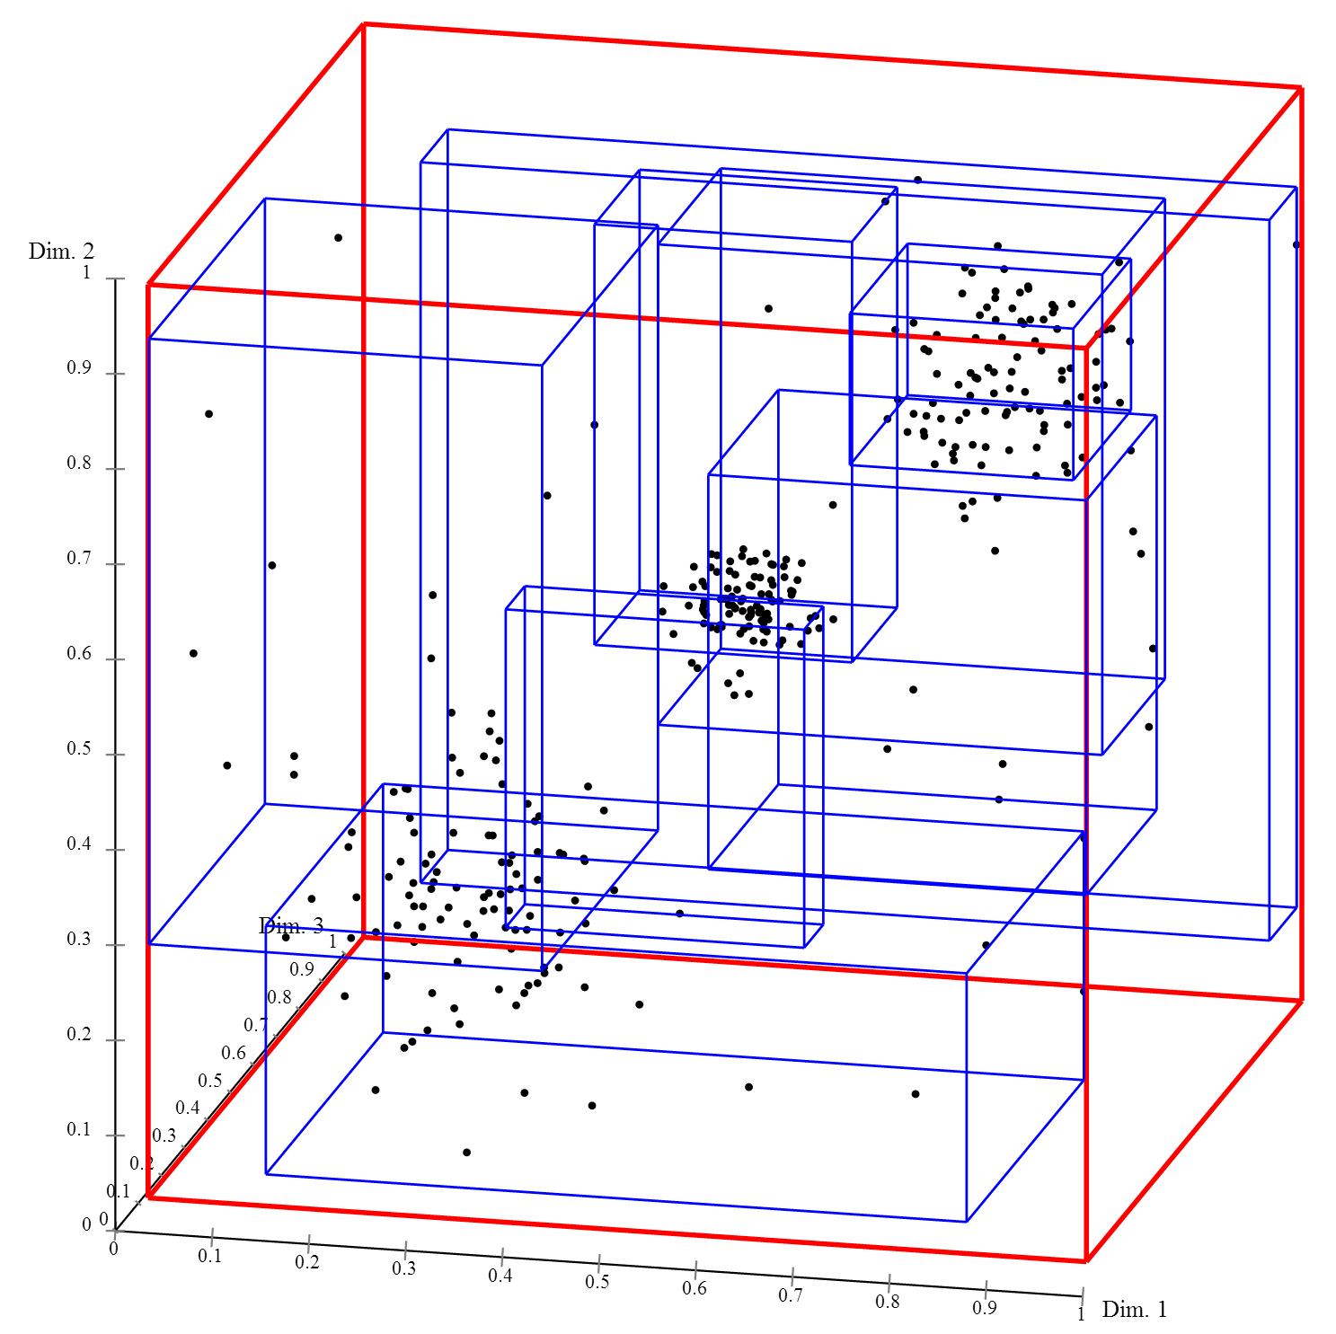
R-Tree in the Multidimensional Space
3D R-Tree:
https://en.wikipedia.org/wiki/R-tree

Slide 66
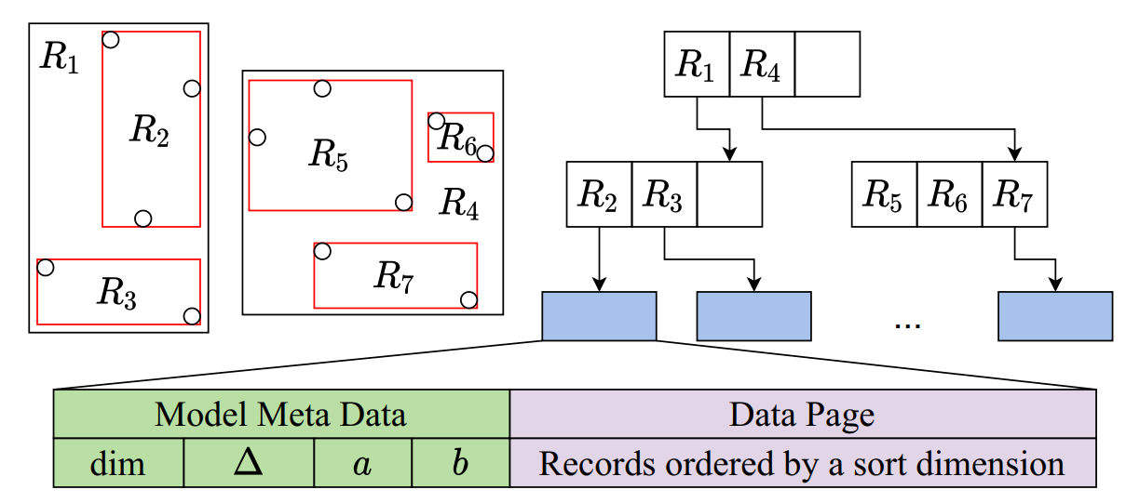
Augmentation-Based Learned Indexes – IF-Index (cont'd)
Augmented R-tree with learned models
  The model-based search in leaf nodes only
dim is the selected sorting dimension, ∆ is the maximum prediction error, and a, b are the slope and interception of the linear model
Notes:
[IF-Index] Hadian, A., Kumar, A., Heinis, T.: Hands-off model integration in spatial index structures. In: AIDB@VLDB, 2020.

Slide 67
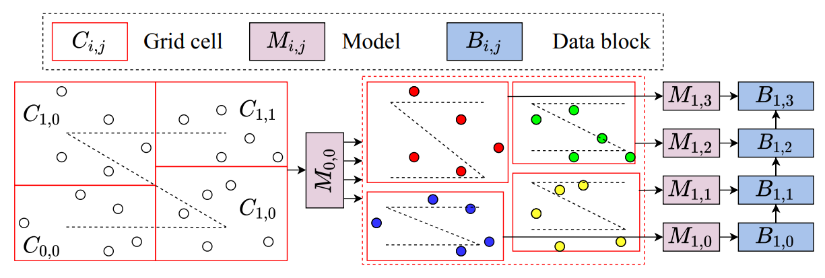
Augmentation-Based Learned Indexes – RSMI
Spatial points are partitioned into equal-depth grid cells, which are ordered by space-filling curves
A learned model M_{i,j} is trained to map each grid cell to its sorting order
Recursively partition data + train models for cells with many points
Data points inside cells are ranked by Z-order curves
Leaf models are trained to predict the block ID for each point
Notes:
[RSMI] Qi, J., Liu, G., Jensen, C.S., Kulik, L.: Effectively learning spatial indices. Proc. VLDB Endow. 13(11), 2341–2354, 2020.

Slide 68
Categories of Multidimensional Learned Indexes
Projection-based Indexes
Augmentation-based Indexes
Grid-based Indexes
Notes:
How good are multi-dimensional learned indexes? An experimental survey
Qiyu Liu, Maocheng Li, Yuxiang Zeng, Yanyan Shen, Lei Chen
The VLDB Journal, 34(2), 2025
URL: https://arxiv.org/abs/2405.05536

Slide 69
Grid-Based Learned Indexes
No physical cells are stored (i.e., only logically)
Learned CDF functions for a set of selected dimensions are trained to locate the grid cell
Index Examples: Flood, Tsunami, etc.
Notes:
How good are multi-dimensional learned indexes? An experimental survey
Qiyu Liu, Maocheng Li, Yuxiang Zeng, Yanyan Shen, Lei Chen
The VLDB Journal, 34(2), 2025
URL: https://arxiv.org/abs/2405.05536

Slide 70
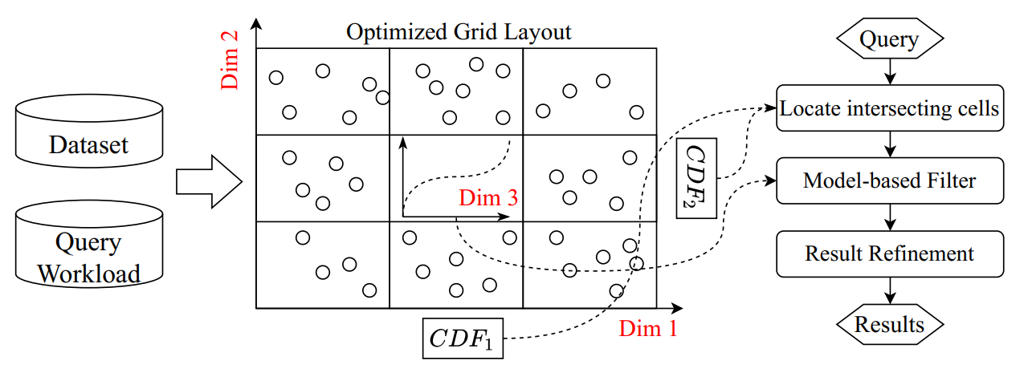
Grid-Based Learned Indexes – Flood
Common grid index as the data layout
(d-1) dimensions are used to construct the grid
The last dimension is chosen for ordering the data within each grid cell
Notes:
[Flood] Nathan, V., Ding, J., Alizadeh, M., Kraska, T.: Learning multi-dimensional indexes. In: SIGMOD Conference, pp. 985–1000. ACM, 2020.

Slide 71
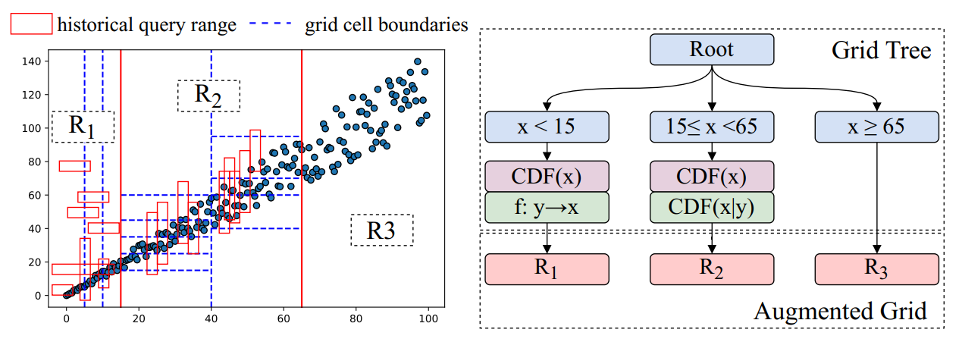
Grid-Based Learned Indexes – Tsunami
Tsunami further improves Flood’s performance on correlated data and skewed query workloads
  A grid tree (similar to kd-tree) adapts to skewed query workloads
  An augmented grid index is optimized to capture data correlations
Notes:
[Tsunami] Ding, J., Nathan, V., Alizadeh, M., Kraska, T.: Tsunami: A learned multi-dimensional index for correlated data and skewed workloads. Proc. VLDB Endow. 14(2), 74–86, 2020.

Slide 72
Learned Indexes Over Stream Data
Data stream applications that need to check the set membership
  Duplicate item detection
  Malicious URL checking
  Web caching
  IP traffic monitoring
Stable Learned Bloom Filters (SLBF)
  Support stream updates
  Low false negative rate, but better false positive rate and storage trade-off
Qiyu Liu, Libin Zheng, Yanyan Shen, Lei Chen. Stable Learned Bloom Filters for Data Streams. Proc. VLDB Endow. 13(11): 2355-2367, 2020.
Notes:
Qiyu Liu, Libin Zheng, Yanyan Shen, Lei Chen:
Stable Learned Bloom Filters for Data Streams. Proc. VLDB Endow. 13(11): 2355-2367 (2020)

Slide 73
Disadvantages of Learned Bloom Filter (LBF)
Learned Bloom Filter (LBF) may have the decayed performance for more and more insertion updates
  High false positive rate (FPR) under many item insertions
For infinite data stream, FPR → 100%
(f (x) ≥ τ)

Slide 74
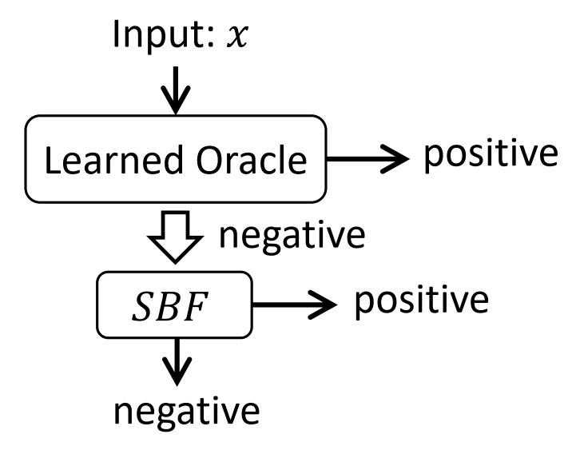
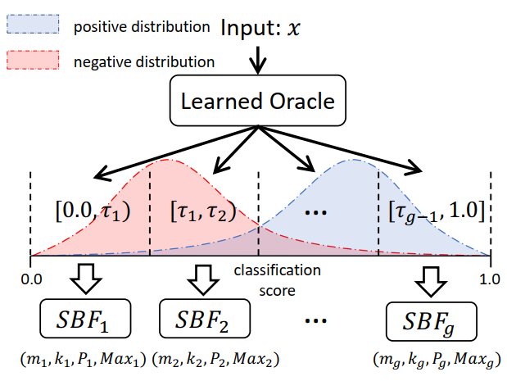
Stable Learned Bloom Filter (SLBF)
Single SLBF (s-SLBF)
  Replace the overflow BF with a backup stable Bloom filter (SBF)
Grouping SLBF (g-SLBF)
  Break the classification score (in range [0, 1]) into several intervals
  Allocate independent sub-filters for each interval
(f (x) ≥ τ)
F. Deng and D. Rafiei. Approximately detecting duplicates for streaming data using stable bloom filters. In SIGMOD, 2006
Notes:
Qiyu Liu, Libin Zheng, Yanyan Shen, Lei Chen:
Stable Learned Bloom Filters for Data Streams. Proc. VLDB Endow. 13(11): 2355-2367 (2020)
F. Deng and D. Rafiei. Approximately detecting
duplicates for streaming data using stable bloom filters. In SIGMOD Conference, pages 25{36. ACM, 2006

Slide 75
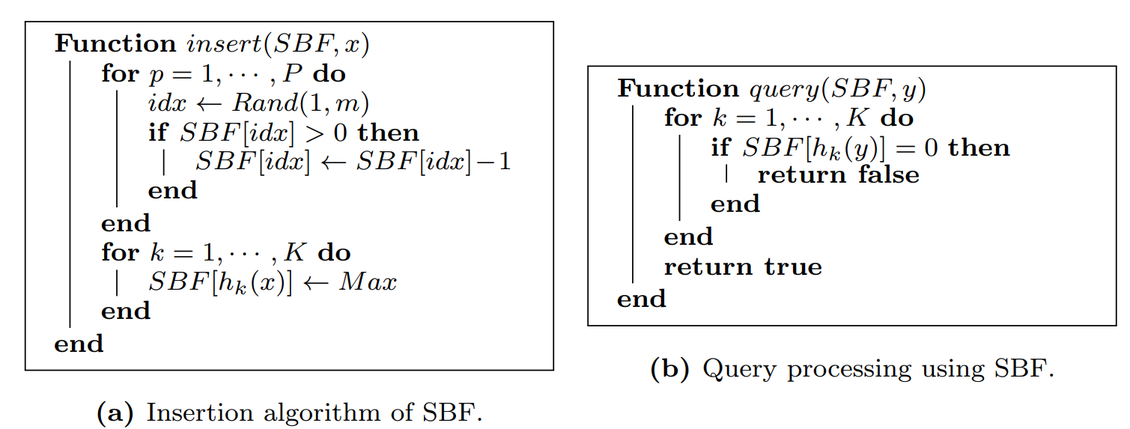
Stable Bloom Filter (SBF)
Clear random bits when inserting an element
F. Deng and D. Rafiei. Approximately detecting duplicates for streaming data using stable bloom filters. In SIGMOD, 2006
Notes:
F. Deng and D. Rafiei. Approximately detecting
duplicates for streaming data using stable bloom filters. In SIGMOD Conference, pages 25{36. ACM, 2006

Slide 76
Pros and Cons of Learned Indexes
Pros
  Lower space cost
  Lower computational cost
Cons
  Challenging to design learned indexes with low FPR and high accuracy
  May not adapt to changing data distributions (e.g., for stream data with updates)
  Costly for index updates

Slide 77
Summary
The Motivation, Structure, and Usage of the B⁺-Tree Index, Hash, and Bloom Filter
Range Index – Learned Index to Replace B⁺-Tree
Point Index – Learned Hash-Map
Existence Index – Learned Bloom Filter
Variants of Learned Indexes
  Learned Indexes Over Multidimensional Data
  Stable Learned Bloom Filter (SLBF) for stream updates
Pros and Cons of Learned Indexes

Slide 78
Reading Materials
[RMI] Tim Kraska, Alex Beutel, Ed H. Chi, Jeffrey Dean, Neoklis Polyzotis. The Case for Learned Index Structures. SIGMOD Conference, 2018. URL: https://dl.acm.org/doi/10.1145/3183713.3196909
[PLEX] M. Stoian, A. Kipf, R. Marcus, and T. Kraska. Towards Practical Learned Indexing. In AIDB@VLDB 2021, 2021.
[GRE] C. Wongkham, B. Lu, C. Liu, Z. Zhong, E. Lo, and T. Wang. Are updatable learned indexes ready? Proc. VLDB Endow., 15(11):3004–3017, jul 2022. URL: https://www.vldb.org/pvldb/vol15/p3004-wongkham.pdf
[RS] A. Kipf, R. Marcus, A. van Renen, M. Stoian, A. Kemper, T. Kraska, and T. Neumann. RadixSpline: A single-pass learned index. In Proceedings of the Third International Workshop on Exploiting Artificial Intelligence Techniques for Data Management, aiDM @ SIGMOD ’20, pages 1–5, Portland, Oregon, June 2020.
C. Tang, Y. Wang, Z. Dong, G. Hu, Z. Wang, M. Wang, and H. Chen. Xindex: A scalable learned index for multicore data storage. In PPoPP, pages 308–320, 2020. URL: https://dl.acm.org/doi/10.1145/3332466.3374547
Notes:
RS = radix spline

Slide 79
Reading Materials (cont'd)
[DPGM] P. Ferragina and G. Vinciguerra. The PGM-index: A fully-dynamic compressed learned index with provable worst-case bounds. In VLDB, volume 13, pages 1162–1175, 2020.
[XIndex] C. Tang, Y. Wang, Z. Dong, G. Hu, Z. Wang, M. Wang, and H. Chen. Xindex: A scalable learned index for multicore data storage. In PPoPP, pages 308–320, 2020
[SIndex] Y. Wang, C. Tang, Z. Wang, and H. Chen. SIndex: A scalable learned index for string keys. In APSys 2020, pages 17–24, 2020.
[FINEdex] P. Li, Y. Hua, J. Jia, and P. Zuo. FINEdex: A Fine-grained Learned Index Scheme for Scalable and Concurrent Memory Systems. In VLDB, volume 15, pages 321–334, 2021.
[ALEX] J. Ding, U. F. Minhas, J. Yu, C. Wang, J. Do, Y. Li, H. Zhang, B. Chandramouli, J. Gehrke, D. Kossmann, D. Lomet, and T. Kraska. ALEX: An Updatable Adaptive Learned Index. In SIGMOD, pages 969–984, 2020. URL: https://dl.acm.org/doi/10.1145/3318464.3389711
[LIPP] J. Wu, Y. Zhang, S. Chen, J. Wang, Y. Chen, and C. Xing. Updatable learned index with precise positions. In VLDB, volume 14, page 1276, 2021. URL: https://vldb.org/pvldb/vol14/p1276-wu.pdf
[MAB+tree] A. H. 0001 and T. Heinis. MADEX: Learning-augmented Algorithmic Index Structures. In B. He, B. Reinwald, and Y. Wu, editors, AIDB@VLDB 2020, 2020.

Slide 80
Reading Materials – Survey
Qiyu Liu, Maocheng Li, Yuxiang Zeng, Yanyan Shen, Lei Chen. How good are multi-dimensional learned indexes? An experimental survey. The VLDB Journal, 34(2), 2025. URL: https://arxiv.org/abs/2405.05536
Zhaoyan Sun, Xuanhe Zhou, and Guoliang Li. Learned Index: A Comprehensive Experimental Evaluation, PVLDB, 2023. URL: https://www.vldb.org/pvldb/vol16/p1992-li.pdf
Qiyu Liu, Siyuan Han, Yanlin Qi, Jingshu Peng, Jin Li, Longlong Lin, Lei Chen. Why Are Learned Indexes So Effective but Sometimes Ineffective? PVLDB, 2025. URL: https://arxiv.org/pdf/2410.00846
R. Marcus, A. Kipf, A. van Renen, M. Stoian, S. Misra, A. Kemper, T. Neumann, and T. Kraska. Benchmarking learned indexes. Proc. VLDB Endow., 14(1):1–13, sep 2020. URL: https://vldb.org/pvldb/vol14/p1-marcus.pdf

Slide 81
Reading Materials – Multidimensional Learned Indexes
[GLIN-ALEX] Congying Wang and Jia Yu. GLIN: A Lightweight Learned Indexing Mechanism for Complex Geometries. arXiv preprint arXiv:2207.07745, 2022.
[SLBRIN] Lijun Wang, Linshu Hu, Chenhua Fu, Yuhan Yu, Peng Tang, Feng Zhang, and Renyi Liu. SLBRIN: A Spatial Learned Index Based on BRIN. ISPRS International Journal of Geo-Information 12, 4, 171, 2023.
[LSTI] Xiaofeng Ding, Yinting Zheng, Zuan Wang, Kim-Kwang Raymond Choo, and Hai Jin. A learned spatial textual index for efficient keyword queries. Journal of Intelligent Information Systems 60, 3, page 803–827, 2023.
[IF-X] Ali Hadian, Ankit Kumar, and Thomas Heinis. Hands-off Model Integration in Spatial Index Structures. In Proceedings of the 2nd International Workshop on Applied AI for Database Systems and Applications, 2020.
[Period Index] Andreas Behrend, Anton Dignös, Johann Gamper, Philip Schmiegelt, Hannes Voigt, Matthias Rottmann, and Karsten Kahl. Period Index: A Learned 2D Hash Index for Range and Duration Queries. In Proceedings of the 16th International Symposium on Spatial and Temporal Databases. 100–109, 2019

Slide 82
Reading Materials – Multidimensional Learned Indexes (cont'd)
[ZM-Index] Wang, H., Fu, X., Xu, J., Lu, H.: Learned index for spatial queries. In: MDM, pp. 569–574. IEEE, 2019.
[ML-Index] Davitkova, A., Milchevski, E., Michel, S.: The ML-index: A multidimensional, learned index for point, range, and nearest-neighbor queries. In: EDBT, pp. 407–410. OpenProceedings.org, 2020.
[LISA] Li, P., Lu, H., Zheng, Q., Yang, L., Pan, G.: LISA: A learned index structure for spatial data. In: SIGMOD Conference, pp. 2119–2133. ACM, 2020.
[IF-Index] Hadian, A., Kumar, A., Heinis, T.: Hands-off model integration in spatial index structures. In: AIDB@VLDB, 2020.
[RSMI] Qi, J., Liu, G., Jensen, C.S., Kulik, L.: Effectively learning spatial indices. Proc. VLDB Endow. 13(11), 2341–2354, 2020.
[Flood] Nathan, V., Ding, J., Alizadeh, M., Kraska, T.: Learning multi-dimensional indexes. In: SIGMOD Conference, pp. 985–1000. ACM, 2020.
[Tsunami] Ding, J., Nathan, V., Alizadeh, M., Kraska, T.: Tsunami: A learned multi-dimensional index for correlated data and skewed workloads. Proc. VLDB Endow. 14(2), 74–86, 2020.

Slide 83
Reading Materials – Variants
[MetaBF] Jack Rae, Sergey Bartunov, and Timothy Lillicrap. Meta-learning neural bloom filters. In International Conference on Machine Learning, pages 5271–5280, 2019.
[Google-index] Hussam Abu-Libdeh, Deniz Altınbüken, Alex Beutel, Ed H Chi, Lyric Doshi, Tim Kraska, Andy Ly, Christopher Olston, et al. Learned indexes for a google-scale disk-based database. arXiv preprint arXiv:2012.12501, 2020.
[HLI] Yuquan Ding, Xujian Zhao, and Peiquan Jin. An Error-Bounded Space-Efficient Hybrid Learned Index with High Lookup Performance. In International Conference on Database and Expert Systems Applications. Springer, pages 216–228, 2022.
[AELH] Yuming Lin, Zhengguo Huang, and You Li. Learning hash index based on a shallow autoencoder. Applied Intelligence 53, 12 (2023), pages 14999–15010, 2023.

Slide 84
Reading Materials – Variants (cont'd)
Qiyu Liu, Maocheng Li, Yuxiang Zeng, Yanyan Shen, Lei Chen. How good are Qiyu Liu, Yanyan Shen, and Lei Chen. Stable Learned Bloom Filters for Data Streams. PVLDB, 2020. URL: https://www.vldb.org/pvldb/vol13/p2355-liu.pdf

