Slide 1
AI for DB (AI4DB)
Chapter 5: Learning-based Cost/ Cardinality Estimation
Instructor: Xiang Lian
Email: xxl1584@case.edu
Homepage: http://www.cs.kent.edu/~xlian/
Notes:
The slides of this AI4DB course used some public slides/materials on the Web for teaching purposes only. I would like to acknowledge these resources, and please let me know if I failed to cite them or you want to remove them from my slides.

Slide 2
Objectives
In this chapter, we will:
  Learn the problem of the cardinality/cost/value estimation via learning models
  Understand the learning-based approaches for the cardinality estimation of LIKE predicates

Slide 3
Outline
Introduction
Problem Definition of the Cardinality Estimation
Cardinality Estimation Techniques
Cardinality Estimation for Approximate String Matching
Learning-based Approaches for the Cardinality Estimation of LIKE Predicates
Path Length Estimation in Graphs

Slide 4
Introduction
The cardinality estimation has been used in many real scenarios
  The design of the join order or query plan in relational databases
    Relational queries
    LIKE predicates
  Network security monitoring
  Data streams
  Search engines
  Online data mining
  …

Slide 5
Cardinality Semantics
The number of (unique) attribute values satisfying some predicates
The number of (distinct) tuples satisfying some predicates
The number of substring occurrences in a column (attribute)
Notes:
Hazar Harmouch, Felix Naumann:
Cardinality Estimation: An Experimental Survey. Proc. VLDB Endow. 11(4): 499-512 (2017)

Slide 6
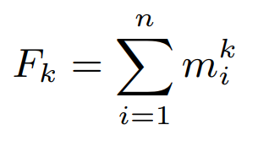
Problem Definition of the Cardinality
Input:
  Given a multi-set E = (e₁, e₂, ..., e_{n}) of size n, where e_{j} is from a domain [1, N], and
  The number of occurences of i (within [1, N]) in E, m_{i} = |{j | e_{j} = i}|
Output: frequency moments, F_{k}
Cardinality (zeroth frequency moment, F₀): The number of unique attribute values (i.e., k = 0)
Notes:
Hazar Harmouch, Felix Naumann:
Cardinality Estimation: An Experimental Survey. Proc. VLDB Endow. 11(4): 499-512 (2017)

Slide 7
Classification of Cardinality Estimation Approaches
Exact Cardinality Estimation
  Expensive in terms of space and running time
Approximate Cardinality Estimation
  Trading accuracy for efficiency
Notes:
Hazar Harmouch, Felix Naumann:
Cardinality Estimation: An Experimental Survey. Proc. VLDB Endow. 11(4): 499-512 (2017)

Slide 8

Cardinality Estimation Approaches – Bitmap
Bitmap of size N
  Each bit represents one attribute value
  Space-efficient
Bitmap Construction
  All bits in the bitmap are initialized with 0s
  Scan the data set item-wise and set the i-th position of the bitmap to 1, if an item e_{j} has the value i
Estimation via bitmap
  Count the number of 1s in the bitmap
Notes:
Hazar Harmouch, Felix Naumann:
Cardinality Estimation: An Experimental Survey. Proc. VLDB Endow. 11(4): 499-512 (2017)
https://en.wikipedia.org/wiki/Bitmap
https://commons.wikimedia.org/wiki/File:Bitmapfont.png

Slide 9
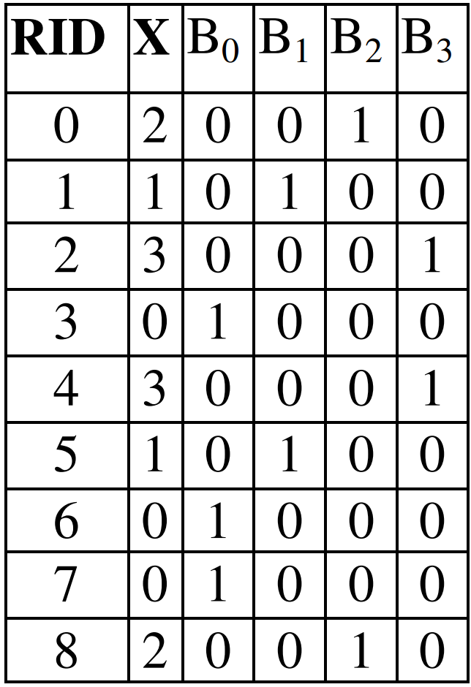


Example of Bitmap
If the domain of an integer attribute is {0, 1, 2, 3}, then bitmap needs 4 bits to represent, instead of 4 bytes (i.e., 32 bits)
another attribute value 3
integers
bits
Bitmaps B₀~B₃ for attribute X
Notes:
Hazar Harmouch, Felix Naumann:
Cardinality Estimation: An Experimental Survey. Proc. VLDB Endow. 11(4): 499-512 (2017)
https://en.wikipedia.org/wiki/Bitmap_index
https://docs.oracle.com/cd/B28359_01/server.111/b28313/indexes.htm#CIHGAFFF
http://www.vldb.org/pvldb/vol8/p1382-nagarkar.pdf
https://sdm.lbl.gov/~kewu/ps/LBNL-62756.pdf

Slide 10
Cardinality Estimation Approaches – Sorting
Sort all items in the data set
Eliminate all duplicates for consecutive items in the sorted list
However, it is computationally expensive for large-scale data sets!
Notes:
Hazar Harmouch, Felix Naumann:
Cardinality Estimation: An Experimental Survey. Proc. VLDB Endow. 11(4): 499-512 (2017)

Slide 11
Cardinality Estimation Approaches – Hashing
The Construction of a Hash Table
  Scan the data set for one pass
  Hash each item to a bucket and ignore duplicates
However, it requires high memory cost for hashing, sometimes even worse than sorting
Notes:
Hazar Harmouch, Felix Naumann:
Cardinality Estimation: An Experimental Survey. Proc. VLDB Endow. 11(4): 499-512 (2017)

Slide 12
Cardinality Estimation Approaches – Bloom Filter
Bitmap of hash values (Bloom filter)
  Bit vector of size much smaller than N
It requires a prior knowledge of maximum expected cardinality to choose the best bit vector size
A. Kumar, J. Xu, and J. Wang. Space-code Bloom filter for efficient per-flow traffic measurement. IEEE Journal on Selected Areas in Communications, 24(12):2327{2339, 2006.
Notes:
Hazar Harmouch, Felix Naumann:
Cardinality Estimation: An Experimental Survey. Proc. VLDB Endow. 11(4): 499-512 (2017)
https://en.wikipedia.org/wiki/Bloom_filter
A. Kumar, J. Xu, and J. Wang. Space-code Bloom
filter for efficient per-flow traffic measurement. IEEE Journal on Selected Areas in Communications, 24(12):2327{2339, 2006.

Slide 13
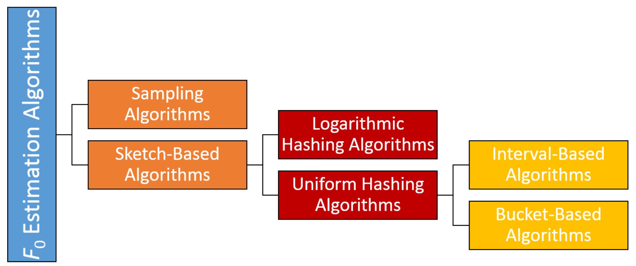
Approximate Cardinality Estimation
Notes:
Hazar Harmouch, Felix Naumann:
Cardinality Estimation: An Experimental Survey. Proc. VLDB Endow. 11(4): 499-512 (2017)

Slide 14


Cardinality Estimation Approaches – Sketch
N is the number of items and n is the size of the universe
Build a synopsis M of small size L
Use an estimator, , to estimate the cardinality F₀ for one pass
FM Algorithm [1985]
  Hash each item v to a random position M[i] in a bit vector M and let M[i] = 1
  Each bit M[i] is selected with probability 1/2^{i+1}
[FM] Flajolet, P., Martin, G.N.: Probabilistic counting algorithms for data base applications. J. of Computer and System Sciences 31 (1985) 182–209
Notes:
Hazar Harmouch, Felix Naumann:
Cardinality Estimation: An Experimental Survey. Proc. VLDB Endow. 11(4): 499-512 (2017)
M. Charikar, S. Chaudhuri, R. Motwani, and
V. Narasayya. Towards estimation error guarantees for distinct values. In Proceedings of the Symposium on Principles of Database Systems (PODS), pages 268{279, 2000.
P. Flajolet. On adaptive sampling. Computing,
43(4):391{400, 1990.
P. B. Gibbons. Distinct sampling for highly-accurate
answers to distinct values queries and event reports. In Proceedings of the International Conference on Very Large Databases (VLDB), volume 1, pages 541{550, 2001.
P. J. Haas, J. F. Naughton, S. Seshadri, and L. Stokes.
Sampling-based estimation of the number of distinct values of an attribute. In Proceedings of the International Conference on Very Large Databases (VLDB), volume 95, pages 311{322, 1995.
Flajolet, P., Martin, G.N.: Probabilistic counting algorithms for data base applications. J. of Computer and System Sciences 31 (1985) 182–209
Let bit(y, k) be the k-th bit of the binary representation of y

Slide 15

Cardinality Estimation Approaches – Sketch (cont'd)
FM Implementation
  Determine the largest b such that the b rightmost bits are all 0s in hashed value h(v)
  Set the b-th bit of M to 1 (i.e., M[b] = 1)
  Let Z = min{i : M[i] = 0} (i.e., the least significant 0-bit in M)
  Estimate the cardinality F₀ as 2^{Z}/0.77351
[FM] Flajolet, P., Martin, G.N.: Probabilistic counting algorithms for data base applications. J. of Computer and System Sciences 31 (1985) 182–209
Notes:
Hazar Harmouch, Felix Naumann:
Cardinality Estimation: An Experimental Survey. Proc. VLDB Endow. 11(4): 499-512 (2017)

Slide 16
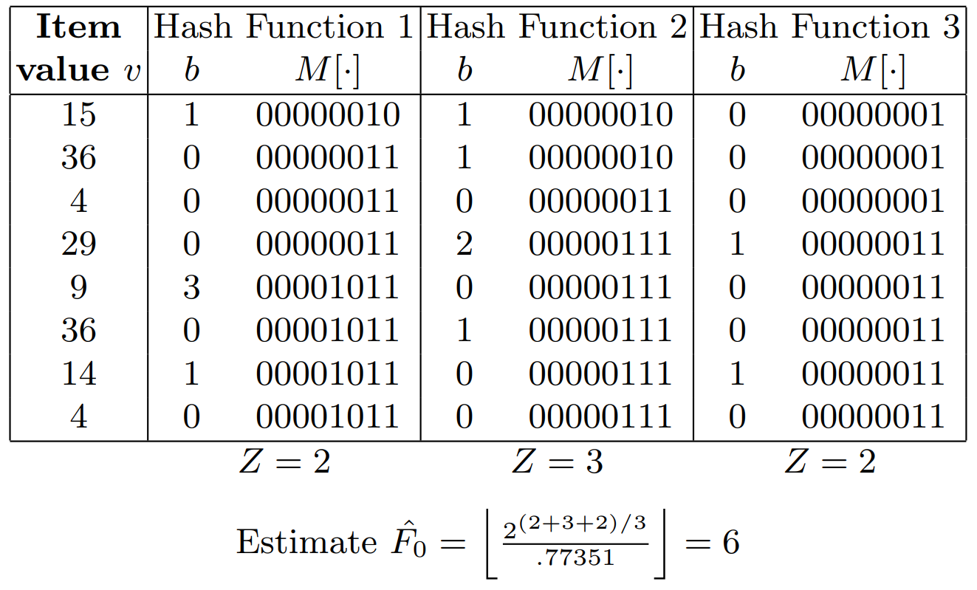
Example of Sketch-Based Cardinality Estimation
M[0] is the rightmost bit
Notes:
Hazar Harmouch, Felix Naumann:
Cardinality Estimation: An Experimental Survey. Proc. VLDB Endow. 11(4): 499-512 (2017)

Slide 17
Cardinality Estimation Approaches – Sketch (cont'd)
AMS Algorithm [1999]
  Use hash function h(v) = A ⋅ v + B, for random numbers A and B
  For each item v, obtain b ≥ 0, which is the largest one such that b rightmost bits in h(v) are all 0s
  Let R be the largest b value for all items
  Estimate the cardinality F₀ as 2^{R}
[AMS] Alon, N., Matias, Y., Szegedy, M.: The space complexity of approximating the frequency moments. J. of Computer and System Sciences 58 (1999) 137–147.
Notes:
Hazar Harmouch, Felix Naumann:
Cardinality Estimation: An Experimental Survey. Proc. VLDB Endow. 11(4): 499-512 (2017)
Alon, N., Matias, Y., Szegedy, M.: The space complexity of approximating the
frequency moments. J. of Computer and System Sciences 58 (1999) 137–147

Slide 18
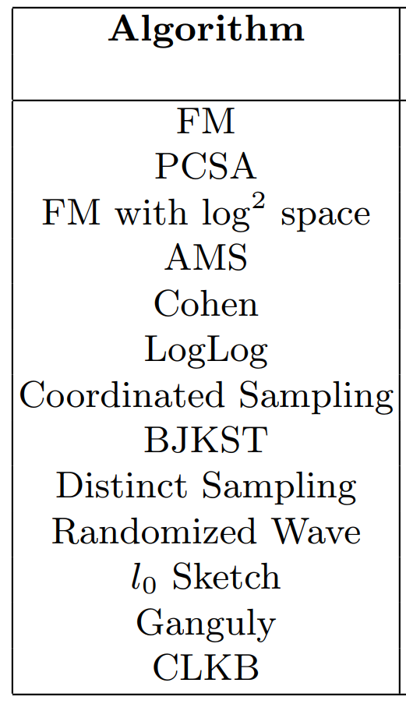
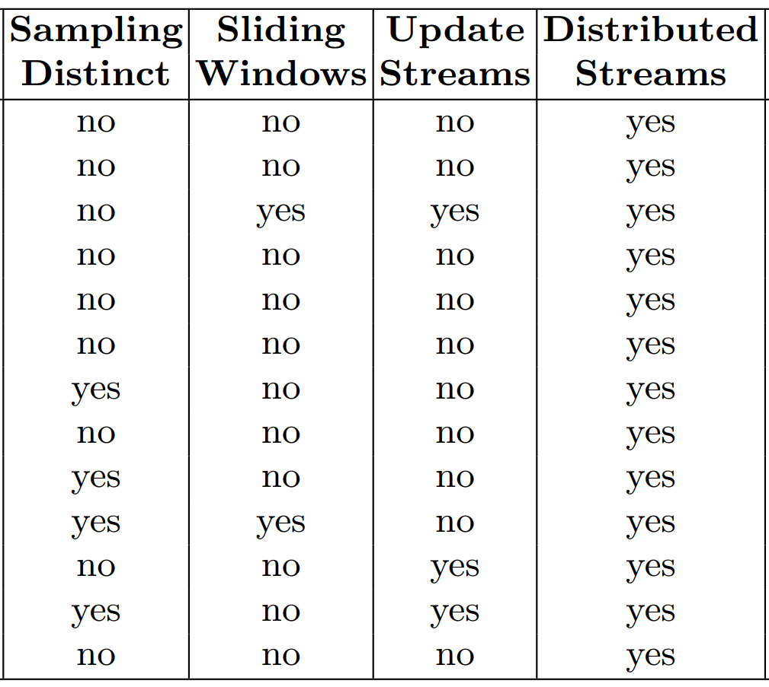


Cardinality Estimation Approaches – Sketch (cont'd)
Many more:
  PCSA Algorithm [1985]
  Loglog Algorithm [2003]
  …
[PCSA] Flajolet, P., Martin, G.N.: Probabilistic counting algorithms for data base applications. J. of Computer and System Sciences 31 (1985) 182–209.
[Loglog] Durand, M., Flajolet, P.: Loglog counting of large cardinalities. In: Proc. 11th European Symp. on Algorithms. (2003) 605–617.
Notes:
Hazar Harmouch, Felix Naumann:
Cardinality Estimation: An Experimental Survey. Proc. VLDB Endow. 11(4): 499-512 (2017)
[PCSA] Flajolet, P., Martin, G.N.: Probabilistic counting algorithms for data base applications. J. of Computer and System Sciences 31 (1985) 182–209.
[Loglog] Durand, M., Flajolet, P.: Loglog counting of large cardinalities. In: Proc. 11th European Symp. on Algorithms. (2003) 605–617.

Slide 19
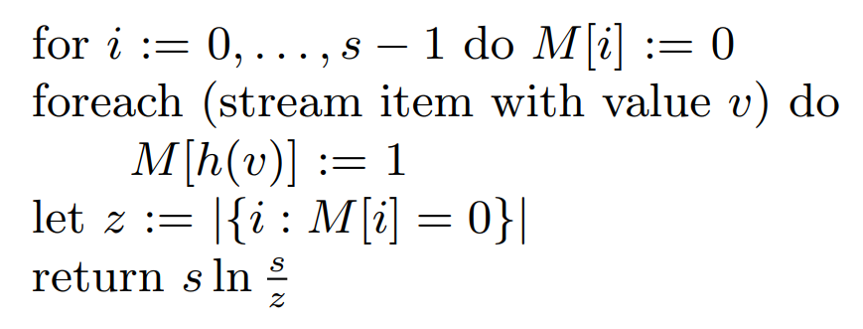
Cardinality Estimation Approaches – Sketch (cont'd)
Linear Counting (LC) Algorithm [1990]
  A uniform hashing algorithm
[LC] Whang, K.Y., Vander-Zanden, B.T., Taylor, H.M.: A linear-time probabilistic counting algorithm for database applications. ACM Transactions on Database Systems 15 (1990) 208–229
Notes:
Hazar Harmouch, Felix Naumann:
Cardinality Estimation: An Experimental Survey. Proc. VLDB Endow. 11(4): 499-512 (2017)
[LC] Whang, K.Y., Vander-Zanden, B.T., Taylor, H.M.: A linear-time probabilistic
counting algorithm for database applications. ACM Transactions on Database
Systems 15 (1990) 208–229

Slide 20
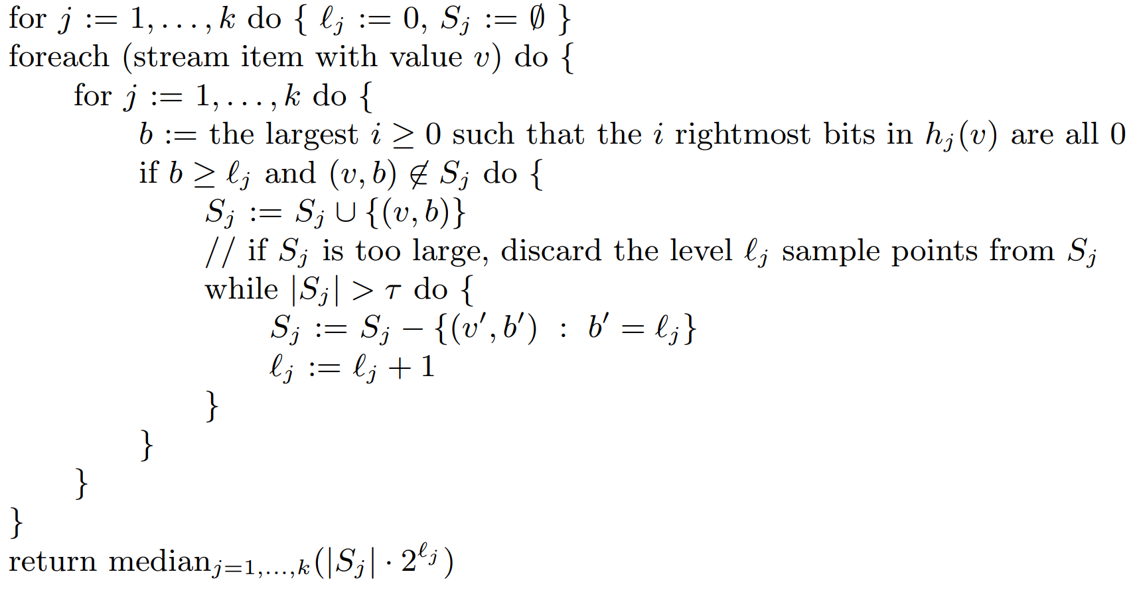
Cardinality Estimation Approaches – Sampling
Coordinated Sampling Algorithm [2016]
(ε, δ)-approximation
Phillip B. Gibbons: Distinct-Values Estimation over Data Streams. Data Stream Management 2016: 121-147.
Notes:
Hazar Harmouch, Felix Naumann:
Cardinality Estimation: An Experimental Survey. Proc. VLDB Endow. 11(4): 499-512 (2017)
Phillip B. Gibbons: Distinct-Values Estimation over Data Streams. Data Stream Management 2016: 121-147

Slide 21
Cardinality Estimation of the Similarity Selection
Yaoshu Wang, Chuan Xiao, Jianbin Qin, Xin Cao, Yifang Sun, Wei Wang, and Makoto Onizuka. 2020. Monotonic cardinality estimation of similarity selection: A deep learning approach. In Proceedings of the 2020 ACM SIGMOD International Conference on Management of Data. 1197–1212.

Slide 22
The Problem of Cardinality Estimation for Similarity Selection
Cardinality Estimation of Similarity Selection
  Input: a set of records D, a query record q, a distance function, and a threshold 𝜃
  Output: estimate the number of records in D whose distances to q are no greater than 𝜃
threshold θ
query point q
Notes:
Yaoshu Wang, Chuan Xiao, Jianbin Qin, Xin Cao, Yifang Sun, Wei Wang, and Makoto Onizuka. 2020. Monotonic cardinality estimation of similarity selection: A deep learning approach. In Proceedings of the 2020 ACM SIGMOD International Conference on Management of Data. 1197–1212.

Slide 23
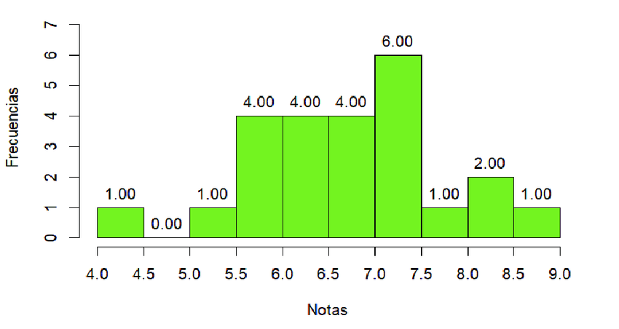

Database Techniques for Cardinality Estimation
Histogram
Aggregated Grid Index
Sampling
  N ⋅ (# of samples in the range) / s
Notes:
Yaoshu Wang, Chuan Xiao, Jianbin Qin, Xin Cao, Yifang Sun, Wei Wang, and Makoto Onizuka. 2020. Monotonic cardinality estimation of similarity selection: A deep learning approach. In Proceedings of the 2020 ACM SIGMOD International Conference on Management of Data. 1197–1212.
https://www.researchgate.net/figure/Histogram-Traditional-Model_fig1_390918925
https://commons.wikimedia.org/wiki/File:Field_grid.png

Slide 24
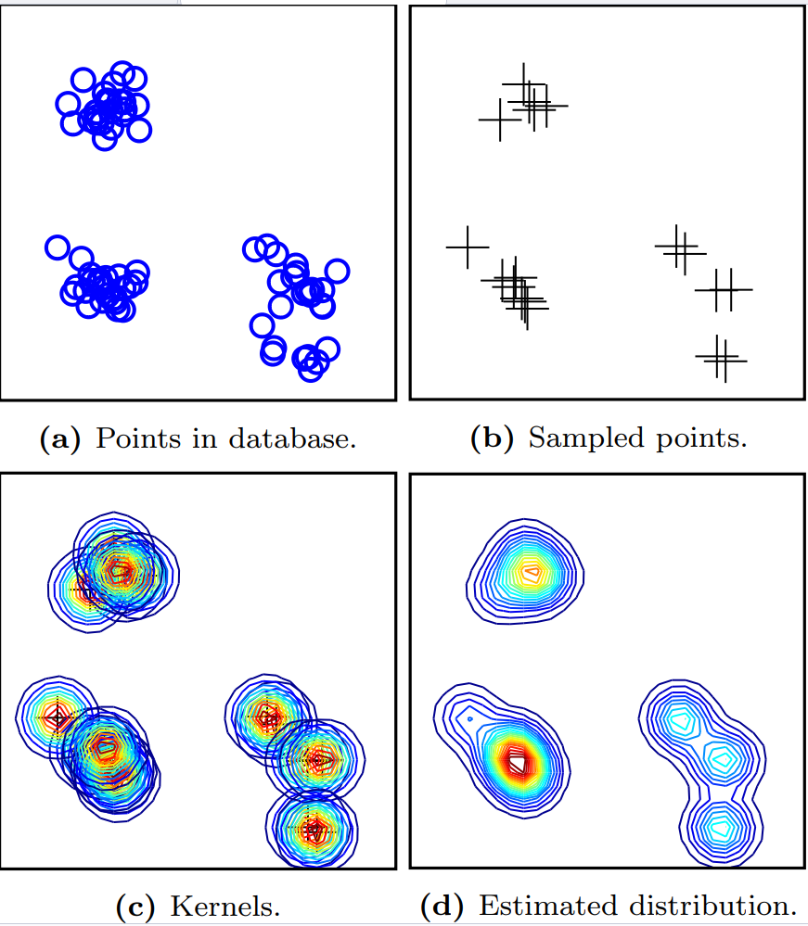
Traditional Learning Models for Cardinality Estimation
Kernel-based Estimator
  Continuously differentiable kernel function
    Gaussian - a standard normal distribution, or
    Epanechnikov - a truncated second-order polynomial
  Optimal Bandwidth – spread of the distributions
Notes:
M. Heimel, M. Kiefer, and V. Markl. Self-tuning, GPU-accelerated kernel densitymodels formultidimensional selectivity estimation. In SIGMOD, pages 1477–1492, 2015.
M. Mattig, T. Fober, C. Beilschmidt, and B. Seeger. Kernel-based cardinality estimation on metric data. In EDBT, pages 349–360, 2018

Slide 25
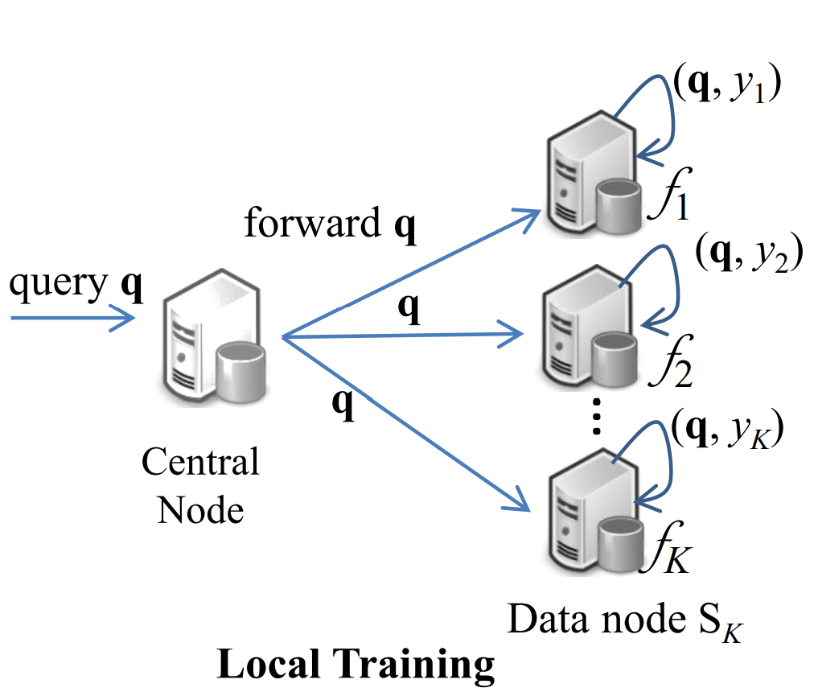
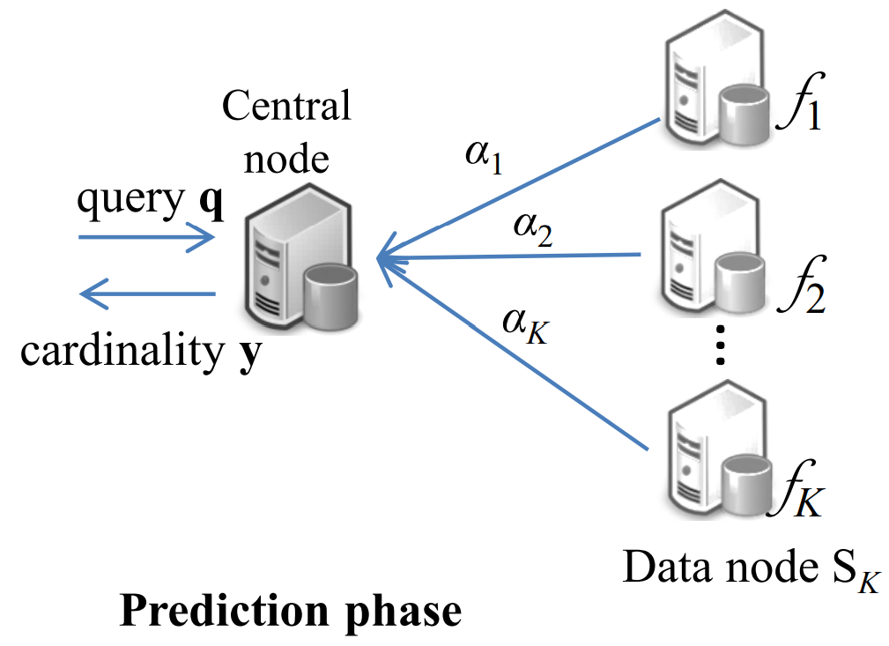
Traditional Learning Models for Cardinality Estimation (cont'd)
Support Vector Regression
Logistic Regression
Gradient Boosting Over Decision Trees
  J. H. Friedman. Greedy function approximation: a gradient boosting machine. Annals of statistics, pages 1189–1232, 2001.
A Query-Driven Approach
  C. Anagnostopoulos and P. Triantafillou. Query-driven learning for predictive analytics of data subspace cardinality. ACM Transactions on Knowledge Discovery from Data, 11(4):47, 2017
  Training pair (q, y)
Notes:
O. Ivanov and S. Bartunov. Adaptive cardinality estimation. arXiv preprint arXiv:1711.08330, 2017
J. H. Friedman. Greedy function approximation: a gradient boosting machine. Annals of statistics, pages 1189–1232, 2001.
C. Anagnostopoulos and P. Triantafillou. Query-driven learning for predictive analytics of data subspace cardinality. ACM Transactions on Knowledge Discovery from Data, 11(4):47, 2017

Slide 26
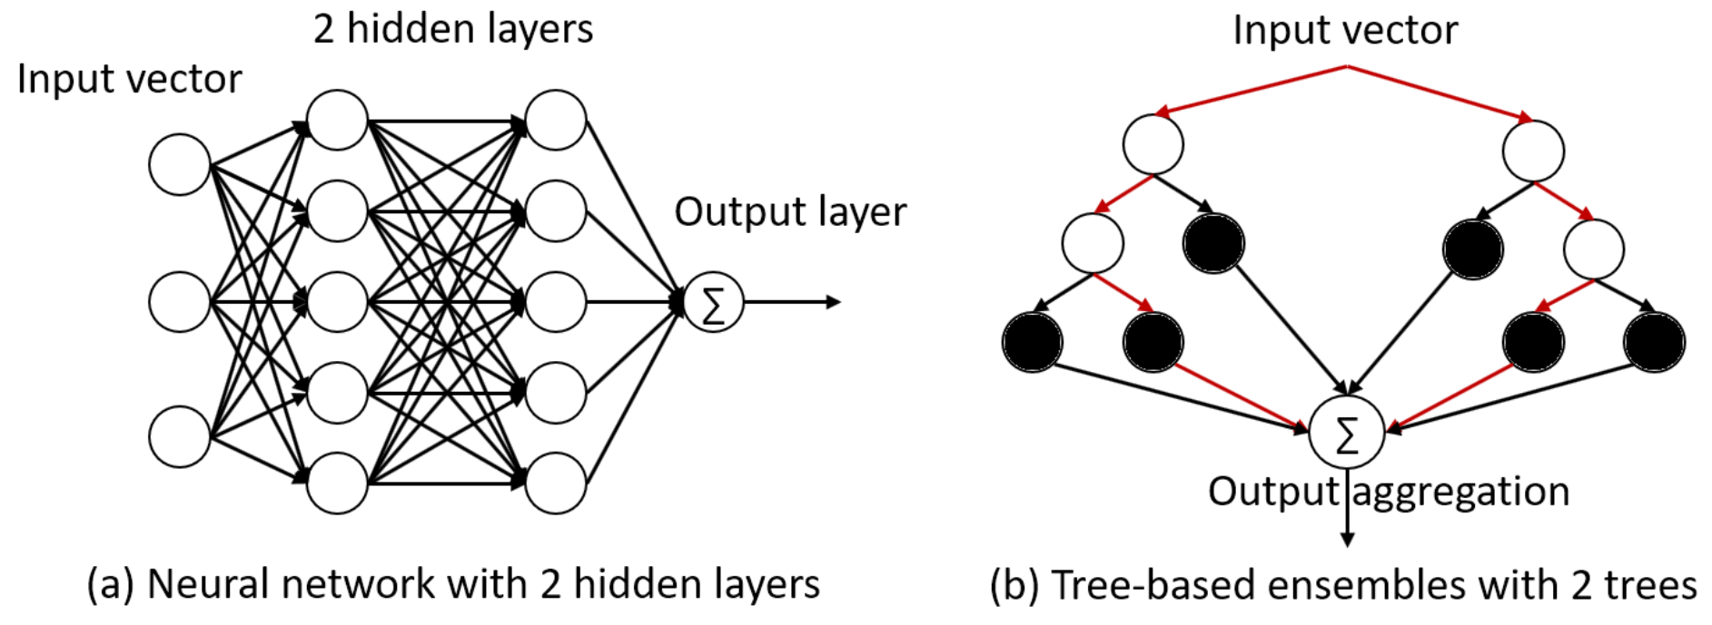
Traditional Learning Models for Cardinality Estimation (cont'd)
Problem: Given a range query with 2d values (lb₁, ub₁, …, lb_{d}, ub_{d}) as the input for the regression model M, estimate the cardinality inside the query range
Solution
  Two-hidden-layer neural networks (ReLU as activation function)
  Tree-based ensembles
    Random forest
    Gradient boosted trees
A. Dutt, C.Wang, A. Nazi, S. Kandula, V. R. Narasayya, and S. Chaudhuri. Selectivity estimation for range predicates using lightweight models. PVLDB, 12(9):1044–1057, 2019
Notes:
A. Dutt, C.Wang, A. Nazi, S. Kandula, V. R. Narasayya, and S. Chaudhuri. Selectivity estimation for range predicates using lightweight models. PVLDB, 12(9):1044–1057, 2019

Slide 27



Deep Learning Models for Cardinality Estimation
Model the cardinality estimation as a regression problem, c(q, θ)
Framework (Data Modeling → Cardinality Estimation)
  Feature extraction function, h, maps an object x and threshold θ to a d-dimensional binary vector x and a non-negative integer threshold τ
  Regression function, g, takes input pair (x, τ) and estimates the cardinality c(x, θ)
Notes:
Yaoshu Wang, Chuan Xiao, Jianbin Qin, Xin Cao, Yifang Sun, Wei Wang, and Makoto Onizuka. 2020. Monotonic cardinality estimation of similarity selection: A deep learning approach. In Proceedings of the 2020 ACM SIGMOD International Conference on Management of Data. 1197–1212.

Slide 28

DL Models for Cardinality Estimation – Feature Extraction
Feature extraction function, h(x, θ)
  Hamming Distance
    Map to a d-dimensional binary vector in the Hamming space
    If θ_{max} ≤ τ_{max}, we set τ = θ ; otherwise,
  (Levenshtein) Edit Distance for String Data
    Map each character to (2τ_{max} + 1) bits in a bit vector of size d = ((𝑙_{max} + 2𝜏_{max}) · |Σ|), where 𝑙_{max} is the maximum length of strings
Example: Given a string 𝑥 = abc, Σ = { a, b, c, d }, 𝑙_{max} = 4, and 𝜏_{𝑚𝑎𝑥} = 1, the binary vector is 111000, 011100, 001110, 000000
Notes:
A. Gionis, P. Indyk, and R. Motwani. Similarity search in high dimensions via hashing. In VLDB, pages 518–529, 1999

Slide 29
DL Models for Cardinality Estimation – Feature Extraction (cont'd)
Feature extraction function, h(x, θ)
  Jaccard Distance for Set Data
    𝑏-bit minwise hashing (LSH)
      Given a set x, denote π(x) as a permutation of elements in x
      Randomly choose k permutations {π ₁(x), π ₂(x), …, π _{k}(x)}
      bmin(π (x)) – the last b bits of the smallest element in π (x), set_bit (i, j) set the i-th bit to 1 out of j bits
      x is transformed to a d(= 2^{b}k)-dimensional bit vector [𝑠𝑒𝑡_𝑏𝑖𝑡 (𝑏𝑚𝑖𝑛(𝜋₁(𝑥)), 2^{𝑏}), …, 𝑠𝑒𝑡_𝑏𝑖𝑡 (𝑏𝑚𝑖𝑛(𝜋_{𝑘}(𝑥)), 2^{𝑏})]
Example: 𝑥 = { 1, 2, 4 }. O = { 1, 2, 3, 4, 5 }. 𝜋₁ = 12345, 𝜋₂ = 54321, and 𝜋₃ = 21453. 𝑏 = 2. We have 𝑏𝑚𝑖𝑛(𝜋₁(𝑥)) = 1, 𝑏𝑚𝑖𝑛(𝜋₂(𝑥)) = 0, and 𝑏𝑚𝑖𝑛(𝜋₃(𝑥)) = 2. The binary vector is 0010, 0001, 0100.

Slide 30


DL Models for Cardinality Estimation – Feature Extraction (cont'd)
Feature extraction function, h(x, θ)
  Euclidean Distance in the Euclidean Space
  LSH
    Given k hash functions, vector x is transformed to a d-dimensional (d = k(v+1)) binary vector: [set_bit(h_{a1,b1}(x), v+1), …, set_bit(h_{ak,bk}(x), v+1)]
Example: 𝑥 = [0.1, 0.2, 0.4]. 𝑣 = 4, k = 3. ℎ_{a1,𝑏1} (𝑥) = 1. ℎ_{a2,𝑏2} (𝑥) = 3, ℎ_{a3,𝑏3} (𝑥) = 4. The binary vector is 00010, 01000, 10000.

Slide 31
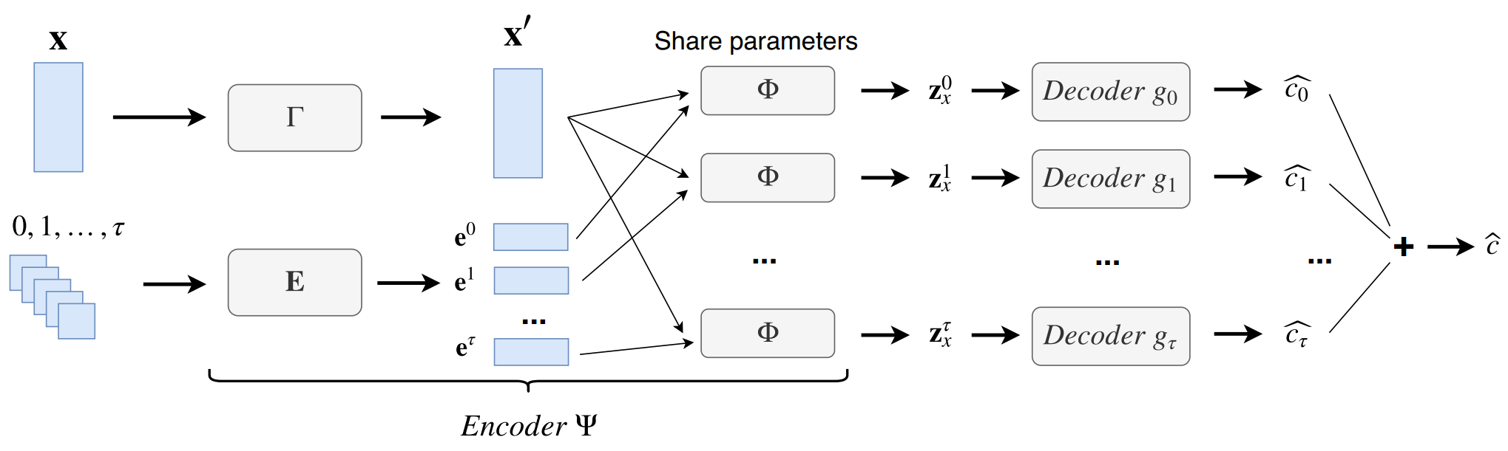
DL Models for Cardinality Estimation – Regression
Regression Model
  Encoder-Decoder Model

Slide 32
DL Models for Cardinality Estimation – Training (Homework)
Read Section 6 (Model Training) of the following paper
Describe the processing of the model training, including, but not limited to:
  Format of Training Data
  Loss Function Used
Yaoshu Wang, Chuan Xiao, Jianbin Qin, Xin Cao, Yifang Sun, Wei Wang, and Makoto Onizuka. 2020. Monotonic cardinality estimation of similarity selection: A deep learning approach. In Proceedings of the 2020 ACM SIGMOD International Conference on Management of Data. 1197–1212.

Slide 33
Cardinality Estimation for Approximate String Search
Suyong Kwon, Kyuseok Shim, Woohwan Jung: Cardinality Estimation of LIKE Predicate Queries using Deep Learning. Proc. ACM Manag. Data 3(1): 20:1-20:26 (2025)
Notes:
Suyong Kwon, Kyuseok Shim, Woohwan Jung:
Cardinality Estimation of LIKE Predicate Queries using Deep Learning. Proc. ACM Manag. Data 3(1): 20:1-20:26 (2025)

Slide 34
Cardinality Estimation for Approximate String Search
Approximate string search is widely used in many real-world applications
  Substring matching
  Information retrieval
  Data cleaning
  Entity resolution
  Finding DNA subsequences
  SQL queries with LIKE predicates in relational databases
  …

Slide 35
Preliminary
wildcard character
any string
A wildcard character set Σ_{w} = {'_', '%’}
A finite alphabet Σ
A string s is from (Σ ∪ Σ_{w})*
Terms:
  The i-th position of the string: s[i]
  The substring: s[i, j]
  Like predicates – regular string (or wildcard string)
    E.g., %Air%Co% matches with "Southwest Airlines Co."

Slide 36
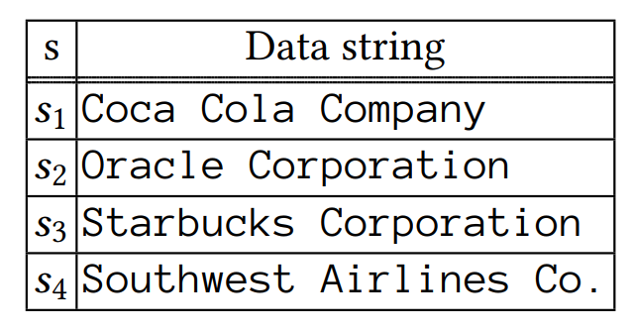
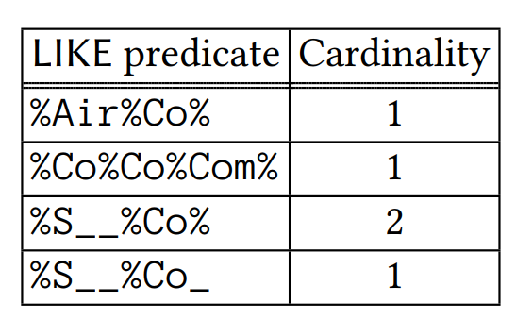
Example of LIKE Predicates
Query selectivity estimation for the join order or query plan
Notes:
Suyong Kwon, Kyuseok Shim, Woohwan Jung: Cardinality Estimation of LIKE Predicate Queries using Deep Learning. Proc. ACM Manag. Data 3(1): 20:1-20:26 (2025)

Slide 37

The Problem of LIKE Predicates
Canonical LIKE Representation
where α_{i} is a wildcard string and β_{i} is a regular string
If all α_{i} are '_' only, then r(q) is a fixed-length pattern
Otherwise (with '%'), r(q) is a variable-length pattern

Slide 38
The Problem of LIKE Predicates (cont'd)
wildcard string
regular string
A LIKE predicate q with r(q) = α₀β₁α₁ … β_{m} α_{m} matches a string s
  There exists a position sequence (pos₁, pos₂, …, pos_{m})
  String s contains substrings β_{i} at the position pos_{i}
  We have pos_{i} + n(α_{i}) + |β_{i}| ≤ pos_{i+1}, where n(α_{i}) is the number of '_' s in the wildcard string α_{i}

Slide 39
Naïve Algorithm for Preparing the Training Data
Given a LIKE predicate q ∈ S_{Q} (or its prefix substrings) and a data string set S_{D}
  Find any occurrence of the pattern q in every data string s ∈S_{D}
  Count the cardinality, c(q), of data strings having the query pattern q
  Add instance (q, c(q)) to the training data
Speedup: using an inverted index
Example: ("%Air%Co_", 1)
Notes:
Suyong Kwon, Kyuseok Shim, Woohwan Jung: Cardinality Estimation of LIKE Predicate Queries using Deep Learning. Proc. ACM Manag. Data 3(1): 20:1-20:26 (2025)

Slide 40
Inverted Index
Position Set, POS(β, s)
  The position set of a string β with a data string s
  s ="Coca Cola Company“
  POS("Co", s) = {1, 6, 11}
Posting Set List, PL(β, S_{D})
  If β = s[pos, pos + |β|−1], the pair (s, pos) is a posting in PL(β, S_{D}), where S_{D} is a data string set
Inverted Index, I_{SD}

Slide 41
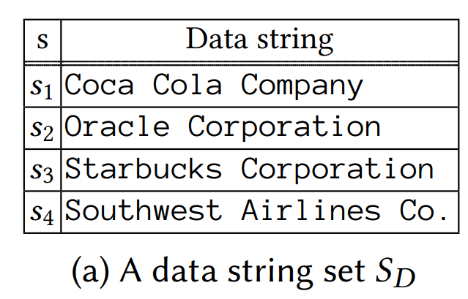
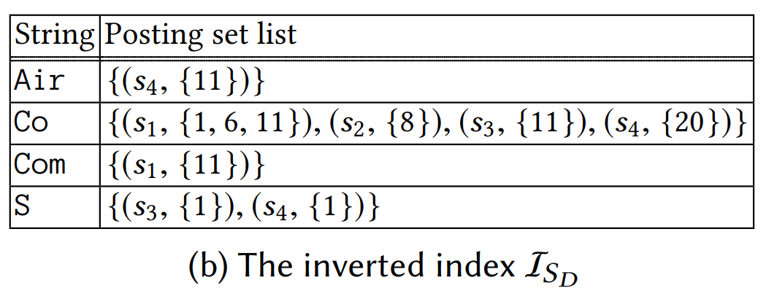
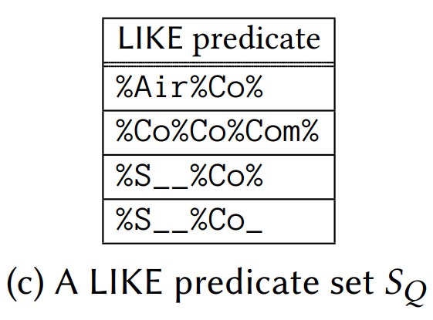
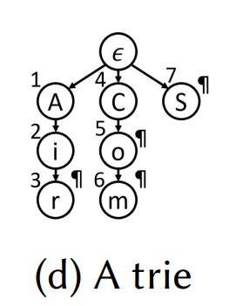
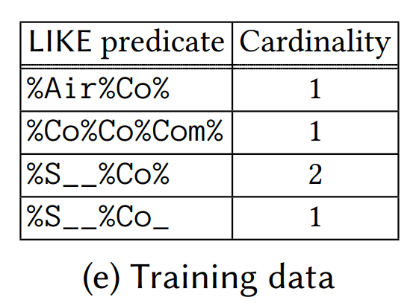
Inverted Index for Generating Training Data

Slide 42
Deep Learning for Cardinality Estimation of LIKE Predicates
Cardinality estimation of sql LIke QUEries using deep learning (CLIQUE) model
Observations
  The cardinality of "%Seatt%" is very close to the cardinality of "%Seattle%"
  The cardinality of "%Seatt%" is also a tight upper bound cardinality of "%Seattle%“
Basic Idea
  Use conditional regression to estimate the ratio of the cardinality to the upper bound cardinality
The cardinality is given by multiplying the estimated ratio with the upper bound cardinality

Slide 43
Deep Learning Model for LIKE Cardinality Estimation
Deep Learning Model
  The embedding layer
  The LSTM encoder
  The conditional regression header
    A final layer to estimate the ratio c(q)/c(cp_{q})
Loss Function
  Mean squared logarithmic error (MSLE)
Learning Method
  Stochastic gradient descent (SGD) by using the Adam optimizer

Slide 44
Learning-Based Travel Time Estimation
Zhihan Zheng, Haitao Yuan, Minxiao Chen, Shangguang Wang:
RLER-TTE: An Efficient and Effective Framework for En Route Travel Time Estimation with Reinforcement Learning. Proc. ACM Manag. Data 3(1): 71:1-71:26 (2025)
Notes:
Zhihan Zheng, Haitao Yuan, Minxiao Chen, Shangguang Wang:
RLER-TTE: An Efficient and Effective Framework for En Route Travel Time Estimation with Reinforcement Learning. Proc. ACM Manag. Data 3(1): 71:1-71:26 (2025)

Slide 45
Intelligent Transportation System
The Travel Time Estimation (TTE) is an important and critical operator
  Route planning
  Vehicle dispatching
  Supply chain management
  Navigation
  Traffic signal control
  …

Slide 46
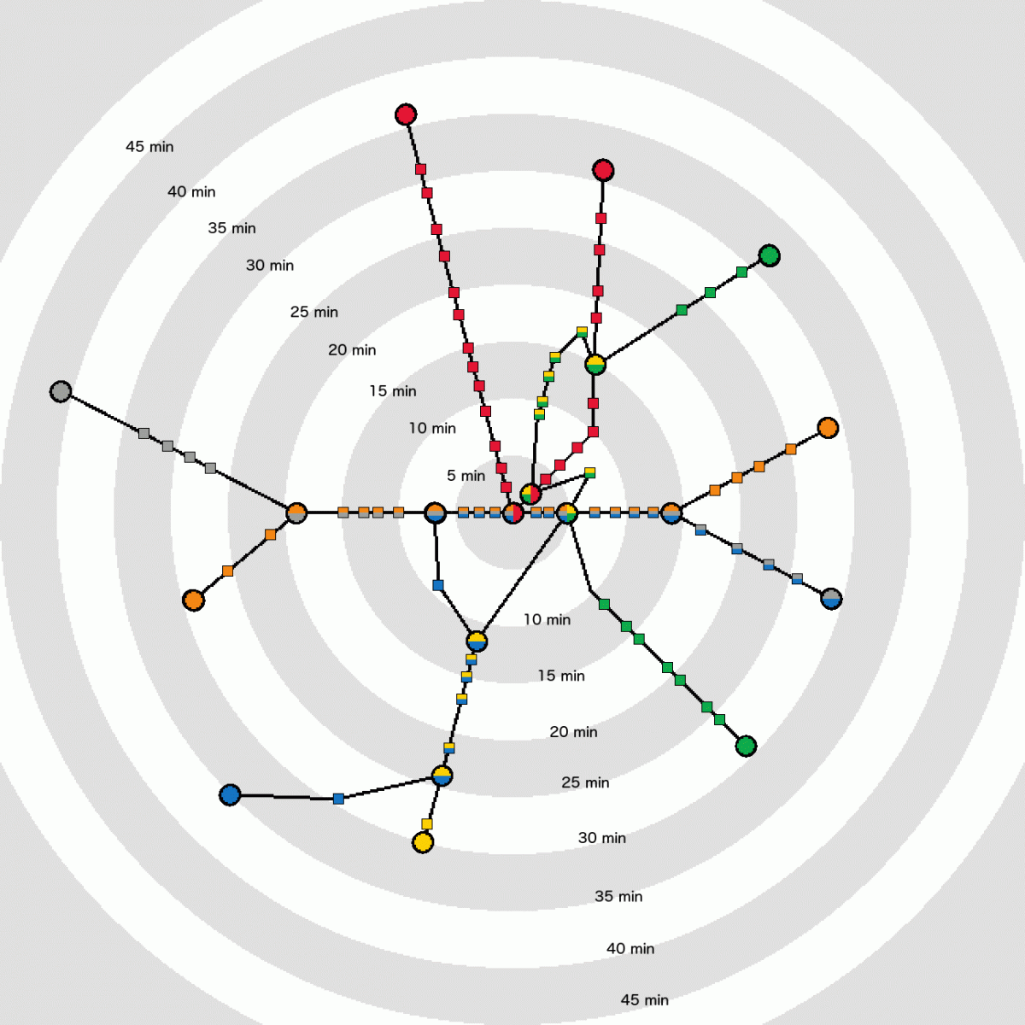
Traditional Travel Time Estimation (TTE) Methods
One-time estimation before the journal begins
This Photo by Unknown Author is licensed under CC BY-NC

Slide 47
En Route Travel Time Estimation (ER-TTE)
Leverage online data to predict the travel time and make meaningful real-time updates
  Driving behavior of drivers
  Real-time trajectory
  Real-time traffic data
    Abnormal traveling time of a road segment

Slide 48
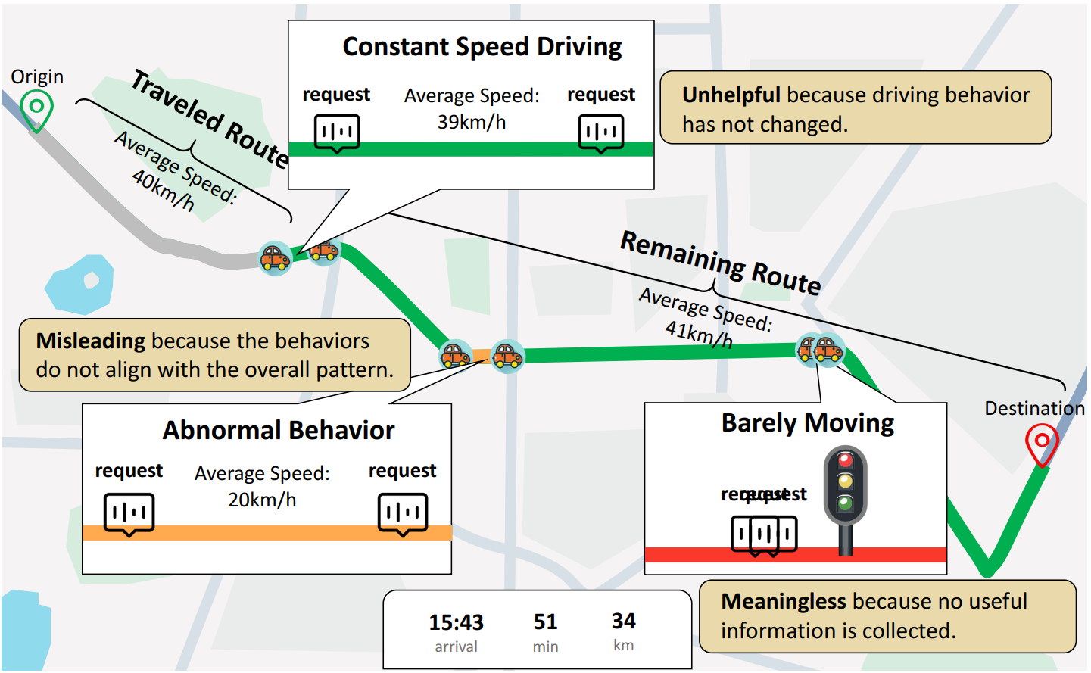
Example of ER-TTE Requests

Slide 49
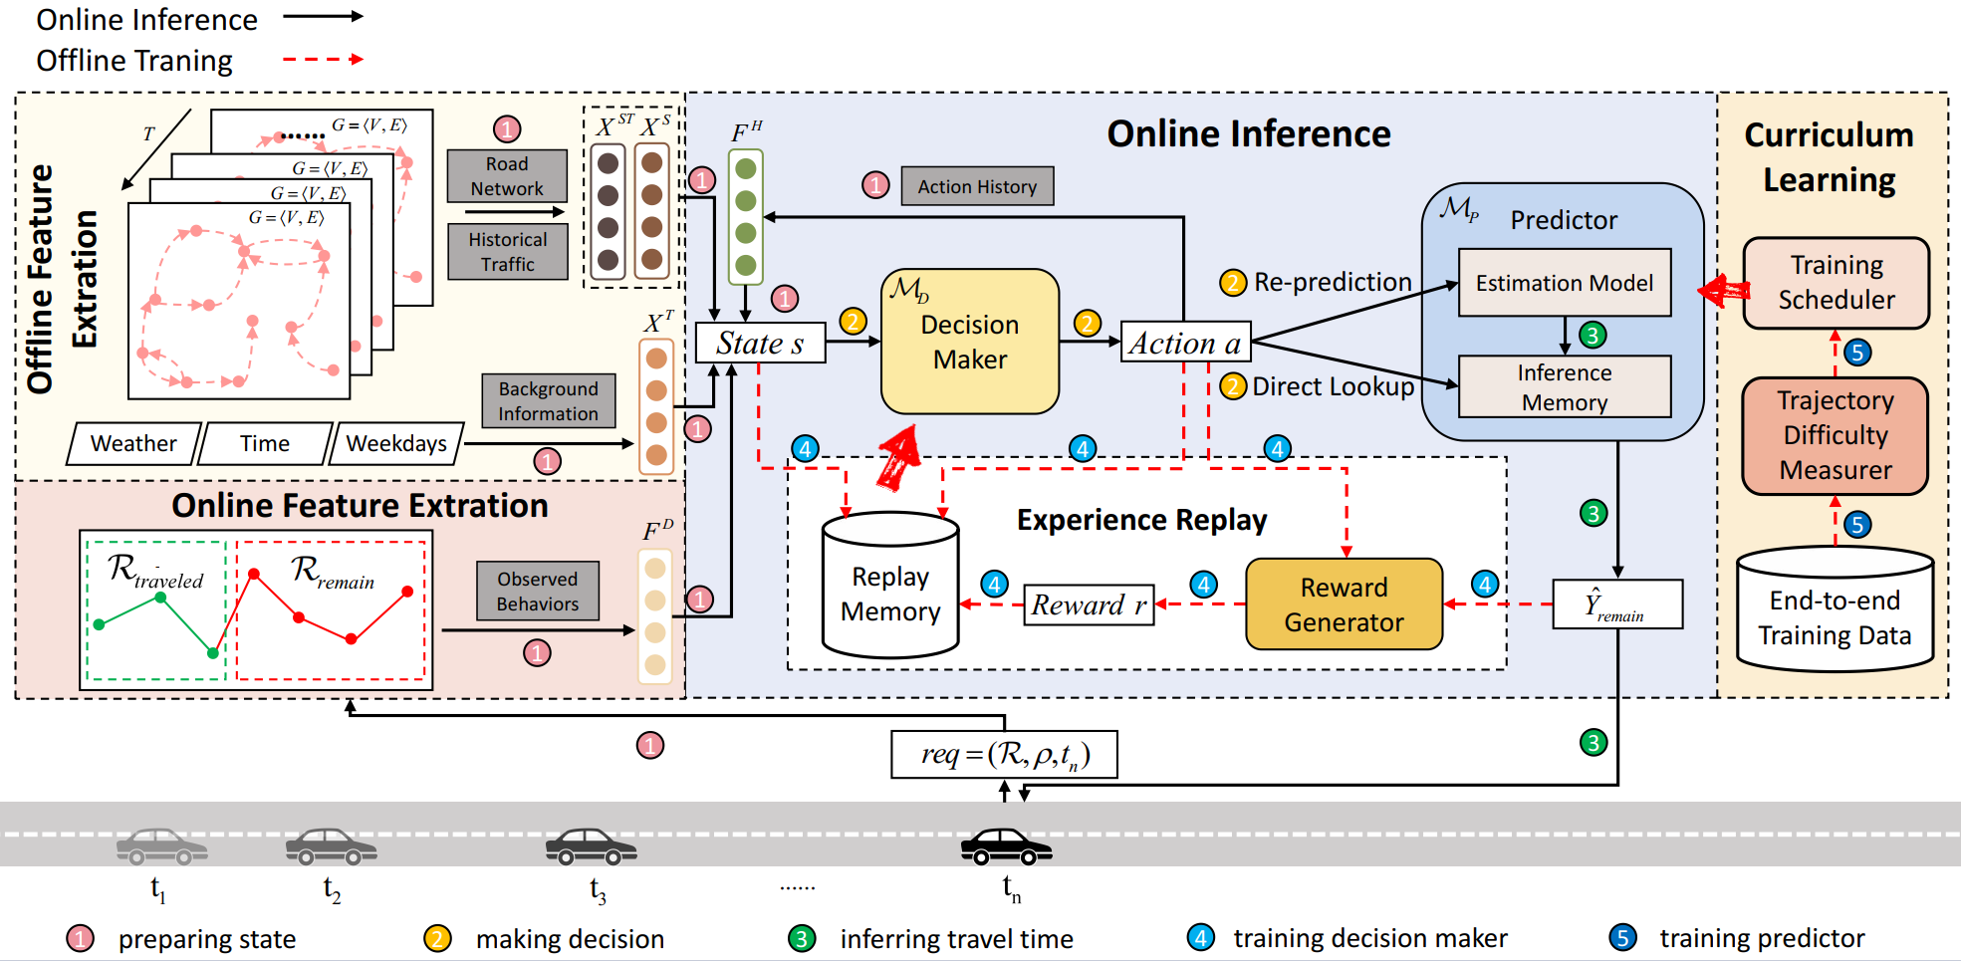
The Framework for En Route Travel Time Estimation
Notes:
Zhihan Zheng, Haitao Yuan, Minxiao Chen, Shangguang Wang:
RLER-TTE: An Efficient and Effective Framework for En Route Travel Time Estimation with Reinforcement Learning. Proc. ACM Manag. Data 3(1): 71:1-71:26 (2025)

Slide 50
The Framework for En Route Travel Time Estimation (cont'd)
1. Preparing state
  Offline feature extraction module
    Spatial-only features (X^{S}): road segment ID, length, and speed limit
    Temporal-only features (X^{T}): attributes of past p time slots, such as departure time, weekdays, and weather conditions
    Spatio-temporal features (XST): min/max/median /average values of traffic speeds for road segments over the past p time periods
  Online feature extraction module
    Real-time driving behaviors (F^{D}): actual traveling speeds of road segments
2. Making decision
3. Inferring travel time
4. Training decision maker
5. Training predictor
Notes:
Zhihan Zheng, Haitao Yuan, Minxiao Chen, Shangguang Wang:
RLER-TTE: An Efficient and Effective Framework for En Route Travel Time Estimation with Reinforcement Learning. Proc. ACM Manag. Data 3(1): 71:1-71:26 (2025)

Slide 51
The Framework for En Route Travel Time Estimation (cont'd)
1. Preparing state
2. Making decision
  Reinforcement learning
  Two options: Re-prediction vs. direct loop-up
3. Inferring travel time
  Meta-learning approaches: SSML vs. MetaER-TTE
4. Training decision maker
  Experience replay mechanism
  Experience: state, action, reward, and next state
5. Training predictor
  Curriculum learning: training scheduler devises a curriculum
Notes:
Zhihan Zheng, Haitao Yuan, Minxiao Chen, Shangguang Wang:
RLER-TTE: An Efficient and Effective Framework for En Route Travel Time Estimation with Reinforcement Learning. Proc. ACM Manag. Data 3(1): 71:1-71:26 (2025)
[SSML] Xiaomin Fang, Jizhou Huang, Fan Wang, Lihang Liu, Yibo Sun, and Haifeng Wang. 2021. SSML: Self-Supervised Meta-Learner for En Route Travel Time Estimation at Baidu Maps. In SIGKDD, Feida Zhu, Beng Chin Ooi, and Chunyan Miao (Eds.). ACM, 2840–2848.
[MetaER-TTE] Yu Fan, Jiajie Xu, Rui Zhou, Jianxin Li, Kai Zheng, Lu Chen, and Chengfei Liu. 2022. MetaER-TTE: An Adaptive Meta-learning Model for En Route Travel Time Estimation. In IJCAI, Luc De Raedt (Ed.). ijcai.org, 2023–2029.

Slide 52
Open AI4DB Problems:
Skyline Cardinality Estimation
Xiaoye Miao, Yangyang Wu, Jiazhen Peng, Yunjun Gao, Jianwei Yin: Efficient and Effective Cardinality Estimation for Skyline Family. Proc. ACM Manag. Data 1(1): 104:1-104:21 (2023)
Zhenjie Zhang, Yin Yang, Ruichu Cai, Dimitris Papadias, Anthony K. H. Tung: Kernel-based skyline cardinality estimation. SIGMOD Conference 2009: 509-522
Notes:
Xiaoye Miao, Yangyang Wu, Jiazhen Peng, Yunjun Gao, Jianwei Yin:
Efficient and Effective Cardinality Estimation for Skyline Family. Proc. ACM Manag. Data 1(1): 104:1-104:21 (2023)
Zhenjie Zhang, Yin Yang, Ruichu Cai, Dimitris Papadias, Anthony K. H. Tung:
Kernel-based skyline cardinality estimation. SIGMOD Conference 2009: 509-522

Slide 53
Skyline Cardinality Estimation
Given a data set DS (of size n), estimate the number, |SKY_{DS}|, of skyline objects in DS
distance to beach
o₆
3 skyline objects
o₃
o₇
o₅
o₄
o₁
o₂
o₈
O
price

Slide 54
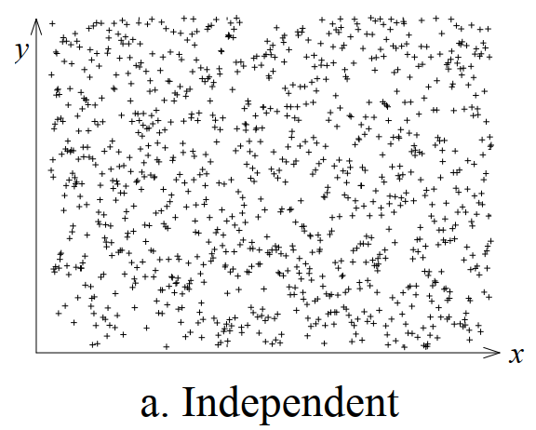
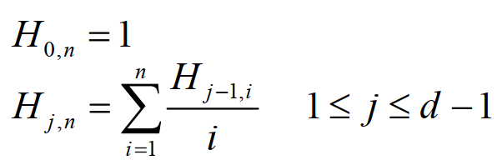
Existing Works on Skyline Cardinality Estimation
Assuming that all d dimensions are independent
  The expected skyline cardinality m equals the (d−1)-th order harmonic H_{d-1,n} of n
  For sufficiently large n, the
  number of skylines is given by:
  m = H_{d-1,n} ≈ ln^{d-1} n / d!
Bentley, J., Kung, H., Schkolnick, M., Thompson, C. On the Average Number of Maxima in a Set of Vectors and Applications. Journal of the ACM, 25(4): 536-543, 1978.
Godfrey, P. Skyline Cardinality for Relational Processing. FoIKS, 2004.

Slide 55
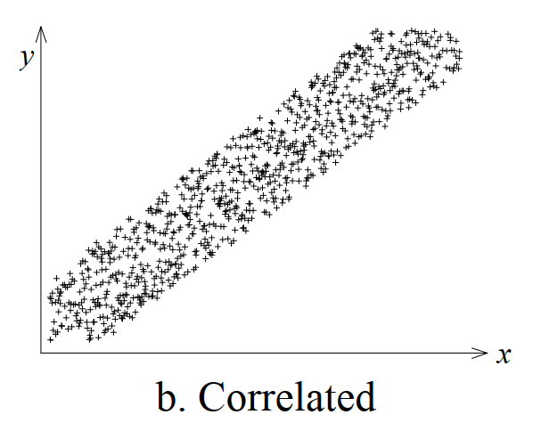
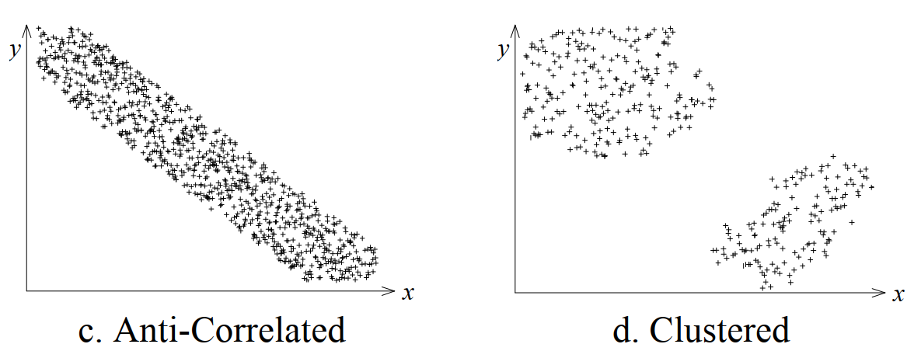
Existing Works on Skyline Cardinality Estimation (cont'd)
However, in practice, data distributions can be correlated, anti-correlated, clustered, and many others

Slide 56
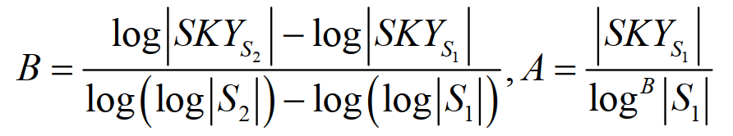
Existing Works on Skyline Cardinality Estimation (cont'd)
Log Sampling (LS)
  Draw a random sample set S from the data set DS
  Split S into two parts S₁ and S₂ with |S₁| and |S₂| points, respectively
  Compute the skyline cardinalities |SKY_{S1}|=A log^{B}|S₁| and |SKY_{S2}| = A log^{B}|S₂|
  The estimated number of skylines in DS is: A log^{B} n
Chaudhuri, S., Dalvi, N., Kaushik, R. Robust Cardinality and Cost Estimation for the Skyline Operator. ICDE, 2006

Slide 57
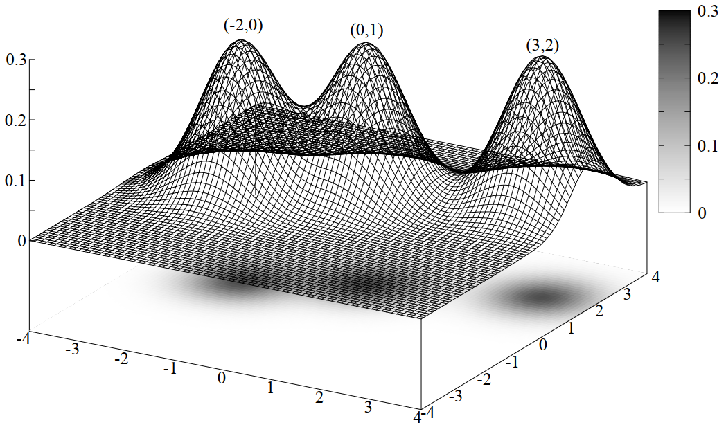
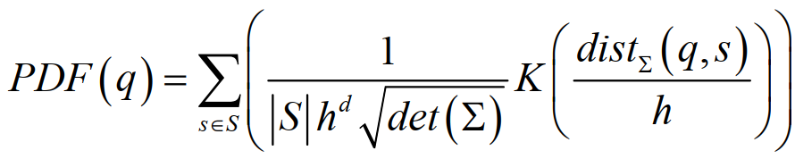
Kernel-Based Skyline Cardinality Estimation
Kernel Density Estimation
Zhenjie Zhang, Yin Yang, Ruichu Cai, Dimitris Papadias, Anthony K. H. Tung: Kernel-based skyline cardinality estimation. SIGMOD Conference 2009: 509-522

Slide 58
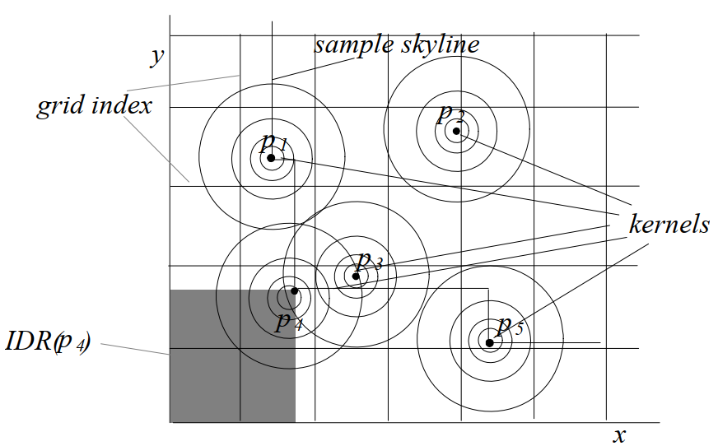

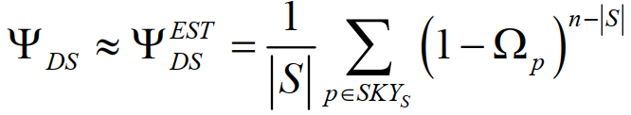
Kernel-Based Skyline Cardinality Estimation (cont'd)
Zhenjie Zhang, Yin Yang, Ruichu Cai, Dimitris Papadias, Anthony K. H. Tung: Kernel-based skyline cardinality estimation. SIGMOD Conference 2009: 509-522

Slide 59
Learned Skyline Cardinality Estimation
How to estimate skyline cardinality using learning-based approach?
  Training data?
  Regression? Classification?
  Loss function?

Slide 60
Open AI4DB Problems:
Inverse Ranking Cardinality Estimation
Li, C.: Enabling data retrieval: by ranking and beyond. In: Ph.D. Dissertation, University of Illinois at Urbana-Champaign (2007)
Xiang Lian, Lei Chen: Probabilistic inverse ranking queries in uncertain databases. VLDB J. 20(1): 107-127 (2011)
Notes:
Li, C.: Enabling data retrieval: by ranking and beyond. In: Ph.D. Dissertation, University of Illinois at Urbana-Champaign (2007)
Xiang Lian, Lei Chen: Probabilistic inverse ranking queries in uncertain databases. VLDB J. 20(1): 107-127 (2011)

Slide 61
Recall: Inverse Ranking Queries [Li, 2007]
monotonic preference function
f(o) = o.height + o.weight
For a newborn baby, we may be interested in his/her health compared with other babies, for example, in terms of height and weight
Given a query baby q and a preference function f(.), an inverse ranking problem is to obtain the rank of baby q among other babies, in order to infer q's health
query baby q
C. Li. Enabling data retrieval: by ranking and beyond. In Ph.D. Dissertation, University of Illinois at Urbana-Champaign, 2007.
Notes:
In contrast, for the inverse ranking query, instead of finding babies with the highest scores in the existing database, we are given a query baby q, and we want to determine the health level of this query baby compared with other babies. In other words, we want to obtain the rank of this query baby in this database. In this example, we can see that the rank of this query baby is 3.

Slide 62
Learned Inverse Ranking Queries
How to estimate the rank of a query object q, using learning-based approach?
  Training data?
  Regression? Classification?
  Loss function?

Slide 63
Open AI4DB Problems:
Cardinality Estimation for Range Aggregate Queries
Qiyu Liu, Xiang Lian, Lei Chen: Probabilistic Maximum Range-Sum Queries on Spatial Database. SIGSPATIAL/GIS 2019: 159-168

Slide 64
Recall: Range Aggregate Queries
A database D contains data objects o, each associated with an attribute o.A
Range aggregate queries
  Given a database D and a query range Q, find the aggregate, f(D, Q), of all objects o ∈ D inside Q
  Aggregate function
    COUNT
    SUM
    MIN/MAX
    AVG
    Medium
    Quantile
Notes:
There are many aggregate query types, such as COUNT, SUM, MIN/MAX, AVG, medium, and quantile.

Slide 65
Learned Range Aggregate Queries
How to estimate the aggregates of o.A inside the query range, using learning-based approach?
  Training data?
  Regression? Classification?
  Loss function?
query range

Slide 66
Summary
Problem Definition of the Cardinality Estimation
Cardinality Estimation Techniques
Cardinality Estimation for Approximate String Matching
Learning-based Approaches for the Cardinality Estimation of LIKE Predicates
Path Length Estimation in Graphs
Open Problems
  Learned skyline cardinality estimation
  Learned inverse ranking queries
  Learned range aggregate queries

Slide 67
Reading Materials
Mehmet Aytimur, Silvan Reiner, Leonard Wörteler, Theodoros Chondrogiannis, and Michael Grossniklaus. 2024. LPLM: A Neural Language Model for Cardinality Estimation of LIKE-Queries. Proceedings of the ACM on Management of Data 2, 1 (2024), 1–25.
Andreas Kipf, Thomas Kipf, Bernhard Radke, Viktor Leis, Peter Boncz, and Alfons Kemper. 2018. Learned cardinalities: Estimating correlated joins with deep learning. arXiv preprint arXiv:1809.00677 (2018)
Suyong Kwon, Woohwan Jung, and Kyuseok Shim. 2022. Cardinality estimation of approximate substring queries using deep learning. Proceddings of the VLDB Endowment 15, 11 (2022)
* Suraj Shetiya, Saravanan Thirumuruganathan, Nick Koudas, and Gautam Das. 2020. Astrid: accurate selectivity estimation for string predicates using deep learning. Proceedings of the VLDB Endowment 14, 4 (2020), 471–484.
* Ji Sun and Guoliang Li. 2019. An End-to-End Learning-based Cost Estimator. Proceedings of the VLDB Endowment 13, 3 (2019), 307–319.
Yaoshu Wang, Chuan Xiao, Jianbin Qin, Xin Cao, Yifang Sun, Wei Wang, and Makoto Onizuka. 2020. Monotonic cardinality estimation of similarity selection: A deep learning approach. In Proceedings of the 2020 ACM SIGMOD International Conference on Management of Data. 1197–1212
Zongheng Yang, Eric Liang, Amog Kamsetty, Chenggang Wu, Yan Duan, Xi Chen, Pieter Abbeel, Joseph M Hellerstein, Sanjay Krishnan, and Ion Stoica. 2019. Deep unsupervised cardinality estimation. arXiv preprint arXiv:1905.04278 (2019).

Slide 68
Reading Materials (cont’d)
P Krishnan, Jeffrey Scott Vitter, and Bala Iyer. 1996. Estimating alphanumeric selectivity in the presence of wildcards. In Proceedings of the 1996 ACM SIGMOD international conference on Management of data. 282–293.
HV Jagadish, Raymond T Ng, and Divesh Srivastava. 1999. Substring selectivity estimation. In Proceedings of the eighteenth ACM SIGMOD-SIGACT-SIGART symposium on Principles of database systems. 249–260.
Suyong Kwon, Kyuseok Shim, Woohwan Jung: Cardinality Estimation of LIKE Predicate Queries using Deep Learning. Proc. ACM Manag. Data 3(1): 20:1-20:26 (2025)
Phillip B. Gibbons: Distinct-Values Estimation over Data Streams. Data Stream Management 2016: 121-147

Slide 69
Reading Materials (cont’d)
[FM] Flajolet, P., Martin, G.N.: Probabilistic counting algorithms for data base applications. J. of Computer and System Sciences 31 (1985) 182–209
[AMS] Alon, N., Matias, Y., Szegedy, M.: The space complexity of approximating the frequency moments. J. of Computer and System Sciences 58 (1999) 137–147.
[PCSA] Flajolet, P., Martin, G.N.: Probabilistic counting algorithms for data base applications. J. of Computer and System Sciences 31 (1985) 182–209.
]Loglog] Durand, M., Flajolet, P.: Loglog counting of large cardinalities. In: Proc. 11th European Symp. on Algorithms. (2003) 605–617.
[LC] Whang, K.Y., Vander-Zanden, B.T., Taylor, H.M.: A linear-time probabilistic counting algorithm for database applications. ACM Transactions on Database Systems 15 (1990) 208–229
P. J. Haas, J. F. Naughton, S. Seshadri, and L. Stokes. Sampling-based estimation of the number of distinct values of an attribute. In Proceedings of the International Conference on Very Large Databases (VLDB), volume 95, pages 311{322, 1995.

