Slide 1
AI for DB (AI4DB)
Chapter 6: Learning-based Approaches for Database Repairs and Queries
Instructor: Xiang Lian
Email: xxl1584@case.edu
Homepage: http://www.cs.kent.edu/~xlian/
Notes:
The slides of this AI4DB course used some public slides/materials on the Web for teaching purposes only. I would like to acknowledge these resources, and please let me know if I failed to cite them or you want to remove them from my slides.

Slide 2
Objectives
In this chapter, we will:
Learn the learning-based data quality improvement
Learn the learning-based time series management
Understand the learning-based query processing

Slide 3



Databases
Ideal Case

Slide 4



incomplete
data
distorted/noisy data
inconsistent data
Databases
Ideal Case
In Reality

Slide 5
Data Quality Issues
Real-world data often contain incomplete, noisy, uncertain, inconsistent, or even erroneous information
Noisy/abnormal sensory data
Imprecise GPS data
Relational tables with user input typos
Expired Web resources that are inconsistent with the latest ones

Slide 6
Incomplete Data Management and Analysis
Data Fusion
Database Search
Big Data Analytics
Data Mining
… …
incomplete
data
imputed
data

Slide 7
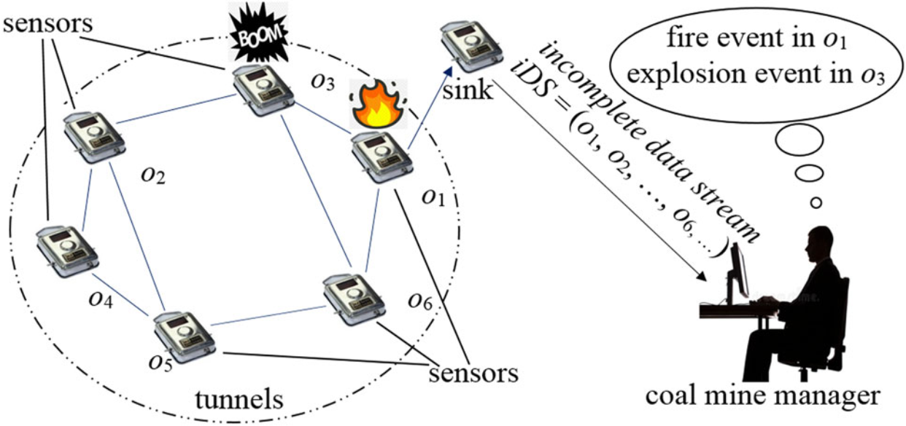

Applications with Incomplete Data
sensor networks
Notes:
Applications
data integration
social network
sensor network
internet intrusion detection
Reasons
transmission errors or package loss
environmental factor
incomplete questionnaire
data integration over data sets with different schemas
privacy protection
Consequences
wrong query results
existing methods may fail over incomplete data

Slide 8
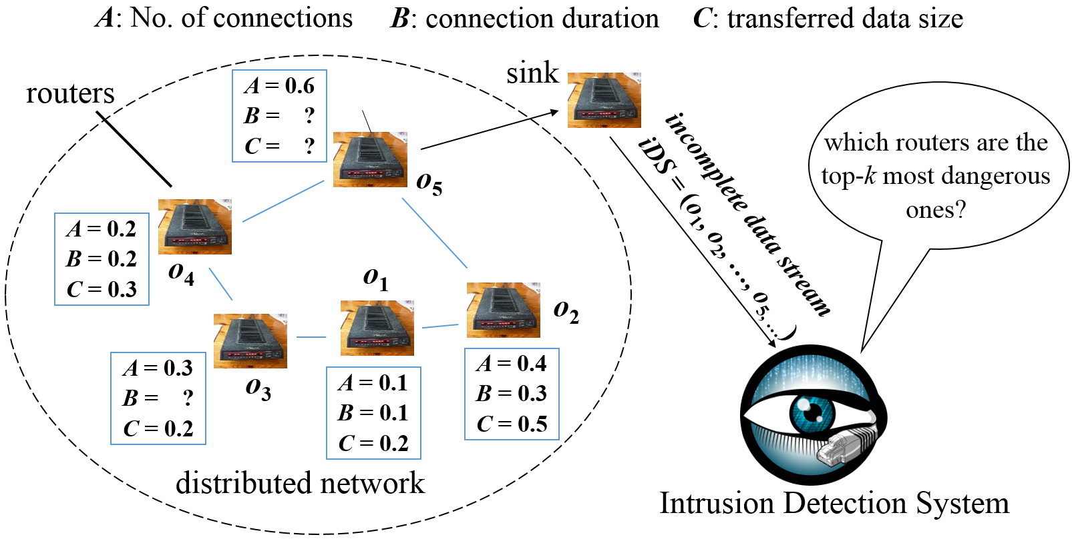
Applications with Incomplete Data (cont'd)
network intrusion detection
Notes:
Applications
data integration
social network
sensor network
internet intrusion detection
Reasons
transmission errors or package loss
environmental factor
incomplete questionnaire
data integration over data sets with different schemas
privacy protection
Consequences
wrong query results
existing methods may fail over incomplete data

Slide 9
Reasons for the Data Incompleteness
Sensor networks
Transmission errors
Packet losses
Sensor failures
Network congestion
IP networks
Hardware failure
Network congestion
No power!
Relational tables
N/A
Not known
User profiles in social networks
No input from users
Privacy protection
Information Extraction (IE)
Inaccurate IE methods from text data
…
4

Slide 10
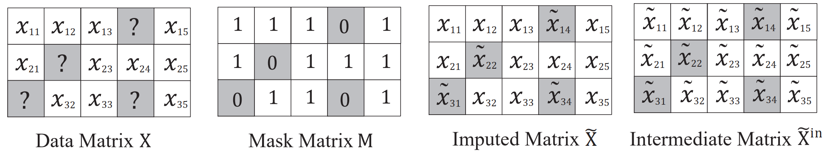
Missing Data Imputation Problem
Given
n data samples of dimensionality d as a data matrix X
𝑥_{𝑖} = (𝑥_{𝑖1}, 𝑥_{𝑖2}, … , 𝑥_{𝑖𝑑})
n mask vector 𝑚_{𝑖}
𝑚_{𝑖j} = 0, if x_{𝑖j} is missing (unobserved)
Impute the unobserved elements in the data matrix X
Notes:
Wang, J., Zhang, Y., Wang, K., Lin, X., & Zhang, W. (2024). Missing data imputation with uncertainty-driven network. Proceedings of the ACM on Management of Data, 2(3), 1-25.

Slide 11
Incomplete Data Imputation Approaches
Imputation via statistics (e.g., mean) [1]
Imputation via hot deck (e.g., nearest neighbor) [2]
Imputation via cold deck (e.g., leveraging data sources from the Web) [3]
Imputation via last observation [4]
Imputation via statistical-based approach (e.g., Naïve Bayes) [5]
6
Notes:
[1] Baraldi, A. N. and C. K. Enders (2010). An introduction to modern missing data analyses. Journal of School Psycholology 48(1): 5-37.
[2] Beretta, Lorenzo, and Alessandro Santaniello. "Nearest neighbor imputation algorithms: a critical evaluation." BMC medical informatics and decision making 16.3 (2016): 74.
[3] Kalton, Graham, and Daniel Kasprzyk. "The treatment of missing survey data." Survey methodology 12.1 (1986): 1-16.
[4] Wood, Angela M., Ian R. White, and Simon G. Thompson. "Are missing outcome data adequately handled? A review of published randomized controlled trials in major medical journals." Clinical trials 1.4 (2004): 368-376.
[5] Farhangfar, Alireza, Lukasz A. Kurgan, and Witold Pedrycz. "A novel framework for imputation of missing values in databases." IEEE Transactions on Systems, Man, and Cybernetics-Part A: Systems and Humans 37.5 (2007): 692-709.
[6] Fan, Wenfei, et al. "Towards certain fixes with editing rules and master data." Proceedings of the VLDB Endowment 3.1-2 (2010): 173-184.
[7] Song, Shaoxu, and Lei Chen. "Differential dependencies: Reasoning and discovery." ACM Transactions on Database Systems (TODS) 36.3 (2011): 16.
[8] Burgette, Lane F., and Jerome P. Reiter. "Multiple imputation for missing data via sequential regression trees." American journal of epidemiology 172.9 (2010): 1070-1076.
[9] Enders, Craig K., and Deborah L. Bandalos. "The relative performance of full information maximum likelihood estimation for missing data in structural equation models." Structural equation modeling 8.3 (2001): 430-457.
[10] Royston, Patrick. "Multiple imputation of missing values." The Stata Journal 4.3 (2004): 227-241.
[11] Franklin, Michael J., et al. "CrowdDB: answering queries with crowdsourcing." Proceedings of the 2011 ACM SIGMOD International Conference on Management of data. ACM, 2011.
[12] Song, Shaoxu, et al. "Screen: Stream data cleaning under speed constraints." Proceedings of the 2015 ACM SIGMOD International Conference on Management of Data. ACM, 2015.
[13] Zhang, Aoqian, Shaoxu Song, and Jianmin Wang. "Sequential data cleaning: a statistical approach." Proceedings of the 2016 International Conference on Management of Data. ACM, 2016.
[14] Zhang, Aoqian, et al. "Time series data cleaning: From anomaly detection to anomaly repairing." Proceedings of the VLDB Endowment 10.10 (2017): 1046-1057.

Slide 12
Incomplete Data Imputation Approaches (cont'd)
Imputation via rule-based approaches (e.g., editing rule [6] and differential dependency [7])
Imputation via regression model [8]
Imputation via maximum likelihood [9]
Imputation via multiple imputation [10]
Imputation via crowdsourcing [11]
Imputation via constraint-based approaches [12, 13, 14]
7
Notes:
[1] Baraldi, A. N. and C. K. Enders (2010). An introduction to modern missing data analyses. Journal of School Psycholology 48(1): 5-37.
[2] Beretta, Lorenzo, and Alessandro Santaniello. "Nearest neighbor imputation algorithms: a critical evaluation." BMC medical informatics and decision making 16.3 (2016): 74.
[3] Kalton, Graham, and Daniel Kasprzyk. "The treatment of missing survey data." Survey methodology 12.1 (1986): 1-16.
[4] Wood, Angela M., Ian R. White, and Simon G. Thompson. "Are missing outcome data adequately handled? A review of published randomized controlled trials in major medical journals." Clinical trials 1.4 (2004): 368-376.
[5] Farhangfar, Alireza, Lukasz A. Kurgan, and Witold Pedrycz. "A novel framework for imputation of missing values in databases." IEEE Transactions on Systems, Man, and Cybernetics-Part A: Systems and Humans 37.5 (2007): 692-709.
[6] Fan, Wenfei, et al. "Towards certain fixes with editing rules and master data." Proceedings of the VLDB Endowment 3.1-2 (2010): 173-184.
[7] Song, Shaoxu, and Lei Chen. "Differential dependencies: Reasoning and discovery." ACM Transactions on Database Systems (TODS) 36.3 (2011): 16.
[8] Burgette, Lane F., and Jerome P. Reiter. "Multiple imputation for missing data via sequential regression trees." American journal of epidemiology 172.9 (2010): 1070-1076.
[9] Enders, Craig K., and Deborah L. Bandalos. "The relative performance of full information maximum likelihood estimation for missing data in structural equation models." Structural equation modeling 8.3 (2001): 430-457.
[10] Royston, Patrick. "Multiple imputation of missing values." The Stata Journal 4.3 (2004): 227-241.
[11] Franklin, Michael J., et al. "CrowdDB: answering queries with crowdsourcing." Proceedings of the 2011 ACM SIGMOD International Conference on Management of data. ACM, 2011.
[12] Song, Shaoxu, et al. "Screen: Stream data cleaning under speed constraints." Proceedings of the 2015 ACM SIGMOD International Conference on Management of Data. ACM, 2015.
[13] Zhang, Aoqian, Shaoxu Song, and Jianmin Wang. "Sequential data cleaning: a statistical approach." Proceedings of the 2016 International Conference on Management of Data. ACM, 2016.
[14] Zhang, Aoqian, et al. "Time series data cleaning: From anomaly detection to anomaly repairing." Proceedings of the VLDB Endowment 10.10 (2017): 1046-1057.

Slide 13
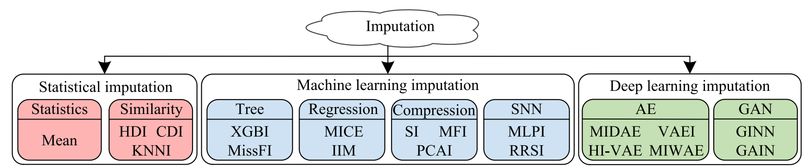
The Taxonomy of Imputation Methods
Rule-based imputation
Human-in-the-loop imputation
…

Slide 14
Examples of Missing Data Imputation
Functional dependency (FD) [1]
gas dens., oxyg. dens. → temp.
sensor ID | temp. | gas dens. | oxyg. dens.
1 | 100 | 3 | 3
2 | 50 | 3 | 2
3 |  | 3 | 2
50
Differential dependency (DD) [2]
gas dens., oxyg. dens. → temp., {[0, 1], [0, 1], [0, 10]}
sensor ID | temp. | gas dens. | oxyg. dens.
1 | 100 | 3 | 3
2 | 50 | 1 | 2
3 |  | 1 | 1
[40, 60]
[1] Wenfei Fan et al. "Towards certain fixes with editing rules and master data." Proceedings of the VLDB Endowment 3.1-2 (2010): 173-184.
[2] Shaoxu Song and Lei Chen. "Differential dependencies: Reasoning and discovery." ACM Transactions on Database Systems (TODS) 36.3 (2011): 16.
Notes:
[1] Baraldi, A. N. and C. K. Enders (2010). An introduction to modern missing data analyses. Journal of School Psycholology 48(1): 5-37.
[2] Beretta, Lorenzo, and Alessandro Santaniello. "Nearest neighbor imputation algorithms: a critical evaluation." BMC medical informatics and decision making 16.3 (2016): 74.
[3] Kalton, Graham, and Daniel Kasprzyk. "The treatment of missing survey data." Survey methodology 12.1 (1986): 1-16.
[4] Wood, Angela M., Ian R. White, and Simon G. Thompson. "Are missing outcome data adequately handled? A review of published randomized controlled trials in major medical journals." Clinical trials 1.4 (2004): 368-376.
[5] Farhangfar, Alireza, Lukasz A. Kurgan, and Witold Pedrycz. "A novel framework for imputation of missing values in databases." IEEE Transactions on Systems, Man, and Cybernetics-Part A: Systems and Humans 37.5 (2007): 692-709.
[6] Fan, Wenfei, et al. "Towards certain fixes with editing rules and master data." Proceedings of the VLDB Endowment 3.1-2 (2010): 173-184.
[7] Song, Shaoxu, and Lei Chen. "Differential dependencies: Reasoning and discovery." ACM Transactions on Database Systems (TODS) 36.3 (2011): 16.
[8] Burgette, Lane F., and Jerome P. Reiter. "Multiple imputation for missing data via sequential regression trees." American journal of epidemiology 172.9 (2010): 1070-1076.
[9] Enders, Craig K., and Deborah L. Bandalos. "The relative performance of full information maximum likelihood estimation for missing data in structural equation models." Structural equation modeling 8.3 (2001): 430-457.
[10] Royston, Patrick. "Multiple imputation of missing values." The Stata Journal 4.3 (2004): 227-241.
[11] Franklin, Michael J., et al. "CrowdDB: answering queries with crowdsourcing." Proceedings of the 2011 ACM SIGMOD International Conference on Management of data. ACM, 2011.
[12] Song, Shaoxu, et al. "Screen: Stream data cleaning under speed constraints." Proceedings of the 2015 ACM SIGMOD International Conference on Management of Data. ACM, 2015.
[13] Zhang, Aoqian, Shaoxu Song, and Jianmin Wang. "Sequential data cleaning: a statistical approach." Proceedings of the 2016 International Conference on Management of Data. ACM, 2016.
[14] Zhang, Aoqian, et al. "Time series data cleaning: From anomaly detection to anomaly repairing." Proceedings of the VLDB Endowment 10.10 (2017): 1046-1057.

Slide 15

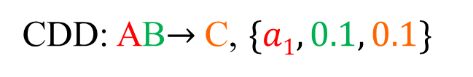
Examples of Missing Data Imputation (cont'd)
Conditional differential dependency (CDD) [1, 2]:
X → A_{j}, ϕ[X A_{j}]
CDD: AB$→$C, $\{a1, 0.1, 0.1\}$
equal to a₁
difference=0.1
difference=0.1
tuple | attribute A | attribute B | attribute C
o₁ | a₁ | 0.2 | 0.1
o₂ | a₁ | 0.3
… | … | …
[0, 0.2]
-
[1] Yihan Wang, Shaoxu Song, Lei Chen, Jeffrey Xu Yu, and Hong Cheng. 2017. Discovering Conditional Matching Rules. ACM Transactions on Knowledge Discovery from Data (TKDD) 11, 4 (2017), 46.
[2] Selasi Kwashie, Jixue Liu, Jiuyong Li, and Feiyue Ye. 2015. Conditional Differential Dependencies (CDDs). In East European Conference on Advances in Databases and Information Systems. Springer, 3–17.
SIGMOD 2021
Notes:
In this paper, we consider conditional differential dependency (CDD) as our imputation tool. For CDD, it is in the form of X→A_{j}, ϕ[X A_{j}], where X are the determinant attributes, A_{j} is the dependent attribute, and function ϕ is a distance constraint on attributes. We have an example to illustrate the basic idea of CDD. Given an CDD AB→C, {a₁, 0.1, 0.1}, for the two samples o₁ and o₂ in the table, they meet the constraints of CDD on determinant attributes AB, since their attribute A both equal to a₁, and the difference of their attributes B is 0.1 (within the CDD interval [0, 0.1] on attribute B). Thus, based on the constraint of CDD on dependent attribute C, we can say that the difference of their attribute C is within 0.1. Therefore, we can impute that the missing attribute C of o₂ must fall into [0, 0.2].

Slide 16
Machine Learning Methods
Compression-based Imputation Methods
Decompose the data matrix X
Reconstruct the data matrix with the imputed values
Disadvantages
The process of decomposition is time-consuming
Highly rely on the linearity assumptions
Rodolphe Jenatton, Nicolas Le Roux, Antoine Bordes, and Guillaume Obozinski. 2012. A latent factor model for highly multi-relational data. In Advances in Neural Information Processing Systems 25: 26th Annual Conference on Neural Information Processing Systems 2012.
Rahul Mazumder, Trevor Hastie, and Robert Tibshirani. 2010. Spectral regularization algorithms for learning large incomplete matrices. The Journal of Machine Learning Research 11 (2010), 2287–2322.
Notes:
Machine Learning for Graph Data Management and Query Processing
Hanchen Wang, Ying Zhang, Wenjie Zhang
PVLDB, 2025.
URL: https://www.vldb.org/pvldb/vol18/p5499-zhang.pdf
Slides: https://hanchen-wang.com/publication/ml4gdb/VLDB25_ML_for_GDB.pdf

Slide 17
Machine Learning Methods (cont'd)
Regression-based Imputation Methods
Model relations between observed and missing features
Disadvantages
Weak correlations between observed and missing features may lead to challenges of predicting missing data
Pedro J García-Laencina, José-Luis Sancho-Gómez, and Aníbal R Figueiras-Vidal. 2010. Pattern classification with missing data: a review. Neural Computing and Applications 19, 2 (2010), 263–282.
Lovedeep Gondara and Ke Wang. 2018. Mida: Multiple imputation using denoising autoencoders. In Advances in Knowledge Discovery and Data Mining: 22nd Pacific-Asia Conference, PAKDD 2018, Melbourne, VIC, Australia, June 3-6, 2018, Proceedings, Part III 22. Springer, 260–272
Notes:
Machine Learning for Graph Data Management and Query Processing
Hanchen Wang, Ying Zhang, Wenjie Zhang
PVLDB, 2025.
URL: https://www.vldb.org/pvldb/vol18/p5499-zhang.pdf
Slides: https://hanchen-wang.com/publication/ml4gdb/VLDB25_ML_for_GDB.pdf

Slide 18
Distribution Modeling Techniques
Distribution-generation-based imputation methods
VGAIN - Variational Autoencoder Generative Adversarial Imputation Network
Distribution-matching-based imputation methods
TDM - Transformed Distribution Matching
Notes:
Xiaoye Miao, Yangyang Wu, Lu Chen, Yunjun Gao, and Jianwei Yin. 2022. An Experimental Survey of Missing Data Imputation Algorithms. IEEE Transactions on Knowledge and Data Engineering (2022).
He Zhao, Ke Sun, Amir Dezfouli, and Edwin V Bonilla. 2023. Transformed Distribution Matching for Missing Value Imputation. In International Conference on Machine Learning. PMLR, 42159–42186

Slide 19
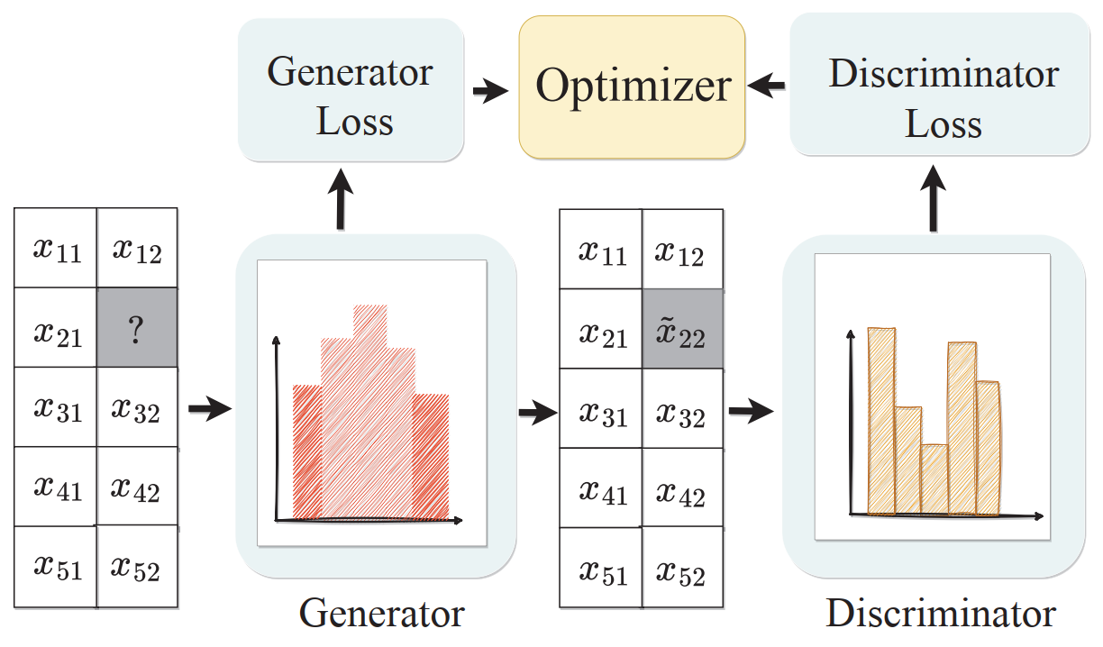
Variational Autoencoder Generative Adversarial Imputation Network (VGAIN)
Use an auto-encoder (AE) and generative adversarial network (GAN) to learn global data distribution
Xiaoye Miao, Yangyang Wu, Lu Chen, Yunjun Gao, and Jianwei Yin. 2022. An Experimental Survey of Missing Data Imputation Algorithms. IEEE Transactions on Knowledge and Data Engineering (2022).
Notes:
Xiaoye Miao, Yangyang Wu, Lu Chen, Yunjun Gao, and Jianwei Yin. 2022. An Experimental Survey of Missing Data Imputation Algorithms. IEEE Transactions on Knowledge and Data Engineering (2022).

Slide 20
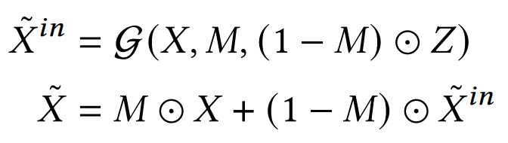
Details of VGAIN
Generator
Output the imputed matrix
Discriminator
Determine whether the imputed data is generated or from the original distribution
noise matrix Z
Xiaoye Miao, Yangyang Wu, Lu Chen, Yunjun Gao, and Jianwei Yin. 2022. An Experimental Survey of Missing Data Imputation Algorithms. IEEE Transactions on Knowledge and Data Engineering (2022).

Slide 21
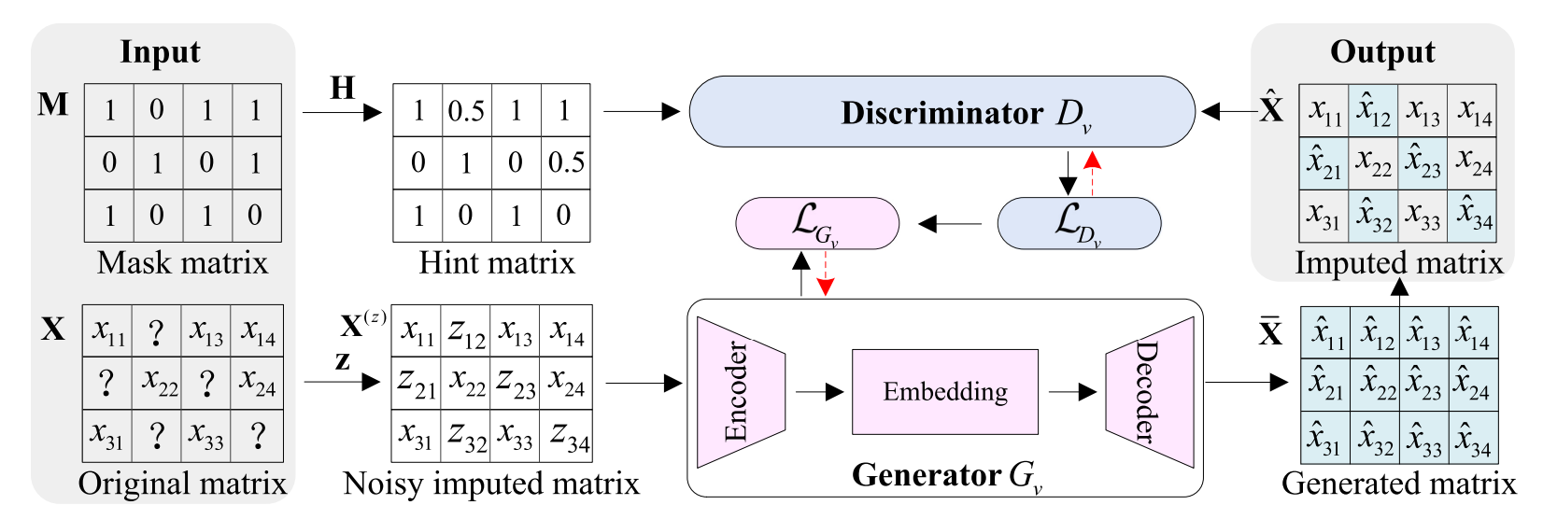
VGAIN Architecture
focus the attention
Xiaoye Miao, Yangyang Wu, Lu Chen, Yunjun Gao, and Jianwei Yin. 2022. An Experimental Survey of Missing Data Imputation Algorithms. IEEE Transactions on Knowledge and Data Engineering (2022).

Slide 22
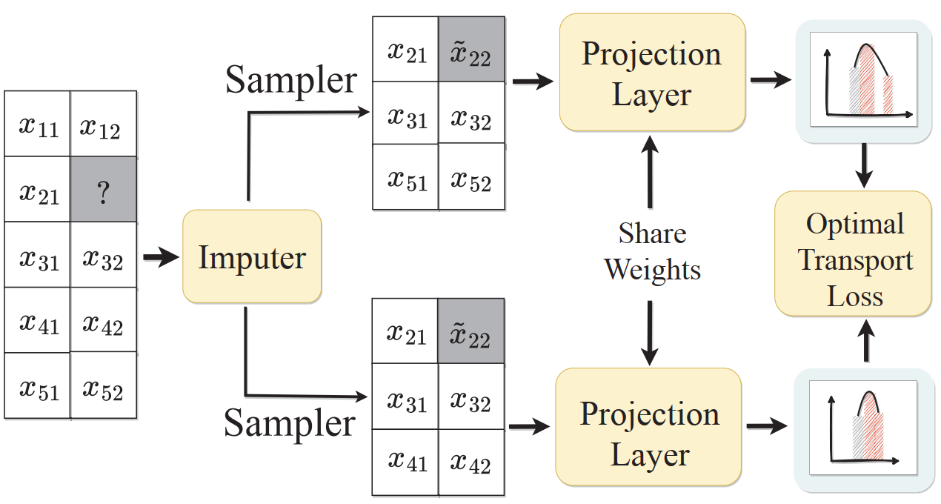
Transformed Distribution Matching (TDM)
Any two batches of data in the raw dataset come from the same global distribution
Use a neural network to impute the missing data, such that the transport distance between empirical distributions of the imputed data batches is minimized
He Zhao, Ke Sun, Amir Dezfouli, and Edwin V Bonilla. 2023. Transformed Distribution Matching for Missing Value Imputation. In International Conference on Machine Learning. PMLR, 42159–42186
Notes:
He Zhao, Ke Sun, Amir Dezfouli, and Edwin V Bonilla. 2023. Transformed Distribution Matching for Missing Value Imputation. In International Conference on Machine Learning. PMLR, 42159–42186

Slide 23
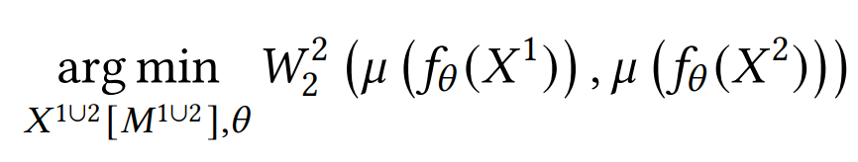
Details of TDM
Impute any two batches of data 𝑋¹ and 𝑋² such that the empirical distributions of the imputed data are matched in the latent space
Optimize the loss function:
where 𝑊₂²(·) is the 2-Wasserstein distance to measure the
distance between two distributions

Slide 24
Disadvantages of Distribution Modeling Techniques
Use sophisticated deep learning (DL) model
Overfitting → inaccurate missing data imputation
Heavily rely on the global distribution
Local information remains insufficiently explored

Slide 25
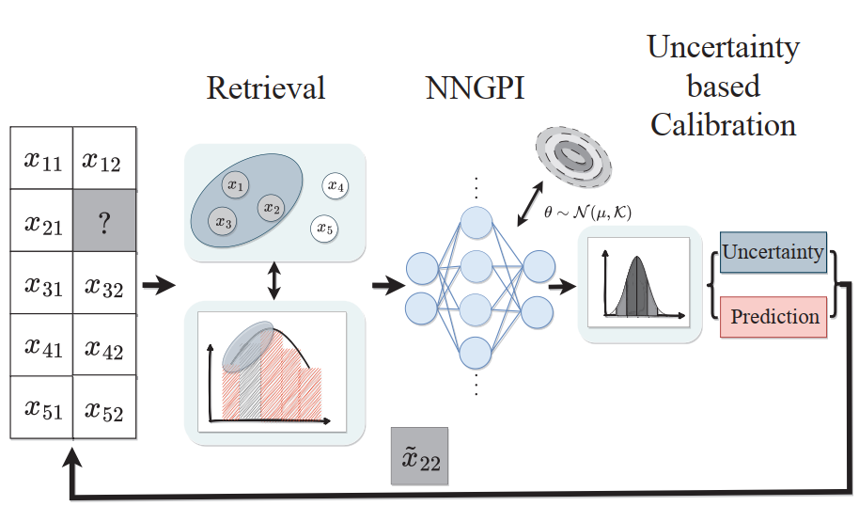
uNcertainty-driven netwOrk for Missing data Imputation (NOMI)
Three key components
Retrieval module
Neural network gaussian process imputator (NNGPI)
Uncertainty-based calibration module
He Zhao, Ke Sun, Amir Dezfouli, and Edwin V Bonilla. 2023. Transformed Distribution Matching for Missing Value Imputation. In International Conference on Machine Learning. PMLR, 42159–42186

Slide 26
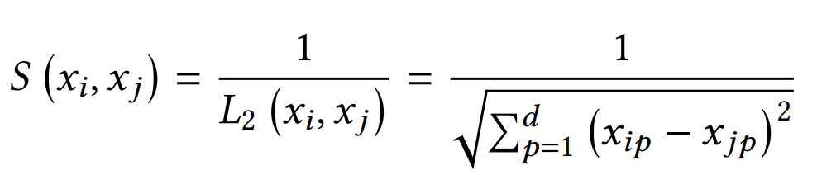
NOMI Details – Retrieval Module
Use the nearest neighbor search to retrieve local information
Calculate pairwise similarity between the input query sample and each data sample in the training dataset given a similarity metric (e.g., L₂-norm distance)

Slide 27
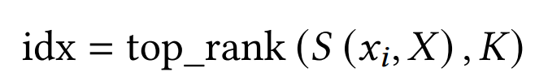

NOMI Details – Retrieval Module (cont'd)
K-nearest neighbors
Input augmented by the local information
concatenation operator
normalized similarity S(., .)
Adaptively assign higher weights to closer neighbors!

Slide 28
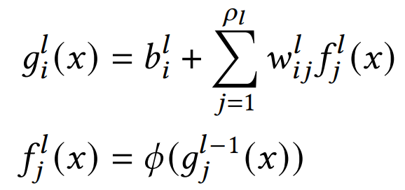
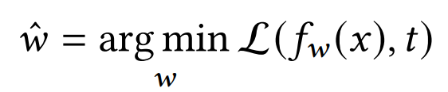
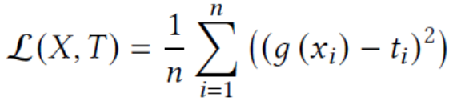
NOMI Details – Neural Network Gaussian Process Imputator
L-layer neural network
Approximate the function f_{w}(·), parameterized by w, between the input x and the target t
Training objective
Gaussian Process

Slide 29
NOMI Details – Uncertainty-based Calibration
Given a test data x*
Based on NNGPI, the probability distribution over w and b induces a probability distribution over output prediction g(x∗)
The predicted mean and variance can be obtained
Calibration
Prioritize the prediction in the current iteration when the uncertainty is low
Prioritize the prediction in the previous iteration when the uncertainty is high

Slide 30
The NOMI Framework
Iteratively run the three key components
Theoretical foundation
NOMI can be reformulated as an instance of the Expectation Maximization (EM) algorithm
He Zhao, Ke Sun, Amir Dezfouli, and Edwin V Bonilla. 2023. Transformed Distribution Matching for Missing Value Imputation. In International Conference on Machine Learning. PMLR, 42159–42186
Notes:
He Zhao, Ke Sun, Amir Dezfouli, and Edwin V Bonilla. 2023. Transformed Distribution Matching for Missing Value Imputation. In International Conference on Machine Learning. PMLR, 42159–42186

Slide 31
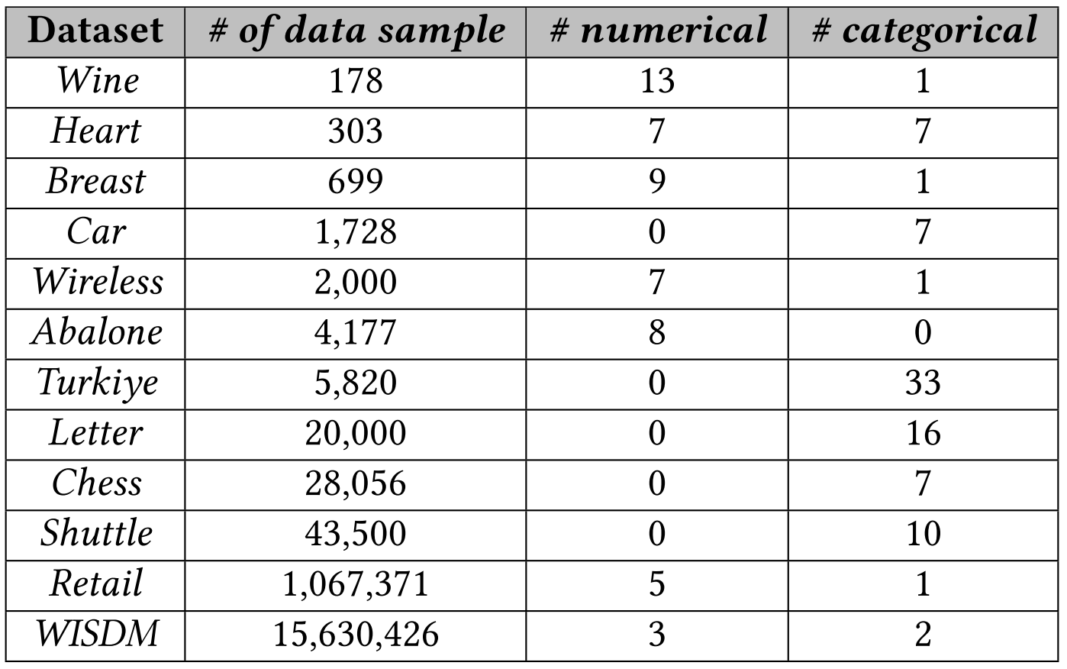
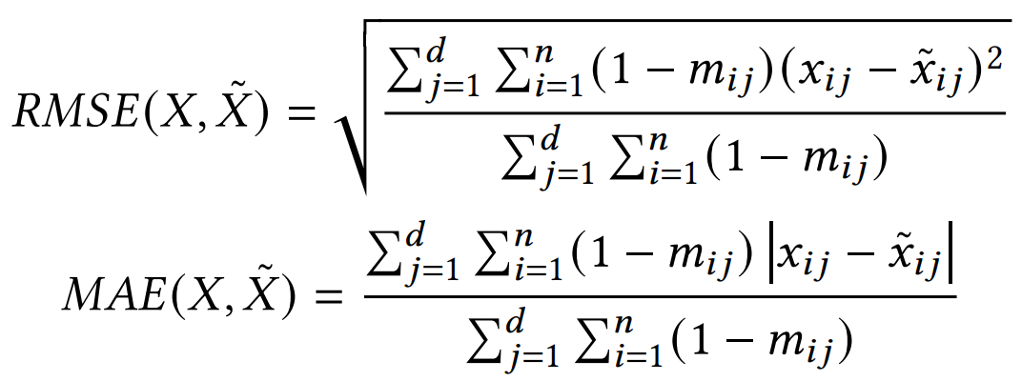
NOMI Experimental Evaluation
Real data sets
Measures
Root mean square error (RMSE)
Mean absolute error (MAE)
Notes:
He Zhao, Ke Sun, Amir Dezfouli, and Edwin V Bonilla. 2023. Transformed Distribution Matching for Missing Value Imputation. In International Conference on Machine Learning. PMLR, 42159–42186

Slide 32
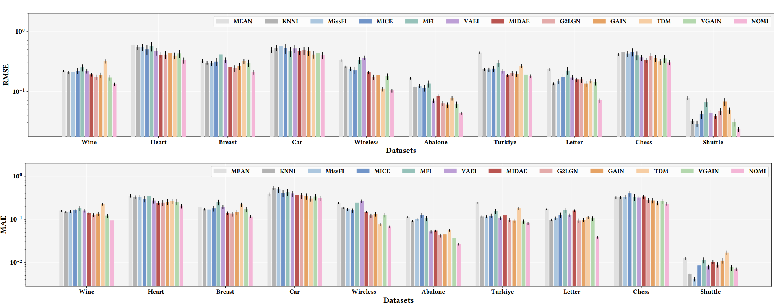

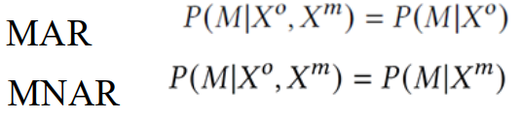
NOMI Experimental Evaluation (cont'd)
Missing mechanism: MCAR
Notes:
He Zhao, Ke Sun, Amir Dezfouli, and Edwin V Bonilla. 2023. Transformed Distribution Matching for Missing Value Imputation. In International Conference on Machine Learning. PMLR, 42159–42186

Slide 33
Mixed-Type Missing Data Imputation
The raw data matrix X may contain various mixed data types
Numerical
Categorical
Text data
…
Jianwei Wang, Kai Wang, Ying Zhang, Wenjie Zhang, Xiwei Xu, and Xuemin Lin. “On LLM-enhanced mixed-type data imputation with high-order message passing.” VLDB (2025)

Slide 34
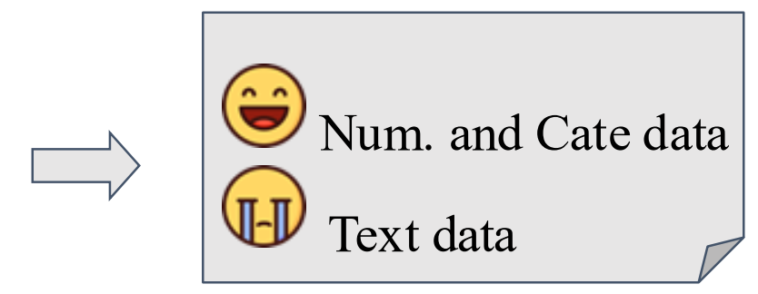
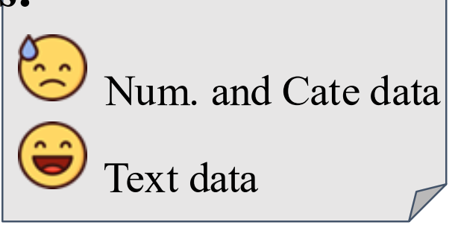

Background of Mixed-Type Missing Data Imputation
Existing learning-based methods and rule-based methods
MICE
GAIN / VGAIN
GRAPE / IGRM
TDM, ReMasker, …
Existing LLM-based methods
DFMs
Table-GPT / Jellyfish
Notes:
Machine Learning for Graph Data Management and Query Processing
Hanchen Wang, Ying Zhang, Wenjie Zhang
PVLDB, 2025.
URL: https://www.vldb.org/pvldb/vol18/p5499-zhang.pdf
Slides: https://hanchen-wang.com/publication/ml4gdb/VLDB25_ML_for_GDB.pdf

Slide 35
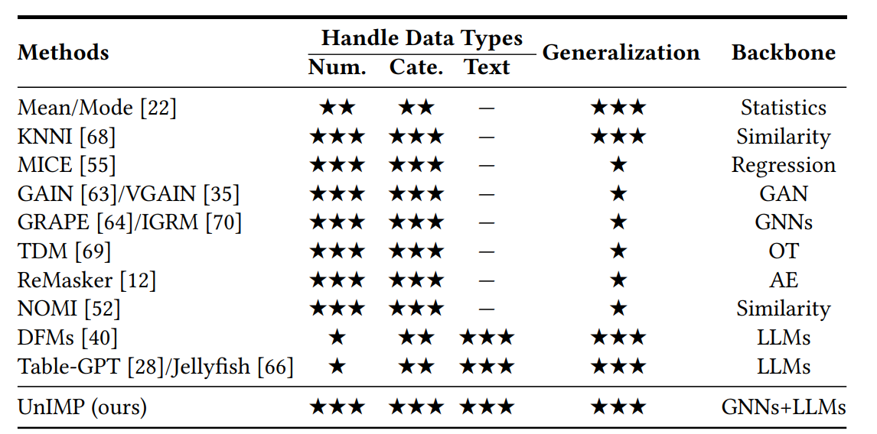
Comparison of Representative Imputation Methods
Jianwei Wang, Kai Wang, Ying Zhang, Wenjie Zhang, Xiwei Xu, and Xuemin Lin. “On LLM-enhanced mixed-type data imputation with high-order message passing.” VLDB (2025)

Slide 36
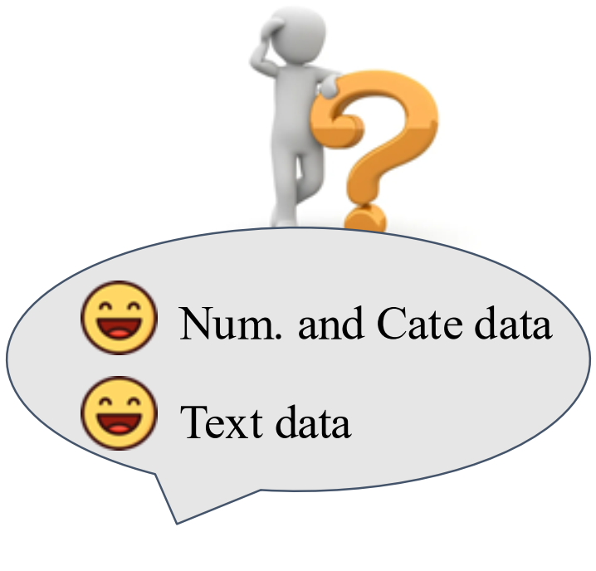
Mixed-Type Missing Data Imputation

Slide 37
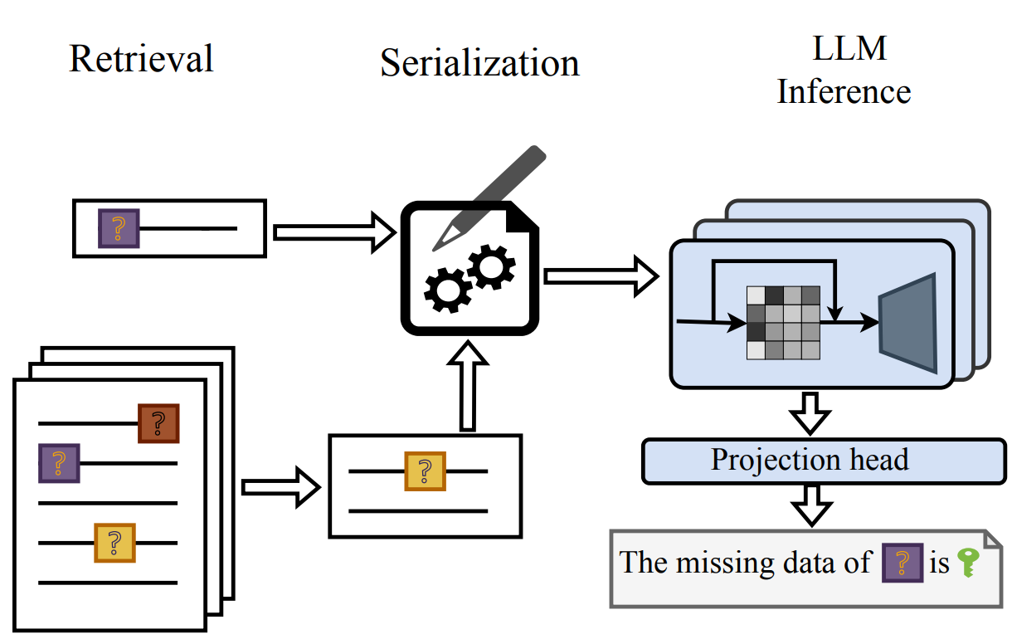
In-Context-Learning-Based Methods – Direct Foundation Models (DFM)
Directly infer missing data by pre-trained LLM with carefully designed prompts
[DFM] Avanika Narayan, Ines Chami, Laurel Orr, and Christopher Ré. 2022. Can Foundation Models Wrangle Your Data? Proceedings of the VLDB Endowment 16, 4 (2022), 738–746.

Slide 38
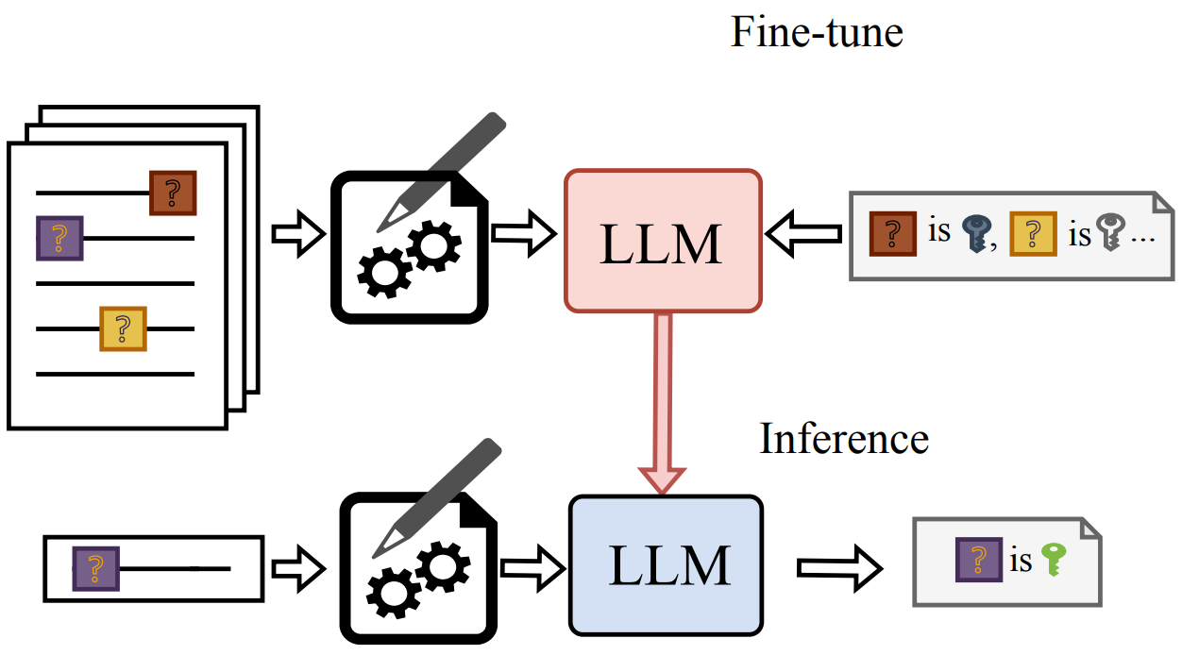
Fine-Tuning-Based Methods – Table-GPT/Jellyfish
Fine-tune LLM to adapt the model for tabular tasks including imputation
[Table-GPT] Peng Li, Yeye He, Dror Yashar, Weiwei Cui, Song Ge, Haidong Zhang, Danielle Rifinski Fainman, Dongmei Zhang, and Surajit Chaudhuri. 2024. Table-GPT: Table Fine-tuned GPT for Diverse Table Tasks. Proceedings of the ACM on Management of Data 2, 3 (2024), 1–28
[Jellyfish] Haochen Zhang, Yuyang Dong, Chuan Xiao, and Masafumi Oyamada. 2024. Jellyfish: Instruction-Tuning Local Large Language Models for Data Preprocessing. In Proceedings of the 2024 Conference on Empirical Methods in Natural Language Processing. 8754–8782.

Slide 39
LLM for Mixed-Type Missing Data Imputation
Imputing each data type separately may ignore the intricate dependencies between them, leading to inconsistencies and reduced overall accuracy
Challenges
Aggregate global-local and high-order information for imputation while capturing inter-column and intra-column patterns
Effectively integrate the aggregation module and train the model to support mixed-type imputation
LLM+GNN
[UnIMP] Jianwei Wang, Kai Wang, Ying Zhang, Wenjie Zhang, Xiwei Xu, and Xuemin Lin. “On LLM-enhanced mixed-type data imputation with high-order message passing.” VLDB (2025)

Slide 40
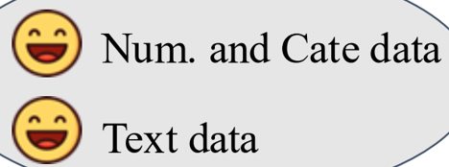
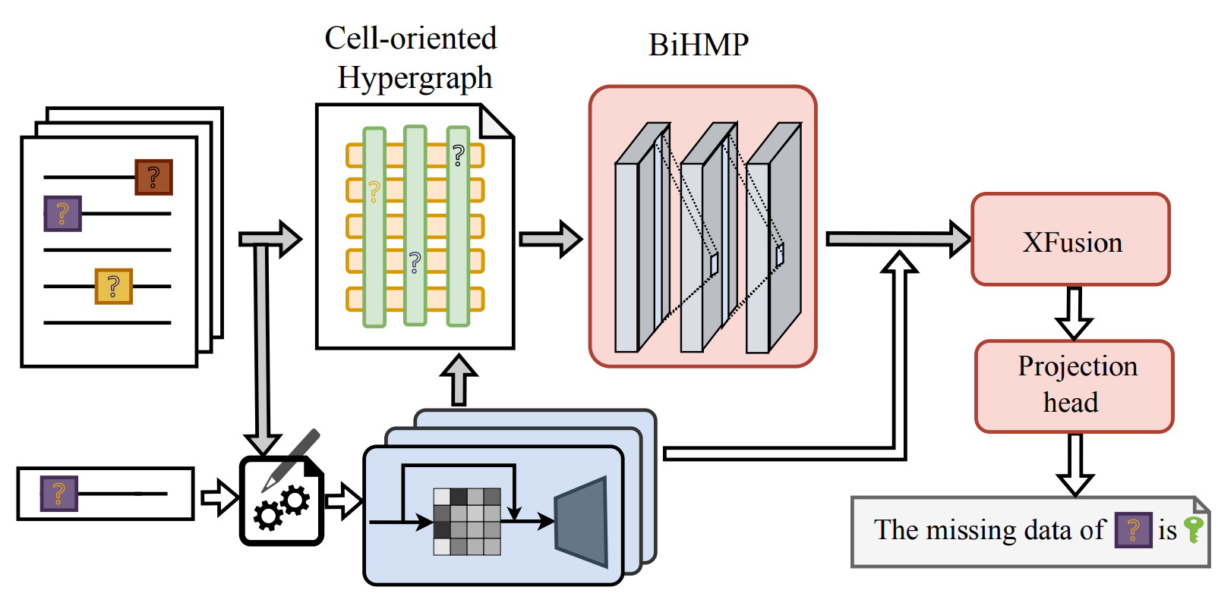
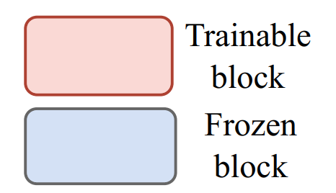
Unified IMPutation (UnIMP)
Employ LLM and the high-order message passing for accurate mixed-type data imputation
[UnIMP] Jianwei Wang, Kai Wang, Ying Zhang, Wenjie Zhang, Xiwei Xu, and Xuemin Lin. “On LLM-enhanced mixed-type data imputation with high-order message passing.” VLDB (2025)
Notes:
[UnIMP] Jianwei Wang, Kai Wang, Ying Zhang, Wenjie Zhang, Xiwei Xu, and Xuemin Lin. “On LLM-enhanced mixed-type data imputation with high-order message passing.” VLDB (2025)

Slide 41
Unified IMPutation (UnIMP) (cont'd)
A cell-oriented hypergraph for tabular data
Each cell x_{ij} ∈ X, create a corresponding node v_{idx} ∈ V, where idx = i * d + j
Nodes in the same column (x_{0j}, x_{1j}, …, x_{nj}) form a hyperedge e_{j}
Nodes in the same row (x_{i0}, x_{i1}, …, x_{id}) form a hyperedge e_{i+d}
Notes:
[UnIMP] Jianwei Wang, Kai Wang, Ying Zhang, Wenjie Zhang, Xiwei Xu, and Xuemin Lin. “On LLM-enhanced mixed-type data imputation with high-order message passing.” VLDB (2025)

Slide 42
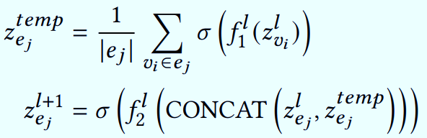
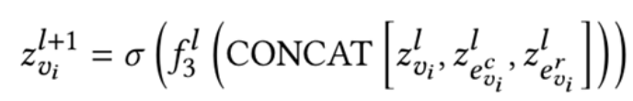
Bidirectional High-order Message-Passing (BiHMP) Network
BiHMP aggregates global-local and high-order information on the constructed hypergraph
Global context (cells across the table)
Local context (neighboring cells)
High-order relationship (the cell value is influenced by multiple columns simultaneously)
Node-to-Hyperedge Layer
Hyperedge-to-Node Layer
Notes:
[UnIMP] Jianwei Wang, Kai Wang, Ying Zhang, Wenjie Zhang, Xiwei Xu, and Xuemin Lin. “On LLM-enhanced mixed-type data imputation with high-order message passing.” VLDB (2025)

Slide 43
XFusion Module + Projection Head
XFusion fuses the aggregated data with the embedded prompts
A project head maps the predicted data back to token space, and decodes tokens into human-readable results
Notes:
[UnIMP] Jianwei Wang, Kai Wang, Ying Zhang, Wenjie Zhang, Xiwei Xu, and Xuemin Lin. “On LLM-enhanced mixed-type data imputation with high-order message passing.” VLDB (2025)

Slide 44
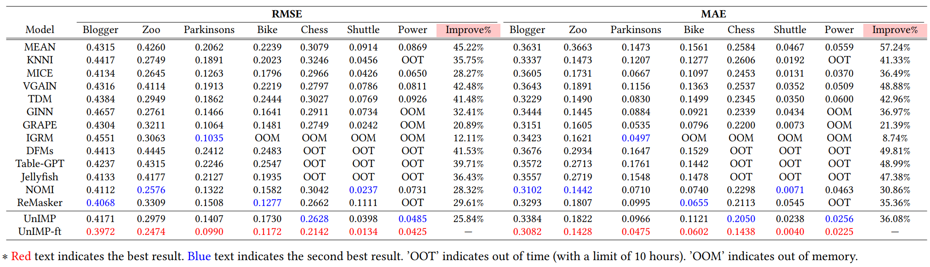
UnIMP Experimental Results
Evaluation: Accuracy Over Numerical and Categorical Data
UnIMP
UnIMP-ft – fine tuned

Slide 45
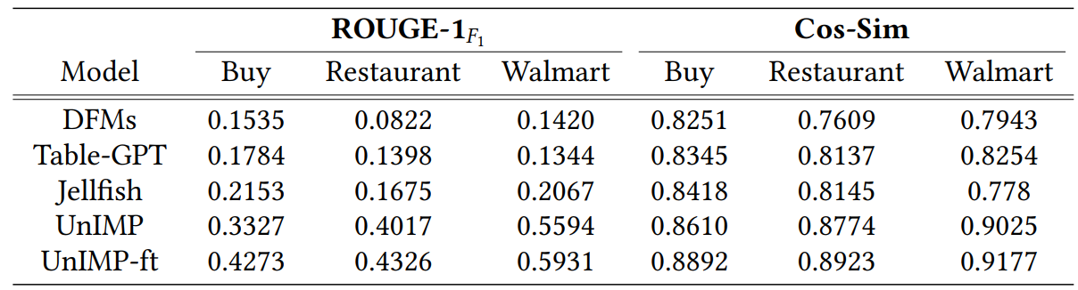
UnIMP Experimental Results (cont'd)
Evaluation: Accuracy Over Text Data

Slide 46
DAMR: Dynamic Adjacency Matrix Representation Learning for Multivariate Time Series Imputation

Slide 47
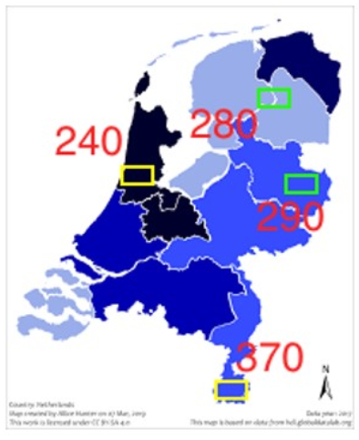
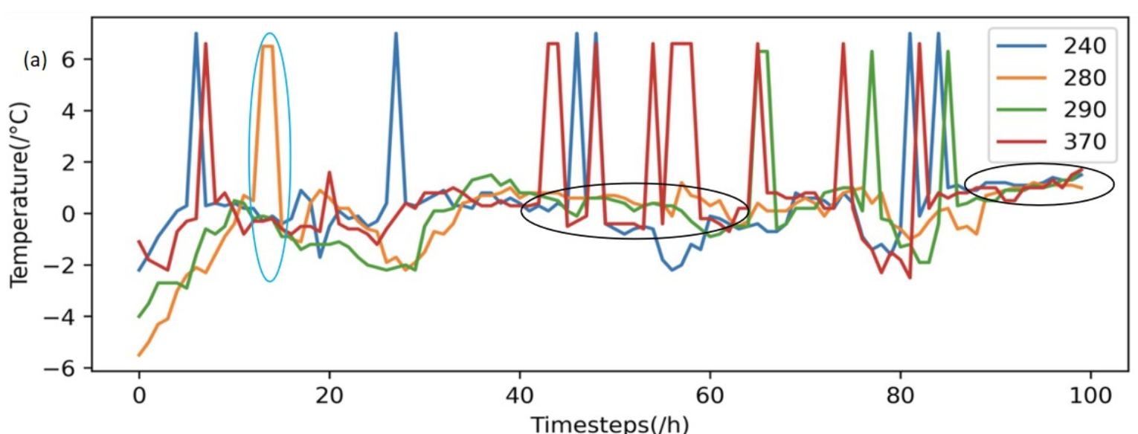
Time Series Data
Time series (a.k.a. data sequence)
An ordered sequence of items over time
Time series examples
Stock price data
Sensory data
Trajectory data
EEG data
Video data
…

Slide 48
Time Series with Missing Attribute Values
Some attribute values of time series data may be missing
Packet losses in sensor networks
Delayed arrival of the collected data
Failure of sensing devices
…

Slide 49
Data Model for Multivariate Time Series
Consider a location-based sensor network with n nodes, each collecting data with d features (dimensions)
An n×d node-feature matrix X_{t} at timestamp t
An n×d mask matrix M_{t} ∈ {0, 1}^{n×d}
M_{t; i,k} = 0, if the k-th feature of the i-th node is missing
An n×n adjacency matrix A_{t} for n sensor nodes
A_{t} indicates the strengths of correlations between two sensor nodes at timestamp t

Slide 50



Problem Formulation of Time Series Imputation
Given time series data with missing values
The goal of multivariate time series imputation is to find a procedure g(.) that reconstructs the node-feature matrix
such that the difference between and is
minimal
Spatial/Temporal Correlations

Slide 51
The Dynamic Adjacency Matrix Representation (DAMR)
DAMR
Estimate the dynamic spatial correlation in the form of an adjacency matrix
Impute the missing values with graph neural networks (GNNs)
[DAMR] Xiaobin Ren, Kaiqi Zhao, Patricia Riddle, Katerina Taskova, Lianyan Li, and Qingyi Pan. DAMR: Dynamic Adjacency Matrix Representation Learning for Multivariate Time Series Imputation. SIGMOD, 2023.

Slide 52
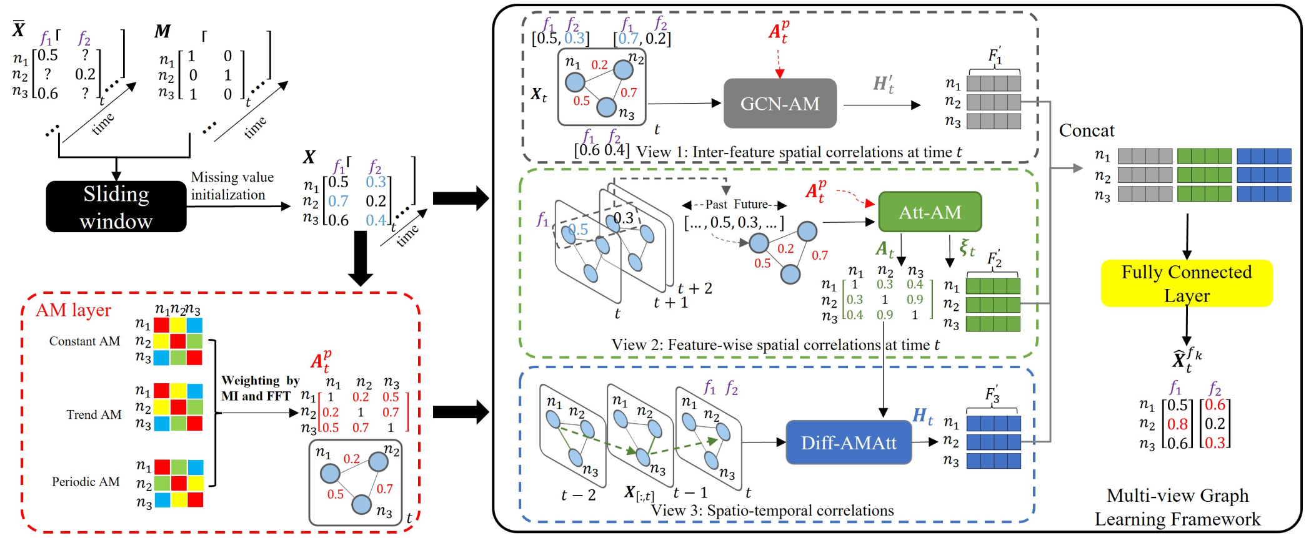
The DAMR Architecture
Initialize missing data with the mean in the sliding window
The Adjacency Matrix (AM) layer constructs the dynamic adjacency matrix (spatial correlations)

Slide 53
The DAMR Architecture (cont'd)
The multi-view graph learning framework
The inter-feature spatial correlations at a specific time (GCN-AM)
The feature-wise spatial correlations at a specific time (Att-AM)
The spatio-temporal correlations among features (Diff-AMAtt)

Slide 61
Summary
The learning-based data quality improvement
Missing value imputation methods
Mixed-type missing value imputation
The learning-based time series management
Missing value imputation in time series data
Understand the learning-based query processing

Slide 62
Reading Materials
Keke Huang, Yimin Shi, Dujian Ding, Yifei Li, Yang Fei, Laks V. S. Lakshmanan, and Xiaokui Xiao. ThriftLLM: On Cost-Effective Selection of Large Language Models for Classification Queries. PVLDB, 2025.
[VGAIN] Xiaoye Miao, Yangyang Wu, Lu Chen, Yunjun Gao, and Jianwei Yin. 2022. An Experimental Survey of Missing Data Imputation Algorithms. IEEE Transactions on Knowledge and Data Engineering (2022).
[TDM] He Zhao, Ke Sun, Amir Dezfouli, and Edwin V Bonilla. 2023. Transformed Distribution Matching for Missing Value Imputation. In International Conference on Machine Learning. PMLR, 42159–42186
[NOMI] Wang, J., Zhang, Y., Wang, K., Lin, X., & Zhang, W. (2024). Missing data imputation with uncertainty-driven network. Proceedings of the ACM on Management of Data, 2(3), 1-25.
Jianwei Wang, Kai Wang, Ying Zhang, Wenjie Zhang, Xiwei Xu, and Xuemin Lin. “On LLM-enhanced mixed-type data imputation with high-order message passing.” VLDB (2025)

Slide 63
Reading Materials (cont'd)
[DFM] Avanika Narayan, Ines Chami, Laurel Orr, and Christopher Ré. 2022. Can Foundation Models Wrangle Your Data? Proceedings of the VLDB Endowment 16, 4 (2022), 738–746.
[Table-GPT] Peng Li, Yeye He, Dror Yashar, Weiwei Cui, Song Ge, Haidong Zhang, Danielle Rifinski Fainman, Dongmei Zhang, and Surajit Chaudhuri. 2024. Table-GPT: Table Fine-tuned GPT for Diverse Table Tasks. Proceedings of the ACM on Management of Data 2, 3 (2024), 1–28
[Jellyfish] Haochen Zhang, Yuyang Dong, Chuan Xiao, and Masafumi Oyamada. 2024. Jellyfish: Instruction-Tuning Local Large Language Models for Data Preprocessing. In Proceedings of the 2024 Conference on Empirical Methods in Natural Language Processing. 8754–8782.
[UnIMP] Jianwei Wang, Kai Wang, Ying Zhang, Wenjie Zhang, Xiwei Xu, and Xuemin Lin. “On LLM-enhanced mixed-type data imputation with high-order message passing.” VLDB (2025)
[DAMR] Xiaobin Ren, Kaiqi Zhao, Patricia Riddle, Katerina Taskova, Lianyan Li, and Qingyi Pan. DAMR: Dynamic Adjacency Matrix Representation Learning for Multivariate Time Series Imputation. SIGMOD, 2023.

