Slide 1
Probabilistic Data Management
Chapter 11: Data Quality in Probabilistic Databases (1)

Slide 2
Objectives
In this chapter, you will:
  Learn how to identify inconsistencies in probabilistic databases
  Discover how to clean uncertain data with quality guarantees
  Become familiar with techniques of resolving inconsistencies in probabilistic databases under possible worlds semantics
  Know how to obtain consistent query answers from inconsistent probabilistic databases

Slide 3
Cleaning Uncertain Data with Quality Guarantees
Cheng et al., Very Large Data Bases (VLDB), 2008

Slide 4
Background
In many emerging applications, data are inherently uncertain
  Sensor data like temperature, humidity, and wind speed
  Location values collected by GPS
  In biometric database, attributes of feature vectors are not exact
The ambiguity of query answers in the uncertain database constitutes the notion of query quality
  i.e., how good a query answer is

Slide 5
Related Work
Probabilistic database
  x-tuple
    E.g. a
  alternative
    E.g. a₁, a₂
Query types
  Range query
  MAX query
Data cleaning in Possible worlds of the probabilistic database
probabilistic database
results of MAX query
partially cleaned database

Slide 6
Problem Definition - Framework
Upon users' query request, provide query answers
With query answers, evaluate query quality and derive a set, X, of optimal x-tuples to be cleaned within a budget constraint C

Slide 7
Problem Definition – Framework (cont'd)
Quality evaluation
  Exponential numbers of possible worlds
  Evaluate over final query answer instead of possible worlds

Slide 8
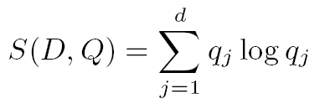
Definition of Data Quality
Possible World Semantics-Quality (PWS-quality)
  Essentially entropy
  Let {r₁, r₂, …, r_{d}} be the set of d distinct PW-results
  Let q_{j} be the probability that r_{j} is the actual answer
  The PWS-quality S(D, Q) of a query Q in probabilistic database D is defined as:

Slide 9
Computation of PWS-Quality
Straightforward method
  Consider every possible world
The x-form of the PWS-quality
  Distribute q_{j} into m x-tuples in the database D
  PRQ query:
  where and Y(x) = x log₂ x
existence probability of t_{i} of x-tuple τ _{k}
qualification probability of t_{i} for Q

Slide 10
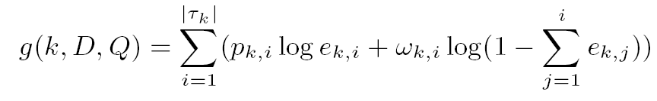
Computation of PWS-Quality (cont.)
The x-form of the PWS-quality (cont.)
  Distribute q_{j} into m x-tuples in the database D
  MAX query:

Slide 11
Data Cleaning Algorithm
To improve the PWS-quality, we only need to consider cleaning x-tuples in the query answer set
Optimization problem:
  g_{k} – - g(k, D, Q)
  c_{k} – cost of cleaning x-tuple τ _{k}
  C – budget constraint
  b_{k} – 0 or 1 bit
A variant of the 0/1 knapsack problem
The time and space are O(CZ) and O(CZ²), respectively

Slide 12
Heuristics for Data Cleaning
Random
  Randomly select x-tuples until budget C is exhausted
MaxQP
  Compute qualification probability P_{k} for each x-tuple τ _{k}
  Choose x-tuples with the highest qualification probabilities to clean until budget C is exhausted
Greedy
  Let f_{k} = g_{k} / c_{k}
  Choose x-tuples with the highest f_{k} to clean until budget C is exhausted

Slide 13
Consistent Query Answers in Inconsistent Probabilistic Databases
ACM Conference on the Management of Data (SIGMOD), 2010

Slide 14
Outline
Background
  Probabilistic/Uncertain Databases
  Inconsistent Databases
Introduction
Related Work
Problem Definition
Probabilistic Consistent Query Answering
Experimental Results
Summary

Slide 15
Background: Probabilistic/Uncertain Databases
Data uncertainty is ubiquitous in many real-world applications
  Sensor networks
  Image data
  Location-based services
  Moving object search
  …
  Privacy preserving for medical data

Slide 16
Probabilistic Databases – Tuple Uncertainty
Product ID | Tuple ID | Price ($) | Prob.
a | a₁ | 120 | 0.5
a | a₂ | 80 | 0.4
b | b₁ | 90 | 0.8
Tuple Uncertainty
  Probabilistic databases
    x-tuples
      a, b
    alternatives
      a₁, a₂, b₁
  Possible worlds semantics
    PW₁ = {a₁, b₁}
    PW₃ = {a₁}
probabilistic database
Possible Worlds, PW_{i} | Prob., Pr{PW_{i}}
PW₁ = {a₁, b₁} | 0.5 × 0.8 = 0.4
PW₂ = {a₂, b₁} | 0.4 × 0.8 = 0.32
PW₃ = {a₁} | 0.5 × (1-0.8) = 0.1
PW₄ = {a₂} | 0.4 × (1-0.8) = 0.08
PW₅ = {b₁} | (1-0.5-0.4) × 0.8 = 0.08
PW₆ = ∅ | (1-0.5-0.4) × (1-0.8) = 0.02
6 possible worlds of the probabilistic database

Slide 17

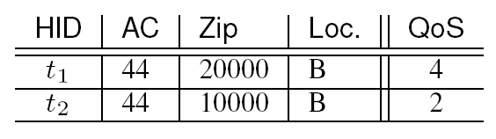
Background: Inconsistent Certain Databases
Inconsistent databases
  An inconsistent database contains tuples that may violate a number of integrity constraints
    Key constraint
    Functional dependency (FD)
t₁ = t₂
RID
restaurant table
restaurant id

Slide 18
Background: Inconsistent Certain Databases (cont'd)
Inconsistencies occur when:
  Integrating data from different data sources
  Collecting inaccurate data from real-world applications
Solutions in the literature
  Data repair
  Consistent query answering
Topics in this chapter:
  Consistent query answering in inconsistent probabilistic databases

Slide 19
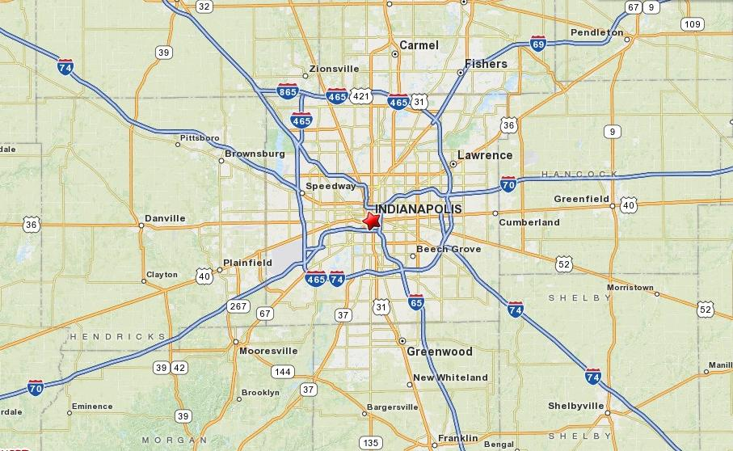
Motivation Example
restaurant t₁
restaurant t₂
Query: retrieve those restaurants with QoS ∈ [4, 5]

Slide 20



Motivation Example
restaurant t₁
restaurant t₂
Web data
news or rumors
commercial data
data sources
Query: retrieve those restaurants with QoS ∈ [4, 5]
integrated data

Slide 21
Motivation Example
Query: retrieve those restaurants with QoS ∈ [4, 5]
inconsistency
source ID | area code | zip code | location | status | quality of service | t_{jr.}p
t₁₁ | 317 | 46201 | A | Open | 5 | 0.2
t₁₂ | 317 | 46201 | B | Closed | 4 | 0.4
t₁₃ | 317 | 46202 | B | Closed | 3 | 0.1
t₂₁ | 317 | 46202 | A | Open | 3 | 0.8
restaurant t₁
restaurant t₂
a probabilistic database
a restaurant database
the percentage of people agreeing on the record

Slide 22
Motivation Example
inconsistency
RID | SID | AC | Zip | Loc. | status | QoS | t_{jr.}p
t₁ | t₁₁ | 317 | 46201 | A | Open | 5 | 0.2
t₁ | t₁₂ | 317 | 46201 | B | Closed | 4 | 0.4
t₁ | t₁₃ | 317 | 46202 | B | Closed | 3 | 0.1
t₂ | t₂₁ | 317 | 46202 | A | Open | 3 | 0.8
inconsistent probabilistic database
probabilistic database
Consistent Query Answers in an Inconsistent Probabilistic Database!
possible worlds
functional dependency:

Slide 23
Outline
Background
Introduction
Related Work
Problem Definition
Probabilistic Consistent Query Answering
Experimental Results
Summary

Slide 24



Introduction
Data sources
  The crawled Web data from Internet
  News or rumors from personal blogs
  Data exchanged or bought from corporations
Inconsistencies in the collected data
  Input typos
  Data expirations
  Subjective comments made by people

Slide 25
Related Work
Inconsistent (certain) databases
  An inconsistent database contains tuples that violate integrity constraints
    Key constraint
    Functional dependency (FD)
A repair of the database is to manipulate tuples with the minimal repair cost such that the resulting data become consistent
  X-repair: tuple deletions only
  S-repair: tuple insertions and deletions
  U-repair: attribute value updates

Slide 26
Related Work – X-Repair
X-repair (under minimal repair semantics)
  Delete tuples t₁₁ and t₁₂
  Delete tuples t₁₁ and t₁₃
RID | SID | AC | Zip | Loc. | status | QoS
t₁ | t₁₁ | 317 | 46201 | A | Open | 5
t₁ | t₁₂ | 317 | 46201 | B | Closed | 4
t₁ | t₁₃ | 317 | 46202 | B | Closed | 3
t₂ | t₂₁ | 317 | 46202 | A | Open | 3

Slide 27
Related Work – Consistent Query Answering (CQA)
answers
answers
consistent query answers
… …
… …
… …
… …
… …
inconsistent certain
database
answers
repair
intersection
minimal repairs

Slide 28
CQA in Inconsistent Probabilistic Databases
Query: retrieve those restaurants with QoS ∈ [4, 5]
X-repair (2 minimal repairs)
  Delete {t₁₁, t₁₂}
  Delete {t₁₁, t₁₃}
We consider all-possible-repairs semantics rather than minimal repairs
query answer: φ
query answer: {t₁₂}
RID | SID | AC | Zip | Loc. | status | QoS | t_{jr.}p
t₁ | t₁₁ | 317 | 46201 | A | Open | 5 | 0.2
t₁ | t₁₂ | 317 | 46201 | B | Closed | 4 | 0.4
t₁ | t₁₃ | 317 | 46202 | B | Closed | 3 | 0.1
t₂ | t₂₁ | 317 | 46202 | A | Open | 3 | 0.8
AC | Zip | Loc.
317 | 46201 | A
317 | 46203 | B
ground truth

Slide 29
All-Possible-Repairs Semantics in Inconsistent Probabilistic Databases
Query: retrieve those restaurants with QoS ∈ [4, 5]
The all-possible-repairs semantics
RID | SID | AC | Zip | Loc. | status | QoS | t_{jr.}p
t₁ | t₁₁ | 317 | 46201 | A | Open | 5 | 0.2
t₁ | t₁₂ | 317 | 46201 | B | Closed | 4 | 0.4
t₁ | t₁₃ | 317 | 46202 | B | Closed | 3 | 0.1
t₂ | t₂₁ | 317 | 46202 | A | Open | 3 | 0.8
AC | Zip | Loc.
317 | 46201 | A
317 | 46203 | B
ground truth
minimal repairs D₁^{R} and D₂^{R}

Slide 30
Probabilistic Consistent Query Answering
CQA in the inconsistent probabilistic database
  Return consistent query answers satisfying
    query predicate, P_{Q}, and
    consistent score predicate, P_{S}, on all possible repairs
Query Types
  PC-Range
  PC-Join
  PC-Topk

Slide 31
Probabilistic Consistent Query Answering (cont'd)
Probabilistic consistent range query (PC-Range)
  Obtain objects satisfying range predicates and with consistent score, score_{R}, greater than α_{R}
Probabilistic consistent join (PC-Join)
  Retrieve object pairs from two databases satisfying join predicates, and with consistent score, score_{J}, greater than α_{J}
Probabilistic consistent top-k query (PC-Topk)
  Obtain k objects with the highest consistent scores, score_{T}

Slide 32
Computation of Consistent Scores
– PC-Range and PC-Join
PC-Range (PC-Join)
  The consistent score of a tuple (pair) indicates the confidence that the tuple (pair) appears in the repaired possible worlds
  score_{R}(t_{j})=t_{j}.P_{rpw}=Pr{t_{j}∈rpw(D)}=t_{j}.p⋅(1-Pr{t_{j} is in some rw(D)})
offline pre-computation

Slide 33
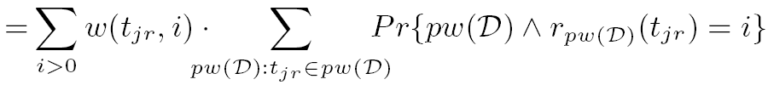
Definition of PC-Topk Queries
Top-k queries in a consistent probabilistic database
  A probabilistic database D
  A preference function f(.)
  A probabilistic top-k query retrieves k tuples, t_{jr}, such that their scores, ϒ_{w}(D, t_{jr}), are the largest, where
a weight function
J. Li, B. Saha, and A. Deshpande. A unified approach to ranking in probabilistic databases. In PVLDB, 2009.

Slide 34

Definition of PC-Topk Queries (cont'd)
PC-Topk queries in an inconsistent probabilistic database
  A PC-Topk query retrieves k tuples, t_{jr}, such that their consistent scores, score_{T}(t_{jr}), are the largest, where
where W_{r}(D^{R}) is the repair weight and

Slide 35
Probabilistic CQA
answers
answers
probabilistic consistent query answers
… …
… …
… …
… …
… …
inconsistent probabilistic
database
answers
repair
aggregation
all possible repairs

Slide 36

Challenge
Time complexity
  Exponential numbers of repaired databases and possible worlds
  Inefficient to materialize all possible repaired databases and possible worlds for each repaired database
…
…
…
…
…
…
…
inconsistent probabilistic
database
exponential number of repaired databases
exponential number of possible worlds

Slide 37
Basic Idea of Solutions
model inconsistent tuples by inconsistency graphs
transform the CQA problem to the one in repaired possible worlds
derive the recursive functions for computing consistent scores
design pruning techniques to quickly filter out false alarms (PC-Topk)

Slide 38
Inconsistency Graphs
RID | SID | AC | Zip | Loc. | status | QoS | t_{jr.}p
t₁ | t₁₁ | 317 | 46201 | A | Open | 5 | 0.2
t₁ | t₁₂ | 317 | 46201 | B | Closed | 4 | 0.4
t₁ | t₁₃ | 317 | 46202 | B | Closed | 3 | 0.1
t₂ | t₂₁ | 317 | 46202 | A | Open | 3 | 0.8
Inconsistency graph, G^{inc}
  Vertex set, V
    Each vertex, v_{jr}, corresponds to a tuple, t_{jr}, in the database
  Edge set, E
    Two vertices have a connecting edge between them, iff their corresponding tuples are inconsistent
A repair of database D is equivalent
to deleting vertices in G^{inc} such that
no edges are left

Slide 39
Repair Worlds
repair world 1
repair world 2
repair world 3
repair world 4
repair world 5
repair world 6
repair world 7

Slide 40
Problem Reduction
CQA over inconsistent probabilistic databases can be reduced to the problem in the repaired possible worlds
recursive functions
consistent scores
…
…
…
…
inconsistent probabilistic
database
possible worlds
pw(D)
repair worlds
rw(D)
repaired possible worlds
rpw(D) = pw(D) - rw(D)

Slide 41

Computation of Consistent Scores for PC-Topk
Consistent Score of PC-Topk
  The consistent score, score_{T}(t_{j}), of a tuple t_{j} indicates the score that t_{j} is in the top-k results of the repaired possible worlds
rpw₁
t_{j} is in top-k results?
Y
ϒ_{w}(t_{j},rpw₁)=0.3
repaired possible worlds
rpw₂
t_{j} is in top-k results?
N
score_{T}(t_{j}) = 0.3+0.3= 0.6
Σ
rpw₃
t_{j} is in top-k results?
N
rpw₄
t_{j} is in top-k results?
Y
ϒ_{w}(t_{j},rpw₄)=0.3
Probabilistic Consistent Top-k (PC-Topk) Query: retrieve k objects, t_{j}, with the highest score_{T}(t_{j})

Slide 42


Consistent Scores for PC-Topk
We rewrite score_{T}(t_{j}) as:
where
recursive function
the probability that there are (i-1) out of (j-1) tuples with rank higher than t_{j} in rpw(D)

Slide 43
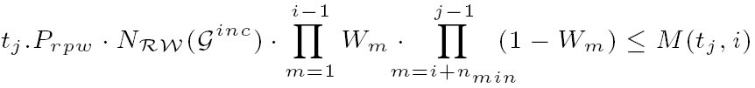
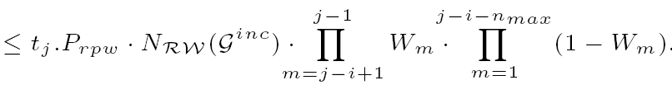
PC-Topk Pruning
PC-Topk Pruning Heuristics
    To obtain bounds of consistent scores at a low cost
      Set a threshold τ to the k-th largest score lower bound among tuples we have seen so far
      Any tuple having score upper bound smaller than τ can be safely pruned
Notes:
Let W_{m} be the m-th largest existence probability in T_{j-1}

Slide 44
Experimental Evaluation
Experimental Settings
  Real/synthetic data sets
    Iceberg sighting data set (IIP): existence probabilities are assigned according to witness probabilities
    Uniform and skew data
    Inconsistencies are injected by randomly selecting tuple pairs
  Parameters:
    Query range [e_{min}, e_{max}], dimensionality d, data size N, join similarity threshold ε, percentage of inconsistent tuples γ, parameter k
  Measures
    time cost (PC-Range, PC-Join, and PC-Topk)
    speed-up ratio (PC-Topk): compared with a baseline method
Notes:
Baseline: Sequentially scan data and calculate the consistent score

Slide 45
Performance of PC-Topk
PC-Topk time cost vs. k
PC-Topk speed-up ratio vs. k
dimensionality d = 2, data size N = 30K, percentage of inconsistent tuples γ = 0.1%

Slide 46
Summary
Consistent query answering (CQA) in inconsistent probabilistic databases
Reduce the problem to the one in the repaired possible worlds
Derive recursive functions to compute consistent scores
Provide effective filtering methods to reduce the search space

