Slide 1
Range Query For Uncertain Moving Objects
Prepared By:
Group # 1
Team member 1-Ritu Phogat, 810962016, rphogat@kent.edu
Team member 2 -Sakshi Arora, 810961998, sarora7@kent.edu

Slide 2
Introduction
In emerging web or mobile based applications such as Uber, a taxi booking application developed to serve million of users in to help them book a taxi nearest to their location in order to preserve the hard earned time and money of both consumer and marketer.
But doing so becomes challenging when the uncertainty of location data hinders in between due to various environmental factors like rain, temperature, network failure etc.
Can be simplified by knowing following:
To know where the object is located with highest probability.
To know if object lies in the range of query region(it’s the desired region specified w.r.t user’s requirement).

Slide 3
Project Description
The intent of this project will be to identify the set of objects that lie within query region with probability greater than the specified threshold probability, within a particular timeInterval(defined by startTime and endTime).
In order to analyze the imprecise data, we model the data in uncertainty areas. We propose to enhance the concept of uncertain location granule to overcome the problems that occur in real-time due to uncertainty of location data.

Slide 4
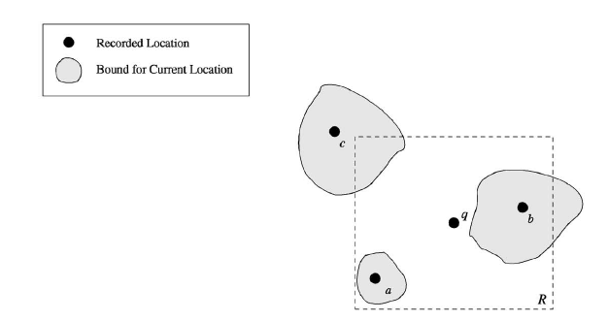
R—> Query Region
q—> Query Point
a,b,c —>moving object’s individual locations

Slide 5
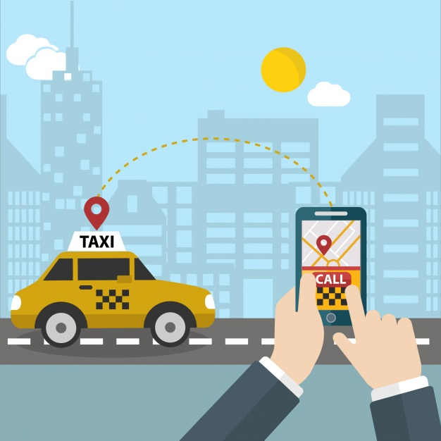
Real-Applications
1. Finding nearby taxis from current location of passenger.
2. Identifying nearby police or military official from criminal position, where Criminal can be a reference object and policemen will be target objects.

Slide 6
Problem Definition
Let Uo be a set of uncertainty granules, say {O1 , . . . , On } and Or be an uncertain reference granule. A probabilistic range query, q(Uo, Or , p), returns the uncertainty granules of the set D that lie within the specified time i.e; Ts and Te, with a probability greater or equal to p, that is:
q(Uo,Or,, p) = {Oi ∈ Uo | P(Oi,Or) ≥ p}.(Given that Ts<T(Oi)<Te)
Here, p is the threshold Probability and p be real numbers.

Slide 7
Calculations Involved
Here, pi is the probability of existence of object(xi,yi) within the query region.
Area(R(xi,yi) n U0) denotes the area of intersected area of query region and Uncertain region of object.
Area(U0) denotes the uncertain area of an object.

Slide 8
The calculated probability is compared with threshold probability(Pt) entered by User as per requirement.
Sliding Time Window is considered in order to get the precise data from the dynamically changing data over the Time.

Slide 9
Data Set Used:
Here, TIMESTAMP is the startingTime of my Trip.
POLYLINE indicates the various positions of the trip after every 15seconds of the trip starting from timestamp given.

Slide 10
Tools used for Implementation
IDE- Eclipse
Programming Language: Java
Library: Apache POI for fetching data from excel file.

Slide 11
Algorithm:
Let t1 and t2 be start and end time. S be the set of all moving objects in dataset. λ be threshold
X <— 0
For I <— to S
A <— Ui(t1,t2) ∩ R
If(A ≠ 0) then
Pi <— A/Ui(t1,t2)
If(pi ≠ 0 && pi >= λ) then X <— X ∪ (Oi, pi)
Return X

Slide 12
Input and Output
Input: start_time, end_time, probabilistic_threshold and region(x1,y1,x2,y2).
Output: Id of taxi(taxi_Id) which lies within the region(x1,y1,x2,y2) and within specified time interval with probability>Pth.

Slide 13
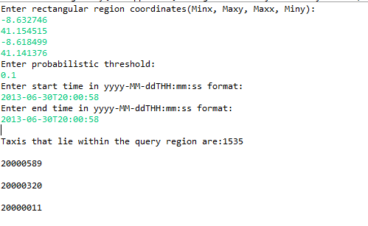
Implementation Output

Slide 14
Future Work
The proposed Algorithm has the complexity of O(n^2), which can be further reduced by making the code more efficient.
The output of the project can be made more interactive and user-friendly by implementing the Graphics.

Slide 15
References
http://ieeexplore.ieee.org/stamp/stamp.jsp?arnumber=1316838
http://ieeexplore.ieee.org/stamp/stamp.jsp?arnumber=4221707
https://ac.els-cdn.com/S0020025517301342/1-s2.0-S0020025517301342-main.pdf?_tid=3860221a-c5ae-11e7-ac23-00000aacb35e&acdnat=1510273952_80eedecbb9ec5e2b78c241ce0da55794
DataSet:
https://archive.ics.uci.edu/ml/datasets/Taxi+Service+Trajectory+-+Prediction+Challenge,+ECML+PKDD+2015#

Slide 16
“ Thank you!!!!!!!!!!!!!!!!!!!! ”

