Slide 1
Skyline query with R*-Tree: Branch and Bound Skyline (BBS) Algorithm
Tod Knott
Jamie Vetrovsky
Justin Guting
Richard Ghrist

Slide 2
Introduction to topic
The paper describes a skyline in the following way: “The skyline of a set of d-dimensional points contains the points that are not dominated by any other point on all dimensions”.
Skylines can be computed in a variety of different ways including:
Block nested loops
Divide and conquer
Bitmap and Index
Nearest Neighbor

Slide 3
Branch and Bound Skyline (BBS) Algorithm
The paper introduces the Branch and Bound Skyline (BBS) algorithm. The BBS algorithm is built upon the shortcomings of nearest neighbor (NN) in order to create a more effective and efficient skyline computation.
It is a progressive algorithm based on NN search.
It is IO optimal, meaning it performs a single access to R-Tree nodes that may contain a skyline point.
Much Smaller overhead than NN.
Does not retrieve duplicates skyline points.

Slide 4
Branch and Bound Skyline (BBS) Algorithm Cont.
Motivation for the development of BBS stems from improving the NN algorithm. NN has some advantages including:
Quick returning of the initial skyline points
Applicability to arbitrary data distributions and dimensions.
But NN suffers from major drawbacks though:
Need for duplicate elimination is d>2
Multiple accesses to the same node
Large overhead.

Slide 5
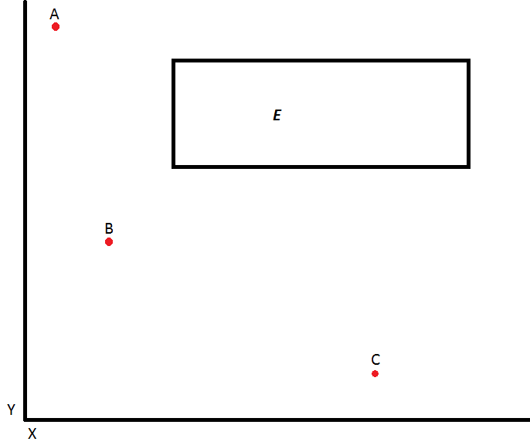
Details of BBS
Design
Based on an R tree, but can use any multidimensional access methods.
At a basic level, BBS will pick a known skyline point, and compare to an MBR.
Point A dominates MBR E, thus we can remove all points in MBR E as potential candidates for skyline points.

Slide 6
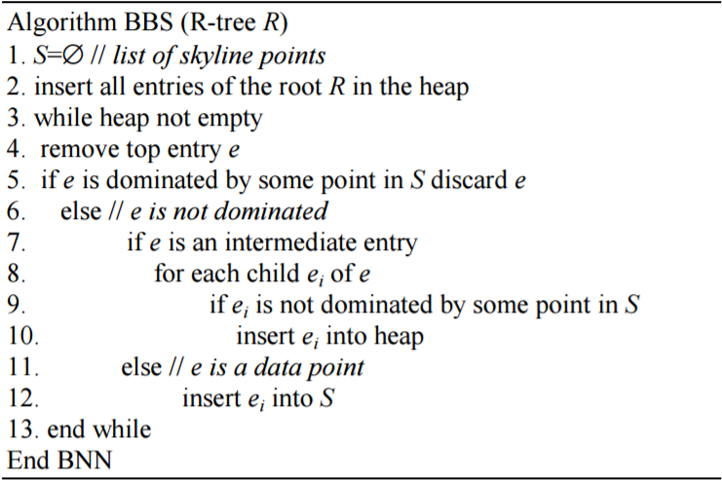
Design of BBS

Slide 7
Our implementation
Hardware used:
Windows 7 Professional Server
Software used:
Apache Web Server
HTML/Javascript
D3.js
Ruby on Rails

Slide 8
Problems we had
Finding an R-Tree implementation in Ruby to use.
Writing said R-Tree since there is no good implementation in Ruby to use.
R-tree becomes inefficient in higher dimensional space.
Visualizing points in higher dimensional space becomes difficult

Slide 9
Future work/updates for this
Multidimensions
Runtime
Visualizations in k dimensions
Past 3d would be confusing to humans in our 3d world
Making current algorithm better
Interactive visualization

Slide 10
Questions?

