Slide 1
VIDEO SURVEILLANCE FRAMEWORK BASED ON BIGDATA MANAGEMENT FOR ROAD TRANSPORT SYSTEM
By
SAIKUMAR KEESARI
VAMSI KRISHNA EDARA

Slide 2
contents
Research questions
Introduction
Description
Background work
Problem definition
Problem explanation
Results
Future work

Slide 3
RESEARCH QUESTIONS
Whether the present algorithms are applicable for the large scale video analytics when the data is stored or present in the cloud?
How to improve the accuracy in tracking of vehicles in the road traffic to have a safe drive.

Slide 4
Introduction
Intelligent Transportation Systems (ITS) and Advanced Traveler Information Systems (ATIS) are the emerging areas, which solve the issues in traffic management and planning and designing infrastructure to meet the demanding needs of public.
Introduce video processing algorithm for purpose of video monitoring.
Reduce the gap between video processing algorithms and large scale video analytics.
Intelligent Video Surveillance System (IVSS) – safe driving, path prediction, travel time
Vision-based traffic flow data extraction algorithm to support multi-channel live traffic video streams in real-time utilizing video co-processors and with the aid of apache hadoop servers
Vision-based algorithm to validate the effectiveness at the server site

Slide 5
Description
implementation of a big data management framework which helps
1. Devising the Intelligent Video Surveillance for Road Transport System by adopting different algorithms, tracking the systems, processing the large video data frames.
2. Early traffic monitoring system such as
CCTV monitoring, image processing techniques, IP based camera are all combined to provide an intelligent surveillance system which helps in monitoring the data from the large sets of video datasets which stores some terabytes of data for a long amount of time.
3. To know the exact speed of the vehicle

Slide 6
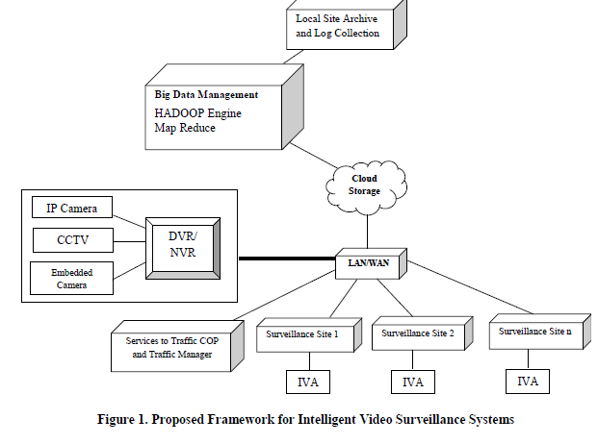
cont.
Proposed
Framework
>Data acquisition and
Management including
Archiving is done at local site
>video summarization is carried
out using color Histogramming
followed by key frame selection
>The local sites rely upon
Hadoop Distributed File System
(HDFS)

Slide 7
Background work
Different papers that we have concentrated or studied which helped us in doing this research project are like
1. Video monitoring systems based on bigdata processing
2. Query object detection in video data in Hadoop framework
3. Fast target tracking based on the video Image
4. Real-time bigdata analytics for multimedia transmission and storage etc

Slide 8
Software and hardware requirements
Query languages: SQL like language called HiveQL
Programming languages: JAVA
Software tools: Apache Hadoop framework and MapReduce framework
In the Map function, the list of frames with least RGB value is produced,
In the Reduce function collects similar list across different local sites with same least RGB value and group them together.
This group of frames is defined as Key frames to be analyzed at the remote surveillance center.

Slide 9
Problem definition
Preprocess the data set and reduce the noise by Key Frame Selection Based on Color Histogramming Implemented Using Map-Reduce.

Slide 10
IVA AT SURVEILLANCE SITE
After preprocessing, data is sent to cloud which acts as communication medium.
The refined and cleaned information is sent to the Intelligent Video Analytics Engine which is present in the remote server location.

Slide 11
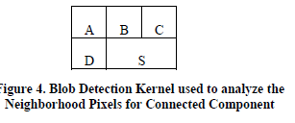
Blob detection and tracking
An algorithm is proposed to detect each and every moving vehicle designated as blobs
A blob is defined to be filled with square. Can be reached by moving vertically or horizontally.
For position S in the kernel neighboring pixels A, B, C & D are checked for the least label value.
The pixel with minimal label value is added to the list of connected pixels.

Slide 12
Blob detection algorithm
1. Read the Image Array
2. Initialize labelTable, xMinTable, xMaxTable, yMinTable, yMaxTable, massTable to 0
3. Initialize labelBuffer to the no. of pixels in the image
4. For Each Pixel S the nearest pixels are verified
A B C
D S
5. Assign Labels for each Pixel and enter it into labelTable
6. Iterate through pixels looking for connected regions.
7. Find the neighbouring pixel with the least labelValue
8. If the found neighbour is a foreground pixel
a. Set S Pixel Label value to min and assign the least labelValue to the pixel b. Update min & max X, Y values on the found neighbour into labelTable c. Increment the massTable value
9. If the found neighbour is not a foreground pixel a. Enter the min & max X, Y values into the xMinTable, xMaxTable, yMinTable, yMaxTable b. Increment the label value
10. Repeat Steps 3 to 8 for all pixels
11. Rearrange the labelValue of the each labelBuffer starting from 0
12. Assign color value to each labelValue (Blob)

Slide 13
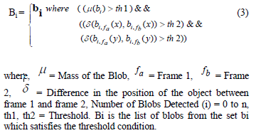
Blob filtering
In this Section, the identified Blobs are labeled from 1 to n numbers.
Each blob’s X and Y position is calculated and the mass of each blob is calculated.
The mass table in the above algorithm provides the value of each blob’s spatial mass which can be calculated.
The filtered Blobs need to be tracked to find out the spatial movement of the blobs and their correlation between the frames.
The correlation between the frames is found out to conclude whether the blobs have their movement independent or depend on some other blobs.

Slide 14
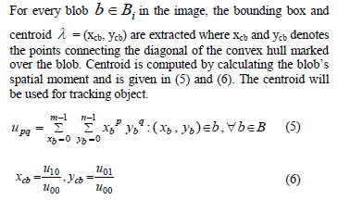
Blob tracking
The moving blobs represent the vehicle motion in the images.
It has asserted that the convex hull surrounding a vehicle in an image is a good approximation of the projection of a vehicle in the image.
To characterize the moving blobs, we calculate the convex hull and calculate the centroid for the blobs.
Calculating centroid

Slide 15
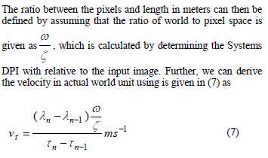
Velocity estimation
For a set of Two Blobs, Calculate the velocity of the blobs by fixing a reference point and calculate the displacement.
And the velocity is

Slide 16
Speed flow density relationship
Under uninterrupted flow conditions, speed, density, and flow are all related by the equation
q=k*v
Where q = Flow (vehicles/hour), v = Speed (miles/hour, kilometers/hour) and
k = Density (vehicles/mile, vehicles/kilometer
Relationship:
The velocity of vehicles follows normal distribution and its differential probability density function of two vehicles a and b is

Slide 17
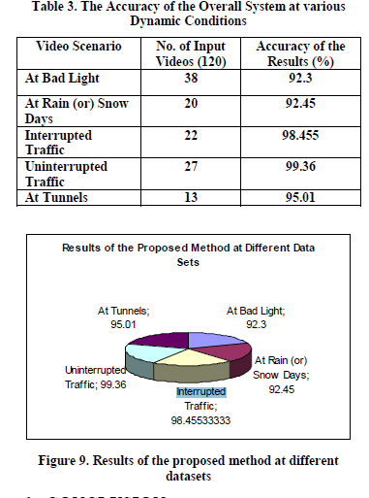
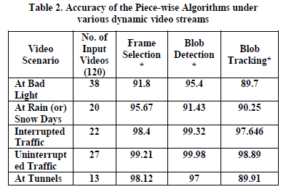
Experimental results
Experimental results of the proposed vehicle speed estimation
are presented to demonstrate the real-time velocity estimation of random vehicles.
The Proposed Method is tested over a range of videos taken at different scenarios like Bad Light, Rainy (or) Snow Days, Interrupted Traffic scene at urban road side, Uninterrupted Traffic Scene at National Highways, Video Taken at Tunnels.

Slide 18
Future work
These research can be further extended by strengthening the IVA at the server site using different core algorithms.
Proposed technique is an agile in nature so extensions can be done to it as we have introduced different algorithms such as blob detection,tracking.

