Slide 1
Preserving private data among social networking sites through k-anonymity
By (Group 17)
Mahesha Yelluru Rao
Surabhee Sinha
Deep Vakharia

Slide 2
Public Data Releases and Privacy
Large amount of data collected by Government (eg. Census Data and Health records) are made public every year
If records are released publicly, then we have no assurance that these records will hide an individual's identity.
What can be done to hide an individual’s identity ??
Hide personally Identifying information that uniquely identifies a person such as name, SSN, phone number, email id.
Hiding Uniquely identifying information can’t make the person anonymous

Slide 3
Re-Identification By Linking
Table 2
Table 1

Slide 4
Attack (1967)

Slide 5
Attack

Slide 6
Attack

Slide 7
Attack

Slide 8
Attack

Slide 9
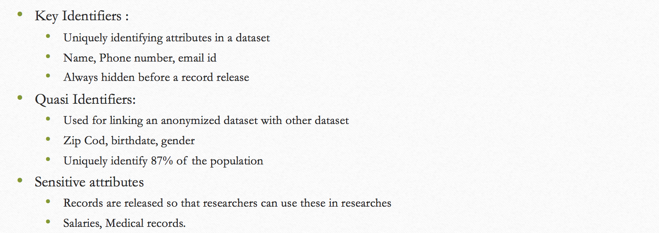
Classification of Attributes

Slide 10
Classification of attributes
Key Identifiers
Quasi Identifiers
Sensitive attributes
Name | DOB | Sex | Zip code | Disease
Adam | 7/12/1980 | M | 67306 | Cancer
Sam | 4/5/1967 | M | 67234 | Bronchitis
Katie | 3/10/1985 | F | 23876 | Hepatitis
Miller | 12/6/1987 | M | 15623 | Cancer

Slide 11
K anonymity
Information of a person cannot be distinguished by k other people in data set.
There should be at least k-1 people who have the same information
quasi identifiers present in the table must appear in k records
Example: If attacker wants to identify a person from a released table then the only information he will have is Zip code and gender which will be same for k people.

Slide 12
Generalization
Generalization
All the quasi identifiers are identified and made less specific
1

Slide 13
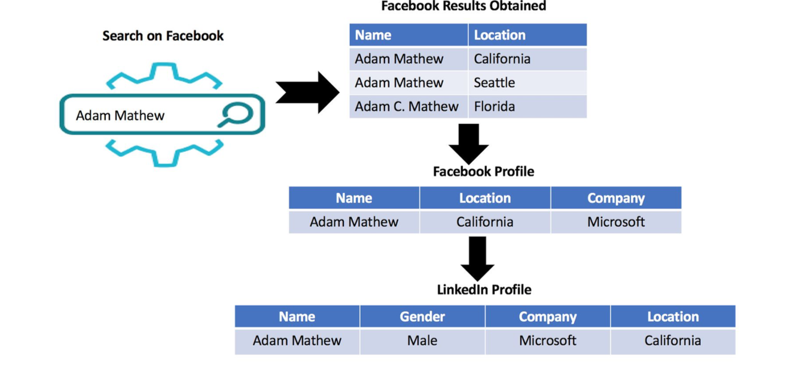
Preserving private data among social networking sites through k-anonymity(Cont.)

Slide 14
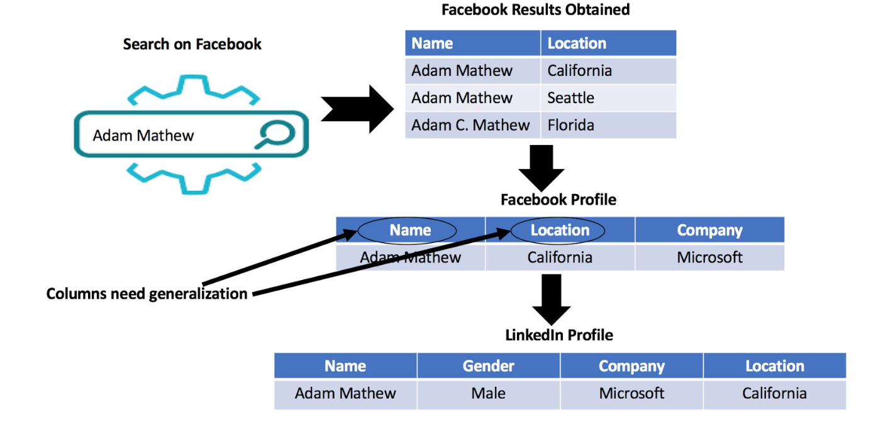
Preserving private data among social networking sites through k-anonymity(Cont.)

Slide 15
How to deal with this problem of privacy ?
In both the social networking sites, find all the data that has duplicate values for quasi identifiers
Generalize k quasi identifiers
Can be added as an option in social networking sites for those who want to maintain privacy
Benefits
can’t easily link one profile on one social networking site with another
privacy will be maintained
at the same time the profile will remain public

Slide 16
Algorithm
Initialize social data set & professional data set;
divide quasi-identifiers in social data by n generalized group ;
for each generalized group,
update quasi-identifier with new zip code (updating zip code value)
for each value in professional data set,
if updated quasi-identifier equal to value
not masked
else
masked

Slide 17
Implementation

Slide 18
Conclusion
Hence by Generalizing , we cannot disclose the user's identity in public
This simple idea will make social networking sites a more secure platform
Future Work: can add some more complex algorithm to mask user’s data more efficiently

Slide 19
Thank you !!!!

