Slide 1
Range-Aggregate Query on Distributed Uncertain Database
Graduate Team #1
Niranjan Rai, nrai@kent.edu
Pujit Koirala, pkoirala@kent.edu
Sudeep Tuladhar, stuladha@kent.edu

Slide 2
Uncertain/Probabilistic Data
Database containing noise or the probability
associated with it being accurate.
Can be uncertain due to unreliable source of data.
As the data is growing in its in Volume, Velocity and Variety, it also has great concern in Veracity(accuracy).
Uncertain data can be mainly found in sensor data, trend predictions, social media data, etc.

Slide 3
Range Query
Range query retrieves all the list of tuples that lies on the given range.
a query range Q2
a query range Q1
Data objects

Slide 4
Aggregate Query
Aggregate Query performs some aggregation function[COUNT, AVG, SUM, MIN, MAX ] and returns the summarized informations from the group of tuples.
<B , 19>
<A , 26>
<H , 25>
SUM = 231
AVG = 28.875
MIN = 12
MAX = 61
<E , 61>
<G , 12>
<C , 36>
<Name, Age>
<D , 20>
<F , 32>
Data objects

Slide 5
Range-Aggregate Query
Given a Range and an aggregate function, Range-Aggregate Query returns the result of aggregate function for the given range .
Basically, it is the combination of Range and Aggregate query.
a query range Q1
Apply Aggregate function

Slide 6
Range-Aggregate Query on Uncertain Database
In uncertain database we need to consider the probability associated with each of the instances contained in the uncertain object.
Time and Memory consuming as we have to go through each tuple to check the probability associated within in the given range.
There are very few researches that are focused on Range-Aggregate Query on Uncertain Database

Slide 7
Threshold Probability = 0.6
Range
c₁
a₂
0.5
a₁
0.8
b₂
c₂
0.2
b₃
0.5
b₁

Slide 8
Motivation and Problem Statement
RAQ plays vital role in extracting valuable information and has many applications.
Range-Aggregate Queries available only in either centralized uncertain data or distributed certain data.
Need for distributed approach for faster processing of Uncertain Data
Very few researches on Range-Aggregate Query on Uncertain Database.

Slide 9
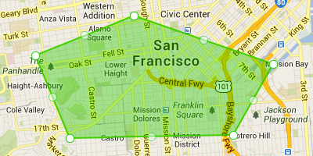

Slide 10
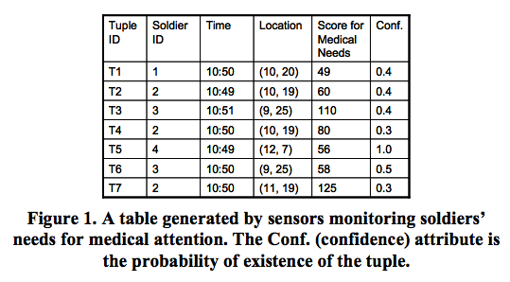
Sample Dataset

Slide 11
Proposed Solution
Perform Range-Aggregate Query on Uncertain Database in Distributed Environment.
Use Map Reduce framework, a core component of Apache Hadoop Framework.
It processes huge data in parallel and on clusters.

Slide 12
Proposed Solution
<Range, Threshold>
Partition 1
1
<objectID, Value>
Partition 2
2
Aggregate value
reducer
Partition N
N
Uncertain Database
mapper
Figure 1: Data Flow Diagram of Proposed Solution

Slide 13
MapReduce Pseudo-Code
func map(Range, threshold):
for each tuple in db:
if tuple.attribute >Range.min and tuple.attribute < Range.max:
if tuple.confidence > thresholdProbability:
emit(tupleId, tuple.value)
end if
end if
end for
end func
func reduce(keys, values):
return Array.average(values) //if aggregate function is average
end func

Slide 14
Expected Output
A system which can process Range-Aggregate query on Uncertain Database
Query processing is parallel and efficient.
A bug free parallel processing system which is much faster than the available centralized system.

Slide 15
Future Enhancement
Implement indexing techniques to increase query speed and efficiency.
Introduce effective pruning techniques.

Slide 16
Conclusion
We proposed a Range-Aggregate query on Uncertain Database for Distributed System.
Map-Reduce framework helps to perform queries faster even with less memory.

Slide 17
Questions??

