Slide 1
Visualization of query processing over large-scale road networks
By Undergraduate Group 2: Stuart McKaige,
Jonathan Winder, Govinda Baweja, Joshua Ryder

Slide 2
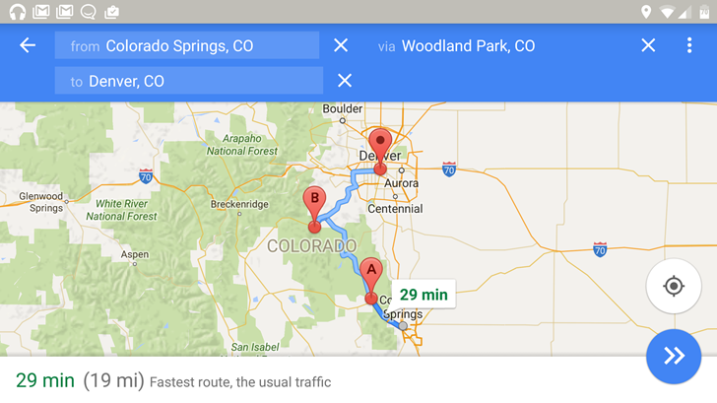
Problem Definition
Trip planner query (TPQ) on a probabilistic time-dependent graph (PT-Graph)
Min travel time between multiple points (with staying time)
Uncertain edge-delay function (UDF)
[2]

Slide 3
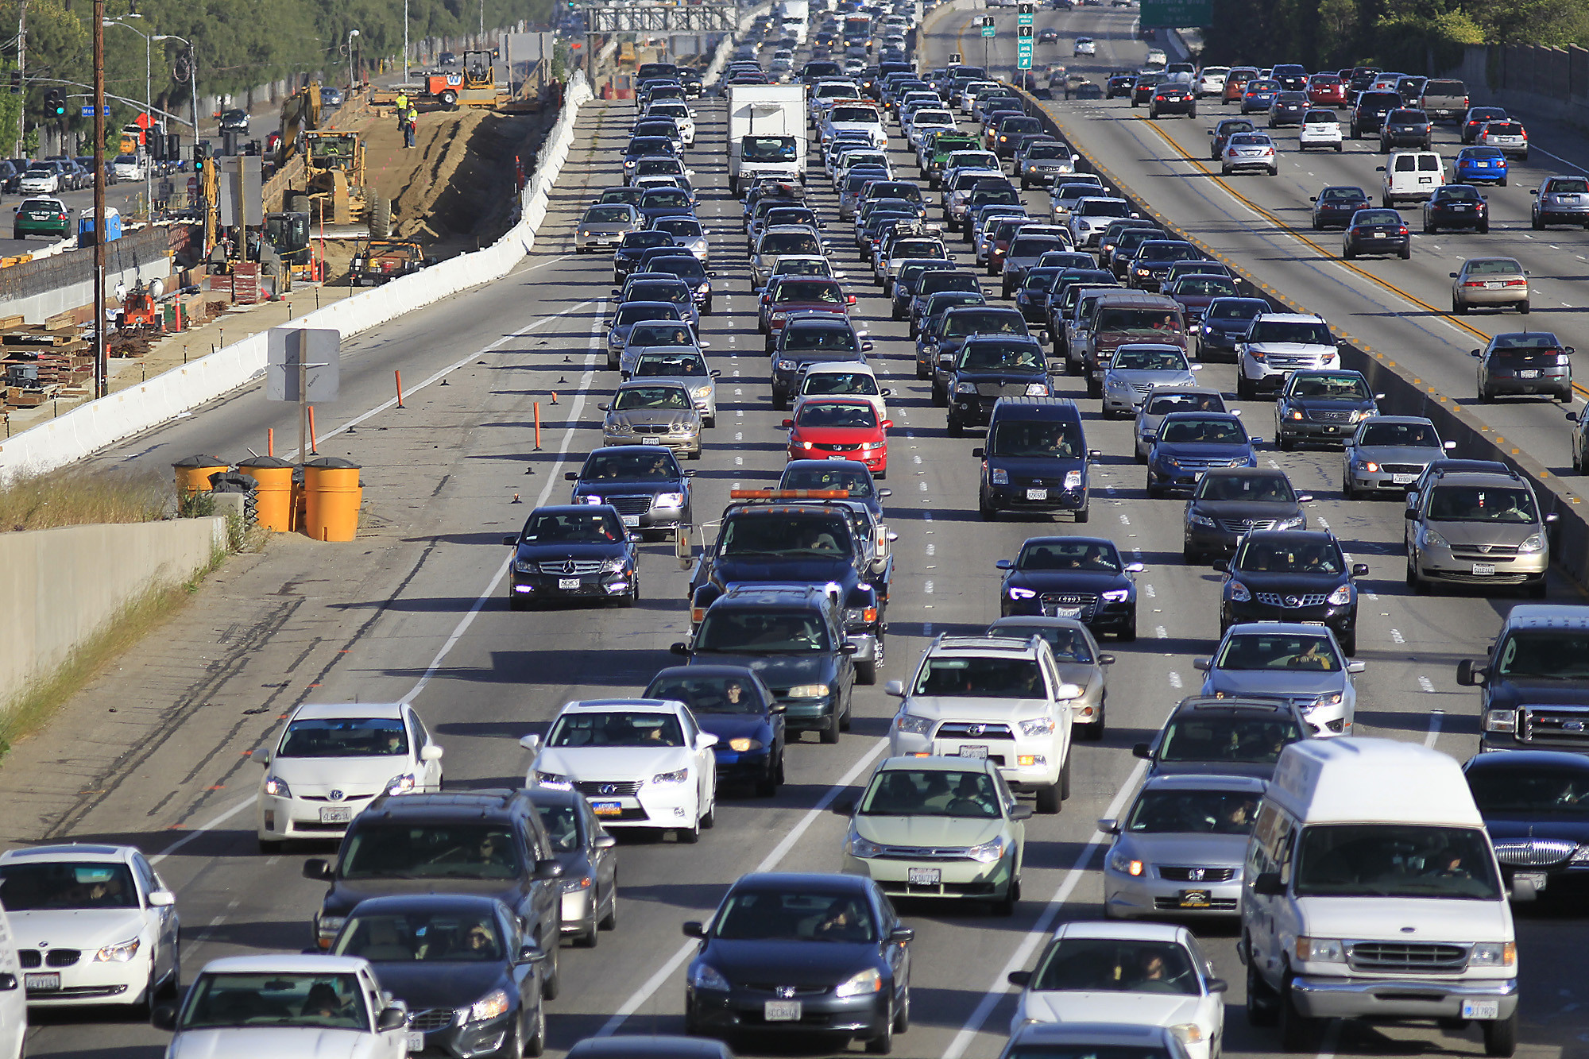
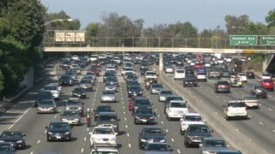
Importance
Trip planning
Time changing road conditions
[3]

Slide 4
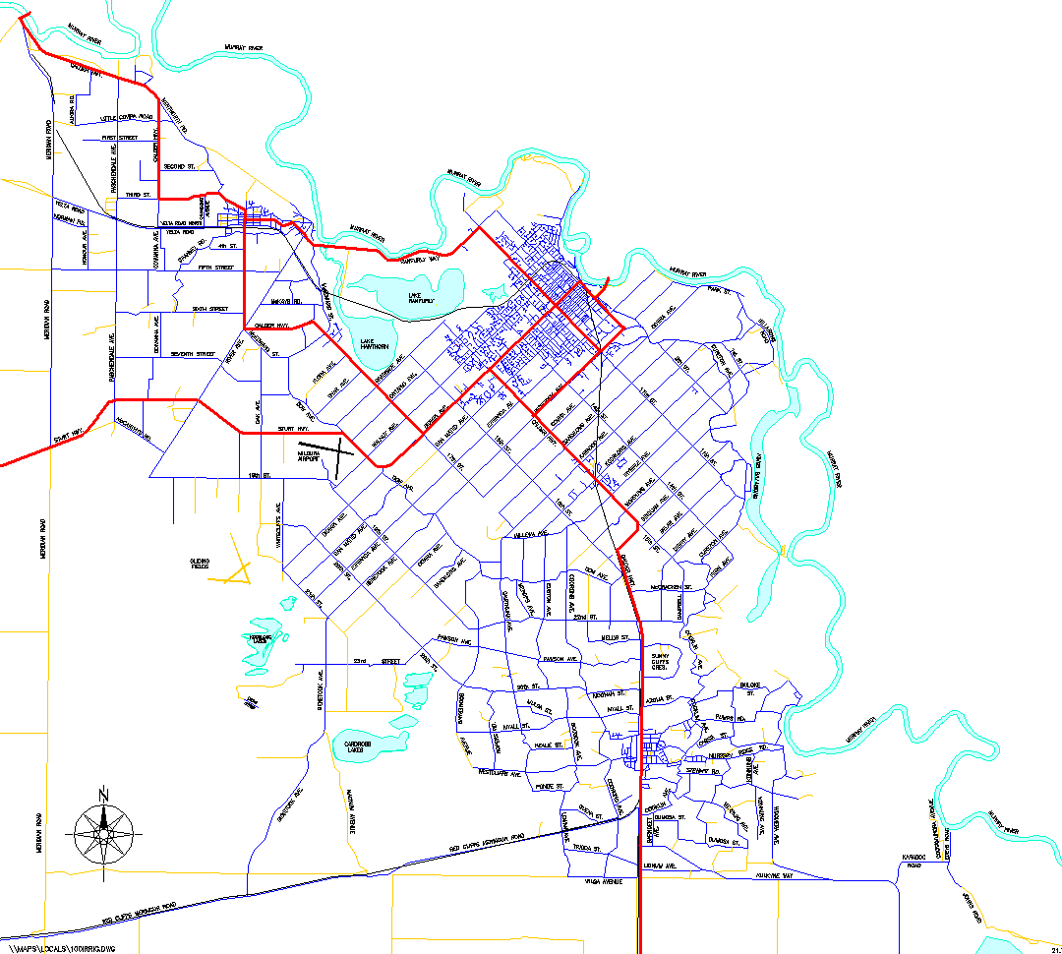
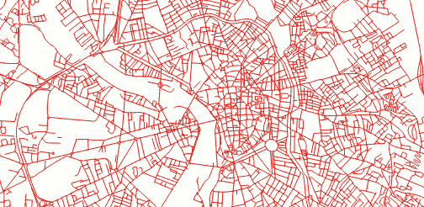
Short comings
Assumed exact traffic information is available
Other methods consider edges with probability of existing
Scaling efficiency
[4]
[5]

Slide 5
Big Picture
Filter and refine
Filter phase prune to weed out false alarms
Refine phase remaining candidates are refined and given as the answer

Slide 6
Filter phase (Time interval pruning)
Lower/upper bounds of travel time
If $LB_T(Plan)≥τ$ can be safely pruned
Interval computation of the travel time
Relaxed traveling time interval

Slide 7
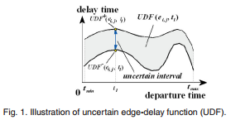
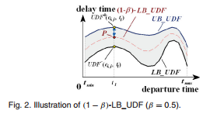
Filter phase (Probabilistic pruning)
Probabilistic distributions to prune trip with low confidences
If $UB_Pr\left(Plan\right)≤α$ then it can be safely pruned
(1-β)UDF
we can safely prune any plan, Plan, satisfying LB_T(Plan_{1−β}) ≥ 𝝉 , where LB_T(Plan_{1−β}) is the lower bound of the traveling time by using (1−β)-UDF function on one edge in Plan.
[1]
[1]

Slide 8
Pre-Computation
Distance Bound Derivation (lower and upper bound) for the shorted path
Velocity Bound Derivation
Traveling time interval
(1-beta) maximum velocity function

Slide 9
Indexing
Hierarchical tree index
Pruning
Distance bounds between two query points in a node
Distance bounds for a path with multiple query points in a node
Traveling time interval with nodes
Departure time interval from a node
Traveling time among nodes
[1]

Slide 10
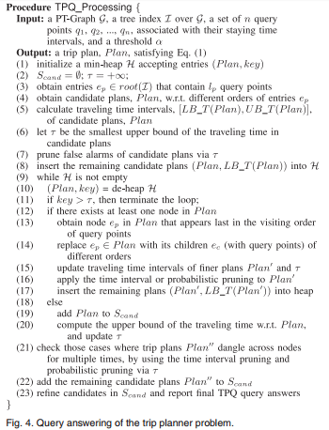
Refine phase and Algorithm
Minimum heap
Index traversal
Refine by calculating best plan confidence
analysis
[1]

Slide 11
Implementation, Resources Used
Apache, MySQL through XAMPP
PHP, JavaScript – Languages Used
Google Maps API – Visual (JavaScript Based)
Denver Road Network – Dataset
http://crisp.cs.du.edu/datasets

Slide 12
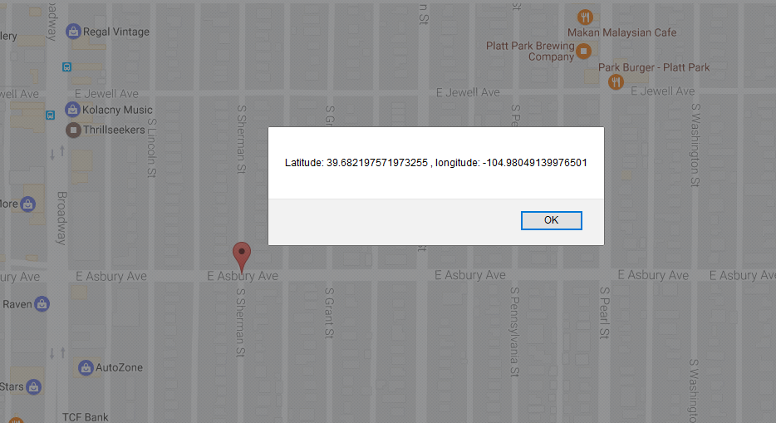
Point Selection
Selecting a Point for Start and Finish
Fig 5: Illustration of point selection

Slide 13
Pruning Data
Pruning Data through use of MBR
MBR set by min Latitude/Longitude and max Latitude/Longitude plus an added buffer.
Prune routes that take you outside of the MBR + Buffer range.

Slide 14
Finding a Route
Road Data
Node ID
Road Type
Length
Connected Nodes
Road Conditions
Speed Limit
Rush Hour
Weather

Slide 15
Shortcomings, Performance Issues
Lack of Historical Data for Proper Weather Predictions.
Lack of information on what roads are more likely to be congested during rush hour.
Computational Time increase for larger MBRs
Google API Free user Limitations

Slide 16
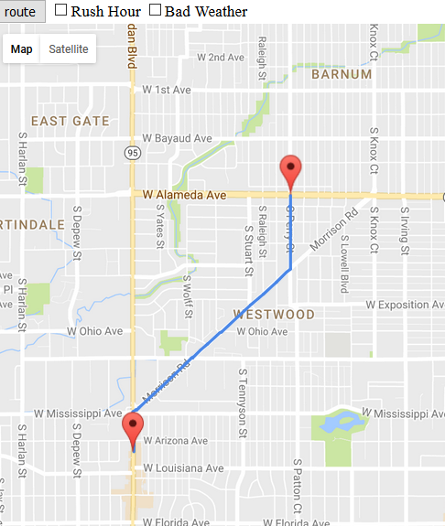
Results
Figure 6: Showing normal route vs alternative for rush hour

Slide 17
Any Questions?

Slide 18
References:
X. Lian and L. Chen, "Trip Planner Over Probabilistic Time-Dependent Road Networks," in IEEE Transactions on Knowledge and Data Engineering, vol. 26, no. 8, pp. 2058-2071, Aug. 2014. doi: 10.1109/TKDE.2013.159
http://www.androidpolice.com/2016/04/14/psa-google-maps-for-android-can-navigate-to-multiple-destinations-with-a-little-help-from-a-desktop/
http://www.latimes.com/local/lanow/la-me-ln-tunneling-under-sepulveda-pass-big-gamble-to-ease-traffic-nightmare-20160311-story.html
http://lgam.wikidot.com/road-network
http://blog.mathieu-leplatre.info/use-postgis-topologies-to-clean-up-road-networks.html

