Slide 1
Keyword Search over RDF Graphs
By Harsh Patel, Haleigh Robbins, Michael Francesconi and Becca Leppelmeier

Slide 2
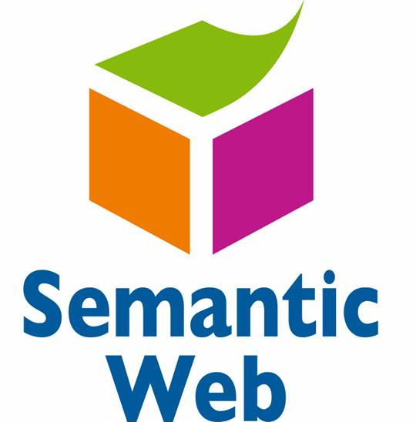
What is RDF?
Resource Description Framework
W3C specification for storing metadata
Uses XML formatting
Common applications:
Semantic web modeling
Data serialization
Knowledge management
IMG source: https://streamshare.com.au/wp-content/uploads/semantic-web.jpg

Slide 3
RDF Syntax
Three components:
Subject
An IRI or blank node
Predicate
An IRI
Object
An IRI, blank node, or literal
Together these form an RDF graph
IMG source: http://www.accessola2.com/olita/insideolita/wordpress/wp-content/uploads/2014/04/hitchens_app2_Slide9.jpg

Slide 4
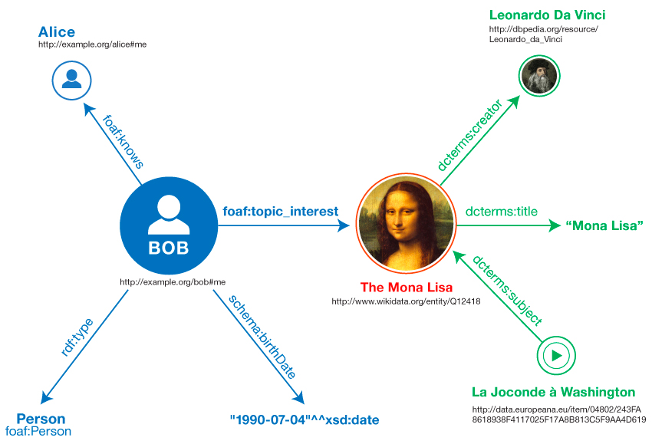
Visualizing RDF Triples
Objects and Subjects are the nodes
Predicate connects the nodes
Many to many relationship
An object can have many subjects
A subject can be connected to many objects
IMG source: https://www.w3.org/TR/rdf11-primer/example-graph-iris.jpg

Slide 5
Problem: Efficient Keyword Searches
Typically RDF queries are done via structured query languages like SPARQL
Requires expertise from users
Must understand the underlying data structure
How can we make RDF queries more usable?
IMG source: http://www.nila.org/wp-content/uploads/2015/06/Confusing.jpeg

Slide 6
Solution: Keyword Queries
Users can search RDF graphs by searching for keywords
Returns a set of ranked subgraphs that match the keywords
Advantages:
Increased usability
Easier to use without expertise on the dataset
Demonstrably faster than structured query language approaches
IMG source: https://i.ytimg.com/vi/msa5ua7kZmQ/maxresdefault.jpg

Slide 7
Finding the Subgraphs that Matches the Keywords
Need to find unique subgraphs
Should not find the same subgraph twice
Subgraph needs to be maximal
Should not find a subset of another subgraph that was already found
Subgraphs need to contain triples that match one of the keywords
Subgraph triples should contain different keywords than it’s neighbors
If match the same keywords should be considered two separate subgraphs

Slide 8
How will we achieve this?
We will follow the the techniques presented in the following paper:
Elbassuoni, S., & Blanco, R. (2011, October). Keyword search over RDF graphs. In Proceedings of the 20th ACM international conference on Information and knowledge management (pp. 237-242). ACM.
Implement the algorithm defined in the paper
Test the algorithm on a real world RDF dataset
Compare our results against the paper to see if we were successful
Tools we intend to use:
C++/Java, IsaViz, possibly Hadoop/AWS MapReduce

Slide 9
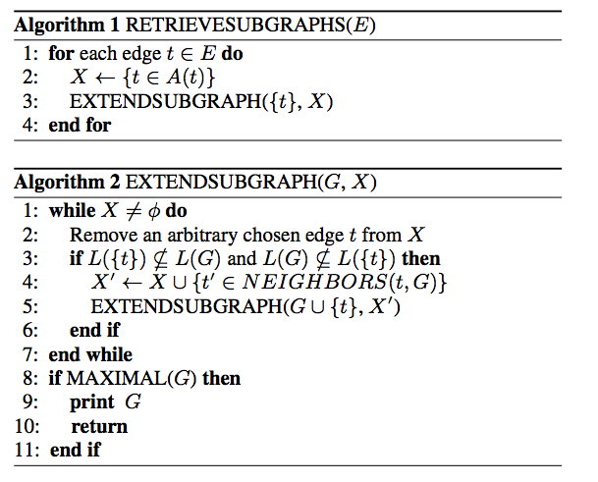
Algorithm for Subgraph
IMG source: Elbassuoni, S., & Blanco, R. (2011, October). Keyword search over RDF graphs. In Proceedings of the 20th ACM international conference on Information and knowledge management (pp. 237-242). ACM.

Slide 10
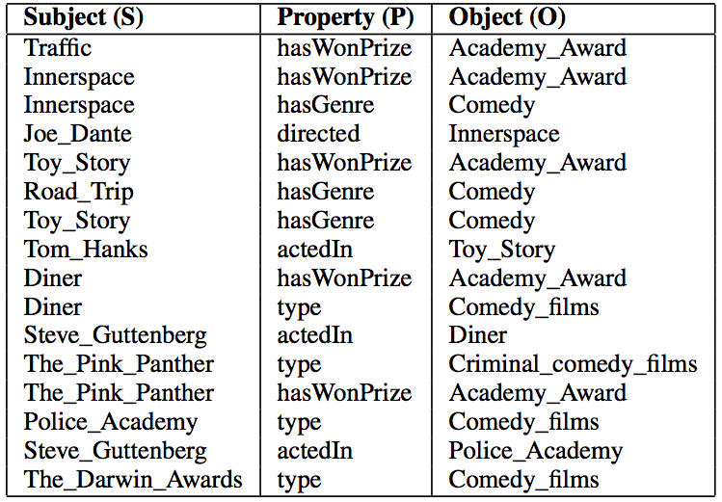
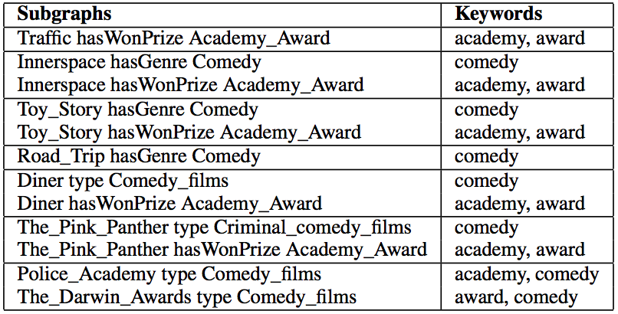
Expected Results
Dataset of Triples
Results
IMG source: Elbassuoni, S., & Blanco, R. (2011, October). Keyword search over RDF graphs. In Proceedings of the 20th ACM international conference on Information and knowledge management (pp. 237-242). ACM.

Slide 11
Questions?
IMG Source: http://www.taroticallyspeaking.com/readings/framing-tarot-card-reading-questions/

