Slide 1
aR-Tree based hierarchical clustering:
A new approach of analyzing social media data
Weichuan Dong
Qingsong Liu
Zhengyong Ren Huanyang Zhao

Slide 2
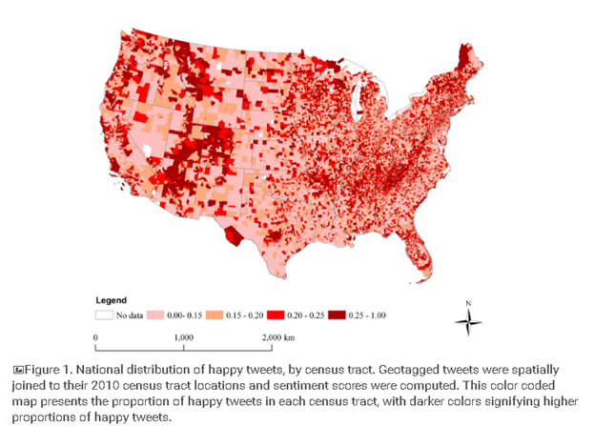
Introduction:
Geotagged social media data has been widely used in socioeconomic studies in recent years
Sentiment analysis remains a popular topic
A typical data collection session would result large volumes of data, approximately 10% are geotagged
Existing methods pay little attention to data clustering & indexing due to the use of commercial softwares
An non-commercial, alternative approach is going to be very useful
Notes:
Nowadays our civilization faces an explosion of various kinds of space-related data, such as measurements from static and mobile sensors, GPS tracks, or georeferenced photos put on the Web by general people. As potential sources of valuable information and knowledge, these data call for scalable methods of analysis, which must take into account the particular features of the geographical space: its heterogeneity, variety of properties and relationships, spatial and temporal autocorrelation, anisotropy, and scale dependence.
Clustering is one of the general approaches to exploring and analyzing large amounts of data since it allows an analyst to consider groups of objects rather than individual objects, which are too numerous. Clustering associates objects in groups (clusters) such that the objects in each group share some properties that do not hold (or hold much less) for the other objects. Spatial clustering builds clusters from objects being spatially close and/or having similar spatial properties (shapes, spatial relationships among components, etc.).
Generally speaking, sentiment analysis aims to determine the attitude of a speaker, writer, or other subject with respect to some topic or the overall contextual polarity or emotional reaction to a document, interaction, or event. The attitude may be a judgment or evaluation (see appraisal theory), affective state (that is to say, the emotional state of the author or speaker), or the intended emotional communication (that is to say, the emotional effect intended by the author or interlocutor).

Slide 3
Project Object:
•We aim to formulate a new approach that indexes spatially clustered social media data and is capable of distinguishing and categorizing the data basing on the sentiments.
•Able to detect cluster quickly
•Able to get the main opinion from the cluster

Slide 4
Methodology:
Exploratory of the data using text analysis
Detect Clusters from Bottom-up in multiple hierarchies
Detect the sentiment for each tweets and aggregate to clusters
Using indexing mechanism for quick query

Slide 5
Data:
•Previous study on voluminous volunteered spatiotemporal data collected from social media, which implemented a new perspective in understanding the public’s shopping behavior
•Public’s reactions to the Thanksgiving shopping season (Nov 3~Dec 6, i.e. one week before the black Friday and one week after it) of 2012
•A total of approximately 6 million tweets were collected, among them, 72,000 are geotagged. 40,000 are extracted and cleansed for this project.

Slide 6
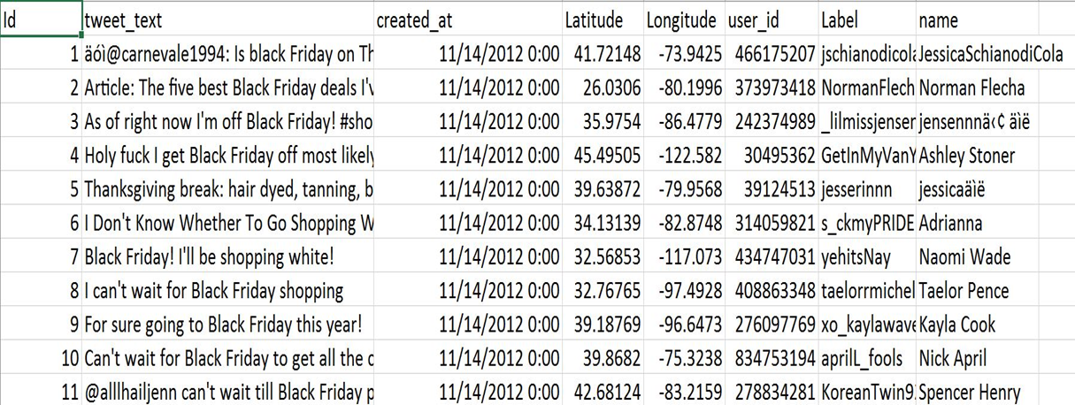
Data structure

Slide 7
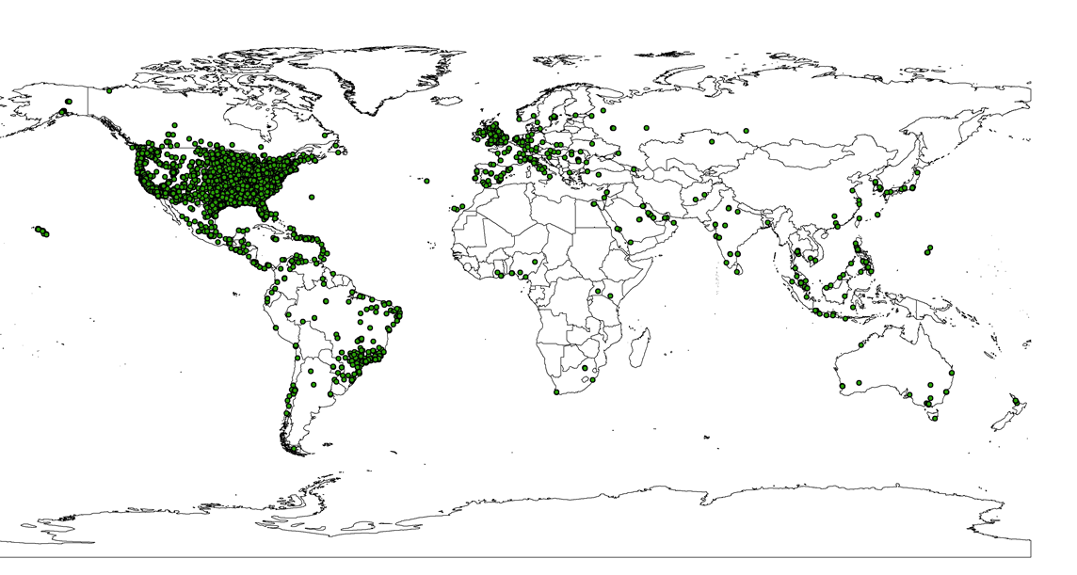

Slide 8
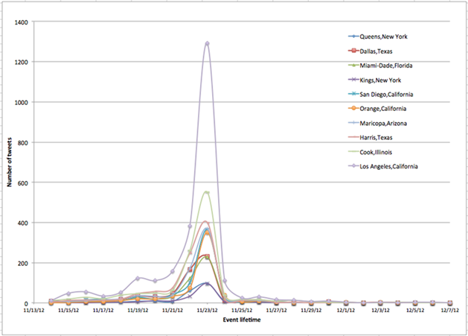
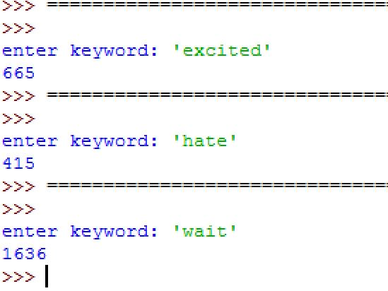
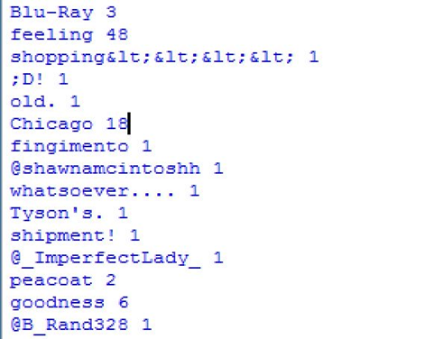
Text indexing/searching
Identify the most frequently appeared terms according to the temporal trend of the tweets - track the changes in public’s reaction and shopping behaviors

Slide 9
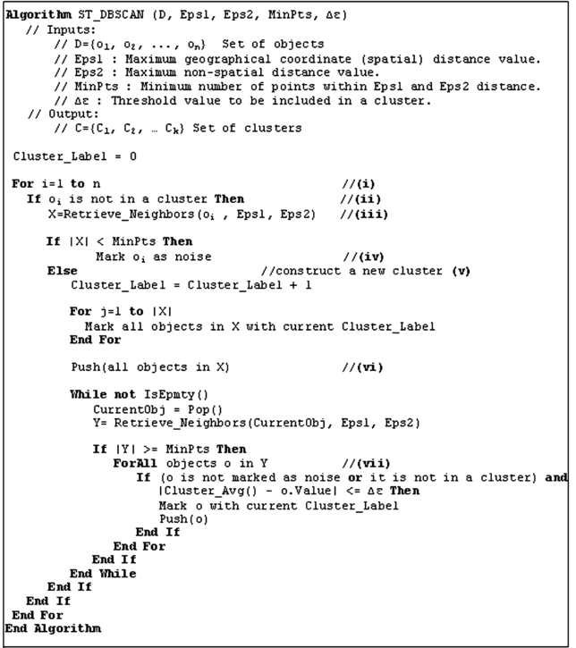
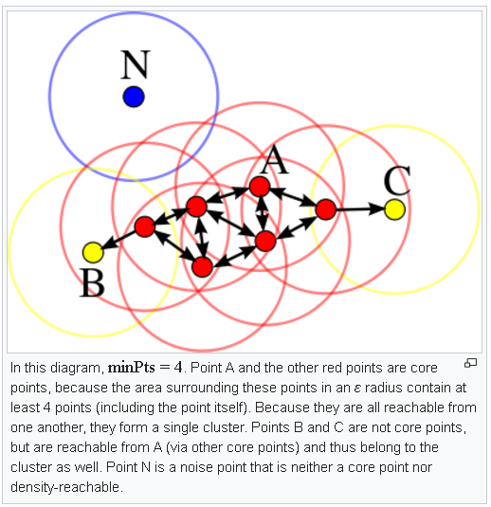
DBScan Clustering

Slide 10
DBScan Clustering results:
scale | 0 | 1 | 2 | 3 | 4 | 5
dist | 10km | 20km | 40km | 80km | 160km | 320km
num | 1033 | 713 | 339 | 182 | 106 | 62

Slide 11
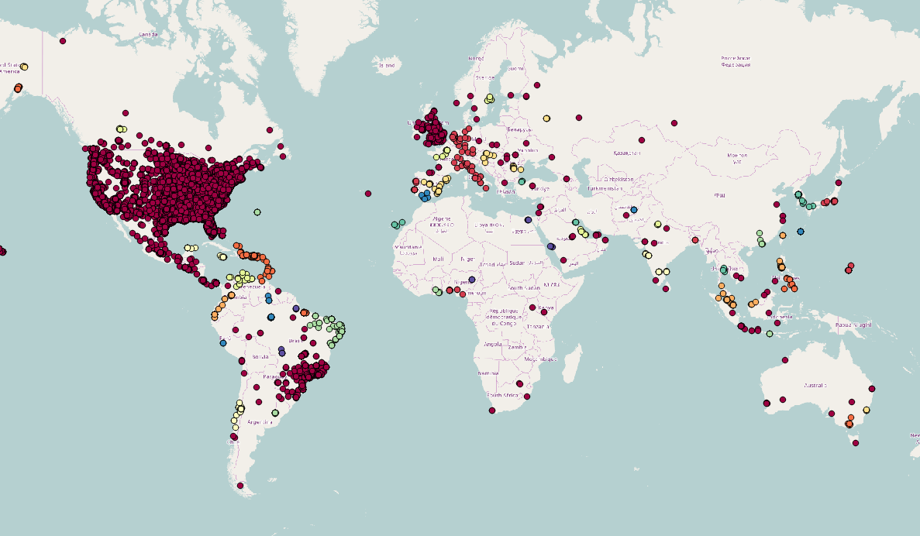

Slide 12
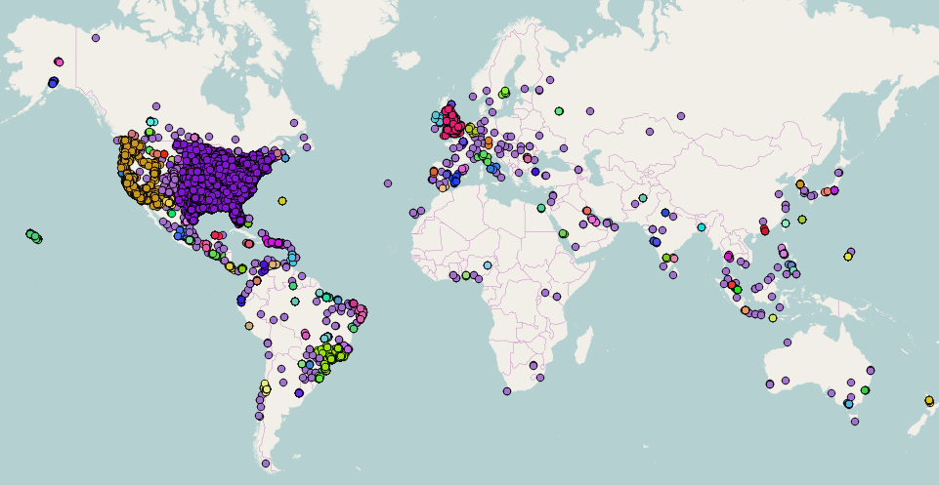

Slide 13
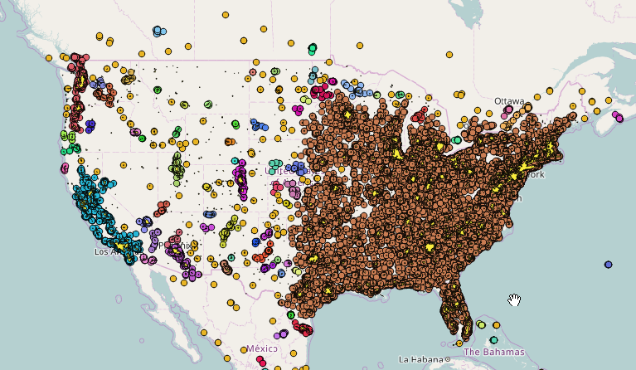

Slide 14
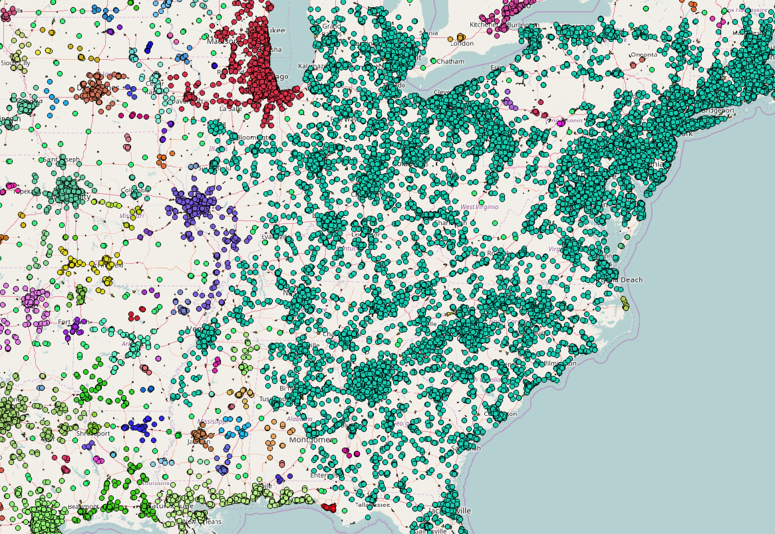

Slide 15
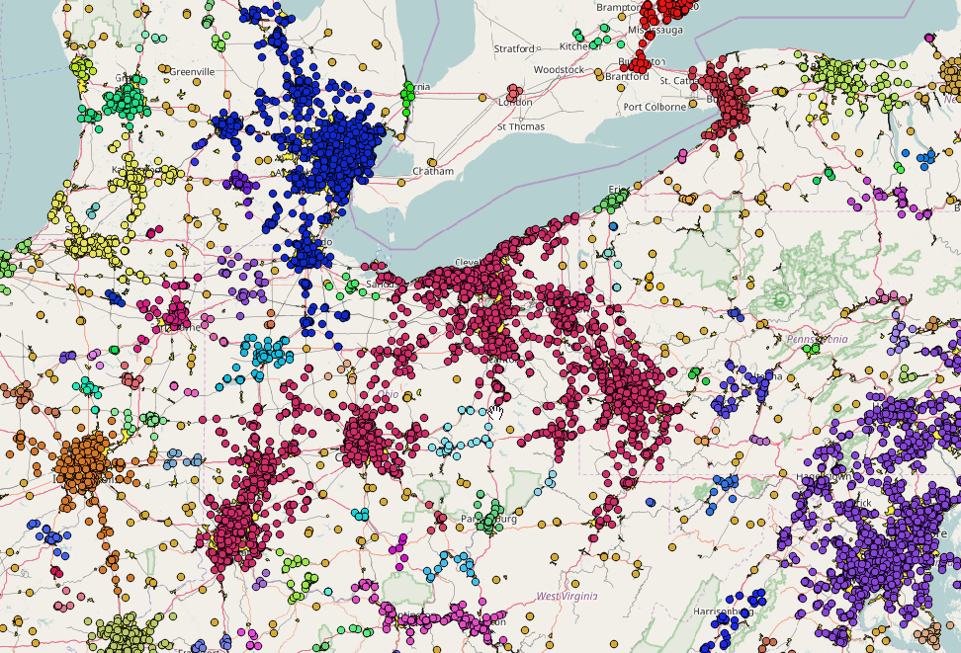

Slide 16
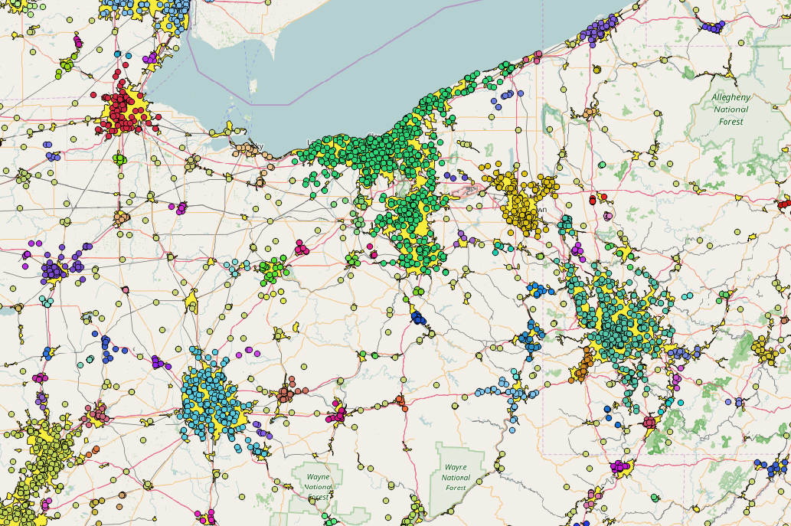

Slide 17
Sentiment analysis:

Slide 18
Sentiment analysis:

Slide 19
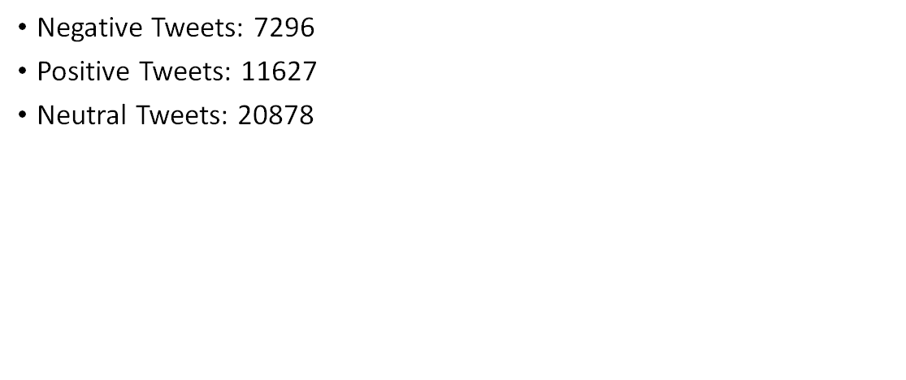
Sentiment analysis:

Slide 20
Sentiment Analysis:

Slide 21
Indexing method:
point Index：
Our index structure stores all the point data in this form（location，value）：
location（latitude，longitude）∈R_{space}；
Value is the overall result of the emotion words，it may be 1，-1or 0；
1:positive -1: negative 0 :neutral

Slide 22
Indexing method:
aR-tree index：
Each node N of aR-tree is associated with a cluster region R_{N} and indexes a set of clusters contained in that region.
1;Non-leaf nodes contain entries(ptr, cluster region, aggregates)
Ptr is the pointers to its children nodes.
Cluster region ⊆ R_{space} is the space covered by that cluster.
Aggregates is a tuple(count1, count2, count3, sum) of aggregate information
over all data points indexed by that node.
2;A leaf node contains a lowest level cluster.

Slide 23
Aggregates of leaf node(lowest level cluster):
Count1 is the total numbers of the positive point datas.
If the value of point data is 1, count1=count1 + 1.
Count2 is the total numbers of the negative point datas.
If the value of point data is -1, count2=count2 + 1.
Count3 is the total numbers of the neutral point datas.
If the value of point data is 0, count3= count3+1
Sum is the sum overall result of all point datas.
If the value of point data is 1, sum=sum + 1.
If the value of point data is -1,sum=sum - 1.

Slide 24
Aggregates of non-leaf node(high level cluster):
Count1 is the sum count1 of all its children.
Count2 is the sum count2 of all its children.
Count3 is the sum count3 of all its children.
Sum is the sum overall result of all its children.

Slide 25
Software tools
Windows environment
Python twitter module + Mongodb: tweets collection,storage & processing
Python machine learning module (scikit-learn): spatial clustering
Python scripting:indexing basing on research paper Progressive Approximate Aggregate Queries with a Multi-Resolution Tree Structure(Losif & Sharad, 2001)
SentiStrength analytical package: sentiment analysis
Python whoosh module: full-text indexing
Quantum GIS: cartographical designing and mapping

Slide 26
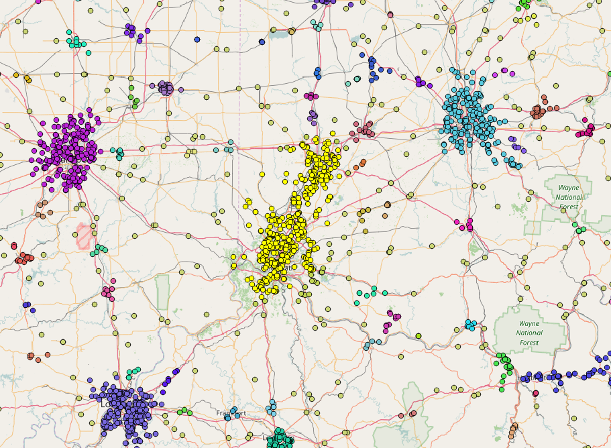
Expected Results:

