Slide 1
Wikipedia Traffic Forecasting
Compiled by-
Divya Lingwal Karishma Patil
Shivani Mathur Monalisa Singh

Slide 2
Introduction
It is important to predict the websites future traffic volume, in order to provide a quality of service to the users.
We are implementing the process of Data analysis for Wikipedia Traffic using the time-series approach.
Predicting the future behaviour of time series for Wikipedia articles.

Slide 3
Problem Statement
Wikipedia has large number of potential users viewing approximately 145,000 Wikipedia articles.
It is essential to deal with the problem of overload, for that we need to predict future web traffic for thousands of Wikipedia articles.

Slide 4
Project Description
AIM: To help predict future views of Wikipedia articles
Using Time series analysis which encapsulates problems like analysis, inference, classification and forecast.
We are using R programming language.
Used both Time series analysis and forecasting techniques.
Analyzed all 4 components of Time series.
Datasets used:
User view data, each column is a date and each row is an article
Mapping between article names and a unique ID column

Slide 5
Brief Introduction of Wikimedia and Mediawiki
MEDIAWIKI
WIKIMEDIA

Slide 6
Procedure
Data Cleaning
Data transformation
Time Series extraction
Parameter extraction
Forecasted Methods

Slide 7
Data Cleaning
Finding the missing values-8% missing values
Few missing values. These seem to be important so we did not remove them

Slide 8
Data Transformation
Split data into 2 parts: ‘Page’ and ‘Dates’

Slide 9
Data Transformation cont’d
Divided the article info from *wikipedia*, *wikimedia*, and *mediawiki*

Slide 10
Data Transformation cont’d
Tokenized the pages into different columns
Access: Desktop, Mobile-web. All-access
Agent: All-agents, Spider
Locale: wikmed, medwik, codes(zh,en,ja,es,fr) for wikipedia

Slide 11
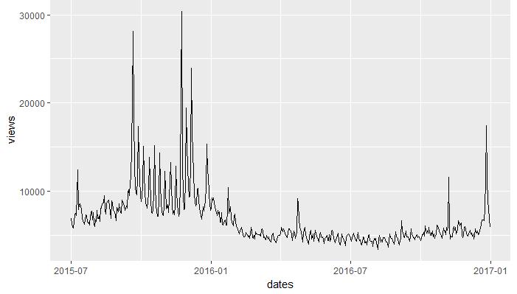
Experimental Evaluations
Un-Smoothened Graph
Need to smooth it to check for better patterns and trends

Slide 12
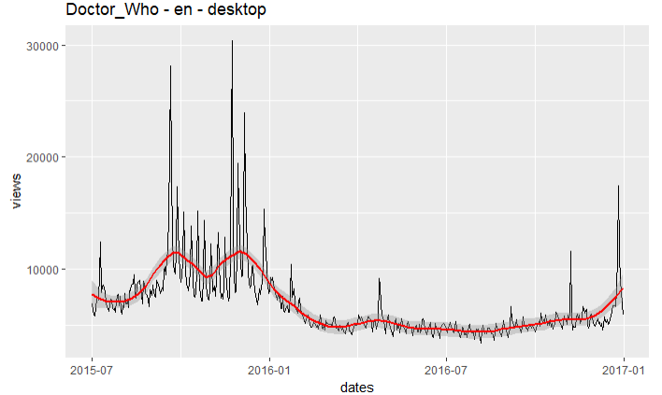
Smoothing

Slide 13
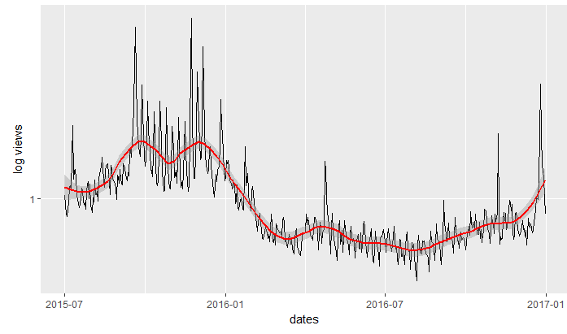
Normalized Time series

Slide 14
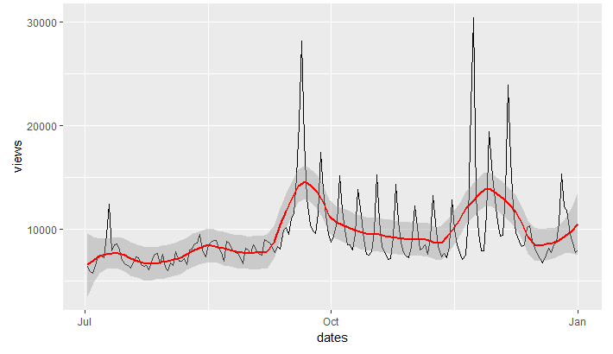
Scale changed to visualize better

Slide 15
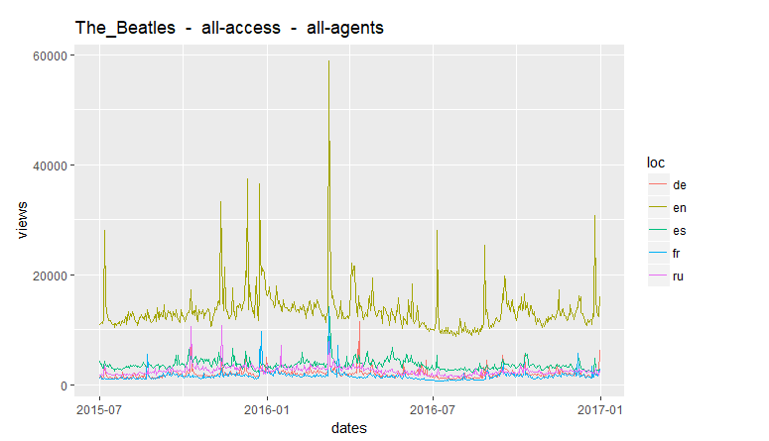
Curve according to specifications

Slide 16
Data Overview
Comparison of articles in 7 languages:
German, Chinese, English, Spanish, French, Japanese, Russian.
Higher frequency for english articles
Slightly higher number of mobile viewers than Desktop viewers

Slide 17
Calculating Time Series parameters
To analyze the time series data we need to find the following parameters:
Mean
Standard Deviation
Amplitude
Slope
Linear model for slope: Views~ pages+dates

Slide 19
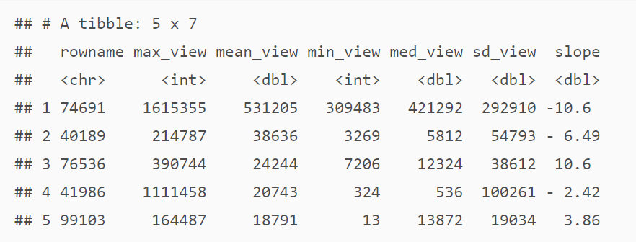
Individual observations with extreme parameters
Finding out the values with highest views

Slide 20
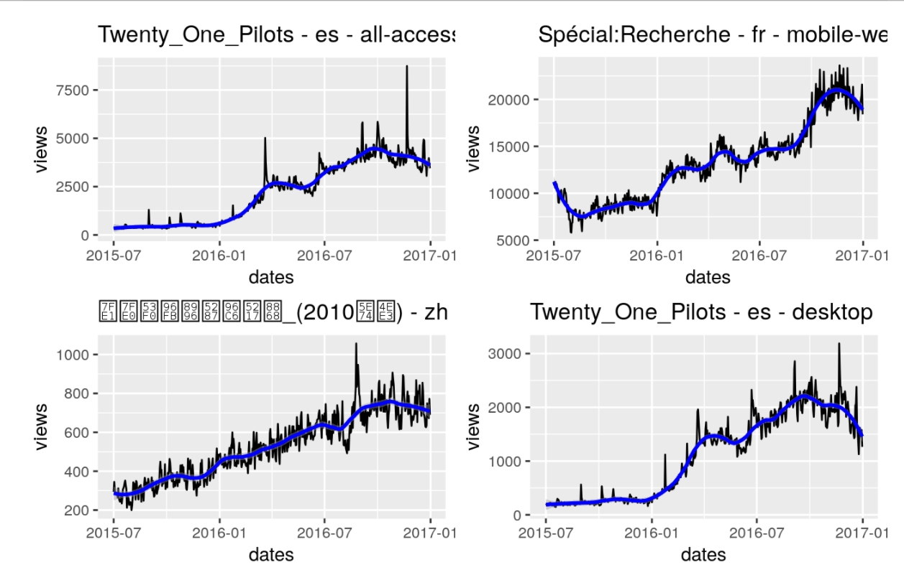
Time-Series Visualization of Top 4 Articles

Slide 21
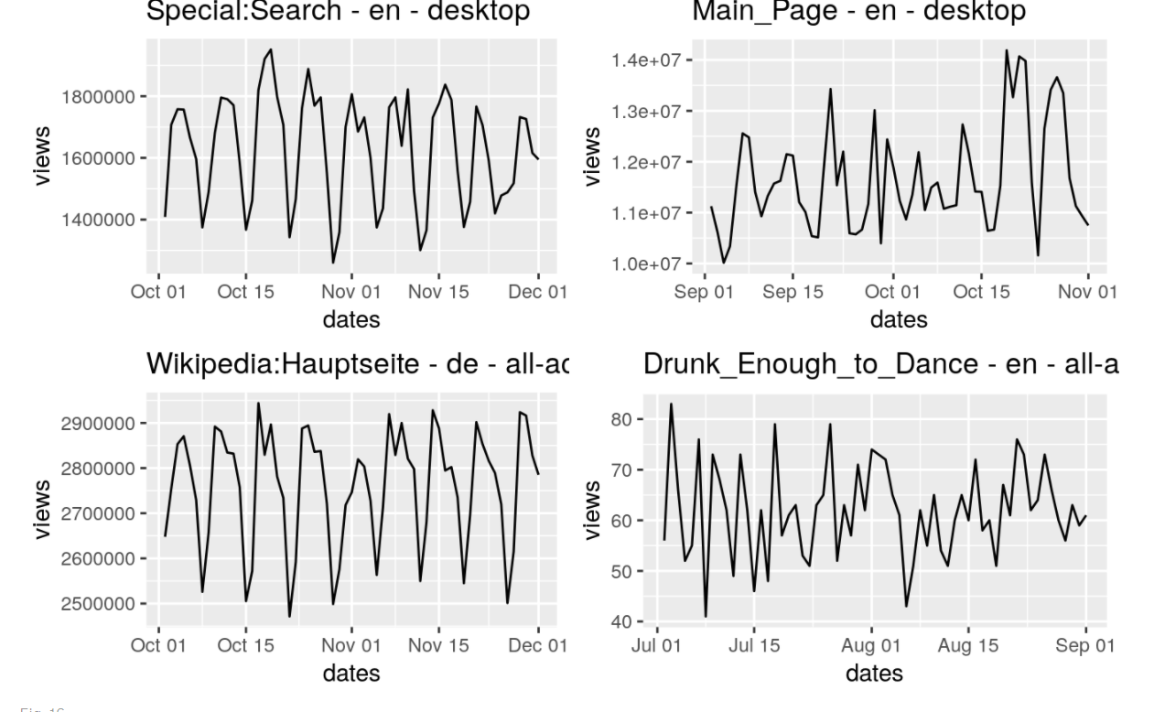
Plotting time series for shorter duration
Plotting time series for 2-month duration

Slide 22
Forecasting Approach
In our project we forecast 2 months data and measure the prediction accuracy by keeping a holdout sample of 60 days from our forecast data. We have done this by using autoregressive integrated moving average(ARIMA) model.
This consists of three parts( parameterized by indices p, d, q ) as ARIMA(p, d, q):
Auto-regressive/p: p indicates the range of lags.
Integrated/d: d is a differencing parameter, which gives us the number of times we are subtracting the current and the previous values of a time series.
Moving average/q: q gives us the number of previous error terms to include in the regression error of the model.

Slide 23
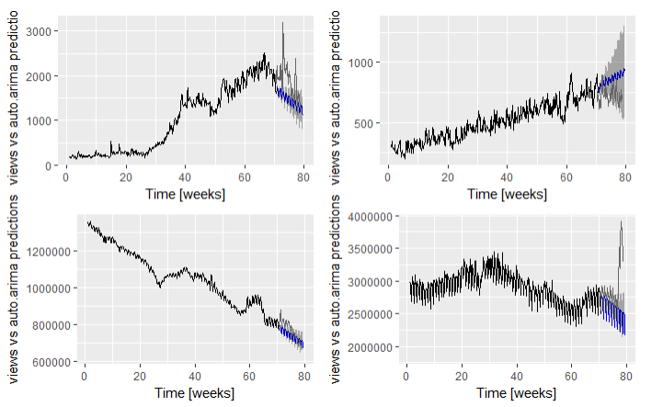
Forecasts

Slide 24
Future Work
Seasonality component
Holt- Winters method

Slide 25
THANK YOU

