Slide 1
Use of Time-Series Data in Strategic Managerial Decisions
Group 6 Members- Rahul, Chinmay, Alec and Zi

Slide 2
A time series is a series of data points indexed (or listed or graphed) in time order.
Most commonly, a time series is a sequence taken at successive equally spaced points in time.
Time series forecasting is the use of a model to predict future values based on previously observed values.

Slide 3
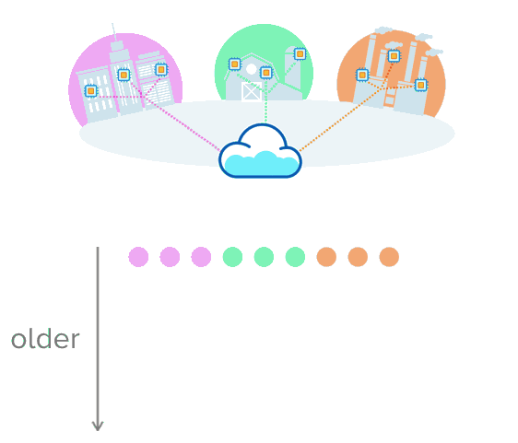
Time-series data : Example
Imagine sensors collecting data from three settings: a city, farm, and factory. In this example, each of these sources periodically sends new readings, creating a series of measurements collected over time.

Slide 4
Time Series Example
Here’s another example, with real data from the City of New York, showing every taxicab ride for the first few seconds of 2018. We would see, each row is a “measurement” collected at a specific time.

Slide 5
Time Series Datasets
These datasets primarily have 3 things in common:
The data that arrives is almost always recorded as a new entry
The data typically arrives in time order
Time is a primary axis (time-intervals can be either regular or irregular)

Slide 6
Why Time-Series is Powerful?
Time-series datasets track changes to the overall system as INSERTs, not UPDATEs.
It allows us to measure change: analyze how something changed in the past, monitor how something is changing in the present, predict how it may change in the future.
Notes:
This practice of recording each and every change to the system as a new, different row is what makes time-series data so powerful. It allows us to measure change: analyze how something changed in the past, monitor how something is changing in the present, predict how it may change in the future.

Slide 7
Time Series
How Relevant?
What do self-driving Teslas, autonomous Wall Street trading algorithms, smart homes, transportation networks that fulfill lightning-fast same-day deliveries, and an open-data-publishing NYPD have in common?
Answer is Time Series

Slide 8
Project Detail
Data details- Car sales data of different makers in the Norwegian market
Source: Statista.com
Year- Jan 2007 to Jan 2017
Observation - 4378
Important attributes - 3 (Car Manufacturer, Number of Sales per month and Percentage Share)

Slide 9
What we are finding
Decoding the time series data
Finding seasonality in sales of a particular manufacturer (yearly)
Cross comparing the seasonality to find out the window of opportunity in the market
Finding trends of different manufacturers and compare them, finding who is doing better, by what percentage
Significance of Autocorrelation of Residuals
Impact of competitors on each other
Prediction of future sales of different car brands

Slide 10
Decoding Time Series
Time Series can be Additive or Multiplicative
Time Series Data is composed of three components- Trend, Seasonality and Random (Noise)
Trend gives historical changes in data and implies prediction of future behaviour
Seasonality Shows periodic fluctuations
Seasonal Pattern exists if the series is influenced by seasonal factors like festivals, special holidays
Seasonality gets affected by Unanticipated Events
Random will always present

Slide 11
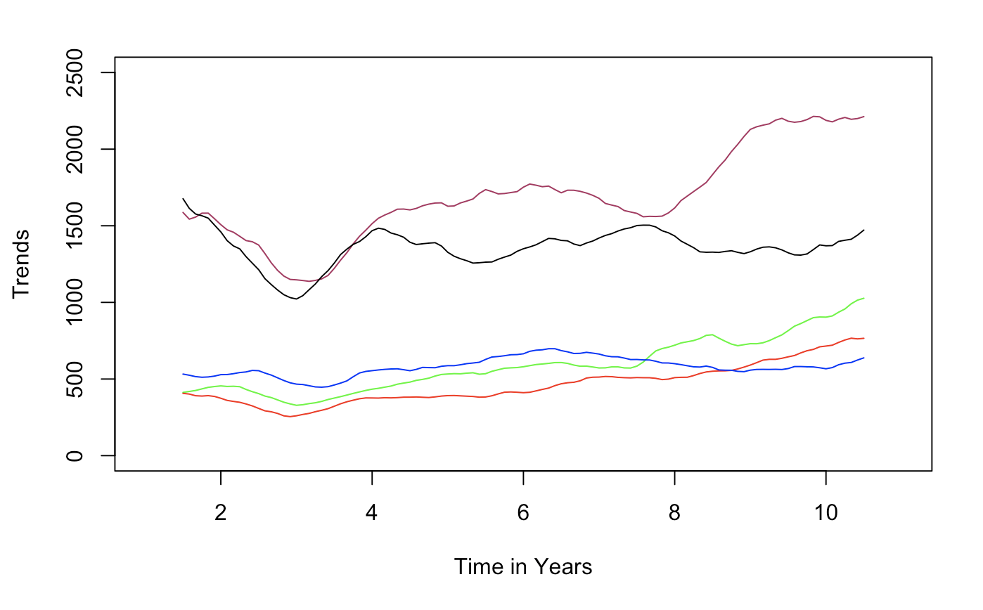
Trend
Volkswagen
Toyota
BMW
Mercedes
Audi
Trends help in predicting long term behaviour in Market (BMW, Mercedes, Audi, Toyota, Volkswagen)

Slide 12
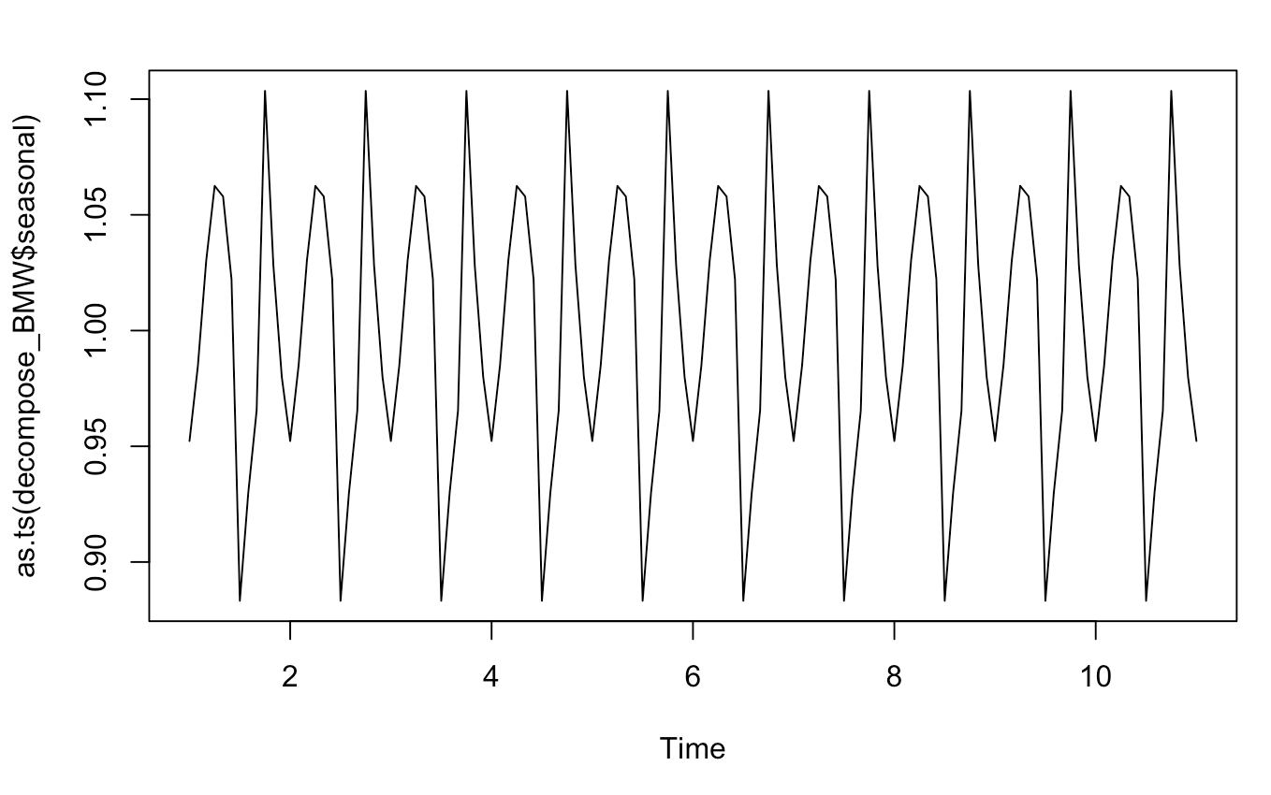
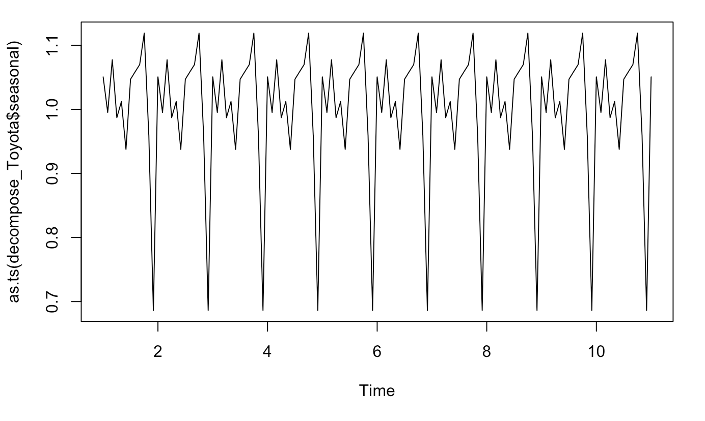
Seasonality
Seasonal of Toyota, Freq=12
Seasonal of BMW, Freq=12

Slide 13
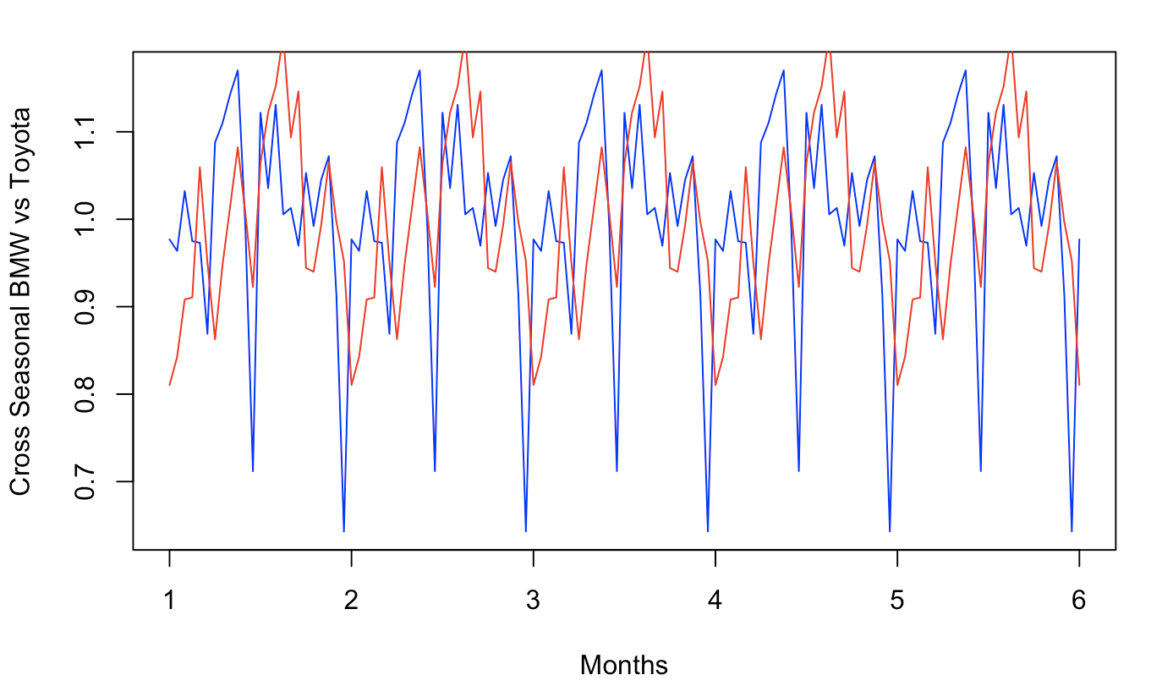
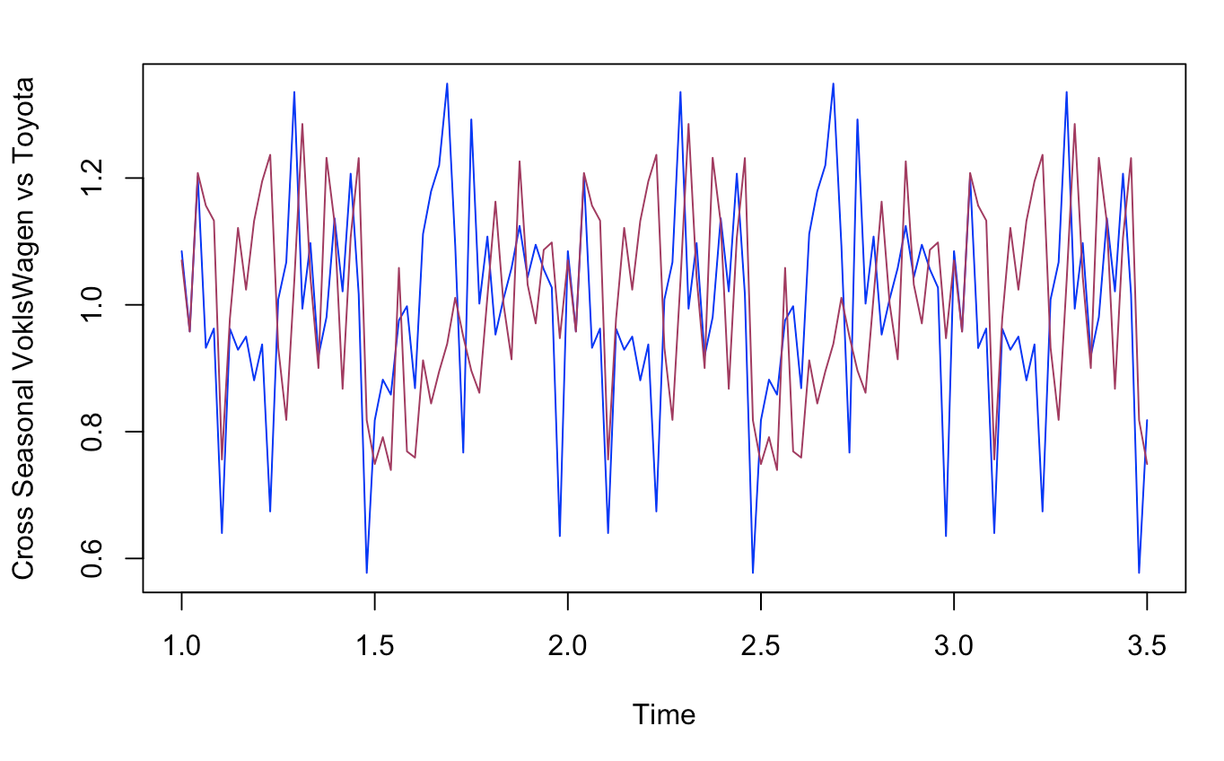
Seasonality for Marketing Windows
Toyota vs Others seasonal: Seasonality Shows Where Toyota Should Focus (Toyota, BMW, Volkswagen )

Slide 14
Autocorrelation between residuals
Residuals of any time series must be random, like white noise
Residuals should NOT have any correlation between them
Significant Autocorrelation of residuals implies something is missing while predicting a model
Significant Autocorrelation of residuals in any quarter implies unusual circumstances which affected seasonality- worth investigating
Autocorrelation between residuals can tell if residuals can be useful for forecast
Autocorrelation of residuals should be less than statistical significance line

Slide 15
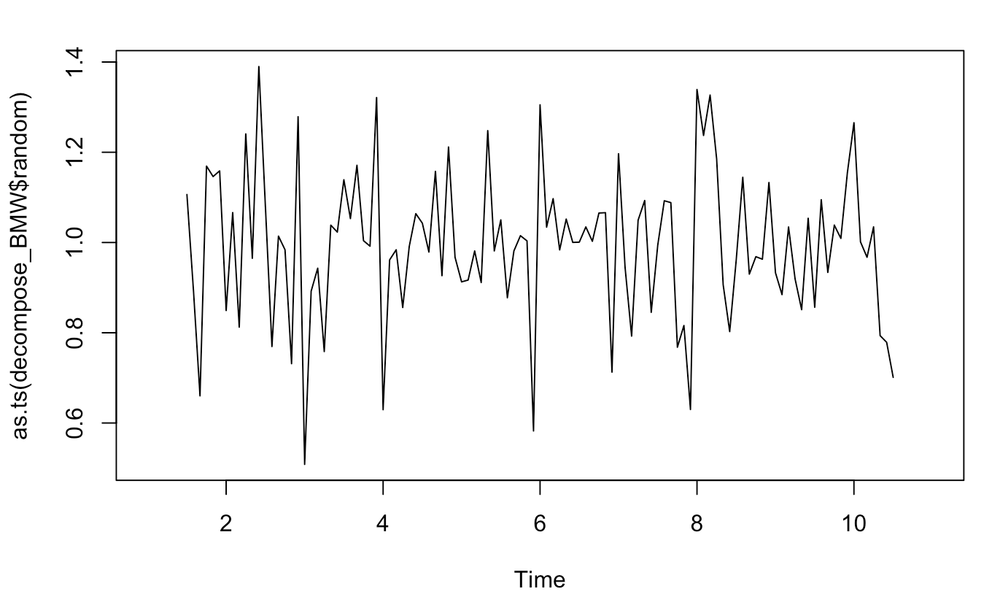
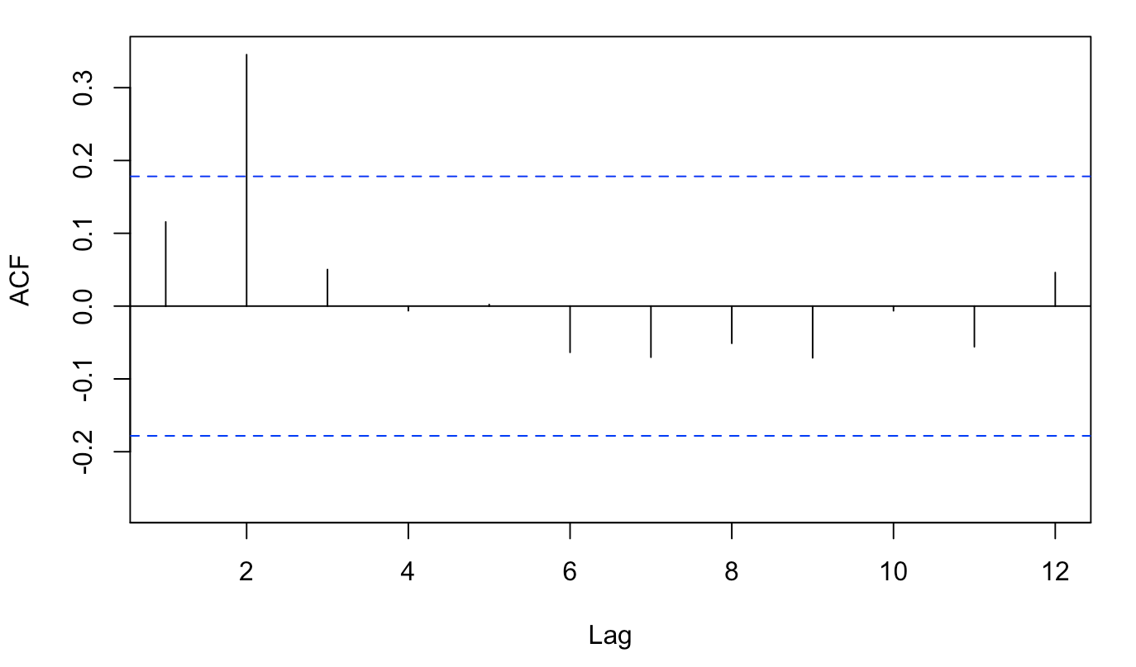
BMW-ACF of Residuals
BMW Random
ACF of Residuals

Slide 16
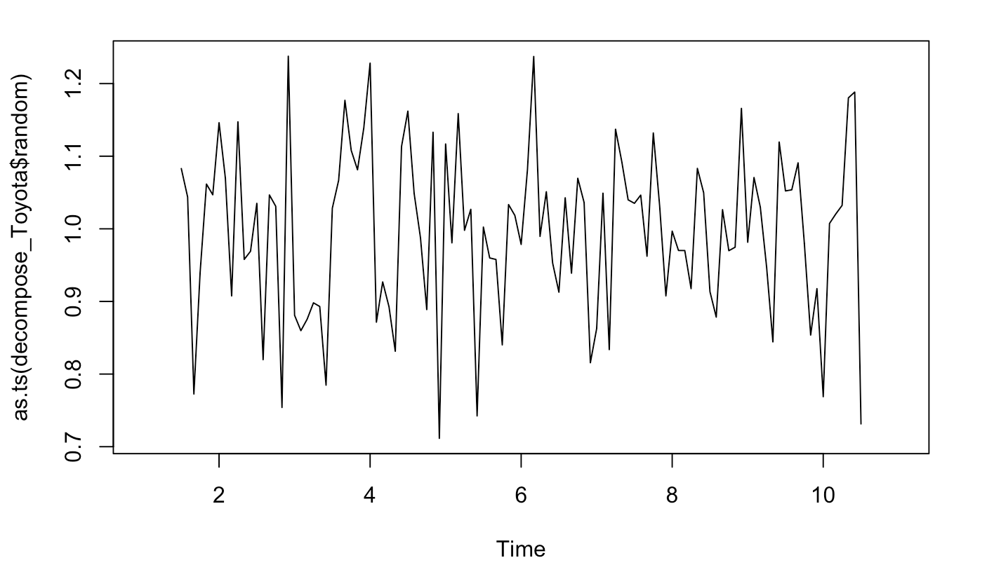
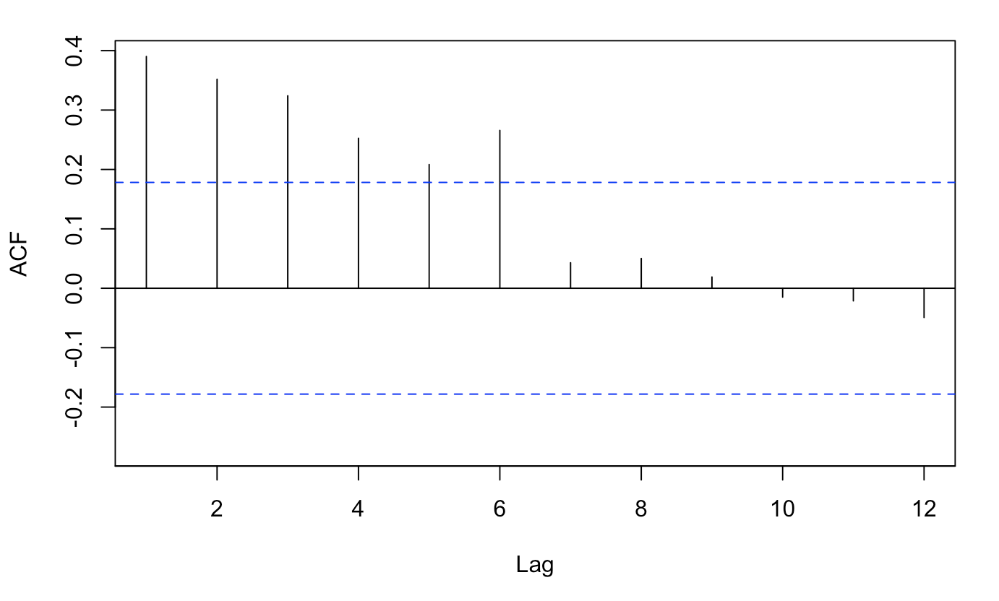
Toyota-ACF of Residuals
Toyota Random
ACF of Residuals

Slide 17
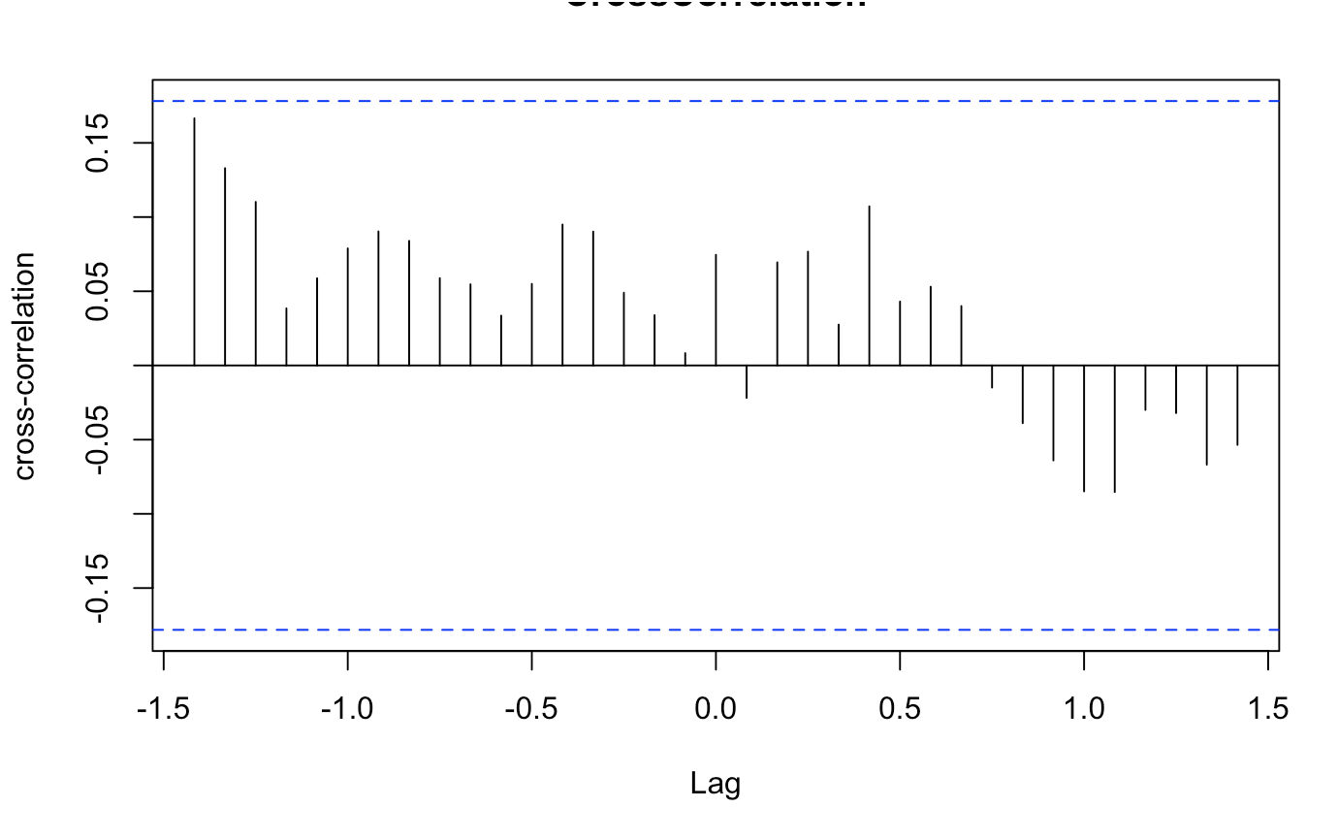
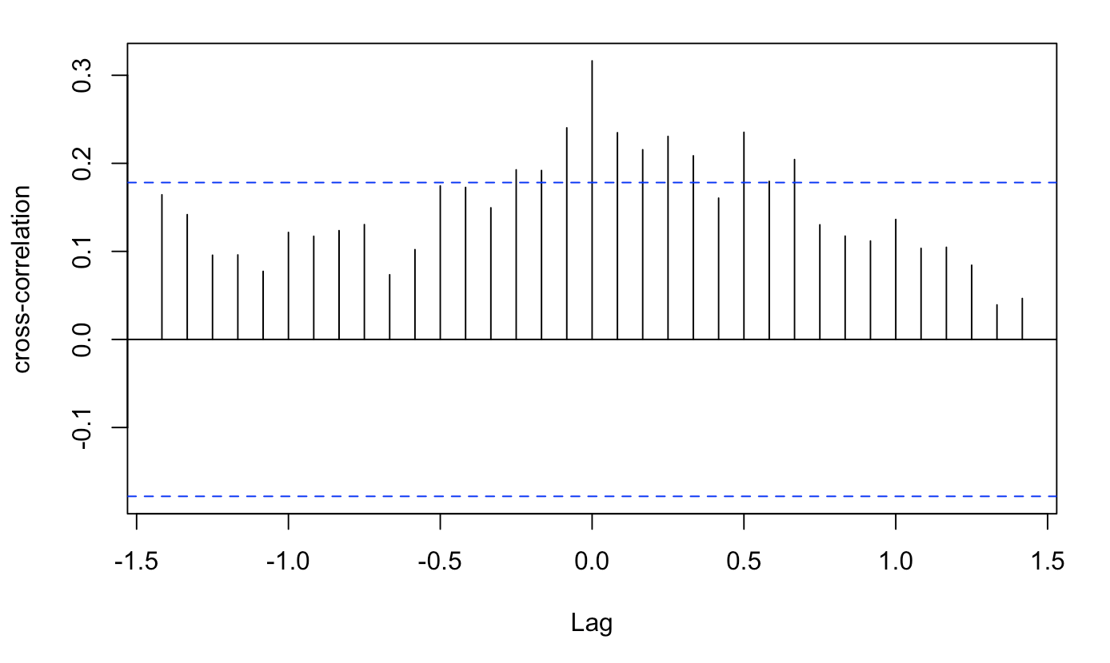
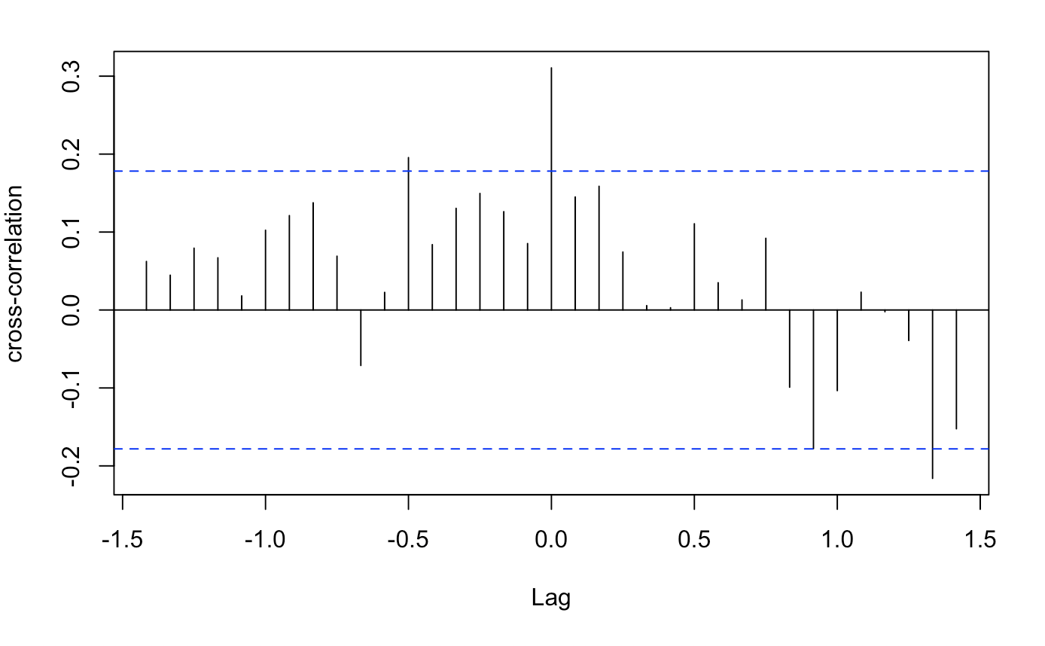
Cross Correlation of Time Series
Toyota vs. BMW
Audi vs. BMW
Toyota vs. Volkswagen

Slide 18
Forecasting - BMW
BMW data was from 1/2007 - 1/2017. There was 121 months worth of data. We decided to use the data from 1/2007 - 8/2016 to predict the next 12 months.
So our actual predicted data is 6 months. 2/2017 - 8/2017
ARIMA modeling was used for forecasting. Optimal model was chosen by the auto.arima function in R.
Data was also tested to make sure it was stationary. Stationary data is necessary for ARIMA modeling.

Slide 19
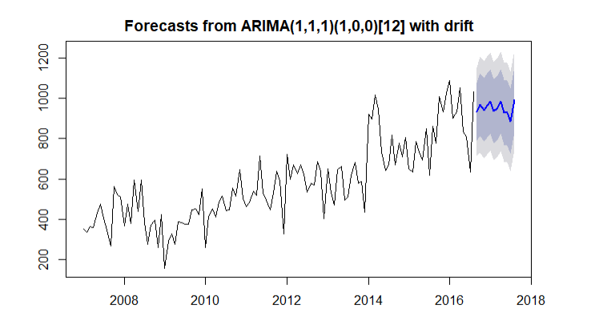
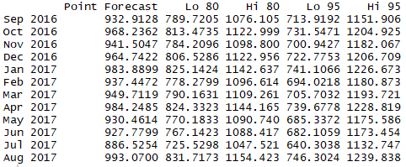
Forecasting - BMW

Slide 20
Forecasting - Toyota
Toyota data was from 1/2007 - 1/2017. There was 121 months worth of data. We decided to use the data from 1/2007 - 8/2016 to predict the next 12 months.
So our actual predicted data is 6 months. 2/2017 - 8/2017
ARIMA modeling was used for forecasting. Optimal model was chosen by the auto.arima function in R.
Data was also tested to make sure it was stationary. Stationary data is necessary for ARIMA modeling.

Slide 21
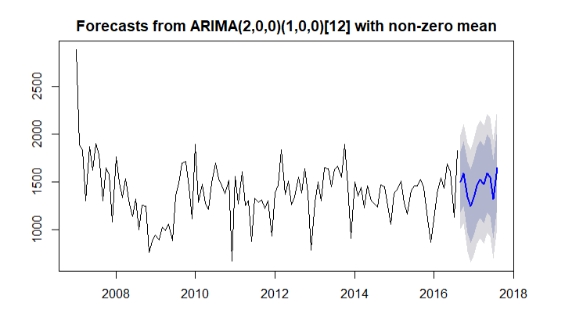
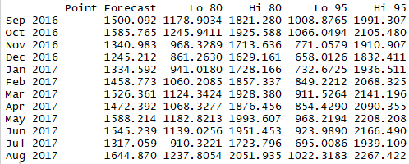
Forecasting - Toyota

Slide 22
Conclusion
Trend in Time Series helped us deciding the future of marketing.
Cross Seasonality is important in finding marketing windows
Autocorrelation of Residuals may have information about accidental events which might be worth investigating
Correlation between two competitive brands in a market gives

