Slide 1
CS 63016 & CS 73016
Big Data Analytics
Chapter 7: Big Data Applications -Time Series
Xiang Lian
Department of Computer Science
Kent State University
Email: xlian@kent.edu
Homepage: http://www.cs.kent.edu/~xlian/
Notes:
The slides of this Big Data course used some public slides/materials on the Web. I would like to acknowledge these resources, and please let me know if I failed to cite them.

Slide 2
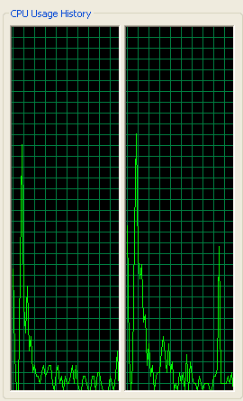
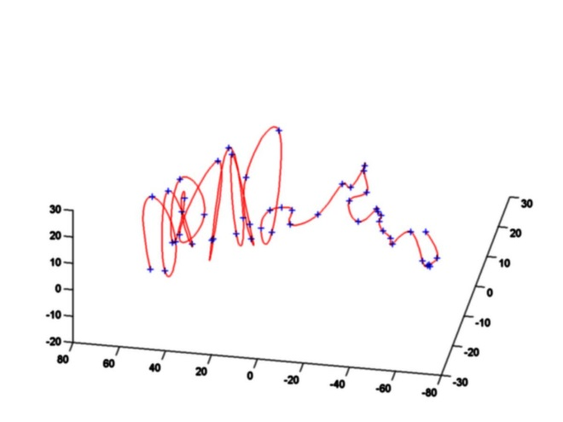
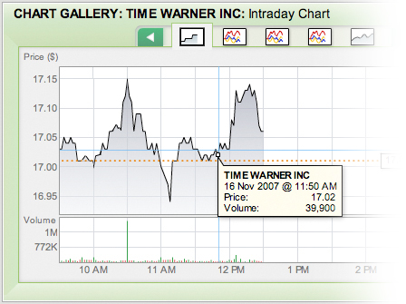
Time Series Data and Applications
A time series is an ordered sequence of data values at consecutive timestamps
financial stock data
trajectory of moving objects
sensory data
video data
Notes:
www.matrixinvestmentgroup.com/
www.cse.wustl.edu/~pless/wumap.html
www.research.ibm.com/MediaStar/VideoAnn.html

Slide 3
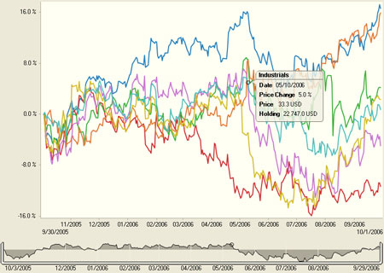
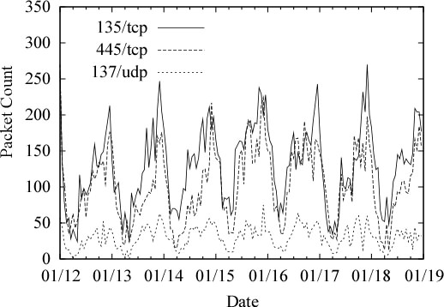
Properties of Time Series Data
Time series data
  Temporal data correlation
  High dimensionality
  Containing repeated patterns
Notes:
http://www.panopticon.com/products/line_graph_data_visualization.htm
http://www.usenix.org/events/sec05/tech/full_papers/shinoda/shinoda_html/
http://www.bts.gov/publications/transportation_indicators/december_2002/Special/html/A_Time_Series_Analysis_of_US_Inland_Waterways_Trade.html

Slide 4
Past Research Topics on Time Series
Similarity search on static time-series data
  Similarity measure
  Dimensionality reduction techniques
  Query processing

Slide 5
Similarity Search over Time-Series Databases
Given a time-series database D and a user-specified query time series Q, a similarity query is to retrieve time series S ∈ D that are similar to Q
similarity
search
time
series
…
Efficiency!
…
…
query time series Q
time-series database D
Notes:
In this paper, we study the fundamental problem of similarity search in the static time-series database. Assume we have a time-series database containing many series. Given a query time series, we want to find those time series that are similar to the query series.
Since there are lots of time series in the database, it is very important to enhance the efficiency of the search.

Slide 6
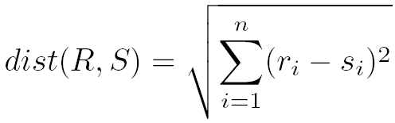

Similarity Measures Without Warping
Euclidean distance
  Given R = <r₁, r₂, …, r_{n}> and S = <s₁, s₂, …, s_{n}>
L_{p}-norm distance
r₁
r₂
… …
r_{n}
R
… …
S
s₁
s₂
… …
s_{n}

Slide 7
Similarity Measures With Warping
The distance function allows the matching between two time series on warping positions
r₁
r₂
r_{m}
r₃
… …
R
… …
S
s₁
s₂
… …
s_{n}

Slide 8
Similarity Measures With Warping (cont'd)
Dynamic Time Warping (DTW)
r₁
r₂
… …
r_{m}
r₁
r₂
r_{m}
r₁
r₂
r_{m}
r₃
… …
r₃
… …
R
… …
… …
… …
S
s₁
s₂
… …
s_{n}
s₁
s₂
… …
s_{n}
s₁
s₂
… …
s_{n}
case 1
case 2
case 3

Slide 9
Similarity Measures With Warping (cont'd)
Longest Common Subsequences (LCSS)
r₁
r₂
… …
r_{m}
r₁
r₂
r_{m}
r₁
r₂
r_{m}
r₃
… …
r₃
… …
R
≤ε
… …
>ε
… …
>ε
… …
S
s₁
s₂
… …
s_{n}
s₁
s₂
… …
s_{n}
s₁
s₂
… …
s_{n}
case 1
case 2.1
case 2.2

Slide 10
Similarity Measures With Warping (cont'd)
Edit distance with Real Penalty (ERP)
r₁
r₂
… …
r_{m}
r₁
r₂
r_{m}
r₁
r₂
r_{m}
r₃
… …
r₃
… …
R
dist(r₁,s₁)
… …
dist(r₁,g)
… …
dist(s₁,g)
… …
S
s₁
s₂
… …
s_{n}
s₁
s₂
… …
s_{n}
s₁
s₂
… …
s_{n}
case 1
case 2
case 3

Slide 11
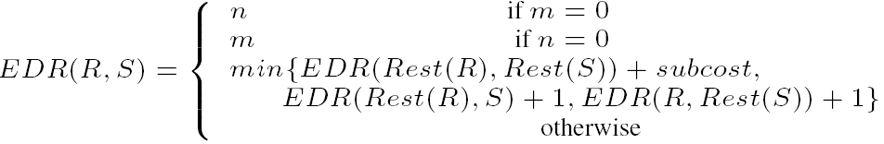
Similarity Measures With Warping (cont'd)
Edit Distance on Real sequence (EDR)
r₁
r₂
… …
r_{m}
r₁
r₂
r_{m}
r₁
r₂
r_{m}
r₃
… …
r₃
… …
R
subcost
… …
1
… …
1
… …
S
s₁
s₂
… …
s_{n}
s₁
s₂
… …
s_{n}
s₁
s₂
… …
s_{n}
case 1
case 2
case 3

Slide 12
GEMINI Framework for Similarity Search on Time-Series Data
Similarity search over time-series databases
  The whole matching [FODO, 1993]
  The subsequence matching [SIGMOD, 1994]
GEMINI
  Convert each time series S of length n to a lower dimensional space
  Insert the reduced data into a multidimensional index, on which the similarity search is processed
    The reduction method should follow the lower bounding lemma to guarantee no false dismissals

Slide 13
Dimensionality Reduction
Since the dimensionality of time series is usually high, the query processing on high-dimensional data may incur the problem of "dimensionality curse"
  Query performance on multidimensional indexes degrades dramatically with the increasing dimensionality
  Thus, dimensionality reduction techniques are proposed to reduce the dimension of time-series data
y
value
a 2D reduced data point
dimensionality reduction
1
time
100
O
x
a time series with dimensionality 100
a 2-dimensional reduced space

Slide 14
Dimensionality Reduction (cont'd)
Dimensionality reduction techniques:
  Singular Value Decomposition (SVD)
  Discrete Fourier Transform (DFT)
  Discrete Wavelet Transform (DWT)
  Piecewise Aggregate Approximation (PAA)
  Piecewise Linear Approximation (PLA)
  Adaptive Piecewise Constant Approximation (APCA)
  Chebyshev Polynomials (CP)
[PAKDD, 2001; VLDB, 2007]
[SIGMOD, 2001
[SIGMOD, 2004]
Notes:
Previous dimensionality reduction techniques include …
In particular, APCA and CP are the state-of-the-art techniques, and they can be indexed using any multidimensional tree index. In contrast, PLA is usually used for approximating time series. There is one previous work on PLA, called L-index, which divides a time series into different lengths and is however non-indexable for the similarity search. Thus, the only available approach for PLA is now the sequential scan.
[PAKDD, 2001] Y. Morinaka, M. Yoshikawa, T. Amagasa, and S. Uemura. The L-index: An indexing structure for efficient subsequence matching in time sequence databases. In PAKDD, 2001.
[SIGMOD, 2001] E. Keogh, K. Chakrabarti, M. Pazzani, and S. Mehrotra. Locally adaptive dimensionality reduction for indexing large time series databases. In SIGMOD, 2001.
[SIGMOD, 2004] Y. Cai and R. Ng. Indexing spatio-temporal trajectories with Chebyshev polynomials. In SIGMOD, 2004.

Slide 15
Singular Value Decomposition (SVD)
Reduce the dimensionality of time series data by considering the first few principal components
P (x, y)
the reduced 1D data point P' (a)
O
a
a
O
2-dimensional original data space
1-dimensional reduced space
Notes:
http://research.microsoft.com/pubs/79078/ldr.pdf

Slide 16
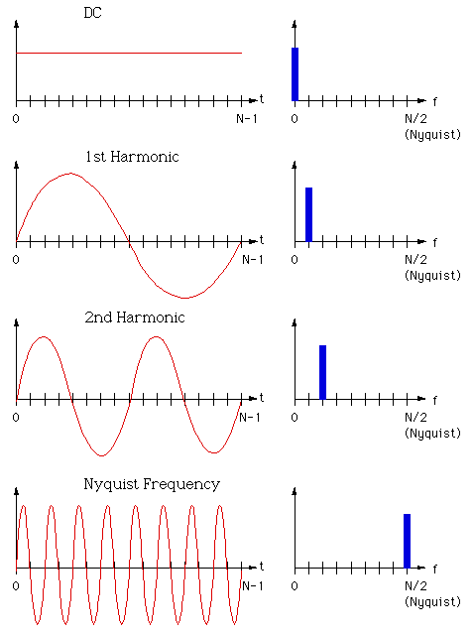
Discrete Fourier Transform (DFT)
Transform time series data from the time domain to frequency domain
  x_{t} – time series data at timestamp t (0 ≤ t ≤ n - 1)
  X_{f} – transformed data
  DFT:
Notes:
http://local.wasp.uwa.edu.au/~pbourke/miscellaneous/dft/

Slide 17
Discrete Wavelet Transform (DWT)
difference between 127 and mean (99)
Example of DWT:
mean of 127 and 71
DWT coefficients

Slide 18
Piecewise Aggregate Approximation (PAA)
Example:
  Convert 4-dimensional time series (1, 3, 7, 5) into a 2-dimensional point (2, 6)
Original time-series data:
PAA representation:
value
9
7
6
5
PAA
3
2
1
O
1
2
3
4
time

Slide 19
CP, PLA, and APCA
Dimensionality reduction techniques:
  Singular Value Decomposition (SVD)
  Discrete Fourier Transform (DFT)
  Discrete Wavelet Transform (DWT)
  Piecewise Aggregate Approximation (PAA)
  Piecewise Linear Approximation (PLA)
  Adaptive Piecewise Constant Approximation (APCA)
  Chebyshev Polynomials (CP)
non-indexable
indexable
[PAKDD, 2001; VLDB, 2007]
[SIGMOD, 2001]
[SIGMOD, 2004]
indexable
Notes:
Previous dimensionality reduction techniques include …
In particular, APCA and CP are the state-of-the-art techniques, and they can be indexed using any multidimensional tree index. In contrast, PLA is usually used for approximating time series. There is one previous work on PLA, called L-index, which divides a time series into different lengths and is however non-indexable for the similarity search. Thus, the only available approach for PLA is now the sequential scan.
[PAKDD, 2001] Y. Morinaka, M. Yoshikawa, T. Amagasa, and S. Uemura. The L-index: An indexing structure for efficient subsequence matching in time sequence databases. In PAKDD, 2001.
[SIGMOD, 2001] E. Keogh, K. Chakrabarti, M. Pazzani, and S. Mehrotra. Locally adaptive dimensionality reduction for indexing large time series databases. In SIGMOD, 2001.
[SIGMOD, 2004] Y. Cai and R. Ng. Indexing spatio-temporal trajectories with Chebyshev polynomials. In SIGMOD, 2004.

Slide 20
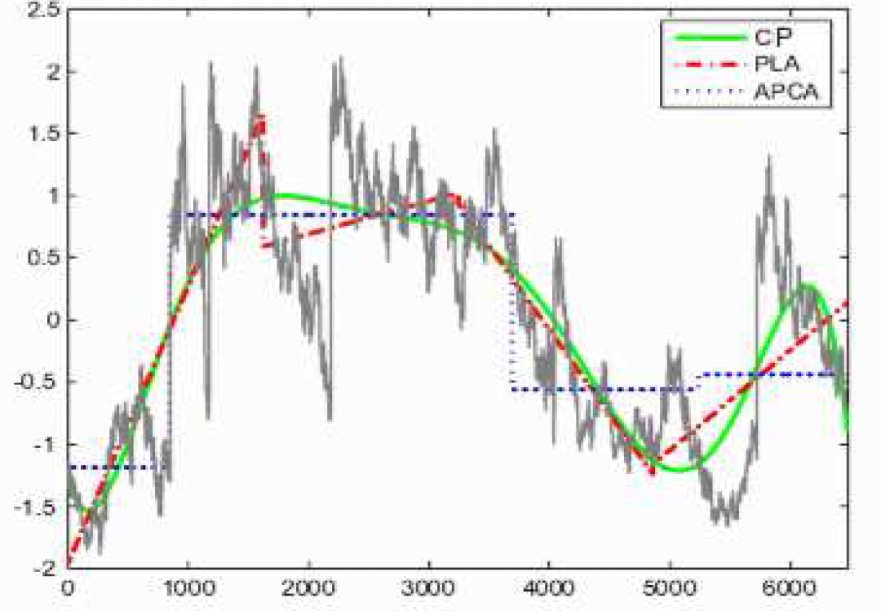
CP, PLA, and APCA
2.5
CP
2
PLA
APCA
1.5
1
0.5
0
-0.5
-1
-1.5
-2
0
1000
2000
3000
4000
5000
6000
Opening Stock Prices (ALCOA data set)

Slide 21
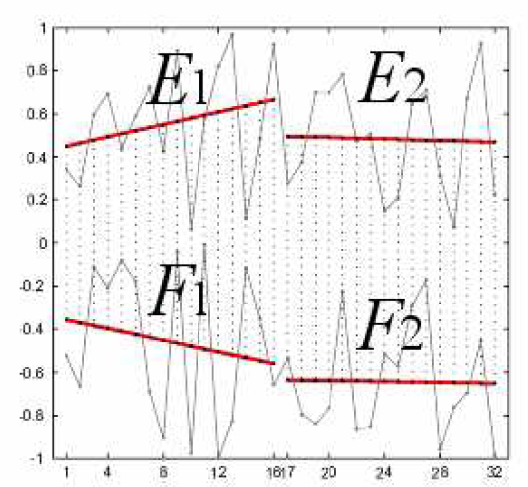
Indexable Piecewise Linear Approximation
Divide each time series S = <s₁, s₂, …, s_{n}> into m segments of equal length l (i.e. n = l ⋅ m)
For the i-th segment, we approximate it with a line segment in the form a_{i} ⋅ t + b_{i} (t∈[1, l]), such that the reconstruction error is minimized
PLA representation:
  S_{PLA} = <a₁, b₁; a₂, b₂; …; a_{m}, b_{m}>
m = 2
Notes:
Specifically, our PLA representation of time series is to divide the time series into segments of equal lengths. As shown in the figure, the two segments E1 and F1 from two time series, respectively, are of the same length. Similarly, E2 and F2 are of the same length. Note that, segments of equal lengths inherently make the PLA reduction method indexable, whereas the previous L-index method are non-indexable due to different lengths of the corresponding segments (e.g. E1 and F1).
The line of the i-th segment is defined as the one that minimizes the reconstruction error, in the form a_i * t + b_i. The reduced PLA data can be represented by coefficients of line segments <a₁, b₁; a₂, b₂; …; a_{m}, b_{m}>

Slide 22
Lower Bounding Lemma
PLA distance dist_{PLA}(S, Q)
  S_{PLA}⁼ <a₁₁, b₁₁; …; a_{1m}, b_{1m}>
  Q_{PLA}⁼ <a₂₁, b₂₁; …; a_{2m}, b_{2m}>
  where a_{3i}=a_{1i}–a_{2i} and b_{3i}=b_{1i}–b_{2i}
Lower bounding lemma
  dist_{PLA}(S, Q) ≤ dist (S, Q)
  This lemma can guarantee the similarity search with no-false-dismissals over PLA index
m = 2
Notes:
Given two reduced PLA data of S and Q, we define the distance between two reduced data by summing up the distance between corresponding line segments for all segments. For example, the distance between E1 and F1 plug that between E2 and F2.
We have proved that this distance between two reduced data is a lower bound of the original time series, which can guarantee that no-false-dismissals are introduced for the similarity search over PLA index

Slide 23
PLA Index
PLA-reduced
query point q
We use R-tree to index the reduced PLA data
In order to perform the similarity search, we need to compute the minimum possible distance mindist_{PLA}(q, e) from a PLA-reduced query point q to an MBR node e
  q = <q_{a1}, q_{b1}; …; q_{am}, q_{bm}> and x = <x_{a1}, x_{b1}; …; x_{am}, x_{bm}>
NOT
Euclidean
distance
x ∈ e
MBR node e
computation of
mindist_{PLA}(q, e)
dist²_{PLA}(q^{(i)}, x^{(i)})
Notes:
In order to speed up the similarity search, we index the reduced PLA data with an R-tree. Since the distance between any two reduced PLA data is not Euclidean distance any more, the minimum distance from any PLA query point to an intermediate node of R-tree is not Euclidean distance either. Thus, we have to re-define this distance.
As shown in the figure, given a PLA query point q and an MBR node e, the minimum distance from q to e is the minimum possible distance from q to any point x in the node e.
The distance from q to x can be formalized in this complex formula, which is a summation of distances from each segment.

Slide 24
Calculating Minimum dist²_{PLA}(q^{(i)}, x^{(i)})
Without loss of generality, we consider the reduced data from the i-th segment, q^{(i)} and x^{(i)}
Interestingly, we can simplify dist²_{PLA}(q^{(i)}, x^{(i)}) as:
where
Goal:
obtain minimum dist²_{PLA}(q^{(i)}, x^{(i)})
Euclidean distance between points A(u_{A}, v_{A}) and B(u_{B}, v_{B})
in a 2D u-v space
constraints of points A and B
Problem Definition – Related Work – PLA Lower Bound – PLA Index – Experiment
Notes:
Without loss of generality, we consider each segment, on which the distance dist_{PLA}²(q^{(i)}, x^{(i)}) is given in the above formula. Our goal is to obtain the minimum possible distance dist_{PLA}²(q^{(i)}, x^{(i)}), which is not trivial.
Fortunately, after simplifying dist_{PLA}²(q^{(i)}, x^{(i)}), we find that it can be viewed as the Euclidean distance between points A and B in a 2D u-v space, where the constraints of A and B are given in these four formulae.

Slide 25
Calculating Minimum dist²_{PLA}(q^{(i)}, x^{(i)}) (cont.)
In the u-v space, A and B are represented by two line segments, respectively
B is along u-axis
A is on a line going through origin O
minimum possible distance of dist_{PLA}(q^{(i)}, x^{(i)})
Problem Definition – Related Work – PLA Lower Bound – PLA Index – Experiment
Notes:
As indicated by the constraints of A and B, A is a line going through origin O, and B is along u-axis. Both A and B are line segments. Therefore, the problem of finding minimum possible distance of dist_{PLA}²(q^{(i)}, x^{(i)}) is not reduced to the problem of obtaining the minimum distance between two line segments.

Slide 26
Case 1
case 1.1
case 1.2
case 1.3
case 1.4
case 1.5
v
B₁(u_{B1},v_{B1})
B₂(u_{B2},v_{B2})
B
u
A
A₂(u_{A2},v_{A2})
A₁(u_{A1},v_{A1})

Slide 27
Case 2
case 2.1
case 2.2
case 2.3
case 2.4
case 2.5
v
A₂
B₁
B₂
A
B
u
A₁

Slide 28
Case 3
case 3.1
case 3.2
case 3.3
case 3.4
case 3.5
v
A
A₂
A₁
B₁
B₂
B
u
Symmetric to Case 1

Slide 29
Notes:
According to different relative positions of the two line segments in the u-v space, we can obtain the minimum distance between two line segments with respect to different cases.

Slide 30
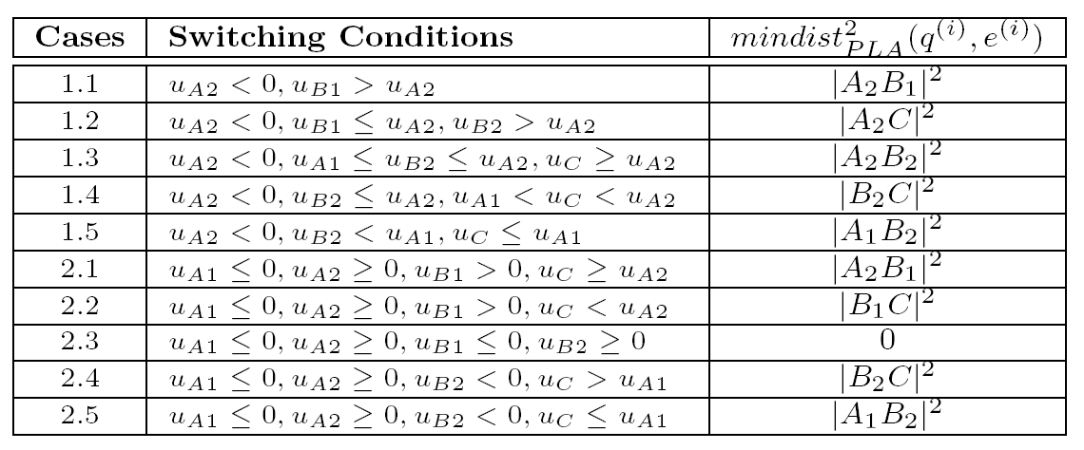
A Summary of Different Cases
Notes:
These switching cases can be summarized in this table. In this way, we can obtain the minimum distance from any query point to MBR nodes by checking a few switching conditions.

Slide 31
Query Processing Over PLA Index
Now we can compute mindist_{PLA}(q, e) between any PLA-reduced query point q and an MBR node e
We answer a k nearest neighbor (kNN) query, by traversing the R-tree index in a best-first manner
  Maintain a min-heap with entries in the form (e, key), where e is an MBR (or point) and key is either mindist_{PLA}(q, e) (or dist_{PLA}(q, e))
Notes:
With this minimum distance between point and MBR node, we can answer the kNN query by traversing the R-tree index
In particular, we maintain a minimum heap containing entries with key defined as the minimum distance from a point to node/point in the reduced PLA space and search the index in a traditional best-first manner

Slide 32
Present Research Topics on Time Series
Similarity search on stream time series
  Efficient representation for similarity query processing on stream time series
  Similarity queries on the predicted future time series
  Similarity join over multiple stream time series

Slide 33
Coal Mine Application
In a coal mine, sensors are deployed to collect the density of oxygen, dust, and gas, as well as the humidity and temperature
In order to keep the safety of workers, the system needs to monitor the sensor data
similarity
match
coal mine
monitoring
system
dangerous
patterns
sensor data
emergency

Slide 34
Problem Statement
Assume we have time-series streams in the form S = (s₁, s₂, … , s_{i}, …), in which we consider sliding windows of size w, that is, W_{i} = (s_{i}, s_{i+1}, … , s_{i+w-1})
Given a set of pre-defined time-series patterns, P = {p₁, p₂, … , p_{m}}, we study the problem of retrieving the similar match between every window W_{i}, for i = 1, … , in high speed time-series stream S and patterns p_{i} ∈ P
w
…
w
w
similarity
match
p₁
…
p₂
… …
…
p_{m}
w
…
patterns
time-series streams

Slide 35
Multi-Scaled Segment Mean (MSM)
computation
cost
low
low
high
high
pruning
power

Slide 36
Multi-Step Filtering Scheme
?
Step-by-step filtering scheme (SS)
step 1
step 2
step 3
step 4

Slide 37
Stopping Conditions of SS
Denote cost_{j} as the total cost of pruning from level (l_{min}+1) to level j
Stopping conditions
  (1) We reach the last approximation level, or
  (2) All patterns are pruned, or
  (3) cost_{j} > cost_{j-1}, where

Slide 38
Other Filtering Schemes
Jump-step filtering scheme (JS)
One-step filtering scheme (OS)
step 1
step 1
step 2

Slide 39
Motivation of Similarity Queries on Future Time Series
In the scenario of stream time series, stream data are often delayed due to various reasons
  The communication congestion in the network
  Batching processing
Some real applications may request a similarity search on time-series data in the future
  In the stock market, we want to know which stocks will follow a certain pattern, so as to either make a profit or reduce losses
  In sensor networks, we may need to predict dangerous events (e.g., fires) in the near future from the streaming sensory data
Notes:
For example, in the archived time series databases, the most commonly-used query, similarity query, retrieves all the data sequences that are similar to a given query sequence, which assumes that all data sequences are available in the database.
However, in the context of the stream time series, stream data are often delayed for reasons such as network congestion or batch processing. So the time series data are no longer complete in this case, and similarity search on such incomplete data can give inaccurate results.

Slide 40
Problem Definition and Framework
Assume we have n stream time series T₁, T₂, …, T_{n}
For each stream time series T_{i}, at the current timestamp (m-1) , we know the most recent H data t₀, t₁, …, and t_{m-1}
Data t_{m}, t_{m+1}, …, t_{m+Δt-1} from each stream time series will arrive at the future timestamp (m+Δt) in a batch
Notes:
Motivated by this, we propose the framework of our problem.
As shown in the figure, we have n stream time series. Assume at the current timestamp, we know the most recent H values of each stream time series. Because of the delay, the future Δt values will not arrive until Δt timestamps later.
Our similarity search problem is to find future subsequences that are similar to a query sequence. Here, future subsequences are those that contain future values that have not arrived.
Therefore, we have two goals:
(1) predict future values with a predictor, and
(2) perform similarity search on future subsequences
After the actual Δt data arrive, we may need to train the predictor with as low cost as possible.

Slide 41
Problem Definition and Framework (cont'd)
Our goal:
  The prediction problem:
    Given H consecutive data x₁, x₂, …, and x_{H}, predict the subsequent Δt values x_{H+1}, x_{H+2}, …, and x_{H+Δt}
  Similarity search over n⋅Δt future subsequences
Solutions:
  Polynomial Predictions and probabilistic prediction
  Index the predicted future time series and perform the search on future time series
Notes:
Please refer to notes of the last slide

Slide 42
Data Predictions
Polynomial Predictions
  Basic idea:
    Use a curve to approximate the most recent data with the smallest approximation error, and
    Predict future values with the curve
    Linear prediction: x = a⋅t + b
    Quadratic prediction: x = a⋅t² + b⋅t + c

Slide 43
Discussion on Polynomial Predictions
Advantages:
  Efficient for online processing
  They can achieve acceptable prediction accuracy
Drawbacks:
  They can only predict short-term values with small error, but not long-term ones
  They make use only H most recent data, but not all of the historical data. Therefore, values are predicted locally, but not from the global point of view
Notes:
The polynomial approach is efficient for online processing and can achieve acceptable accuracy for short-term prediction.
However, it is not suitable for long-term values. For example, in the previous slide, the predicted values of the line may go out of the value range [min, max].
Furthermore, it makes use of the most recent data. So values are predicted locally. Next, we propose a probabilistic approach which can predict from the global point of view.

Slide 44
Probabilistic Prediction
Observation:
  Those subsequences in the stream time series that appear frequent in history have a higher probability of occurring again in the future
Basic idea:
  Maintain the symbolic representation of subsequences in an aggregate trie as well as some aggregates for prediction and error feedback;
  Predict the future data utilizing probabilities based on aggregates; and
  Perform the similarity search on future subsequences
Notes:
Our second probabilistic prediction is based on the observation that, subsequences that appear frequent in history have higher chance to appear again in the future.
Therefore, in the probabilistic approach, we maintain the symbolic representation of historical subsequences in a special index called aggregate trie, which contains some aggregates for prediction and its feedback.
As a second step, we predict the future data from the aggregate trie, and
The predicted future subsequences are used for similarity search.

Slide 45
Symbolic Representation
Symbolic representation of time series:
  abcbbaa
Notes:
Before we continue to discuss details of the aggregate trie, we first introduce the symbolic representation of a sequence.
As an example in the figure, we divide a time series into 7 segments of equal length. Within each segment, we take the average and map the mean value to a unique symbol. For example, in the first segment of the figure, the mean value 1 is mapped to symbol a. Therefore, the entire time series is discretized to a string with 7 symbols abcbbaa.
The symbolic representation is able to approximate a time series with small space cost, since each symbol can be represented by only a few bits.

Slide 46
Illustration of Predictions
Notes:
Figures for the illustration of the last and next slides

Slide 47
Aggregate Trie
Convert subsequences into strings
Insert them into an aggregate trie
  Meanwhile, update the aggregates in the trie
  Each node of the trie keeps three aggregates <freq, hit, miss>, where freq is the frequency that a string appears in history, hit the times that prediction succeeds and miss that fails
  Intuition of keeping aggregates:
    If the frequency freq of a string is high, it will have a higher probability to appear again in the future
    If the prediction of a string fails quite often, that is, its aggregate miss is large, we have to lower the chance of choosing this string as the predicted result
Notes:
Return to our problem.
We convert subsequences in the stream time series into their symbolic representations, i.e. strings.
Then, we insert them into an aggregate trie.
Our aggregate trie is different from the normal one, in the sense that it contains an aggregate triple in each node, that is, <freq, hit, miss>. In particular, freq is the frequency that a string appears in history, hit the times that prediction succeeds and miss that fails.
Intuitively, if the frequency of a string is high it will have a higher probability to appear again in the future.
Furthermore, if our prediction always fails for a string, which means its miss aggregate is large, then we are likely to predict this string wrongly again next time.

Slide 48
Predictions with the Aggregate Trie
Prob ∝ freq ⋅ hit / (hit + miss)
Example of prediction: aabX₁
  Traverse the aggregate trie through path aab
  Compute the probability of each possible symbol of X₁
    For example, aggregates <freq_a, hit_a, miss_a> for symbol a
    The probability Prob_a of symbol a is proportional to freq_a ⋅ hit_a / (hit_a + miss_a) in the leaf node of aaba
    Similarly, the probability Prob_b of symbol b is proportional to freq_b ⋅ hit_b / (hit_b + miss_b) in the leaf node of aabb
    …
  Select the symbol either with the highest probability or proportional to its probability
Notes:
So we predict the future data according to the probability that it is likely to be.
Specifically, we define this probability by freq ⋅ hit / (hit + miss)
As an example (in the figure of the next slide), assume currently we know symbols aab, and want to predict the next symbol X₁.
We traverse the aggregate trie through path aab. Then, we calculate the probability of each possible value of X₁.
For example, we obtain aggregates <freq_a, hit_a, miss_a> for symbol a, and compute the probability proportional to freq_a ⋅ hit_a / (hit_a + miss_a). Symbol b and c are similar.
Finally, we select the symbol as X₁ with the highest probability or proportional to its probability

Slide 49
Error Feedback in the Aggregate Trie
After the actual values arrive …
  Error feedback with aggregates <freq, hit, miss>
  As in the previous example, aabX₁
    Wrong prediction: if the actual value of X₁ is a whereas the prediction is b, then increase the aggregate miss_b in <freq_b, hit_b, miss_b> of path "aabb" by Prob_b and freq_a in that of path "aaba" by 1.
    Correct prediction (X₁ = b): increase hit_b and freq_b on the path "aabb" by Prob_b and 1, respectively
Notes:
After the actual values arrive, we need to feed back the prediction error.
Recall that if the prediction of a string fails quite often, we increase the miss aggregate so as to lower the chance of choosing this string as the predicted result.
Therefore, for a wrong prediction in the trie, e.g. b, we increase the aggregate miss_b in <freq_b, hit_b, miss_b> by Prob_b, and for the actual symbol a, increase freq_a in <freq_a, hit_a, miss_a> by 1.
For the correct prediction, simply increase hit_b and freq_b by Prob_b and 1, respectively

Slide 50
Alternative Index for the Aggregate Trie
In the trie, each path from the root to leaf is unique, and thus can be mapped to a unique multidimensional key
  For example, if there are totally 10 symbols a₀ ~ a₉, we map them to integers 0 ~ 9, respectively
  String a₂a₃a₉ corresponds to a unique key <2, 3, 9> of a time series
  Therefore, any entry such as <a₂a₃a₉X, freq_X, hit_X, miss_X> in the trie can be represented by a key <2, 3, 9, tid> and aggregates <freq_X, hit_X, miss_X>, where tid is the series id
Instead of tries, we index strings in an extended hashing file HI [6] to facilitate the prediction
Furthermore, a B⁺-tree FI is used to index future subsequences and help the similarity search as well as updating aggregates
Notes:
Next, we discuss the alternative index for the aggregate trie.
Note that, the aggregate trie is capable of predicting one stream time series only. In the case of multiple time series, one possible way is to maintain multiple separate tries, however, considering thousands of stream time series, it is very costly. Furthermore, the height of tries is another problem which may incur high I/O cost. Motivated by this, we aim at build up efficient indexes to reduce the I/O cost.
Observe that, each path of the trie can be uniquely represented by a sequence of symbols. We can map each path to a multidimensional key.
As an example, 10 symbols a₀ ~ a₉ can correspond to integers 0 ~ 9. So a string a₂a₃a₉ can be represented by a key <2, 3, 9>. Together with an id of the stream time series tid, each path of a series can be uniquely identified by a key, for example <2, 3, 9, tid> .
Therefore, instead of tries, we index strings in an extended hashing file with their corresponding keys and aggregates mentioned in the trie. Prediction procedure is similar to that in the aggregate trie.
Another index we use is a B⁺-tree which stores future subsequences for the similarity search and error feedback.
Ps: keys of BI are from

Slide 51
Illustration of Predictions, Queries and Updates in the Probabilistic Approach
Notes:
This figure illustrates the three steps of the probabilistic approach in the next slide. The top index HI is the extended hash index used for prediction, and the bottom one BI is a B⁺-tree with future subsequences.
Step 1(a). At the current timestamp, for each stream time series, predict future subsequences with the extended hash index HI
Step 1(b). Insert the predicted strings of future subsequences into the B⁺-tree FI
Step 2. During the blocked period, perform similarity search over FI
Step 3. Scan all leaf nodes of the B⁺-tree FI and batch update aggregates in HI when the actual data arrive (note that, there is a pointer ptr pointing to the corresponding entry in HI)

Slide 52
Three Steps of the Probabilistic Approach
1(a). At the current timestamp, for each stream time series, predict future subsequences with the extended hash index HI
1(b). Insert the predicted strings of future subsequences into a B⁺-tree FI
2. During the blocked period, perform similarity search over FI
3. Batch update aggregates in HI when the actual data arrive
Notes:
Please refer to notes in the previous slide.

Slide 53


Motivation Example of Similarity Join over Stream Time Series
In environmental surveillance applications, sensors are deployed at different places to collect data such as temperature in the form of time series
Sensory data collected from spatially close sensors often exhibit similar trends
To avoid the abnormal data collected from malfunctioned sensors, we can also perform a similarity join operation on stream time series data to clean the noises in the sensory data
similarity join over stream time series

Slide 54
Similarity Join on Stream Time Series
Similarity Join (SJ)
  Given two time-series databases R and S containing (sub)sequences of length n, an SJ query outputs all pairs <r, s>, such that dist(r, s) ≤ ε, where r ∈ R, s ∈ S, dist(⋅, ⋅) is a distance function between two series and ε is a similarity threshold
Stream Time Series
  The time series data continuously arrive at the system
  Sliding window model
new data T_{i}[t+1] at
timestamp t
W
expired data T_{i}[t-W+1]

Slide 55
Stream SJ Framework
When a new data item arrives at T_{i}
  Obtain a new subsequence S_{new} of T_{i}
  Find those candidate subsequences in other stream time series T_{j} that are similar to S_{new}
  Refine the candidates by computing the actual distances
1. Adaptive Radius-basEd Search (ARES)
2. Synopsis Pruning (SP)

Slide 56
Synopsis
Equi-width histogram
  Each bin stores the frequency of data reduced from subsequences
Bloom filter
  Each bin also contains a bloom filter with start offsets of sliding windows

Slide 57
Adaptive Radius-basEd Search (1)
Example
  A query sequence q of length 2
  A similarity threshold ε
  Problem: retrieve other data sequences similar to q
We can issue range query on each dimension, and combine the resulting candidates

Slide 58

Adaptive Radius-basEd Search (2)
To guarantee the property of no-false-dismissals, the selected radii, τ_{i}, of range queries should satisfy the condition:
Since stream data are changing all the time, we propose a cost model to guide the selection of radius on each dimension adaptively in order to retrieve small number of candidates

Slide 59
Adaptive Selection of Radii
We provide a cost model for ARES, and prove that:
  Assume data points are uniformly distributed within ε distance from each query dimension q_{i} with density d_{i}, where 1 ≤ i ≤ s
  In order to obtain the minimum number of candidates, we always find a query dimension q_{j} with the minimum density d_{j} and set τ_{i} to 0, if i ≠ j; ε, otherwise
  For non-uniform data, we give sub-optimal solution
Example
  If the density of x-axis is smaller
  than y-axis, then we set τ₁ = ε
  and τ₂ = 0

Slide 60
Synopsis Pruning
After ARES, we can obtain a number of candidate pairs, which however still contain some false positives
To further prune false positives, we propose a synopsis pruning (SP) approach to enhance the pruning power

Slide 61
Synopsis Pruning (cont'd)
Basic Heuristics
  Assume we have two time series T_{i} and Q,
  For each series, we divide it into two segments, in which data is reduced
  We can see that if the distance between the second segment of two series is already greater than ε, then we can safely discard this pair

Slide 62
Synopsis Pruning (cont'd)
To enable such pruning, we utilize the bloom filters in synopsis Syn_{i}
We choose hash functions such that start offsets of consecutive segments are mapped to the same position
This way, we can perform the bit operation
0, indicating that this pair can be safely pruned
Q
T_{i}

Slide 63
SJ over Multiple Stream Time Series
When a new data item arrives at T_{i}
  Obtain a new subsequence S_{new} of T_{i}
  Update the synopsis Syn_{i}
  for each stream time series T_{j} (1 ≤ j ≤ m)
    cand = ARES(S_{new}, T_{j} , ε);
    cand" = Synopsis_Pruning (cand, Syn_{j});
  Refine the candidates in set cand" by computing the actual distances
1. Adaptive Radius-basEd Search (ARES)
2. Synopsis Pruning (SP)

Slide 64
Future Research Topics on Time Series
Uncertain time series
  Dimensionality reduction on uncertain time-series data
  Indexing
  Query processing
Graph stream time series
  Evolving graph time series
  Synopsis design
  Efficient graph pattern search
Similarity search in sensor applications
  Efficiently finding contour maps in sensor time series
  Detection of particular events from sensor time series

Slide 65
Motivation of Uncertain Time-Series Databases
Previous work on the similarity search over time-series databases are usually based on the assumption that the search procedure is performed on ideally clean data
In reality, however, application data are often imprecise and uncertain
  Sensor data collected from different sites may be distorted for various reasons such as the packet loss, environmental factors, or even systematic errors of devices themselves

Slide 66
Motivation of Uncertain Time-Series Databases (cont'd)
Candlestick Model

Slide 67
Data Model for Uncertain Time Series
Uncertain time-series databases

Slide 68
Problem Definition
Uncertain Range Query
  Uncertain time series data, T_{i}
  Query time series, Q
  A distance threshold r
  A probabilistic threshold α ∈ (0, 1]
  To find uncertain time series T_{i} such that:
    Pr{dist(Q, T_{i}) ≤ r} ≥ α
Challenges
  High query cost involving the probability computation
  High dimensional uncertain data (dimensionality curse)

Slide 69
Pruning Method
Pruning Heuristics
  Given an uncertain time series T_{i} and a query series Q, let LB(Q, T_{i}) be a lower bound distance between Q and T_{i}
    Pr{LB(Q, T_{i}) ≤ r} ≥ Pr{dist(Q, T_{i}) ≤ r}
  Thus, if Pr{LB(Q, T_{i}) ≤ r} < α, then Pr{dist(Q, T_{i}) ≤ r} < α, indicating that T can be safely pruned
How to obtain the probability upper bound Pr{LB(Q, T_{i}) ≤ r} ?
  Dimensionality reduction on uncertain data
    Statistical Pair-based Uncertain Time Series Reduction (SPUR)

Slide 70
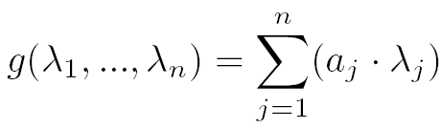
Statistical Pair-based Uncertain Time Series Reduction (SPUR)
Dimensionality reduction
  Function g(.) can be derived from Discrete Fourier Transform (DFT)
a variable

Slide 71
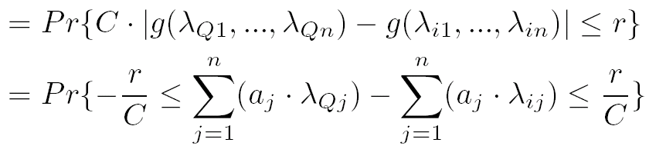
Statistical Pair-based Uncertain Time Series Reduction (cont'd)
Dimensionality reduction
  Pr{LB(Q, T_{i}) ≤ r}
≈
Central Limit Theorem (CLT)
where

Slide 72
Statistical Pair-based Uncertain Time Series Reduction (cont'd)
Dimensionality reduction
  We can choose d different sets of coefficients, a_{j} to obtain d-dimensional reduced data
reduced data: mean and variance of g(.)

Slide 73
Indexing
Pruning over index
  Obtain upper bound probability Pr{LB(Q, T_{i}) ≤ r} for any uncertain time series T_{i} in a node N

Slide 74
Conclusions
Past
  Static time series databases
    Similarity measures
    Dimensionality reduction techniques
    Query processing
Present
  Stream time series
    Similarity search on future stream time series
    Similarity join over multiple stream time series
Future
  Uncertain time series
    Dimensionality reduction on uncertain data
    Indexing and query processing
  Graph stream time series
  Time series in real applications such as sensor networks

Slide 75
Reading Materials

