Slide 1
CS 43105 Data Mining Techniques
Chapter 3 Output: Knowledge
Xiang Lian
Department of Computer Science
Kent State University
Email: xlian@kent.edu
Homepage: http://www.cs.kent.edu/~xlian/
Notes:
References
Ian H. Witten, Eibe Frank, and Mark A. Hall. Data Mining: Practical Machine Learning Tools and Techniques: 3rd Edition. ISBN-13: 9780123748560, Publisher: Elsevier Science, Publication date: 1/20/2011.
https://hanj.cs.illinois.edu/bk3/bk3_slidesindex.htm
http://www.cs.kent.edu/~jin/DM11/DM11.html

Slide 2
Outline
Knowledge Representation
  Tables
  Linear Models
  Trees
  Rules
  Instance-based Representation
  Clusters

Slide 3
Output: Knowledge Representation
Tables
Linear models
Trees
Rules
    Classification rules
    Association rules
    Rules with exceptions
    More expressive rules
Instance-based representation
Clusters

Slide 4
Output: Representing Structural Patterns
Many different ways of representing patterns
  Decision trees, rules, instance-based, …
Also called “knowledge” representation
Representation determines inference method
Understanding the output is the key to understanding the underlying learning methods
Different types of output for different learning problems (e.g. classification, regression, …)

Slide 5
Tables
Simplest way of representing output:
  Use the same format as input!
Decision table for the weather problem:
Main problem: selecting the right attributes
Outlook
Humidity
Play
Sunny
High
No
Sunny
Normal
Yes
Overcast
High
Yes
Overcast
Normal
Yes
Rainy
High
No
Rainy
Normal
No

Slide 6
Linear Models
Another simple representation
Regression model
  Inputs (attribute values) and output are all numeric
Output is the sum of weighted attribute values
  The trick is to find good values for the weights

Slide 7
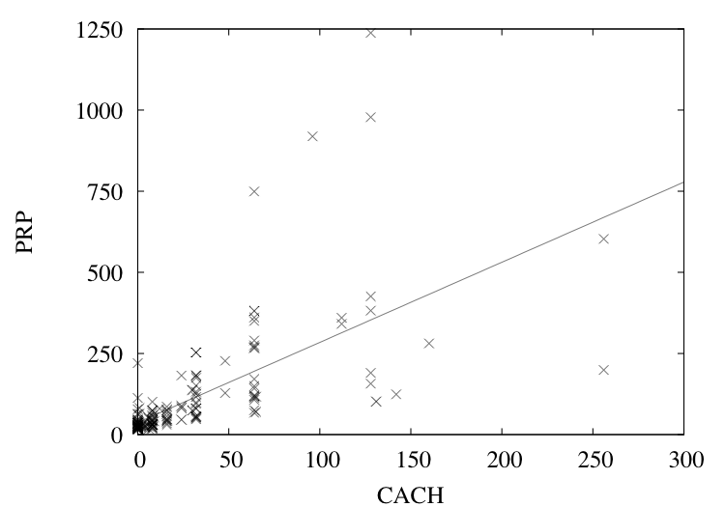
A Linear Regression Function for the CPU Performance Data
PRP = 37.06 + 2.47CACH

Slide 8
Linear Models for Classification
Binary classification
Line separates the two classes
  Decision boundary - defines where the decision changes from one class value to the other
Prediction is made by plugging in observed values of the attributes into the expression
  Predict one class if output ≥ 0, and the other class if output < 0
Boundary becomes a high-dimensional plane (hyperplane) when there are multiple attributes

Slide 9
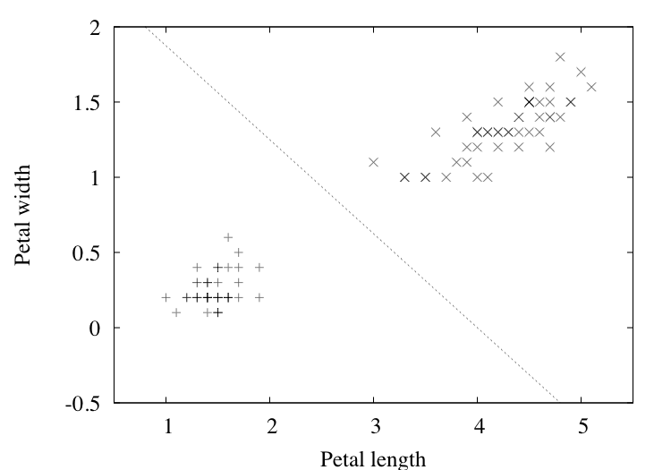
Separating Setosas From Versicolors
2.0 – 0.5PETAL-LENGTH – 0.8PETAL-WIDTH = 0

Slide 10
Trees
“Divide-and-conquer” approach produces tree
Nodes involve testing a particular attribute
Usually, attribute value is compared to constant
Other possibilities:
  Comparing values of two attributes
  Using a function of one or more attributes
Leaves assign classification, set of classifications, or probability distribution to instances
Unknown instance is routed down the tree

Slide 11
Nominal and Numeric Attributes
Nominal:
number of children usually equal to number values
⇒ attribute won’t get tested more than once
  Other possibility: division into two subsets
Numeric:
test whether value is greater or less than constant
⇒ attribute may get tested several times
  Other possibility: three-way split (or multi-way split)
    Integer: less than, equal to, greater than
    Real: below, within, above

Slide 12
Missing Values
Does absence of value have some significance?
  Yes ⇒ “missing” is a separate value
  No ⇒ “missing” must be treated in a special way
  Solution A: assign instance to most popular branch
  Solution B: split instance into pieces
    Pieces receive weight according to fraction of training instances that go down each branch
    Classifications from leave nodes are combined using the weights that have percolated to them

Slide 13
Trees for Numeric Prediction
Regression: the process of computing an expression that predicts a numeric quantity
Regression tree: “decision tree” where each leaf predicts a numeric quantity
  Predicted value is average value of training instances that reach the leaf
Model tree: “regression tree” with linear regression models at the leaf nodes
  Linear patches approximate continuous function

Slide 14
Linear Regression for the CPU Data
PRP =
- 56.1
+ 0.049 MYCT
+ 0.015 MMIN
+ 0.006 MMAX
+ 0.630 CACH
- 0.270 CHMIN
+ 1.46 CHMAX

Slide 15
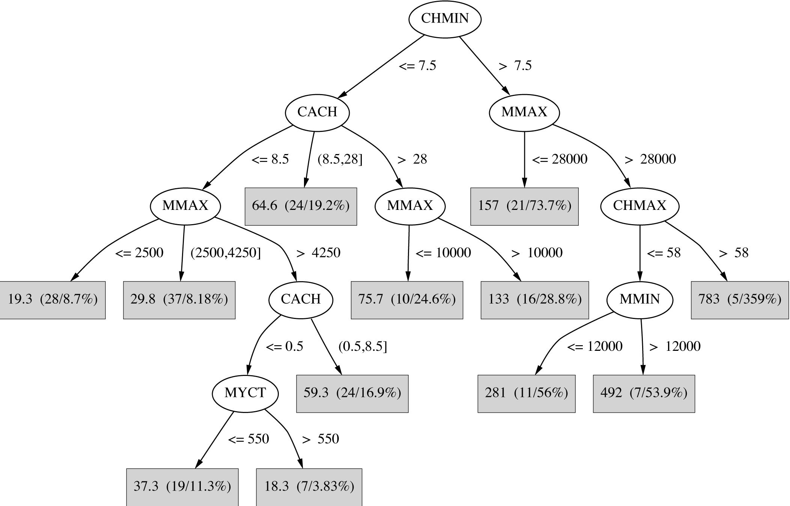
Regression Tree for the CPU Data

Slide 16
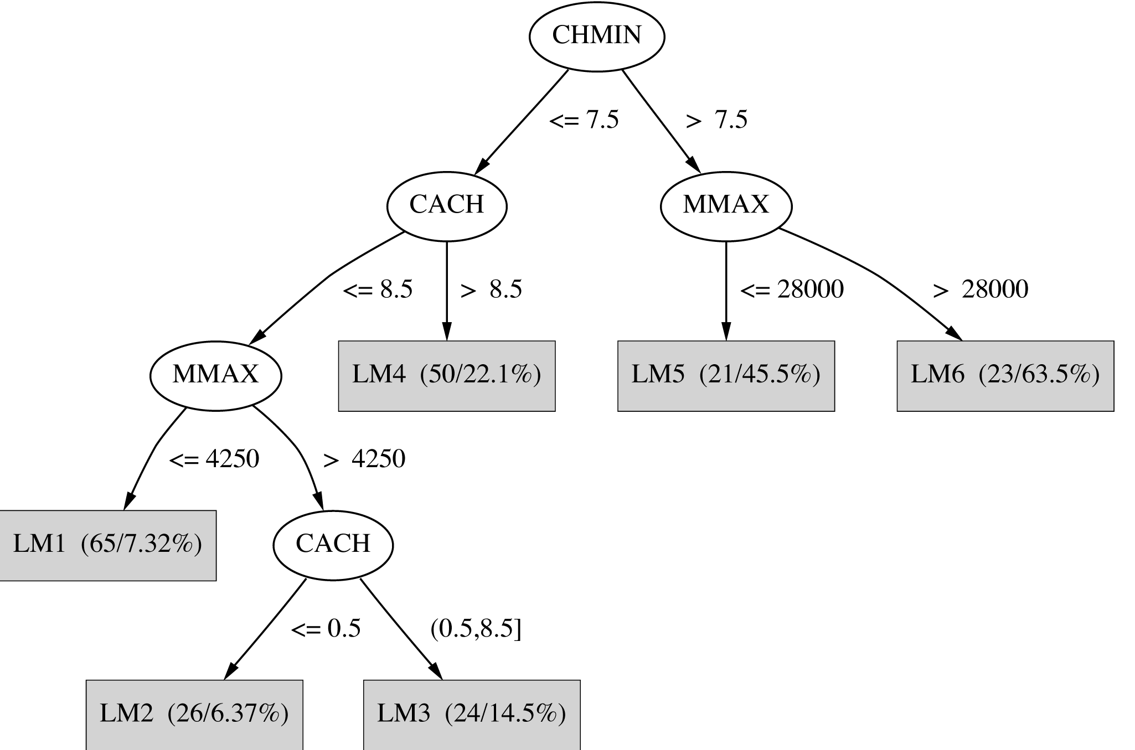
Model Tree for the CPU Data

Slide 17
Classification Rules
Popular alternative to decision trees
Antecedent (pre-condition): a series of tests (just like the tests at the nodes of a decision tree)
Tests are usually logically ANDed together (but may also be general logical expressions)
Consequent (conclusion): classes, set of classes, or probability distribution assigned by rule
Individual rules are often logically ORed together
  Conflicts arise if different conclusions apply

Slide 18
From Trees to Rules
Easy: converting a tree into a set of rules
  One rule for each leaf:
      Antecedent contains a condition for every node on the path from the root to the leaf
      Consequent is class assigned by the leaf
Produces rules that are unambiguous
  Doesn’t matter in which order they are executed
But: resulting rules are unnecessarily complex
  Pruning to remove redundant tests/rules

Slide 19
From Rules to Trees
More difficult: transforming a rule set into a tree
  Tree cannot easily express disjunction between rules
Example: rules which test different attributes
Symmetry needs to be broken
Corresponding tree contains identical subtrees
(⇒ “replicated subtree problem”)
If a and b then x
If c and d then x

Slide 20
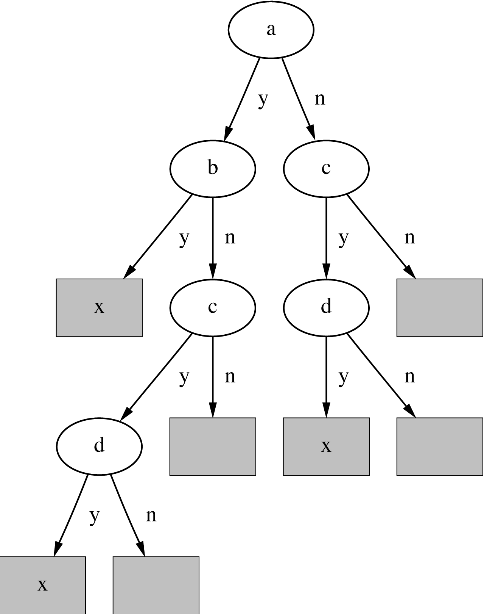
A Tree for a Simple Disjunction

Slide 21
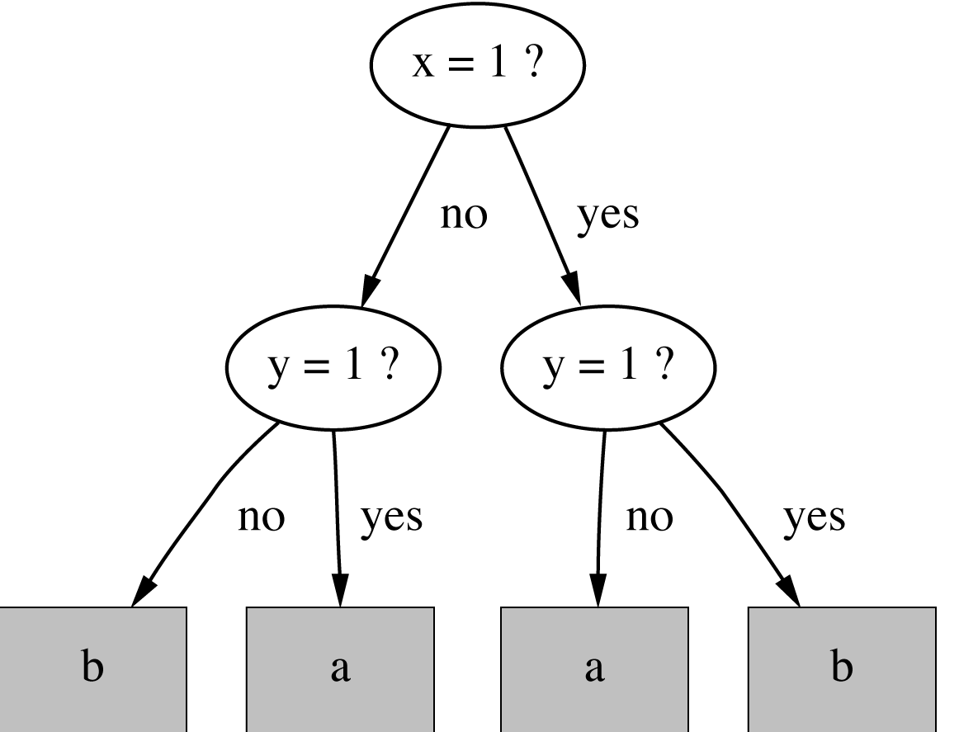
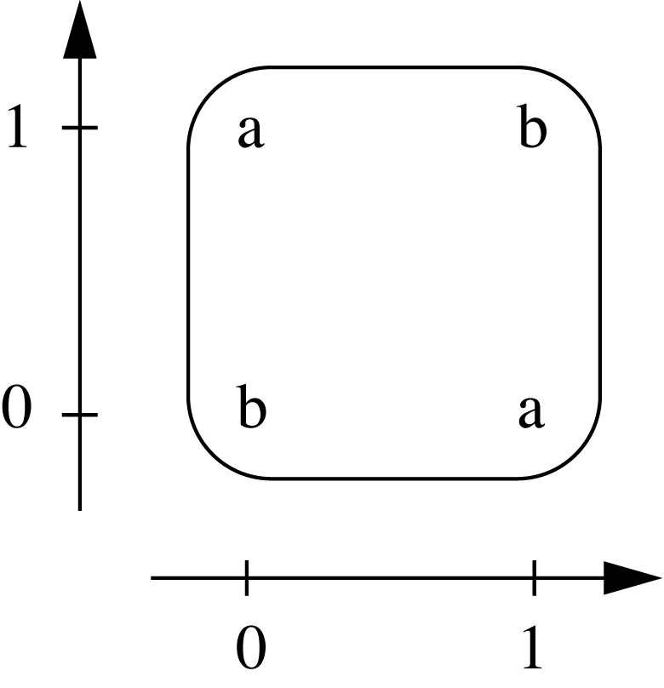
The Exclusive-OR Problem
If x = 1 and y = 0
then class = a
If x = 0 and y = 1
then class = a
If x = 0 and y = 0
then class = b
If x = 1 and y = 1
then class = b

Slide 22
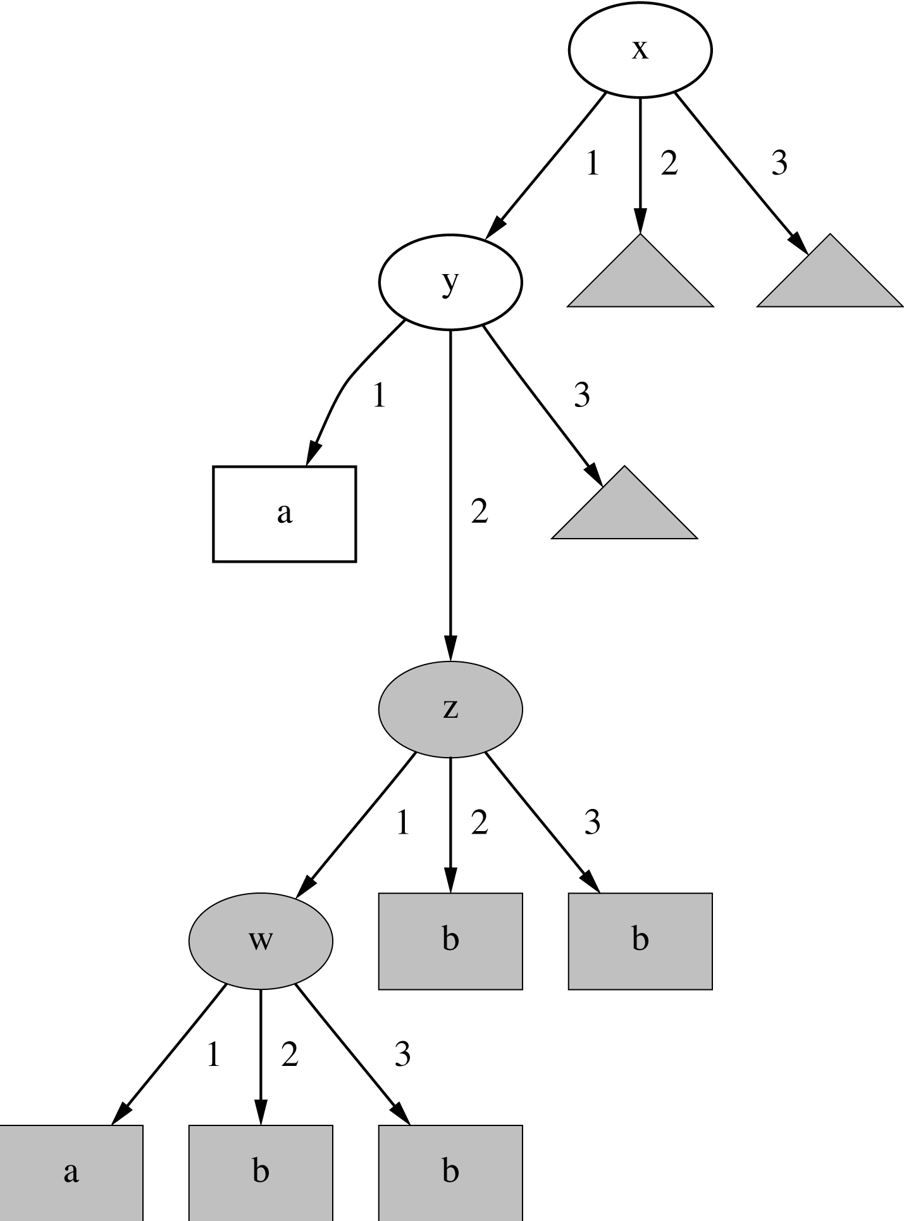
A Tree with a Replicated Subtree
If x = 1 and y = 1
then class = a
If z = 1 and w = 1
then class = a
Otherwise class = b

Slide 23
“Nuggets” of Knowledge
Are rules independent pieces of knowledge? (It seems easy to add a rule to an existing rule base.)
Problem: ignores how rules are executed
Two ways of executing a rule set:
  Ordered set of rules (“decision list”)
        Order is important for interpretation
      Unordered set of rules
        Rules may overlap and lead to different conclusions for the same instance

Slide 24
Interpreting Rules
What if two or more rules conflict?
  Give no conclusion at all?
  Go with rule that is most popular on training data?
  …
What if no rule applies to a test instance?
  Give no conclusion at all?
  Go with class that is most frequent in training data?
  …

Slide 25
Special Case: Boolean Class
Assumption: if instance does not belong to class “yes”, it belongs to class “no”
Trick: only learn rules for class “yes” and use default rule for “no”
Order of rules is not important. No conflicts!
Rule can be written in disjunctive normal form
If x = 1 and y = 1 then class = a
If z = 1 and w = 1 then class = a
Otherwise class = b

Slide 26
Association Rules
Association rules…
  … can predict any attribute and combinations of attributes
  … are not intended to be used together as a set
Problem: immense number of possible associations
  Output needs to be restricted to show only the most predictive associations ⇒ only those with high support and high confidence

Slide 27
Support and Confidence of a Rule
Support: number of instances predicted correctly
Confidence: number of correct predictions, as proportion of all instances that rule applies to
Example: 4 cool days with normal humidity
  Support = 4, confidence = 100%
Normally: minimum support and confidence pre-specified (e.g. 58 rules with support ≥ 2 and confidence ≥ 95% for weather data)
If temperature = cool then humidity = normal

Slide 28
Rules with Exceptions
Idea: allow rules to have exceptions
Example: rule for iris data
New instance:
Modified rule:
If petal-length ≥ 2.45 and petal-length < 4.45 then Iris-versicolor
Sepal
length
Sepal
width
Petal
length
Petal
width
Type
5.1
3.5
2.6
0.2
Iris-setosa
If petal-length ≥ 2.45 and petal-length < 4.45 then Iris-versicolor
EXCEPT if petal-width < 1.0 then Iris-setosa

Slide 29
A More Complex Example
Exceptions to exceptions to exceptions …
default: Iris-setosa
except if petal-length ≥ 2.45 and petal-length < 5.355
and petal-width < 1.75
then Iris-versicolor
except if petal-length ≥ 4.95 and petal-width < 1.55
then Iris-virginica
else if sepal-length < 4.95 and sepal-width ≥ 2.45
then Iris-virginica
else if petal-length ≥ 3.35
then Iris-virginica
except if petal-length < 4.85 and sepal-length < 5.95
then Iris-versicolor

Slide 30
Advantages of Using Exceptions
Rules can be updated incrementally
  Easy to incorporate new data
  Easy to incorporate domain knowledge
People often think in terms of exceptions
Each conclusion can be considered just in the context of rules and exceptions that lead to it
  Locality property is important for understanding large rule sets
  “Normal” rule sets don’t offer this advantage

Slide 31
More on Exceptions
Default...except if...then...
is logically equivalent to
if...then...else
(where the else specifies what the default did)
But: exceptions offer a psychological advantage
  Assumption: defaults and tests early on apply more widely than exceptions further down
  Exceptions reflect special cases

Slide 32
Rules Involving Relations
So far: all rules involved comparing an attribute-value to a constant (e.g. temperature < 45)
These rules are called “propositional” because they have the same expressive power as propositional logic
What if problem involves relationships between examples (e.g. family tree problem from above)?
  Can’t be expressed with propositional rules
  More expressive representation required

Slide 33
Instance-based Representation
Simplest form of learning: rote learning
  Training instances are searched for instance that most closely resembles new instance
  The instances themselves represent the knowledge
  Also called instance-based learning
Similarity function defines what’s “learned”
Instance-based learning is lazy learning
Methods: nearest-neighbor, k-nearest-neighbor, …

Slide 34
The Distance Function
Simplest case: one numeric attribute
  Distance is the difference between the two attribute values involved (or a function thereof)
Several numeric attributes (attributes may be normalized):
  Manhattan Distance (L₁-norm)
  Euclidean distance (L₂-norm)
  L ∞-norm
  …
Nominal attributes: distance is set to 1 if values are different, 0 if they are equal
Are all attributes equally important?
  Weighting the attributes might be necessary

Slide 35
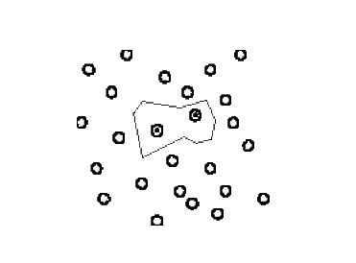
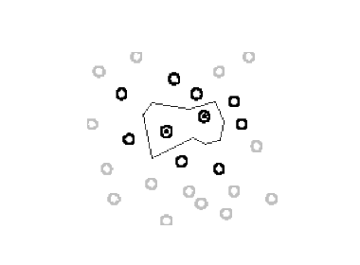
Learning Prototypes
Only those instances involved in a decision need to be considered
Noisy instances should be filtered out
Idea: only use prototypical examples

Slide 36
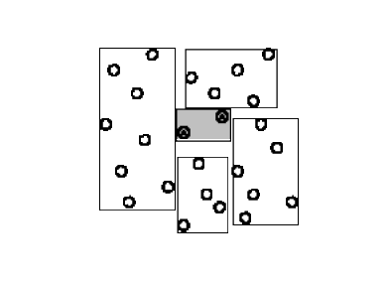
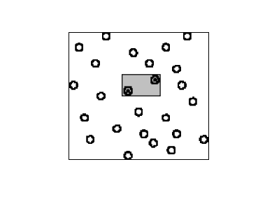
Rectangular Generalizations
Nearest-neighbor rule is used outside rectangles
Rectangles are rules! (But they can be more conservative than “normal” rules.)
Nested rectangles are rules with exceptions

Slide 37
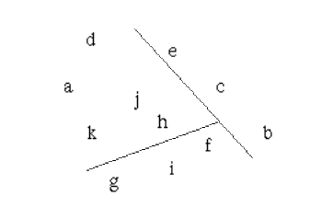
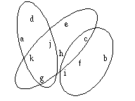
Representing Clusters I
Simple 2-D representation
Venn diagram
Overlapping clusters

Slide 38
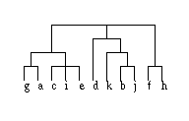
Representing Clusters II
Probabilistic assignment
Dendrogram
1 2 3
a 0.4 0.1 0.5
b 0.1 0.8 0.1
c 0.3 0.3 0.4
d 0.1 0.1 0.8
e 0.4 0.2 0.4
f 0.1 0.4 0.5
g 0.7 0.2 0.1
h 0.5 0.4 0.1
…
NB: dendron is the Greek word for tree

