Slide 1
CS 43105 Data Mining Techniques
Chapter 4 Frequent Itemset Mining
Xiang Lian
Department of Computer Science
Kent State University
Email: xlian@kent.edu
Homepage: http://www.cs.kent.edu/~xlian/
Notes:
References
Ian H. Witten, Eibe Frank, and Mark A. Hall. Data Mining: Practical Machine Learning Tools and Techniques: 3rd Edition. ISBN-13: 9780123748560, Publisher: Elsevier Science, Publication date: 1/20/2011.
https://hanj.cs.illinois.edu/bk3/bk3_slidesindex.htm
http://www.cs.kent.edu/~jin/DM11/DM11.html

Slide 2
Outline
Basic Concepts
Frequent Itemset Mining

Slide 3
What is Data Mining?
=Pattern Mining?
What patterns?
Why are they useful?

Slide 4
What Is Frequent Pattern Analysis?
Frequent pattern: a pattern (a set of items, subsequences, substructures, etc.) that occurs frequently in a data set
First proposed by Agrawal, Imielinski, and Swami [AIS93] in the context of frequent itemsets and association rule mining
Motivation: Finding inherent regularities in data
  What products were often purchased together?— Beer and diapers?!
  What are the subsequent purchases after buying a PC?
  What kinds of DNA are sensitive to this new drug?
  Can we automatically classify Web documents?
Applications
  Basket data analysis, cross-marketing, catalog design, sale campaign analysis, Web log (click stream) analysis, and DNA sequence analysis.

Slide 5
Why Is Frequent Pattern Mining Important?
Frequent pattern: An intrinsic and important property of datasets
Foundation for many essential data mining tasks
  Association, correlation, and causality analysis
  Sequential, structural (e.g., sub-graph) patterns
  Pattern analysis in spatiotemporal, multimedia, time-series, and stream data
  Classification: discriminative, frequent pattern analysis
  Cluster analysis: frequent pattern-based clustering
  Data warehousing: iceberg cube and cube-gradient
  Semantic data compression: fascicles
  Broad applications

Slide 6
Frequent Patterns/Itemsets
itemset: A set of one or more items
  Example: {Milk, Bread, Diaper}
k-itemset X = {x₁, …, x_{k}}
  An itemset that contains k items
Customer
buys both
Customer
buys diaper
Customer
buys beer

Slide 7
Definition: Frequent Itemset
Absolute support or support count (σ)
  Frequency of occurrence of an itemset
  E.g. σ({Milk, Bread,Diaper}) = 2
Relative support or support
  Fraction of transactions that contain an itemset
  E.g. s({Milk, Bread, Diaper}) = 2/5
Frequent itemset
  An itemset whose support is greater than or equal to a minsup threshold

Slide 8
Frequent Itemsets Mining
TID | Transactions
100 | { A, B, E }
200 | { B, D }
300 | { A, B, E }
400 | { A, C }
500 | { B, C }
600 | { A, C }
700 | { A, B }
800 | { A, B, C, E }
900 | { A, B, C }
1000 | { A, C, E }
Minimum support level 50%
  {A}, {B}, {C}, {A,B}, {A,C}

Slide 9
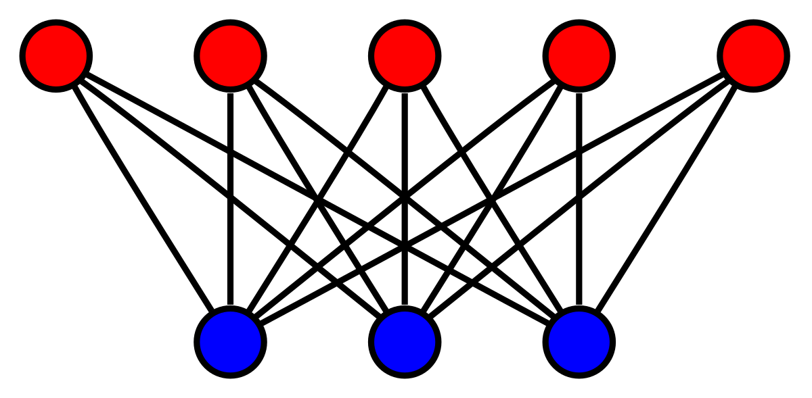
Three Different Views of FIM
Transactional Database
  How we do store a transactional database?
    Horizontal, Vertical, Transaction-Item Pair
Binary Matrix
Bipartite Graph
TIDs
items
9
This Photo by Unknown Author is licensed under CC BY-SA

Slide 10
Representation of Transactional Databases
Horizontal vs. vertical data layout

Slide 11
Representation of Transactional Databases (cont'd)
Binary Matrix Representation

Slide 12
Frequent Itemset Generation
Given d items, there are 2^{d} possible candidate itemsets

Slide 13
Frequent Itemset Generation
Brute-force approach:
  Each itemset in the lattice is a candidate frequent itemset
  Count the support of each candidate by scanning the database
  Match each transaction against every candidate
  Complexity ~ O(NMw) => Expensive since M = 2^{d} !!!

Slide 14
Scalable Frequent Itemset Mining Methods
Scalable mining methods: Three major approaches
  Apriori (Agrawal & Srikant@VLDB’94)
  Vertical data format approach (Charm—Zaki & Hsiao @SDM’02)
  Frequent pattern growth (FPgrowth—Han, Pei & Yin @SIGMOD’00)

Slide 15
Reducing the Number of Candidates
Apriori pruning principle:
  If an itemset is frequent, then all of its subsets must also be frequent
    Reason: every transaction having {beer, diaper, nuts} also contains the subset {beer, diaper}
  If there is any itemset which is infrequent, its superset should not be generated/tested!
Apriori pruning principle holds due to the following property of the support measure:
  Support of an itemset never exceeds the support of its subsets
  This is known as the anti-monotone property of support

Slide 16
Illustrating Apriori Principle
Found to be Infrequent
Pruned supersets

Slide 17
Illustrating Apriori Principle
Items (1-itemsets)
Pairs (2-itemsets)
(No need to generate
candidates involving Coke
or Eggs)
Minimum Support = 3
Triplets (3-itemsets)
If every subset is considered,
⁶C₁ + ⁶C₂ + ⁶C₃ = 41
With support-based pruning,
6 + 6 + 1 = 13

Slide 18
The Apriori Algorithm—Another Example
Sup_{min} = 2
Itemset | sup
{A} | 2
{B} | 3
{C} | 3
{D} | 1
{E} | 3
Database TDB
Itemset | sup
{A} | 2
{B} | 3
{C} | 3
{E} | 3
L₁
Tid | Items
10 | A, C, D
20 | B, C, E
30 | A, B, C, E
40 | B, E
C₁
1st scan
C₂
Itemset | sup
{A, B} | 1
{A, C} | 2
{A, E} | 1
{B, C} | 2
{B, E} | 3
{C, E} | 2
C₂
Itemset
{A, B}
{A, C}
{A, E}
{B, C}
{B, E}
{C, E}
L₂
Itemset | sup
{A, C} | 2
{B, C} | 2
{B, E} | 3
{C, E} | 2
2nd scan
C₃
Itemset
{B, C, E}
3rd scan
L₃
Itemset | sup
{B, C, E} | 2

Slide 19
Apriori: A Candidate Generation & Test Approach
Apriori Method
  Initially, scan DB once to get frequent 1-itemset
  Generate length (k+1) candidate itemsets from length k frequent itemsets
  Test the candidates against DB
  Terminate when no frequent or candidate set can be generated

Slide 20
The Apriori Algorithm (Pseudo-Code)
C_{k}: Candidate itemset of size k
L_{k} : frequent itemset of size k
L₁ = {frequent items};
for (k = 1; L_{k} !=∅; k++) do begin
C_{k+1} = candidates generated from L_{k};
for each transaction t in database do
  increment the count of all candidates in C_{k+1} that are contained in t
L_{k+1} = candidates in C_{k+1} with min_support
end
return ∪_{k} L_{k};

Slide 21
Apriori
R. Agrawal and R. Srikant. Fast algorithms for mining association rules. VLDB, 487-499, 1994

Slide 22
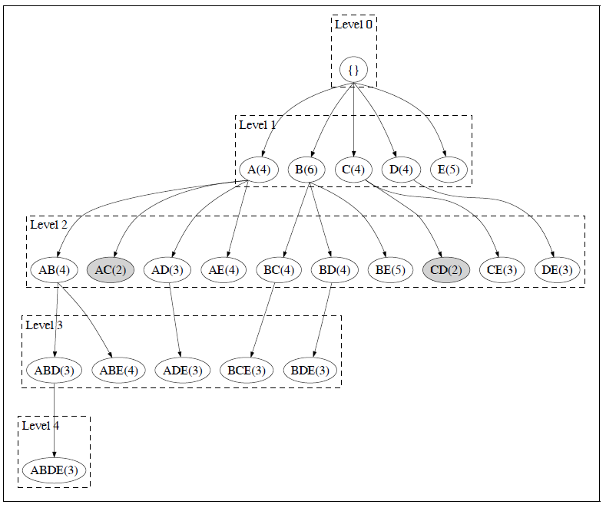

Slide 23
Implementation of Apriori
How to generate candidates?
  Step 1: self-joining L_{k}
  Step 2: pruning
Example of Candidate-generation
  L₃={abc, abd, acd, ace, bcd}
  Self-joining: L₃*L₃
    abcd from abc and abd
    acde from acd and ace
  Pruning:
    acde is removed because ade is not in L₃
  C₄ = {abcd}

Slide 24
How to Generate Candidates?
Suppose the items in L_{k-1} are listed in an order
Step 1: self-joining L_{k-1} (SQL Implementation)
  insert into C_{k}
  select p.item₁, p.item₂, …, p.item_{k-1}, q.item_{k-1}
  from L_{k-1} p, L_{k-1} q
  where p.item₁=q.item₁, …, p.item_{k-2}=q.item_{k-2}, p.item_{k-1} < q.item_{k-1}
Step 2: pruning
  forall itemsets c in C_{k} do
    forall (k-1)-subsets s of c do
      if (s is not in L_{k-1}) then delete c from C_{k}

Slide 25
Challenges of Frequent Itemset Mining
Challenges
  Multiple scans of transaction database
  Huge number of candidates
  Tedious workload of support counting for candidates
Improving Apriori: general ideas
  Reduce passes of transaction database scans
  Shrink number of candidates
  Facilitate support counting of candidates

Slide 26
Alternative Methods for Frequent Itemset Generation
Representation of Transactional Database
  horizontal vs. vertical data layout

Slide 27
ECLAT: Mining by Exploring Vertical Data Format
For each item, store a list of transaction ids (tids)
TID-list

Slide 28
ECLAT
Determine support of any k-itemset by intersecting tid-lists of two of its (k-1) subsets.
3 traversal approaches:
  top-down, bottom-up and hybrid
Advantage: very fast support counting
Disadvantage: intermediate tid-lists may become too large for memory
∧
→

Slide 30
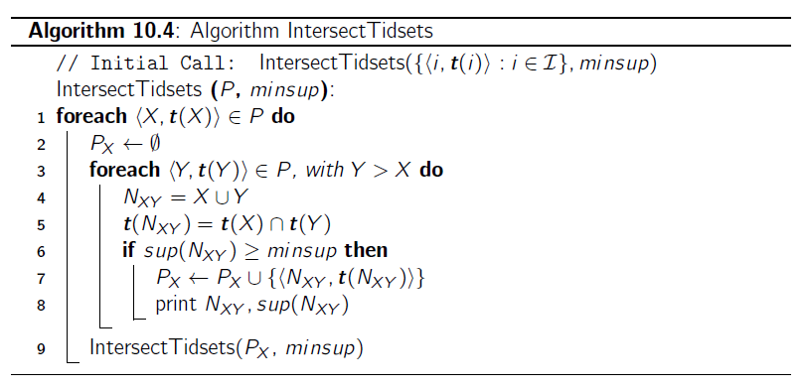

Slide 31
FP-Growth Algorithm
Use a compressed representation of the database using an FP-tree
Once an FP-tree has been constructed, it uses a recursive divide-and-conquer approach to mine the frequent itemsets

Slide 32
Construct FP-tree from a Transaction Database
TID Items bought (ordered) frequent items
100 {f, a, c, d, g, i, m, p} {f, c, a, m, p}
200 {a, b, c, f, l, m, o} {f, c, a, b, m}
300 {b, f, h, j, o, w} {f, b}
400 {b, c, k, s, p} {c, b, p}
500 {a, f, c, e, l, p, m, n} {f, c, a, m, p}
min_support = 3
{}
Header Table
Item frequency head
f 4
c 4
a 3
b 3
m 3
p 3
Scan DB once, find frequent 1-itemset (single item pattern)
Sort frequent items in frequency descending order, f-list
Scan DB again, construct FP-tree
f:4
c:1
c:3
b:1
b:1
a:3
p:1
m:2
b:1
F-list = f-c-a-b-m-p
p:2
m:1

Slide 33
Partition Patterns and Databases
Frequent patterns can be partitioned into subsets according to f-list
  F-list = f-c-a-b-m-p
  Patterns containing p
  Patterns having m but no p
  …
  Patterns having c but no a nor b, m, p
  Pattern f
Completeness and non-redundency

Slide 34
Find Patterns Having P From P-conditional Database
Starting at the frequent item header table in the FP-tree
Traverse the FP-tree by following the link of each frequent item p
Accumulate all of transformed prefix paths of item p to form p’s conditional pattern base
{}
Header Table
Item frequency head
f 4
c 4
a 3
b 3
m 3
p 3
f:4
c:1
Conditional pattern bases
item cond. pattern base
c f:3
a fc:3
b fca:1, f:1, c:1
m fca:2, fcab:1
p fcam:2, cb:1
c:3
b:1
b:1
a:3
p:1
m:2
b:1
p:2
m:1

Slide 35
From Conditional Pattern-bases to Conditional FP-trees
For each pattern-base
  Accumulate the count for each item in the base
  Construct the FP-tree for the frequent items of the pattern base
m-conditional pattern base:
  fca:2, fcab:1
{}
Header Table
Item frequency head
f 4
c 4
a 3
b 3
m 3
p 3
f:4
c:1
All frequent patterns relate to m
m,
fm, cm, am,
fcm, fam, cam,
fcam
{}
c:3
b:1
b:1

f:3

a:3
p:1
m:2
b:1
c:3
p:2
m:1
a:3
m-conditional FP-tree

Slide 36
Recursion: Mining Each Conditional FP-tree
{}
{}
Cond. pattern base of “am”: (fc:3)
f:3
c:3
f:3
am-conditional FP-tree
c:3
{}
Cond. pattern base of “cm”: (f:3)
a:3
f:3
m-conditional FP-tree
cm-conditional FP-tree
{}
Cond. pattern base of “cam”: (f:3)
f:3
cam-conditional FP-tree

Slide 37
Another Example -- FP-Tree Construction
null
After reading TID=1:
A:1
B:1
After reading TID=2:
null
A:1
B:1
B:1
C:1
D:1

Slide 38
Another Example -- FP-Tree Construction
Transaction Database
null
A:7
B:3
B:5
C:3
C:1
D:1
Header table
D:1
C:3
E:1
D:1
E:1
D:1
E:1
D:1
Pointers are used to assist frequent itemset generation

Slide 39
FP-Growth
null
Conditional Pattern base for D:
P = {(A:1,B:1,C:1),
(A:1,B:1),
(A:1,C:1),
(A:1),
(B:1,C:1)}
Recursively apply FP-growth on P
Frequent Itemsets found (with sup > 1):
AD, BD, CD, ACD, BCD
A:7
B:1
B:5
C:1
C:1
D:1
C:3
D:1
D:1
D:1
D:1

Slide 40
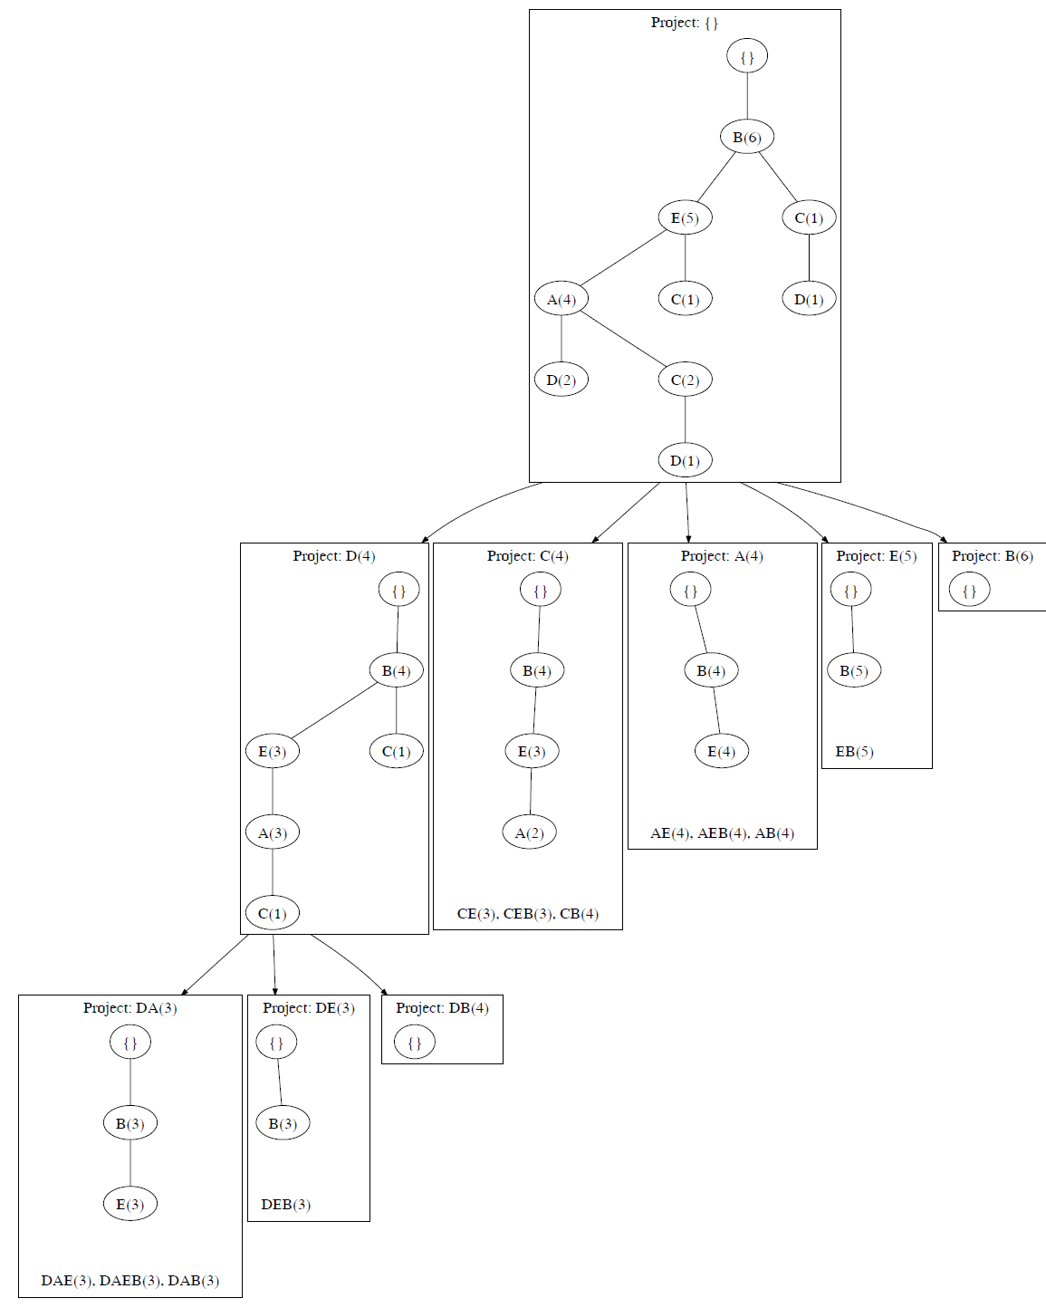

Slide 41
Compact Representation of Frequent Itemsets
Some itemsets are redundant because they have identical support as their supersets
Number of frequent itemsets
Need a compact representation

Slide 42
Maximal Frequent Itemset
An itemset is maximal frequent if none of its immediate supersets is frequent
Maximal Itemsets
Infrequent Itemsets
Border

Slide 43
Closed Itemset
An itemset is closed if none of its immediate supersets has the same support as the itemset

Slide 44
Maximal vs. Closed Itemsets
Transaction Ids
Not supported by any transactions

Slide 45
Maximal vs. Closed Frequent Itemsets
Minimum support = 2
Closed but not maximal
Closed and maximal
# Closed = 9
# Maximal = 4

Slide 46
Maximal vs. Closed Itemsets

Slide 47
Ref: Basic Concepts of Frequent Pattern Mining
(Association Rules) R. Agrawal, T. Imielinski, and A. Swami. Mining association rules between sets of items in large databases. SIGMOD'93
(Max-pattern) R. J. Bayardo. Efficiently mining long patterns from databases. SIGMOD'98
(Closed-pattern) N. Pasquier, Y. Bastide, R. Taouil, and L. Lakhal. Discovering frequent closed itemsets for association rules. ICDT'99
(Sequential pattern) R. Agrawal and R. Srikant. Mining sequential patterns. ICDE'95

Slide 48
Ref: Apriori and Its Improvements
R. Agrawal and R. Srikant. Fast algorithms for mining association rules. VLDB'94
H. Mannila, H. Toivonen, and A. I. Verkamo. Efficient algorithms for discovering association rules. KDD'94
A. Savasere, E. Omiecinski, and S. Navathe. An efficient algorithm for mining association rules in large databases. VLDB'95
J. S. Park, M. S. Chen, and P. S. Yu. An effective hash-based algorithm for mining association rules. SIGMOD'95
H. Toivonen. Sampling large databases for association rules. VLDB'96
S. Brin, R. Motwani, J. D. Ullman, and S. Tsur. Dynamic itemset counting and implication rules for market basket analysis. SIGMOD'97
S. Sarawagi, S. Thomas, and R. Agrawal. Integrating association rule mining with relational database systems: Alternatives and implications. SIGMOD'98

Slide 49
Ref: Depth-First, Projection-Based FP Mining
R. Agarwal, C. Aggarwal, and V. V. V. Prasad. A tree projection algorithm for generation of frequent itemsets. J. Parallel and Distributed Computing, 2002.
G. Grahne and J. Zhu, Efficiently Using Prefix-Trees in Mining Frequent Itemsets, Proc. FIMI'03
B. Goethals and M. Zaki. An introduction to workshop on frequent itemset mining implementations. Proc. ICDM’03 Int. Workshop on Frequent Itemset Mining Implementations (FIMI’03), Melbourne, FL, Nov. 2003
J. Han, J. Pei, and Y. Yin. Mining frequent patterns without candidate generation. SIGMOD’ 00
J. Liu, Y. Pan, K. Wang, and J. Han. Mining Frequent Item Sets by Opportunistic Projection. KDD'02
J. Han, J. Wang, Y. Lu, and P. Tzvetkov. Mining Top-K Frequent Closed Patterns without Minimum Support. ICDM'02
J. Wang, J. Han, and J. Pei. CLOSET+: Searching for the Best Strategies for Mining Frequent Closed Itemsets. KDD'03

Slide 50
Ref: Vertical Format and Row Enumeration Methods
M. J. Zaki, S. Parthasarathy, M. Ogihara, and W. Li. Parallel algorithm for discovery of association rules. DAMI:97.
M. J. Zaki and C. J. Hsiao. CHARM: An Efficient Algorithm for Closed Itemset Mining, SDM'02.
C. Bucila, J. Gehrke, D. Kifer, and W. White. DualMiner: A Dual-Pruning Algorithm for Itemsets with Constraints. KDD’02.
F. Pan, G. Cong, A. K. H. Tung, J. Yang, and M. Zaki , CARPENTER: Finding Closed Patterns in Long Biological Datasets. KDD'03.
H. Liu, J. Han, D. Xin, and Z. Shao, Mining Interesting Patterns from Very High Dimensional Data: A Top-Down Row Enumeration Approach, SDM'06.

Slide 51
Ref: Mining Correlations and Interesting Rules
S. Brin, R. Motwani, and C. Silverstein. Beyond market basket: Generalizing association rules to correlations. SIGMOD'97.
M. Klemettinen, H. Mannila, P. Ronkainen, H. Toivonen, and A. I. Verkamo. Finding interesting rules from large sets of discovered association rules. CIKM'94.
R. J. Hilderman and H. J. Hamilton. Knowledge Discovery and Measures of Interest. Kluwer Academic, 2001.
C. Silverstein, S. Brin, R. Motwani, and J. Ullman. Scalable techniques for mining causal structures. VLDB'98.
P.-N. Tan, V. Kumar, and J. Srivastava. Selecting the Right Interestingness Measure for Association Patterns. KDD'02.
E. Omiecinski. Alternative Interest Measures for Mining Associations. TKDE’03.
T. Wu, Y. Chen, and J. Han, “Re-Examination of Interestingness Measures in Pattern Mining: A Unified Framework", Data Mining and Knowledge Discovery, 21(3):371-397, 2010

