Slide 1
Probabilistic Data Management
Chapter 9: Probabilistic Query Answering (7)

Slide 2
Objectives
In this chapter, you will:
  Explore the definitions of more probabilistic query types
    PNN on locally correlated data

Slide 3
Introduction
In real-world applications, data are often uncertain and imprecise
Correlations are often contained in these data
  Sensor networks
    Spatially close sensors often report correlated data within the same period of time
  Relational/probabilistic databases
    Functional dependencies, A→B
  Data integration
    Intermediate join results: (R JOIN_{p1} S) JOIN_{p2} (R JOIN_{p3} T)

Slide 4
Representing and Querying Correlated Tuples in Probabilistic Databases
P. Sen and A. Deshpande, International Conference on Data Engineering (ICDE), 2007

Slide 5
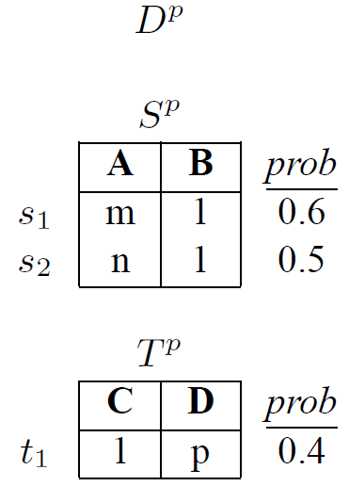
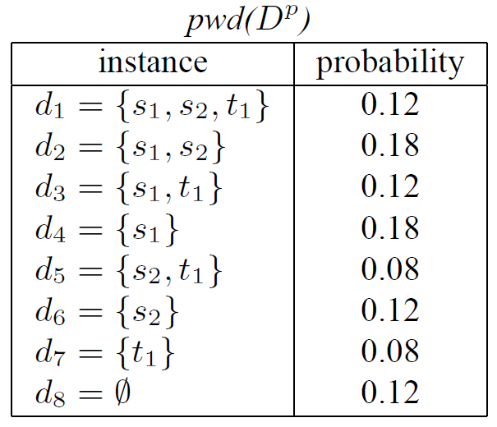

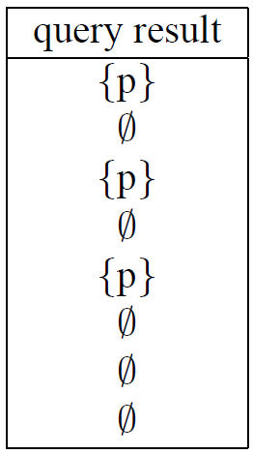
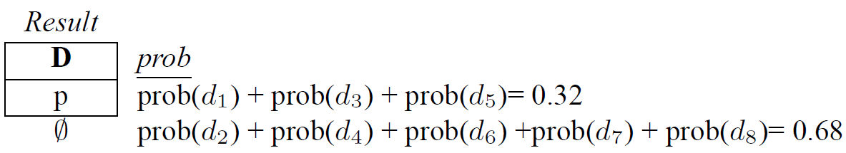
Example of Tuple Correlation
probabilistic database
possible worlds
query evaluation
(tuple independence)
P. Sen and A. Deshpande. Representing and Querying Correlated Tuples in Probabilistic Databases. In ICDE, 2007

Slide 6
Example of Tuple Correlation (cont'd)
Tuple Correlations
  Independent
    s₁, s₂, t₁ are independent of each other
  Implies
    Presence of t₁ implies absence of s₁ and s₂
  Mutually exclusive
    Presence of t₁ implies absence of s₁
    Presence of s₁ implies absence of t₁
  nxor
    Presence (absence) of t₁ almost certainly implies presence (absence) of s₁
probabilistic database
(tuple correlations)
P. Sen and A. Deshpande. Representing and Querying Correlated Tuples in Probabilistic Databases. In ICDE, 2007

Slide 7
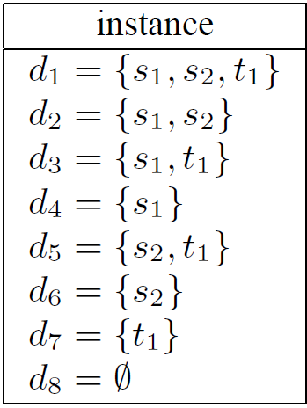
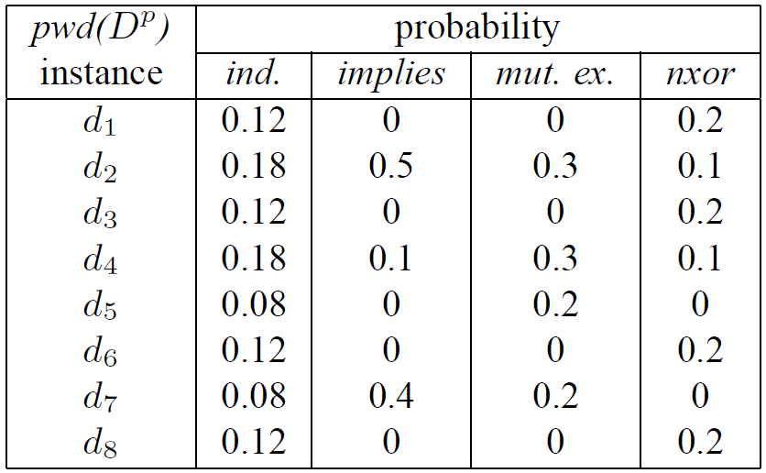
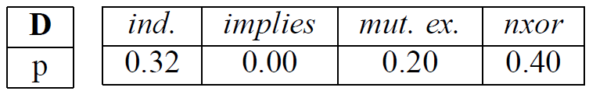
Example of Tuple Correlation (cont'd)
probabilistic database
(tuple correlations)
P. Sen and A. Deshpande. Representing and Querying Correlated Tuples in Probabilistic Databases. In ICDE, 2007

Slide 8

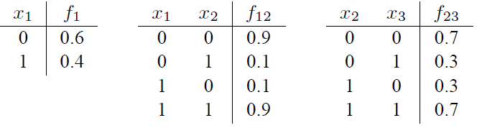

Probabilistic Graphical Model
Factored representation
P. Sen and A. Deshpande. Representing and Querying Correlated Tuples in Probabilistic Databases. In ICDE, 2007

Slide 9
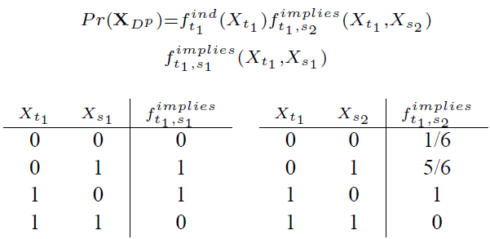
Probabilistic Graphical Model (cont'd)
probabilistic database
Implies: Presence of t₁ implies absence of s₁ and s₂
P. Sen and A. Deshpande. Representing and Querying Correlated Tuples in Probabilistic Databases. In ICDE, 2007

Slide 10
Indexing Correlated Probabilistic Databases
B. Kanagal and A. Deshpande, International Conference on Management of data (SIGMOD), 2009

Slide 11
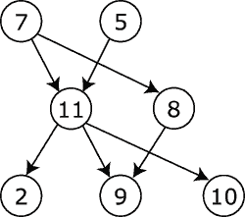
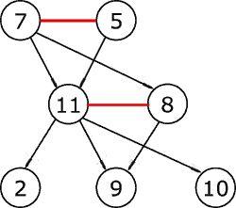
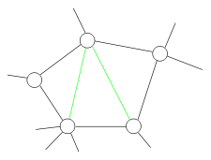
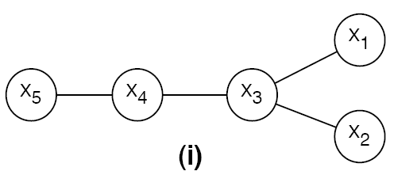
Junction Tree Algorithm (Hugin Algorithm)
For probabilistic graphical model
  If the graph is a directed acyclic graph, then moralize it by connecting nodes that have a common child, and then making all edges in the graph undirected
  Triangulate the graph to make it chordal
  Construct a junction tree from the
  triangulated graph
  Message passing
Steiner tree
Notes:
http://www.cs.bgu.ac.il/~pdm072/BN-VariableElim.ppt

Slide 12
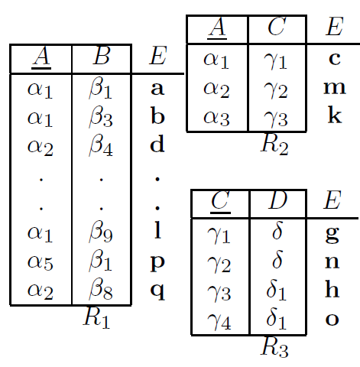
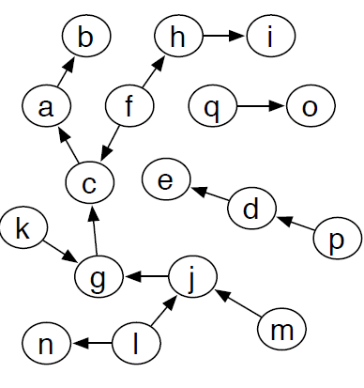
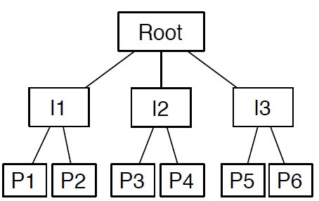
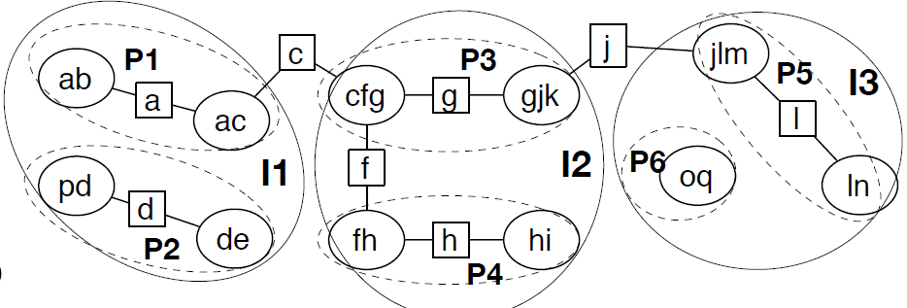
Indexing Correlated Uncertain Data
probabilistic graphical model
probabilistic database
junction tree
INDSEP index
B. Kanagal and A. Deshpande. Indexing Correlated Probabilistic Databases. In SIGMOD, 2009.

Slide 13
Indexing Correlated Uncertain Data (cont'd)
Partition the junction tree into groups
  Each group corresponds to one leaf node
  Pre-compute joint probabilities within nodes, and shortcut potentials among nodes
  Recursively group tree nodes, and build a tree structure
B. Kanagal and A. Deshpande. Indexing Correlated Probabilistic Databases. In SIGMOD, 2009.

Slide 14
Efficient Query Evaluation over Temporally Correlated Probabilistic Streams
B. Kanagal and A. Deshpande, International Conference on Data Engineering (ICDE), 2009

Slide 15
Temporally Correlated Probabilistic Data
Probabilistic data in a streaming fashion have many real applications
  Sensor network
  RFID
Probabilistic data streams often exhibit temporal correlations
B. Kanagal and A. Deshpande. Efficient Query Evaluation over Temporally Correlated Probabilistic Streams. In ICDE, 2009.

Slide 16
Markovian Stream Model
A Markovian Stream
  Data at each timestamp correspond to a random variable
  Data at two consecutive timestamps are correlated
  Data that are not at two consecutive timestamps are conditionally independent
  No deletion
p(X₁), marginal distribution
p(X₃ | X₂), conditional probability table
…
a markovian stream
B. Kanagal and A. Deshpande. Efficient Query Evaluation over Temporally Correlated Probabilistic Streams. In ICDE, 2009.

Slide 17
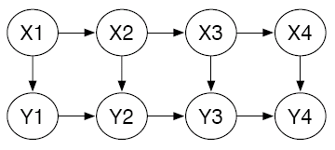
Markovian Stream Model (cont'd)
Two Markovian Streams
stream 1
…
stream 2
…
B. Kanagal and A. Deshpande. Efficient Query Evaluation over Temporally Correlated Probabilistic Streams. In ICDE, 2009.

Slide 18
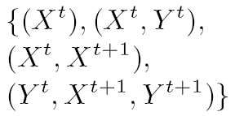
Markov Sequences
Schema graph
  Graphical representation of the two step joint distribution that repeats continuously
Clique list
  The set of direct dependencies present between successive sets of random variables
…
…
schema graph
clique list

Slide 19
A Generic Framework for Handling Uncertain Data with Local Correlations
Very Large Data Bases (VLDB), 2011

Slide 20
Motivation Example
Sensory data: <temperature, light>
Forest monitoring application
forest
Notes:
Let me first give a motivation example.
In the application of forest monitoring, we deploy some sensors to the outdoor environment of the forest, and collect data such as temperature and light through this sensor network. Each sensor may report a sample at a timestamp.

Slide 21
Motivation Example (cont'd)
Samples s_{i} collected from sensor node n_{i}
Notes:
As an example, one possible combination of reported samples from different sensors is shown in the figure. The data are in a 2-dimensional <temperature, light> space. Each point, for example, s1 is a sample collected for sensor n1.

Slide 22
Motivation Example (cont'd)
Sensory data are uncertain and imprecise
uncertainty regions
Notes:
In practice, however, data reported from each data can be imprecise and uncertain, for reasons such as environmental factors, packet losses, or low battery power.
Thus, in the literature, we can model such uncertain sensory data from each sensor by an uncertain object, which is represented by an uncertainty region. Within the uncertainty region, samples are located following arbitrary probabilistic distribution.

Slide 23
Motivation Example (cont'd)
3 monitoring areas
forest
Notes:
While some existing works in the literature of uncertain/probabilistic databases assume the independence among different uncertain objects, this may not hold for some applications.
For example, in the previous example, we sensors are deployed in 3 monitoring areas.

Slide 24
Motivation Example (cont'd)
3 monitoring areas
forest
sensors far away
spatially close sensors
Notes:
Within each monitoring area, sensors are close to each other, for example n4 and n5. In contrast, sensors from different monitoring areas are far awary from each other.

Slide 25
Locally Correlated Sensory Data
Area 2
Efficient Query Answering on Locally Correlated Uncertain Data
Area 1
Area 3
Notes:
Therefore, we can see that sensory data collected from spatially close sensors are locally correlated with each other within each monitoring areas, whereas independent of other sensory data from sensors far away.
Thus, we can naturally model such sensory data by locally correlated uncertain objects. Our problem is to efficiently answer queries over such uncertain data with local correlations.

Slide 26
Nearest Neighbor Queries on Locally Correlated Uncertain Data
Notes:
In particular, our work considers one common query, nearest neighbor query (LC-PNN), which retrieves uncertain objects that are nearest neighbor of a given query point q, over locally correlated uncertain data.

Slide 27
Outline
Introduction
Model for Locally Correlated Uncertain Data
Problem Definition
Query Answering on Uncertain Data With Local Correlations
Experimental Evaluation
Conclusions
Notes:
Here is the outline of the presentation.

Slide 28
Introduction
Uncertain data are pervasive in real applications
  Sensor networks
  RFID networks
  Location-based services
  Data integration
While existing works often assume the independence among uncertain objects,
  Uncertain objects exhibit correlations
local correlations!
Notes:
Data uncertainties are ubiquitous in real applications such as
Sensor networks
RFID networks
Location-based services
Data integration
Previous works either consider independent uncertain objects or consider uncertain data with global correlations. In contrast, in our work, we identify the property of local correlations in uncertain data naturally inferred from real applications such as sensor network monitoring

Slide 29
Data Model for Local Correlations
Data Model
  Each uncertain object contains several locally correlated partitions (LCPs)
    Uncertain objects within each LCP are correlated with each other
    Uncertain objects from distinct LCPs are independent of each other
Notes:
Here is our uncertainty model for locally correlated data.
We assume that uncertain object contains several locally correlated partitions (LCPs). Within each partition, uncertain objects are correlated with each other, and uncertain objects from distinct partitions are independent with each other.

Slide 30
Data Model for Local Correlations (cont'd)
Bayesian network
  Each vertex corresponds to a random variable
  Each vertex is associated with a conditional probability table (CPT)
Notes:
Within each LCP, we model the correlation among uncertain objects by a graphical model, Bayesian network.
In the network, each vertex represents a random variable, indicating the uncertain sensory data from an object in our example. Edges show the dependence relationships among uncertain objects. Each vertex is also associated with a conditional probability table to model the prior/conditional probabilities of object value assignments.

Slide 31
Data Model for Local Correlations (cont'd)
The joint probability of variables
  Join tuples in CPTs and multiply conditional probabilities
  Variable elimination
Notes:
Here is an example of CPT. In order to obtain the joint probability of random variables, we need to join these CPTs and evaluate the probabilities, which is costly especially when the graph is large.

Slide 32
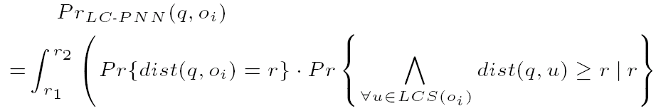
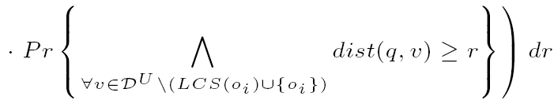

Definition of LC-PNN Query
Probabilistic Nearest Neighbor Query on Uncertain and Locally Correlated Data, LC-PNN
Notes:
Here is the problem definition:
Given an uncertain database D^{U} with locally correlated uncertain objects,
a query object q, and
a probabilistic threshold a,
The LC-PNN query retrieves uncertain objects o_{i} ∈ D^{U} that are nearest neighbors of query object q with LC-PNN probabilities not smaller than α
The LC-PNN probability is given by this formula. The first term is the probability that dist(q, o_i) = r, the second term is related to those locally correlated uncertain objects u within the same LCP as o_i, and the last term is related to those objects in LCPs other than LCP of o_i. We require this probability greater than threshold alpha to guarantee the query confidence

Slide 33
Challenges & Solutions
Challenges
  Straightforward method of linear scan is costly
  Computation cost of integration is expensive
  Dealing with data correlations
Filtering Methods
  Index pruning
  Candidate filtering with pre-computations
Notes:
The straightforward method to answer LC-PNN is the linear scan method, which sequentially scan the database to compute the LC-PNN probability for each candidate. This incurs quadratic time complexity w.r.t. database size, and the computation of integration in the previous formula is costly. Furthermore, we also have to compute local correlations in the graph, and it is not efficient.
Therefore, we propose two methods to reduce the search space:
Index pruning
Candidate filtering with pre-computations

Slide 34
Index Pruning
Basic idea
  Let best_so_far be the smallest maximum distance from query point q to any uncertain objects seen so far
  Then, any objects/nodes e having mindist(q, e) > best_so_far can be safely pruned
best_so_far
Notes:
The first method is the index pruning. The idea is to find a parameter best_so_far, which is the smallest maximum distance from query point q to any uncertain objects that we have seen so far.
Then, we can obtain a circle centered at q and with radius best_so_far. Any object outside this circle (e.g.o_3) can be safely pruned.

Slide 35
Candidate Filtering with Pre-Computations
Basic idea
  Obtain an upper bound, UB_Pr_{LC-PNN}(q, o_{i}), of the LC-PNN probability
  Object o_{i} can be safely pruned, if UB_Pr_{LC-PNN}(q, o_{i}) < α
How to obtain the probability upper bound?
Derived from formula of the LC-PNN probability upper bound via pivots!
Notes:
Our basic idea of the second Candidate Filtering method is to obtain an upper bound of the LC-PNN probability by pre-computations. Then, an object can be safely pruned, if its upper bound is < α
Νοω τηε προβλεμ ισ ηοω το οβταιν συχη αν υππερ βουνδ. Ωε δεριϖε τηισ υππερ βουνδ φρομ πιϖοτσ

Slide 36

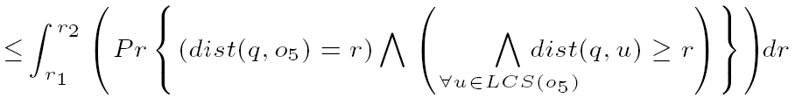

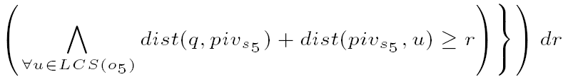
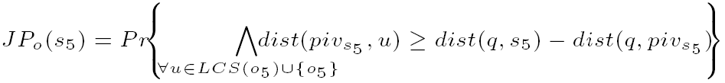
Derivation of Probability Upper Bound
pivot piv_{s5}
λ
Notes:
Starting from the formula of LC-PNN probability, we first relax the probability by ignoring those objects in LCPs other than that containing o_5.
Then, we further relax this probability by introducing a pivot piv_s5. By rewriting this upper bound, we can obtain the formula of joint probability JP_0. The RHS of the inequality can be obtained, once we know the query point q. Thus, our basic idea is to pre-compute the joint probability by pre-selecting some values lambda on the RHS.

Slide 37
Candidate Positions of Pivots
sample s₅
pivot piv_{s5}
Notes:
We select possible positions of pivots as follows. We first uniformly divide the data space into cells (squares) of length delta. Then candidate pivots are centers of cells.
Candidate pivots divide the cell into 4 quadrants. If sample there is a sample s_5 in the northeast quadrant, then we will use the pivot sw in southwest quadrant. This is because, in the formula, joint probability JP_o can achieve smaller (tighter) upper bound when using pivot sw.

Slide 38
Selection of Pivot Positions
We provide a cost model to formalize the filtering and refinement costs, and obtain a good value of parameter δ to achieve low query cost
Notes:
We give a cost model to formalize the filtering and refinement costs, and obtain a good value of parameter δελτα to achieve small query cost

Slide 39
LC-PNN Query Procedure
Index uncertain objects containing LCPs in an R-tree based index
For an LC-PNN query
  When traversing the index, apply index pruning method and candidate filtering to remove false alarms
Refine candidates and return true query answers
Notes:
We answer LC-PNN queries as follows:
We organize locally correlated uncertain data by constructing an R-tree index over LCPs of uncertain objects
For each LC-PNN query,
We apply index pruning method and candidate filtering to remove false alarms, during the index traversal
Finally, we refine the remaining candidates and return actual query answers

Slide 40
Experimental Evaluation
Data Sets
  Real data: California road network
  Synthetic data: lUeU, lUeG, lSeU, and lSeG
    Generate center locations of LCPs with Uniform or Skew distribution
    Produce extent lengths of LCPs with Uniform or Gaussian distribution
    Within LCPs, randomly generate locally correlated uncertain objects with Bayesian networks
Competitor
  Basic method [Cheng et al., SIGMOD 2003]
    Assuming uncertain objects are independent
Measures
  Wall clock time
  Speed-up ratio
Notes:
We tested our approach on real/synthetic data.
Real data are MBRs of spatial data in California road network
Synthetic data:
Generate center locations of LCPs with Uniform or Skew distribution
Produce extent lengths of LCPs with Uniform or Gaussian distribution
For different distribution combinations, we obtain 4 types of data sets
Competitor
We compare our approach with Basic method which assumes independent uncertain objects. We compare our approach with the one using filtering steps.
Measures
Wall clock time
Speed-up ratio compared with Basic method

Slide 41
LC-PNN Performance vs. α
Extent length of LCP = [1, 3], data size N = 150K, average No. of uncertain objects in an LCP = 5
Notes:
We test the performance of our approach for different probabilistic threshold alpha from 0.1 to 0.9. The results show that wall clock time is low and the speed-up ratio is by one order of magnitude compared with the basic method.

Slide 42
Summary
We proposed the problem of queries over locally correlated uncertain data, in particular, the LC-PNN query, which is important in real applications
We designed the index pruning method, and based on a proposed cost model, we presented the candidate filtering method via offline pre-computations w.r.t. pivots
We provided efficient query processing techniques to answer LC-PNN queries on locally correlated uncertain data
We conducted extensive experiments to verify the LC-PNN query efficiency
Notes:
To conclude,
We identified and formulate the problem of queries over locally correlated uncertain data in real applications such as sensor networks
We designed two filtering methods, index pruning and candidate filtering via offline pre-computations
We provide efficient LC-PNN query procedure
We show extensive experiments to confirm the LC-PNN query efficiency

