Slide 1
Effective Indexing for Approximate Constrained Shortest Path Queries on Large Road Networks
By: Sibo Wang, Xiaokui Xiao, Yin Yang, Wenqing Lin

Slide 2
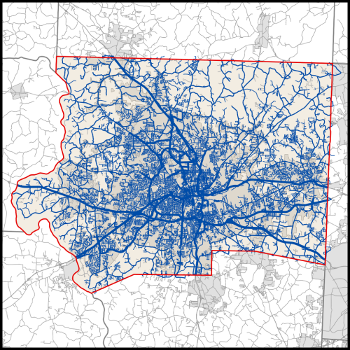
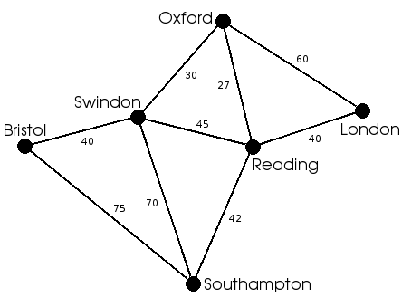
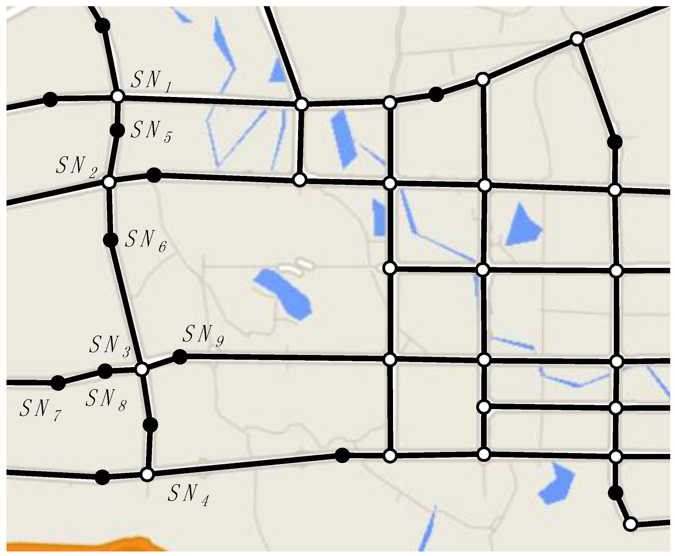
Motivation
Constrained Shortest Path(CSP) query:
finds the shortest path from an origin to destination based on the given constraint
Constraint?-+
Time
Distance
Toll-Payment
Safety
What about+ the Large Networks?
Solutions available. But:
Mostly approximate
or Prohibitively Expensive
Expensive ,Why?
Fail to utilize the special properties of road networks
Most of them process queries without INDEXES

Slide 3
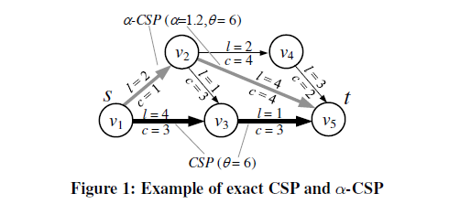
Formal Definitions
α-CSP QUERY: Given an origin s, a destination t, a cost constraint θ, and an approximation ratio α, an α-CSP QUERY returns a path P, such that c(P) ≤ θ, and , and ℓ(P) ≤ α.ℓ(P_{opt}), where P_{opt} is the optimal answer to the exact CSP query with origin s, destination t, and cost constraint θ.
Path v1,v3,v5 = CSP
Path v1,v2,v5= α-CSP

Slide 4
(α-DOMINANCE):
Let P1 and P2 be two paths connecting the same origin and destination vertices. P1 α-dominates P2 iff c(P1) ≤ c(P2) and ℓ(P1) ≤ α · ℓ(P2).
For instance, consider paths P1 = {(v1, v2), (v2, v5)} and P2 = {(v1, v3), (v3,v5)} in the above example. When α = 1.2, P1 α-dominates P2, since
the cost of P1 is c(P1) = 5 ≤ c(P2) = 6,and
the length of P1 is ℓ(P1) = 6 ≤ α · ℓ(P2) = 1.2 × 5 = 6.
P1
P2

Slide 5
Skyline set:
a set S of paths is called a skyline set, iff no path in S is α-dominated by another in the same set S.
We say that a path P is a skyline path if P is in a skyline set.
Note that if two paths P1 and P2 have the same cost, it is possible that they α-dominate each other, in which case we put the path with smaller length in a skyline set.
For exact CSP, we define dominance relationship and skyline in the same way, by simply fixing α = 1.

Slide 6
Problem Statement
Available solutions for CSP on larger networks.
Exact CSP without Index
α -CSP without Index
Exact CSP with Index
α -CSP with index
But all of the available solutions are either EXPENSIVE or IMPRACTICAL.

Slide 7
Proposed Solution
COLA (COnstrained LAbeling)
What is COLA?
index-based approximate CSP processing for large road networks
Mainly exploits two important properties of road network:
real road networks are often(roughly) planar, thus, can be effectively split into partitions
relatively small number of landmark vertices in the road network that commonly appear in CSP results.
How does it work?
COLA PARTITIONS the road network and constructs an OVERLAY GRAPH on top of the partitions.
The INDEX STRUCTURE is then built on the overlay graph, whose size is much SMALLER than the original graph
Then, α-CSP query processing is done with a pair of origin and destination vertices s and t ϵ G and a cost constraint θ, using overlay graph and the COLA index to get the Shortest Path

Slide 8
OVERLAY GRAPH : Given an input graph G, a partitioning T of G, and the query approximation ratio α, a graph Gº = ( Vº, Eº) is an overlay graph of G with respect to T, if it satisfies the following three conditions :
Vº consists of all boundary vertices with respect to T;
For each edge eº ε Eº that starts at a vertex v and ends at vertex v’, there exists a path P in G that goes from v to v’ such that c(P) = c( eº ) and l(P)= l( eº );
For any pair of origin and destination vertices s, t ε Gº, and any path P in G from s to t, there exists a path Pº in G​º that goes from s to t that α-dominates P, i.e. , c(Pº) ) ≤ c(P) and l(Pº) ) ≤ α.l(P).
How does it work?
It compresses the input graph by:
Including only the boundary vertices of the partitions and removing all other vertices
Using edges to represent paths in G
Reducing the number of edges by removing paths that are α-dominated by others

Slide 9
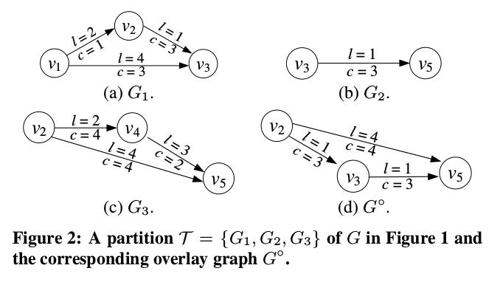

Slide 11
COLA-Index
What is a COLA-index?
Definition: Given an overlay graph G^{o,} a COLA index contains label sets B_{in} (vº) and B_{out}(vº) for each vertex vº E G satisfying the following conditions:
Each entry in B_{in} (vº) corresponds to a path from another vertex in Gº to vº.
Each entry in B_{out} (vº) corresponds to a path from vº to another vertex in Gº.
For any path P between any two vertices sº, tº, ε Vº ( P may contain vertices in V/Vº) , the COLA index contains both an out-label in B_{out}(sº) with cost c_{o} and length l_{o} and an in-label in B_{in}(tº) with cost c_{i} and length l_{i} such that c_{o}+c_{i} ≤ c(P) and l_{o}+l_{i} ≤ α.l(P)
Example:

Slide 12
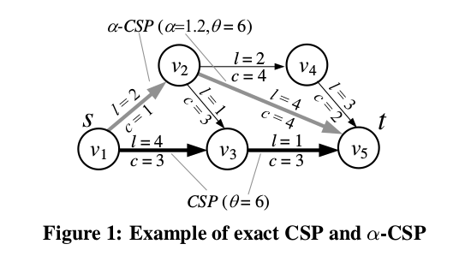
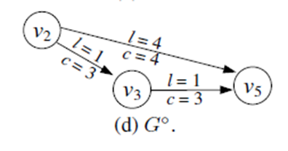
Let a =1.1 and P₁º =(v₂,v₃), P₂º=(v₃,v₅) and P₃º=(v₂,v₅).
Let P₁’ , P₂’ and P₃’ be three trivial paths from
v₂ to v₂, v₃ to v₃ and v₅ to v₅,
with zero cost/length, respectively.
B_{out}(v₂) ={ P₁º,P₁’} , B_{in}(v₂) = {P₁’}
B_{out}(v₃) ={ P₂’} , B_{in}(v₃) = {P₂’}
B_{out}(v₅) ={ P₃’} , B_{in}(v₅) = {P₂º,P₃º,P₃’}
To satisfy condition 3:
Five paths concerning nodes in Gº: P₁=((v₂,v₄),(v₄,v₅)), P₂=(v₂,v₃), P₃=(v₃,v₅), P₄=(v₂,v₅), P₅=((v₂,v₃),(v₃,v₅))
P₁ has cost(c₁) = 6 and length(l₁) = 5
But P₁º in B_{out}(v₂) and P₂º in B_{in}(v₅) has combined cost less than path P₁
i.e. c(P₁º) + c(P₂º) ≤ c(P₁) and l(P₁º)+l(P₂º) ≤ α .l(p1)
P₃º
P₁º
P₂º

Slide 13
Query Processing
The main idea of COLA query processing is to build B_{out}(s) and B_{in}(t) during query time, using the COLA index as well as subgraphs G_{s},G_{t} ∈ T containing s and t, respectively.
B_{out}(s) and B_{in}(t) must satisfy that the α-CSP result can be obtained by concatenating a path from B_{out}(s) and another from B_{in}(t).
The main challenge thus lies in the computation of B_{out}(s) and B_{in}(t).

Slide 14
Given an α-CSP query from v1 to v5 with cost threshold θ = 7 and α=1.1
Check v1 and v5 are boundary vertices?
Since v5 is a boundary vertex, Bin(v5) = {P◦2 , P◦3 , P′3 } from COLA-index.
But v1 is not a boundary vertex, its out-label set Bout(v1) needs to be computed on the fly
COLA initiates a Dijkstra-like search from v1 to other vertices in v1’s subgraph
it retrieves the skyline set from v1 to v2, which contains only P1 = (v1, v2)
Then, it joins the skyline set with Bout(v2), and adds the joined paths into Bout(v1) if they are not α-dominated by any path in Bout(v1)
After that, we have Bout(v1) = {P1, P1 · P◦1 }, where P1 · P◦1 denotes the concatenation of P1 and P◦1 .
COLA retrieves the skyline set from v1 to v3, and joins paths in the skyline set with Bout(v3). These paths are P2 = (v1, v3) and P3 = [(v1, v2), (v2, v3)].
P3(identical to P1·P◦1) is not added to Bout(v1), which ends up with
Bout(v1) = {P1, P1・ P◦1 , P2}.
By joining Bout(v1) and Bin(v5), COLA retrieves a skyline set for all paths from v1 to v5
i.e. P=[(v1,v2),(v2,v3),(v3,v5)]

Slide 15
Optimizations
Observation 1
First optimization of the join between Bout(s) and Bin(t), :
If c(Po)+c(Pi) > θ, then joining Po (resp. Pi) with any path in Bin(t) (resp. Bout(s)) with cost higher than Pi (resp. Po) cannot lead to an α-CSP result;
If c(Po)+c(Pi) ≤ θ , then joining Po (resp. Pi) with any path in Bin(t) (resp. Bout(s)) with length longer than Pi (resp. Po) can be discarded
Bout(s)
Path | End Vertex | Cost | Length
Po1 | V1 | 4 | 7
Po2 | V2 | 7 | 4
Po3 | V5 | 7 | 10
Po4 | V4 | 12 | 6
Cost constraint(θ)=13
Bin(t)
Path | Start Vertex | Cost | Length
Pi1 | V5 | 7 | 5
Pi2 | V4 | 6 | 6
Pi3 | V2 | 5 | 12
Pi4 | V6 | 4 | 13
LabelJoin(P*)=Po2.Pi3

Slide 16
OBSERVATION 2.
Let P be a path from s to w◦ from the join result of skyline set L(v◦) and Bout(v◦). P cannot possibly lead to an α-CSP result, if any of the following is true.
w◦ cannot possibly reach t on the input graph G
The minimum cost for any path from w◦ to t exceeds θ−c(P);
There exists a path P′ from s to t satisfying the cost constrain such that the minimum length of any path from w◦ to
t exceeds ℓ(P′)/α − ℓ(P).
According to the above observation, before performing any join operation,
we first select a set of end vertices W for the join results that can possibly lead to an α-CSP result, which is incrementally pruned using Observation 2.
Then, we filter the COLA Index, and use only the labels that reach a vertex in W.

Slide 17
α-DIJK
Index free solution used for:
Computing skyline paths
Intra-partition search during query processing in COLA
For building the COLA index
As a standalone index free solution for α-CSP
CP-Dijk | α-Dijk
Distributes the “budget” for pruning equally to each vertex on the path In case of many vertex on the path, each receives only little pruning power | Distributes more pruning power to “Landmark vertexes” and lesser to other Results in reduction of path to be examined and acceleration of query

