Slide 1
Graph Indexing for Shortest-Path Finding over Dynamic Sub-Graphs
Mohamed S. Hassan Walid G. Aref Ahmed M. Aly

Slide 2
Motivation
Finding shortest path between vertices is one of the most important operations performed over graphs
In many scenarios, users are interested in filtering the graph before finding the closest path
For instance, finding shortest path between U1 and U2 in a social network. The returned path has to use certain types of relationships (e.g., family relationships). This can be expressed by:
SPathU1,U2 (σrelation=family(SocialNetwork))
The paper induces a new technique for finding shortest path on a sub-graph, G’, that is dynamically selected at query time
The first work to answer Edge-Constrained Shortest path(ECSP) on dynamic graphs

Slide 3
Problem Definition
Let G = (V, E, L, l, w) be a directed weighted graph, where V is a set of vertexes, E is a set of positively weighted edges, L is a set of labels (that can be viewed as colors), l is a function that assigns a label to each edge, and w is a function that assigns a weight to each edge .
Let Q(s, d, A) be an edge-constrained shortest-path (ECSP) query, where s ∈ V is the source vertex, d ∈ V is the destination vertex, and A ⊆ L is the set of allowed labels by Q.
Q searches for a path P = (e1, e2,...,ec) from s to d that uses only edges with labels from A, such that the summation$\sum_{e∈P}{w\left(e\right)}$ is minimized.

Slide 4
Simple example
Consider the query Q(1, 6, {Blue, Red})
1 is the source vertex, 6 is the destination vertex, and Blue, Red are the only allowed edges.
The path P = 1 → 2 → 4 → 5 → 6 is the shortest with cost=8, but it is not the right answer since it has Green edge.
The answer to Q is the path of cost= 9 given by 1 → 2 → 6

Slide 5
Straightforward Approaches
One way to answer an ECSP query is to use Dijkstra’s algorithm. The label of each edge e is being checked during the graph traversal. If the edge satisfies the label condition, it get processed. Otherwise e is discarded
Another way is to use an indexing technique that is designed for unconstrained shortest-path(no edge restrictions)
This can be achieved by building $2^{L}$ indexes
L is the set of label the underlying graph G
To answer a query, one of the $2^{L}$ indexes that corresponds to the labels permitted by the query is selected
Although these two approaches may lead to a correct answer, both are impractical since the first approach traverse a large portion of the graph, and the second approach requires an exponential space.

Slide 6
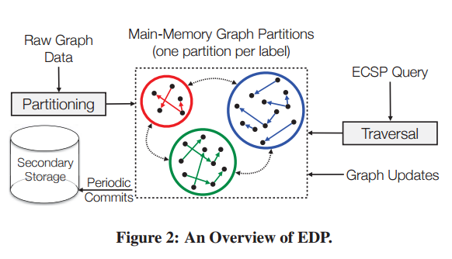
Edge-Disjoint Partitioning (EDP)
EDP is the proposed technique for answering exact ECSP queries
EDP consists of two main components
1- Indexing: treats the contracted sub-paths of any ECSP query as independent tuples, and indexes these tuples
2- Traversal: connects the appropriate contracted sub-paths efficiently to form the answer of any ECSP query

Slide 7
Index Construction- Graph Partitioning
EDP partitions an input graph so that any two edges of different labels cannot co-exist in the same partition
The intuition behind this partitioning:
1- Reduce the traversal search space
2- Each partition can catch all the monochrome sub-paths it computes so that they can be leveraged by future queries
|L| partitions will be formed

Slide 8
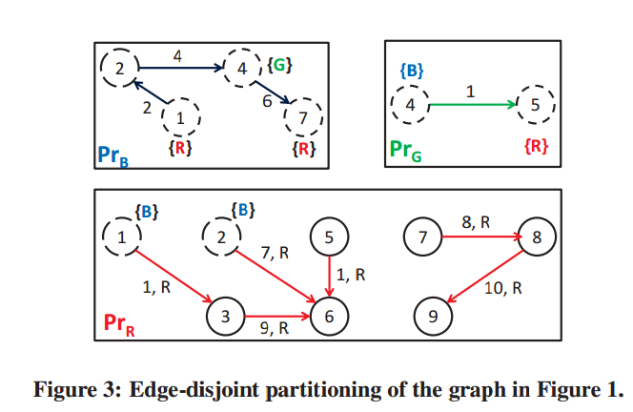
Graph Partitioning
Bridge Vertex: Given Partitions $Pri$and $Prj$, a vertex v ∈ $Pri$is termed a bridge vertex in $Pri if and only if ∃ an edge, say (v, u) ∈ Prj$where $i != j.$The bridge vertices are marked with dashed circles.
OtherHosts List: For a bridge vertex $v ∈ Pri (i.e., Pri(v)),$the OtherHosts list is the set of label identifiers of all the outgoing edges of $v ∈ G$not equal to the identifier of Label $i$, where $i$ is the label identifier of Partition $Pri$. The bridge vertex $PrG(4)$ has its OtherHosts list set = {B}.

Slide 9
Comments on Partitioning
Although EDP replicates some vertexes in more than one partition, the replicated vertexes are light-weight, i.e., only the vertex identifier and some connectivity information are replicated
The worst case space complexity after replicated vertices is $O\left(m+ncf\right), ncf≅m$, where c is the number of labels and f is the maximum fan-out
In partitioning process the graph edges E are scanned only once
Partitioning can be unbalanced, e.g., some partitions have most of the edges while the other partitions are almost empty
Advantage of unbalancing is that we will be able to precompute more effective shortcuts in these partitions
Disadvantage of unbalancing is that the increase in the number of reachable bridge vertexes from the partition’s vertexes

Slide 10
Repository for Shortest Sub-Paths
EDP stores a set of shortest paths in each partition $Pri$ in a hash table
These shortest paths are used by the traversal algorithm as monochrome sub-path to construct the final query answer
EDP may save two types of paths:
The SPath from $Pri(v)$to destination $d$ if $d$ is hosted by $Pri$
The SPath from $Pri(v)$to the bridge vertex in $Pri$
This SPath repository is built incrementally during query answering
The size of repository does not exceed a user-specified size
In order to limit the size, an adopted last-recent-used (LRU) replacement policy is applied

Slide 11
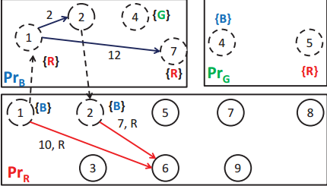
Shortcuts

Slide 12
Query Processing- EDP Index Traversal
Given an ECSP query $Q(s,d,A)$and the graph indexing $I(G)$
EDP-QP follows a greedy traversal approach over the index $I(G)$to answer ECSP queries.
EDP-QP traversal algorithm does not explore all possible path. As soon as the current vertex instance is a destination vertex (d), the algorithm yields the shortest-path cost and terminate
Only the partitions corresponding to the allowed labels of Q are considered, the other partitions are ignored
EDP-QP- traversal algorithm uses a min-priority queue PQ of vertices whose final shortest path weight from source vertex have not been determined yet

Slide 13
Query Answering Example1
Given $Q1=(1, 6, \{R\})$, $I(G)$figure 3
$PQ= ∅$
Enqueue 1, $PQ= ((PrR, 1 , 0))$
Dequeue min ($PrR, 1 , 0$)
Enqueue 3, $PQ=((PrR, 3, 1))$
Dequeue min $(PrR, 3, 1)$
Enqueue 6, $PQ=((PrR, 6, 10))$
Dequeue min $(PrR, 6, 10)$, 6= d , terminate

Slide 14
After processing $Q1$, some information will be stored, for example, the shortcut 1 6 with cost 10 will be stored
The stored information will increase efficiency of the future queries
R

Slide 15
After processing $Q1$, some information will be stored, for example, the shortcut 1 6 with cost 10 will be stored
The stored information will increase efficiency of the future queries
R

Slide 16
Query Answering Example2
In example 2 , a preprocessing is assumed to be occured before the Q2 issuing
$Q2= \left(1, 6, \left\{R, B\right\}\right)$
$PQ= ∅$
Enqueue 1, $PQ=((PrR, 1 , 0))$, min out-edge
Dequeue min $\left(PrR, 1 , 0\right)$ 1 is a bridge vertex, and its OtherHost list
Enqueue 1, 6 $PQ=((PrB, 1, 0), (PrR, 6, 10))$
Dequeue min $\left(PrB, 1 , 0\right)$
EDP-QP will not find V. 6 in $PrB$
EDP-QP will try to leave $PrB$through bridge vertices
In $PrB$, there are three reachable bridges (2,4,7) from 1
The bridge 4 will be discarded since its OtherHosts list does not contain allowed labels
$PQ=((PrR, 2, 2), (PrR, 6, 10), (PrR, 7, 12))$
Dequeue min
$PQ=((PrR, 6, 9), (PrR, 6, 10), (PrR, 7, 12))$
Dequeue min $(R, 6, 9)$, 6= d , terminate

Slide 17
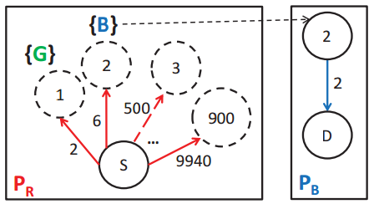
Handling Large Bridge Vertexes
The partitioning scheme formed by EDP may lead to many bridge vertices in one partition
EDP handles this issue by not exploring all possible transitions at once
In right figure, S has 900 bridges, inserting the 900 bridges in PQ may harm the efficiency
A system parameter MaxBreadth is defined and set to the average fan-out of the vertices in G
All the bridge vertices, of every partition, and their order is found by running Dijkstra’s alg.
EDP-QP runs a separate thread for the first request to compute a bridge-edges set from scratch and store them in EDP’s index to avoid any re-computation of the bridge-edges in the future

Slide 18
Support Graph Updates
EDP supports all kind of updates (e.g., topological and non-topological upd
EDP adopts a timestamp-based approach to decide whether an indexed monochrome sub-path needs to be recomputed or not
After the graph partitioning phase, EDP finds the disconnected components of each partition by running the Tarjan’s algorithm
Each disconnected component is given an identifier that is unique with respect to the hosting position
Each disconnected component holds time stamp TS(Ci)
Also, each indexed monochrome sub-path in component Ci, say Pij , has Timestamp TS(Pij )
The timestamps of the sub-path and its hosting component are compared to decide if Pij needs to be recomputed, i.e., if TS(Pij ) is less than TS(Ci), sub-path Pij is recomputed and is assigned a new higher timestamp

Slide 20
Processing Graph Updates
Update edge weight: the edge’s hosting component is determined and its timestamp (TS(Ci)) is set to the value of the global clock
Update edge label: The edge is removed from its original component and added to its new component, the timestamp of the old and new components are updated
Add edge: the label of added edge e determines the hosting partition. If the endpoint vertexes of the edge is hosted by different components, EDP adds an entry to a system hash-table that these components are connected
Delete edge: the timestamp of its hosting component is updated
Add vertex: nothing takes place until an edge connected to this vertex is added
Delete vertex: all the incoming/outgoing edges of that instance are deleted and the timestamp of the affected components are updated
EDP performs any graph-update operation in O(1) time except when deleting a vertex, which takes linear time in the number of partitions hosting that vertex’s instances
On demand, Pij is recomputed only if TS(Pij ) is less than TS(Ci)

Slide 21
Experiments and Results
Table 2 shows the preprocessing (Indexing) time of EDP and the state-of-the-art CHLR

