Slide 1
Schema for Student Registration System
Student (Id, Name, Addr, Status)
Professor (Id, Name, DeptId)
Course (DeptId, CrsCode, CrsName, Descr)
Transcript (StudId, CrsCode, Semester, Grade)
Teaching (ProfId, CrsCode, Semester)
Department (DeptId, Name)

Slide 2
Query Sublanguage of SQL
SELECT C.CrsName
FROM Course C
WHERE C.DeptId = ‘CS’
Tuple variable C ranges over rows of Course.
Evaluation strategy:
FROM clause produces Cartesian product of listed tables
WHERE clause assigns rows to C in sequence and produces table containing only rows satisfying condition
SELECT clause retains listed columns
Equivalent to: π_{CrsName}σ_{DeptId=‘CS’}(Course)

Slide 3
Join Queries
SELECT C.CrsName
FROM Course C, Teaching T
WHERE C.CrsCode=T.CrsCode AND T.Semester=‘S2000’
List CS courses taught in S2000
Tuple variables clarify meaning.
Join condition “C.CrsCode=T.CrsCode”
relates facts to each other
Selection condition “ T.Semester=‘S2000’ ”
eliminates irrelevant rows
Equivalent (using natural join) to:
π_{CrsName}(Course
σ_{Semester=‘S2000’} (Teaching) )
π_{CrsName} (σ_{Sem=‘S2000’} (Course Teaching) )

Slide 4
Correspondence Between SQL and Relational Algebra
SELECT C.CrsName
FROM Course C, Teaching T
WHERE C.CrsCode = T.CrsCode AND T.Semester = ‘S2000’
Also equivalent to:
π_{CrsName} σC_CrsCode=T_CrsCode AND Semester=‘S2000’
(Course [C_CrsCode, DeptId, CrsName, Desc]
× Teaching [ProfId, T_CrsCode, Semester])
This is the simplest evaluation algorithm for SELECT.
Relational algebra expressions are procedural.
Which of the two equivalent expressions is more easily evaluated?

Slide 5
Self-join Queries
Find Ids of all professors who taught at least two courses in the same semester:
SELECT T1.ProfId
FROM Teaching T1, Teaching T2
WHERE T1.ProfId = T2.ProfId
AND T1.Semester = T2.Semester
AND T1.CrsCode <> T2.CrsCode
Tuple variables are essential in this query!
Equivalent to:
π_{ProfId} (σ_{T1.CrsCode≠T2.CrsCode}(Teaching[ProfId, T1.CrsCode, Semester]
Teaching[ProfId, T2.CrsCode, Semester]))

Slide 6
Duplicates
Duplicate rows not allowed in a relation
However, duplicate elimination from query result is costly and not done by default; must be explicitly requested:
SELECT DISTINCT …..
FROM …..

Slide 7
Use of Expressions
Equality and comparison operators apply to strings (based on lexical ordering)
WHERE S.Name < ‘P’
Concatenate operator applies to strings
WHERE S.Name || ‘--’ || S.Address = ….
Expressions can also be used in SELECT clause:
SELECT S.Name || ‘--’ || S.Address AS NmAdd
FROM Student S

Slide 8
Set Operators
SQL provides UNION, EXCEPT (set difference), and INTERSECT for union compatible tables
Example: Find all professors in the CS Department and all professors that have taught CS courses
(SELECT P.Name
FROM Professor P, Teaching T
WHERE P.Id=T.ProfId AND T.CrsCode LIKE ‘CS%’)
UNION
(SELECT P.Name
FROM Professor P
WHERE P.DeptId = ‘CS’)
Notes:
% -- 0 or more characters
_ -- 1 single character

Slide 9
Nested Queries
List all courses that were not taught in S2000
SELECT C.CrsName
FROM Course C
WHERE C.CrsCode NOT IN
(SELECT T.CrsCode --subquery
FROM Teaching T
WHERE T.Sem = ‘S2000’)
Evaluation strategy: subquery evaluated once to
produces set of courses taught in S2000. Each row
(as C) tested against this set.

Slide 10
Correlated Nested Queries
Output a row <prof, dept> if prof has taught a course
in dept.
SELECT P.Name, D.Name --outer query
FROM Professor P, Department D
WHERE P.Id IN
-- set of all ProfId’s who have taught a course in D.DeptId
(SELECT T.ProfId --subquery
FROM Teaching T, Course C
WHERE T.CrsCode=C.CrsCode AND
C.DeptId=D.DeptId --correlation
)

Slide 11
Correlated Nested Queries (con’t)
Tuple variables T and C are local to subquery
Tuple variables P and D are global to subquery
Correlation: subquery uses a global variable, D
The value of D.DeptId parameterizes an evaluation of the subquery
Subquery must (at least) be re-evaluated for each distinct value of D.DeptId
Correlated queries can be expensive to evaluate

Slide 12
Division in SQL
Query type: Find the subset of items in one set that are related to all items in another set
Example: Find professors who taught courses in all departments
Why does this involve division?
ProfId DeptId
DeptId
Contains row
<p,d> if professor
p taught a
course in
department d
All department Ids
π_{ProfId,DeptId}(Teaching Course) / π_{DeptId}(Department)

Slide 13
Division in SQL
Strategy for implementing division in SQL:
Find set, A, of all departments in which a particular professor, p, has taught a course
Find set, B, of all departments
Output p if A ⊇ B, or, equivalently, if B–A is empty

Slide 14
Division – SQL Solution
SELECT P.Id
FROM Professor P
WHERE NOT EXISTS
(SELECT D.DeptId -- set B of all dept Ids
FROM Department D
EXCEPT
SELECT C.DeptId -- set A of dept Ids of depts in
-- which P taught a course
FROM Teaching T, Course C
WHERE T.ProfId=P.Id -- global variable
AND T.CrsCode=C.CrsCode)
π_{ProfId,DeptId}(Teaching Course) / π_{DeptId}(Department)

Slide 15
Aggregates
Functions that operate on sets:
COUNT, SUM, AVG, MAX, MIN
Produce numbers (not tables)
Not part of relational algebra (but not hard to add)
SELECT COUNT(*)
FROM Professor P
SELECT MAX (Salary)
FROM Employee E

Slide 16
Aggregates (cont’d)
Count the number of courses taught in S2000
SELECT COUNT (T.CrsCode)
FROM Teaching T
WHERE T.Semester = ‘S2000’
But if multiple sections of same course
are taught, use:
SELECT COUNT (DISTINCT T.CrsCode)
FROM Teaching T
WHERE T.Semester = ‘S2000’

Slide 17
Grouping
But how do we compute the number of courses taught in S2000 per professor?
Strategy 1: Fire off a separate query for each professor:
SELECT COUNT(T.CrsCode)
FROM Teaching T
WHERE T.Semester = ‘S2000’ AND T.ProfId = 123456789
Cumbersome
What if the number of professors changes? Add another query?
Strategy 2: define a special grouping operator:
SELECT T.ProfId, COUNT(T.CrsCode)
FROM Teaching T
WHERE T.Semester = ‘S2000’
GROUP BY T.ProfId

Slide 18
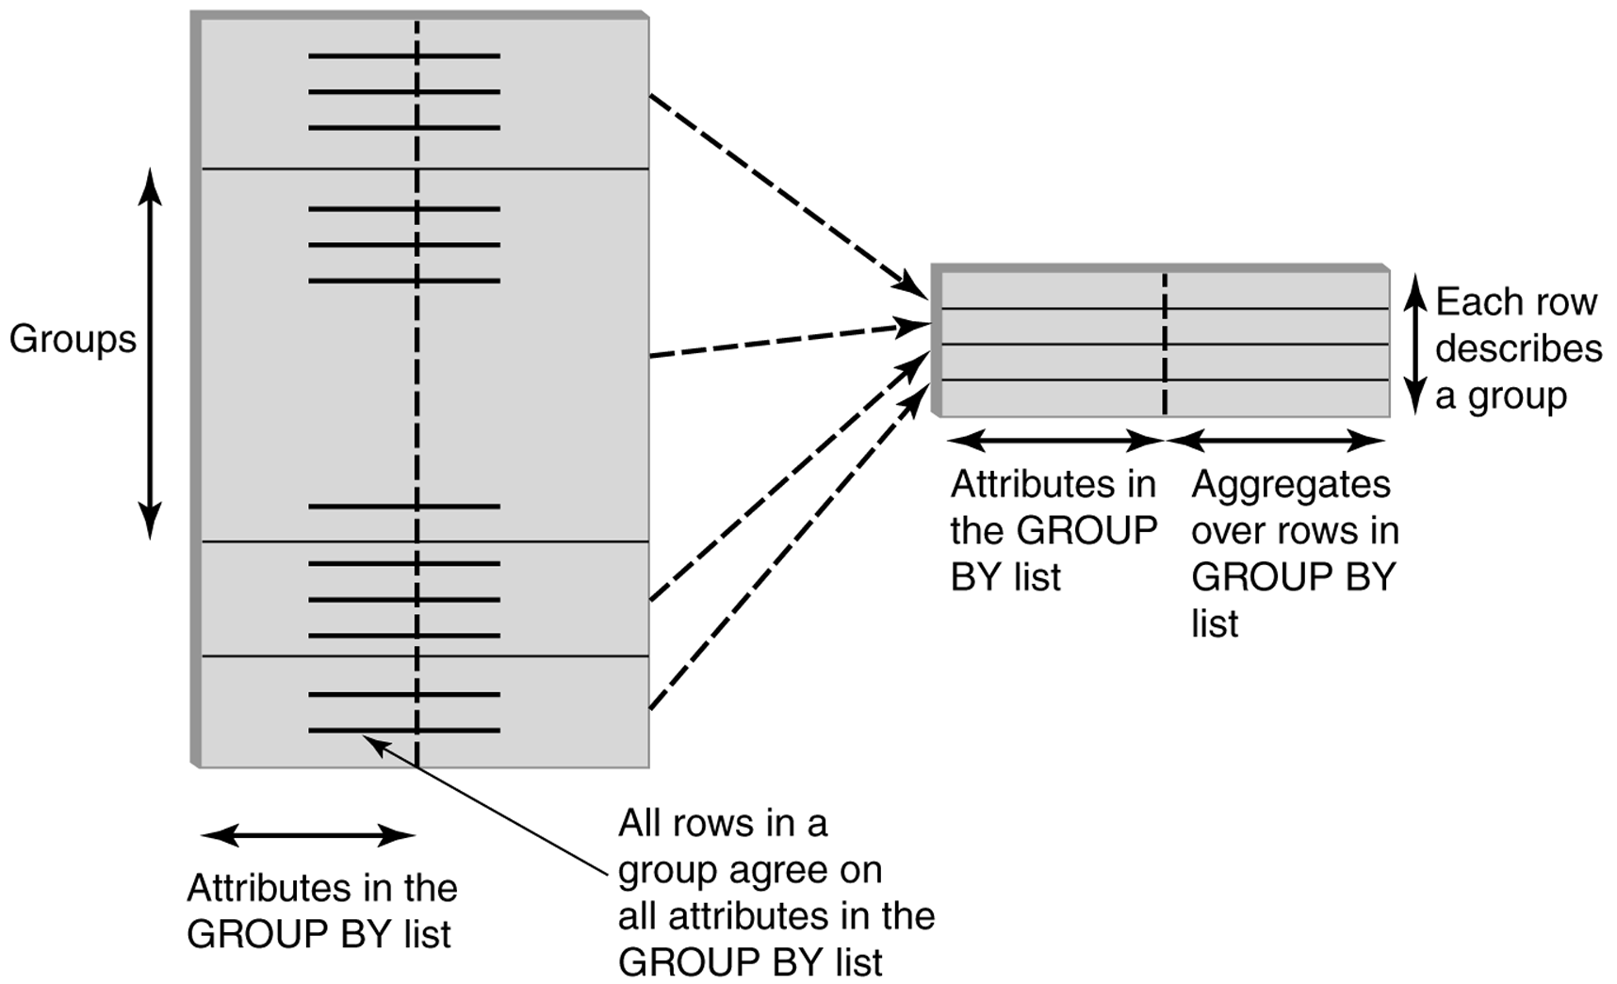
GROUP BY

Slide 19
GROUP BY - Example
Transcript
Attributes:
–student’s Id
–avg grade
–number of courses
1234
1234
1234
1234
1234 3.3 4
SELECT T.StudId, AVG(T.Grade), COUNT (*)
FROM Transcript T
GROUP BY T.StudId

Slide 20
HAVING Clause
Eliminates unwanted groups (analogous to WHERE clause, but works on groups instead of individual tuples)
HAVING condition is constructed from attributes of GROUP BY list and aggregates on attributes not in that list
SELECT T.StudId,
AVG(T.Grade) AS CumGpa,
COUNT (*) AS NumCrs
FROM Transcript T
WHERE T.CrsCode LIKE ‘CS%’
GROUP BY T.StudId
HAVING AVG (T.Grade) > 3.5

Slide 21
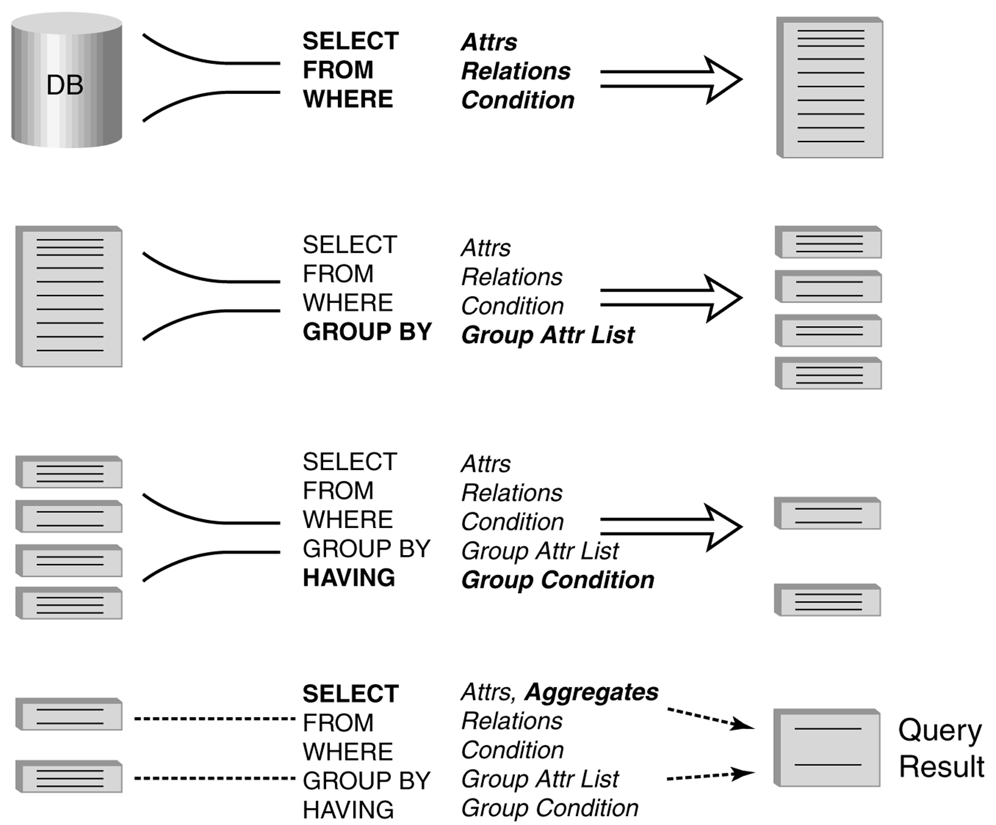
Evaluation of GroupBy with Having

Slide 22
Example
Output the name and address of all seniors on the Dean’s List
SELECT S.Id, S.Name
FROM Student S, Transcript T
WHERE S.Id = T.StudId AND S.Status = ‘senior’
GROUP BY
HAVING AVG (T.Grade) > 3.5 AND SUM (T.Credit) > 90
S.Id -- wrong
S.Id, S.Name -- right
Every attribute that occurs in SELECT clause must also occur in GROUP BY or it must be an aggregate. S.Name does not.

Slide 23
Aggregates: Proper and Improper Usage
SELECT COUNT (T.CrsCode), T. ProfId
– makes no sense (in the absence of
GROUP BY clause)
SELECT COUNT (*), AVG (T.Grade)
– but this is OK
WHERE T.Grade > COUNT (SELECT ….)
– aggregate cannot be applied to result
of SELECT statement

Slide 24
ORDER BY Clause
Causes rows to be output in a specified order
SELECT T.StudId, COUNT (*) AS NumCrs,
AVG(T.Grade) AS CumGpa
FROM Transcript T
WHERE T.CrsCode LIKE ‘CS%’
GROUP BY T.StudId
HAVING AVG (T.Grade) > 3.5
ORDER BY DESC CumGpa, ASC StudId
Descending
Ascending

Slide 25
Query Evaluation with GROUP BY, HAVING, ORDER BY
Evaluate FROM: produces Cartesian product, A, of tables in FROM list
Evaluate WHERE: produces table, B, consisting of rows of A that satisfy WHERE condition
Evaluate GROUP BY: partitions B into groups that agree on attribute values in GROUP BY list
Evaluate HAVING: eliminates groups in B that do not satisfy HAVING condition
Evaluate SELECT: produces table C containing a row for each group. Attributes in SELECT list limited to those in GROUP BY list and aggregates over group
Evaluate ORDER BY: orders rows of C
A s b e f o r e

