Slide 1
CSCI 6315 Applied Database Systems Review for Final Exam
Xiang Lian
The University of Texas Rio Grande Valley
Edinburg, TX 78539
xiang.lian@utrgv.edu

Slide 2
Review
Chapters 5, 6-8, 14-15, and 22 in your textbook
Lecture slides
In-class exercises
Assignments
Projects

Slide 3
Review (cont'd)
Question Types
Q/A
Relational algebra & SQL
Normalization theory
attribute closure, lossless decomposition, dependency preserving
Physical data organization & indexing
Heap file, sorted file, (un)clustered index, B⁺-tree
Transaction Management
Precedence graph, conflict serializable, serial schedule
5 Questions (100 points) + 1 Bonus Question (20 extra points)

Slide 4
Time, Location, and Event
Time
5:55pm ~ 8:25pm, May 11 (Wednesday)
Place
ENGR 1.290 (classroom)
Event
Closed-book exam

Slide 5
Chapter 5.1 Relational Algebra
Relational algebra
Selection
Projection
Cartesian product
Union
Set Difference
Join
Intersection

Slide 6
Relational Algebra
Five basic operations in relational algebra: Selection, Projection, Cartesian product, Union, and Set Difference.
These perform most of the data retrieval operations needed.
Also have Join, Intersection, and Division operations, which can be expressed in terms of 5 basic operations.
Pearson Education © 2014
6

Slide 7
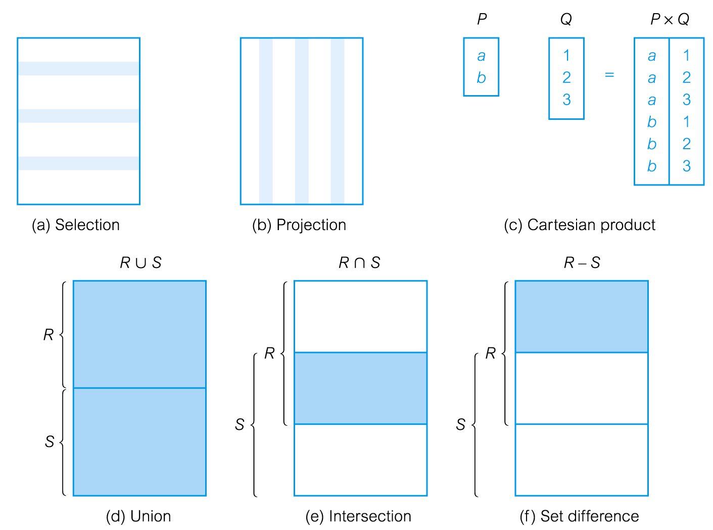
Relational Algebra Operations
Pearson Education © 2014
7

Slide 8
Selection (or Restriction)
σ_{predicate} (R)
Works on a single relation R and defines a relation that contains only those tuples (rows) of R that satisfy the specified condition (predicate).
Pearson Education © 2014
8

Slide 9
Example - Selection (or Restriction)
List all staff with a salary greater than £10,000.
σ_{salary > 10000} (Staff)
Pearson Education © 2014
9

Slide 10
Projection
Π_{col1, . . . , coln}(R)
Works on a single relation R and defines a relation that contains a vertical subset of R, extracting the values of specified attributes and eliminating duplicates.
Pearson Education © 2014
10

Slide 11
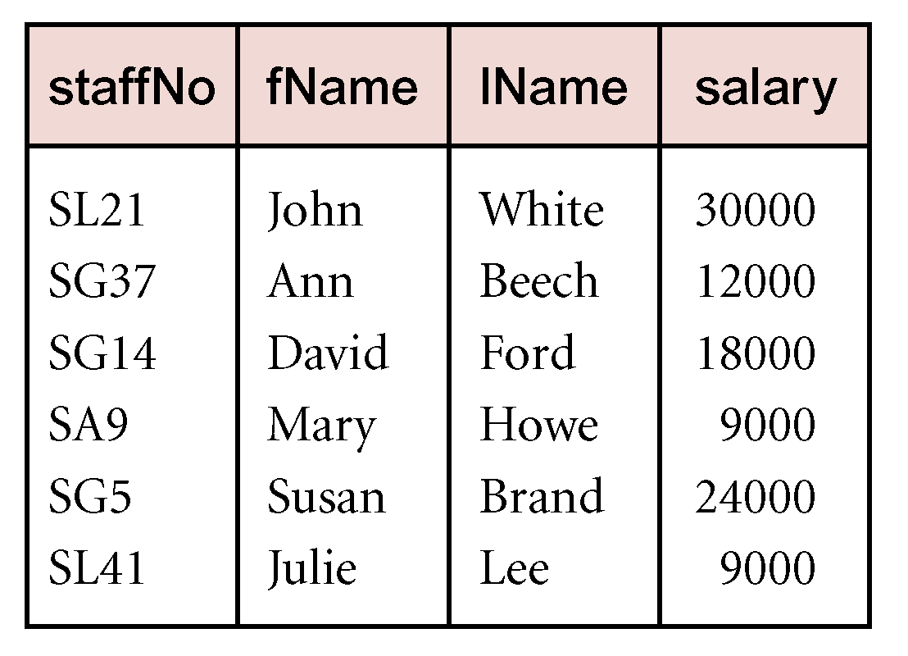
Example - Projection
Produce a list of salaries for all staff, showing only staffNo, fName, lName, and salary details.
Π_{staffNo, fName, lName, salary}(Staff)
11
Pearson Education © 2014

Slide 12
Union
R ∪ S
Union of two relations R and S defines a relation that contains all the tuples of R, or S, or both R and S, duplicate tuples being eliminated.
R and S must be union-compatible.
If R and S have I and J tuples, respectively, union is obtained by concatenating them into one relation with a maximum of (I + J) tuples.
Pearson Education © 2014
12

Slide 13
Intersection
R ∩ S
Defines a relation consisting of the set of all tuples that are in both R and S.
R and S must be union-compatible.
Expressed using basic operations:
R ∩ S = R – (R – S)
Pearson Education © 2014
13

Slide 14
Cartesian product
R X S
Defines a relation that is the concatenation of every tuple of relation R with every tuple of relation S.
Pearson Education © 2014
14

Slide 15
Set Difference
R – S
Defines a relation consisting of the tuples that are in relation R, but not in S.
R and S must be union-compatible.
Pearson Education © 2014
15

Slide 16
Theta join (θ-join)
R _{F}S
Defines a relation that contains tuples satisfying the predicate F from the Cartesian product of R and S.
The predicate F is of the form R.a_{i} θ S.b_{i} where θ may be one of the comparison operators (<, ≤, >, ≥, =, ≠).
Pearson Education © 2014
16

Slide 17
Chapters 6-8 SQL
Basic clauses in SQL
SELECT
FROM
WHERE
Examples in lecture slides and reading materials

Slide 18
SELECT Statement
FROM Specifies table(s) to be used.
WHERE Filters rows.
GROUP BY Forms groups of rows with same
column value.
HAVING Filters groups subject to some
condition.
SELECT Specifies which columns are to
appear in output.
ORDER BY Specifies the order of the output.
Pearson Education © 2014
18

Slide 19
Query Sublanguage of SQL
SELECT C.CrsName
FROM Course C
WHERE C.DeptId = ‘CS’
Tuple variable C ranges over rows of Course.
Evaluation strategy:
FROM clause produces Cartesian product of listed tables
WHERE clause assigns rows to C in sequence and produces table containing only rows satisfying condition
SELECT clause retains listed columns
Equivalent to: π_{CrsName}σ_{DeptId=‘CS’}(Course)

Slide 20
Join Queries
SELECT C.CrsName
FROM Course C, Teaching T
WHERE C.CrsCode=T.CrsCode AND T.Semester=‘S2000’
List CS courses taught in S2000
Tuple variables clarify meaning.
Join condition “C.CrsCode=T.CrsCode”
relates facts to each other
Selection condition “ T.Semester=‘S2000’ ”
eliminates irrelevant rows
Equivalent (using natural join) to:
π_{CrsName}(Course
σ_{Semester=‘S2000’} (Teaching) )
π_{CrsName} (σ_{Sem=‘S2000’} (Course Teaching) )

Slide 21
Correspondence Between SQL and Relational Algebra
SELECT C.CrsName
FROM Course C, Teaching T
WHERE C.CrsCode = T.CrsCode AND T.Semester = ‘S2000’
Also equivalent to:
π_{CrsName} σC_CrsCode=T_CrsCode AND Semester=‘S2000’
(Course [C_CrsCode, DeptId, CrsName, Desc]
× Teaching [ProfId, T_CrsCode, Semester])
This is the simplest evaluation algorithm for SELECT.
Relational algebra expressions are procedural.
Which of the two equivalent expressions is more easily evaluated?

Slide 22
Self-join Queries
Find Ids of all professors who taught at least two courses in the same semester:
SELECT T1.ProfId
FROM Teaching T1, Teaching T2
WHERE T1.ProfId = T2.ProfId
AND T1.Semester = T2.Semester
AND T1.CrsCode <> T2.CrsCode
Tuple variables are essential in this query!
Equivalent to:
π_{ProfId} (σ_{T1.CrsCode≠T2.CrsCode}(Teaching[ProfId, T1.CrsCode, Semester]
Teaching[ProfId, T2.CrsCode, Semester]))

Slide 23
Set Operators
SQL provides UNION, EXCEPT (set difference), and INTERSECT for union compatible tables
Example: Find all professors in the CS Department and all professors that have taught CS courses
(SELECT P.Name
FROM Professor P, Teaching T
WHERE P.Id=T.ProfId AND T.CrsCode LIKE ‘CS%’)
UNION
(SELECT P.Name
FROM Professor P
WHERE P.DeptId = ‘CS’)
Notes:
% -- 0 or more characters
_ -- 1 single character

Slide 24
Chapters 14-15 Normalization Theory
Redundancy in the schema
Update, deletion, insertion anomalies
Solution: decomposition
Normalization theory
Functional dependencies
FD closure
Attribute closure

Slide 25
Redundancy
Dependencies between attributes cause redundancy
Ex. All addresses in the same town have the same zip code
SSN Name Town Zip
1234 Joe Stony Brook 11790
4321 Mary Stony Brook 11790
5454 Tom Stony Brook 11790
………………….
Redundancy

Slide 26
Anomalies
Redundancy leads to anomalies:
Update anomaly: A change in Address must be made in several places
Deletion anomaly: Suppose a person gives up all hobbies. Do we:
Set Hobby attribute to null? No, since Hobby is part of key
Delete the entire row? No, since we lose other information in the row
Insertion anomaly: Hobby value must be supplied for any inserted row since Hobby is part of key

Slide 27
Decomposition
Solution: use two relations to store Person information
Person1 (SSN, Name, Address)
Hobbies (SSN, Hobby)
The decomposition is more general: people without hobbies can now be described
No update anomalies:
Name and address stored once
A hobby can be separately supplied or deleted

Slide 28
Functional Dependencies
Definition: A functional dependency (FD) on a relation schema R is a constraint of the form
X → Y, where X and Y are subsets of attributes of R.
Definition: An FD X → Y is satisfied in an instance r of R if for every pair of tuples, t and s: if t and s agree on all attributes in X then they must agree on all attributes in Y
Key constraint is a special kind of functional dependency: all attributes of relation occur on the right-hand side of the FD:
SSN → SSN, Name, Address

Slide 29
Armstrong’s Axioms for FDs
This is the syntactic way of computing/testing the various properties of FDs
Reflexivity: If Y ⊆ X then X → Y (trivial FD)
Name, Address → Name
Augmentation: If X → Y then X Z→ YZ
If Town → Zip then Town, Name → Zip, Name
Transitivity: If X → Y and Y → Z then X → Z

Slide 30
Generating F⁺
F
AB→ C
AB→ BCD
A→ D AB→ BD AB→ BCDE AB→ CDE
D→ E BCD → BCDE
union
decomp
aug
trans
aug
Thus, AB→ BD, AB → BCD, AB → BCDE, and AB → CDE
are all elements of F⁺

Slide 31
Computation of Attribute Closure X⁺_{F}
closure := X; // since X ⊆ X⁺_{F}
repeat
old := closure;
if there is an FD Z → V in F such that
Z ⊆ closure and V ⊆ closure
then closure := closure ∪ V
until old = closure
– If T ⊆ closure then X → T is entailed by F

Slide 32
Example: Computation of Attribute Closure
Problem: Compute the attribute closure of AB with
respect to the set of FDs :
AB → C (a)
A → D (b)
D → E (c)
AC → B (d)
Solution:
Initially closure = {AB}
Using (a) closure = {ABC}
Using (b) closure = {ABCD}
Using (c) closure = {ABCDE}

Slide 33
Chapter 22 Transaction Management
What are properties of transactions in the database system?
What is serial schedule?
What is conflict serializability?
How to construct a precedence graph?
How to determine whether or not a schedule is conflict serializability?
If the schedule is conflict serializable, then how to find an equivalent serial schedule?

Slide 34
Properties of Transactions
Four basic (ACID) properties that define a transaction are:
Atomicity ‘All or nothing’ property.
Consistency Must transform database from one consistent state to another.
Isolation Partial effects of incomplete transactions should not be visible to other transactions.
Durability Effects of a committed transaction are permanent and must not be lost because of later failure.
Pearson Education © 2014
34

Slide 35
Serializability
Schedule
Sequence of reads/writes by set of concurrent transactions.
Serial Schedule
Schedule where operations of each transaction are executed consecutively without any interleaved operations from other transactions.
No guarantee that results of all serial executions of a given set of transactions will be identical.
Pearson Education © 2014
35

Slide 36
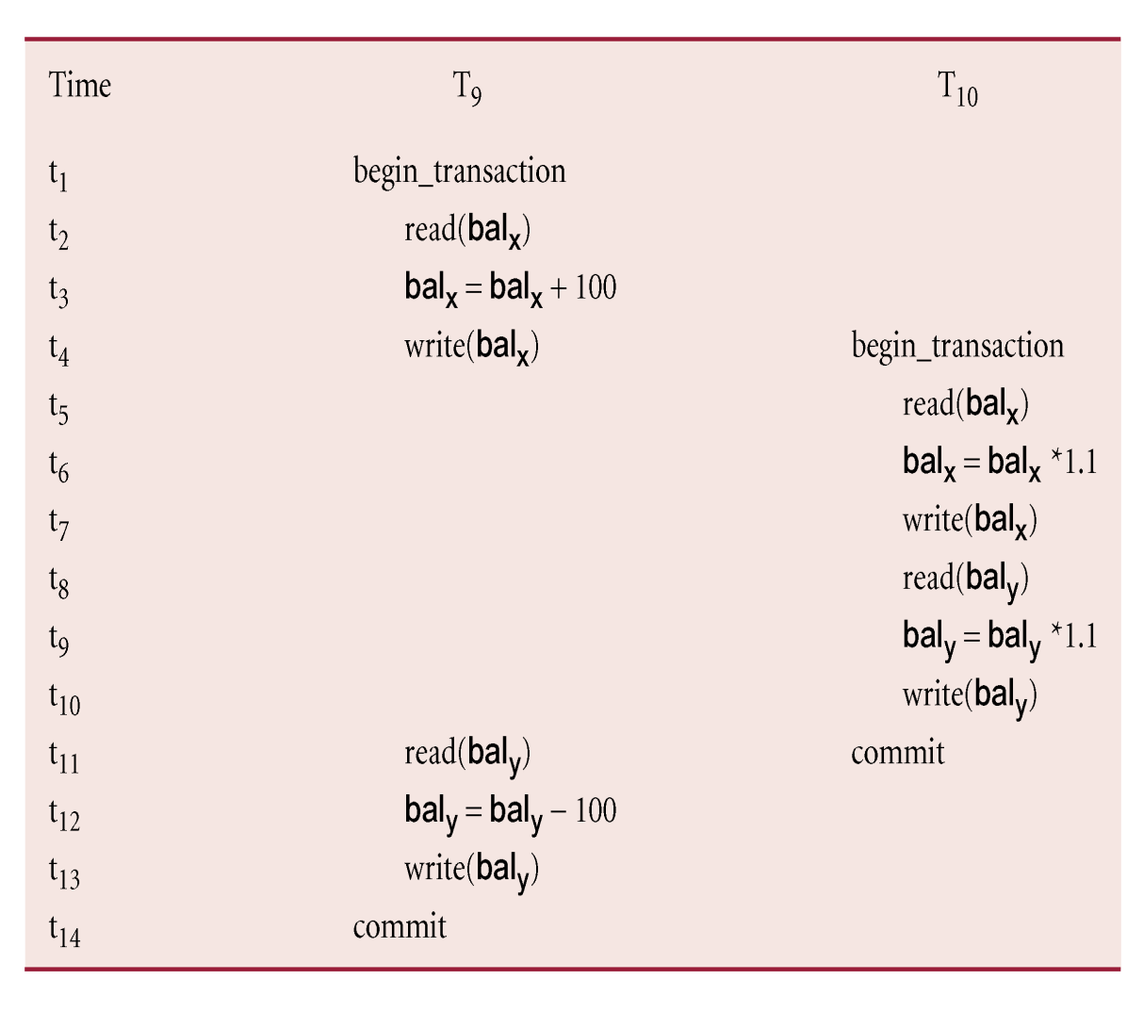
Example of Conflict Serializability
Pearson Education © 2014
36

Slide 37
Precedence Graph
Create:
node for each transaction;
a directed edge T_{i} → T_{j}, if T_{j} reads the value of an item written by T_{i};
a directed edge T_{i} → T_{j}, if T_{j} writes a value into an item after it has been read by T_{i}.
a directed edge T_{i} → T_{j}, if T_{j} writes a value into an item after it has been written by T_{i}.
If precedence graph contains cycle schedule is not conflict serializable.
Pearson Education © 2014
37

Slide 38
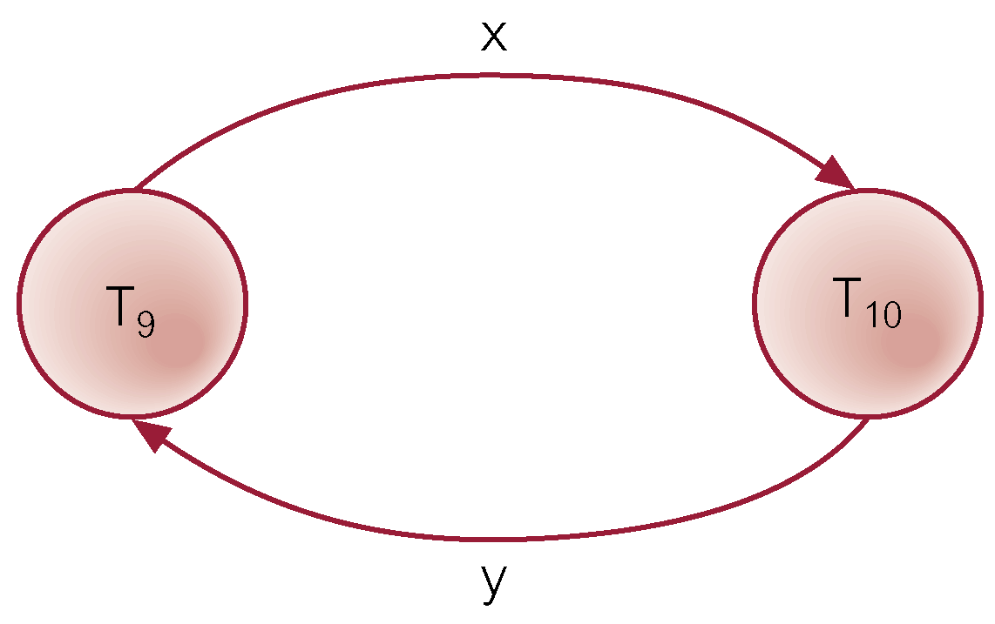
Example - Non-conflict serializable schedule
Pearson Education © 2014
38

Slide 39
How to Determine Whether a Schedule is Conflict Serializable?
Construct a precedence graph
If the precedence graph has a cycle, then the schedule is not conflict serializable; otherwise, the schedule is conflict serializable

Slide 40
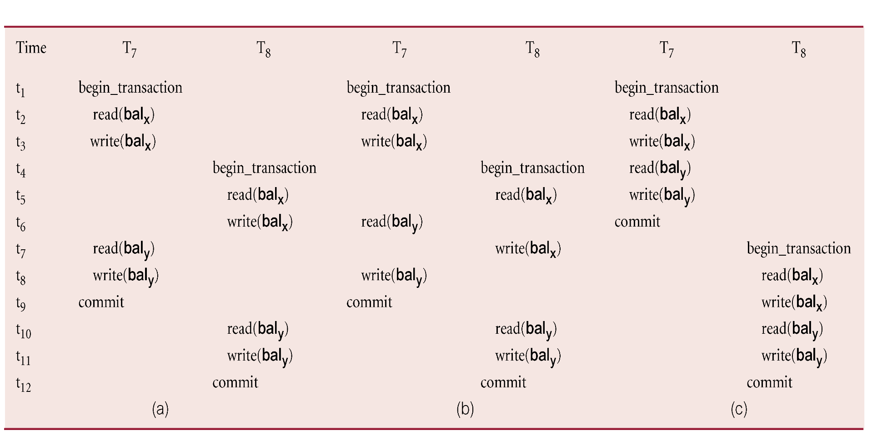
Example of Equivalent Serial Schedule
If the schedule is conflict serializable, we can find an equivalent serial schedule
40
Pearson Education © 2014

Slide 41
Appendix F Physical Data Organization and Indexing
Heap file
Sorted file
Integrated file containing index and rows
Clustered index vs. unclustered index
Dense index vs sparse index
Concrete indices
B+ tree
Hash index

Slide 42
Appendix F Physical Data Organization and Indexing (cont'd)
Clustered index vs. unclustered index
What are clustered and unclustered indices?
I/O cost of accessing data files and indices
B⁺-tree index
How to handle insertion?
If the leaf node is full, split nodes, re-distribute tuples, promote the index entry to the index node

Slide 43
Heap Files
Rows appended to end of file as they are inserted
Hence the file is unordered
Deleted rows create gaps in file
File must be periodically compacted to recover space

Slide 44
Transcript Stored as a Heap File
666666 MGT123 F1994 4.0
123456 CS305 S1996 4.0 page 0
987654 CS305 F1995 2.0
717171 CS315 S1997 4.0
666666 EE101 S1998 3.0 page 1
765432 MAT123 S1996 2.0
515151 EE101 F1995 3.0
234567 CS305 S1999 4.0
page 2
878787 MGT123 S1996 3.0

Slide 45
Sorted File
Rows are sorted based on some attribute(s)
Access path is binary search
Equality or range query based on that attribute has cost log₂F to retrieve page containing first row
Successive rows are in same (or successive) page(s) and cache hits are likely
By storing all pages on the same track, seek time can be minimized
Example – Transcript sorted on StudId :
SELECT T.Course, T.Grade
FROM Transcript T
WHERE T.StudId = 123456
SELECT T.Course, T.Grade
FROM Transcript T
WHERE T.StudId BETWEEN
111111 AND 199999

Slide 46
Transcript Stored as a Sorted File
111111 MGT123 F1994 4.0
111111 CS305 S1996 4.0 page 0
123456 CS305 F1995 2.0
123456 CS315 S1997 4.0
123456 EE101 S1998 3.0 page 1
232323 MAT123 S1996 2.0
234567 EE101 F1995 3.0
234567 CS305 S1999 4.0
page 2
313131 MGT123 S1996 3.0

Slide 47
Index Structure
Contains:
Index entries
Can contain the data tuple itself (index and table are integrated in this case); or
Search key value and a pointer to a row having that value; table stored separately in this case – unintegrated index
Location mechanism
Algorithm + data structure for locating an index entry with a given search key value
Index entries are stored in accordance with the search key value
Entries with the same search key value are stored together (hash, B- tree)
Entries may be sorted on search key value (B-tree)

Slide 48
Index Structure
S
Search key
value
Location Mechanism
Location mechanism
facilitates finding
index entry for S
S
Index entries
Once index entry is found, the row can be directly accessed
S, …….

Slide 49
Storage Structure
Structure of file containing a table
Heap file (no index, not integrated)
Sorted file (no index, not integrated)
Integrated file containing index and rows (index entries contain rows in this case)
ISAM (Index-Sequential Access Method)
Multilevel index
B⁺ tree
Hash

Slide 50
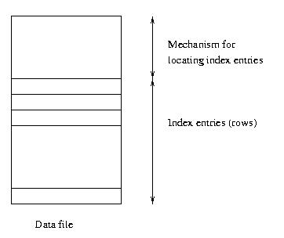
Clustered Main Index
Storage structure
contains table
and (main) index;
rows are contained
in index entries

Slide 51
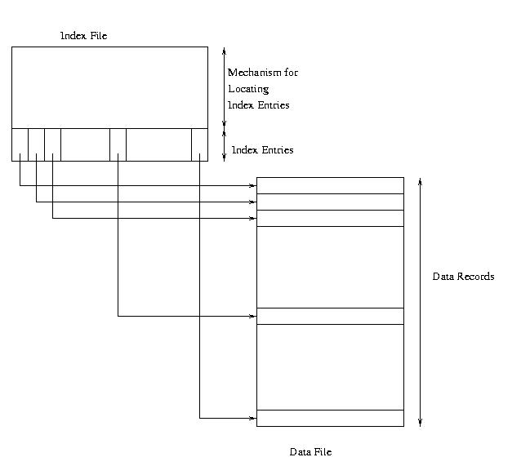
Clustered Secondary Index

Slide 52
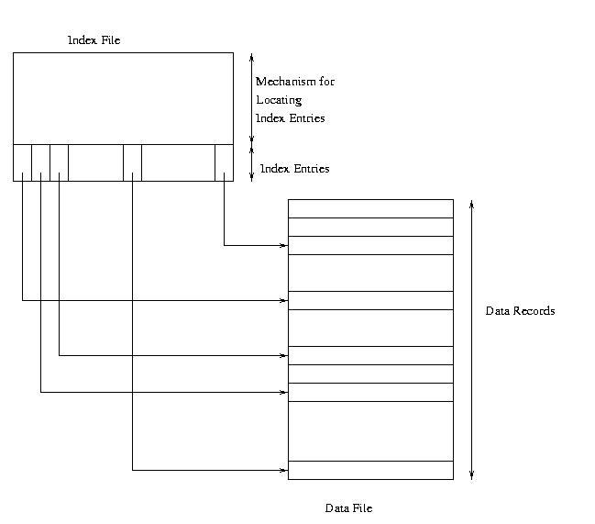
Unclustered Secondary Index

Slide 53
Example – Cost of Range Search
Data file has 10,000 pages, 100 rows in search range
Page transfers for table rows (assume 20 rows/page):
Heap: 10,000 (entire file must be scanned)
File sorted on search key: log₂ 10000 + (5 or 6) ≈ 19
Unclustered index: ≤ 100
Clustered index: 5 or 6
Page transfers for index entries (assume 200 entries/page)
Heap and sorted: 0
Unclustered secondary index: 1 or 2 (all index entries for the rows in the range must be read)
Clustered secondary index: 1 (only first entry must be read)

Slide 54
Sparse vs. Dense Index
Dense index: has index entry for each data record
Unclustered index must be dense
Clustered index need not be dense
Sparse index: has index entry for each page of data file

Slide 55
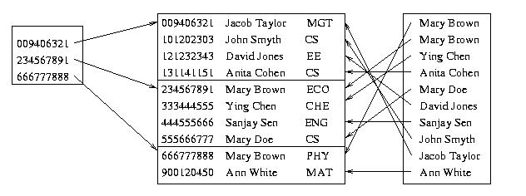
Sparse Vs. Dense Index
Id Name Dept
Sparse,
clustered
index sorted
on Id
Data file sorted on Id
Dense,
unclustered
index sorted
on Name

Slide 56
Two-Level Index
– Separator level is a sparse index over pages of index entries
– Leaf level contains index entries
– Cost of searching the separator level << cost of searching index level
since separator level is sparse
– Cost or retrieving row once index entry is found is 0 (if integrated) or 1 (if not)

Slide 57
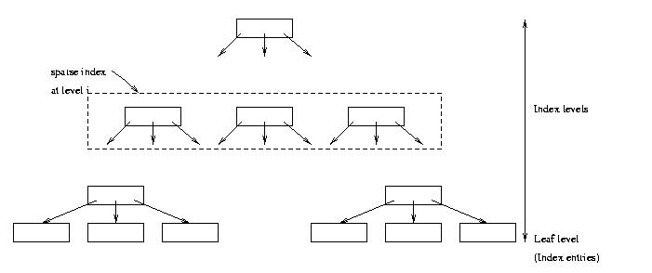
Multilevel Index
– Search cost = number of levels in tree
– If Φ is the fanout of a separator page, cost is log_{Φ} Q + 1
– Example: if Φ = 100 and Q = 10,000, cost = 3
(reduced to 2 if root is kept in main memory)

Slide 58
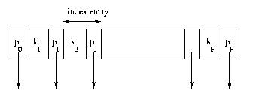
Index Sequential Access Method (ISAM)
Generally an integrated storage structure
Clustered, index entries contain rows
Separator entry = (k_{i} , p_{i}); k_{i} is a search key value; p_{i} is a pointer to a lower level page
k_{i} separates set of search key values in the two subtrees pointed at by p_{i-1} and p_{i.}

Slide 59
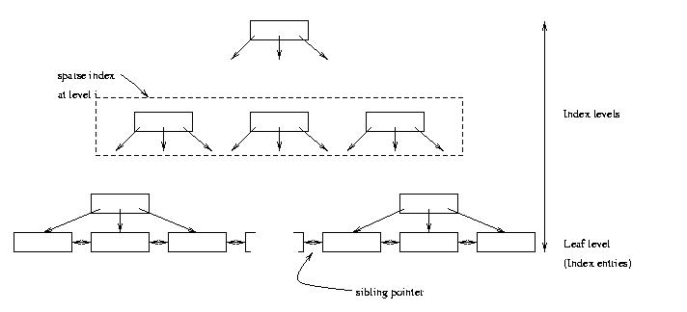
B⁺ Tree Structure
– Leaf level is a (sorted) linked list of index entries
– Sibling pointers support range searches in spite of
allocation and deallocation of leaf pages (but leaf
pages might not be physically contiguous on disk)

Slide 60
Insertion and Deletion in B⁺ Tree
Structure of tree changes to handle row insertion and deletion – no overflow chains
Tree remains balanced: all paths from root to index entries have same length
Algorithm guarantees that the number of separator entries in an index page is between Φ/2 and Φ
Hence the maximum search cost is log_{Φ/2}Q + 1 (with ISAM search cost depends on length of overflow chain)

Slide 61
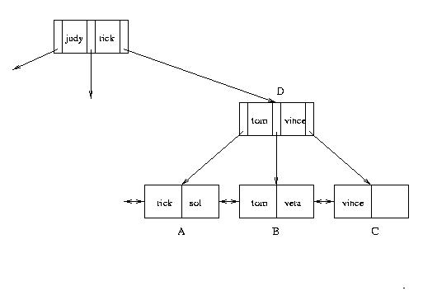
Handling Insertions (cont’d)
– Insert “vera”: Since there is no room in leaf page:
1. Create new leaf page, C
2. Split index entries between B and C (but maintain
sorted order)
3. Add separator entry at parent level

Slide 62
Good Luck!
Q/A

